Slide 1
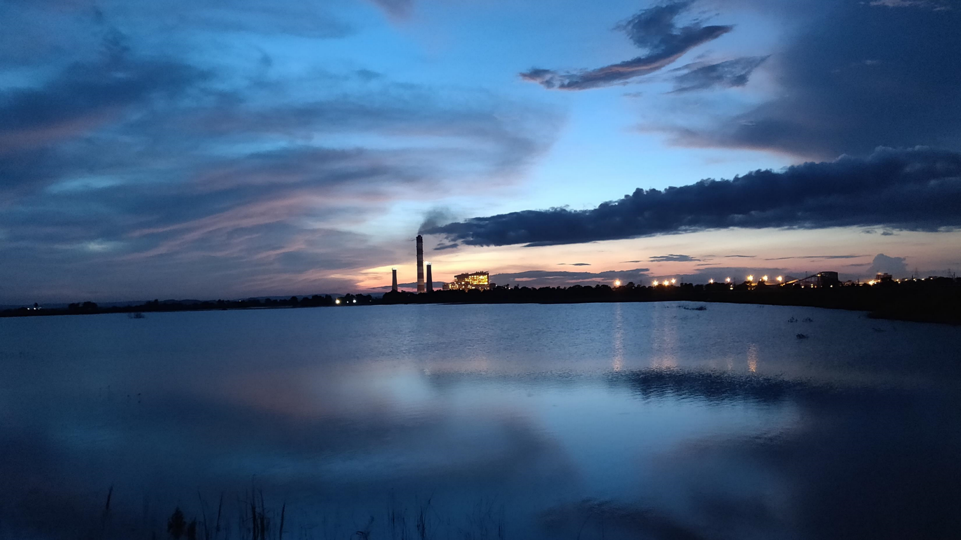
Indian Power Stations O&M Conference IPS 2024
दर्लीपाली
DARLIPALI
“Quantum leaps in dry fly ash evacuation system to enhance dry fly ash evacuation capacity - An NTPC Darlipali Experience”
Presenter: Raunak Singh Rana
Co-Authors: S. Suresh
Gurpreet Singh Heer
Lukesh Kumar
Notes:
Mass flow rate calculation, temperature, data,

Slide 2
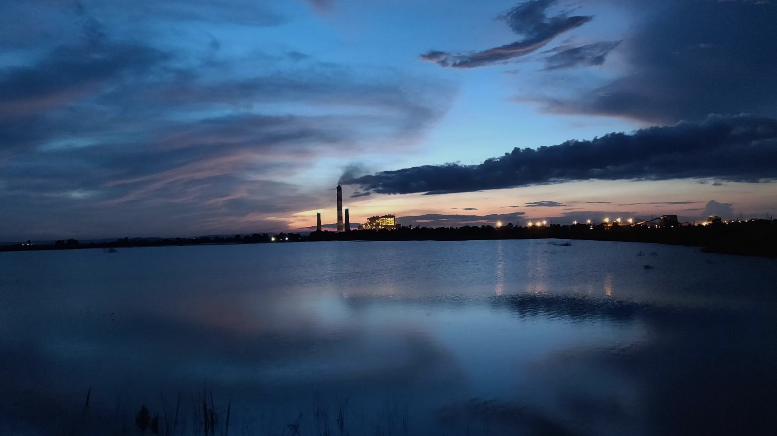
Presentation Outline
Results & Improvements
Problem Identification
Ash Evacuation Challenges
Root Cause Analysis & Actions taken

Slide 3
Ash Evacuation Challenges

Slide 4
Ash Evacuation Challenges
Fly Ash Generated in India – A Report by CEA
SUMMARY OF FLY ASH GENERATION AND UTILIZATION DURING 1ST HALF OF YEAR 2022-23

Slide 5
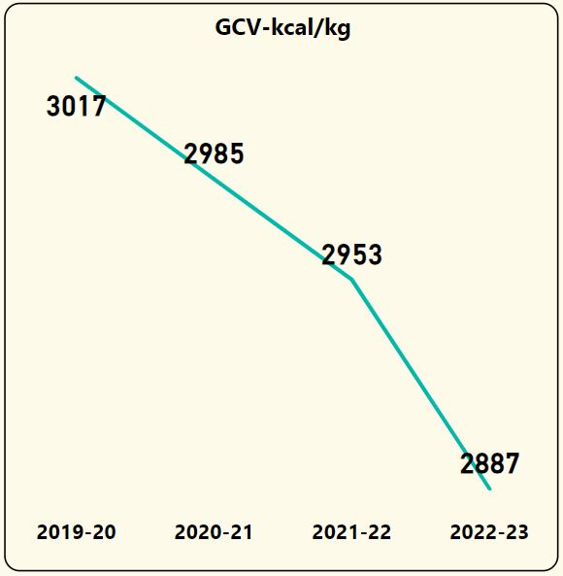
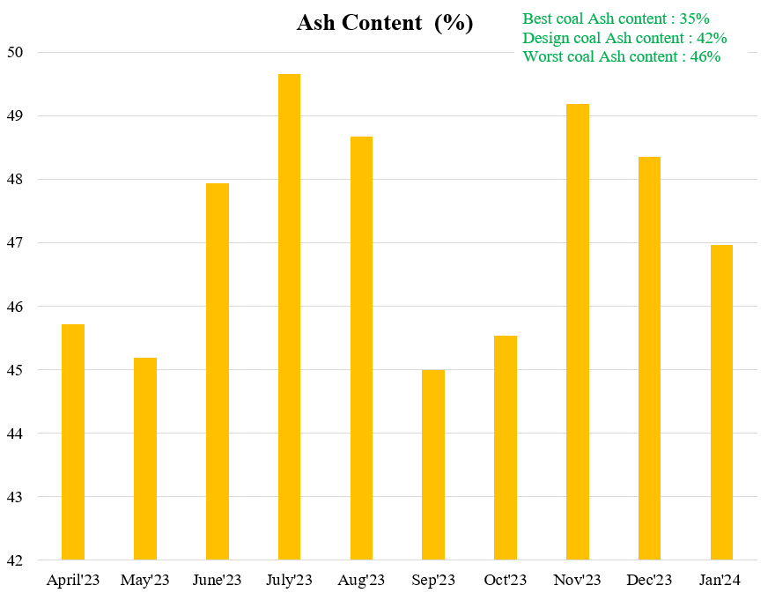
Ash Evacuation Challenges
Decreasing Coal Quality
Trend of GCV of coal fired at NTPC Darlipali
Monthly ash content in coal at NTPC Darlipali

Slide 6
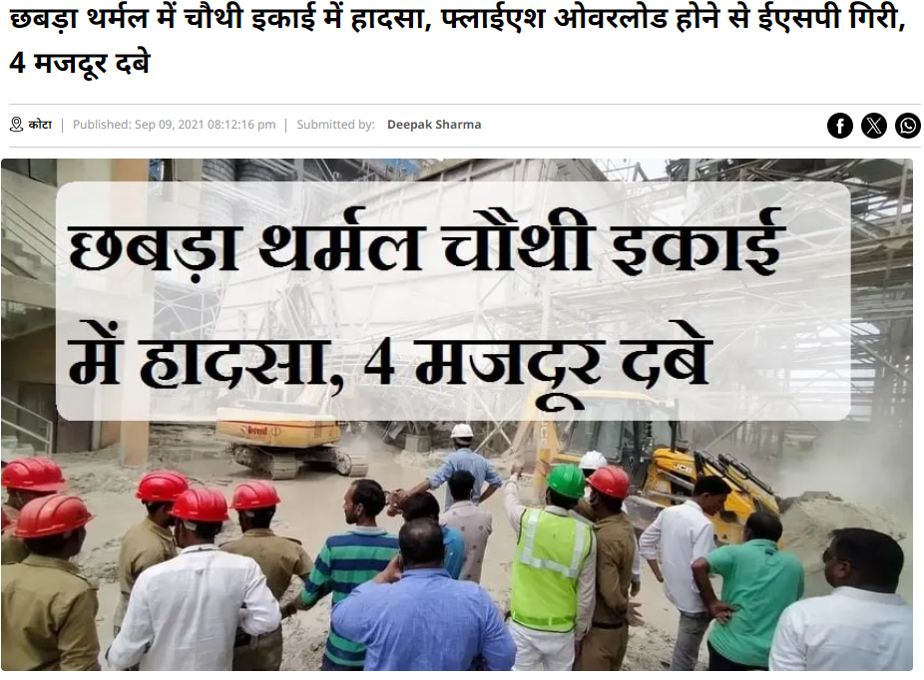
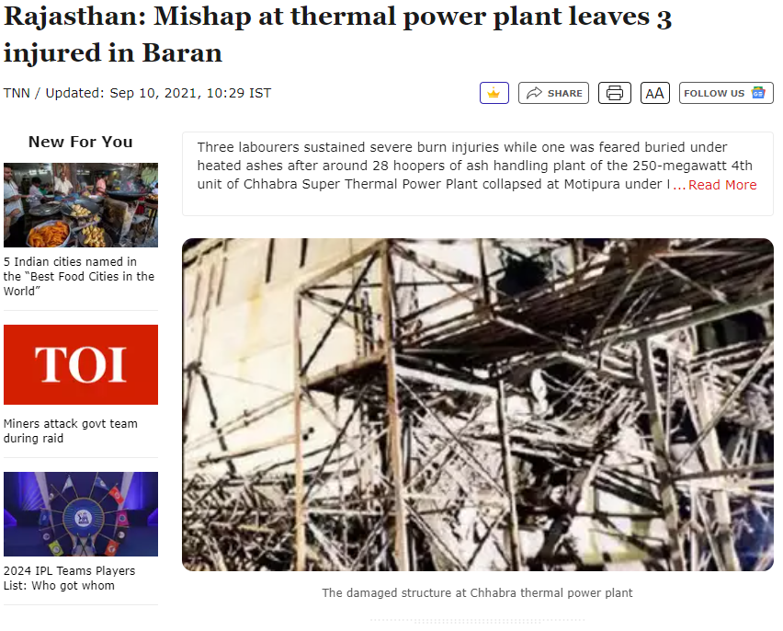
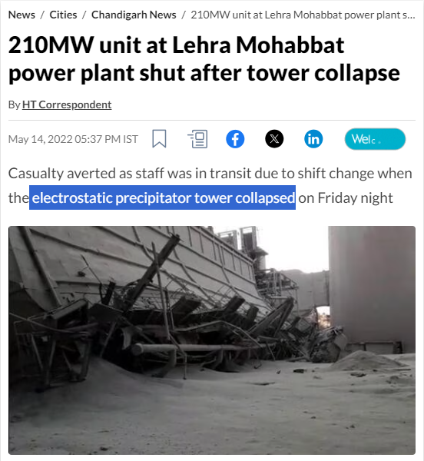
Ash Evacuation Challenges
Catastrophic Failures in Electrostatic Precipitators (ESP) Due to Poor Fly Ash Evacuation

Slide 7
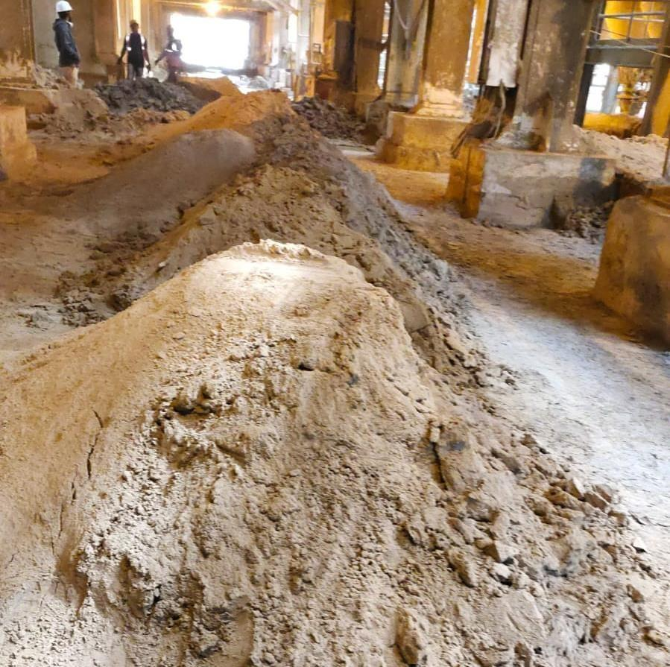
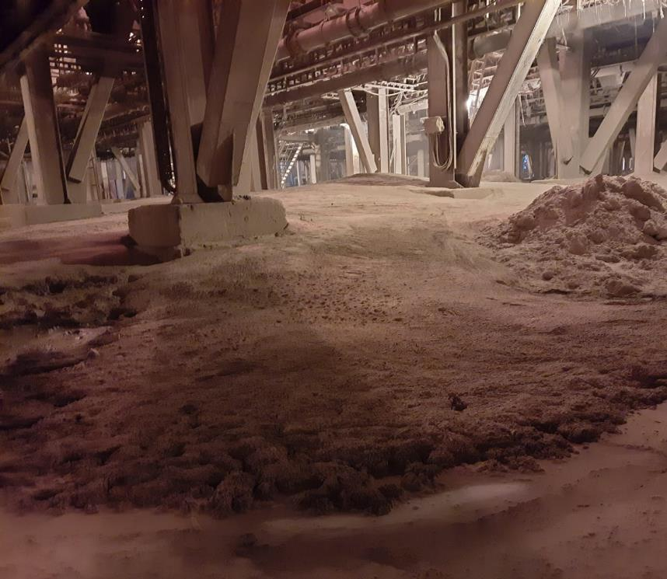
Ash Evacuation Challenges
Ash Dumping Below Electrostatic Precipitators (ESP) Due to Poor Fly Ash Evacuation at NTPC Darlipali

Slide 8
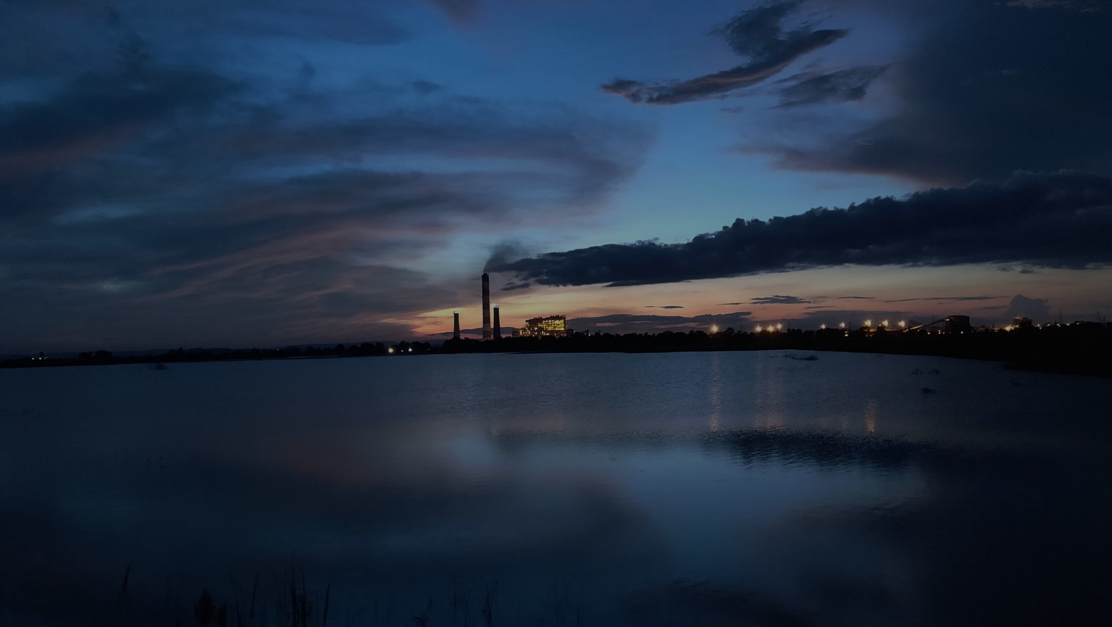
Ash Evacuation Challenges
Equipments | Equipment Running & stand by (as per design per unit) | Equipment running to cater poor evacuation (per unit) | Standby availability per unit)
TACs | 3R + 2S | 5 | All TACs i/s – No standby
IACs | 1R + 1S | 2 | All IACs i/s – No standby
FA pipeline | 3R + 3S | 5 | Only 1 line standby
ALV and associated valves (per pass) | 1R + 3S | 2 | Only 2 ALV standby
Repercussions of Poor Fly ash Evacuation
Notes:
Bar chart

Slide 9
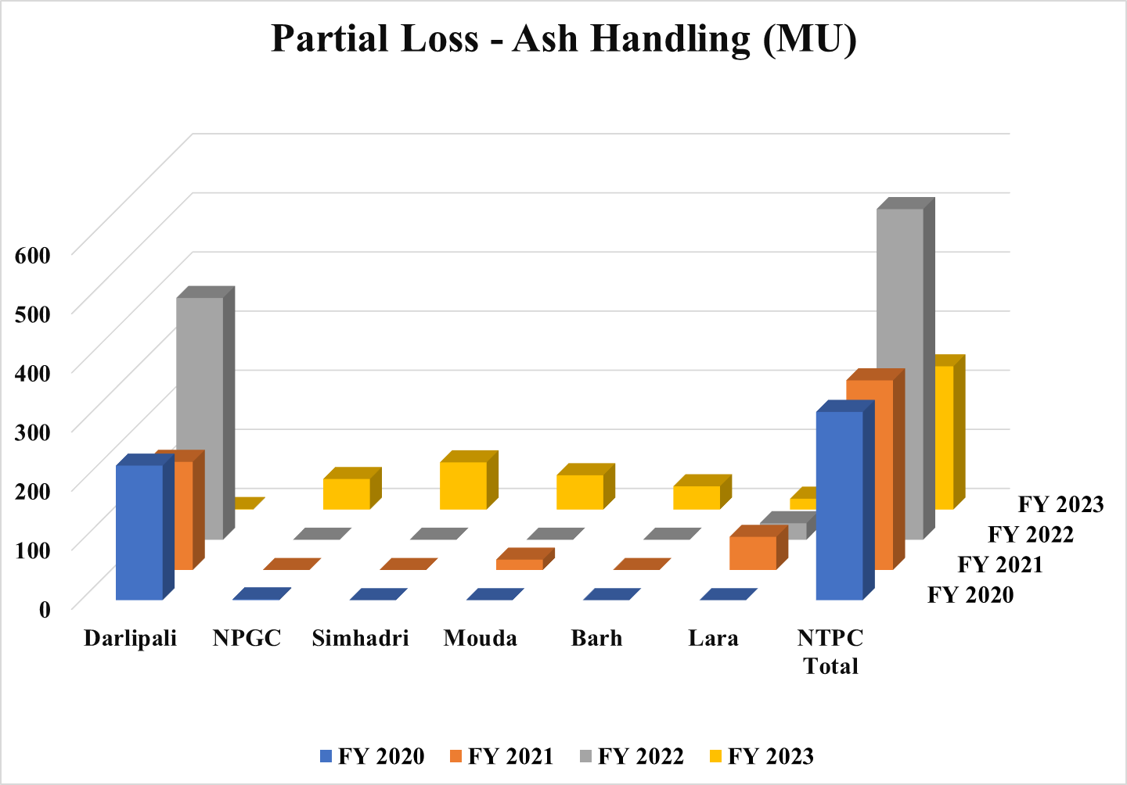
Ash Evacuation Challenges
Repercussions of Poor Fly ash Evacuation

Slide 10
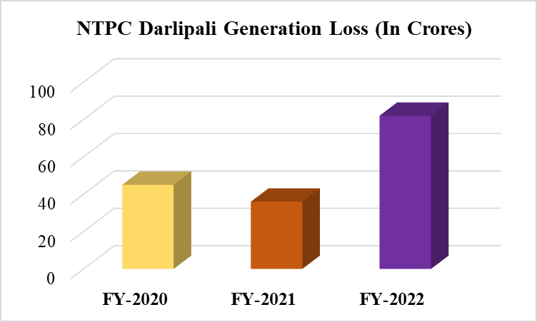
Ash Evacuation Challenges
Repercussions of Poor Fly ash Evacuation
Notes:
Bar chart

Slide 11
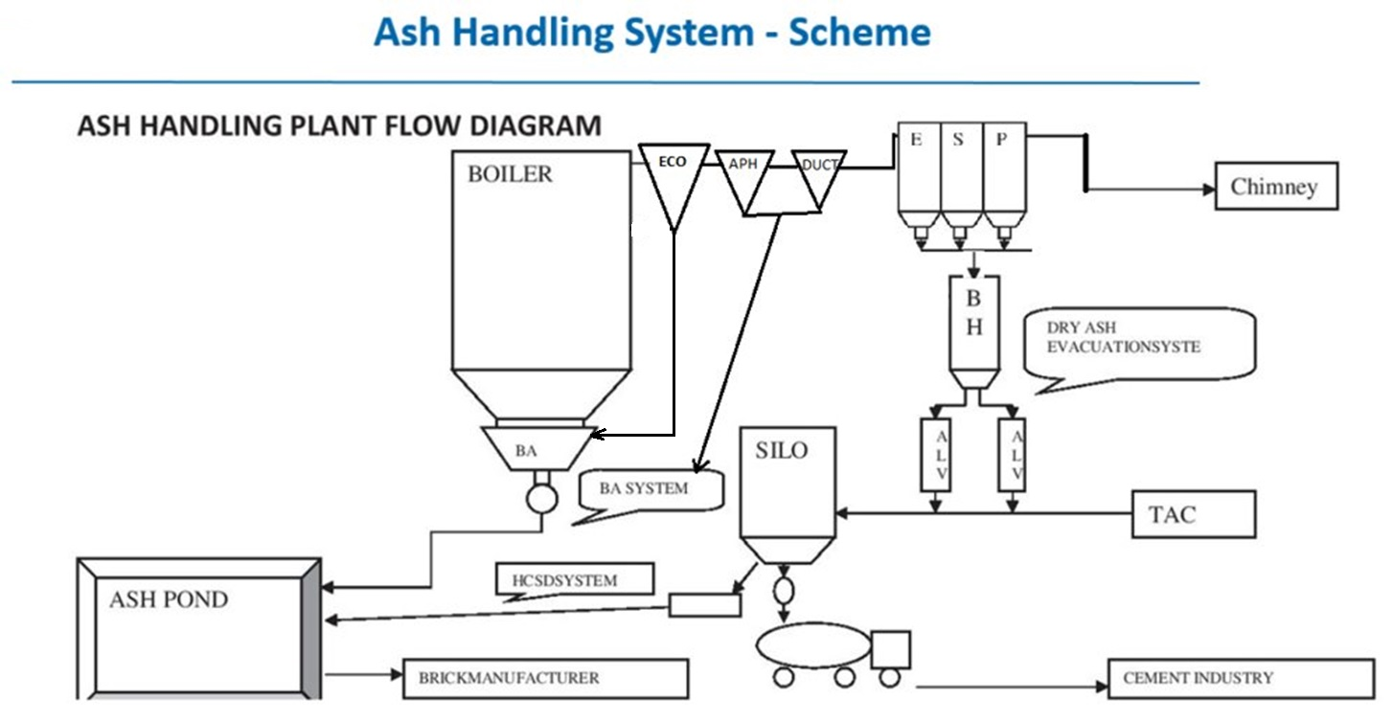

Slide 12
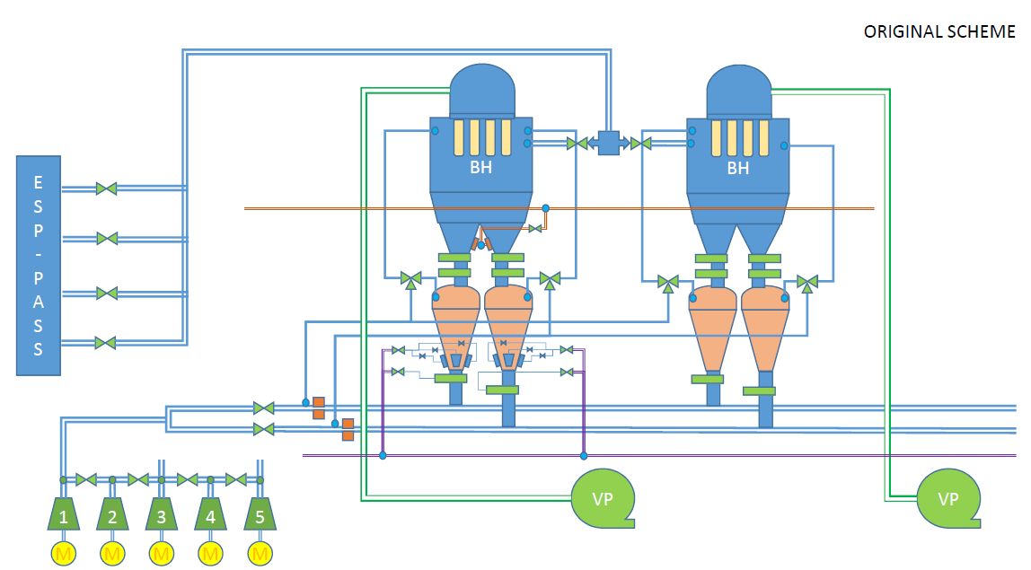
Fly ash from ESP Hopper to Buffer Hopper
Ash Inlet Valve
Bag Filters
Venting Line
UDG
BH Blower
Equalising valve
Air lock vessel (ALV)
Boosting Line
Fluidizing pads
FA line 1,2 to silo
LDG
Instrument Air header
Orifice
Vacuum pump
Transport Air Compressor

Slide 13
Poor Evacuation from ESP to Buffer Hopper
Problem Identification
Poor Evacuation from Buffer Hopper to ALV
Poor Discharge from ALV to HCSD Silo

Slide 14
Root Cause Analysis & Actions taken
Root Cause Analysis & Actions taken

Slide 15
Root Cause Analysis
Evacuation with minimum clean Air by throttling the Air intake Valve to 20% (Air is the carrying medium for Ash Conveying)
Poor Evacuation from ESP to Buffer Hopper
Frequent jamming of Material Handling Valves
Economizer ash and Coarse Ash collection in the Initial hoppers of ESP due to poor evacuation of ash from Economizer and Duct & APH hoppers
Interruption in Ash evacuation due to high Buffer hopper level

Slide 16
Actions taken
Air Intake Valve opening increased to 100%
Scheduled maintenance of MHV Air intake valve minimized the valve jamming
Poor Evacuation from ESP to Buffer Hopper
Economizer & APH/Duct hoppers evacuation improved by splitting the discharge lines into Two.
Buffer Hopper Level transmitter mal function problem addressed by shifting the location where the temperature is less

Slide 17
Root Cause Analysis & Actions taken – Case Study
Economizer ash and Coarse Ash collection in the Initial hoppers of ESP
Eco-Hoppers Original Scheme
Two major problems:
Discharge line choking and overflow from flushing apparatus was observed upon opening KGVs to 100%.
Frequent leakages from MS discharge pipe.
Notes:
Bar chart

Slide 18
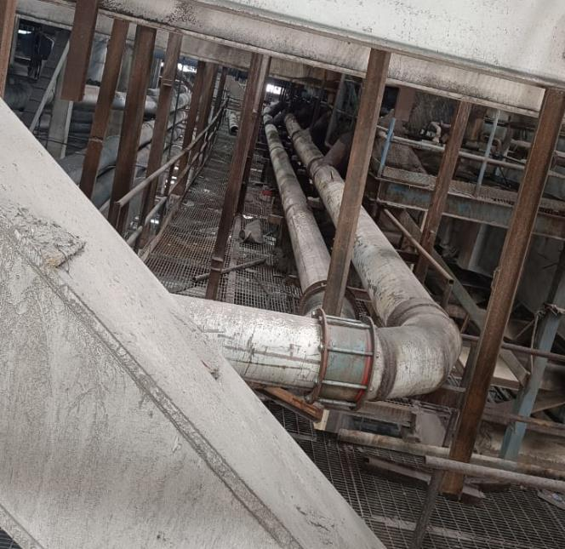
Root Cause Analysis & Actions taken – Case Study
Coarse Ash Collection in ESP Hoppers
Poor Evacuation from ESP to Buffer Hopper
Action Taken
Additional Discharge header
Bifurcation of Economizer & APH/Duct Hopper Discharge Header
Original header
Notes:
Bar chart

Slide 19
Root Cause Analysis
Lack of sufficient Venting-Boosting time
Poor Evacuation from Buffer Hopper to ALV
Improper & Frequent change in Ash Filling & Discharge time of Airlock vessel
Idle time in Airlock vessel evacuation sequence.

Slide 20
Actions taken
Venting-Boosting Time optimized
Poor Evacuation from Buffer Hopper to ALV
Ash Filling and discharge time into Airlock vessel optimized
Idle time eliminated from Airlock vessel evacuation sequence.

Slide 21
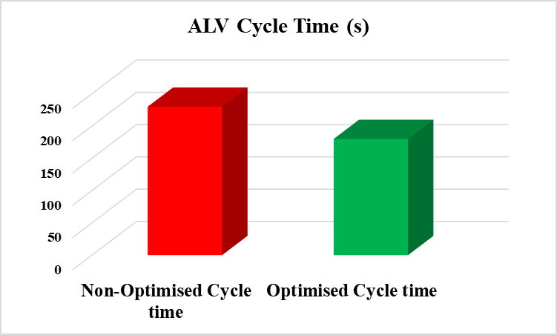
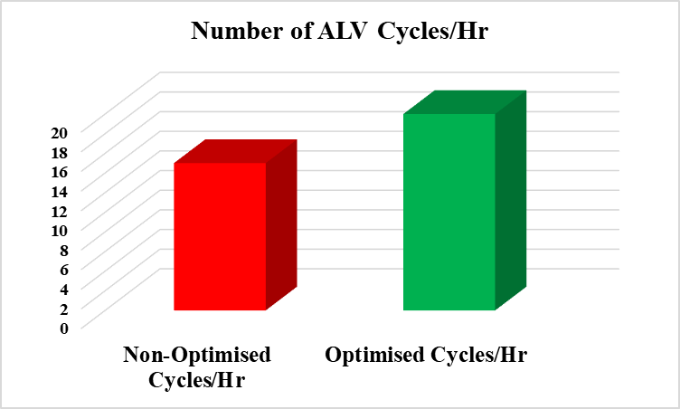
Root Cause Analysis & Actions taken – Case Study
ALV Filling-Discharge Sequence timer optimization
Improper timings in ALV Filling-Discharge Sequence
Poor Evacuation from Buffer Hopper to ALV
233 s
180 s
Action Taken
20 Cycle
15 Cycle
Ash Filling and discharge time, Venting and Boosting time into Airlock vessel optimized. Idle time eliminated.
Net Improvement in Ash conveyed per cycle – 30 Tons/Hr/Line
Notes:
Bar chart

Slide 22
Root Cause Analysis
Frequent damage of Fluidizing pads due to high Fluidizing pressure of Air lock vessel
Poor Discharge from ALV to HCSD Silo
Interruption in Ash conveying as the Silo level was maintaining high due to restriction in HCSD discharge flow
Repeated Conveying Line pressurization & leakages

Slide 23
Actions taken
Separate header laid & header pressure maintained low thereby avoided the Fluidizing pad damage/passing
Poor Discharge from ALV to HCSD Silo
HCSD Pump speed increased thereby increased the ash transportation from Silo to Ash dyke
Silo Vent fan speed increased from 31000 to 32000 rpm. Number of couplings is FA lines reduced to half.

Slide 24
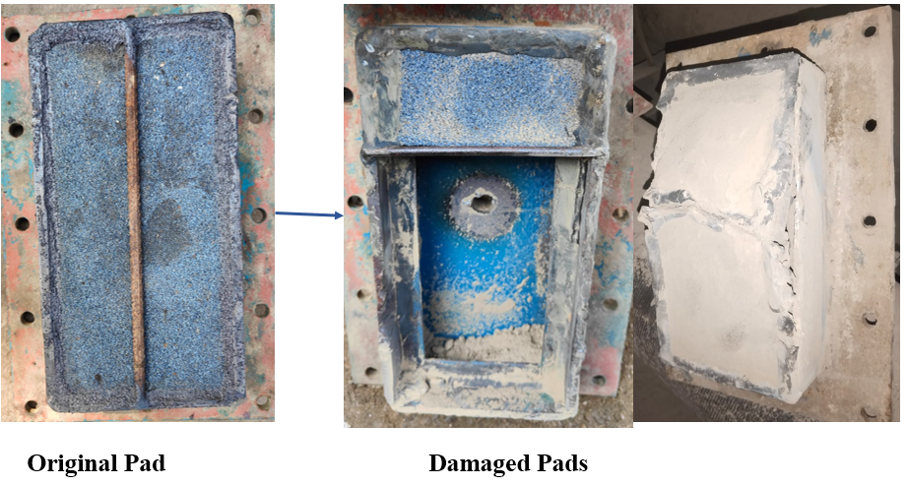
Root Cause Analysis & Actions taken – Case Study
Frequent damage of ALV Fluidizing pads
Poor Discharge from ALV to HCSD Silo
Root Cause Analysis
No Separate header for Fluidizing air
Fluidizing air taken from instrument air header (High Pressure) (Pr. ~ 6 Ksc)
Notes:
Bar chart

Slide 25
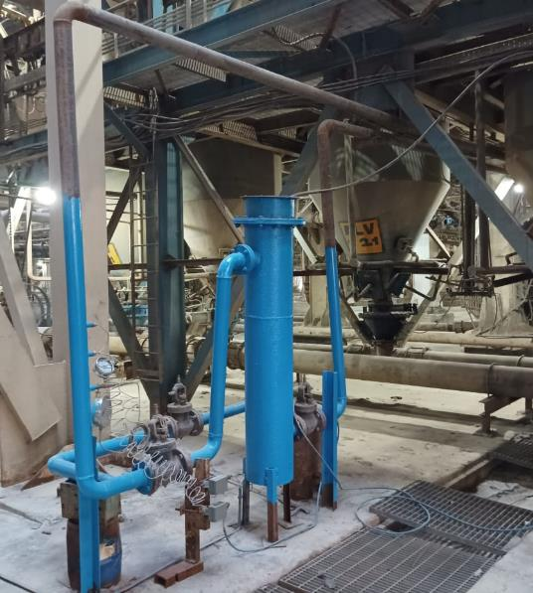
Root Cause Analysis & Actions taken – Case Study
Frequent damage of ALV Fluidizing pads due to high Fluidizing pressure
Poor Discharge from ALV to HCSD Silo
Action Taken
Separate Fluidizing air header with heater laid & header pressure maintained at 3 Ksc with throttling valve
Notes:
Bar chart

Slide 26
Results & Improvements

Slide 27
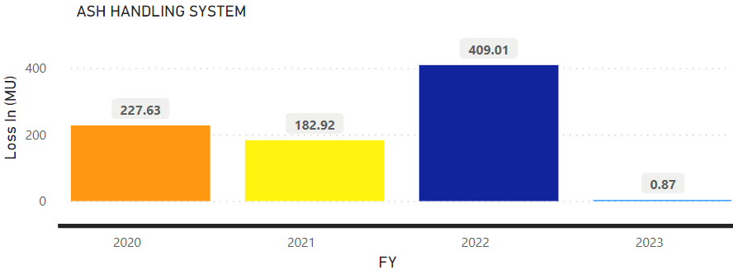
Results & Improvements
Zero Partial loss on the account of Dry-Ash Evacuation system

Slide 28
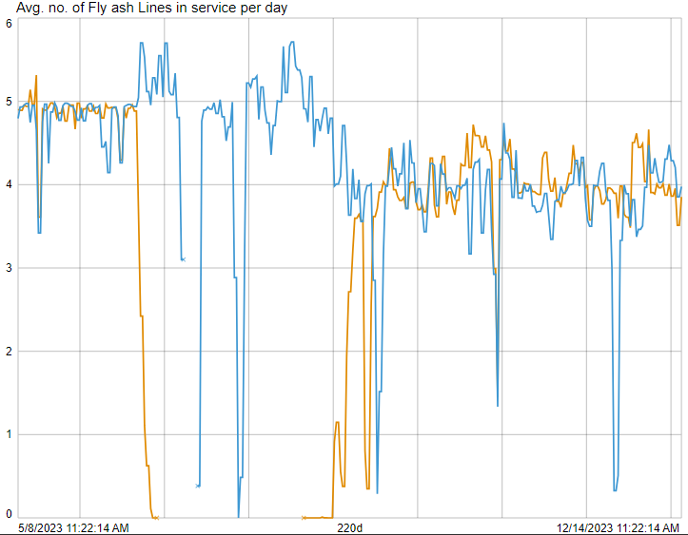
Results & Improvements
Unit 1
Unit 2
Improvement of system Reliability and Availability
Earlier 10 out of 10 TACs and 10 out of 12 FA lines were in service leaving no stand-by equipment.
Now, 2 TACs are stand-by and 5 FA lines are stand-by.

Slide 29
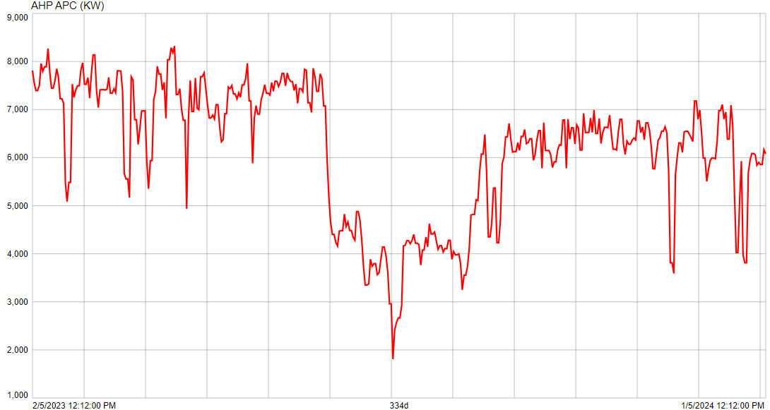
Results & Improvements
Reduction in Auxiliary Power Consumption (APC)
Reduction in APC ---> Saving - INR 89,85,600 (last four months)
Saving of INR 2,69,56,800 (2.7 crores annually)

Slide 30
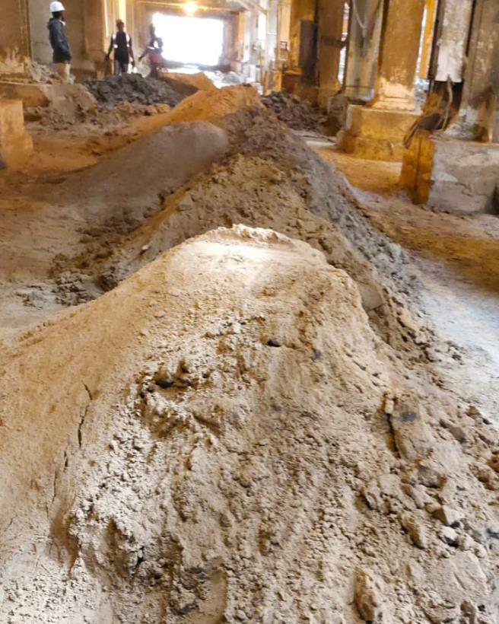
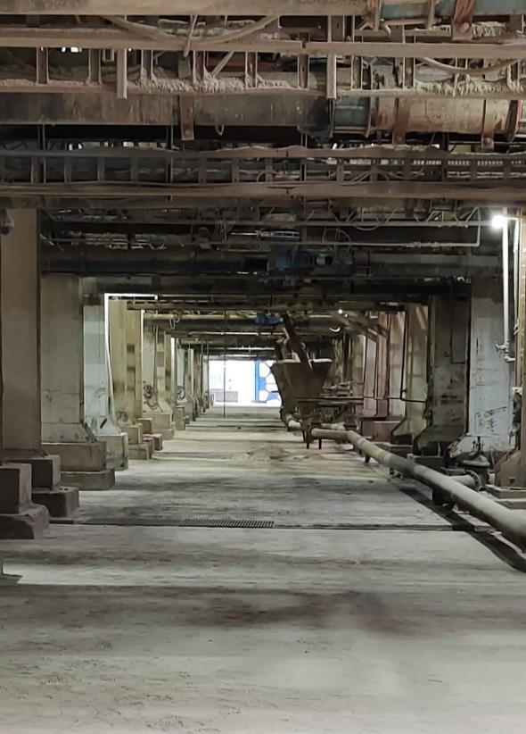
Results & Improvements
Before
After
Safety and Environment

Slide 31
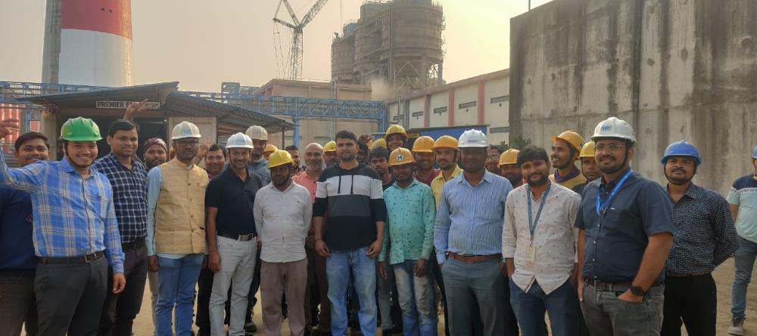
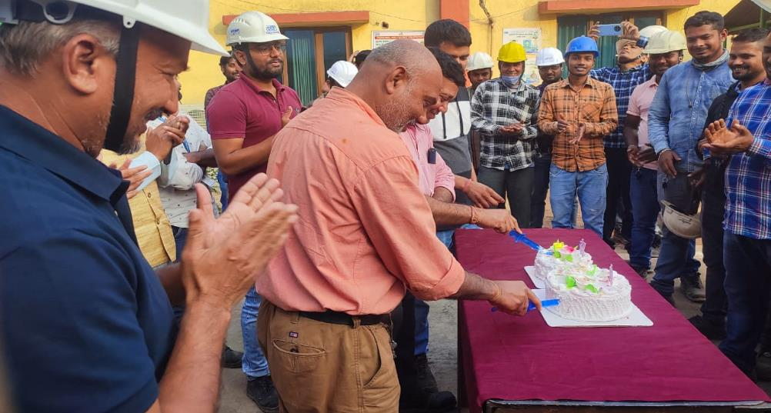
Results & Improvements
Improvement
of Employee
and workers morale

