Slide 1
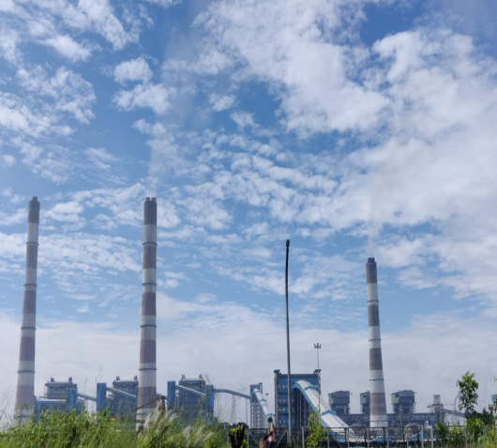
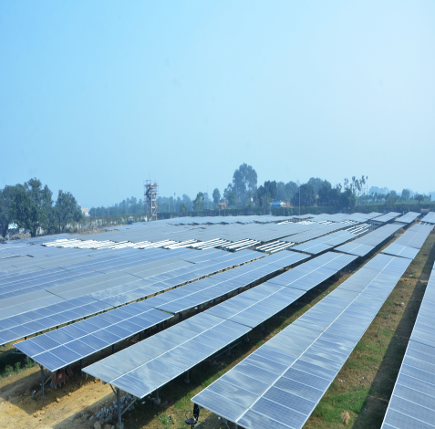
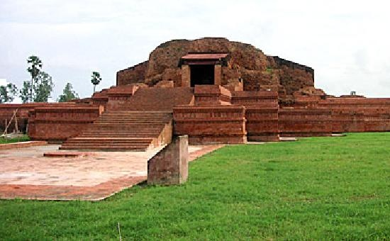


IPS 2024
NTPC Kahalgaon
3 MW Solar Plant
Vikramshila Ruins- Kahalgaon
Coarse and Fine Ash Segregation and Evacuation: Maximizing Revenue through Innovative Ash Management at NTPC Kahalgaon
* Asesh Singha Roy, DGM(Operation), NTPC Kahalgaon
Follow us on:
/ntpc1
/ntpcltd1
/ntpclimited
/Company/ntpc
/ntpclimited

Slide 2
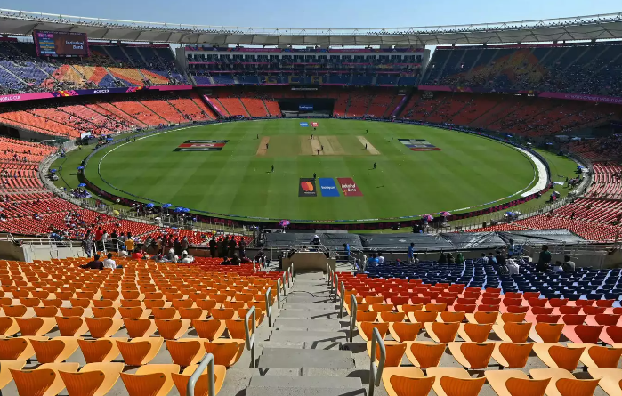


Changing value with Simple Innovative measure
Test Cricket Stadium
T20
IPL
Changing format of a Game & change of some criteria – greatly enhanced popularity & its profitability

Slide 3
Objective of the Pilot Project
Fly ash System evacuates mixture of Coarse & Fine Ash as per design
Fine Ash has higher demand in Industry if sold separately
Pilot Project objective –
Achieving Segregation of Fine & Coarse Ash in existing system without major modification/ investment
Segregating Fly Ash as per Industry demand - thereby maximizing Ash utilization

Slide 4
Presentation Overview
Ash Evacuation System Overview
Challenges & Solution
Cost Benefit Analysis of Pilot Project
Conclusion & Recommendation
Methodology of Fine & Coarse Ash Segregation

Slide 5
Ash Collection in different parts of Flue gas path
j
Fly Ash Generation – 134 TPH (approx.) for each 500MW unit

Slide 6
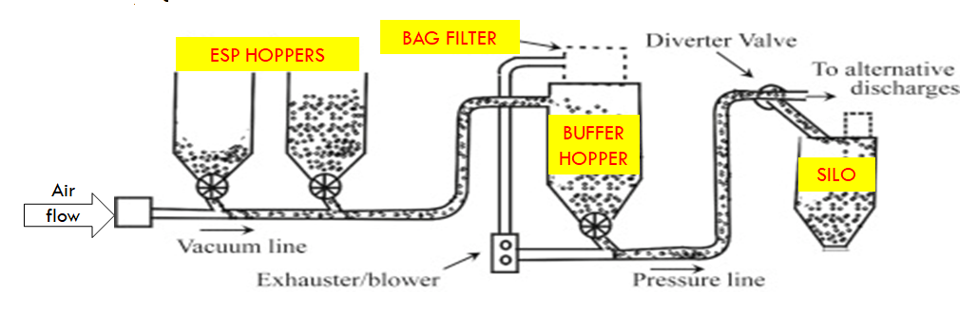
Ash Collection in ESP Hoppers & Conveying System
j

Slide 7
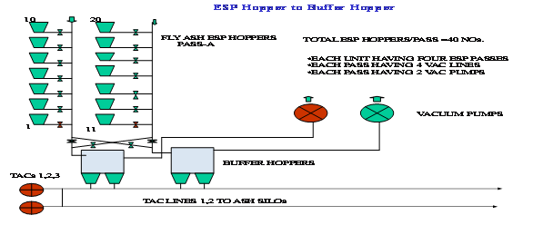
Vacuum convey system-ESP hopper to Buffer Hopper

Slide 8
Pressure Conveying system-Buffer Hopper to Silo
Maximum Conveying Distance = 1.1 Km ;
Maximum Conveying Capacity = 150 TPH per TAC Line
Working Pressure = 1.2 Kg/cm2 (Maximum) ; Maximum Particle Size = 250micron

Slide 9
Presentation Overview
Ash Evacuation System Overview
Challenges & Solution
Cost Benefit Analysis of Pilot Project
Conclusion & Recommendation
Methodology of Fine & Coarse Ash Segregation

Slide 10
Fly ash conveying line arrangement before fine/coarse ash evacuation
SILO-5
SILO-6
FA LINE 7A
SILO-7
FA LINE 5A
FA LINE 6A
FA LINE 5B
FA LINE 7B
FA LINE 6B
Fly ash conveying line Re-orientation for fine/ coarse ash evacuation
SILO-5
FA LINE 7A
SILO-6
FA LINE 5B
SILO-7
FA LINE 5A
FA LINE 6A
FA LINE 7B
FA LINE6B
Coarse Ash Silo
Fine Ash Silo

Slide 11
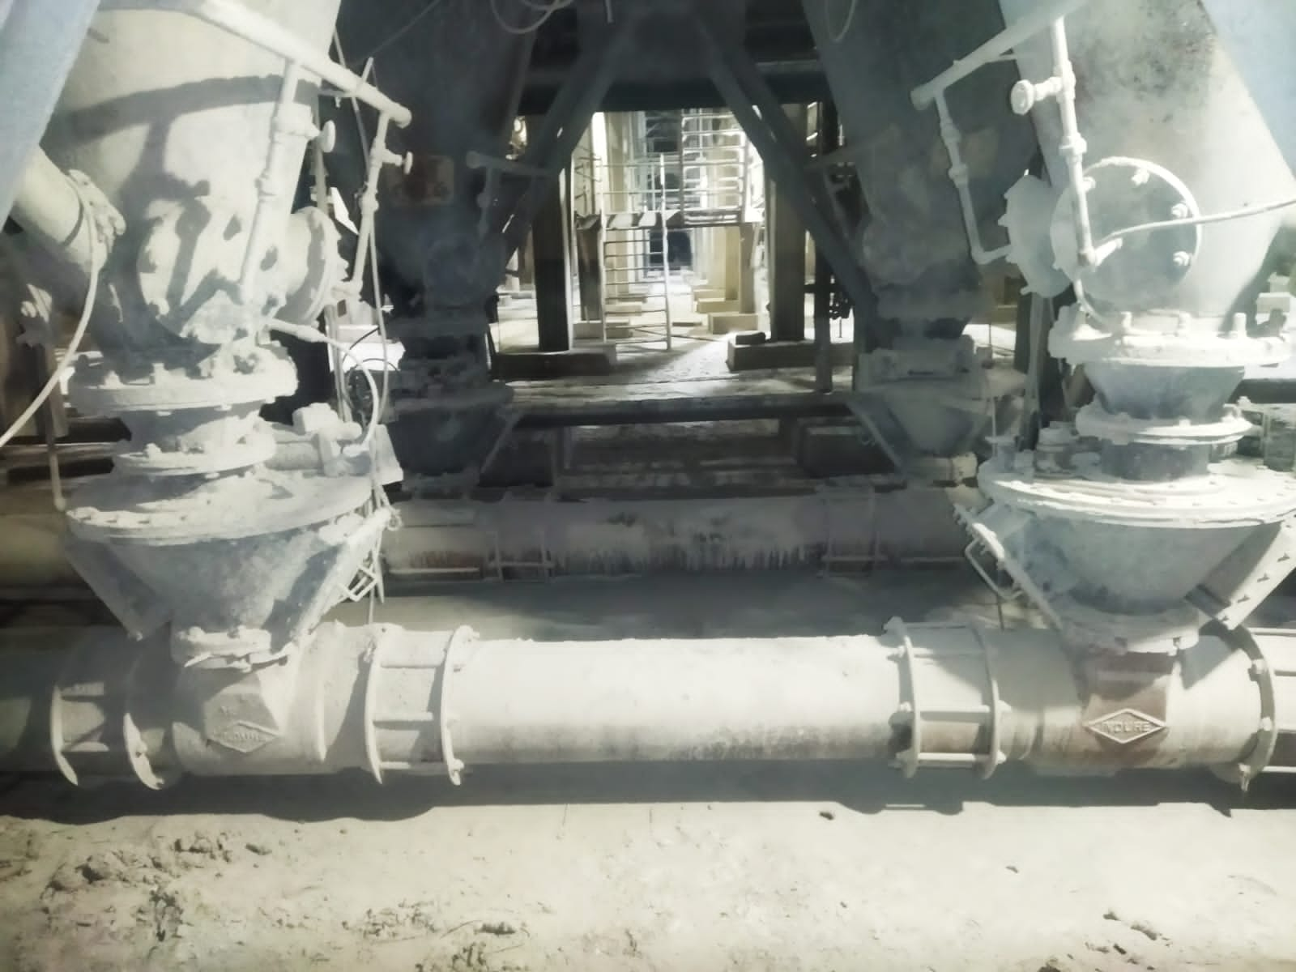
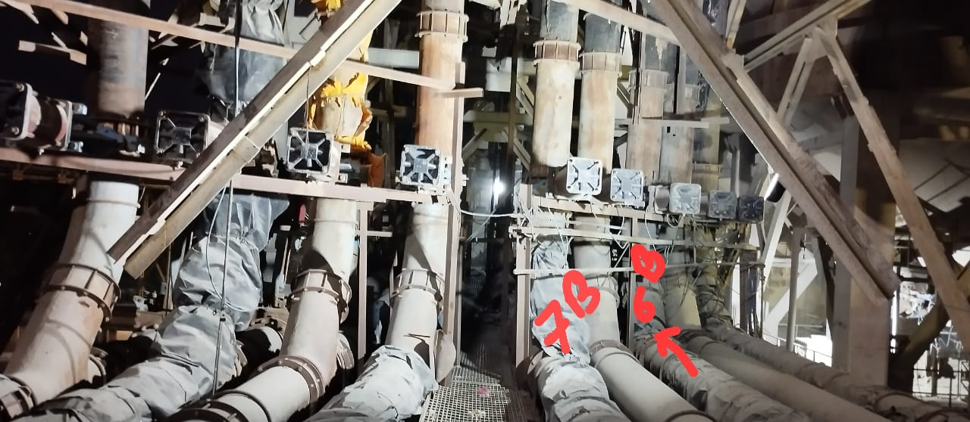
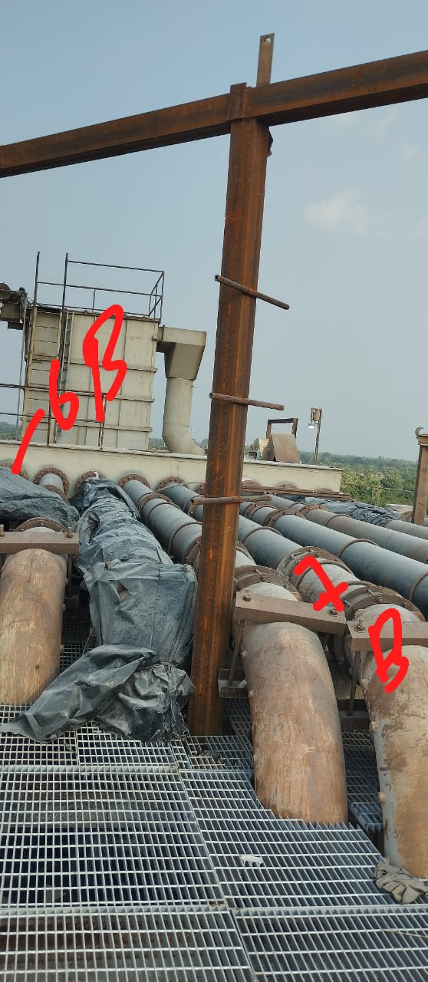
TAC Line Layout at different Position
TAC Line below ALT
TAC Line At Silo
TAC Line At Silo Top

Slide 12
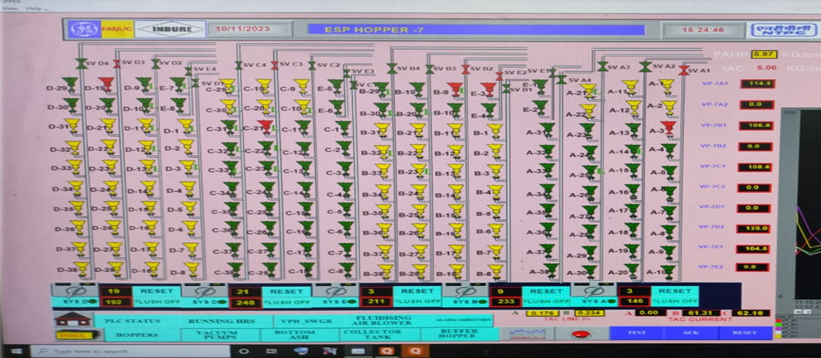
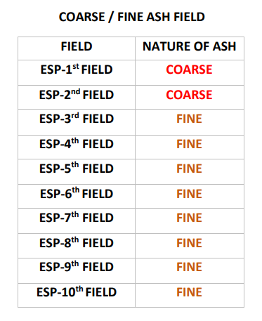
Coarse & fine ash selection of ESP hoppers
COARSE ASH SELECTION : B, D, E PASS
FINE ASH SELCTION : A, C PASS

Slide 13
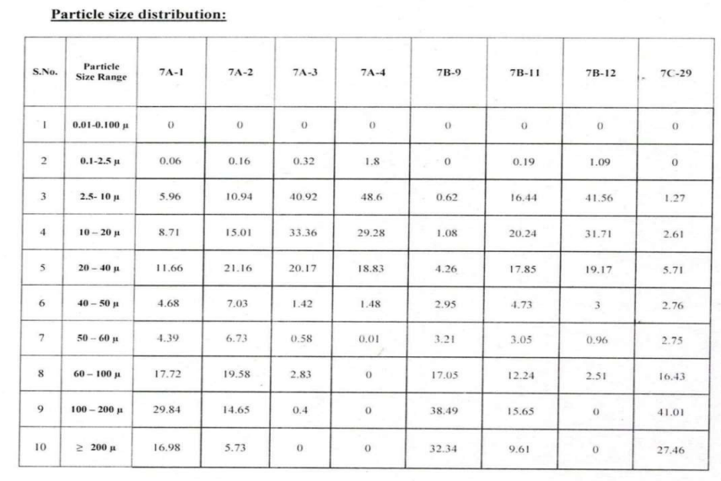
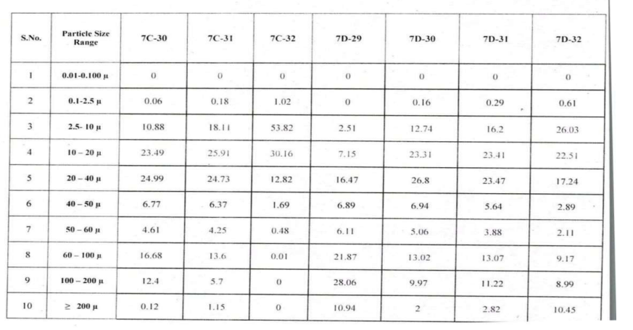
Particle Size Distribution

Slide 14
Coarse & Fine Ash Cycle Sequence
Coarse Selection :- B,D, E – All 3 Buffer Hoppers selected together; Duration of evacuation – 20 Mins for Single Hopper; So for 06 hoppers total duration = 120 Mins; (Coal Flow - 450TPH)
Next Flushing :- No ESP Hopper Selection; Only any branch Selection (Vacuum Conveying Line); Complete conveying line clear; Duration – 30 Mins;
Fine Ash:- A,C – Front 2 hoppers are bypassed & Hopper No. 3-10 selected from PLC System; Duration of Operation for 32 Hoppers upto 1:30 Hrs; (A,C fine mode in simultaneous operation when B, D, E in Coarse mode upto 1:30 Hrs;)
Then Coarse of A,C, E – Duration - 120 Mins;
(Flushing time 30 Mins required when Coarse to Fine is changed)

Slide 15
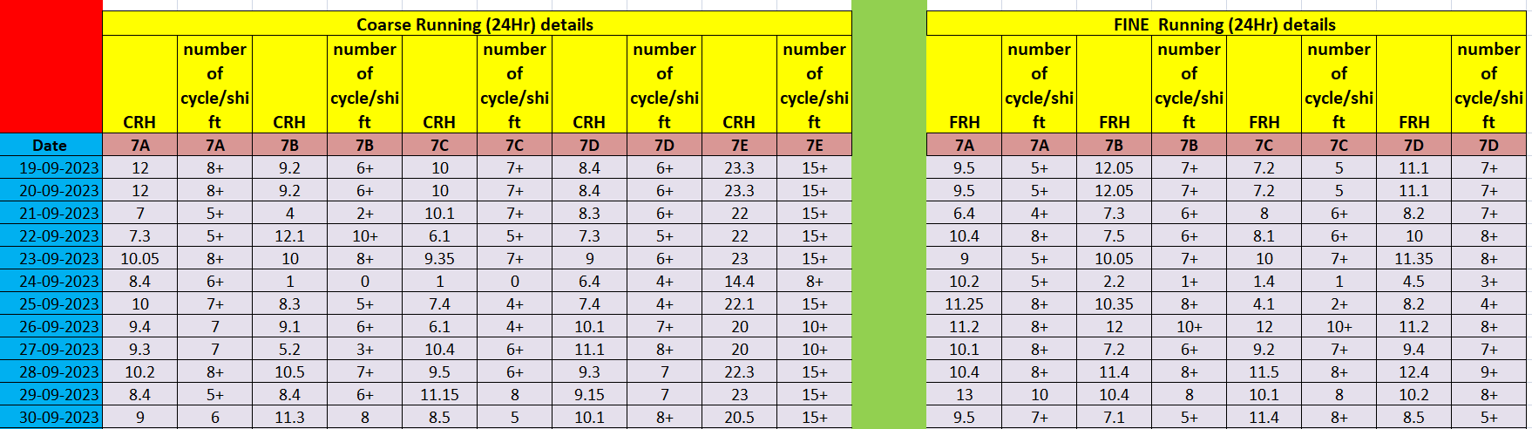
Running Hours of Coarse & Fine Ash

Slide 16
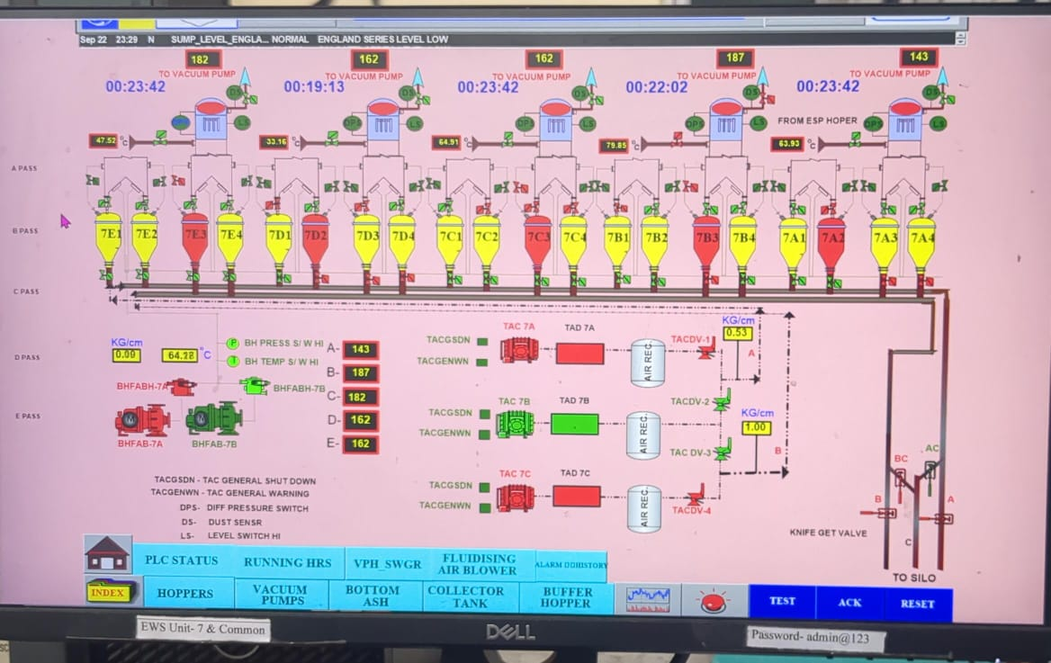
Air lock vessel selection for coarse and fine ash

Slide 17
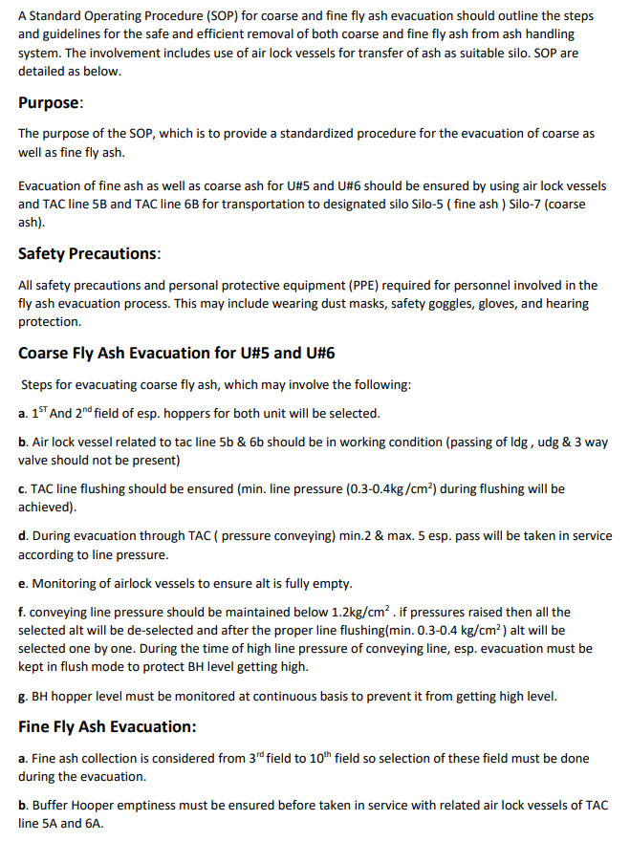
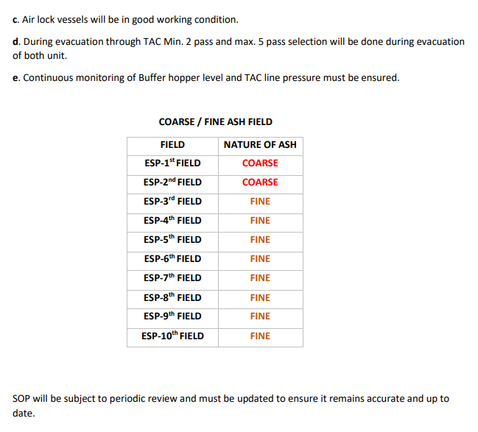
SOP

Slide 18
Challenges Faced in Ash Evacuation
System was designed to evacuate both coarse ash and fine ash mixed, which resulted in less wear and tear on the system. However, when coarse ash and fine ash were separated and evacuated separately various challenges were faced.
Clogging in the conveying system
Dust emissions due to line leakages
Wear and tear to the air lock vessels
Silo level high
Air lock vessels are not doing proper discharge due to high density of coarse ash
Increase in Cycle time of evacuation
Evacuation done in manual mode

Slide 19
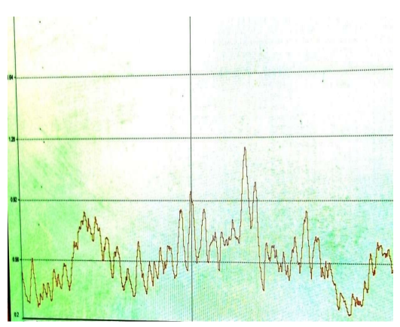
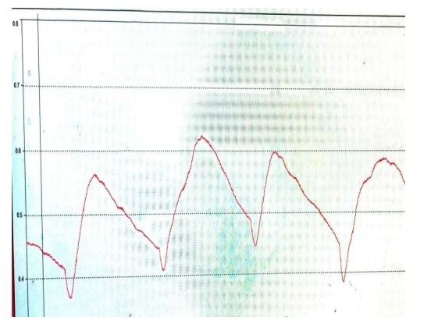
Conveying Pressure during Evacuation
Pressure line Graph of Coarse Ash Conveying
Pressure line Graph of Fine Ash Conveying

Slide 20
Solutions
Controlled fluidizing air is provided
Installation of NRV in respective air lock vessels of TAC line 5B and 6B
Frequent maintenance of air lock vessels
Silo evacuation frequency increased
To ensure emptiness of air lock vessels during the fine ash evacuation extra fluidizing air is provided from Equalizing valve (instrument air)

Slide 21
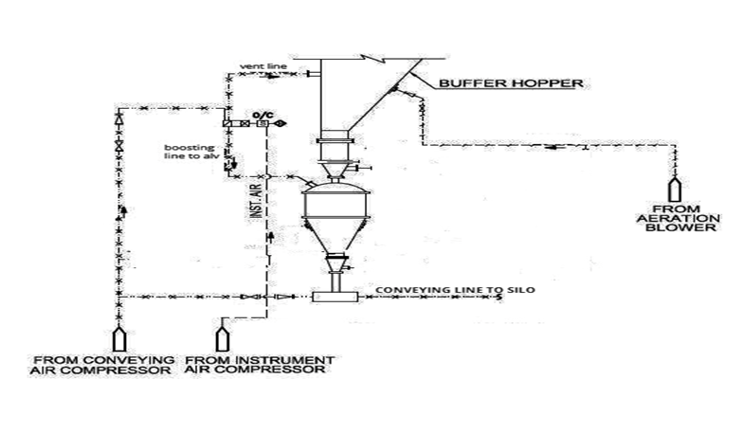
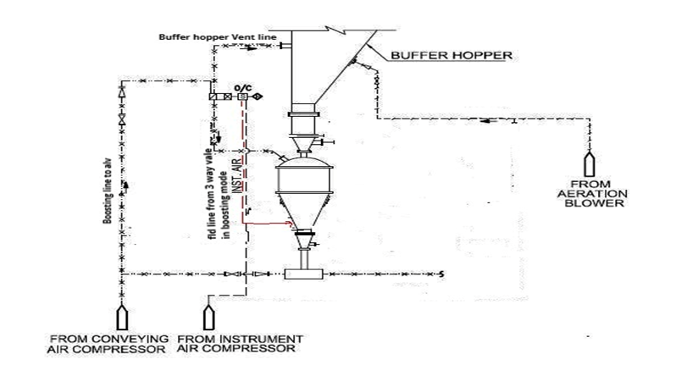
Modifications
Before modification - ALV
Modification at ALV for coarse ash Evacuation

Slide 22
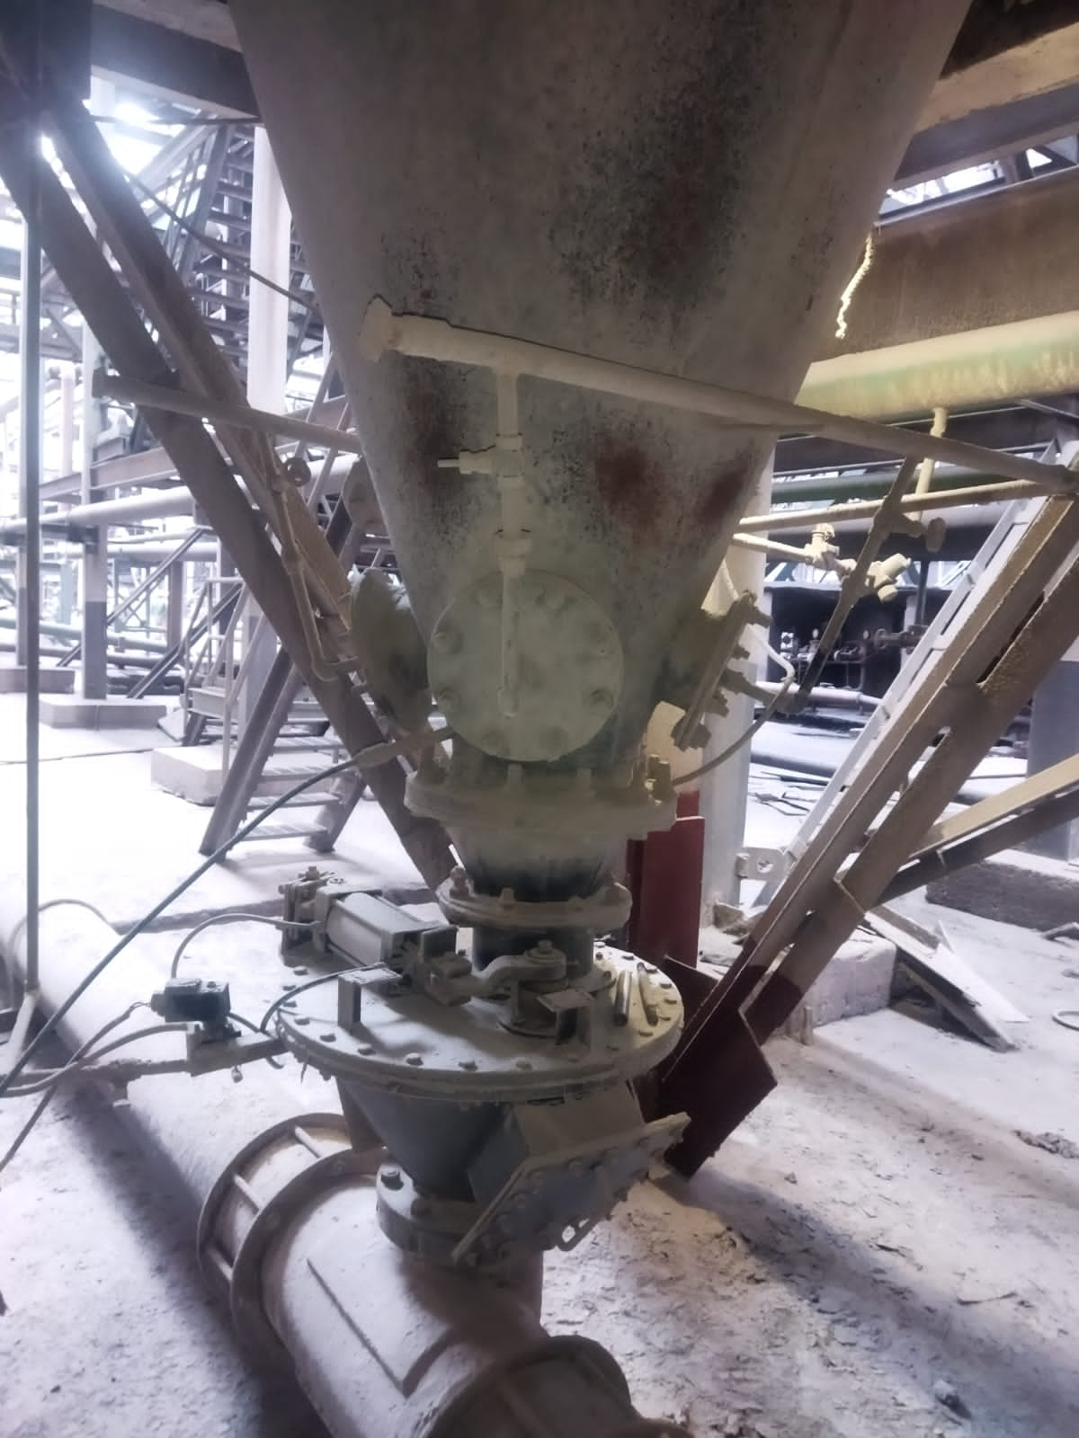
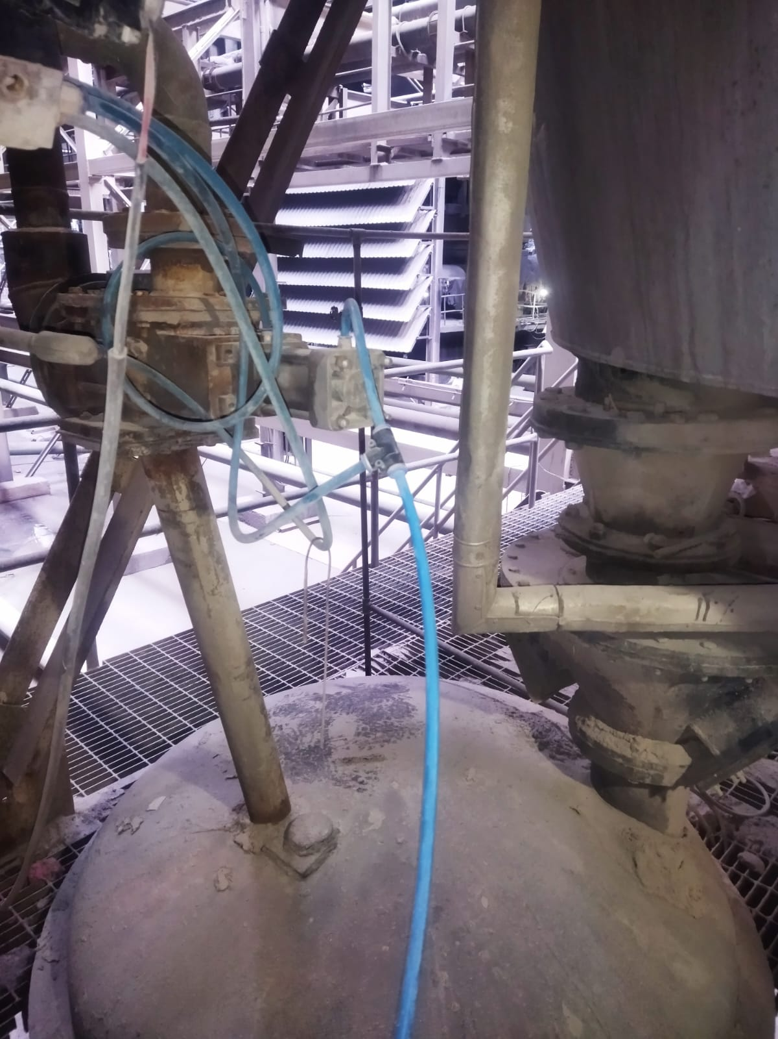
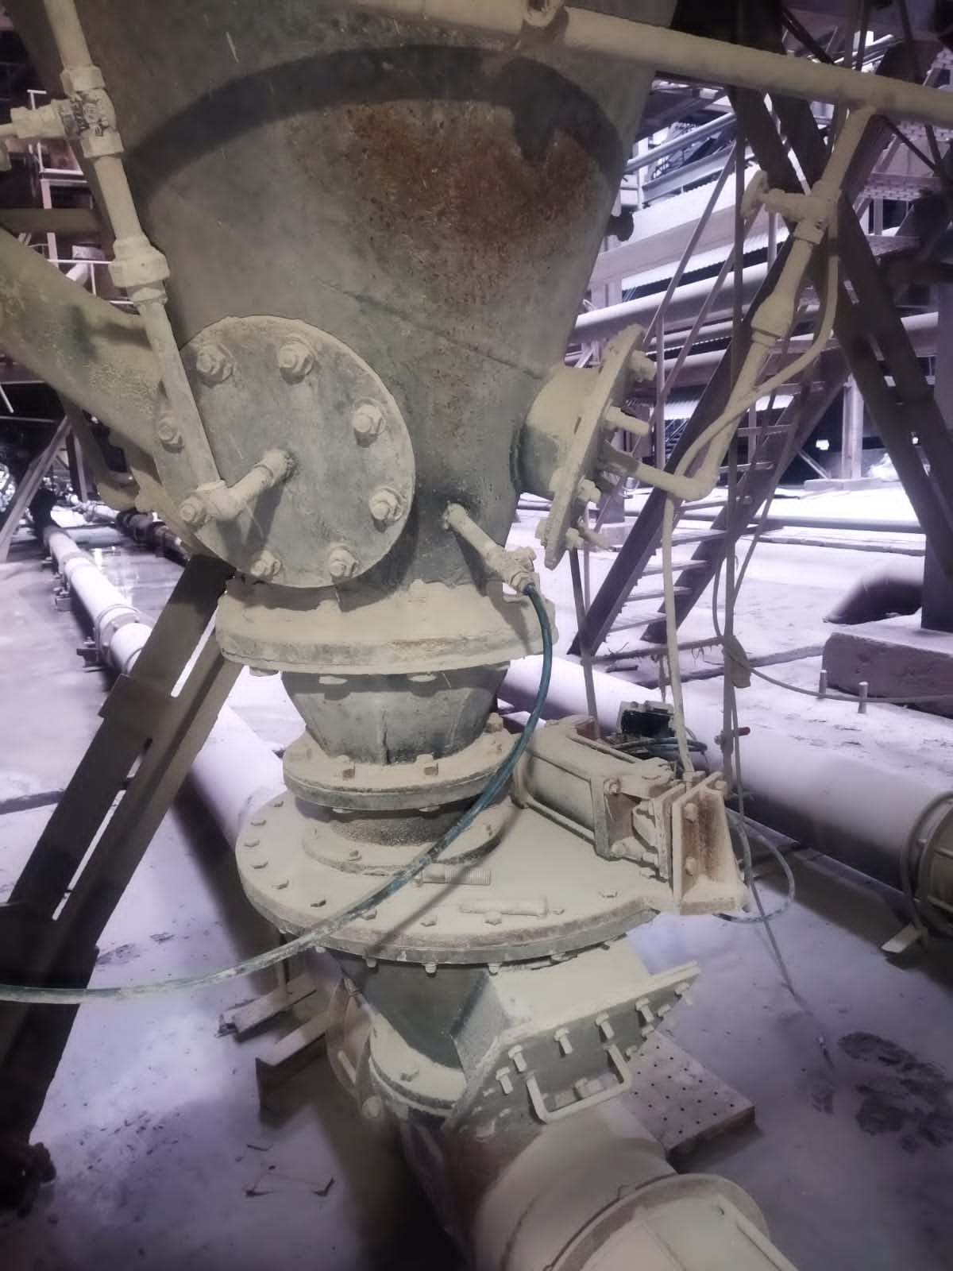
Fluidizing Air to ALT from Equalizing Valve

Slide 23
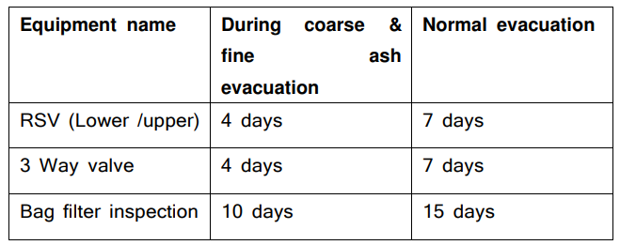
Comparison of Maintenance Time

Slide 24
Cost-Benefit Analysis of the Pilot Project
AV
Average coal flow/Hr. (500MW Unit): - 420 T/hr.
Ash Generation: - 420* 0.40= 168 T/hr.
Fly Ash generation: - 168*0.8= 134 T/hr.
Coarse Ash: - 134*0.85= 114 T/hr
Fine Ash: -20 T/hr ; Fly ash rate= Rs 260/T
Earning from Fly Ash/hr = 260*134= Rs 34840/-
Say, Rate of Coarse Ash= Rs 230/T & Fine Ash= Rs700/T
After Segregation, Earning from fly ash= 230*114 + 20*700= 26496+20160= Rs 40220/-
Increase in revenue/Hr per Unit= Rs (40220-34840) = Rs 5380/-
Total incremental Revenue/Year in Kahalgaon Stage#2 = 5380*24*365*3= Rs 14.13Cr

Slide 25
Conclusion & Recommendation
Segregation of Fine & Coarse Ash in existing system without major modification/additional investment is possible
Logic modification in PLC shall further facilitate ease of evacuation
Segregating Fly Ash as per Industry demand shall maximize Ash utilization
Potential Revenue earning (Rs. 14Cr/annum) at Kahalgaon (3X500MW)
This project may be easily replicated to other NTPC Stations where similar arrangement for Fly Ash evacuation System exist

Slide 26




Generating Power
Utilising Ash
Realising Dreams
Thank You
NTPC KAHALGAON
Website: www.ntpc.co.in | Email: info@yoursite.com
Follow us on:
/ntpc1
/ntpcltd1
/ntpclimited
/Company/ntpc
/ntpclimited

