Slide 1


Slide 2


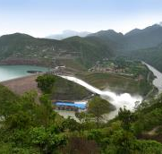
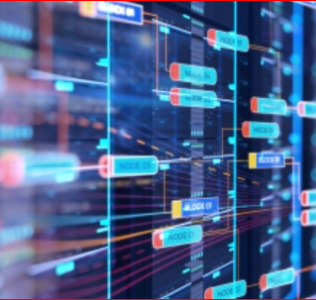
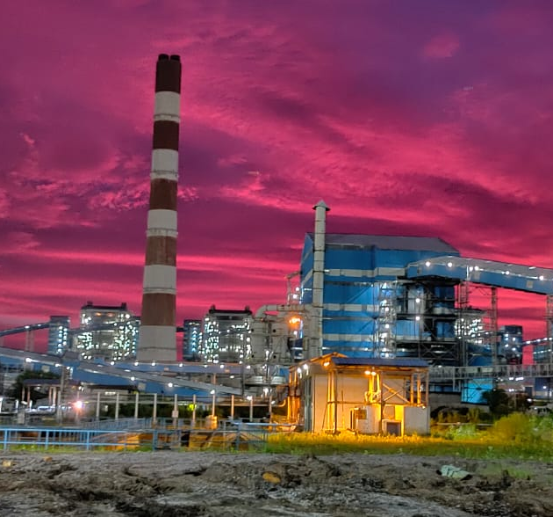
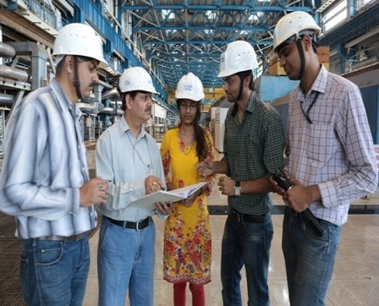
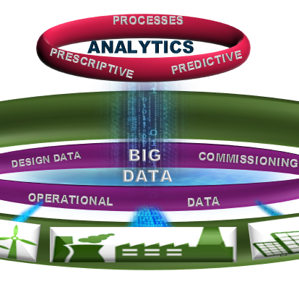
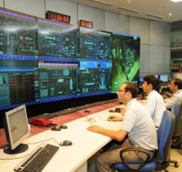
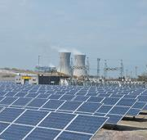
SSTPS
PRADIP
Go Digital Go Paperless
Asset Fault Prediction through Machine Learning Models
Singrauli Super Thermal Power Station
Presented by:
Abhishek Joshi (O&M-C&I)
SAP

Slide 3
FLOW OF PRESENTATION
Introduction
Artificial Intelligence and Machine learning
Failure Mode and Effects Analysis (FMEA)
Predictive/Image Analytics - Case study of TDBFP EHTC
Intangible and Tangible Benefits
Advantages

Slide 4
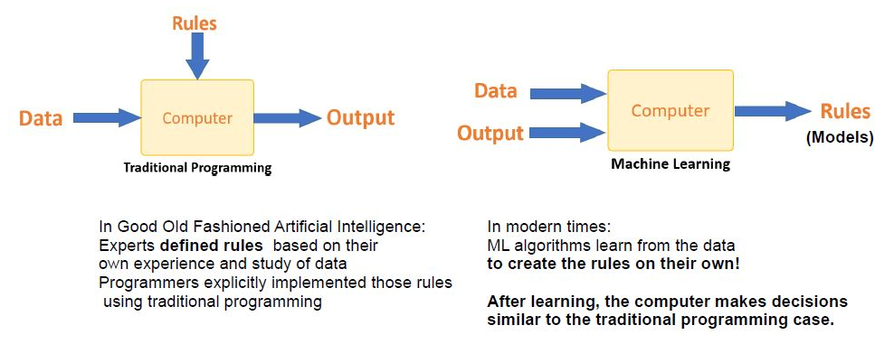
TRADITIONAL PROGRAMMING V/S MACHINE LEARNING

Slide 5
LATE FAILURE MODE DISCOVERY
No. of outage/partial losses
Failure mode creation
Failure mode discovery
Failure
Too Much Time
Time

Slide 6
EARLIER FAILURE MODE DISCOVERY
No. of outage/partial losses
Failure mode discovery
Failure mode creation
Failure
Time
Minimized
Time

Slide 7
THE “MACHINE LEARNING” APPROACH
No. of outage/partial losses
Failure mode discovery
Failure mode creation
Failure
Negative Time
(Predictive)
Time

Slide 8
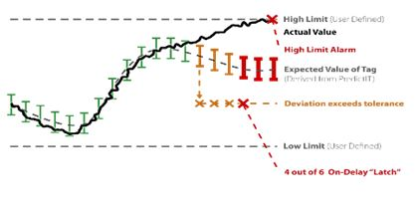
THE “MACHINE LEARNING” APPROACH
Machine Learning Regression models learn the normal behavior of asset from historical data
Each set of measurements of an asset form a ‘Learning Vector’
Model predicts value of each signal of asset using the ML algo.
Anomaly generated on a parameter if difference between predicted value & actual value outside statistical distribution learned by the system
Anomaly generated much before the DCS alarm giving more window for action

Slide 9
Electro-Hydraulic control of Main Turbine & TDBFP
Electro Hydraulic governing is used to control the opening of Control Valve of Main Turbine and TDBFP based on electrical signal, generated from Speed, Load and Pressure transducer.
Any problem in EHTC circuit may disturb the opening of control valve, thereby causing unit disturbance and may lead to Unit Trip.
Being a complex system, even after proper observation, it is hard to predict EHTC failure.

Slide 10
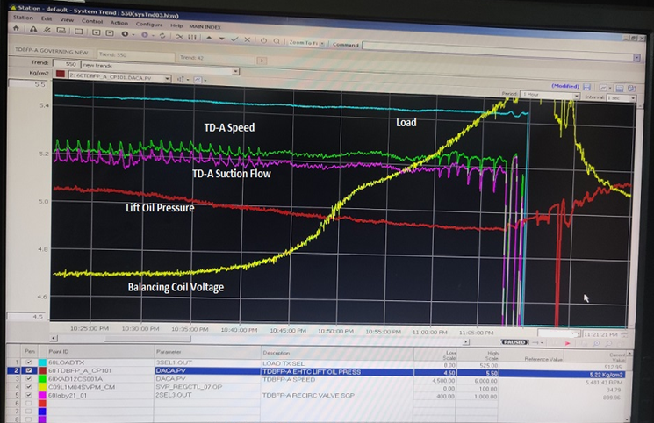
Case Study Of EHTC Failure of Unit-6 TDBFP
13th July 2021: U#6 TDBFP-A:
22:30 hrs – Hunting 20 to 30 rpm.
22:42 hrs - Hunting normalized.
23:05 hrs - Hunting started again.
23:10 hrs – Unit Tripped on Drum Level (Severe Hunting).
Observation:
  Sudden increase in EHTC O/P or balance voltage of plunger coil & TD-A failed.
  Balance voltage of coil suddenly varied from -1.0V to 2.5 V.
  Lift oil pressure constant at 4.95 ksc .

Slide 11
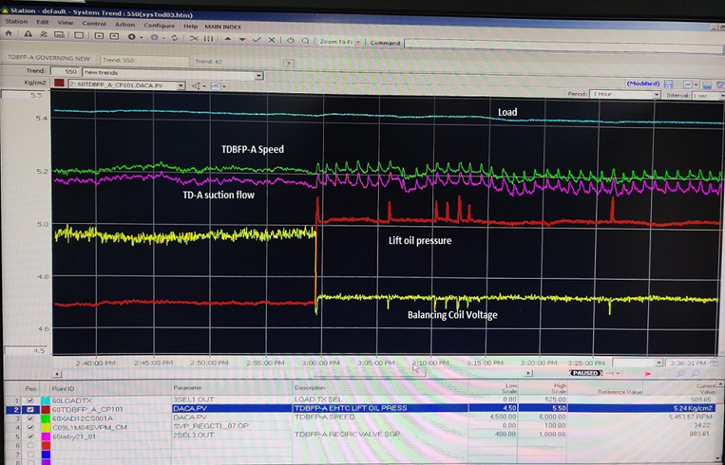
Case Study Of EHTC Failure of Unit-6 TDBFP
Analysis & Investigation:
13th July 2021 15:00 Hrs:
(few hours before tripping)
  Normal Operation
  Sudden change in lift oil pressure
  Resulting change in balance voltage of the coil from -0.5 V to -1.5 V

Slide 12
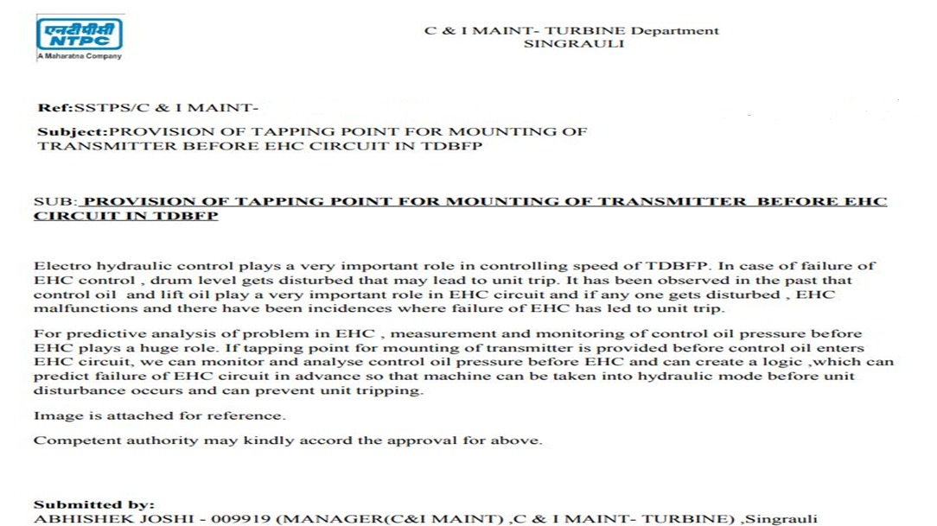

Slide 13
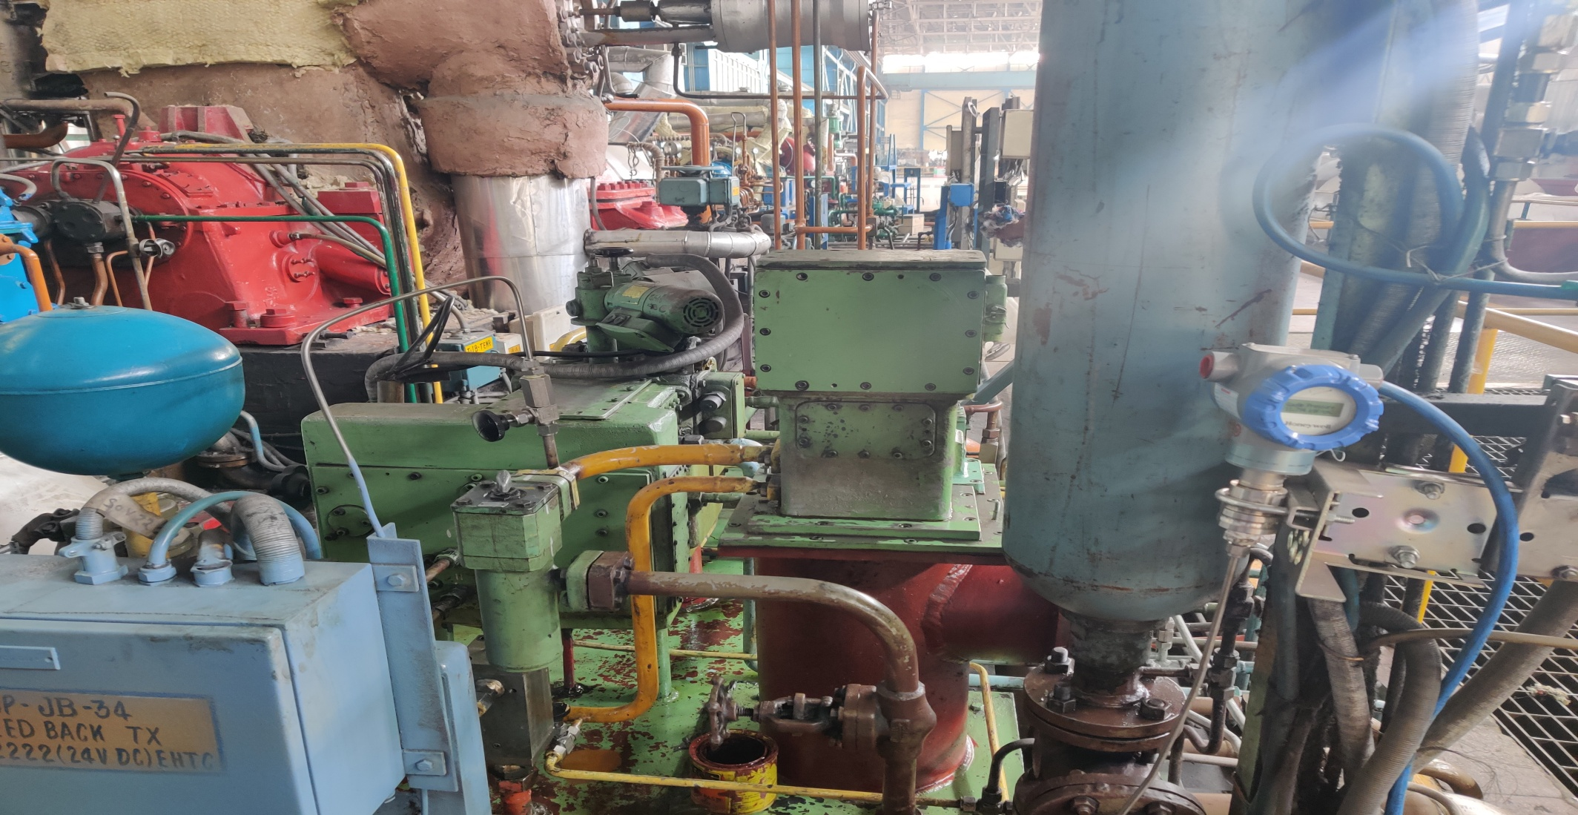
Implementation of new Transmitter

Slide 14
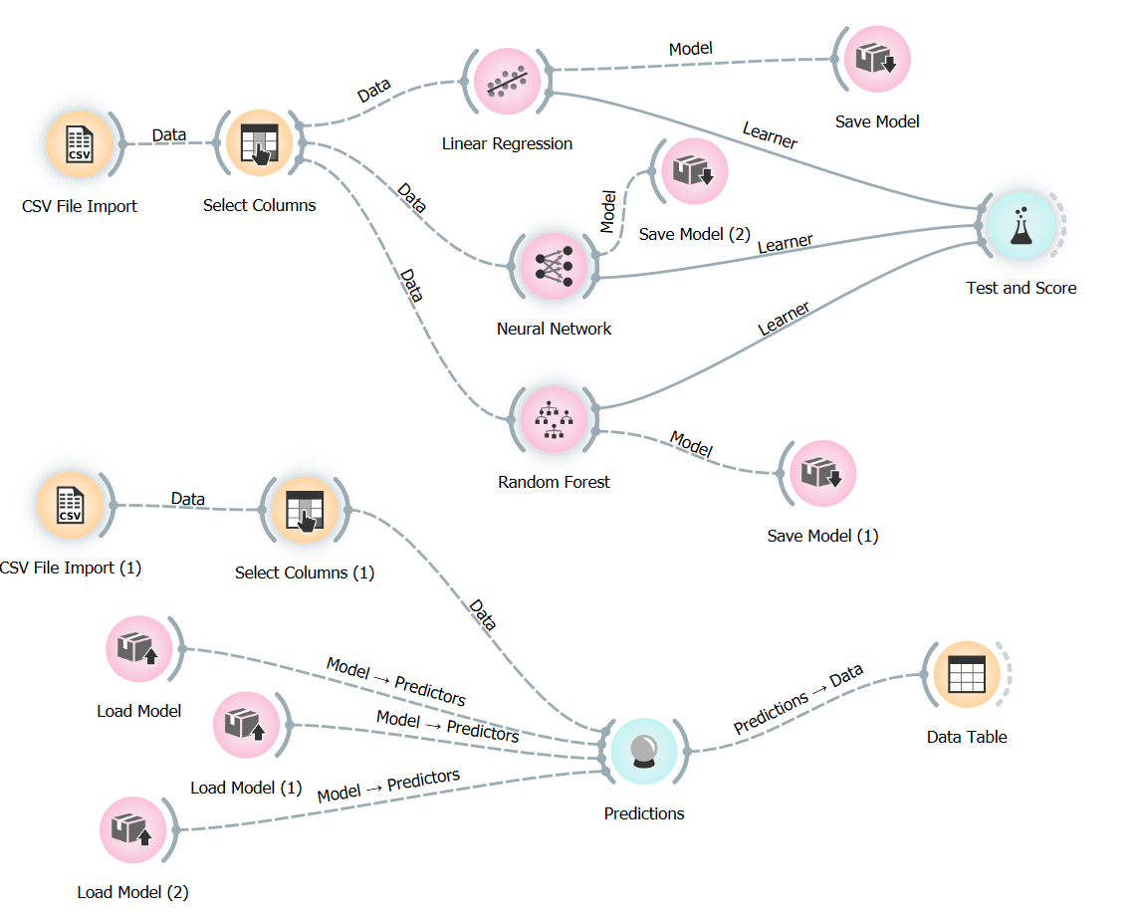
Predictive Modelling using ML

Slide 15
A Glimpse of AI Algorithm of EHTC Logic at NTPC Singrauli
LIFT OIL PR
EHC OIL PR.
CONTROL OIL PR
Adaptive Preset value
Present value
Adaptive Preset value
Present value
Adaptive Preset value
Present value
AND MANY MORE
DEVIATION
HIGH
DEVIATION HIGH
DEVIATION HIGH
EHC BALANCE VOLT
Preset value
Present value
OR
DEVIATION HIGH
SEC. OIL PR
ROC
AND
Watch dog Signal/Quality Signal
AUX. SEC. OIL PR
ROC
OR
Predictive Alarm Information System
AND MANY MORE

Slide 16
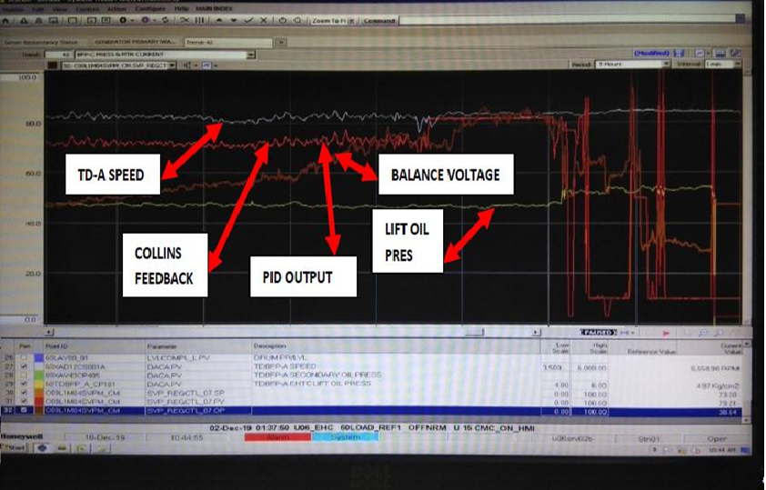
Case Study Of EHTC Failure of Unit-6 TDBFP-A
19th July 2022: U#6 TDBFP-A:
Hunting observed in TDBFP-A speed
ALARM PROVIDED BY OUR PREDICTIVE SYSTEM
Machine taken into hydraulic immediately
Analysis & Investigation:
Repeat of 13th July 2022 event.
  Coil Balance voltage -1.0 V to 2.5 V
  No significant change in lift oil pressure
Tripping on drum level avoided.

Slide 17
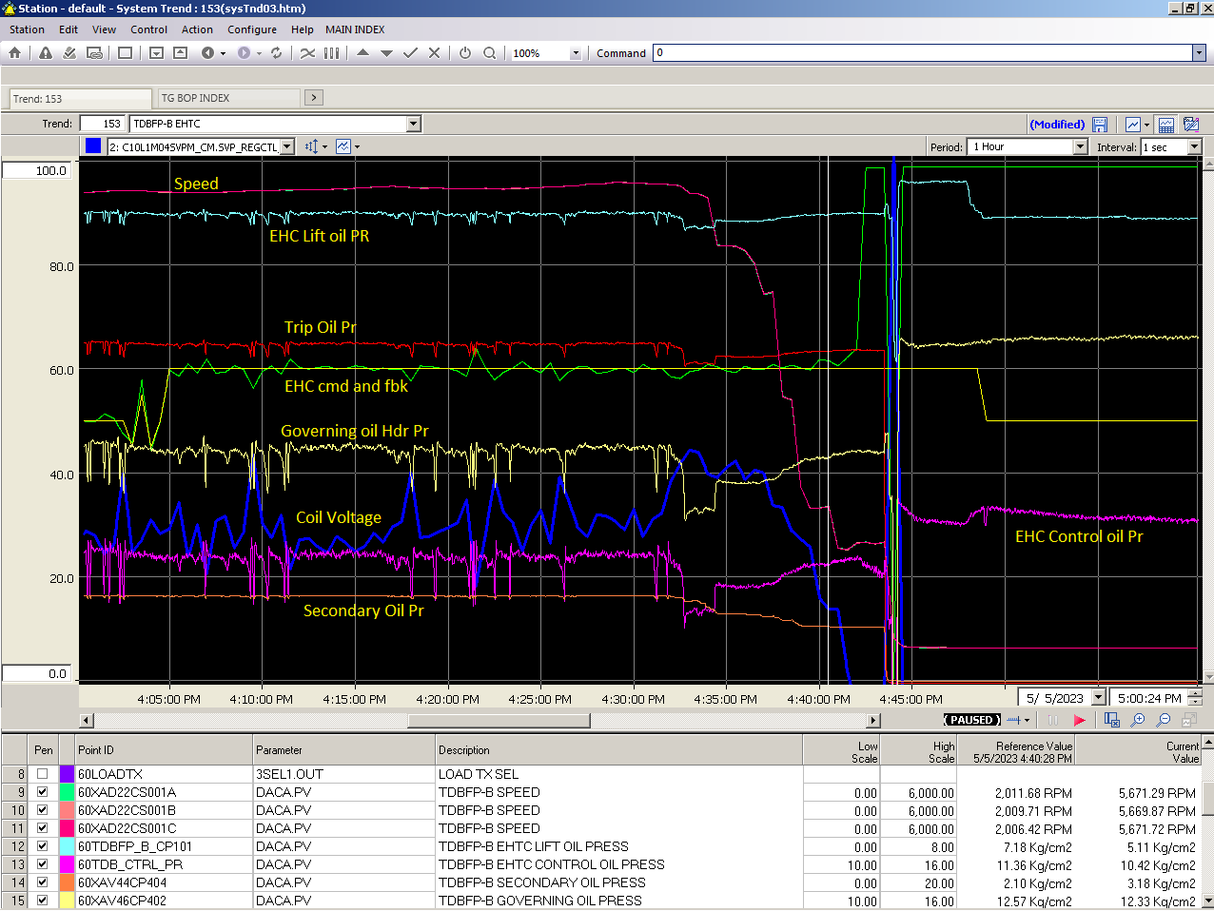
Predictive and Prescriptive Analytics of Unit-6 TDBFP-B
5th May 2023: U#6 TDBFP-B:
At 16:30 hrs.
TD-B was being taken into EHC after Overhauling.
During Unloading of TD-B for governing characteristics checking, it was observed coil voltage started reducing suddenly.
Alert generated by Predictive Algorithm

Slide 18
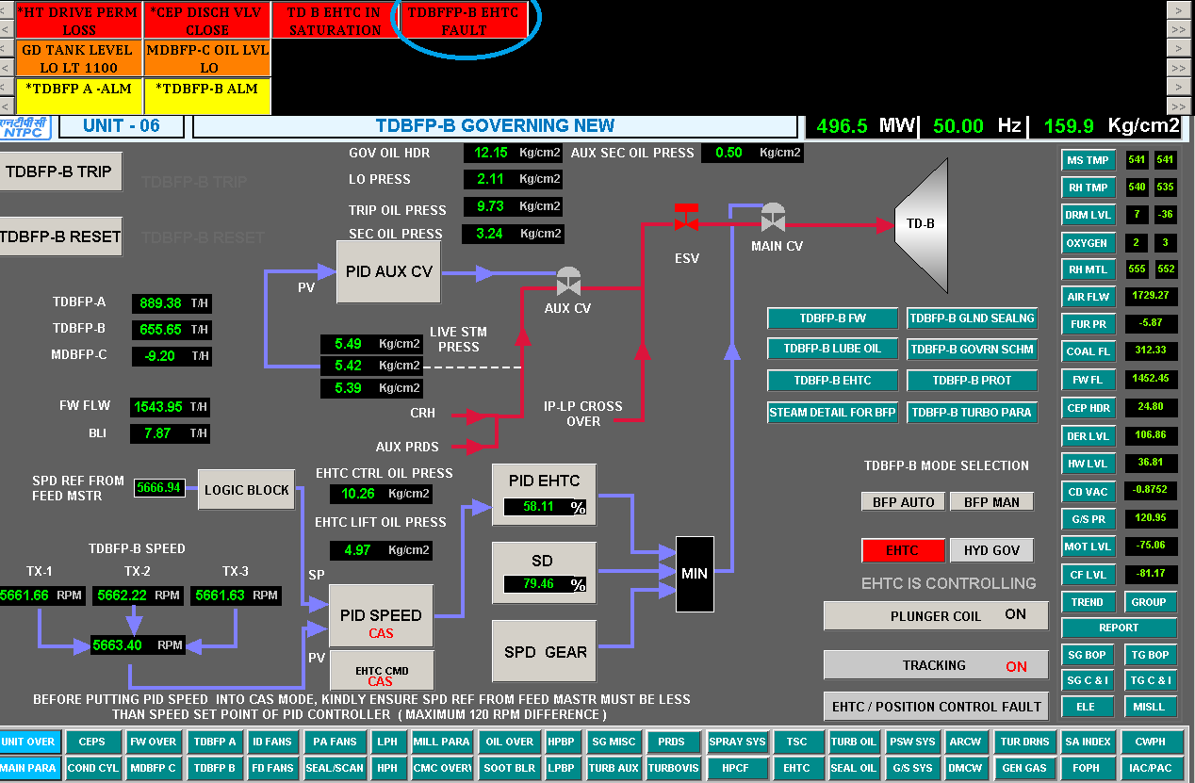
Predictive and Prescriptive Analytics of Unit-6 TDBFP-B

Slide 19
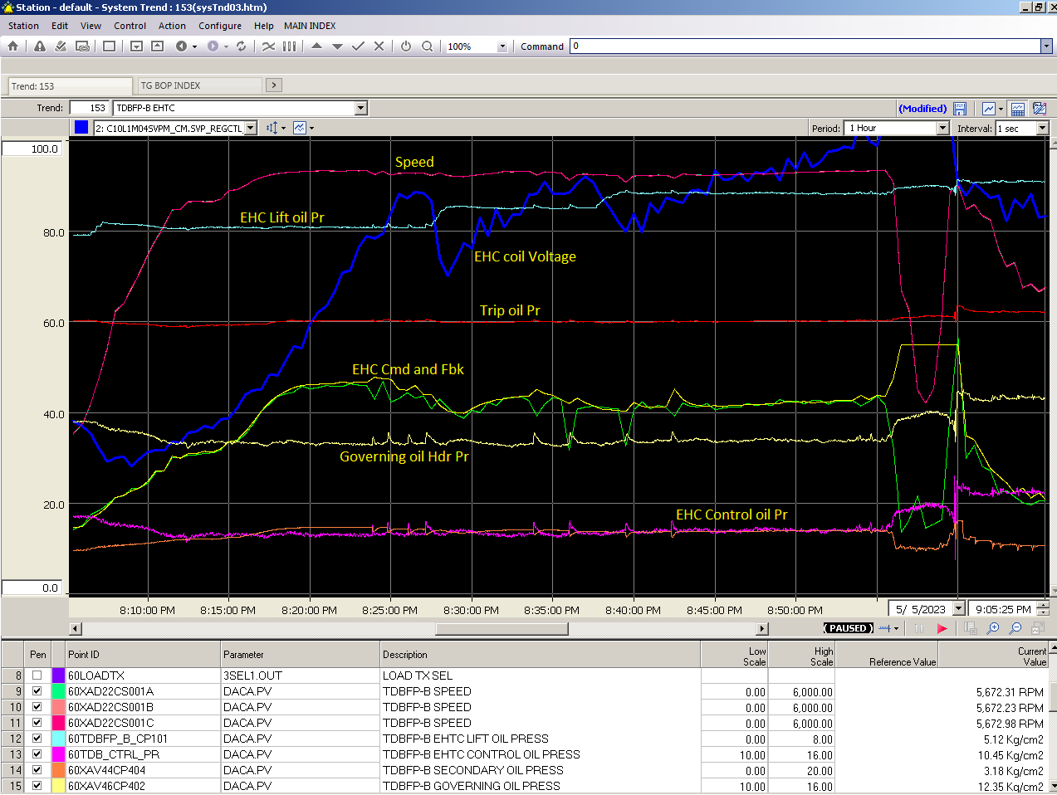
Predictive and Prescriptive Analytics of Unit-6 TDBFP-B
5th May 2023: U#6 TDBFP-B:
At 20:00 hrs.
TD-B was being again taken into EHC.
During loading of TD-B, it was observed coil voltage started increasing suddenly.
Alert generated by Predictive Algorithm at 20:18 hrs
At 20:55 hrs, EHC malfunctioned.

Slide 20
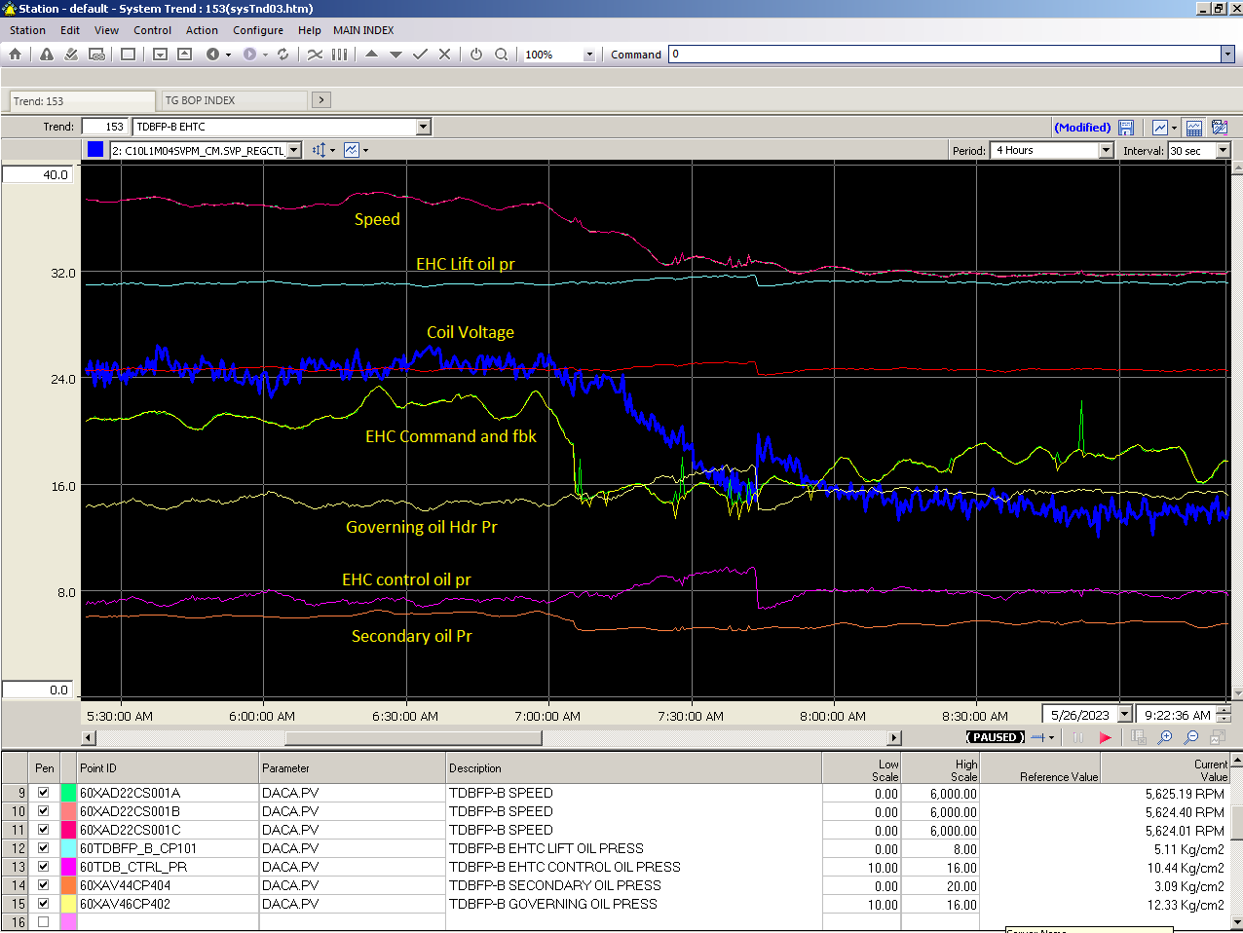
Predictive and Prescriptive Analytics of Unit-6 TDBFP-B
24th May 2023: U#6 TDBFP-B:
At 17:30 hrs.
TD-B was again taken into EHC after work by BHEL expert.
Alerts were still being generated by predictive model but they were within limits

Slide 21
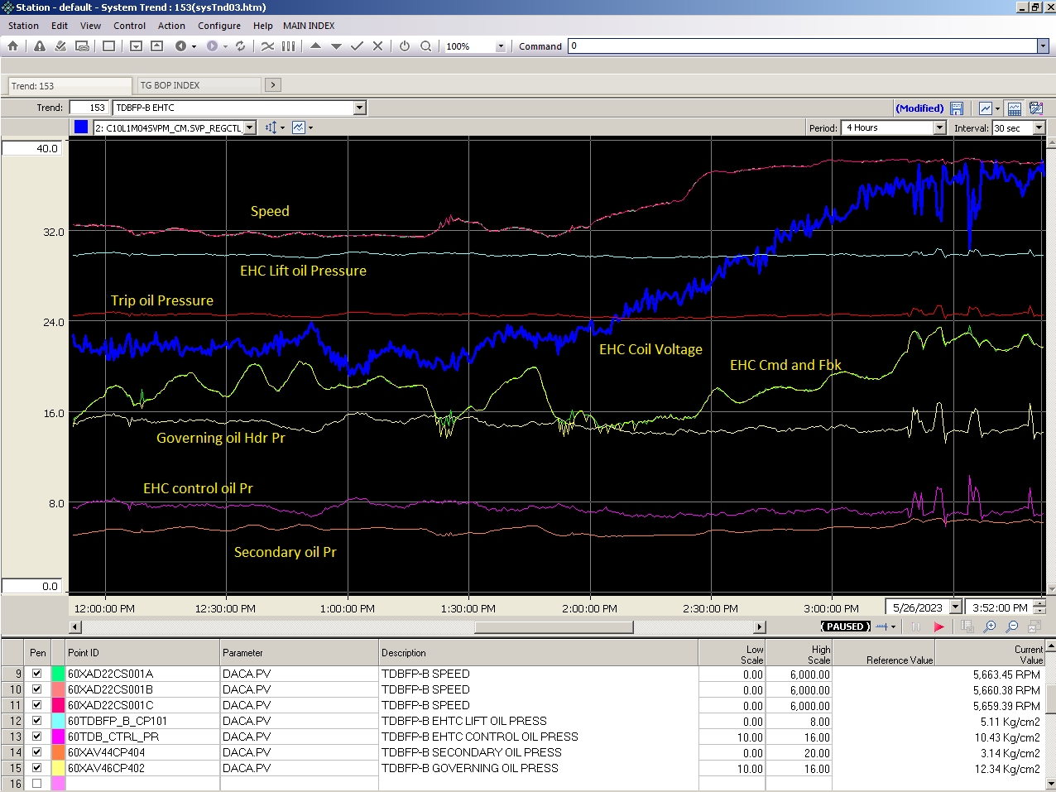
Predictive and Prescriptive Analytics of Unit-6 TDBFP-B
27th May 2023: U#6 TDBFP-B:
At 11:30 hrs.
Alerts generated by predictive model were outside statistical distribution
TD-B was taken out of EHC

Slide 22
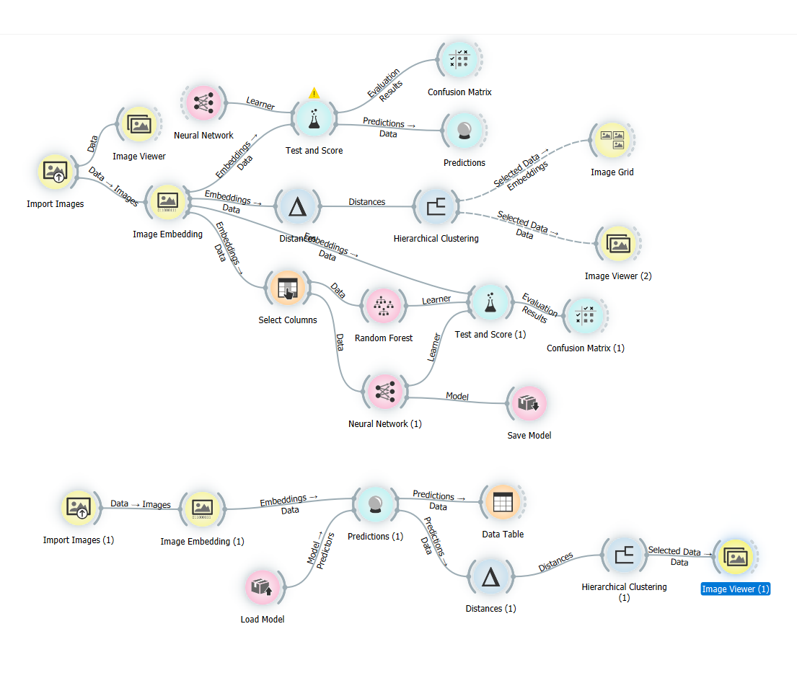
Image Analytics for Diagnosis

Slide 23
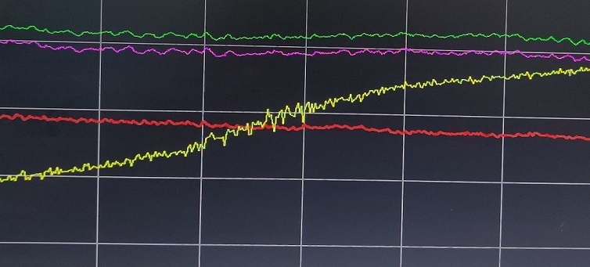
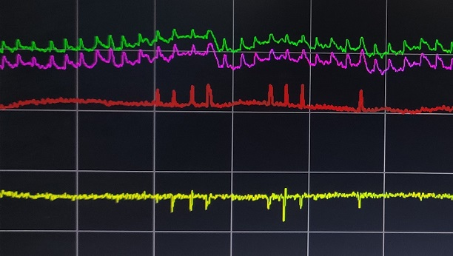
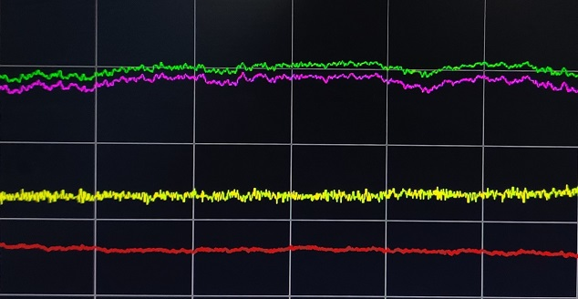
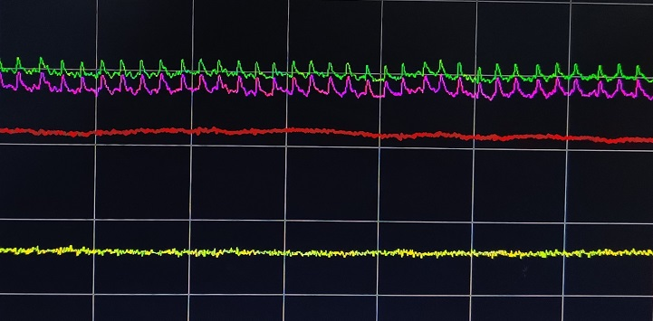
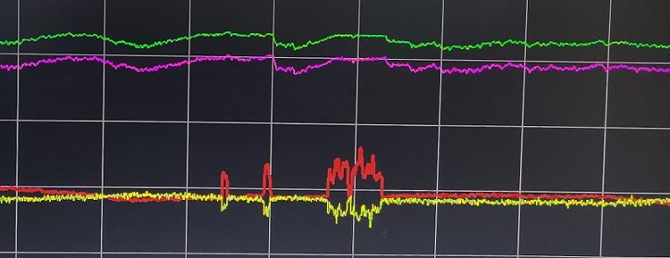
Training Images for Benchmarking – Signature Development
Speed
Lift Oil Pressure
Balancing Voltage
Balancing Voltage
Lift oil _ balance voltage fault
Multiple Faults
Speed
Normal
Lift Oil Pressure
Balancing Voltage
speed fault
Lift oil _ balance voltage fault

Slide 24
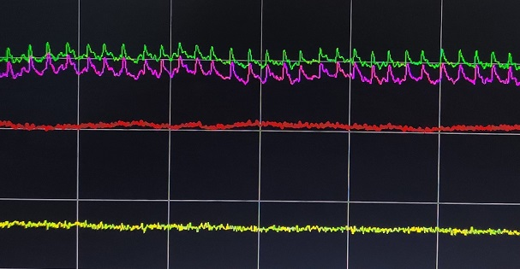
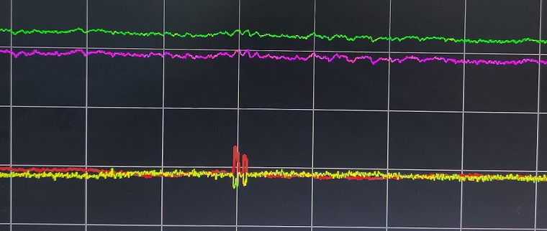
Test Runs for Diagnostics
Speed
Speed
Instance 01
Instance 02
Lift Oil Pressure
Balancing Voltage
Instance 03

Slide 25
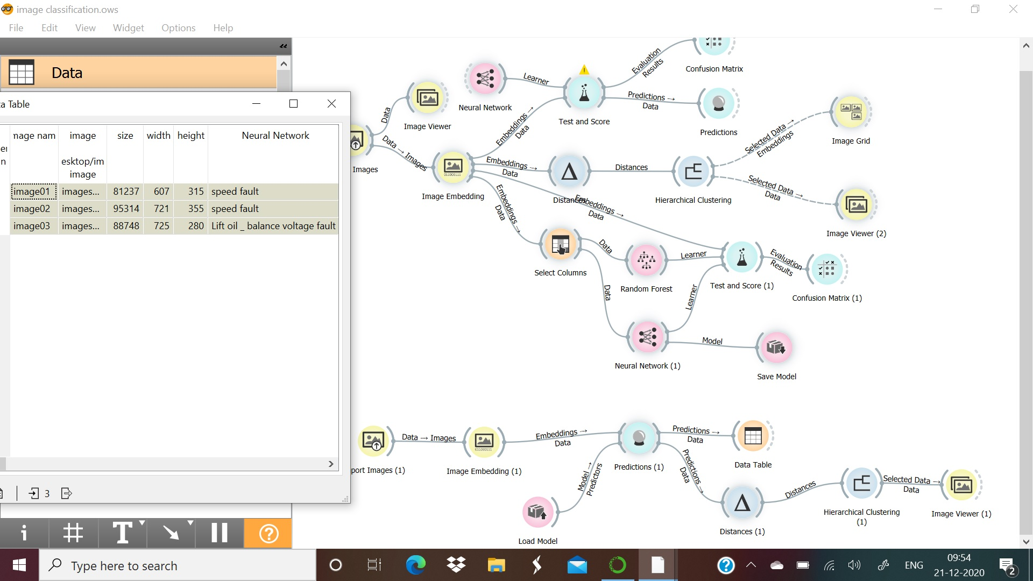
Image Analytics for Diagnosis

Slide 26
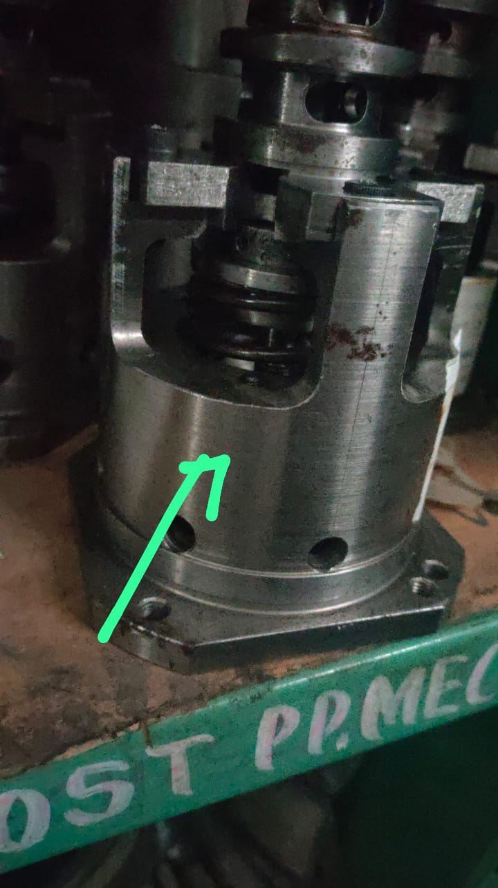
Predictive and Prescriptive Analytics of Unit-6 TDBFP-B
1St August 2023: U#6 TDBFP-B:
At 11:30 hrs.
Alerts generated by prescriptive model with following diagnosis:
Balance position of the pilot valve is getting changed with respect to the speed.
Leakage and spring problem suspected in EHC assembly.
Issues detected in EHC assembly:
Size of the marked assembly was shorter in length.
Mechanical Clearances between pilot and sleeve had increased.

Slide 27
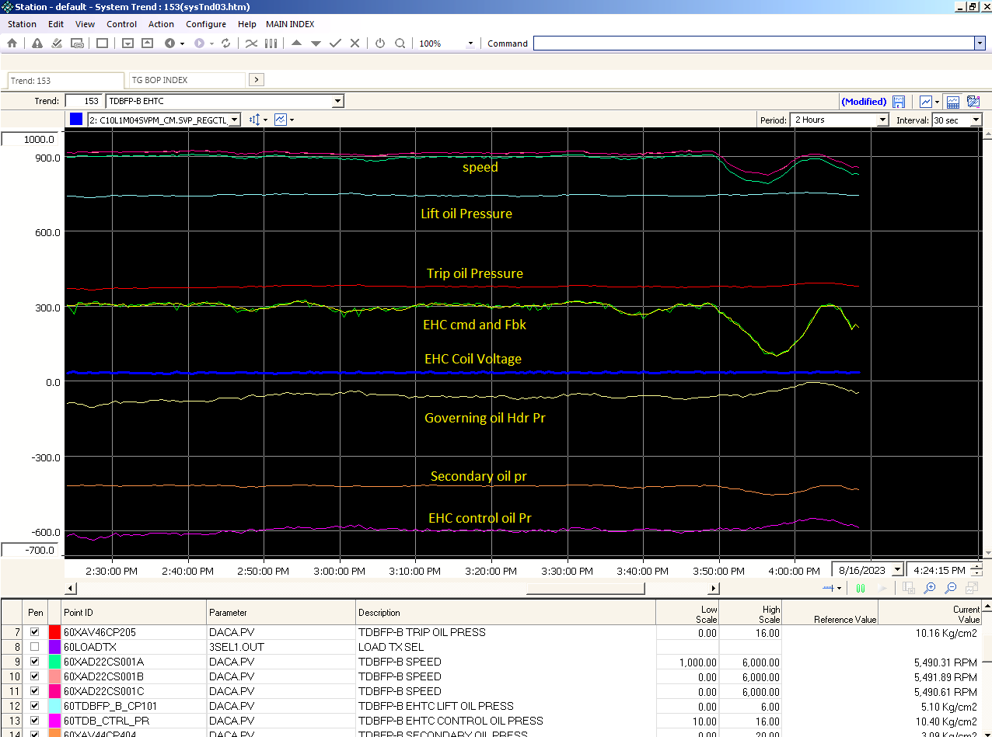
Predictive and Prescriptive Analytics of Unit-6 TDBFP-B
4th Aug 2023: U#6 TDBFP-B:
At 10:00 hrs.
Finally, TD-B was taken into EHC.
EHC assembly was replaced.
NO alert generated by predictive model till now.

Slide 28
Why EHC is Critical ?
2022-23 Data on EHC malfunction
1. Unit-5 Dadri Coal : Unit tripped on EHC malfunction( Collins Tx-2 failure).
2. Unit-4 Dadri Coal : Unit tripped on EHC failure(Command and feedback mismatch).
3. Unit-5 Ramagundam : Unit tripped on Collins Tx-1 failure.
4. Unit-4 Dadri Coal : Unit again tripped on Malfunction of EHC system.
5. Unit-1 Simhadri : Unit tripped on EHC problem.
6. Unit-2 Farakka : Unit tripped on EHC malfunction (Collins Tx-2 feedback froze).
7. Unit-3 Bongaigaon : Unit tripped on EHC problem.
8. Unit-1 Simhadri : Unit tripped on EHC malfunction.
If one can predict, one can prevent

Slide 29
FUTURE POTENTIALS OF THE PROJECT
Automatic capture of relevant DDCMIS data through PI Server to the Predictive Analytics system.
Automatic scheduling of Analysis (00:00 hrs every day).
Access of Analytics result to concerned in control room (Operations, MTP, EEMG)
Application of the tools for other systems such as early detection of BTL etc and final extrapolation to complete process including off-site areas.
Development and deployment of Image Analytics based Diagnostics (Asset Fault Signature) for various critical equipment.

Slide 30
ADVANTAGES
Heading Font Size 36
Font Family: Tw Cen MT (Normal)
1
5
2
4
3
Content Font Size 14
Font Family: Tw Cen MT (Normal)
High Return on Investment
Predictive Maintenance
Reduction in Plant outage.
Asset health Optimization
Sustainability

Slide 31
ADVANTAGES
Heading Font Size 36
Font Family: Tw Cen MT (Normal)
6
7
8
9
Content Font Size 14
Font Family: Tw Cen MT (Normal)
Safety
Reliability
Scalability
Profitability

Slide 32
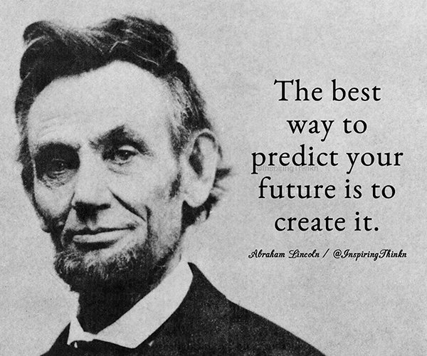
CONCLUSION

Slide 33

Thank You

