Slide 1
Optimizing Thermal Power Plant Auxiliary Power Consumption Through Unconventional Innovative Approaches at Sasan Power Limited

Slide 2
Prakash Upadhyay HOD (Operation) Sasan Power Limited Experience – 26 years for O&M of Thermal Power Plant
Arijit Debroy DGM (O&E)
Sasan Power Limited Experience – 13 years for O&M of Thermal Power Plant

Slide 3
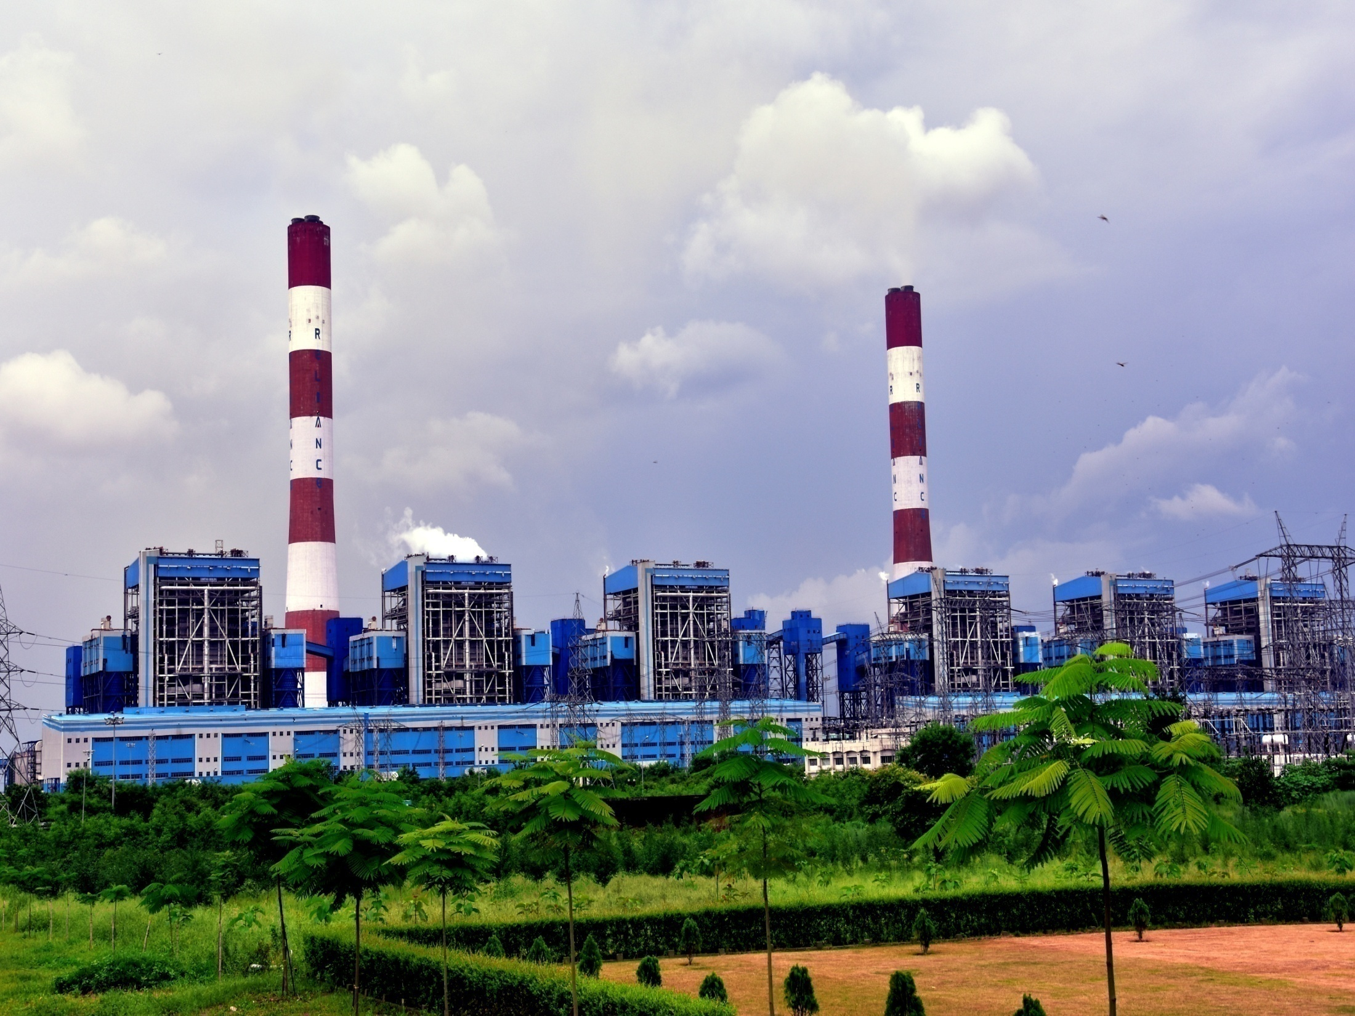
SASAN POWER LIMITED ISO-9001,ISO-14001,ISO 45001 & ISO 50001 Certified Company World’s Largest Integrated Coal Mine and Power Project At A Single Location

Slide 4
Sasan Project Salient Features
The First Integrated Ultra Mega Power Project along with Integrated Captive Mine which provides power at most competitive tariff in the country to 14 DISCOMs in 7 states.
First and Only Ultra Mega Power Project based on Domestic coal with 20 MTPA Coal Production capacity & “State of Art” mining equipment and Largest Size HEMM
Super Critical Technology which reduces approx 2.5 MMT of carbon di-oxide emission over a time span of 25 years.
Sasan Power Limited clocked more than 94% PLF (Plant Load Factor) from FY’19 to FY’22, thus consolidating its top-most position amongst all thermal power plants of India for four consecutive years. This FY’24 it stands in 2nd Position till January 2024.
Lowest Specific Water Consumption amongst all similar capacity supercritical thermal power plants in India (SWC <1.85 m³/MWh)
Environment friendly, Cheapest, Fastest Overland conveying system of length 14.2 km conveying 4500 TPH coal with VFD driven drive at 5.6 m/s belt speed
Robust Power Evacuation – 4 transmission lines of 765 kV and 4 lines of 400 kV.

Slide 5
Performance Parameters: Y-o-Y Progress

Slide 6
Best in Class APC Reduction Practices (1/2)
CEP stage reduction from 8 numbers to 7 numbers to reduce throttling losses due to Deaerator CV for which current reduced from 220A to 190 A; thus, saving 14.55 MUs per annum for the Station
Stoppage of AC Scanner Air Fan by providing the required cooling air through Cold PA fan
Start-up with TDBFPs to reduce APC by keeping MDBFP in standby during start up for 5 hours is 16000 kWh for each Start up.
Boiler filling with BFPT Booster Pump instead of MDBFP.
Winterization Plan (from November to February ~ 120 days) includes stoppage of:
02 nos. of CW Pumps. (each of loading 3500 kW)
04 nos. of ACW Pumps (each of loading 170 kW)
CT Fans (72 numbers for Station each of loading 60 kW)
Air Washer Unit System Pumps & Fans (each of loading 25 kW & 80 kW respectively)
HVAC Screw Chillers (2 nos. each of capacity 180 kW)
Impeller trimming of CCCW pumps by 5% to save 2.4 MUs for the Station

Slide 7
Best in Class APC Reduction Practices (2/2)
Five Coal Mill Operation at or more than full load (>660MW) started whenever total coal flow <350TPH to save approximately 1250 kWh per unit.
Orifice installation in Service Airline at selected locations of usage during cleaning activities in all units to reduce the Compressed Air power consumption. Also, one compressor (4 numbers are run in place of 5 numbers as per OEM) is taken shutdown during late night hours to save energy.
Stoppage of some low load consuming equipment that are stopped throughout the year in SPL:
Oil gun cooling fan by providing the supply from FD fan discharge line
APH Guide Bearing LOPs in all units saving 0.13 MUs per annum for the Station
In-plant Raw Water Pump by using natural R_{L} difference and gravity flow of water to Cascade Aerator
BCP Cooling Water Pump by deploying the CCCW pressure for cooling of heat barrier
Hot-well Make-up Pump – Normal makeup was previous standard & emergency makeup only during startups. Later, makeup sourced from emergency line via CST.
LOP stoppage of Standby Mill saving 0.03 MUs per annum for the Station

Slide 8
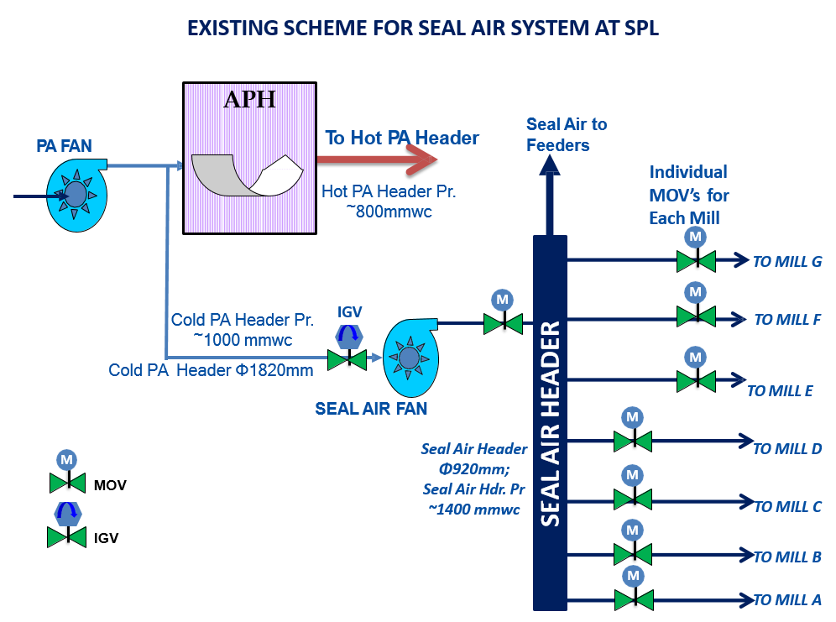
Unconventional Practices Deployed at SPL
No. 1 – Modifications in Seal Air System
In thermal power generating units using pulverized coal combustion technology for power generation have an inevitable Sealing Air system whose main purpose is to boost and maintain the pressure of seal air above the pulverized coal transporting primary air (PA) pressure so that the pulverized coal particles do no damage to the costly ancillary rotary driving arrangements.
The system is so vital that usually the principle of redundancy is kept by providing two seal air fans, one in operation and another in standby condition, to eradicate any form of emergency.
We have taken innovative measures to optimize the sizing requirements of the system.

Slide 9
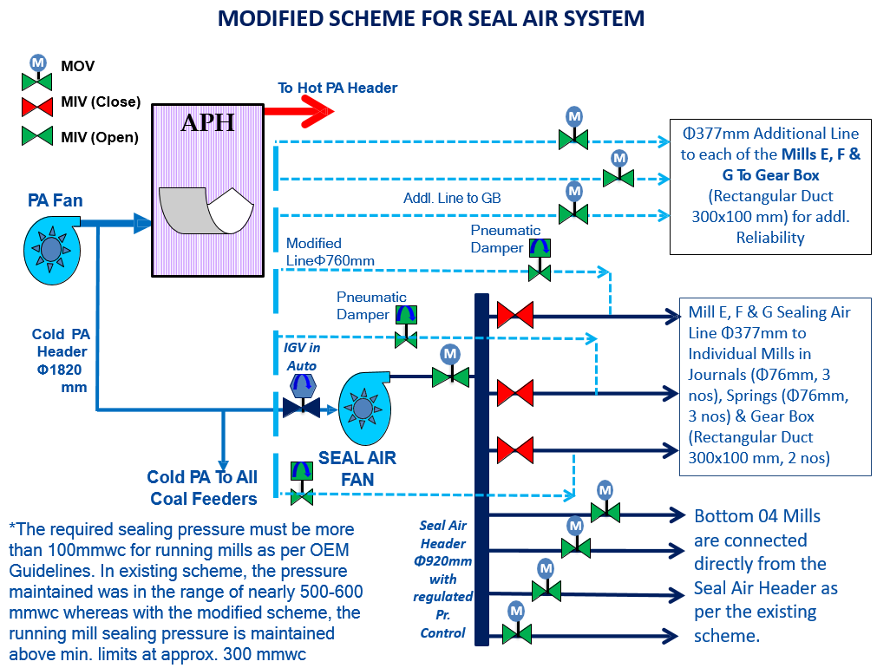
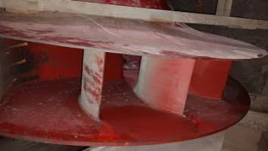
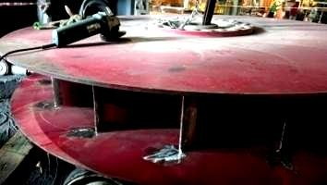
Unconventional Practices Deployed at SPL
No. 1 – Modifications in Seal Air System
Modification – 1 : Auto Operation of IGV
Modification – 2 : Restructuring the flow path of Coal PA to the top 03 mills and the Gear Box (for reliability enhancement)
Modification – 3 : As requirement of Boosted Air Flow reduced, trimming of the Seal Air Fan impeller was done by 10%
 | % Impeller Trimming | Diameter of Impeller (m) | Dis. Pr (mmwc) | Calc. Power (kW) | Power Saving kW | Calc. Flow (m³/h) | Expected current Of Seal Air Fan (A)
Initial | 0 | 1.60 | 1510 | 125.0 | 0.0 | 58211 | 217
Calculated | 10 | 1.45 | 1418 | 92.7 | 32.3 | 52550 | 161
Actual | 10 | 1.45 | ~1320 | -- | 28.8 | -- | ~160
Sl. No | Particulars for Savings/Benefits | UOM | Value
1 | Current Savings by trimming per unit | Amps | 50.0
2 | Electrical Units saving | kW | 28.8
3 | PLF Consideration for Benefit Analysis | % | 95.0
4 | Electrical Units saving per unit per year | kWh | 239275
Seal Air Fan Untrimmed & Trimmed Impeller

Slide 10
Unconventional Practices Deployed at SPL
No. 2 – Modification in Mill Clean-Out-Conveyor (COC) System
OEM Guidelines
O&M Assessment
Practical Observation
Strategic Modification
Reduction in APC & Financial Gains
Initial design of Coal Feeder Clean-Out Conveyor (COC) followed OEM guidelines for continuous operation during coal feeder activity.
Years of O&M monitoring prompted a comprehensive assessment and the findings showed that interrupting COC operation for a 6-hour period did not result in significant coal or coal dust accumulation within the feeder.
Practical observations indicated that running the COC for just 3 minutes was sufficient to effectively remove residual material.
A deliberate modification was implemented across all mills in all units.
COC now runs for 6 minutes only after every 114 minutes (02 hours cycle), aligning with safety, maintenance considerations (reduced wear & tear of chain).
Reduction in APC results in substantial financial gains without compromising system integrity.
Savings of nearly 0.2 Mus per year amounting to nearly 4 LPA at project cost of only INR 15,000/- per unit.

Slide 11
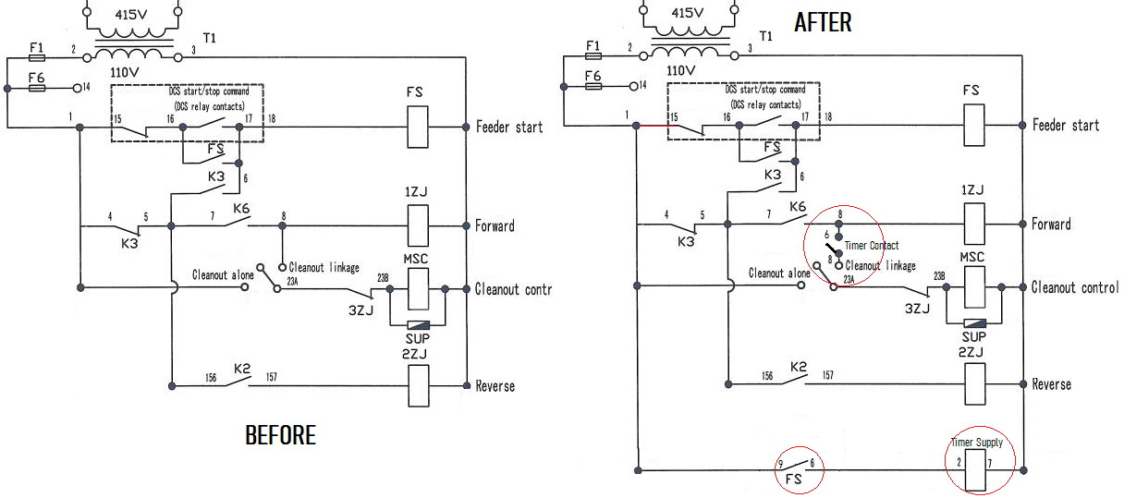
Unconventional Practices Deployed at SPL
No. 2 – Modification in Mill Clean-Out-Conveyor (COC) System

Slide 12
Unconventional Practices Deployed at SPL
No. 3 – Modifications in SCAPH System
Objective of SCAPH
Post-Synchronization Redundancy
Practical Observation
Engineering Innovation - Rotary SCAPH
Reduction in APC & Financial Gains
In the cold startup of units, Steam Coil Air Pre-Heater (SCAPH) is crucial for increasing secondary air or combustion air temperature.
SCAPH becomes unnecessary after synchronization and achieving unit load.
The pressure drop results in a power loss for Forced Draft (F.D.) fan.
Innovative engineering design and modification carried out with minimal investments.
At the same load, coal flow, and secondary air flow, both FDF current cumulatively decreased by ~6A, i.e., 46 units
Aim is to prevent cold end corrosion of APH and facilitate the early operation of coal mills during BLU
However, the tube bundles in the path of secondary air cause a pressure drop of approximately ~30 mmwc across the coils.
This results in a significant saving of 1100 units per day translating to INR 32 LPA for the Station for project cost of INR 4 Lakhs/Unit.

Slide 13
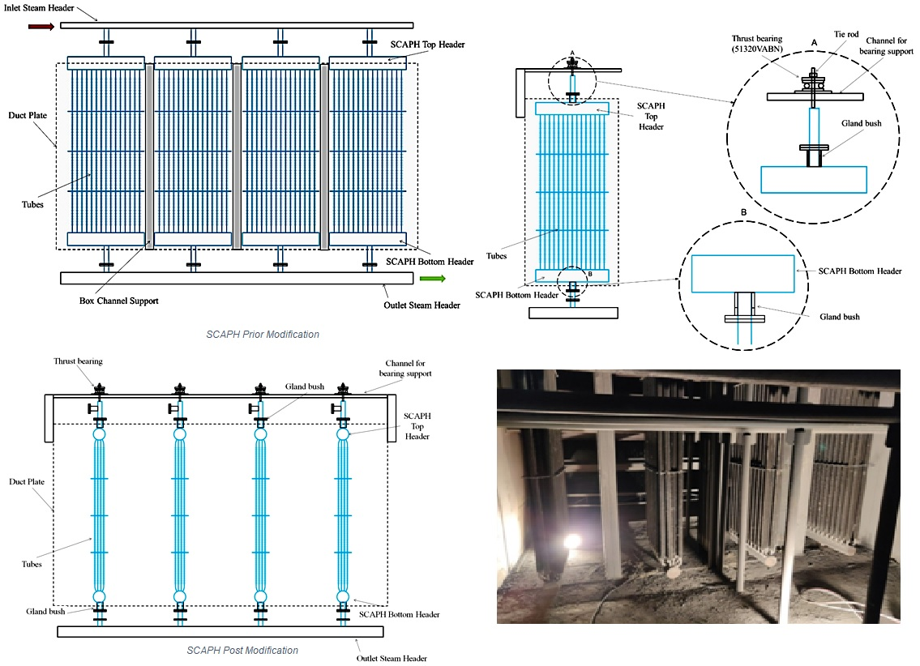
Unconventional Practices Deployed at SPL
Step 1
Removal and relocation of steam inlet header
Step 2
Erection of channel over the SCAPH frame for support of SCAPH coils
Step 3
Fabrication & Modification of FD fan outlet duct (within SCAPH frame)
Step 4
Pipe support provided from top to bottom frame of SCAPH instead of Box support.
Step 5
Arrangement of stuffing box for air side sealing at both end for steam inlet and outlet line in each bank of coil.
Step 6
Extension & modification of steam inlet line length
Step 7
SCAPH coil bank loading, rotating & Alignment arrangement
Step 8
Handle provision and Locking arrangement of SCAPH coil bank.

Slide 14
Unconventional Practices Deployed at SPL
No. 4 – Modifications in Air Washer Units (AWU) System
Unveiling the Overlooked System
SPL's Visionary Energy Commitment
Pump Optimization
Savings Symphony
The Air Washer Unit (AWU) system, often relegated to the sidelines in power plant discussions, plays a pivotal role in refining and purifying air before it graces the turbine hall.
At SPL, our commitment to reducing Auxiliary Power Consumption (APC) extends beyond the obvious, acknowledging the untapped potential for energy savings within the often-neglected AWU system.
In a meticulous pursuit of efficiency, we found our AWU pumps are oversized initially and was tailored for peak loads,
We completed the activity of impeller trimming of all 32 AWU Pumps during the winter months when it usually remains in stopped condition for ~120 days.
The AWU system deserves due recognition in energy management strategies as well
AWU silently contributes to the efficiency of the power plant if not overlooked
We have undergone a study in peak summers and found that the impeller trimming of the pumps by ~25% will not impact its requirement at SPL
Post modification it resulted in a substantial annual saving of 0.6 Mus for the station, equivalent to nearly INR 8 lakhs per annum.

Slide 15
THANK YOU
Think Big, Think Fast, Think Ahead. Ideas Are No One’s Monopoly.
- Dhirubhai Ambani Founder, Reliance Group
From Arijit Debroy & PC Upadhyay
Sasan Power Limited

