Slide 1
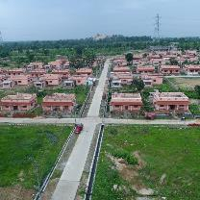
CC-SCOPE
NTPC R&R Colony, Darlipali
NTPC Bhadla
NTPC Kudgi
PROVIDING FLEXIBLE POWER THROUGH GAS STATIONS
NTPC Koldam
NTPC Kayamkulam
NTPC Rojmal
Follow us on:
/ntpc1
/ntpcltd1
/ntpclimited
/Company/ntpc
/ntpclimited

Slide 2
Presentation Outline
Background
Rising importance of gas stations
Exploring various options for revamping of NTPC gas stations
Commercial issues in operation of NTPC gas stations
Efforts for Gas arrangements by NTPC
Proposals to recover high operating costs
Conclusion

Slide 3
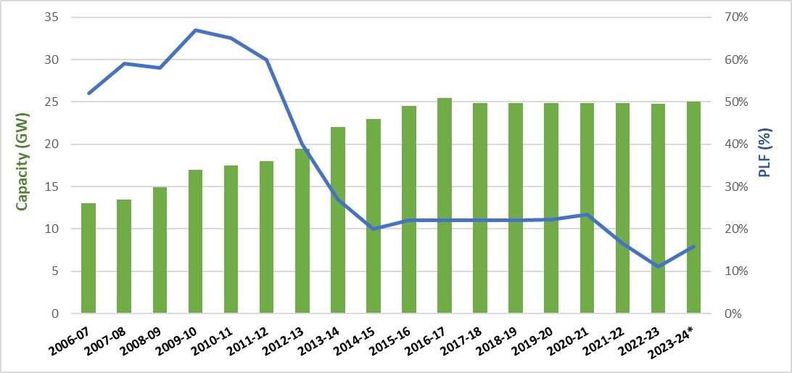
Background
Prior to 2011-12, abundant cheap domestic gas was available from KG-D6 basin.
Gas production from the basin dipped from highest of 69.44 MMSCMD in March 2010 to 5.5 MMSCMD in FY 2017-18
Gas plants forced to import costly RLNG to meet fuel needs.
By 2013, GoI also switched priority allocation of domestic gas from power sector to CGD sector.
ECR increased sharply from Rs 2-3/unit to Rs 12-20/unit
PLF of gas plants dipped sharply from 60% in 2011-12 to 10% in 2022-23.
Beneficiaries of NTPC gas stations also relinquished about 25% of total capacity (900 MW out of 3658 MW) resulting in under recovery of AFC
* up to Oct 2023
Source: CEA monthly data from NPP

Slide 4
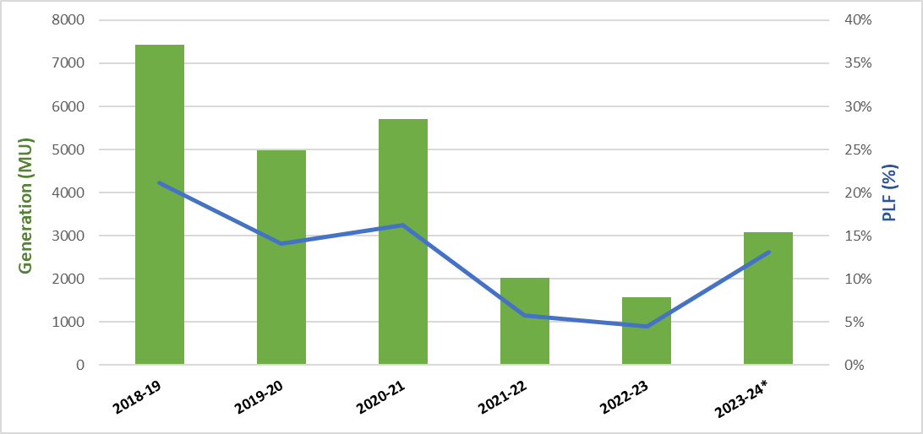
Rising importance of gas stations
India’s peak demand reached all time high of 239.98 GW on 1st Sep 2023.
Expected to increase further in the future due to increased economic activity and extended summers due to global warming.
The proposed increase in RE integration to 500 GW by 2032 in the grid
Higher injection of flexible generation sources required till energy storage options are feasible & affordable on large scale.
Higher ramp-up rate and quick start-up time - USP of gas stations
NTPC gas stations PLF dropped to just 4% in FY 2022-23 but has again revived to 13% in FY 23-24
* up to Nov 2023
Source: NTPC SAP Data

Slide 5
REVAMPING OF NTPC GAS STATIONS

Slide 6
Financial Support from PSDF
April-June 2023 anticipated to be crunch period by MOP
Gas stations instructed to sell power in market during crunch period
Cost of Gen in range of Rs 12-20 per unit but capping of Rs 10 per unit in Power Exchange
Average MCP for day is Rs 5-7 per unit
Sanction of grant by MOP from PSDF to recover shortfall b/w Gen cost & Revenue from market sale
Successfully operated in crunch period from Apr-June 2023
Received recommendation of Rs 76 cr reimbursement from PSDF
PSDF
Cost of generation
Revenue from market sale
NTPC Limited

Slide 7
Selling Gas based Power in HP-DAM
High price- Day Ahead Market (HP-DAM) launched in March 2023
To facilitate sale of power from costly gas stations
17 MU power sold in HP-DAM by NTPC in Sep & Oct 2023
Capping of Rs 20/unit in HP-DAM
No provision of profile bidding
2
HP-DAM
NTPC Limited

Slide 8
Operation under TRAS-Shortfall
Ancillary Services
SRAS
TRAS
Black Start
PRAS
Voltage Control
2
Regular operation under Ancillary services via TRAS-Shortfall
For grid support during peak hours
Earlier declaration of ECR on monthly basis for TRAS
But High volatility in gas prices
NTPC advocated for weekly ECR declaration for gas stations
Weekly ECR declaration allowed by NLDC

Slide 9
Sale of power through bilateral contracts
Sale of power from relinquished capacity through bilateral contracts from Aug-Oct 2023
Power sold to states like Tamil Nadu, AP & West Bengal (not original beneficiaries)
Also obtained consent from original beneficiaries like U.P and J&K to sell power to needy states from their share
The gain realized from the sale of tied up capacity shared with them
Approx. 122 MU sold
Win-Win situation for all – NTPC, Original beneficiaries & States to whom power sold
2

Slide 10
COMMERCIAL ISSUES IN OPERATION OF GAS STATIONS

Slide 11
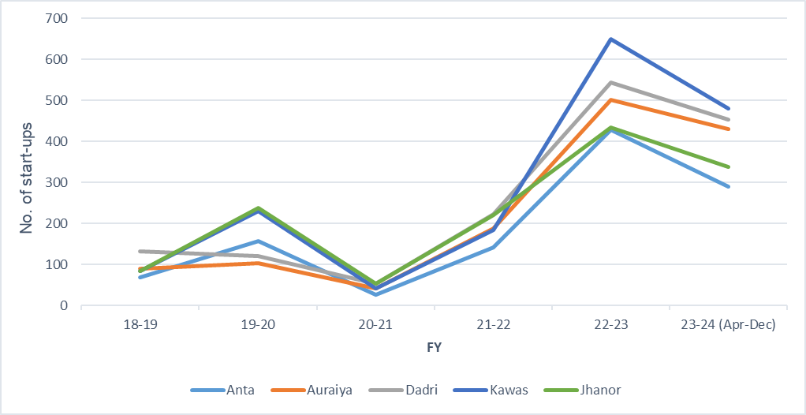
Financial impact due to increase in start-ups
Additional fuel cost incurred for start-up to the tune of 2.5 lakhs per GT & 35 Lakhs per module
No regulatory provision for compensation of start-up cost
Overhaul frequency of gas turbines based on the concept of EOH
EOH of GT increases by an average of 20 hours during each start-up
Earlier completion of allotted EOH, thus shorter overhaul intervals, thereby increasing maintenance costs.
2
Source: NTPC SAP Data

Slide 12
No part-load compensation in Open Cycle & Half module operation
Part-load compensation provided as per degradation curve provided by OEM as per IEGC-2010 (4th amendment)
No degradation curve provided by OEM for Open cycle & Half module operation
In present scenario, Gas stations operate in open cycle for peak hours(4-6 hrs in a day) and remain under shutdown during off-peak hours
If gas stations operate in combined cycle mode, they remain at technical min load in half module combination during off peak hours
In half module operation, one GT is under shut down condition and not contributing to producing steam for steam turbine. The pressure & flow of steam entering the steam turbine is less resulting in lower steam turbine efficiency. So, Heat Rate in half module operation is slightly higher than in full module operation. Also, since same ST auxiliaries are in service but power output from steam turbine is less, APC is also higher.
In case of Open Cycle Operation, flue gas from GTs exhaust is left out in the atmosphere instead of passing it through WHRBs and generate steam. So, for same amount of gas consumption, power output equivalent only to GTs capacity is achieved instead of complete station capacity

Slide 13
GAS PROCUREMENT EFFORTS BY NTPC

Slide 14
Procurement of gas via Monthly Spot Contracts and IGX
Monthly spot contracts with GAIL, GSPCL, Shell, BPCL, IOCL on Reasonable Endeavour (RE) basis
Gas procurement from IGX at cheaper rates starting from 03.11.2023 on Take or Pay (TOP) liability basis
At present, no flexibility regarding consumption of traded gas quantity in any station and no provision of carrying over of unused gas
Actual gas requirement depends on real-time grid condition
NTPC advocating to provide flexibility in consumption in any station and having provision of carrying over of unused gas quantity
2

Slide 15
Procurement of gas via Cargo in future
Annual gas requirement of over 1200 MMSCM expected in coming years
For 2024, Annual contract of 500 MMSCM with GAIL & about 300 MMSCM through spot RE contracts
Gas may also be sourced from IGX but very less volume in exchange
Need to secure additional arrangements for at least 400 MMSCM through modes offering both higher certainty and flexibility
Discussion held with GAIL, GSPCL and PLL to provide gas on firm commitment basis by sourcing cargo as per specific needs of NTPC
The cargo (approx. 80 MMSCM) will be procured strategically from time to time to fulfill shortfall
2

Slide 16
PROPOSALS TO RECOVER HIGH OPERATING COSTS

Slide 17
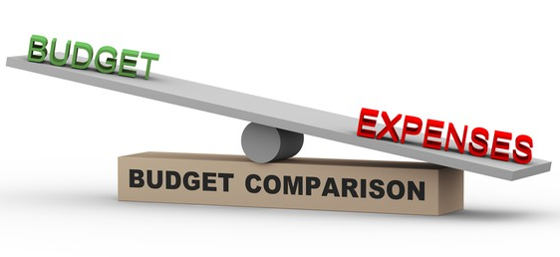
CERC Staff paper on “Grid Security Charge”
Cost of deploying AS being met through DSM pool account
Costly gen from gas stations under AS depleting the DSM pool account at faster rate
As per Staff paper issued by CERC on 25.09.2023, amount in DSM pool account may not be sufficient to recover these costs
Combined annual expenses for deploying AS estimated to be around 9,000 crores
During FY 2022-23, total surplus in the DSM Pool Account was approx. 5,000 Crore
May recover the deficit amount as “Grid Security Charge” options from states in proportion to the shortfall against their allocated share of reserves by NLDC or GNA quantum or both in 1:1 ratio
2

Slide 18
MOP scheme for gas-based power utilization for 2024
No planned maintenance during agreement period & no PSDF support
Two-part tariff: Variable charges linked to gas price (VCGA) & Variable charges not linked to gas price (VCNG)
VCNG = Fixed cost + Transmission charges + NVVN & Power Exchange charges + Gas transportation cost + Taxes + Marketing Margin etc.
VCGA = Delivered Ex-ship (DES) gas price of Gail delivered LNG
Start-up cost (SC) paid separately per MW = 0.5x1.356x10³xVCGA
Bidders selected based on VCNG up to 125% of lowest discovered VCNG
Declared TRAS-Shortfall rates = [(VCNG + VCGA + SC+ Exchange charges)/1.10]
Payment to gas stations based on AG or SG, whichever is lower
No fixed cost from beneficiaries for operation period of scheme
Declaration by generator for supplying untied capacity
2
Expected upcoming crunch period from March – Oct 2024
Competitive bidding by NVVN for market-based sale & TRAS during this period from non-NTPC gas stations (approx. 4000 MW)

Slide 19
Conclusion & Way Forward
Huge variable RE penetration in the grid would require higher injection from flexible power sources
Gas stations with their quick start-up time and higher ramp rate capability can provide the required flexible power until battery storage systems become cost-competitive
But cost of power generation high (Rs 12-20 per unit) due to use of costly imported gas
India should focus on ramping up the domestic gas production from existing reserves and discovering new gas reserves.
If continues to import costly RLNG, states may have to pay extra “Grid Security Charge”
MOP may need to bring various schemes from time to time for recovering high operational costs
2
All time high peak demand reached 239 GW on 1st Sep 2023 & expected to rise to 258 GW in FY’25 & further up to 277 GW in FY’27
Share of Solar & Wind power in total installed capacity is projected to rise to 54% in FY’32 from 27% at present.

Slide 20
Thank You
Presented by:
Nishant Bansal, DM (OS-SIIS)

