Slide 1
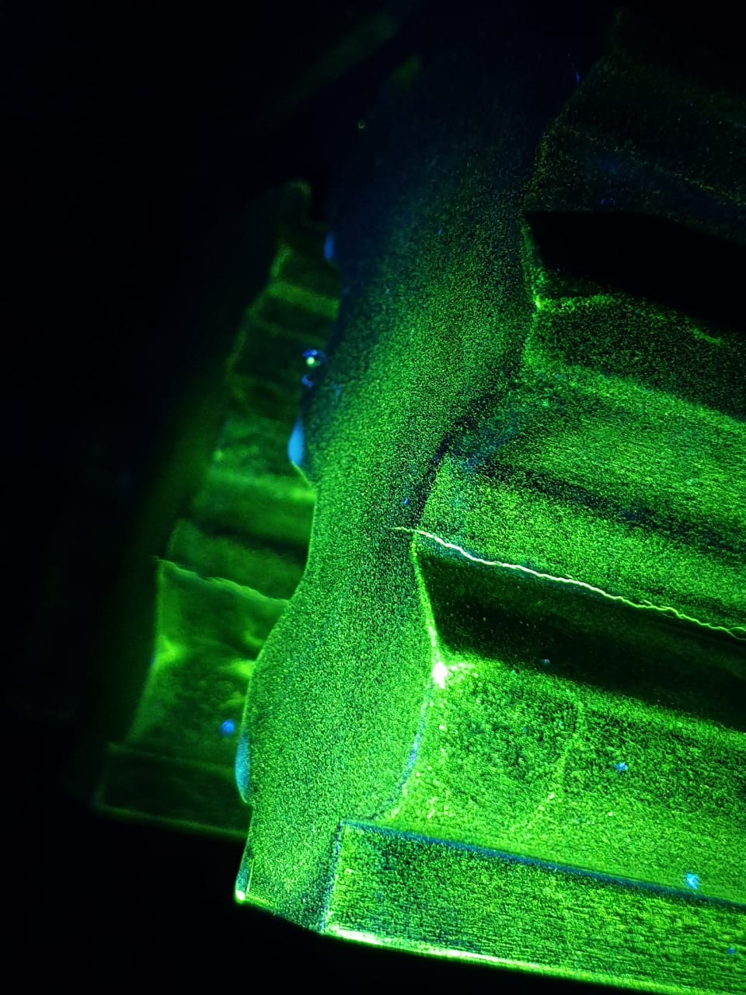
Date : 13.02.2024
Cracking of LPT Rotor Groove
-by ¹K.P. Pradhan, ²S.C. Bhoi, ³A. Mondal
NTPC Talcher, Kaniha
NTPC Rojmal
NTPC Singrauli
Migratory birds at NTPC Dadri
¹NTPC SR-HQ, Secunderabad, ²NTPC TSTPS-Talcher Kaniha, ³ NTPC Energy Technology Research Alliance (NETRA)

Slide 2
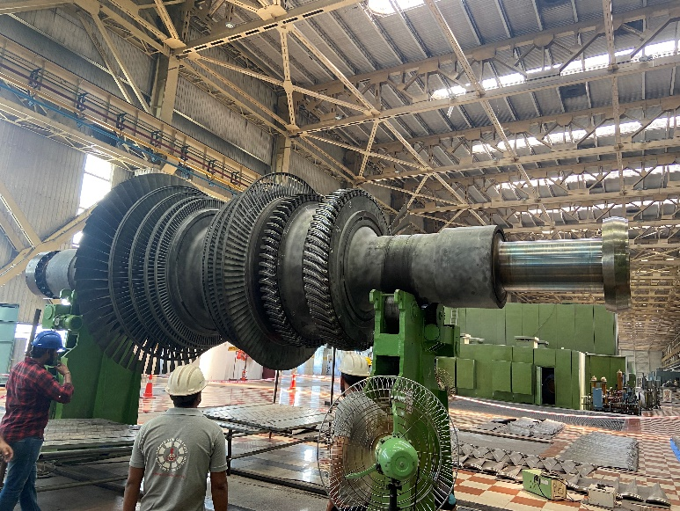
Identification of Crack
MPI of LP Turbine free standing blades and Rotor grooves is done in NTPC during OH of units with periodicity of 4 years as per OS guidelines.
The activity for Rotor groove inspection consists of blade removal (de-blading), groove cleaning and magnetic particle inspection.
TSTPS U#3 OH (June, 2023) : Crack observed in one of the LP turbine 5th stage (Generator Side) rotor grooves (no.27) while carrying out MPI
TSTPS U#4 OH (Aug, 2023): All 5th stage rotors grooves (both sides) (124 nos) found to have crack while carrying out MPI.
Crack Location- 5th stage blade groove

Slide 3
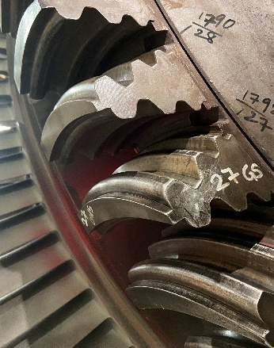
Unit operation details
UNIT # 3
Boiler Light up: September, 2002
Unit Synchronization: January, 2003
Number of starts of unit : approx. 60
Number of operating hours of unit : 164 K hours
UNIT # 4
Boiler light up: July, 2003
Unit Synchronization: October, 2003
Number of starts of unit : approx. 60
Number of operating hours of unit : 158 K hours
Notes:
23

Slide 4
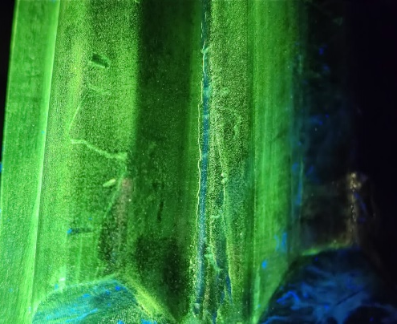
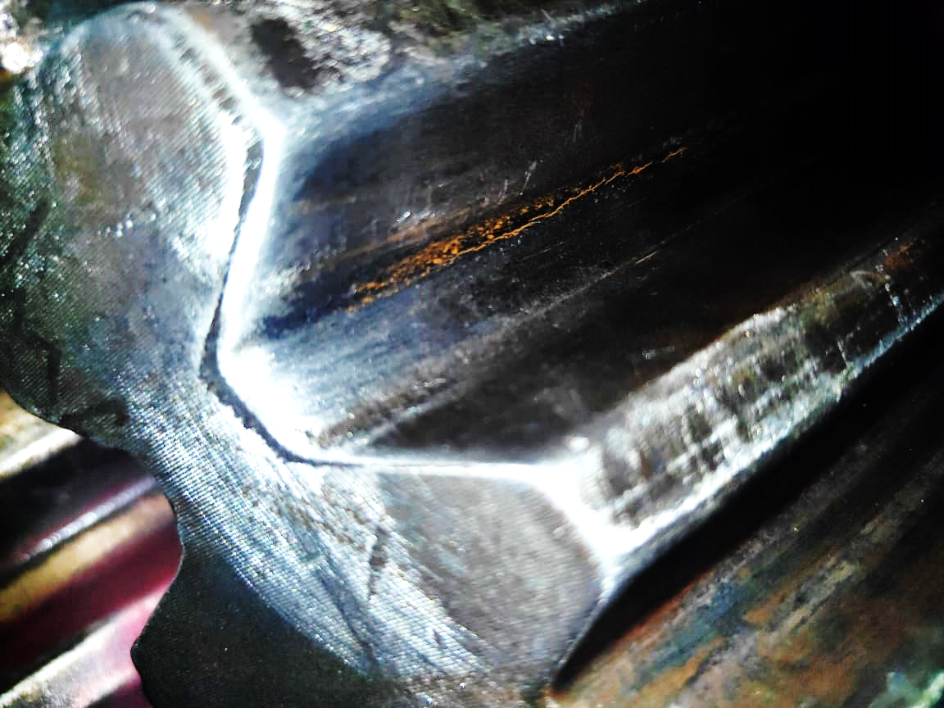
Crack is Intermittently breaking (not continuous), Spread across the length of Steeple-1 (starting from ~20 mm from the edge)
Nature of Crack in U#3 LPT Rotor
Start of crack

Slide 5
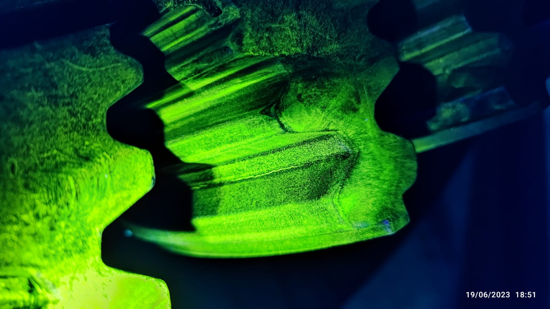
CRACK

Slide 6
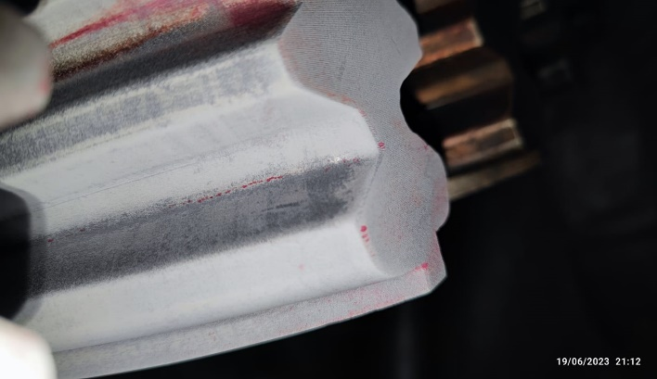
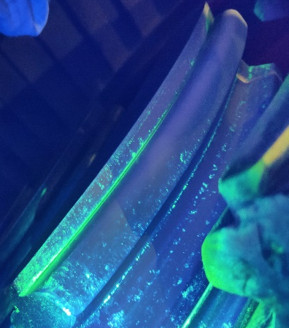
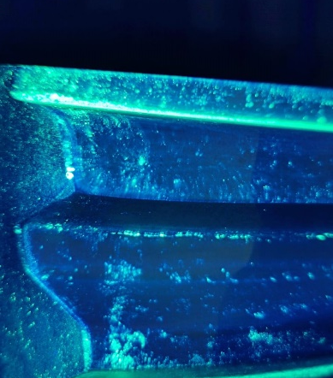
Dye Penetrant Testing and Fluorescent penetrant Testing in Groove No -27
CRACK

Slide 7
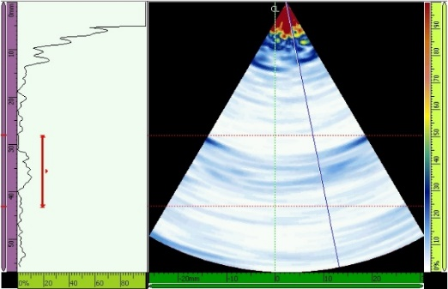
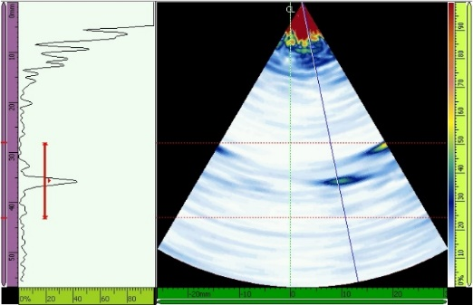
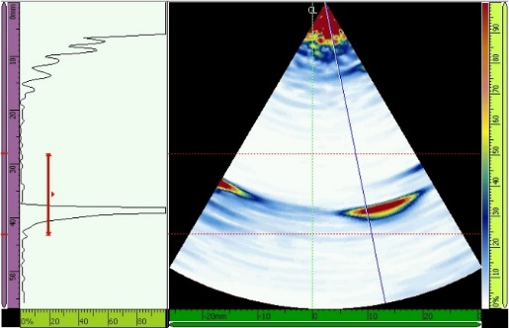
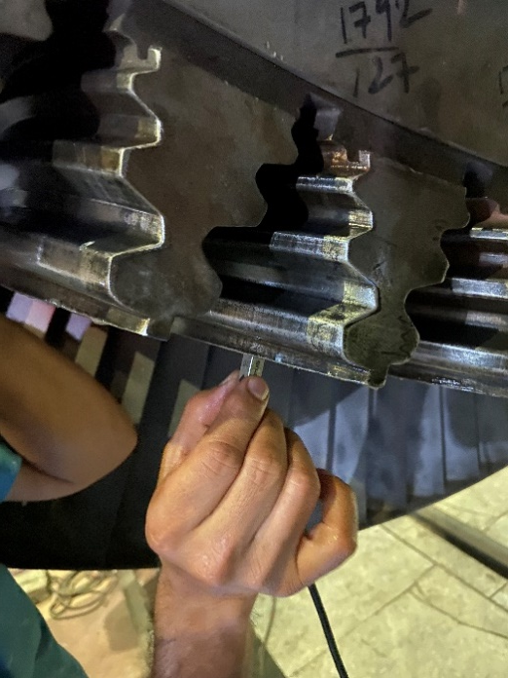
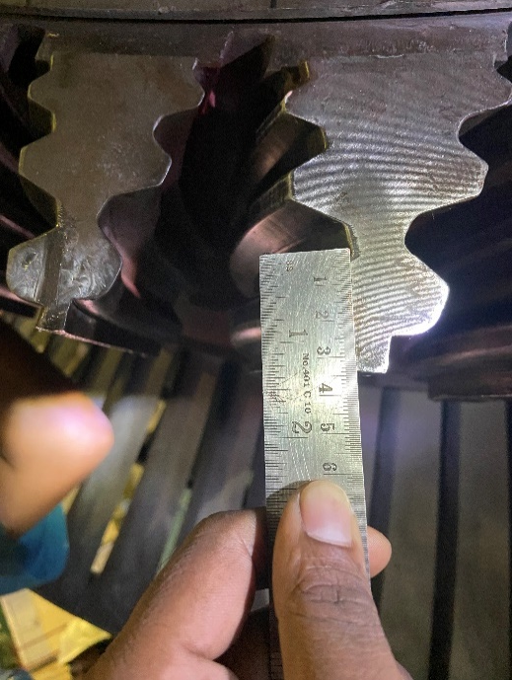
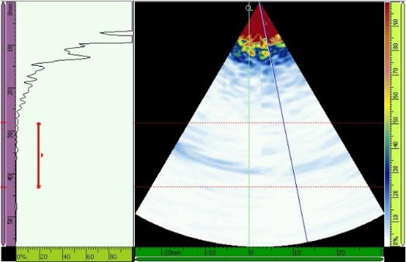
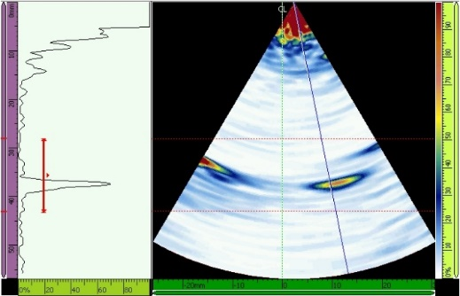
PAUT Comparison between: Groove No: 27 (With Suspected Crack) & Groove No: 28 (Healthy)
PAUT of steeple by NETRA
Healthy Groove
Groove with crack

Slide 8
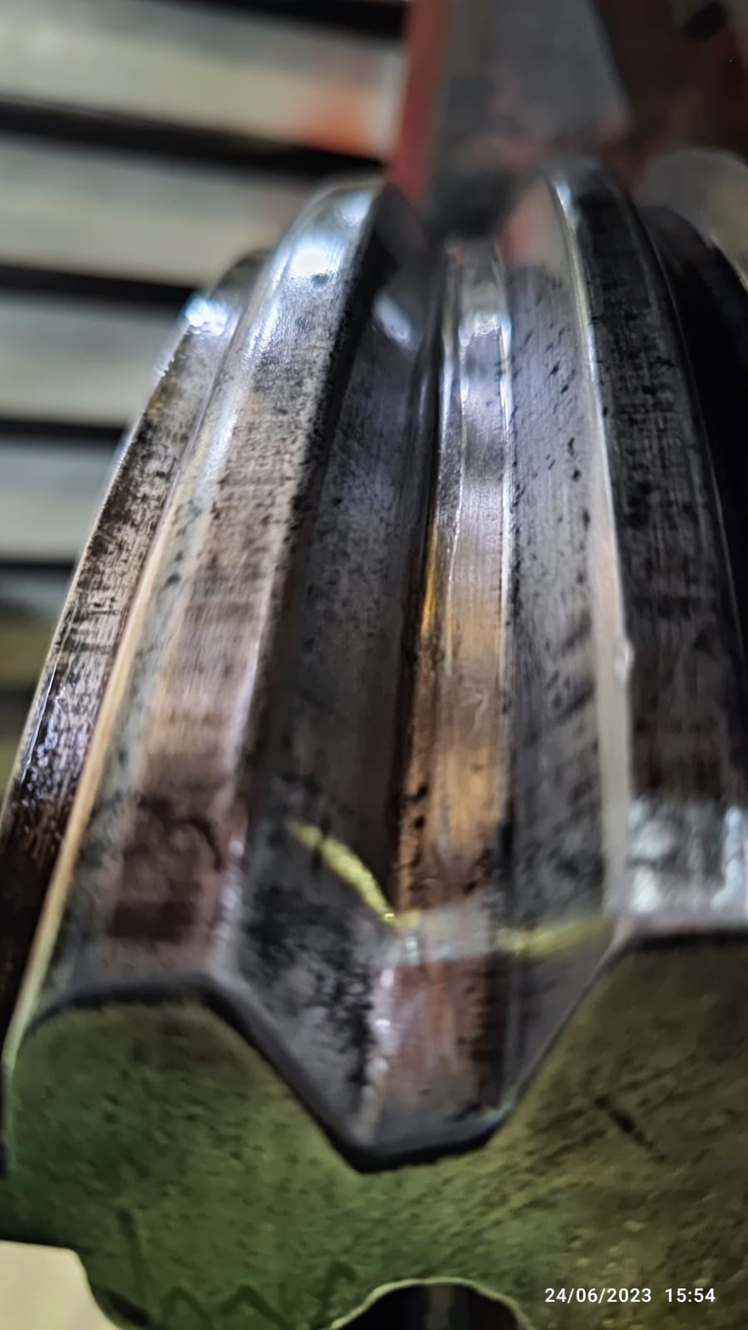
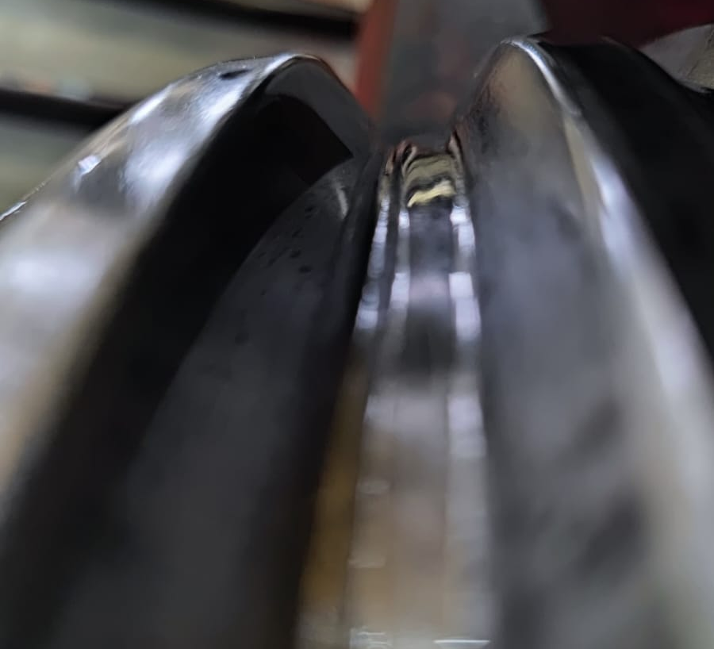
Grinding of Crack
Grinding was done 0.1 to 0.2 mm each time with MPI to check the crack
Crack was completely removed after approx. 2 mm grinding
Grinding Depth 2mm Approx

Slide 9
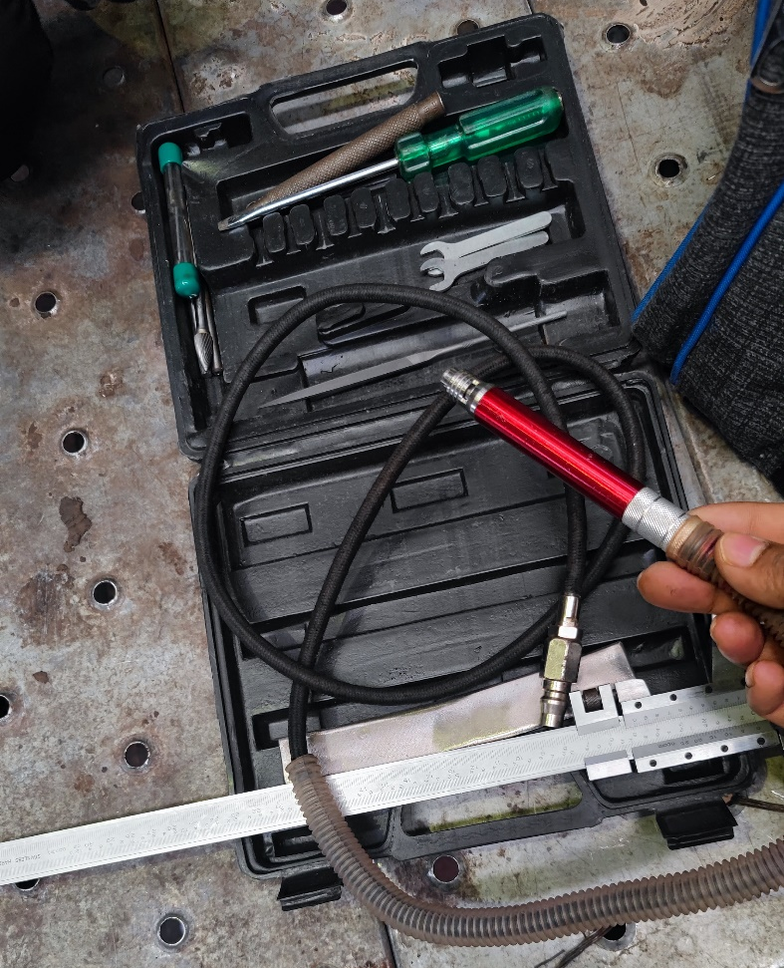
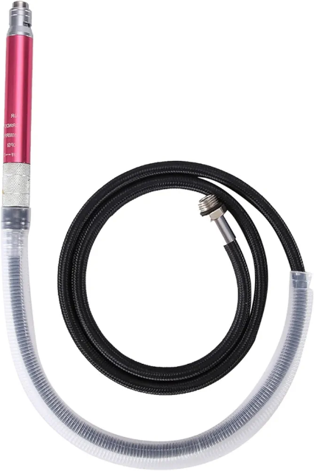
Tools used for grinding
Small milling tools
Miniature pneumatic grinder

Slide 10
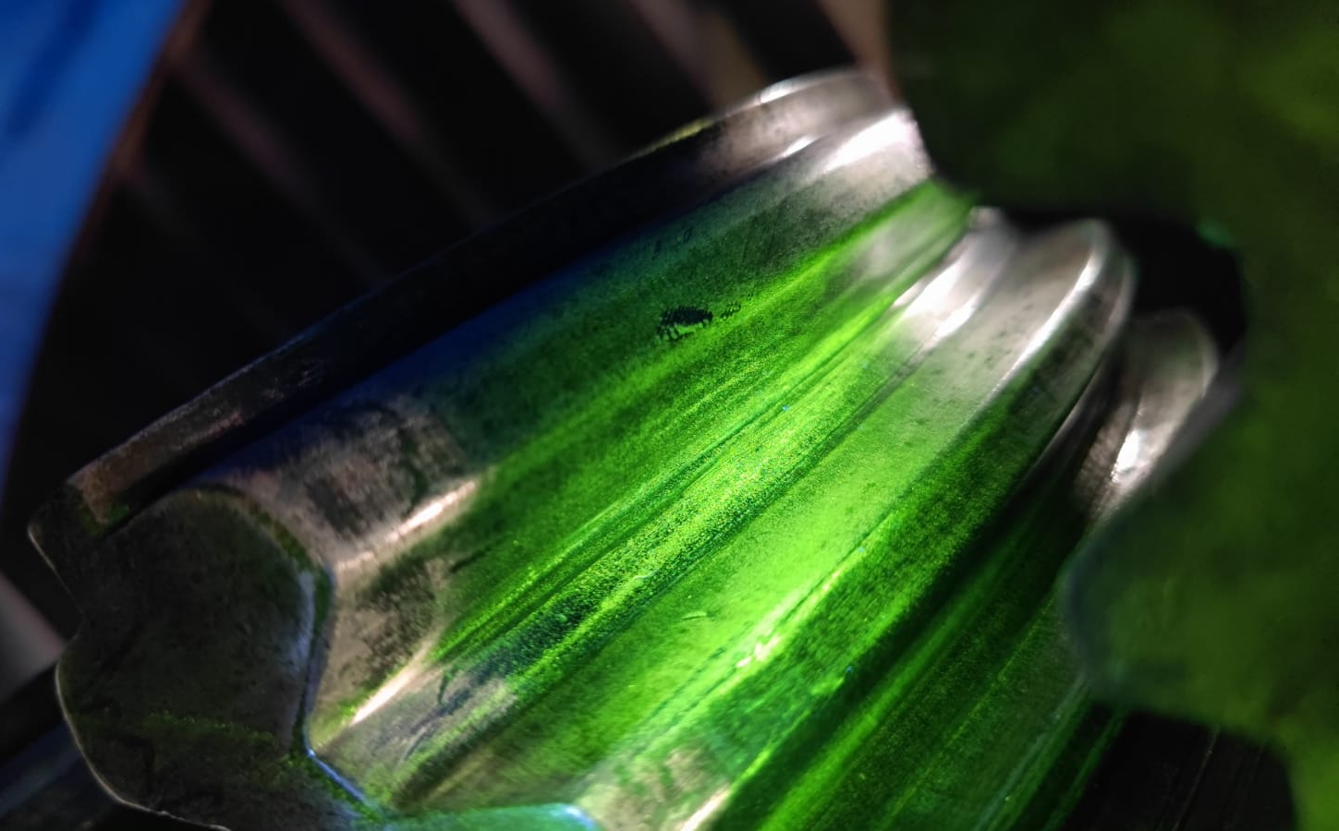
Ensuring crack elimination
Complete removal of crack was ensured through MPI

Slide 11
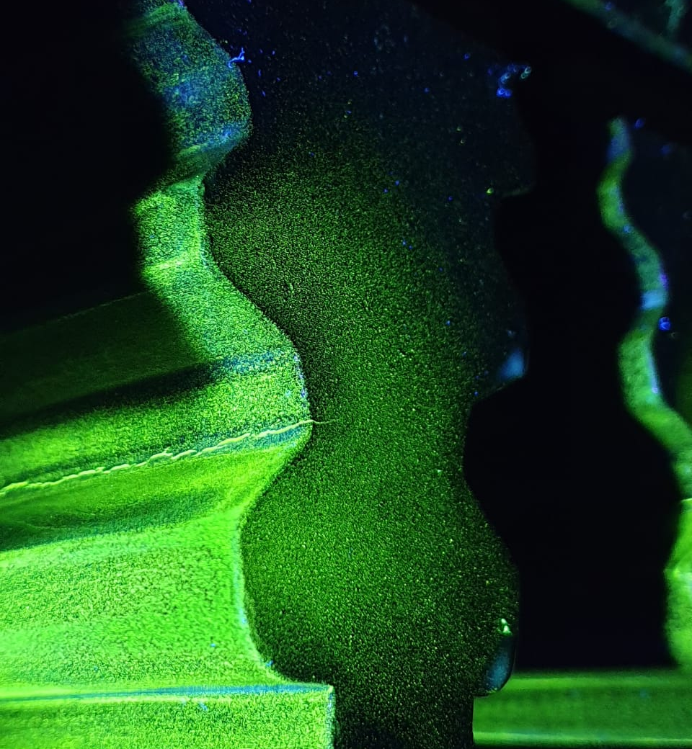
Cracks identified in LP Rotor 5th Stages of Unit#4

Slide 12
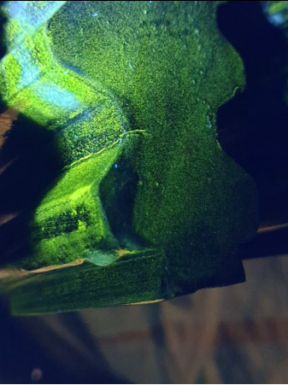
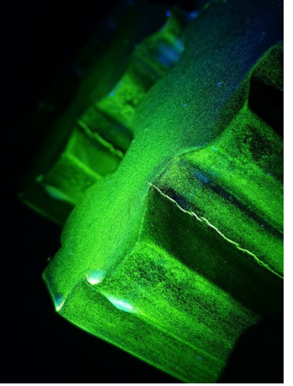
Location of crack : Pressure side ( first serration)
Total number of cracks found in the LP rotor : 124 cracks (one crack in each rotor groove).
Location of Cracks : L-1 steeples
Cracks in 35 grooves found to have propagated to the sides
Crack
Crack

Slide 13
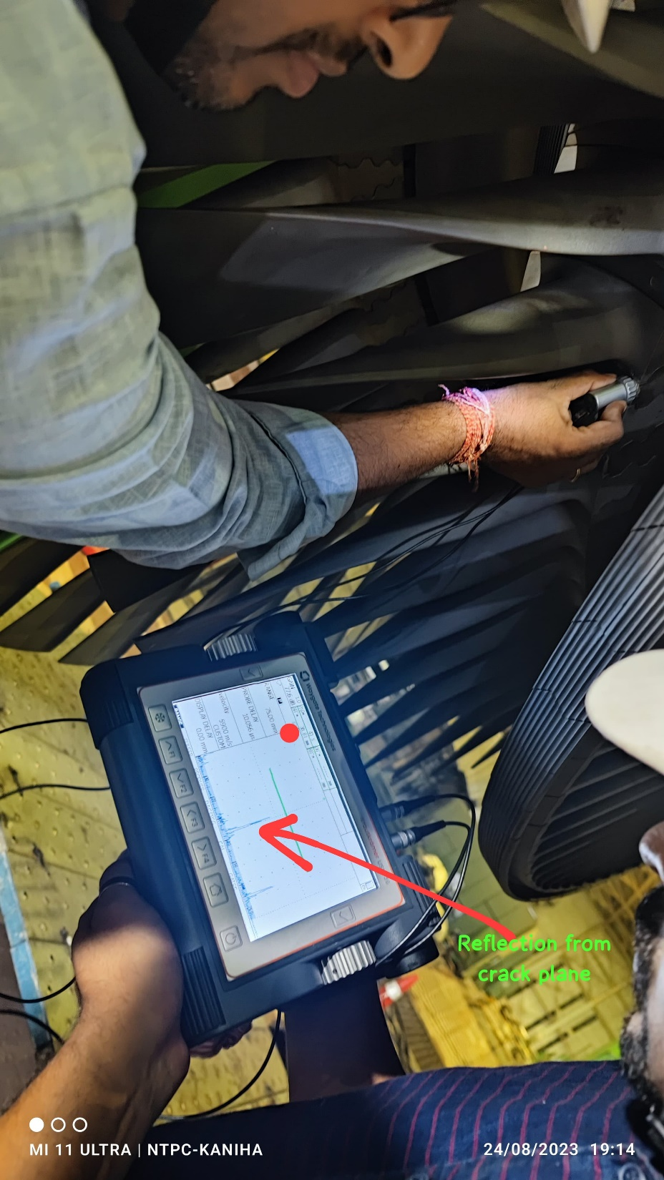
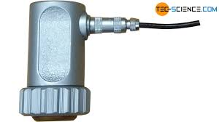
Crack in Rotor groove cross checked using UT

Slide 14
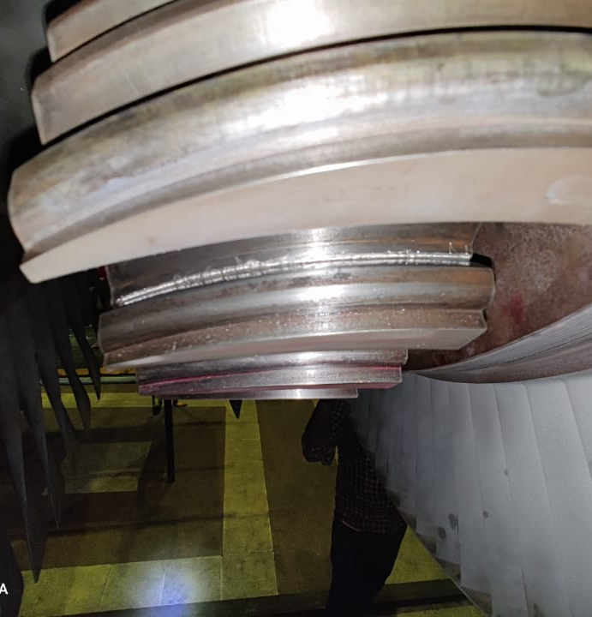
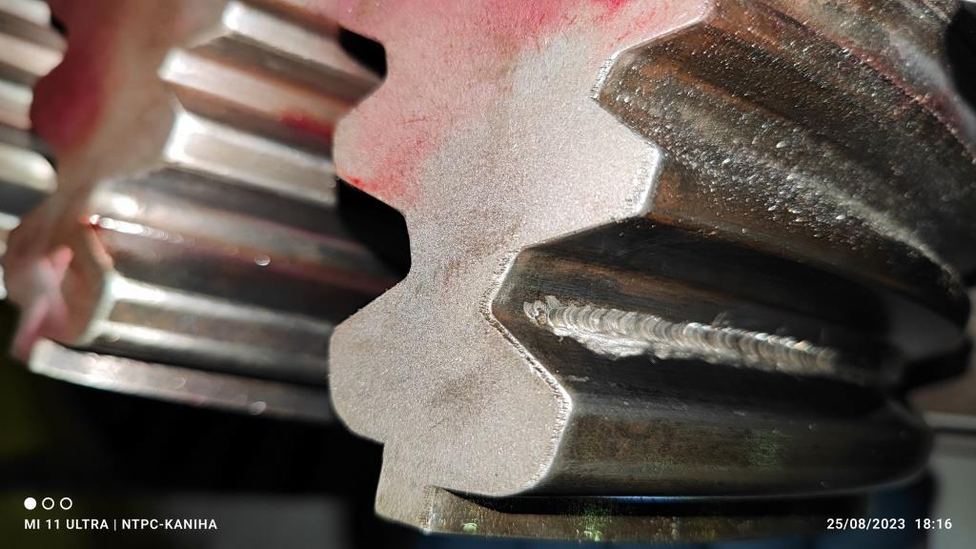
Grinding of crack
Crack was ground using grinding tools up to 5mm depth
However, crack could not be removed

Slide 15
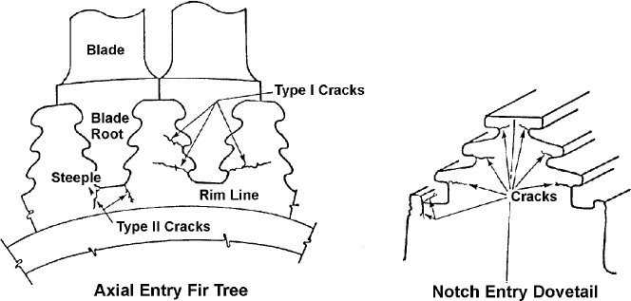
Typical Locations of Disc Rim Cracking

Slide 16
Schematic of axial-entry fir tree groove design in LP rotor with typical cracking locations shown

Slide 17
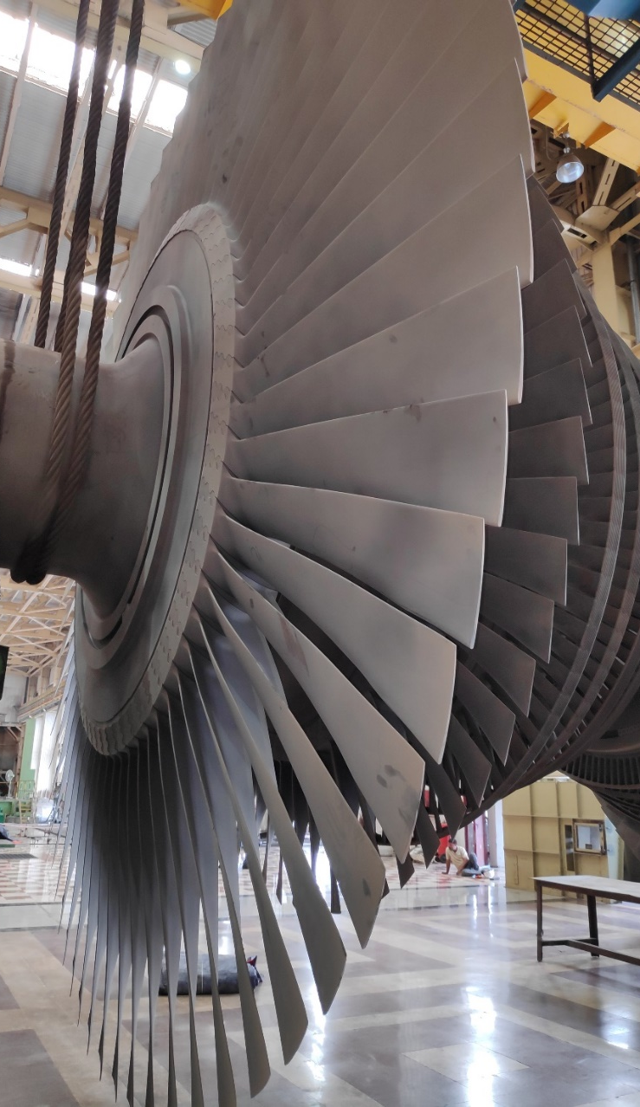
Cursory look into SCC
Although Stress Corrosion Cracking (SCC) can occur in many locations of steam turbine, most of them initiate at LP disc rim, rotor groove or blade attachment area.
Usually power plants operating more than 15 years are susceptible to this failure mechanism. If SCC happens, especially in rotor groove, it has a major influence on steam turbine life.
Because of the complexity of crack growth behavior, it is difficult to estimate the remaining life of the rotor with cracks found.

Slide 18
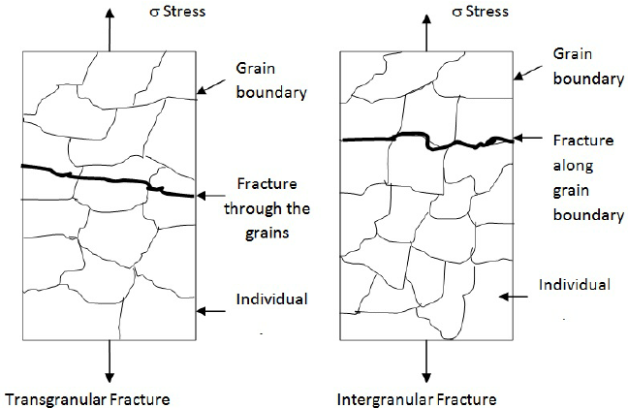
SCC Mechanism
In LP turbine section, cracking on rotor due to SCC has been most prevalent in fir-tree or inverted fir-tree groove designs but it also has been noted in other designs such as finger type design.
Cracks initiate from surface especially around the notches of the grooves and propagate across the steeples.
Corrosion induced cracks are brittle, usually branching, and may be either trans-granular or inter-granular depending upon the material composition, stress levels, and corrosive environment.

Slide 19
Stress Corrosion Cracking Mechanism
Failure mechanism is a function of stress intensity, rotor material, and steam environment so that the probability of occurrence is higher in the longer last stage blades when the moisture of condensation begins to form. Figure below shows an example of SCC found on LP rotor groove
Figure: Example of Stress Corrosion Cracking on LP rotor groove crack and microstructure of crack examined by replication

Slide 20
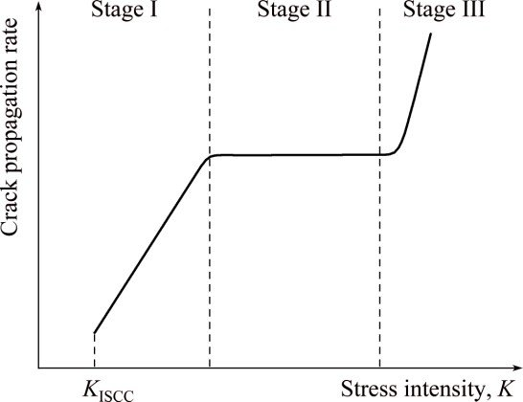
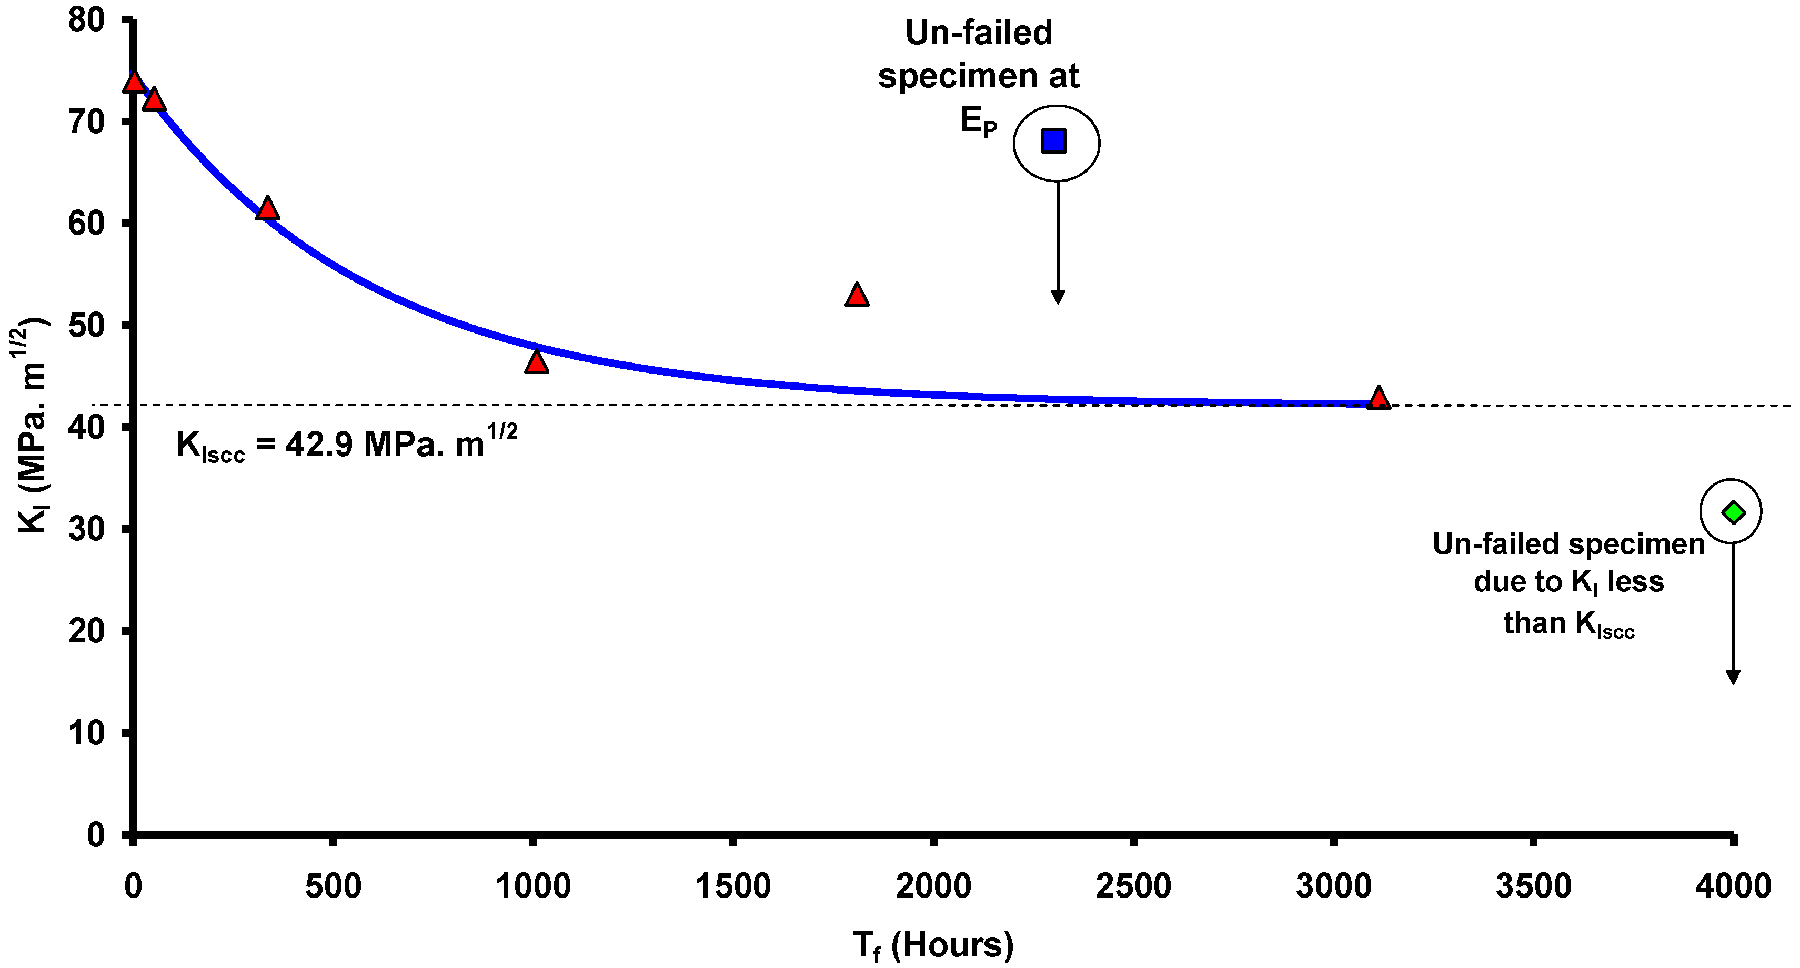
Properties of SCC
Crack propagation rate from SCC can be divided into 3 regions as a function of applied stress intensity factor (K_{I}) which are dependent, constant, and approaching final failure.
In the first phase, SCC can only propagate when stress intensity at rotor groove exceeds the threshold of the crack growth stress intensity (K_{ISCC}).
When K_{I}<K_{ISCC}, indication may be in the form of localized corrosion and its magnitude or degree of severity becomes less significant.

Slide 21
Properties of SCC
For the second phase, crack growth rate is assumed to be constant and independent from applied load or KI. We call this region “plateau” region.
After stable growth phase, in Stage-III, SCC may change its mode to Low Cycle Fatigue (LCF) or High Cycle Fatigue (HCF). The crack is accelerated into unstable regime hence fast fracture will soon come.

Slide 22
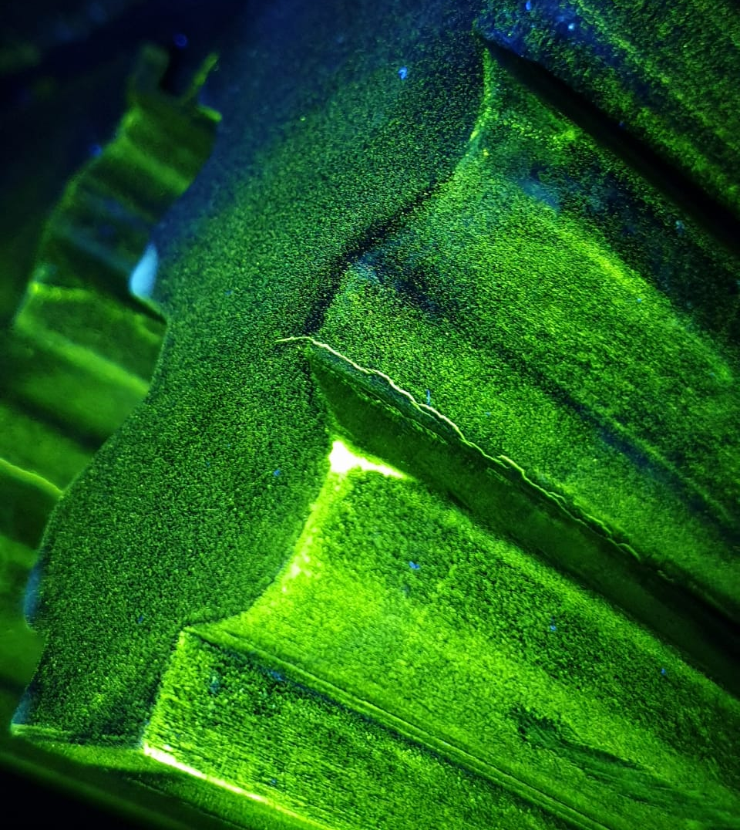
Critical Crack depth
Once SCC is found, actual crack dimensions had been recorded for reference. In addition, the two most crucial things to be determined are critical crack depth and crack growth rate.
The critical crack depth (acr) can be calculated by Finite Element Analysis (FEA) software where acr is the minimum crack depth that the applied stress intensity factor (K_{I}) exceeds the material toughness (K_{IC}).
Note that K_{I} is the function of assumed crack geometry or flaw shape and K_{IC} depends on material properties.

Slide 23
Factors affecting crack
Factors | Mechanism
Root Causes | SCC is caused by a combination of High surface stresses, A susceptible material, Operational and shutdown environments. Design-related root causes are the most important and prevalent. They include High surface tensile stresses and stress concentrations, and Use of high strength materials.
Fractography | SCC cracks of low alloy steels often initiate from pits and propagate intergranularly with branching. The initial part of the crack can be corroded and filled with magnetite. Depending on the ratio of the steady and cyclic stresses, the disc cracks can be a mixture of intergranular and transgranular cracking

Slide 24
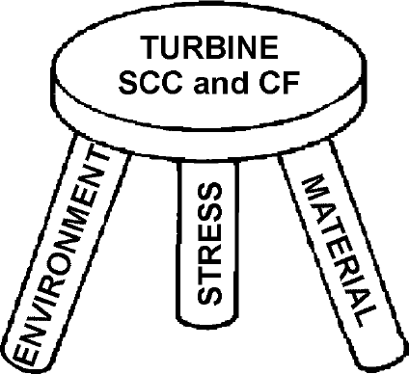
Three Components of Turbine Stress Corrosion and Corrosion Fatigue Cracking in Turbines.
Factors affecting crack

Slide 25
Factors affecting crack
 | Factors | Mechanism
MATERIAL | Materials | All low alloy steels used for LP turbine rotors and discs are susceptible to SCC and CF in numerous turbine environments including pure water and wet steam. The strongest material factor influencing SCC is yield strength. At higher yield strength, SCC crack growth rate can be several orders of magnitude higher than for lower yield strength materials.
STRESS | Vibratory stresses | Vibratory stresses reduce the life when the flaws reach a sufficient size that fatigue becomes a dominant mechanism.
 | Cyclic stresses | Cyclic stresses are caused by: Turbine startups and shutdowns (high cyclic stresses), Turbine and blades ramping through critical speeds at which some components are in resonance (high amplitude, high frequency)

Slide 26
Factors affecting crack
Environment | Factors | Mechanism
 | Shutdown environment | Sodium hydroxide is the most severe SCC environment encountered in steam turbines. The sources of NaOH include Malfunctioning condensate polishers and makeup systems and Improper control of phosphate in boiler water chemistry combined with high carryover.
 | Steam chemistry | Operating outside of recommended steam purity limits for long periods of time; sometimes caused by organic acids from elevated concentrations of steam impurities (particularly of chloride, sodium, and sulfate) and the resulting deposition and concentration by evaporation of moisture are underlying causes of corrosion fatigue. High steam sodium or cation conductivity may indicate conditions that can lead to rapid accumulation of deposits and concentrated liquid films on blade surfaces.
 | Pitting | When corrosive deposits are present, pitting during unprotected layup can be faster than pitting during operation. This is because during the layup, there can be 100 percent relative humidity and there is oxygen present. At high stresses, above the elasticity limit of the material, pitting is enhanced through the mechanism identified as stress induced pitting

Slide 27
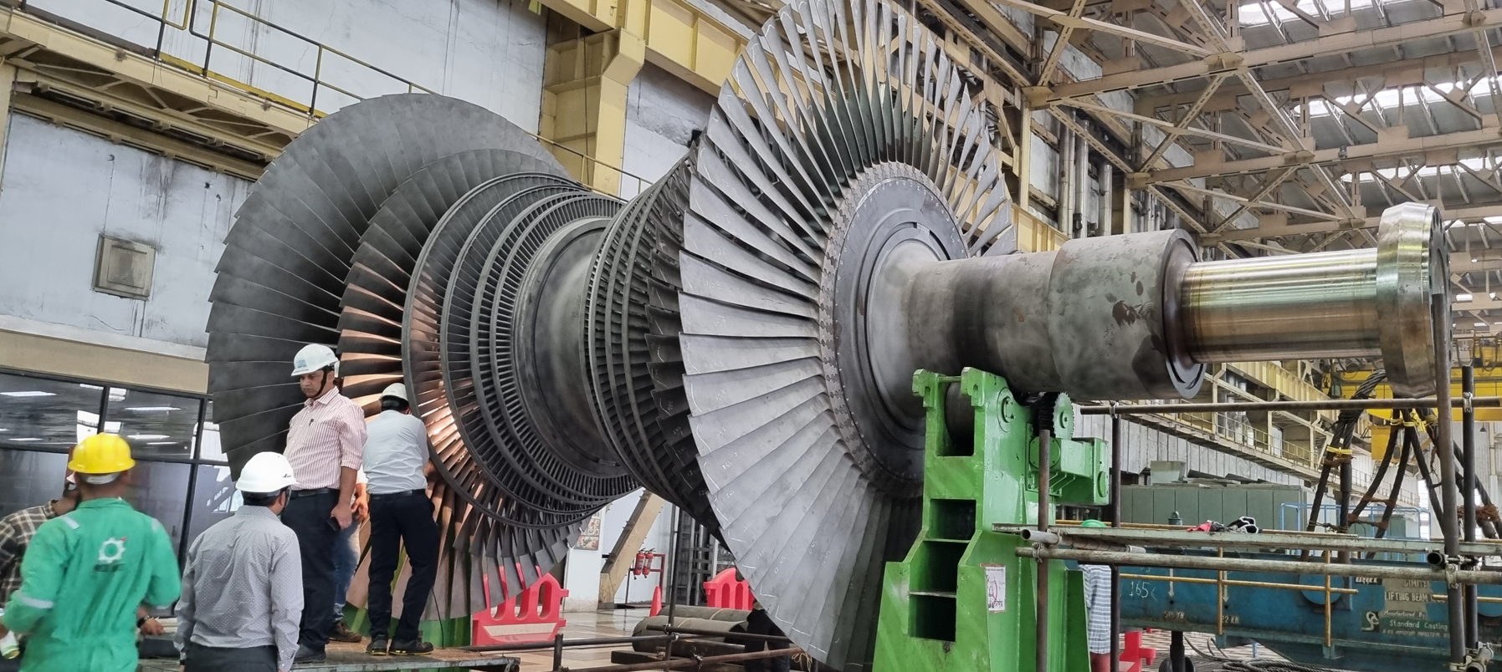
Way forward
Inspection of U#3 LPT rotor in next OH for checking further development of crack if any.
Root Cause analysis for such crack initiation
Allowable crack size?
Repair of U#4 rotor

Slide 28
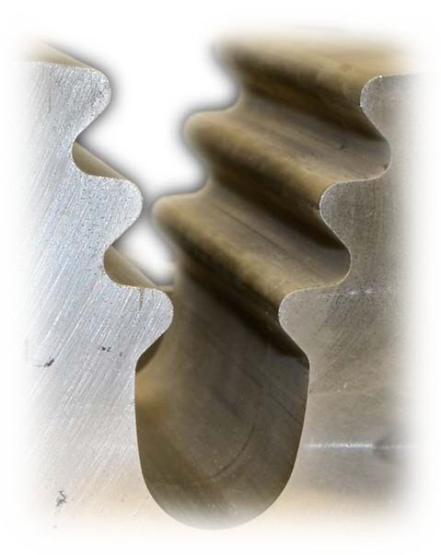
Inspecting Turbine Dovetails with Eddy Current Array Technology
Dovetails are especially prone to fatigue cracking and Stress-Corrosion Cracking (SCC), which is defined as the growth of cracks in a corrosive environment. If left unchecked, SCC can lead to unexpected failure of normally ductile metals subjected to tensile stress, such as is the case in turbines.
The cracking of interest here is typically small and concentrated near dovetail hooks. Conventional eddy current pencil probes and Penetrant Testing (PT) were used for a number of years with very limited success. The specific geometries of dovetails make inspection with these methods unreliable, if at all possible.

Slide 29
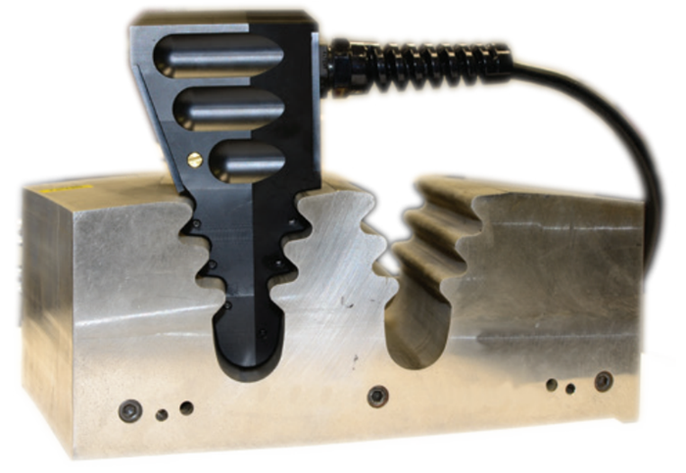
Inspecting Turbine Dovetails with Eddy Current Array Technology
Of the two dovetail parts, inspecting the female portion has proven the most time-consuming and demanding. Inspection usually involves using slow, complex, and costly robots.
Furthermore, because there are almost as many dovetail designs as there are turbines, a one-size-fits-all solution such as a flexible design is virtually unthinkable, especially while wanting to preserve the level of precision necessary to effectively characterize minute cracks.
This application therefore calls for a solution that can scan female dovetails in a single pass and designed to match the dovetail’s profile.

Slide 30
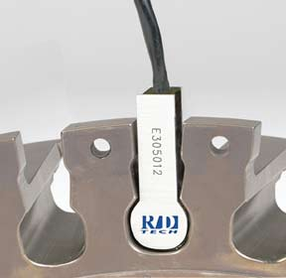
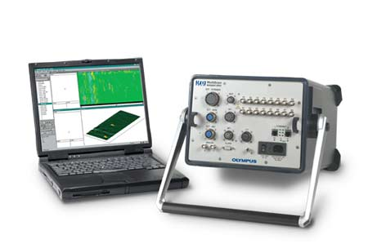
Inspecting Turbine Dovetails with Eddy Current Array Technology
Because dovetails vary greatly in shape and size, they usually require a custom solution. The Eddy Current Array (ECA) technology in the probe remains nonetheless the same.
To scan a wide inspection area, ECA technology uses multiplexing. That is, several individual coils are grouped together in one probe and excited sequentially to eliminate interference from mutual inductance. The coils are designed to have the necessary impedance and penetration level for accurate inspection.
Moreover, the coils are mounted inside a thin (0.25 mm or 9.8 mil), spring-loaded and durable membrane, guaranteeing constant contact with the dovetail. The shape of the probe also makes it very stable and easy to handle, eliminating the need for expensive robotic solutions
MultiScan MS5800 multitechnology acquisition unit

Slide 31
The Challenge
Efficiently inspect turbine dovetails for minute cracking, extending the life of aging equipment.
Dovetails are prone to fatigue cracking and stress corrosion cracking (SCC)
Cracking of interest is typically:
Small
Concentrated at dovetail hooks
Conventional EC pencil probes and PT have very limited success because the specific geometries of dovetails make these methods unreliable, sometimes impossible.

Slide 32
The Challenge
Female dovetails are the most challenging. Inspections usually:
Require much time and effort
Involve slow, complex, and costly robots
Dovetail designs are multifarious
One-size-fits-all solution almost impossible
Need for a solution that can scan female dovetails in a single pass, designed to match the dovetail’s profile.

Slide 33
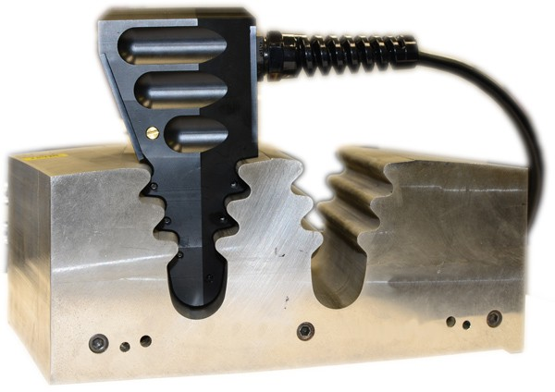
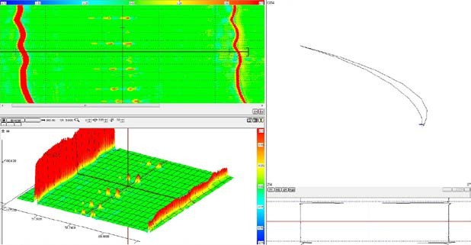
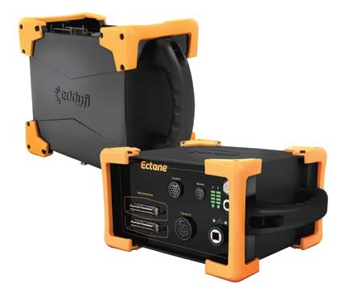
The Solution
ECA probes perfectly profiled to match dovetail geometries.

Slide 34
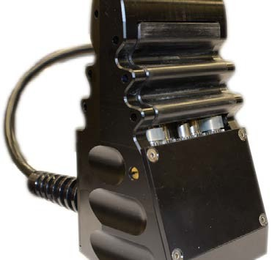
The Solution
To scan a wide inspection area, ECA technology uses multiplexing.
Several individual coils are grouped together in one probe and excited sequentially to eliminate interference from mutual inductance.
Coils designed to have the necessary impedance and penetration level for accurate inspection.
Coils mounted inside thin (0.25 mm/9.8 mil), spring-loaded, durable membrane.
Constant contact with dovetail guaranteed.
Very stable and easy to handle
No need for expensive robotic solutions.

Slide 35
The Solution
Dovetail probe equipped with precision encoders
Allow locating and sizing length of defects in space when analyzing 2D and 3D C-scans with the Magnifi® high-performance acquisition and analysis software.
Magnifi is also capable of computerized record keeping and reporting
Great advantages over PT.

Slide 36
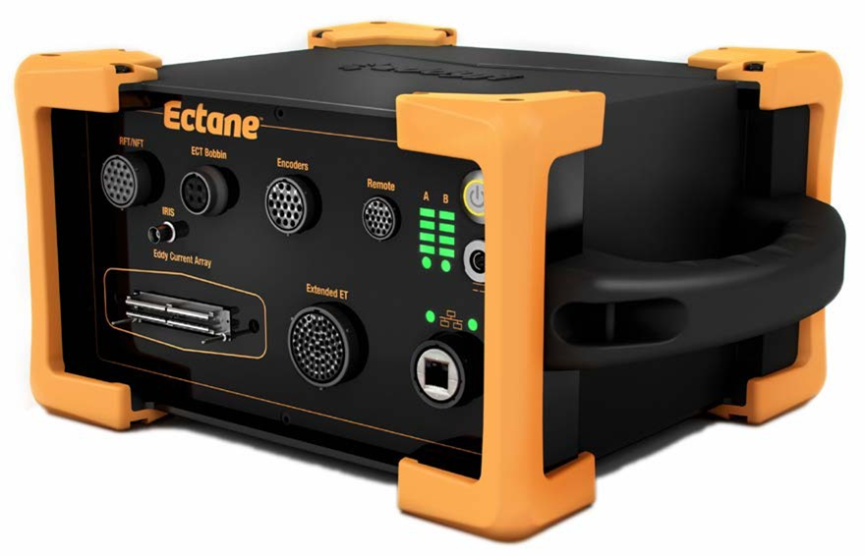
Driving the dovetail probe is the Ectane® — a compact, rugged, battery-operated, and portable ECA data acquisition unit with an integrated multiplexer.

Slide 37
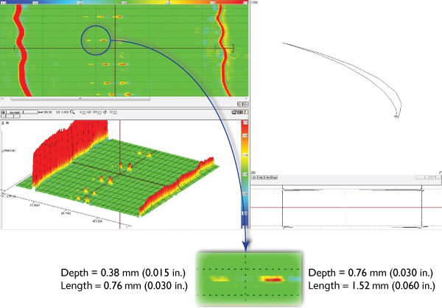
The Solution
Actual testing on dovetail profiles demonstrates that detection capabilities are:
As much as 0.38 mm (0.015 in.) in depth
As short as 0.76 mm (0.030 in.) in length

Slide 38
The Benefits
This dovetail inspection solution has several advantages over others:
Custom solution shaped to specific dovetail profiles
Custom solution designed to target specific “hot spots” or entire dovetail profile
Rapid, single-pass scan of regions of interest
No harsh chemicals or hazardous waste
Easy to handle — no need for expensive robotic solutions
Easier interpretation with C-scan imaging capabilities
Full computerized data recording and archiving

Slide 40
Authors
Shri Krushna Prasad Pradhan
Sr. Manager, QA&I
NTPC SRHQ, Secunderabad
Shri Susil Chandra Bhoi
DGM, Mech Maintenance-Turbine
NTPC TSTPS, Talcher Kaniha
Dr. Avijit Mondal, PhD
Sr. Manager, NETRA
NTPC Energy Technology Research Alliance (NETRA)
Greater NOIDA-201301

