Slide 1
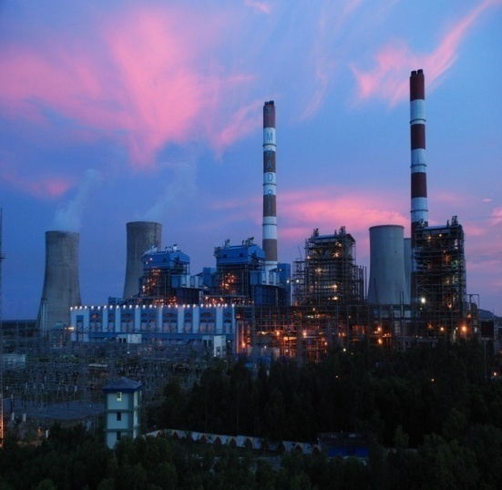
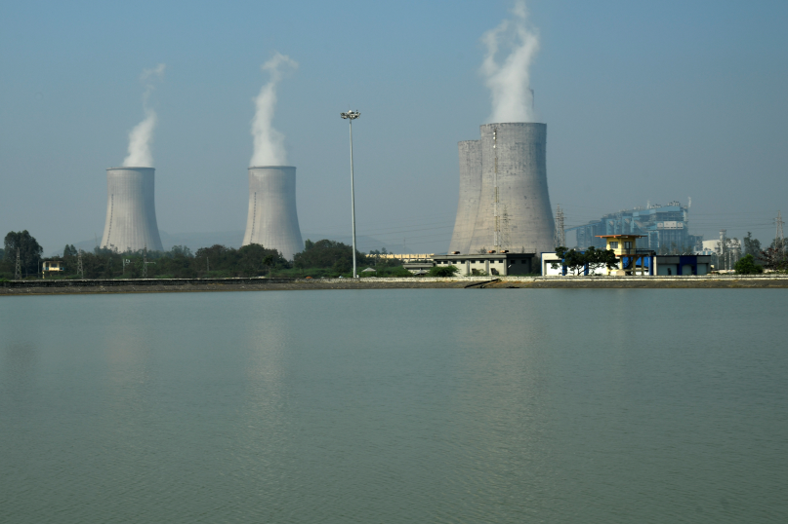
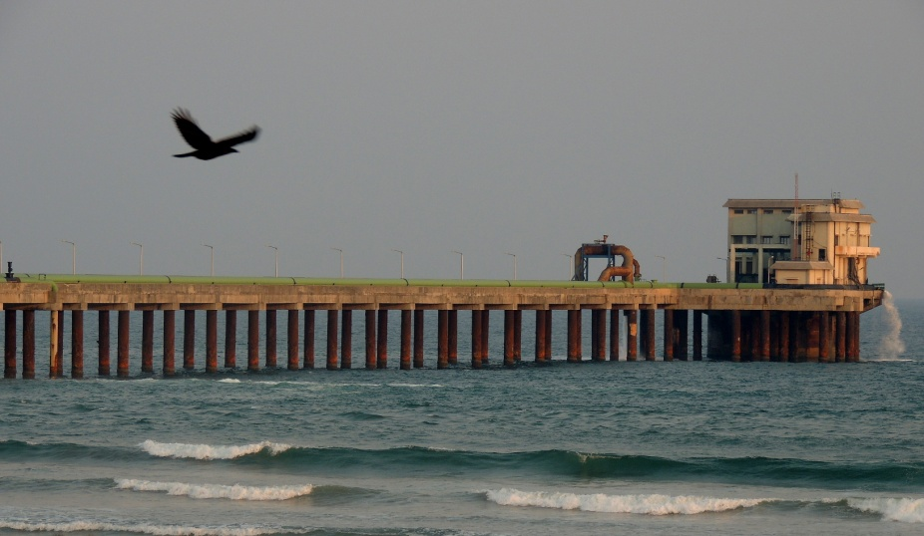
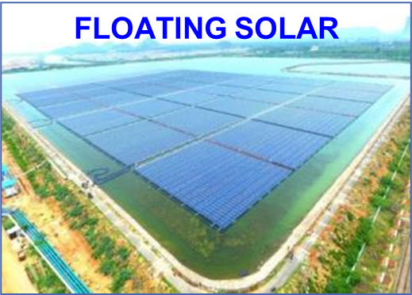
Indian Power Stations O&M Conference,
IPS 2024

Slide 2
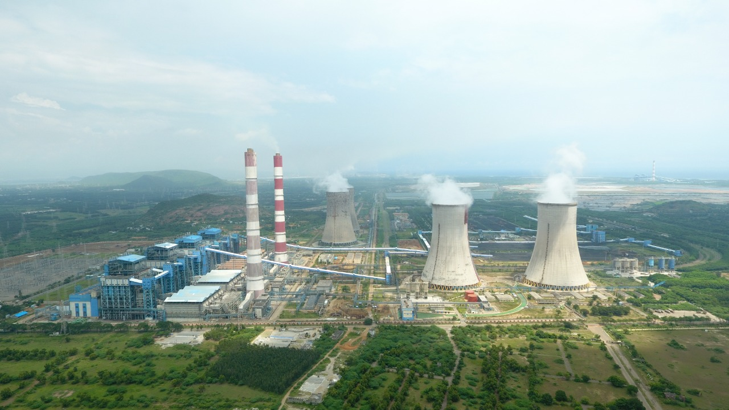
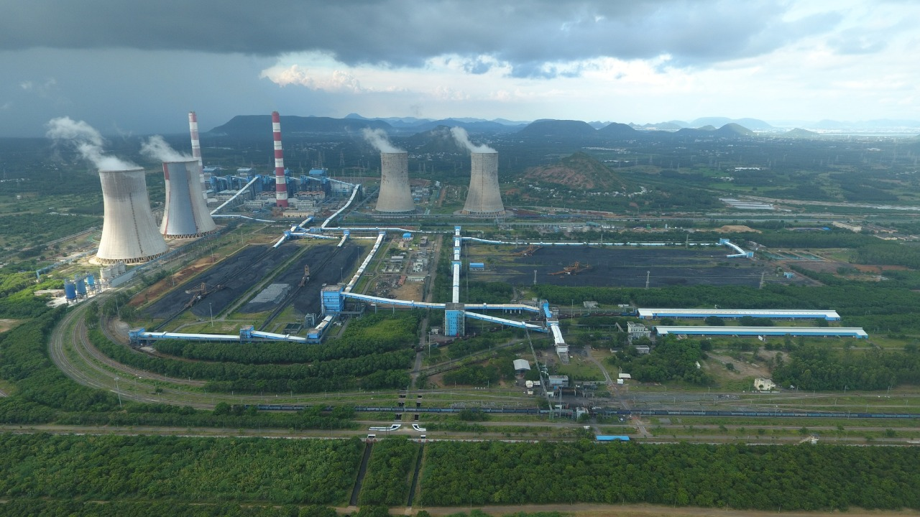
PAPER ID PP256
LIFE ENHANCEMENT OF SIMHADRI NDCT#1 BY REPAIRING & REHABILITATION WORKS INCLUDING COATING WITH MOISTURE CURED URETHANE ON THE SURFACE OF THE RCC SHELL
Rajesh Chawla, AGM NTPC Ltd, Simhadri.
Mahesh Alugolu, AGM NTPC Ltd, Simhadri.
Madhup Chandra Yadav, DGM NTPC Ltd, Simhadri.
Pandab datta, Sr. Manager NTPC Ltd, Simhadri.

Slide 3
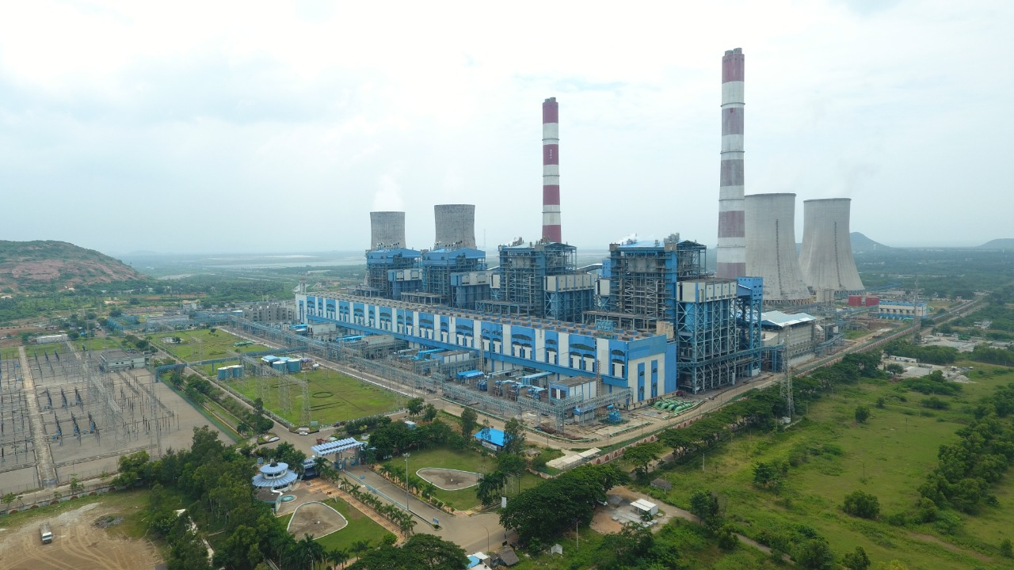
PROJECT OVERVIEW
NTPC Simhadri
PLANT DETAILS
Total Land | 3784 Acres
Project Cost | Rs 3650 Cr (St I) Rs4844 Cr (St II) Rs 110 Cr(Solar)
Commissioning Chronology
Unit# 1 | Feb 2002
Unit# 2 | Aug 2002
Unit# 3 | Mar 2011
Unit# 4 | Mar 2012
Floating Solar | Aug 2021( 25MW)

Slide 4
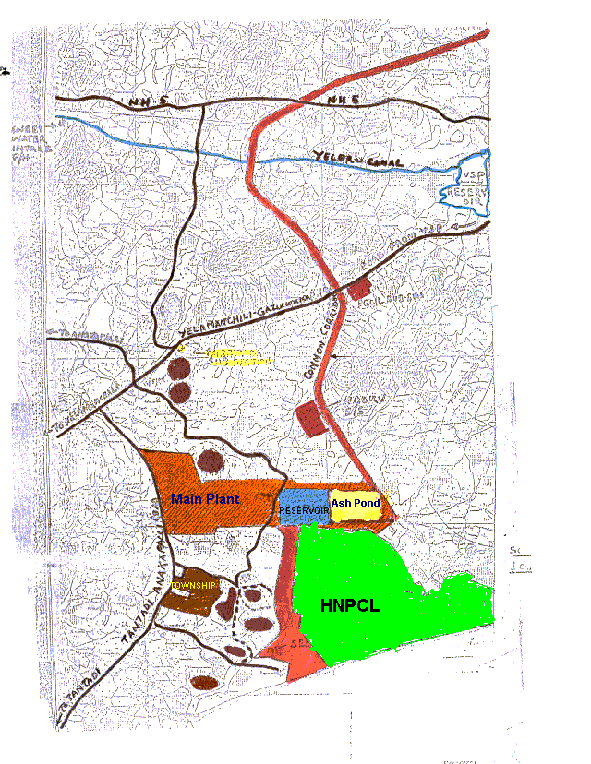
PLANT DETAILS
NTPC Simhadri
SWEET WATER
YELERU CANAL
16 KMs
Coal from
Talcher
700 KM
Capacity : 2000 MW
With 4 x 500 MW units
Solar : 25 MW
Rail Fed Station
Fuel Linkage : 98.2 LMT
MCL : 83.2 LMT
ECL: 15.0 LMT
Water Consent:
Sweet Water: 900 CUM/Hr
Sea Water: 17,885 CUM/Hr
SEA WATER BAY OF BENGAL FOR COOLING
8 KM
Notes:
Fuel Supply agreement with Mahanadi coalfields limited (1/2), Eastern coalfields limited. For FY 23-24 estimated coal consumption is 106.52 LMT.

Slide 5
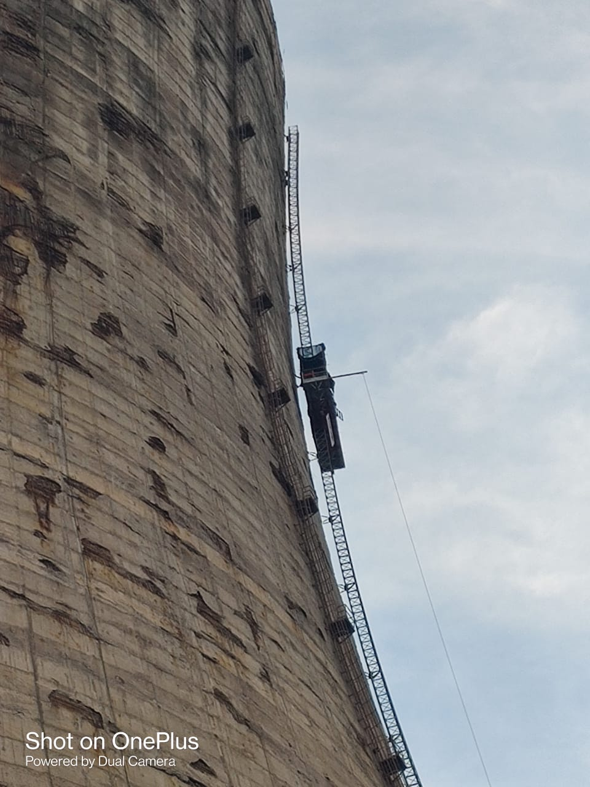
NDCT #1 at NTPC Simhadri
NDCT#1 constructed & commissioned in 2002.
Height of the structure 165 m, Bottom Diameter 100 m, Throat diameter 70 m, Top diameter 75 m & Thickness of RCC shell 500 mm.
Due to close vicinity to seacoast, use of sea water in CW system & Saline mist / drift, NDCTs are susceptible to corrosion.
Signs of deterioration like spalling of concrete, exposure & corrosion of reinforcement bars first observed inside & outside shell in 2009.
Health assessment studies conducted by CBRI Roorkee.
Proposal initiated for repair works couldn’t materialize.
Construction of FRP-IDCT was considered to be more feasible techno commercial solution in the long term & NDCT to be abandoned thereafter.

Slide 6
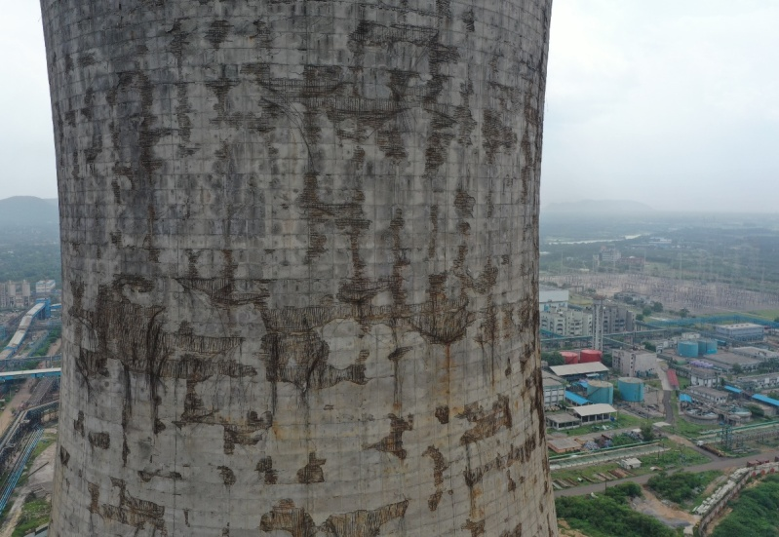
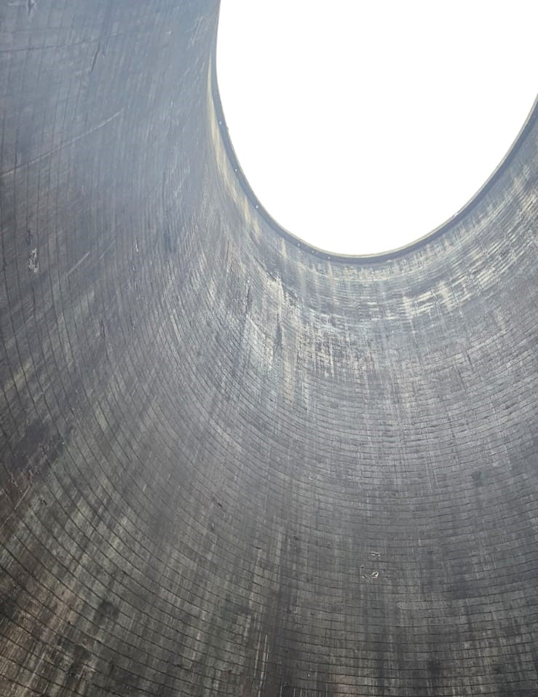
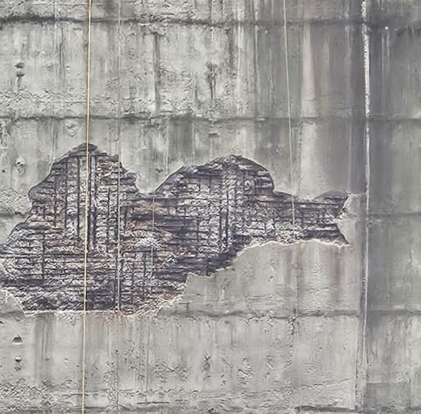
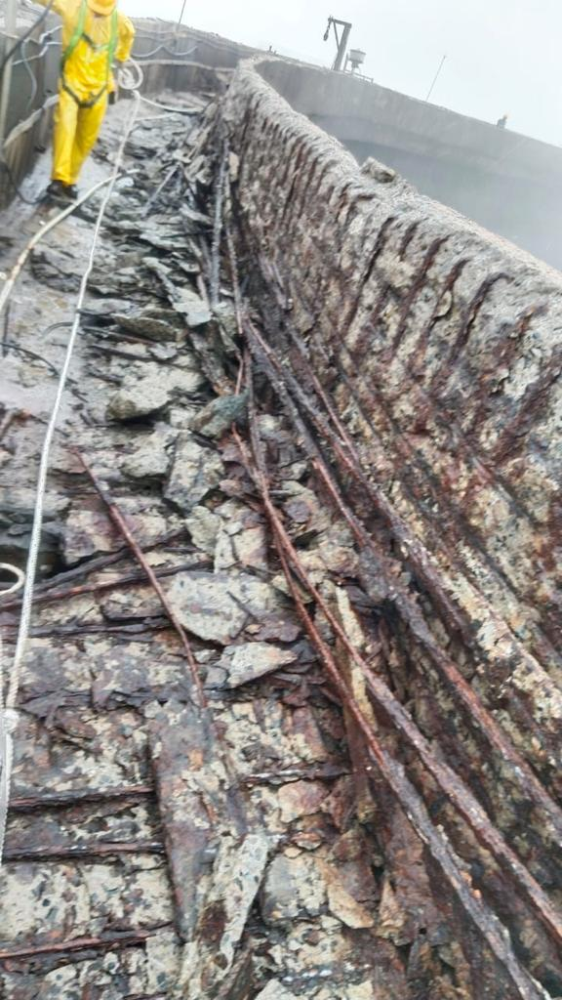
External & Internal Condition of NDCT # 1

Slide 7
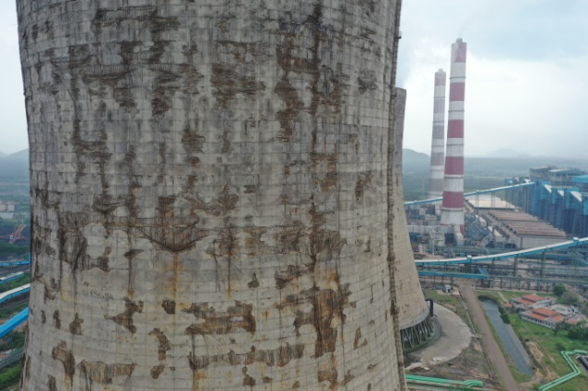
Condition of NDCT # 1
Condition of NDCT structure :
Spalling of cover concrete and exposure of rebars at many locations at the bottom of the RC ring beam of the NDCT#1.
Spalling of concrete and exposure of rebars with loss in diameter due to corrosion observed in most of the locations on the Inner & Outer face of the RC shell of the NDCT #1.
The Walkway platform & approach ladder showed extensive distress.
NDCT had NO access to the Top of the structure. The area was kept barricaded from all sides for safety concerns due to falling of loose concrete.

Slide 8
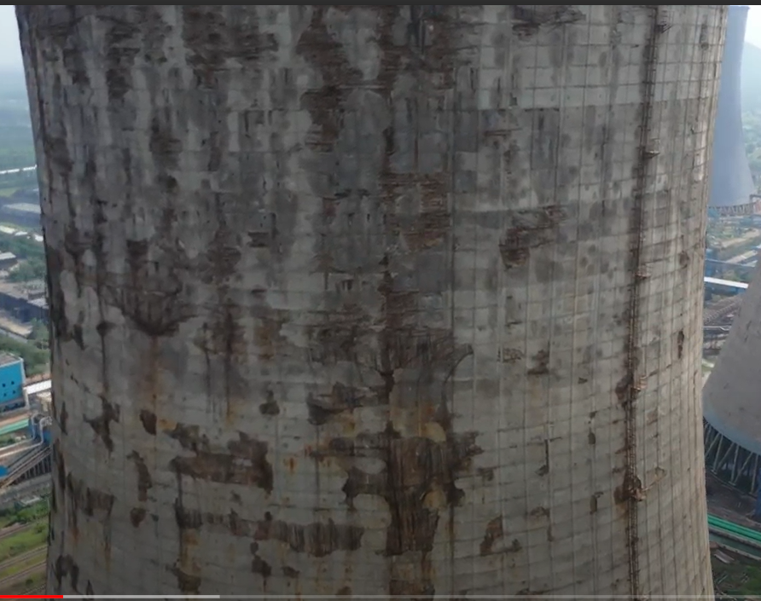
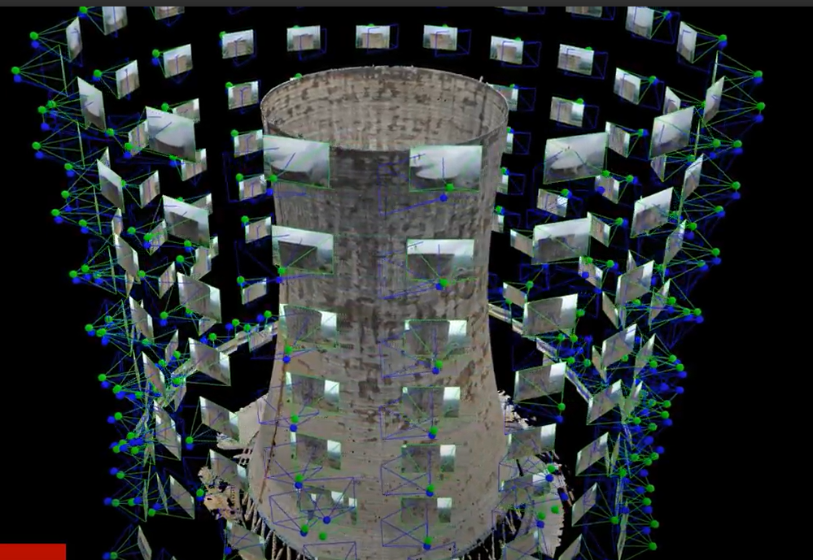
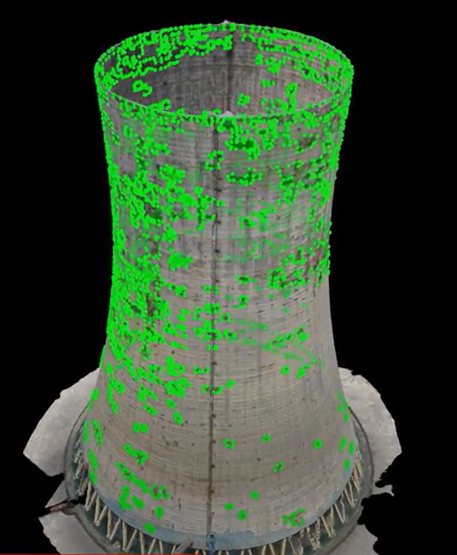
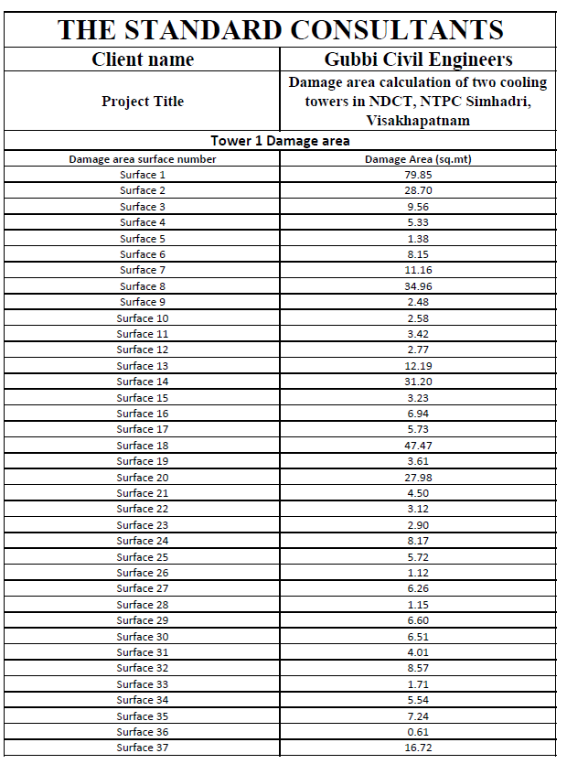
Drone mapping of NDCTs
Damage area of NDCTs is assessed using drone mapping.

Slide 9
Major Concerns
THE MAJOR CONCERN FOR REPAIR & REHABILITATION
SAFE APPROACH TO THE TOP OF NDCT

Slide 10
MULTIPLE METHODOLOGIES EXPLORED
Multiple methods explored to create access to the top of 165 meters high cooling tower for fixing the brackets of rope suspended platforms.
Air landing on the top gallery of NDCT1 by a helicopter through aviation agencies, NDRF.
Air landing on the top gallery of NDCT1 by a hot air balloon.
Arranging professional mountain climbers
Using a Mast-climber

Slide 11
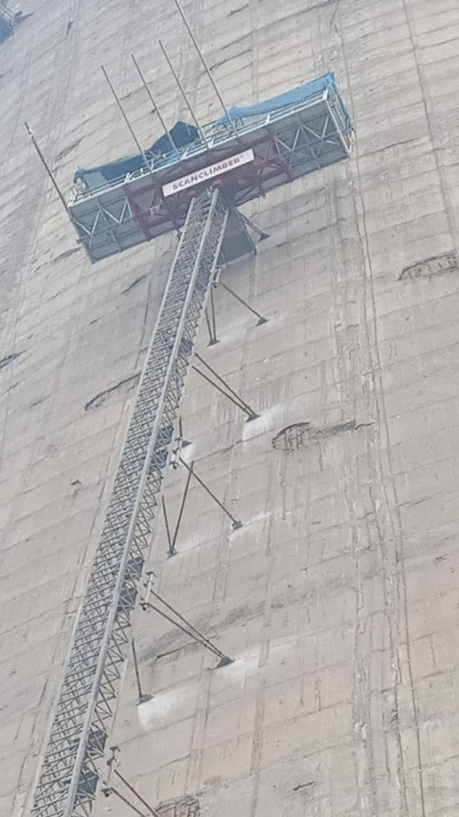
MAST CLIMBER
Mast climber is a type of construction equipment designed to vertically transport workers and materials along the exterior of a building or structure. It consists of a series of vertical masts that are securely attached to the building or concrete structure. A movable platform, equipped with guardrails and other safety features can be raised or lowered along the mast to transport personnel, tools and materials to different levels of the construction site.

Slide 12
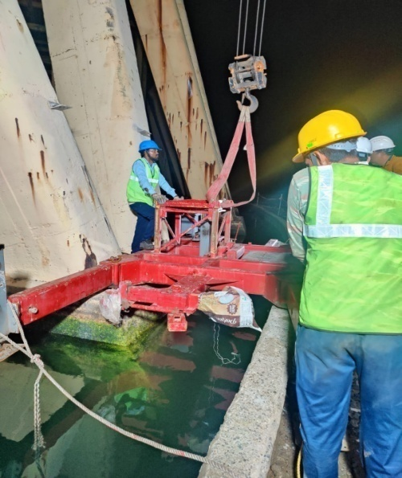
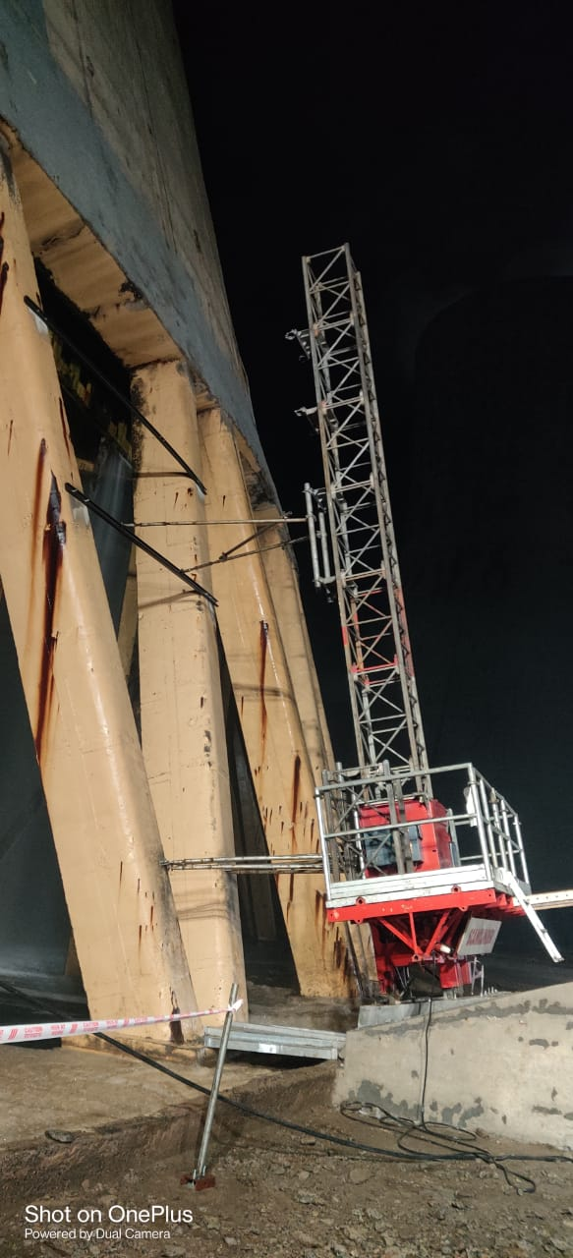
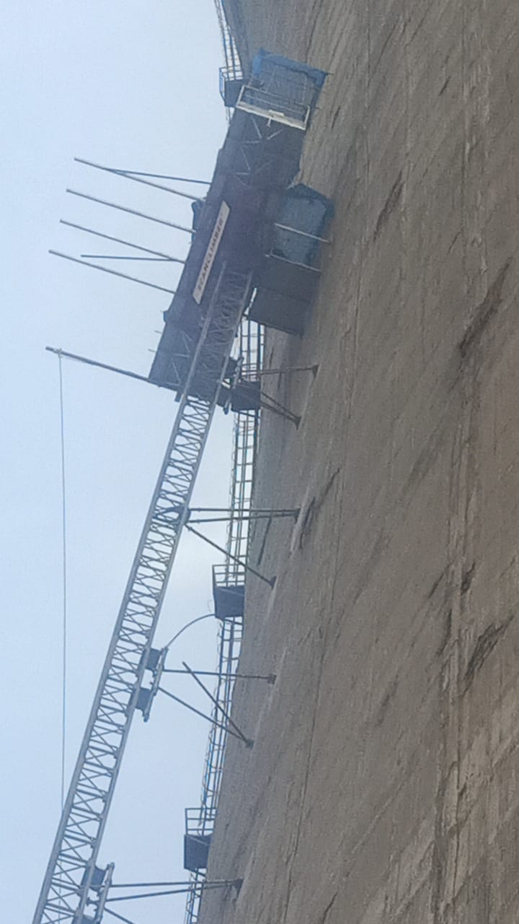
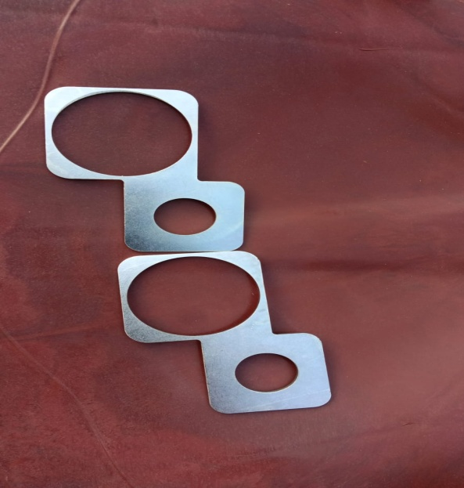
Mast climber erection
Mast climber erection includes
Fixing of base frame to bear the load of the climber. Fixing of mast one over the other and securing them with bolts.
Fixing of lateral supports using an extendable platform on to the surface of the cooling tower to align the climber and support it against lateral forces due to high winds in coastal region.
At NTPC or rather in India, previously a mast climber has never been installed on a cooling towers with hyperbolic curved surface. Special Inserts were used for creating curvature of the mast climber to match the curve of NDCT.

Slide 13
Mitigation of Challenges during Mast climber erection
Foremost challenge was SAFE ERECTION of the mast climber in the zone of falling concrete pieces. Loose Concrete pieces were falling due to the vibrations caused by drilling the supports.
Mast climber modified in house and a 3 layer mesh covering created for safety of workers doing the erection of the climber. Similar protection also created for the extendable platform to mitigate the risk of falling concrete while fixing the lateral supports.
Erection of the mast climber on a Hyperbolic structure
Due to the curve of the cooling tower, the length of the lateral supports was increasing, making the erection challenging. Hence the erected structure dismantled, design & location of base frame modified. Erection started again with modified base frame and modified slope.
Lateral supports were provided to ensure SAFETY and STABILITY of the climber.
Slope corrections were done using special inserts to change the slope of the climber after fixing each lateral support.

Slide 14
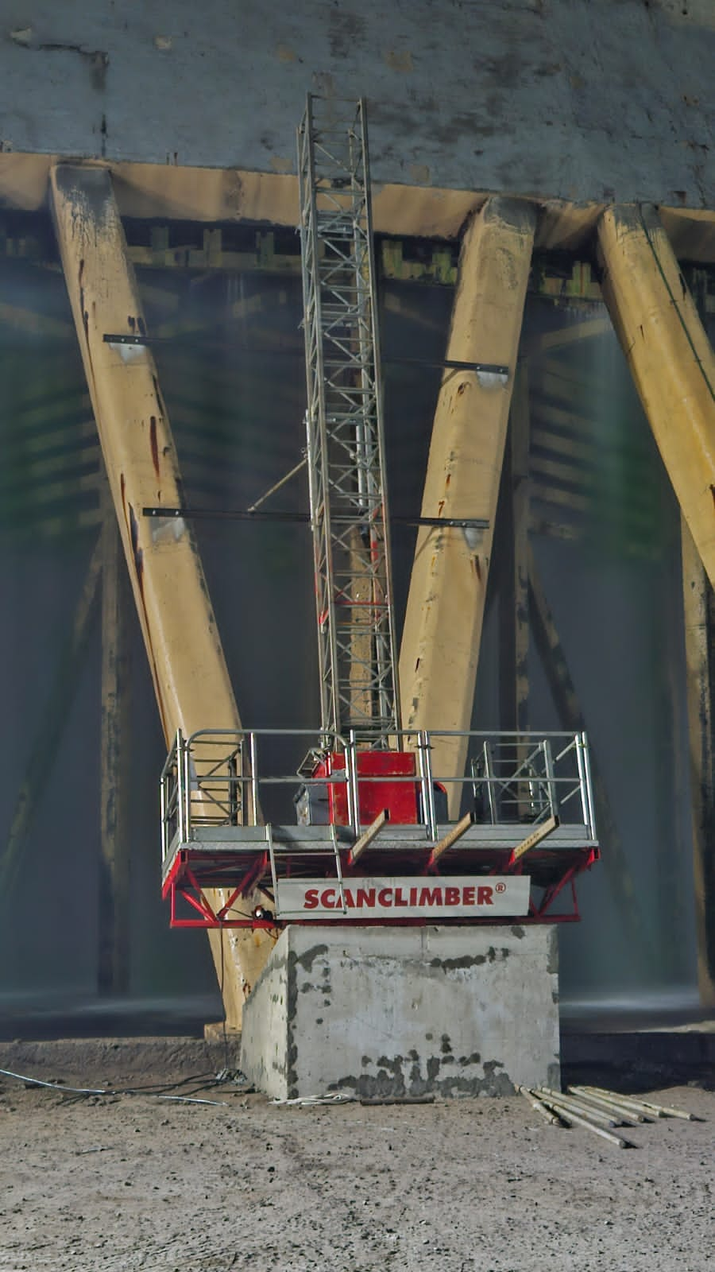
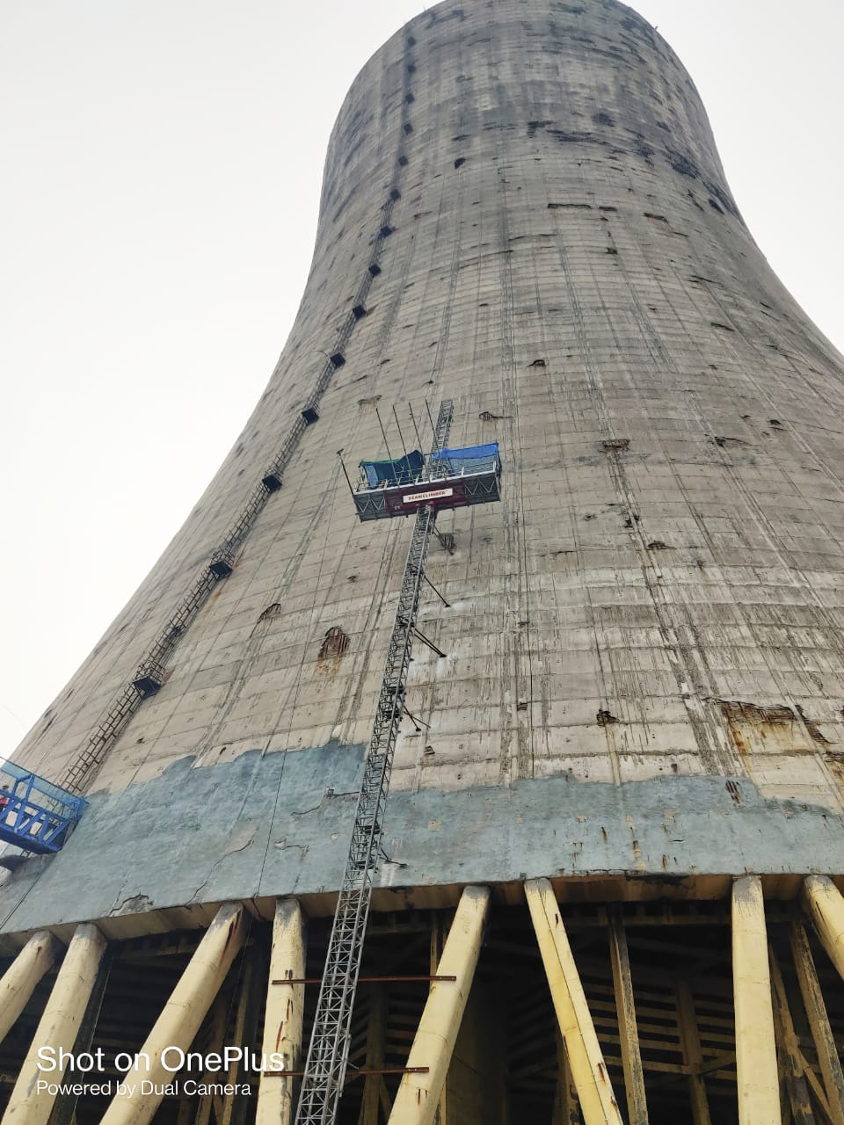
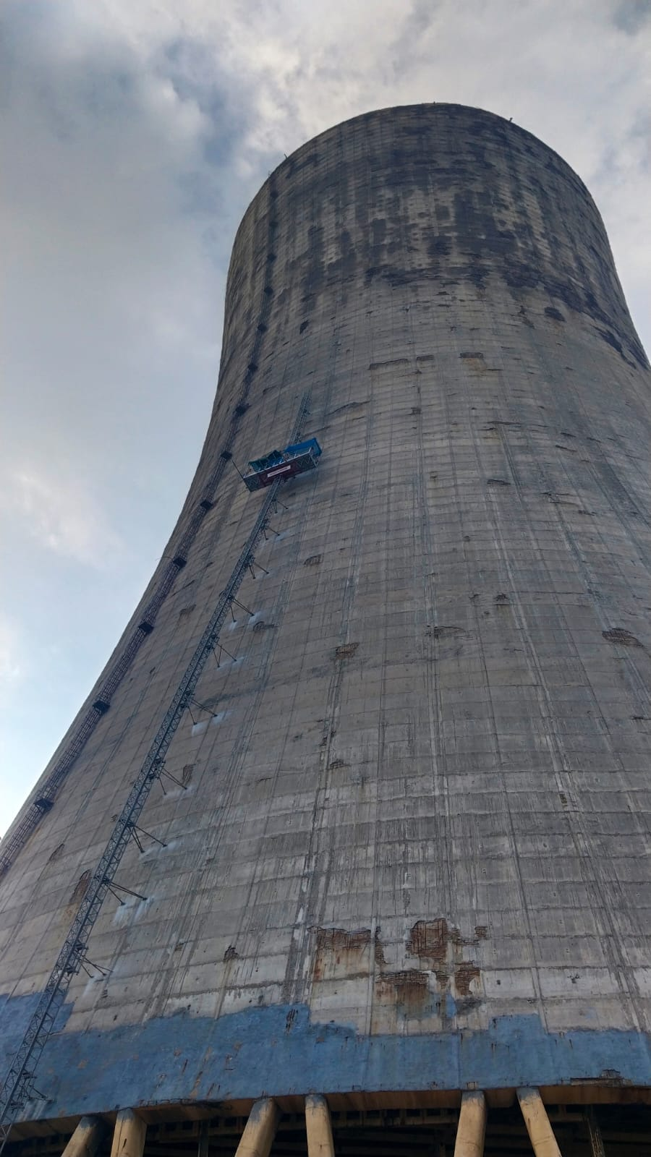
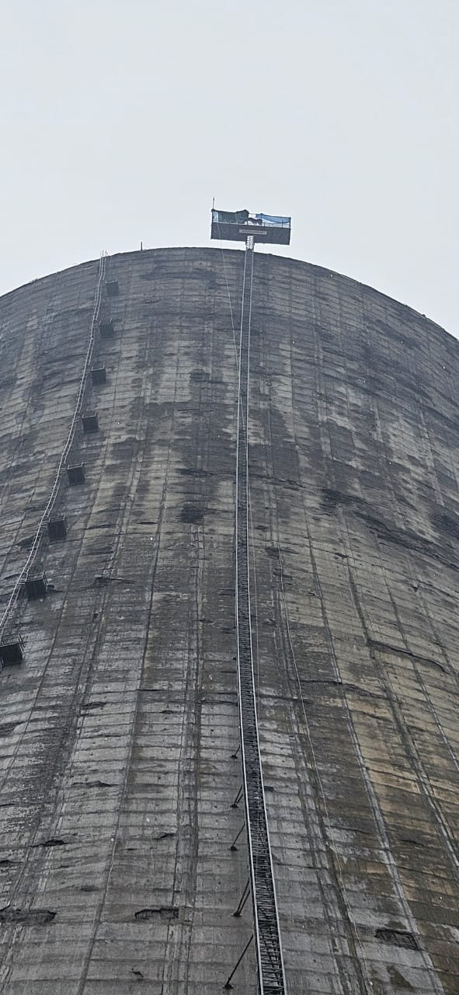
MAST CLIMBER ERECTION
The Mast climber SC5000 was procured, erection started on 17 Nov’23 and completed on 03 Dec’23 .

Slide 15
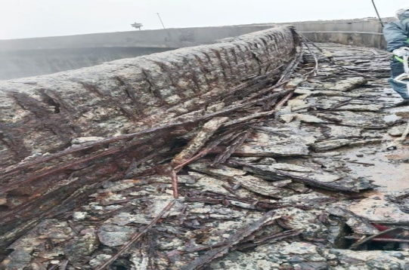
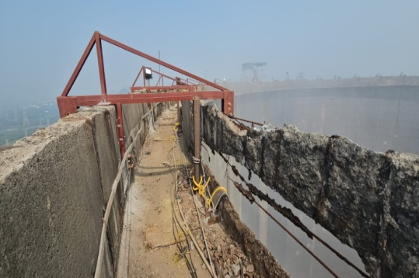
Fixing of Brackets
After erection of the mast climber, a life line was erected which was supported at a distance of 3 meters along the TOP circumference of the NDCT to facilitate safe movement of workers.
This was followed by the inspection of the TOP surface and parapet wall of the NDCT.
Contrary to the previous findings of the Drone survey, the Parapet wall had limited strength at most of the places.
Bracket design modified and support / anchoring done at the platform to overcome the challenge due to damaged Parapet wall.
22 numbers modified brackets were finally installed and erection of RSP was started.

Slide 16
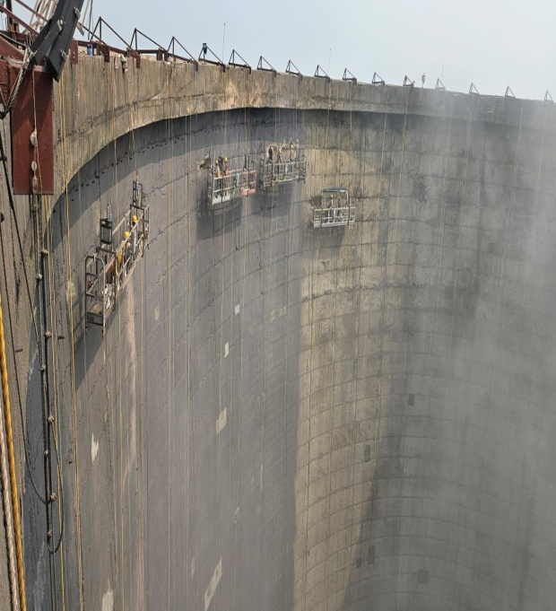
Installation RSPs
Installation of RSP`s
Rope Suspended Platform (RSP), is electrically operated temporarily installed suspended access equipment, which is a suspended manned facility for work at heights by relying on a movable platform driven by motor.
It is designed to suspend along the vertical surface of any structure by steel wire ropes through the suspension mechanism placed at the top of any structure.
22 numbers RSP`s were installed inside the NDCT and load testing by competent person was done

Slide 17
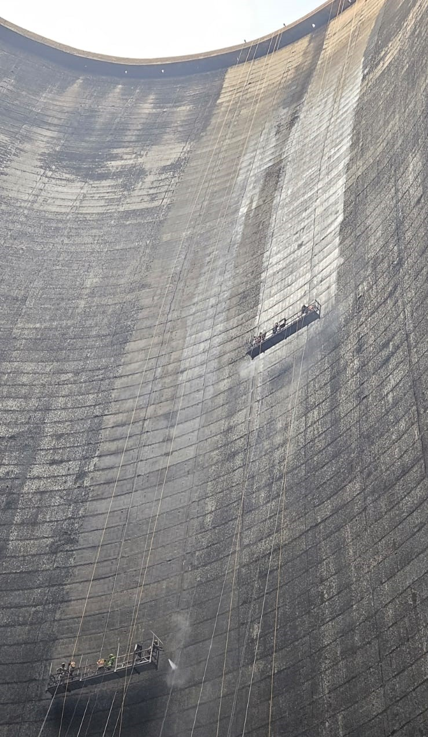
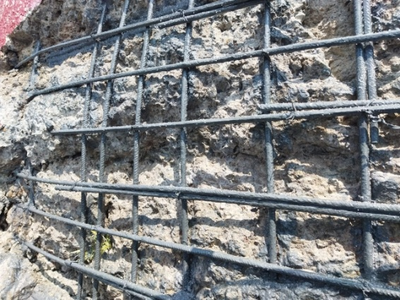
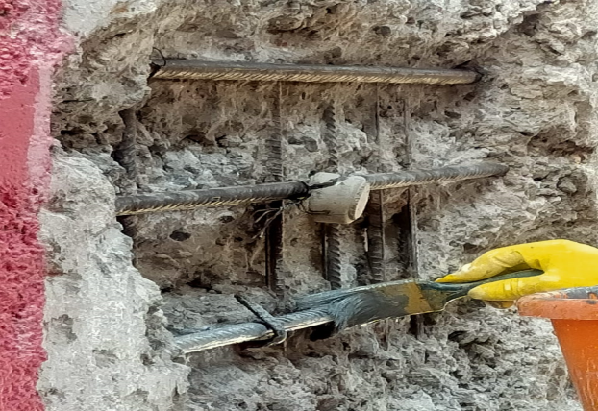
Repair of NDCT
Repair Process:
Chipping, removal of loose concrete by water jetting
Rust Removal & providing additional reinforcement
Applying anti-corrosive coating
Fixing sacrificial anode
Applying epoxy bond coat
Applying polymer modified concrete

Slide 18
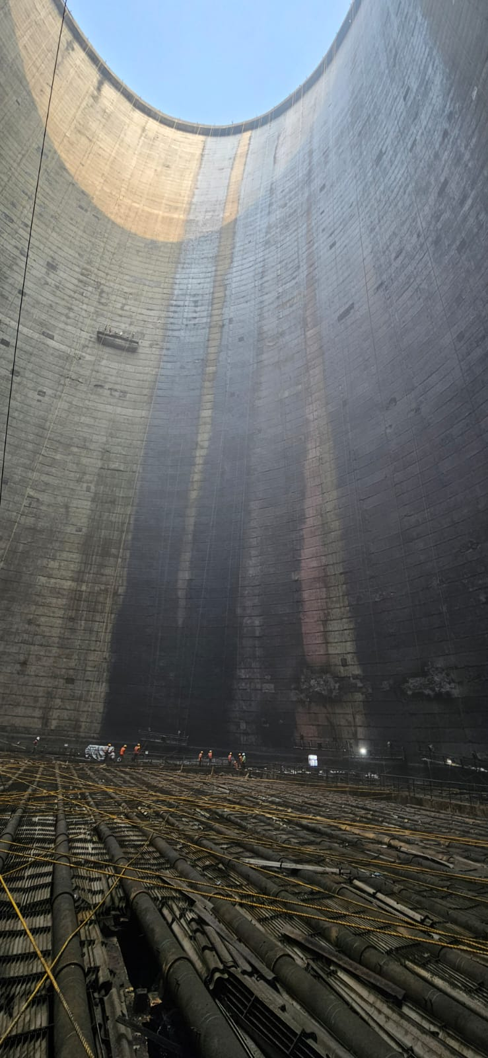
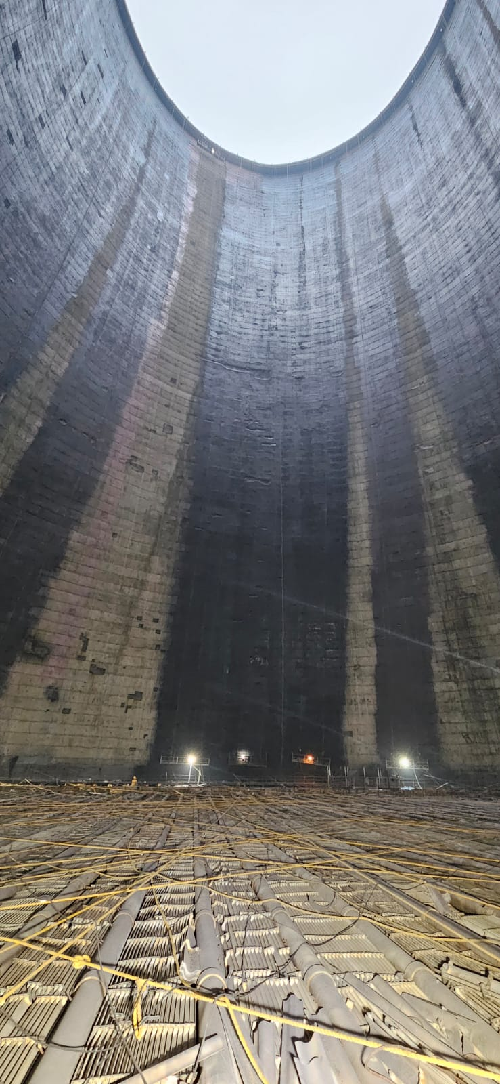
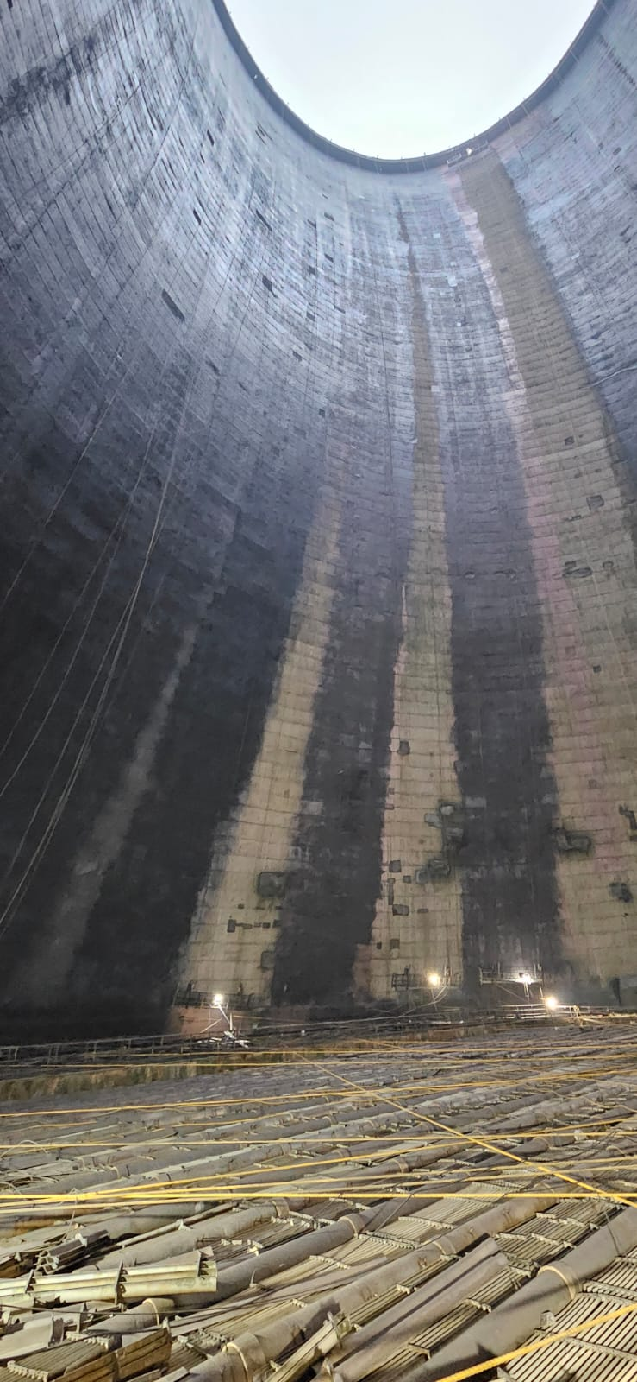
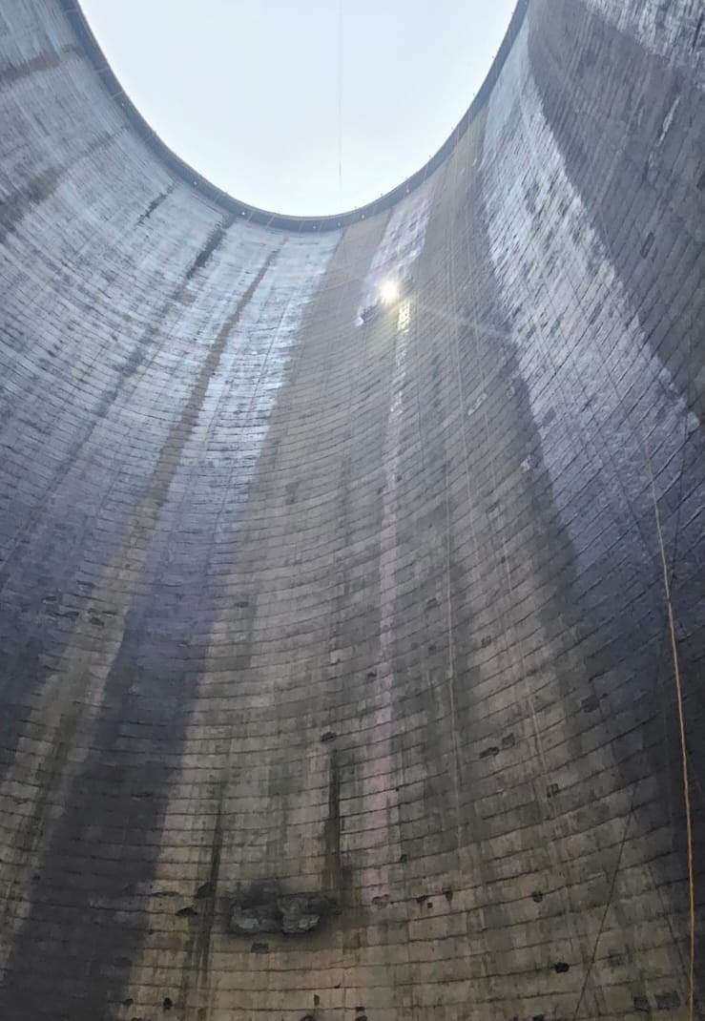
Painting of NDCT
Painting:
Surface preparation: Penetration coat
MCU primer: 2 coats of Primer of DFT 200 microns.
Top sealing coat: Moisture cured urethane (MCU) - DFT 50 microns

Slide 19
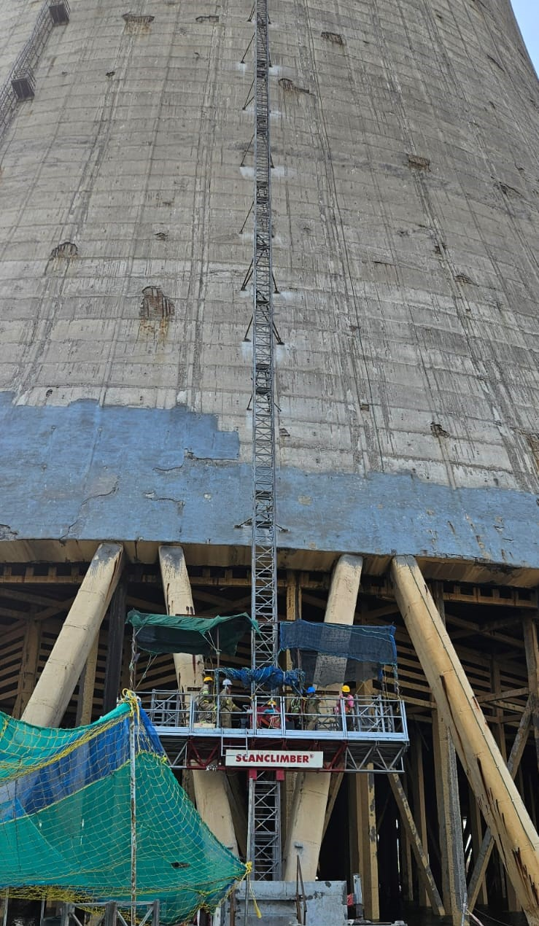
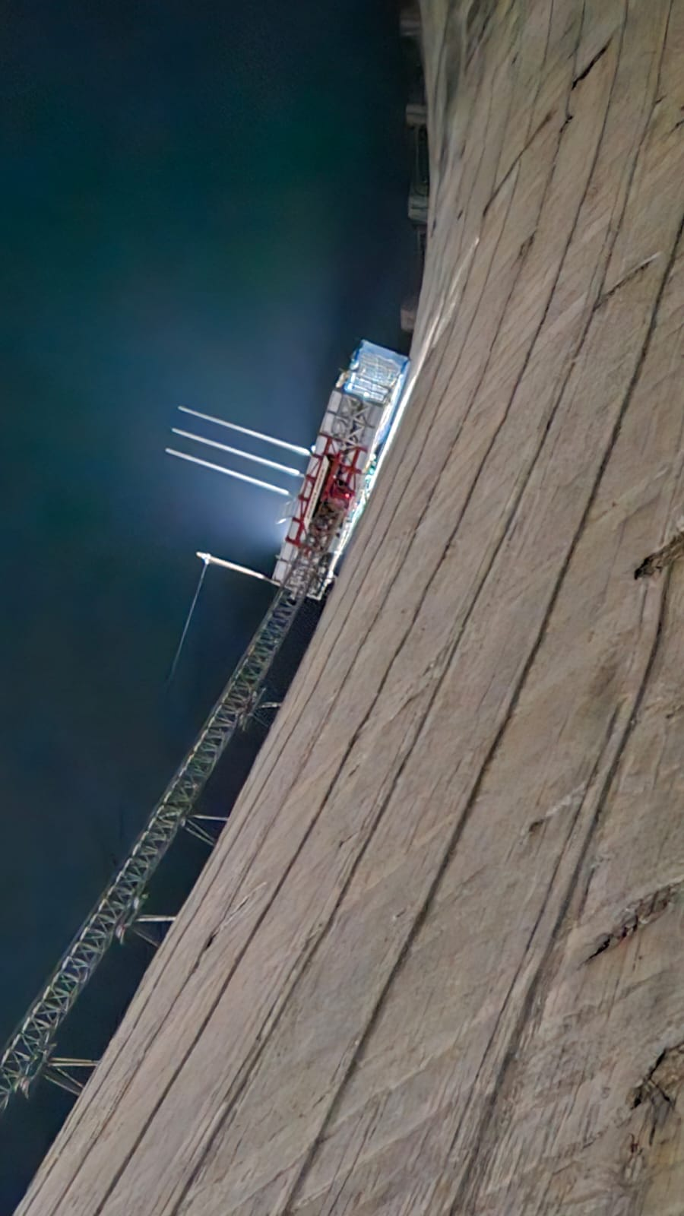
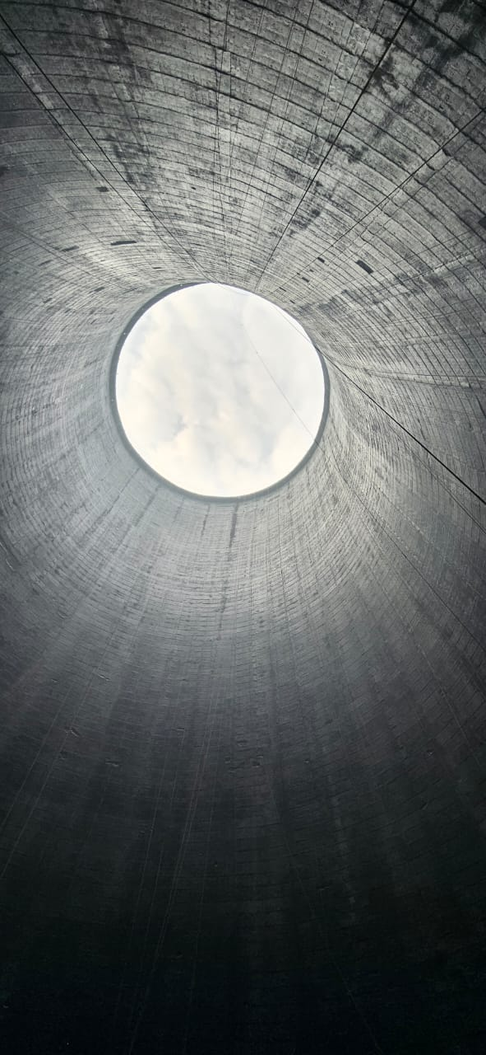
Repair of NDCT-1 with Mast Climber- First time in India

Slide 20
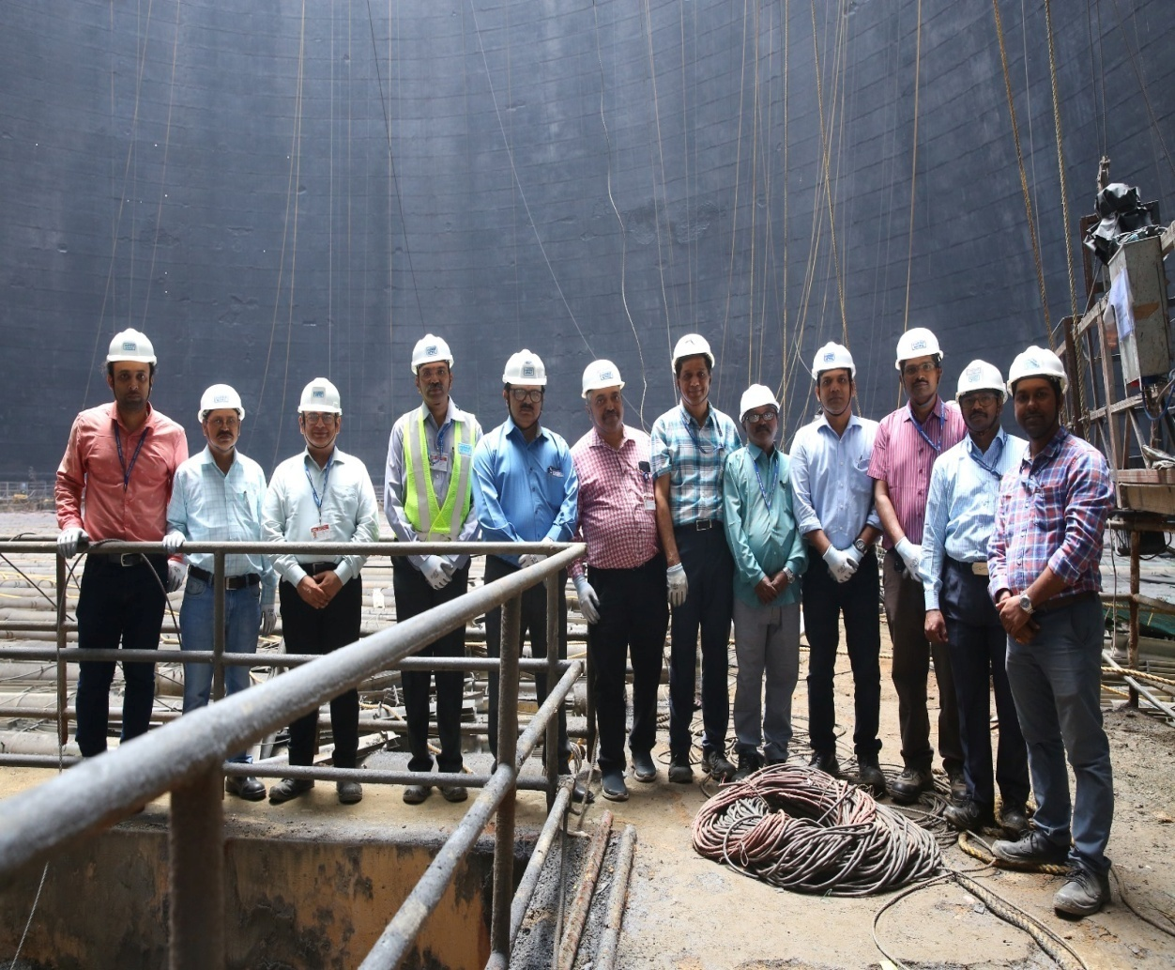
Conclusion
The Paper demonstrates the challenges faced & method adopted for safe repair of NDCT-1 for life enhancement for ensuring sustained Operation of NTPC Simhadri.

Slide 21
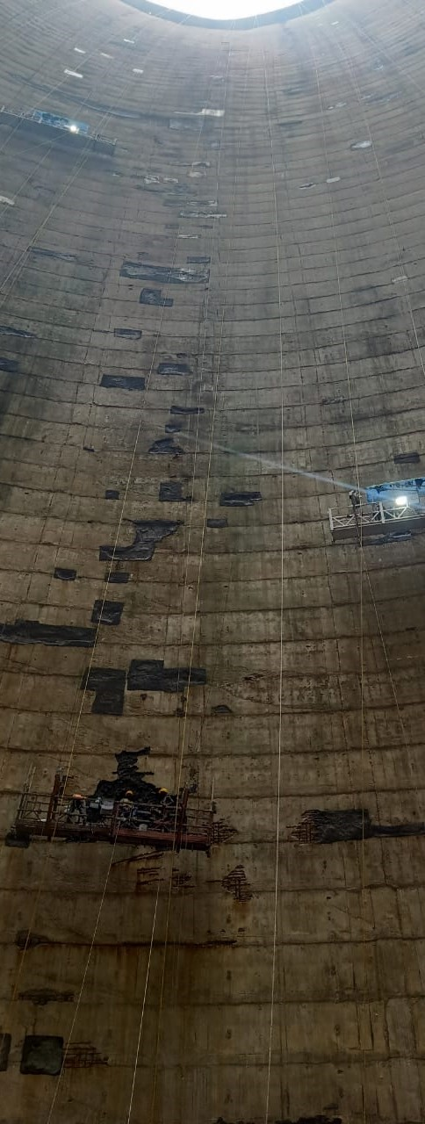
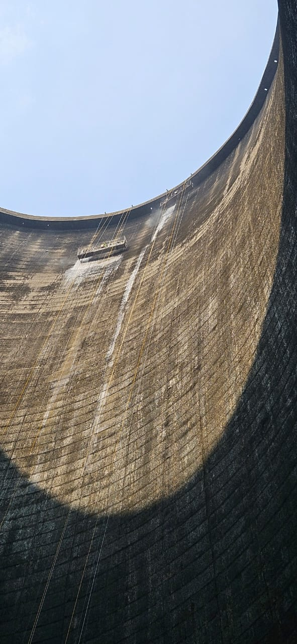
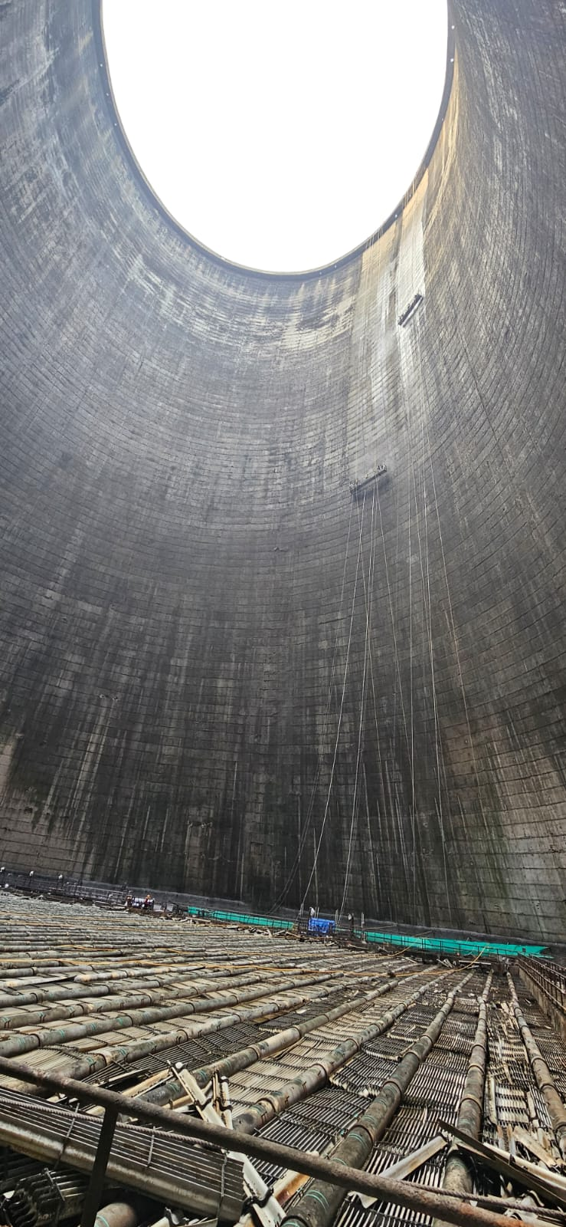
NDCT Internal Surface before Repairing & Painting

Slide 22
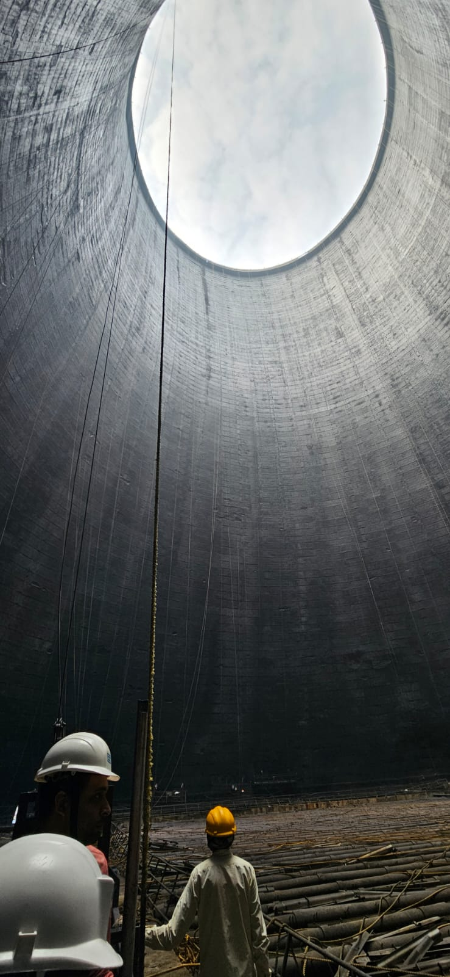
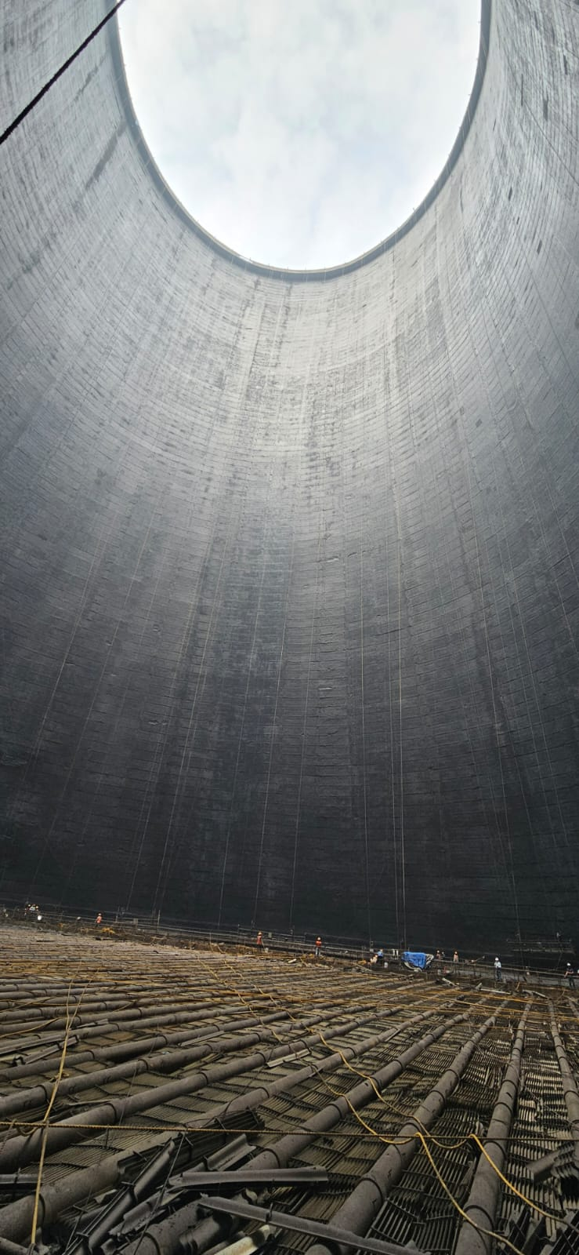
NDCT Internal Surface after Repairing & Painting

Slide 23
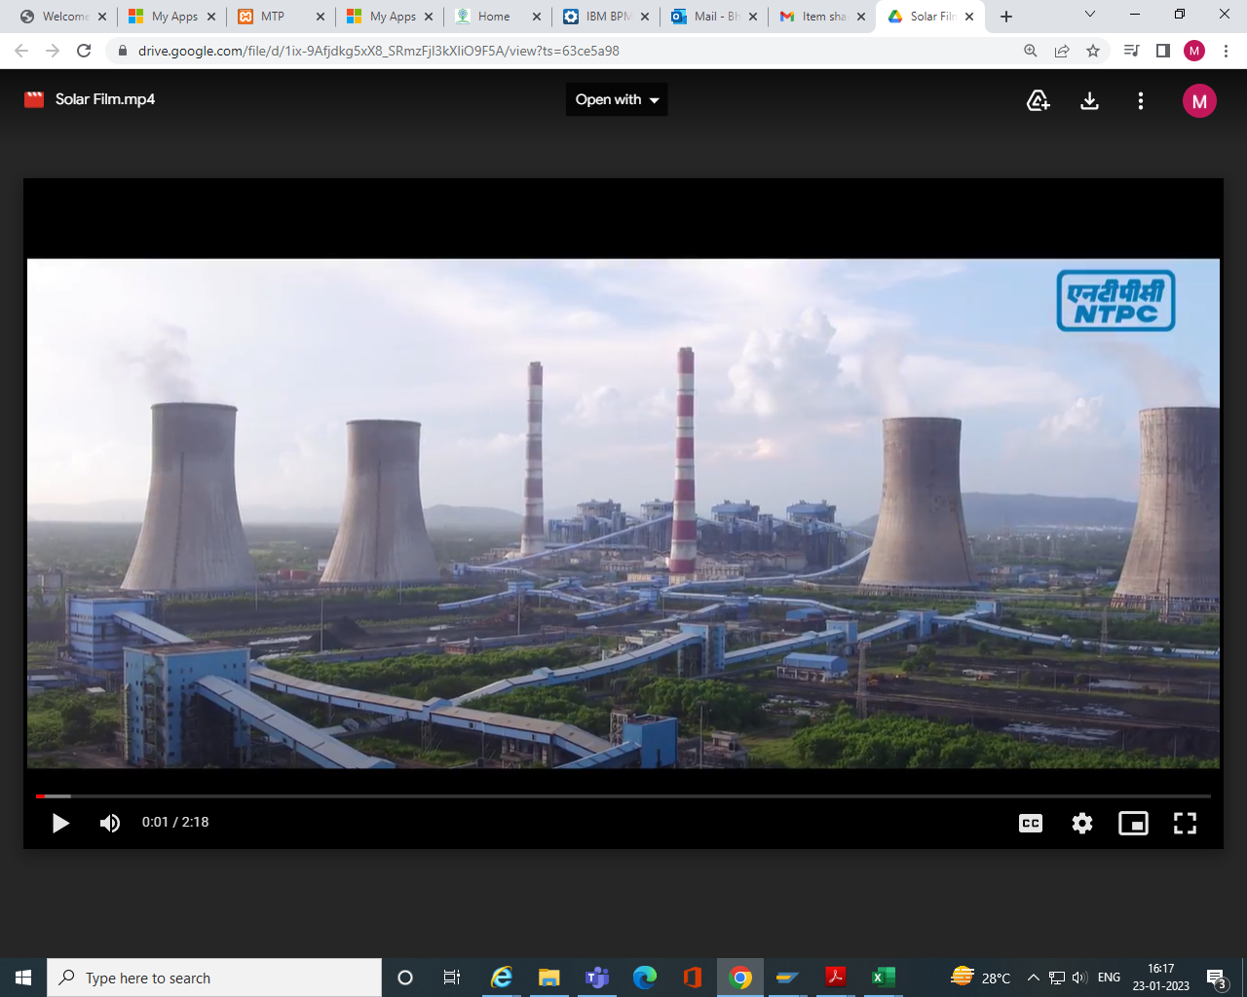
Way Forward
The paper enumerated two major themes:
1. Erection of an Access system for high rise structures
NTPC has many high-rise structures like chimneys, conveyor gallery supports, silos, etc., which are very difficult to access.
Mast climber methodology provides a safe access system, which can be replicated for high rise structures in a time effective manner.
2. Repair and coating of NDCT
  NDCT 1 - Internal repairing completed. External repairing works started.
  NDCT 2 – Installation of Mast climber completed. External and internal repairs & painting to be done.
  NDCT 3 & 4 - Repairing and painting works completed.

Slide 24
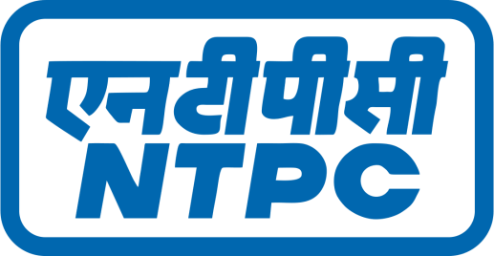
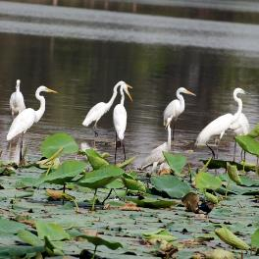

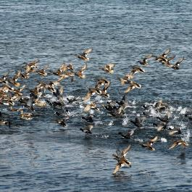

Migratory Birds at NTPC Dadri
Thank You
Website: www.ntpc.co.in
Follow us on:
/ntpc1
/ntpcltd1
/ntpclimited
/Company/ntpc
/ntpclimited

