Slide 1
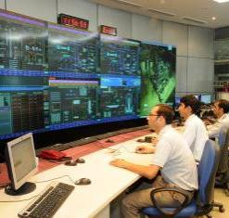
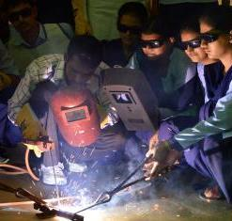
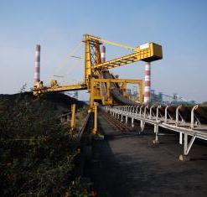
IPS 2024
RAMAGUNDAM
Notes:
1

Slide 2
IN-HOUSE DEVELOPMENT (DESIGN, FABRICATION & PROGRAMMING) OF BELT PATCH OPEN DETECTION SYSTEM FOR CONVEYOR BELTS IN NTPC RAMAGUNDAM.
Atul Krishna Gaikwad
Ratan Kumar Gulipilli
Devendra Patil

Slide 3
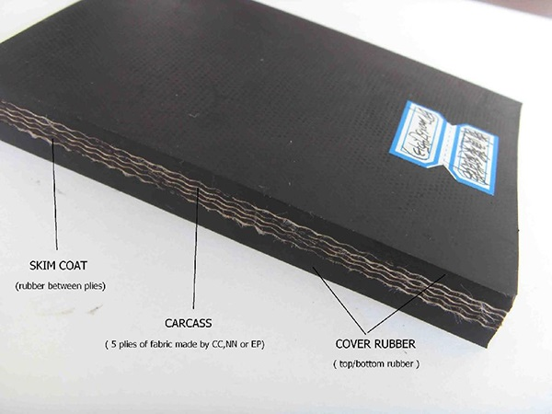
Introduction
Coal Handling Plant (CHP) of RSTPS uses fabric conveyor belts for transporting coal. Fabric conveyor belts are made by sandwiching many synthetic fabric layers between rubber layer through adhesive rubber called skim rubber.
Conveyor belts come in typically 200/250 meters length rolls.
Belts are mainly joined through cold/hot vulcanizing method to achieve required length and to complete the loop.
In conveyor system belt joint are the weakest part and prone to damage.
It contributes to highest inventory of CHP.

Slide 4
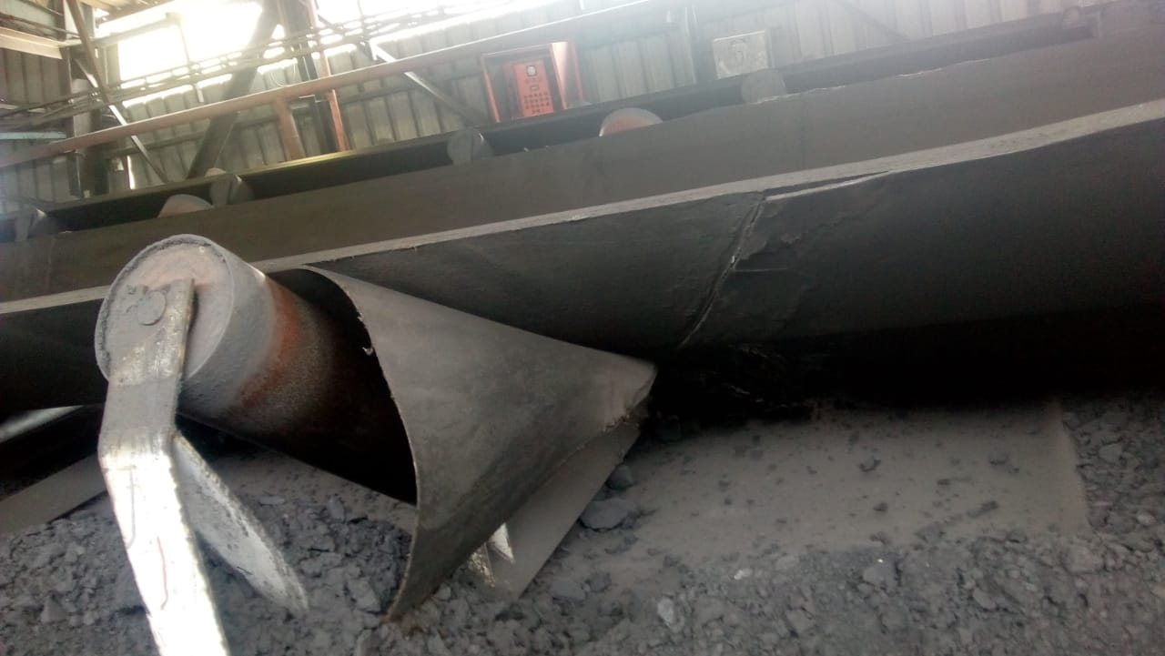
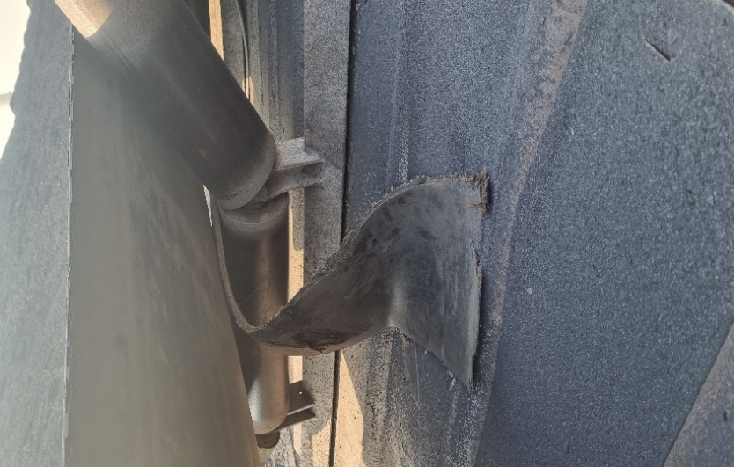
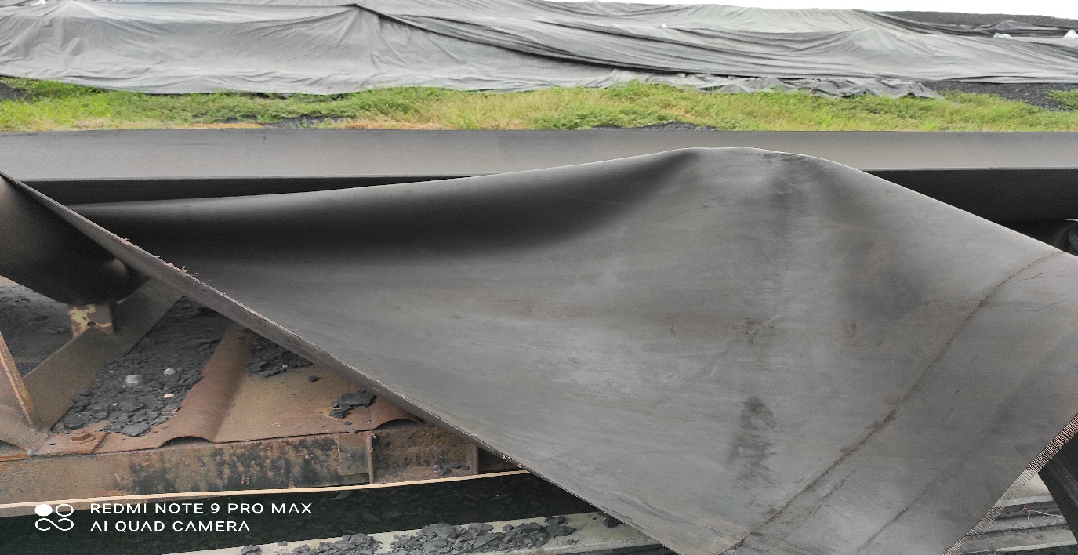
Introduction of Problem
Belt patch opening is a common and serious problem in CHP. Presently this problem is detected by location workers in initial level and get attended.
If this problem, go unnoticed and belt patch stuck up in nip points and joint opened beyond repair then this led to high restoring time of system and may further lead to generation loss.
Planned belt replacement works takes almost 12 hrs. and Unplanned belt replacement work takes more than 24hrs.
Hence timely detection of belt patch is the need of hour.

Slide 5
Breakdown Analysis
Data from 01.01.2020 to 31.12.2022

Slide 6
FISH BONE DIAGRAM ANALYSIS
MACHINE
ONE SIDE FEEDING
MAN
Water/dust ingress
Roof sheet
Damaged Blade
COAL BUILD UP
Improper Scraper/skirt rubber
DEFLECTOR DAMAGED
HOUSE
KEEPING
Poor Adhesion/Solution
IMPROPER CHUTE DESIGN
IMPROPER POSITION
PILE HEIGHT IS HIGH
Over tensioned
BELT SWAY
LACK O F KNOWLEDGE
Improper Belt Joint
STRINGER MISALIGNMENT
TAKE UP MISALIGNMENT
LACK OF
KNOWLEDGE
Coal build up
CARRYING FRAME MISALIGNMENT
IMPROPER
FEEDING
LACK OF SKILL
DAMAGED FRAMES
BELT TENSION
BOOM AT MAX
HEIGHT
BELT SLIP
CONV STRUCTURE MISALIGNMENT
IMPROPER CLEANING
OF CHUTED
LACK O F KNOWLEDGE
Old belt
IDLERS
LACK OF SKILL
ROLLERS JAM
LACK OF KNOWLEDGE
ROLLER SHELL DAMAGE
Belt Joint Patch open/Belt joint damage
LOAD ON BELT
ZERO SPEED
SWITCH FAULT
OVER LOADING
SLURRY COAL
PROBE DAMAGE
COAL QUALITY
INTERLOCK FAILURE
BOULDRES
WET COAL
SUPPLY
FAILURE
SCREEN DAMAGE
CONTROL SUPPLY /PLC FAILURE
POOR MAINTENANCE
TRIP CIRCUIT FAILURE
IMPROPER CRUSHING
MATERIAL
PROTECTIONS& INTERLOCKS
6

Slide 7
Fish Bone Diagram Analysis
Through fish bone diagram analysis and rigorous brainstorming sessions we have conclude that there are many reasons that lead to belt patch open/damage issues.
We have categorised causes into Man, Machine, Material & Protection Interlocks categories.
We have observed that belt joint gets opened or damaged mainly due to Poor housekeeping, Belt sway, Improper feeding, Improper scraper, water and dust ingress into the joints, wet coal handling or chute chocking etc.
Through root cause analysis, we came to deduction that we can minimize the chances of belt patch opening through best operation & maintenance practices but cannot eliminate the problem totally.

Slide 8
Solution
We have surveyed in market for solutions which are suitable for the fabric conveyor belts but did not find suitable solution. After intense brainstorming we have come to the following conclusions:-
a) We can increase the deployment of manpower for continuous observation of all belts.
b) To develop a system for automatic detection of belt patch opening.
The cost of deployment of manpower is very high and they are always prone to human errors. Hence, we decided to develop a system to identify belt patch opening automatically at the initial stage.

Slide 9
Action
We observed several behaviors of opened belt patches during running of conveyor belts and
keenly studied them and identified that opened belt patches while coming to the return side of the conveyor belt, the patch or layer of the belt hits along the return idlers with some intensity.
Hence, we decided to use this force of the running belt patch to develop a system to detect it.
We have discussed the use of many sensors like force sensors but due to many restrictions like patch location, size of the patch, we zeroed the use of tilt sensor.
Hence, we decided to design a mechanical system which will operate with the hitting of opened belt patch and activate tilt sensor.

Slide 10
Mechanism
BELT PATCH
FLAP
SENSOR
ARDUINO
ALARM/SIREN
We experimented with the flap mechanism wherein the flap gets operated while it is hit by belt patch and operates a tilt sensor connected to a flap.
The tilt sensor measures the angle of tilt, and this angle is measured by Arduino.
The Arduino activates the alarm after processing the tilt senor data and activates the alarm. The alarm is a local siren which gets activated when the flap gets hit by the patch.

Slide 11
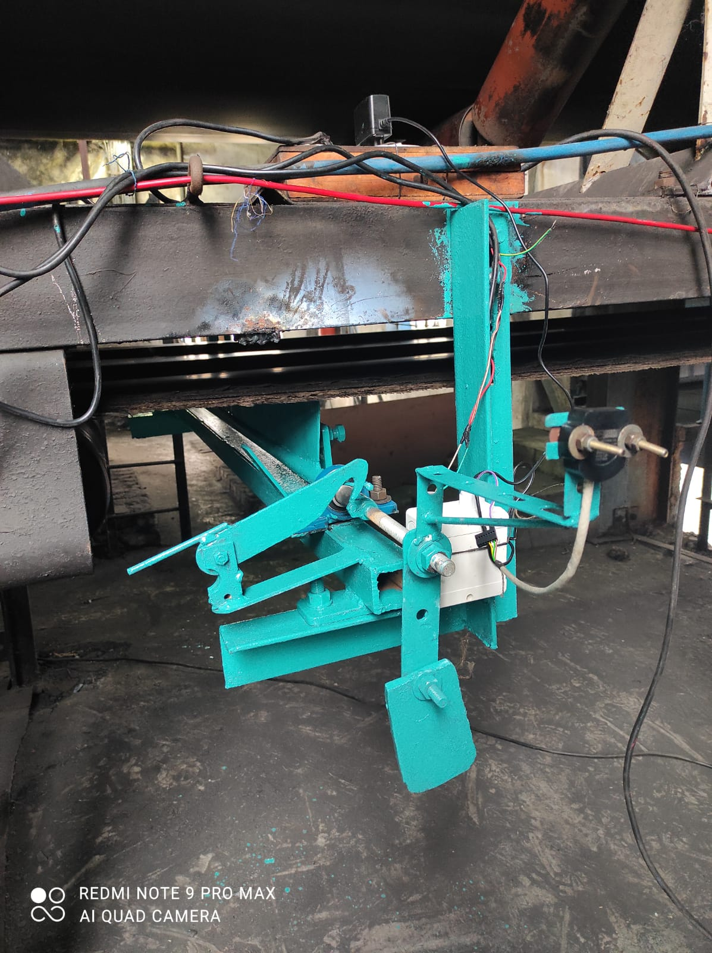
Proof of Concept (POC)
Locking Mechanism
FLAP
Tilt Sensor
CPU UNIT
Counter Weight

Slide 12
POC in Action

Slide 13
Cost Benefit Analysis
Cost of Belt patch detection System:
Cost of manufacturing and supply of BPDS= Rs 25000.00/unit
A) Total cost for all conveyor= 67 nos. belts* 25000.00=Rs 1675000.00
B) Cost of power and control cable= Rs. 1800000.00
Cost of installation= Rs. 3000/unit
C) Total cost of installation= 67*3000= Rs. 201000.00
Hence total cost for Purchase & Installation of BPDS in 67 belts of CHP Ramagundam = A+B+C=1675000+1800000+201000= Rs. 36.76 Lakh

Slide 14
Cost Benefit Analysis
Financial impact of problem:
As per past data & experience there is an average 200 mtr approx. belt gets damaged every year due to belt patch opening if not detected timely.
A. Cost of 200 mtr conveyor belt= INR 1099400.00 (average price of conv belt Rs. 5497 per mtr).
B. Cost of replacement of conveyor belt= 186.50 X 200 + 4 (2 joints, 2 occasion) X 23127
= 37300 + 92508
= Rs. 129808
C. Total financial impact of problem per year = Rs. 1229208
Pay Back Period= 3676000/1229208= 2.99 years
*Note – Reduction of maintenance cost is the added advantage.
This saving can also be incurred in all other NTPC plants.

Slide 15
Intangible benefits
Stress on Location workers will be reduced.
Stress on Control room executive will be reduced as they will be able to identify problem at early stage and shut down of system will not be required for longer period.
Stress on maintenance workers and executives will be reduced due to lesser unplanned belt work.

Slide 16
Conclusion
It is said that the Coal Handling Plant is the heart of coal-based power plant which feeds coal to the bunkers for power generation, then conveyor belts are indeed the veins of system.
Any major breakdown in conveying belt may lead to generation loss.
Belt joint patch/layer opening problem is very common in CHP but this small problem may damage belt beyond repair if not detected timely.
We felt the requirement of a product that could detect belt patch opening in initial stage and alarm the control room for its occurrence.
Hence, we developed a product called belt patch open detection system in-house which can detect opened belt patch at the initial stage and can raise alarm.
This idea/product was selected in NTPC Innovation scheme and now we are developing a market ready prototype with the help of NTPC NETRA.

