Slide 1

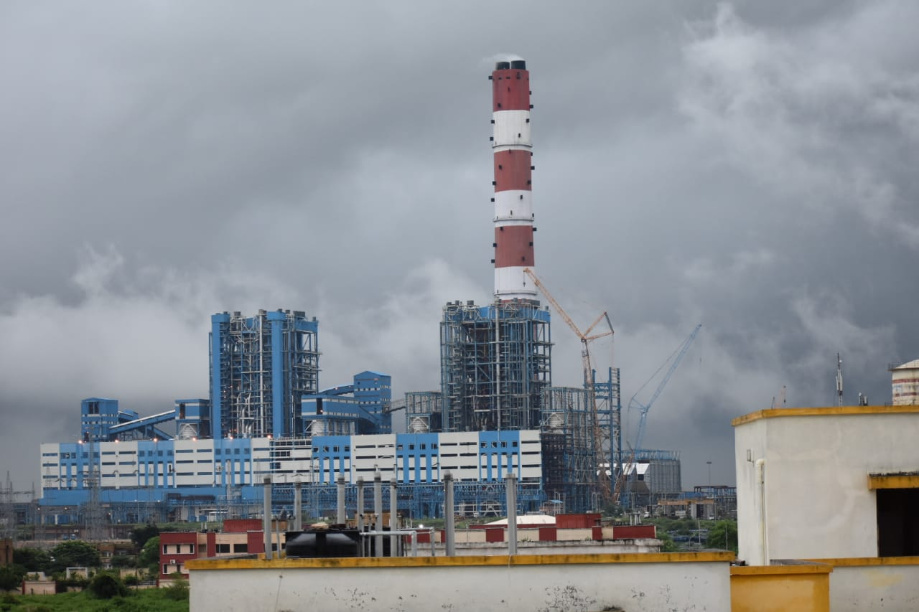
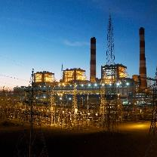
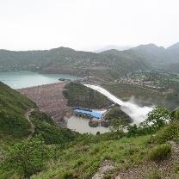
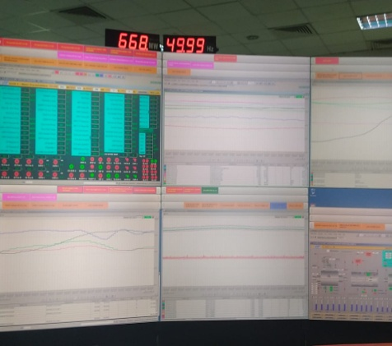
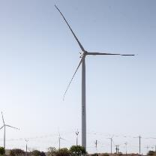
BARH SUPER THERMAL POWER PROJECT
Parag Chatterjee
Senior Manager, NTPC Barh
Maintenance practices for enhancing asset management in EHV substation
Follow us on:
/ntpc1
/ntpcltd1
/ntpclimited
/Company/ntpc
/ntpclimited

Slide 2


ZERO FORCED OUTAGE

Slide 3


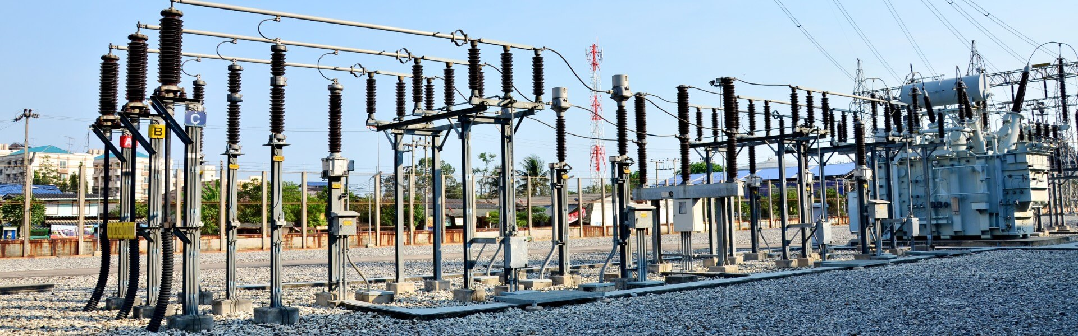


CONTENTS
Asset Management
Safety & Interlocking Design
Case Studies
New Technologies

Slide 4
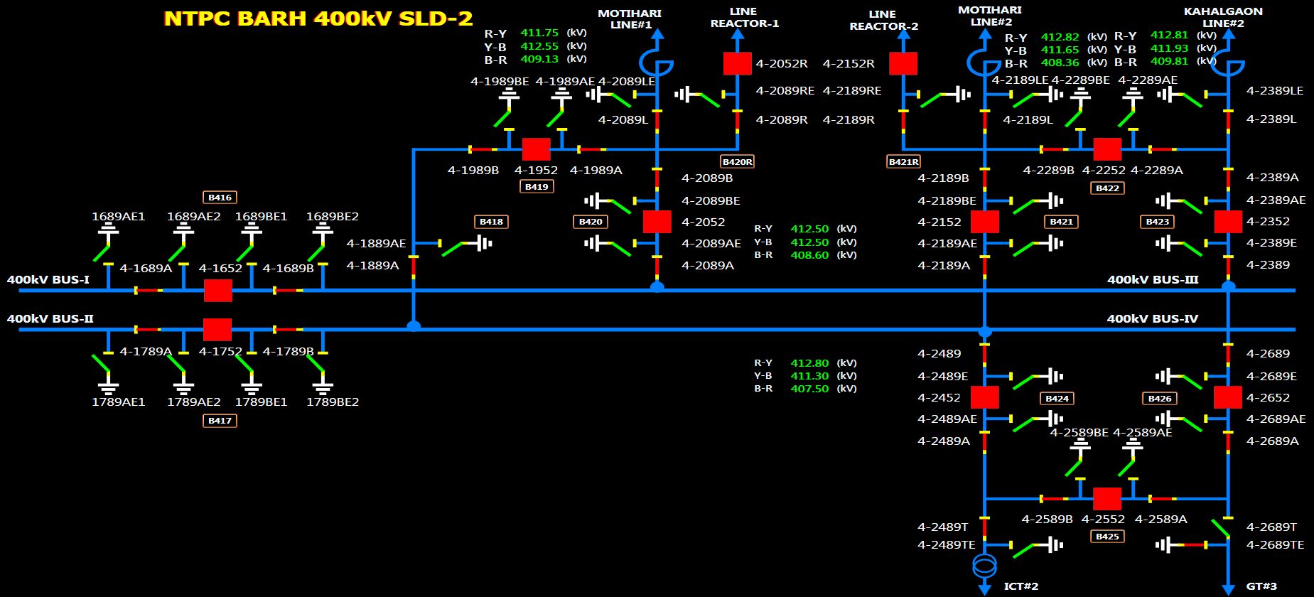
Overview of 400 kV substation (SCADA HMI)

Slide 5
Remote asset management by predictive maintenance

Slide 6
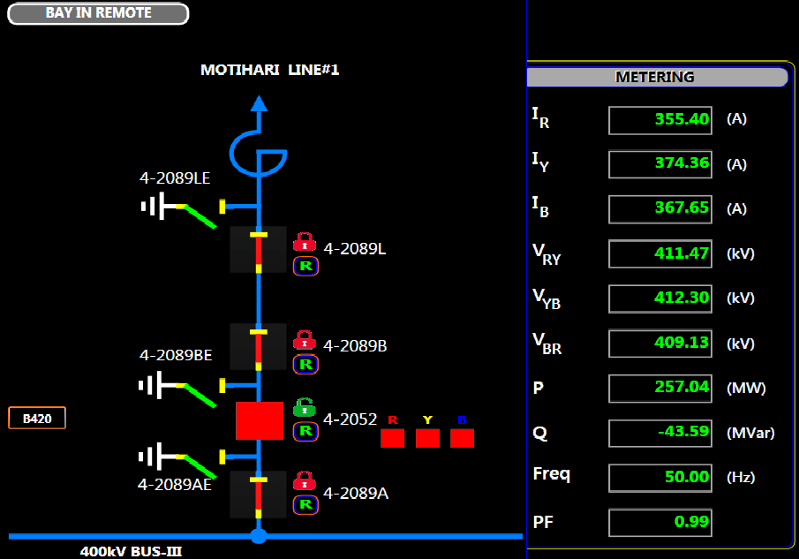
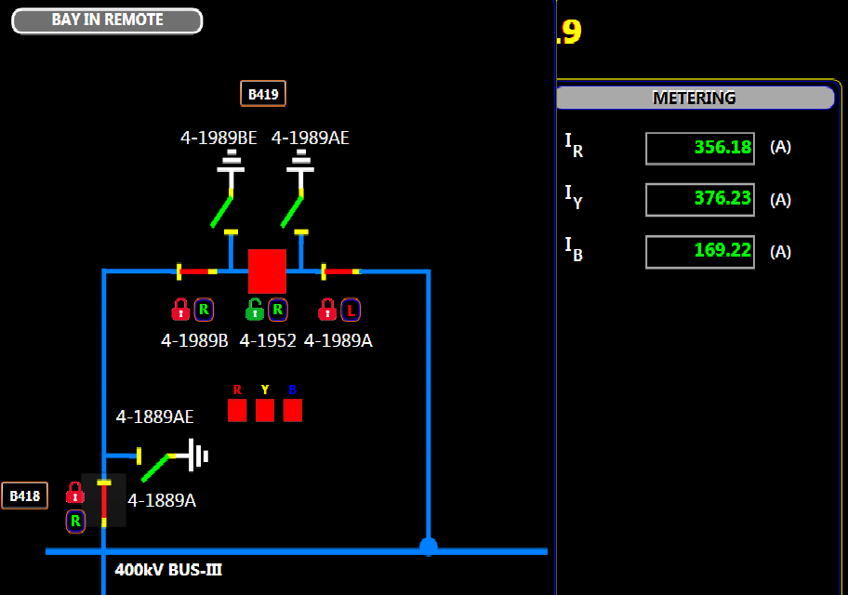
Current sharing across bays

Slide 7
Current sharing across bays before and after maintenance
Ir (TOTAL) | 354 Amps | Iy (TOTAL) | 374 Amps | Ib (TOTAL) | 367Amps
Ir (Main Bay 20) before rectification) | 0 | Iy (Main Bay 20) before rectification) | 0 | Ib (Main Bay 20) before rectification) | 198 Amps
Ir (Main Bay 20) after rectification) | 177 Amps | Iy (Main Bay 20) after rectification) | 180 Amps | Ib (Main Bay 20) after rectification) | 198 Amps
Ir (Tie Bay 19) Initial contribution | 354 Amps | Iy (Tie Bay 19) Initial contribution | 374 Amps | Ib (Tie Bay 19) Initial contribution | 169 Amps
Ir (Tie Bay 19) Final Contribution | 177 Amps | Iy (Tie Bay 19) Final Contribution | 194 Amps | Ib (Tie Bay 19) Final Contribution | 169 Amps

Slide 8
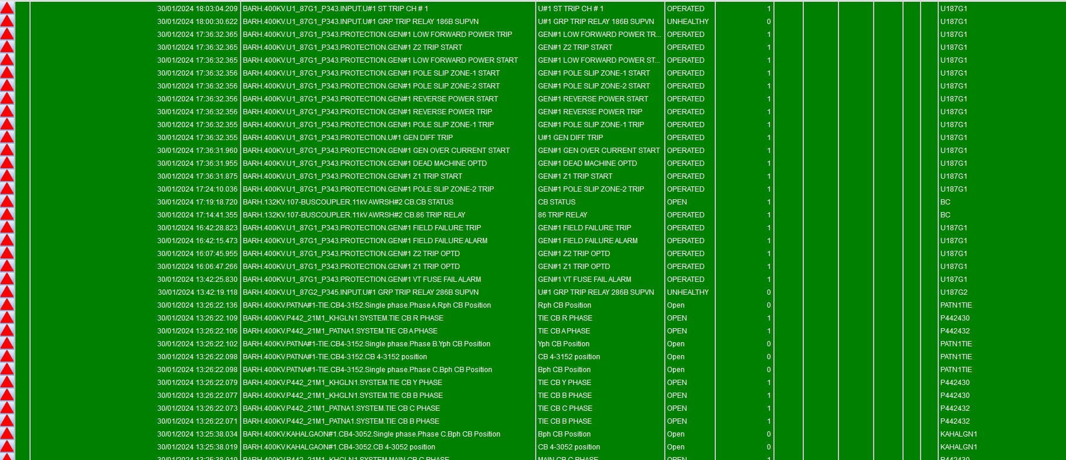
Alarm -Annunciation Dashboard

Slide 9
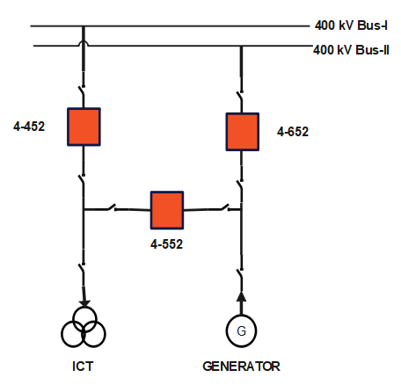
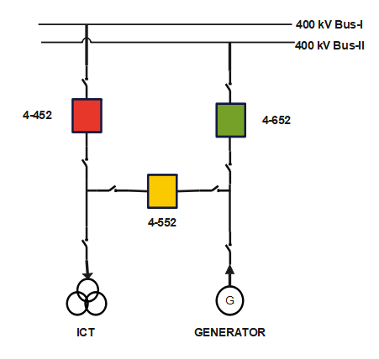
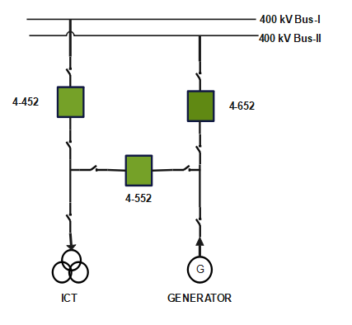
ALARM & ANNUNCIATION DASHBOARD
CASE STUDY 1
Unit in running condition
4-652 Main breaker of Unit
4-552 Tie breaker of Unit & ICT
4-452 Main Breaker of ICT
Unit in tripped condition
4-652 Main breaker of Unit-OFF
4-552 Tie breaker of Unit & ICT-OFF
4-452 Main Breaker of ICT- ON
4-552 conducted in OFF condition
Unit in tripped condition
4-652 Main breaker of Unit-OFF
4-552 Tie breaker of Unit & ICT-OFF
4-452 Main Breaker of ICT- OFF
TIE LBB operated

Slide 10
Fault finding in 400 kV Breaker pole

Slide 11
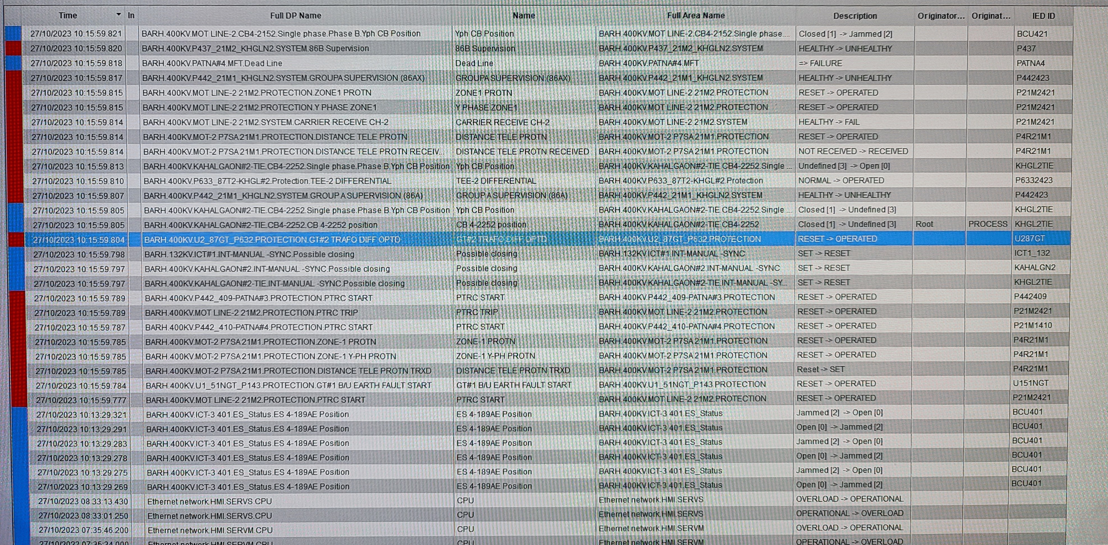
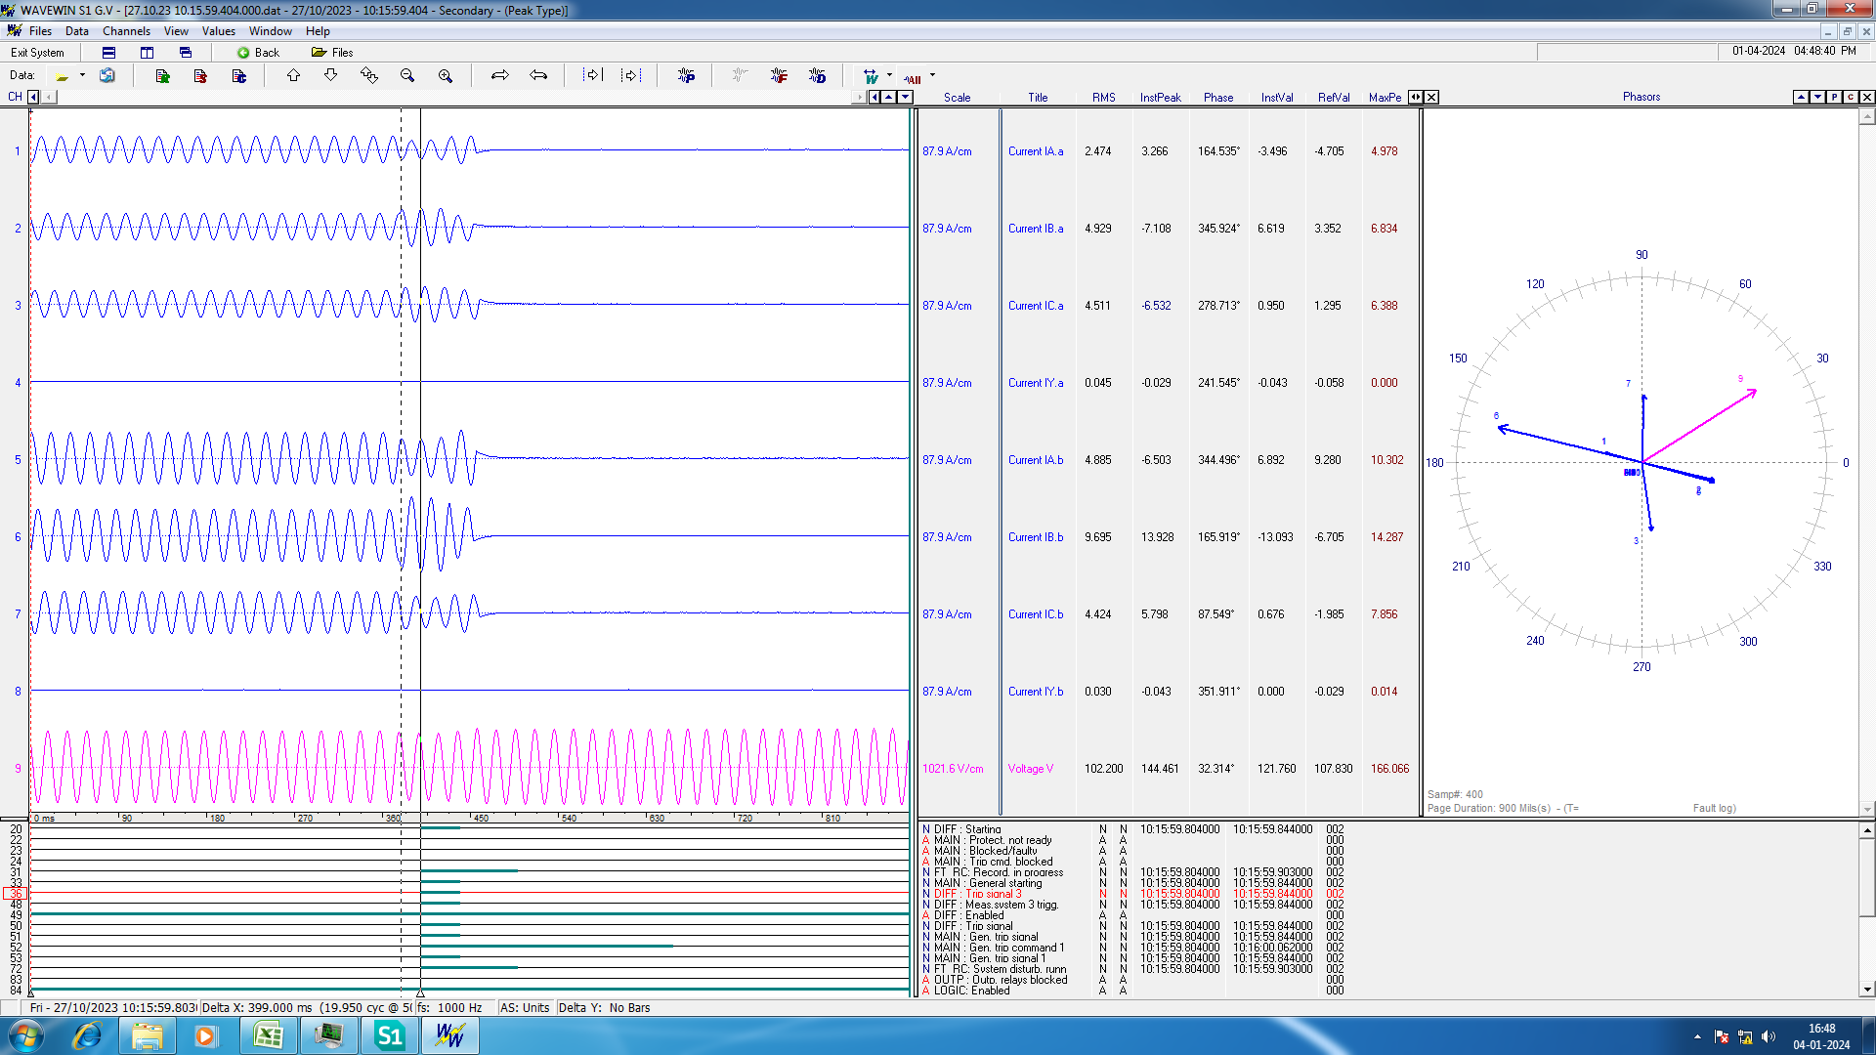
CASE STUDY 2
Events recorded in SCADA
Disturbance recorded in standalone DRPC

Slide 12
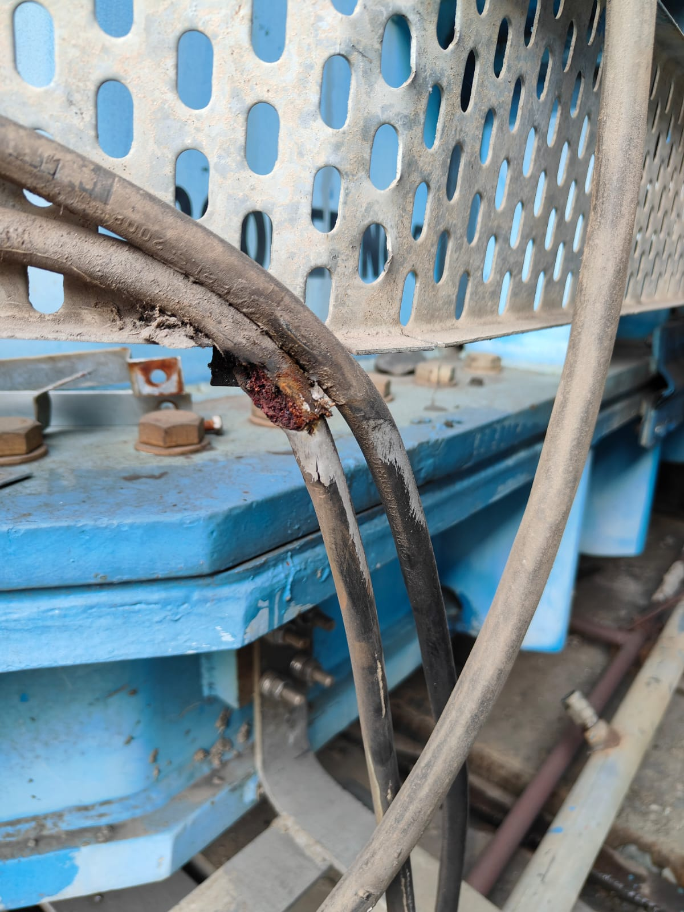
CASE STUDY 2
SCADA dashboard displayed class-A 87GT differential protection
Standalone DRPC connected to remote Generator protection Relays in CCR enabled to analyse the disturbance
Root cause of the problem identified in GT turret CT cable

Slide 13
LINE EARTH SWITCH INTERLOCKING
Clarity in communication to remote desk operator
Additional safety feature
Local closing of E/S enabled only when line voltage < 30% (P-N)

Slide 14
LINE ISOLATOR INTERLOCKING

Slide 15
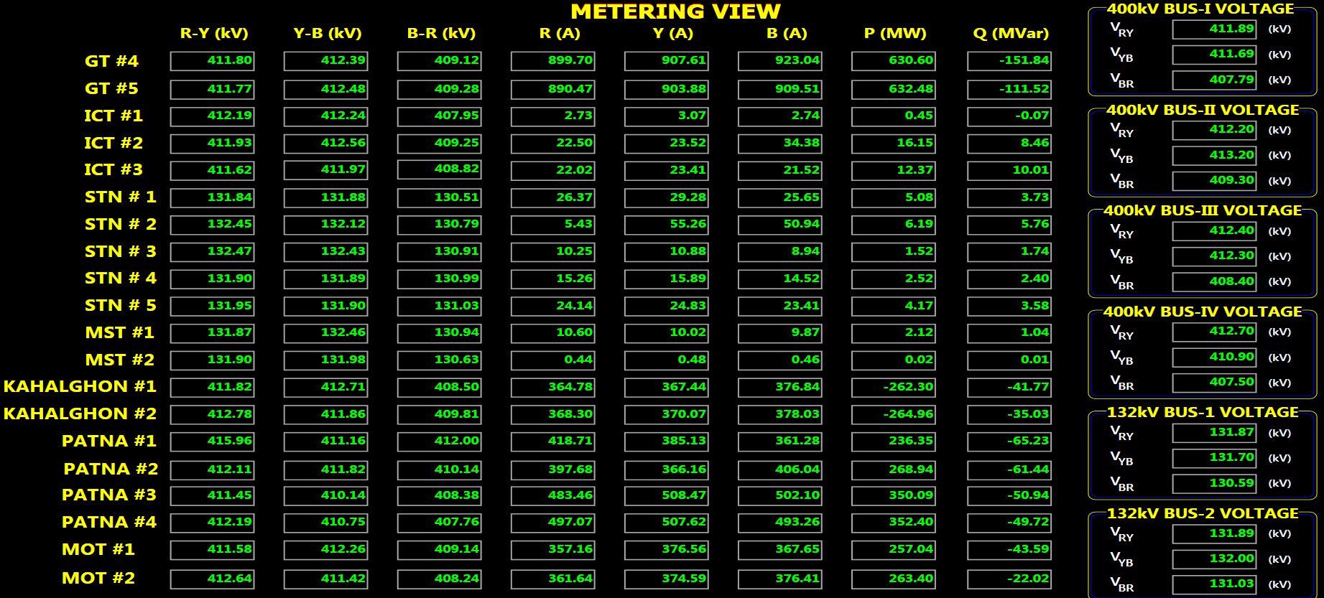
CVT VOLTAGE MONITORING

Slide 16
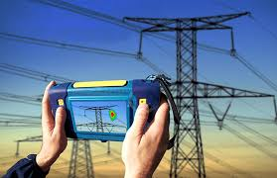
FREQUNCY DOMAIN SPECTROSCOPY
Non-invasive technique
Calculates moisture in solid insulation
Inference on residual life assessment of EHV transformers and bushings

Slide 17
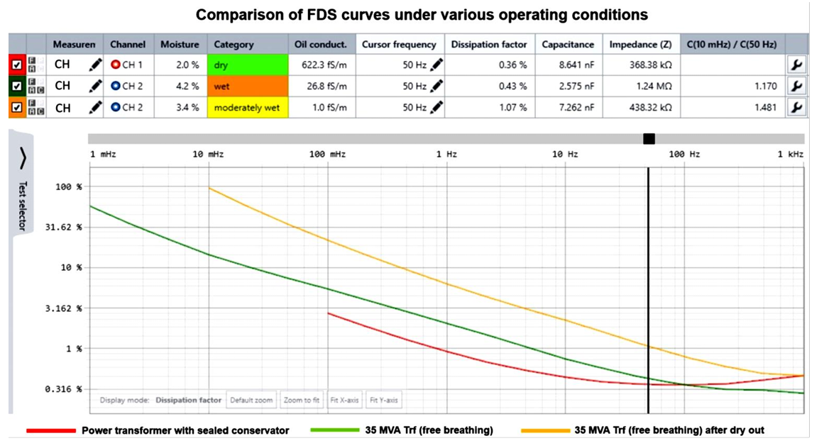
FREQUNCY DOMAIN SPECTROSCOPY

Slide 18
WAY AHEAD
Automated Thermography
Acoustic Partial Discharge
Online Differential Current Monitoring

Slide 19

Q&A!

