Slide 1
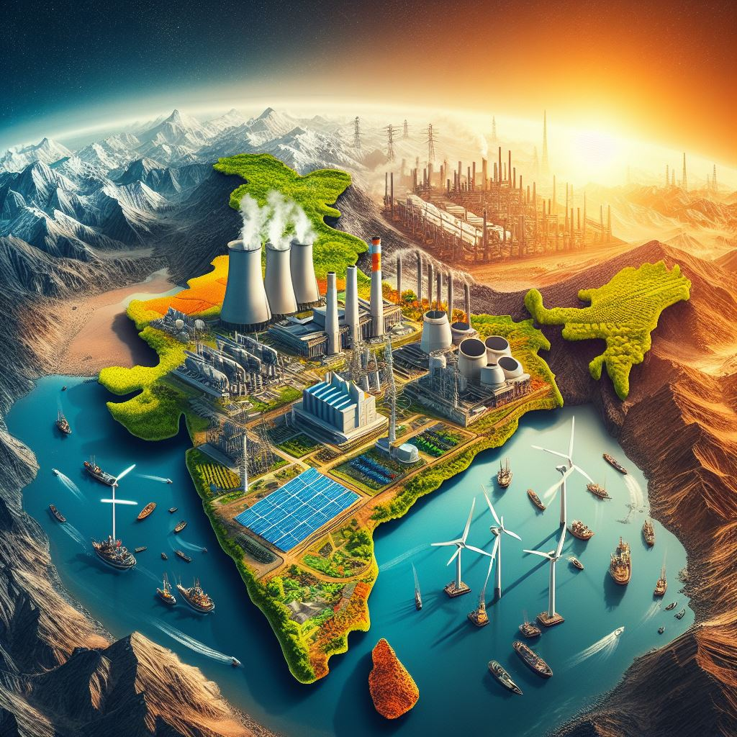
Environmental Challenges – Power Generation and Carbon Footprint Mapping
Dr. Kruthika Eswaran Mr. Manoj Kumar Singh, Mr. Rabinder Kant Sikri
Net Zero Think Pvt. Ltd.

Slide 2
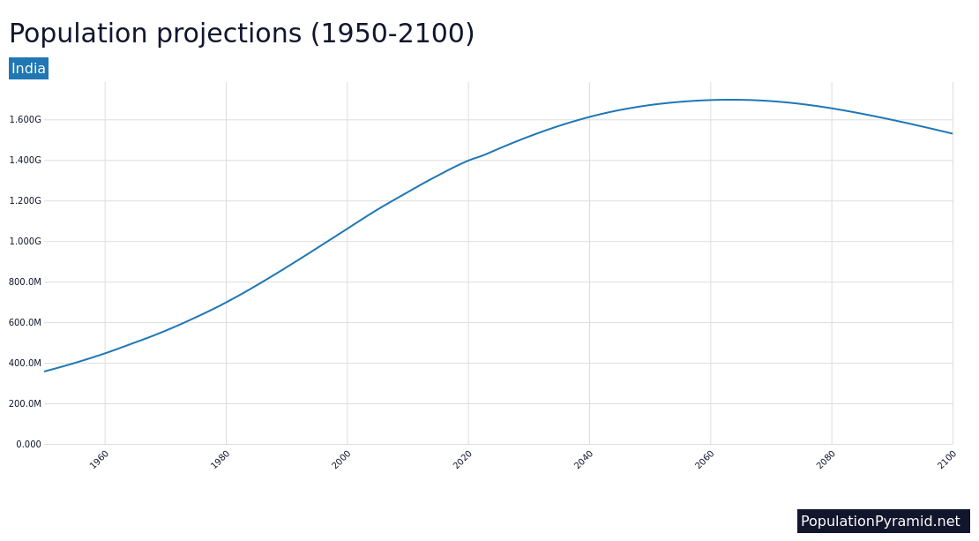
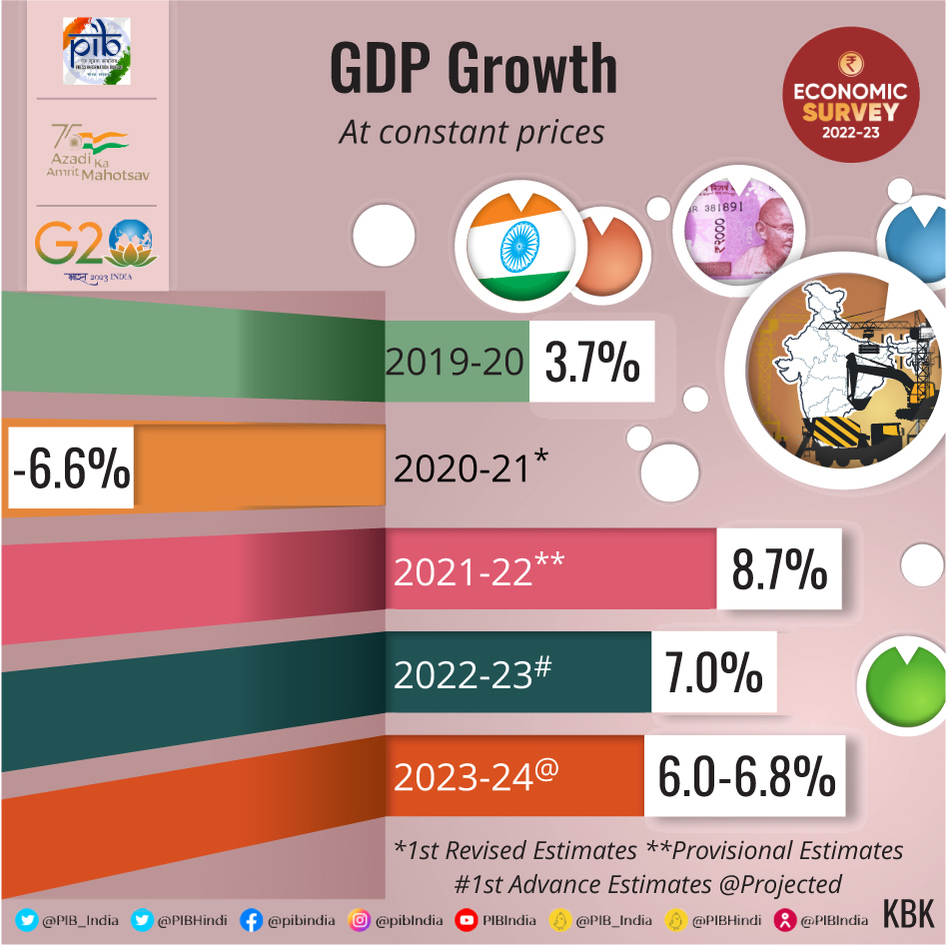
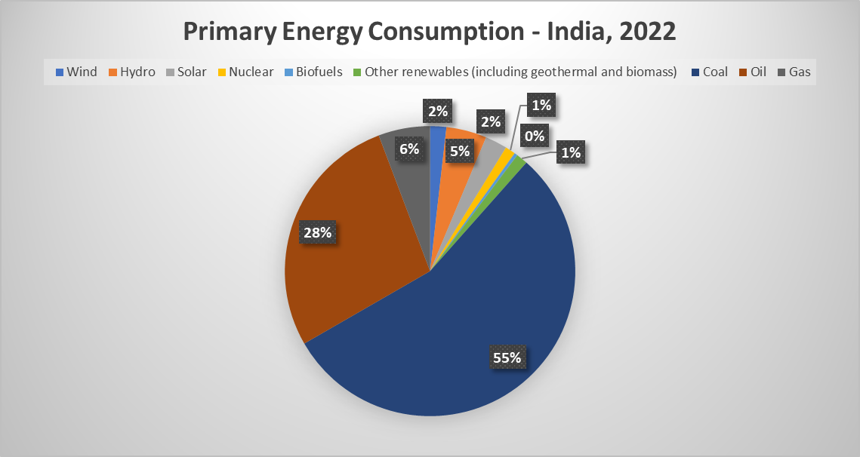
India’s Energy Consumption
India is currently experiencing a rapid increase in population, which is expected to reach 1.66 billion by 2050.
The country's economy is expanding at an unprecedented rate. The GDP is expected to grow between 6.0 and 6.8% in 2023-24, based on global economic and political developments.
India's energy demands have, therefore, surged, making it the world's third-largest energy consumer.
The increasing demand for energy has led to a rise in carbon emissions, causing environmental concerns in India. The government is implementing policies to reduce emissions and address the issue.
Hannah Ritchie and Pablo Rosado (2020) - “Energy Mix” Published online at OurWorldInData.org. Retrieved from: 'https://ourworldindata.org/energy-mix' [Online Resource]

Slide 3
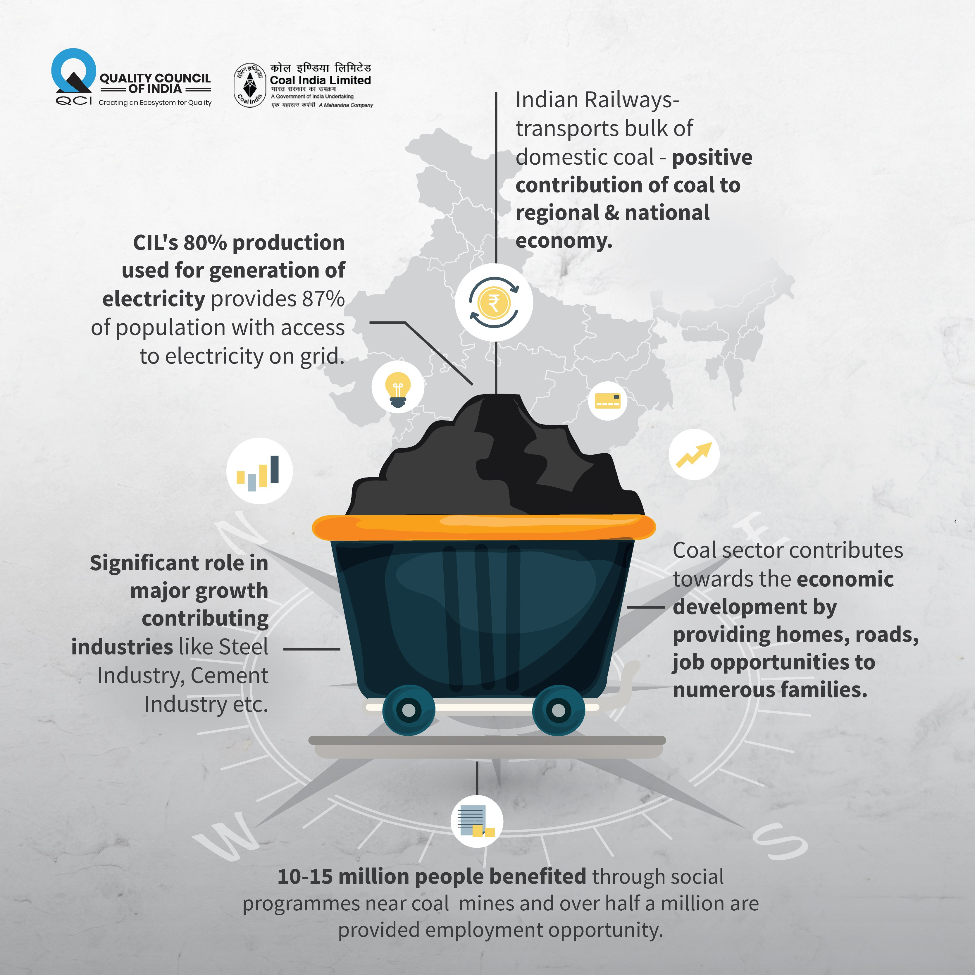
Power Sector – Dominated by Coal
India’s power sector heavily relies on coal, with over 50% of the total installed capacity and over 70% of electricity generation
Coal has been at the forefront of India’s economic growth but also has negative impacts on the environment and human health
Achieving decarbonization in the power sector requires a delicate balance and a just transition towards an increased renewable energy mix.
Source: NPP, 2024; CEA, 2023

Slide 4
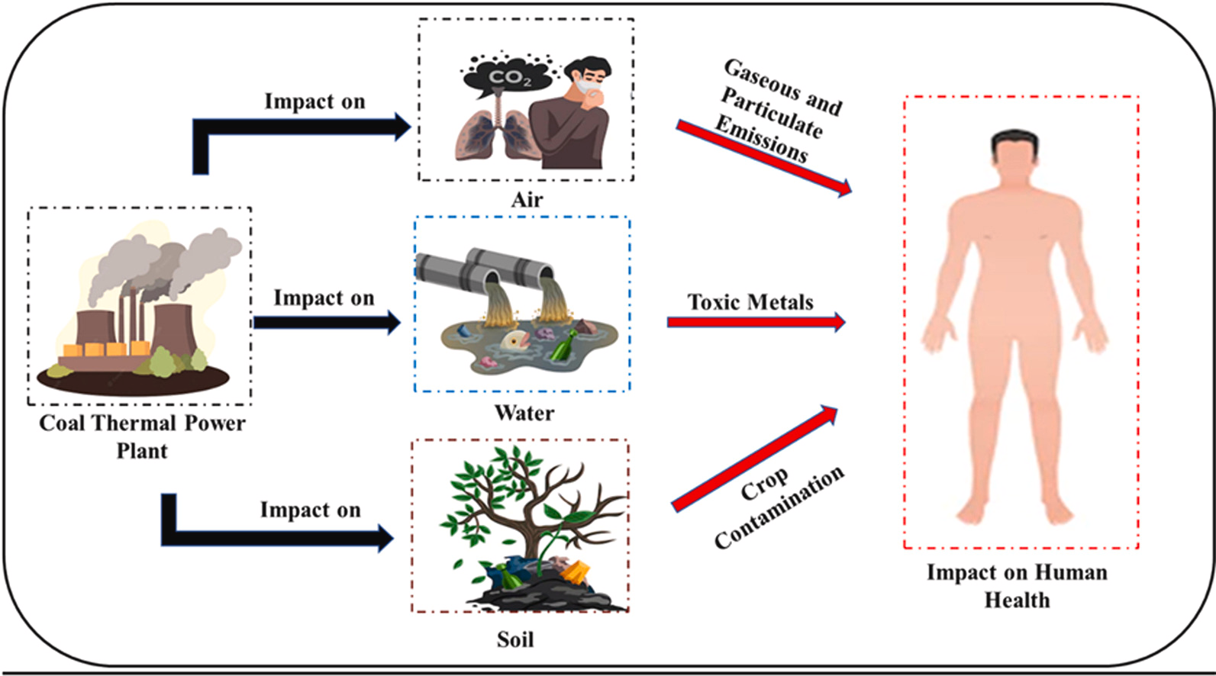
Detrimental Effects of Coal (Fossil Fuels)
Burning fossil fuels contributes to climate change, causing rising temperatures, sea levels, and extreme weather events
Fossil fuels create air and water pollution, which harms the environment and human health
Most plastics are made from fossil fuels, and their production and waste harm the environment and contribute to climate change
Extracting and transporting fossil fuels creates hazardous waste, such as oil spills, which can harm habitats and wildlife
Reducing CO2 emissions is essential to prevent harmful effects and protect our health, wildlife, and the environment

Slide 5
Why Carbon Mapping
We need to map our carbon footprint to reduce the environmental impact of our power generation resources.
This involves identifying vulnerable areas and hotspots and developing strategies to reduce emissions. We should consider the organization's activity in scopes 1, 2, and 3 when calculating its carbon footprint.
(Ramachandra et al., 2014)
The carbon footprint of major cities in India helps to improve national-level emission inventories
Mapping carbon emissions of various power plants and cities across the country will help identify major polluters and develop decarbonization strategies for the power sector at asset level and city level
Implementation of emission reduction strategies helps to gain carbon credits in the global markets
(Lifecycle Emissions of Electricity Generating Sources (IPCC, 2014))

Slide 6
Recommendations
Power Generating Source | Measurement | Reduction | Removal
Coal | Use Continuous Emissions Monitoring Systems (CEMS) to measure and report CO2 emissions. Conduct regular audits for compliance. | Invest in ultra-supercritical coal-fired technologies to reduce CO2 emissions. | Capture and store CO2 emissions with Carbon Capture and Storage (CCS) tech. Explore long-term storage or utilization options.
Gas | Use advanced emissions monitoring systems to measure CO2 emissions accurately. Conduct regular emissions audit | Use high-efficiency gas turbines, combined cycle technologies, and optimized combustion processes to cut CO2 emissions in power generation. | Examine Carbon Capture and Utilization (CCU) tech for capturing & repurposing CO2 emissions in industry or synthetic fuel prod.
Biomass | Implement robust CO2 monitoring and transparent reporting for biomass combustion emissions. | Optimize biomass energy extraction and reduce emissions with advanced combustion and gasification technologies. | Consider biochar production using biomass residues to offset CO2 emissions from biomass power plants.
Wind | Regularly monitor the embodied carbon emissions associated with wind turbine manufacturing, installation, and decommissioning | Research to improve turbine efficiency, reduce material usage, and explore sustainable manufacturing can lower wind power's carbon footprint. | Invest in reforestation or carbon offsets to offset wind power emissions.
Solar | Quantify the life cycle emissions of solar panels, including manufacturing, installation, and end-of-life considerations. | Research to improve solar panel manufacturing energy efficiency, reduce material waste, and explore sustainable sourcing. | Combine solar power projects with carbon sequestration or invest in carbon offsetting programs..

Slide 7
Policy for Decarbonizing the Power Sector
The following points need to be incorporated into Carbon footprint Mapping policies for decarbonizing Power Generation in India (MOEFCC, 2022).
Prioritize Renewables (solar and wind energy) investments for decentralized power generation.
Incentivize cleaner technologies through financial rewards for adoption.
Mandate retrofitting of existing coal plants with efficient technologies.
Phase out outdated facilities and encourage private sector participation.
Establish a national carbon market for emissions trading to drive industry competitiveness.
Foster international collaborations for technology transfer and capacity building.
Implement rigorous emission monitoring and reporting mechanisms to hold producers accountable.
Promote research on energy storage solutions to address renewable intermittency.
Periodically review and adapt policies to align with evolving technologies and global best practices.

Slide 8
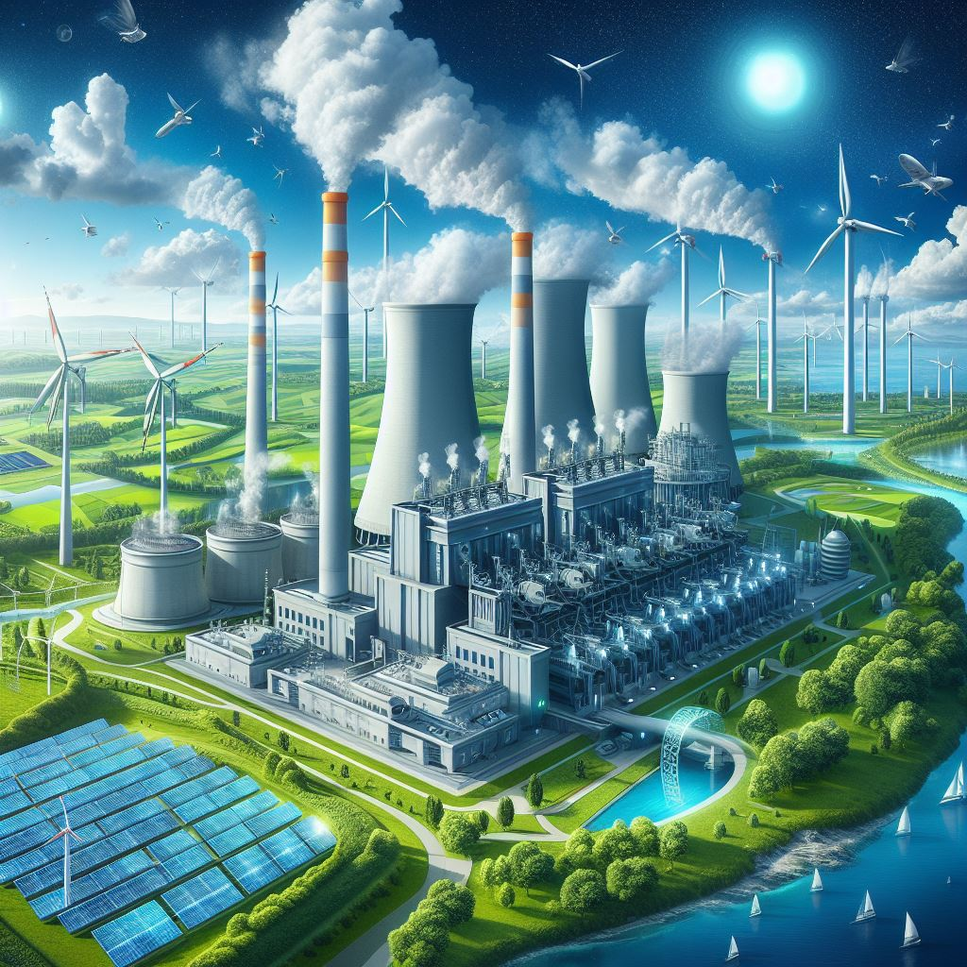
Way Forward
Analyzing CO2 emissions is crucial to enhancing eco-design, optimizing processes, and innovating business models for sustainable energy in India.
Policymakers, industry players, and the public must address environmental issues within the power generation sector to ensure sustainable energy in India.
Mitigating emissions is necessary to promote stability, independence, safety, and an improved quality of life for individuals and their families.
The assessment of carbon footprint in Power Generation should encompass scopes 1, 2, and 3, considering all facets of an organization's activities.
Utilizing a dashboard to monitor carbon intensity through real-time measurement, satellite, and AI software needs to be implemented.
This approach aims to facilitate carbon mitigation through strategies such as carbon capturing, afforestation, process improvement, and more.
(An ideal decarbonized power plant)

Slide 9
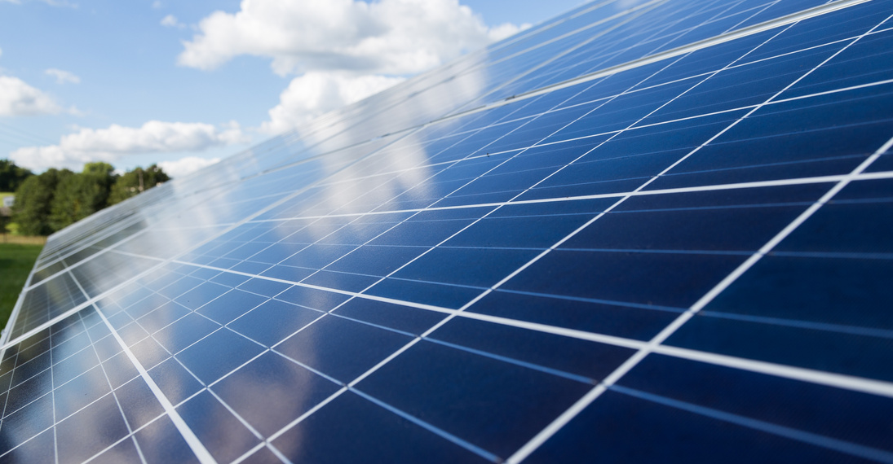
ABOUT NET ZERO THINK
SERVICES & SOLUTIONS
NET ZERO THINK (2022) is the result from several years of research in climate change and the environment. NET ZERO THINK presents itself as a scalable technological initiative developed to fulfil the requirements of corporates, government, NGOs & the private sector to become more sustainable in their business practices.
NET ZERO THINK specializes in providing climate centric net-zero solutions for Energy, infrastructure, Transport, Agriculture & Water Sector by utilising Artificial Intelligence & Machine Learning Platforms. It has a multidisciplinary team of professionals who together have over 100 years of experience in implementing cleantech solutions across the manufacturing, defence, energy, IT, Insurance, & Finance sector.
NET ZERO THINK is present in India and expanding its services across Asia, Africa, Middle East and Island Nations.
GHG Accounting, Scope 3 and SBTi Solutions
Sustainability Solutions
Industries Solutions
Energy Solutions
Carbon Credit Solutions
Climate Change Impact Assessment
Training and Capacity Building
Net Zero Think is developing climate centric tools to achieve sustainability and net zero goals . To know more contact us.
https://netzerothink.com/
support@netzerothink.com
Bengaluru, Karnataka, India.
Join Climate Innovation Community by scanning the QR code or visit: http://www.cic.netzerothink.com/

