Slide 1
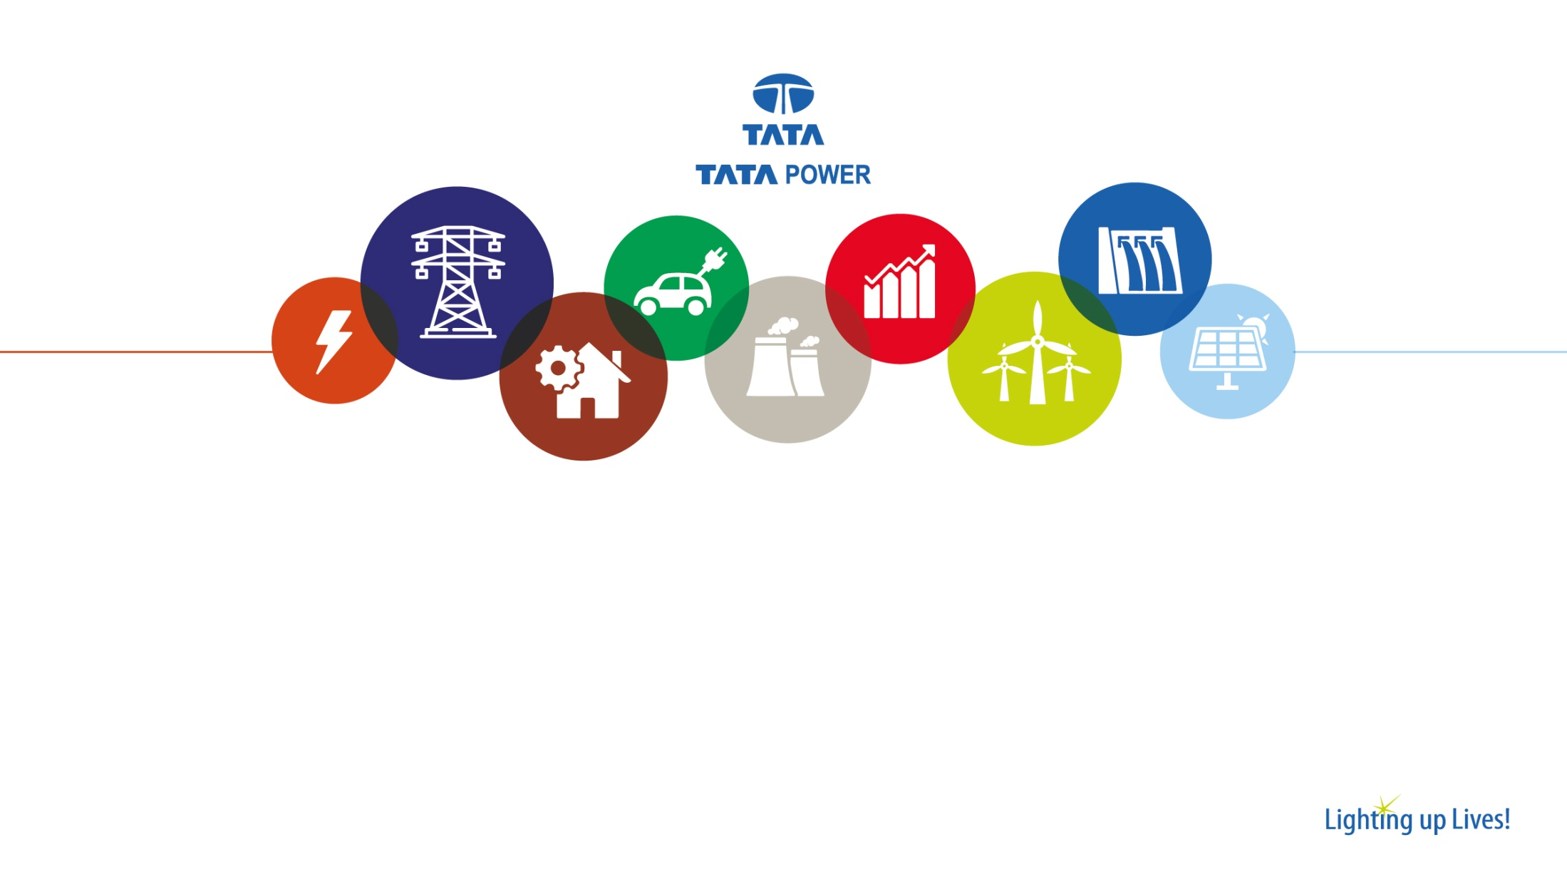
Project “DRISHTI”
Enhancing site safety by integration of Artificial Intelligence, Video Analytics and Public Annunciation with Closed Circuit Television Video Management System.

Slide 2




Business Environment
CERC, ERLDC
Ministry of Environment & Forest
GoJ, JSPCB
LTOA Customers
DVC
150 MW
TPDDL
300 MW
WBSEDCL
300 MW
KSEB
300 MW
TPTCL
Community
PGCIL 400 kV Network
Unit 1 525 MW
Unit 2 525 MW
BCCL/CCL
Imports
Tata Steel
Fuel
Fuel
IOCL/HPCL
O&M Associates
Workforce
Indwell
BTG
RK Sharma
AHS
Energo
CHP
Maithon Power Limited
TATA POWER 74%
DVC 26%
Ministry of Power
Lenders
Notes:
Here In this slide the business environment of MPL has been described. We are the first power project which had been made on PPP model. Our customers are DVC, TPDDL, WBEDCL, KSEB.

Slide 3
Team Details
Sudhakar Tandon
Chief O&M
Project Sponsor
Surodh Dey
HOD C&I and IT
Facilitator
Prince K. Singh
GH C&I
Leader
Project “DRISHTI”
Enhancing site safety by integration of AI, VA and PA with CCTV VMS.
Ankit Anand
Lead Engineer-IMD
Member
Bijit Deb
Lead Engineer-IMD
Member
Notes:
This is our Team details. Myself Mukesh kumar from C&I dept and Abhijit chowdhury is from operation dept.

Slide 4


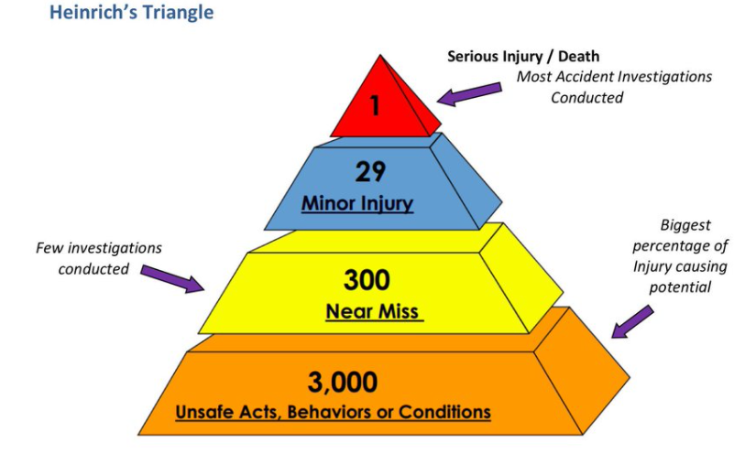
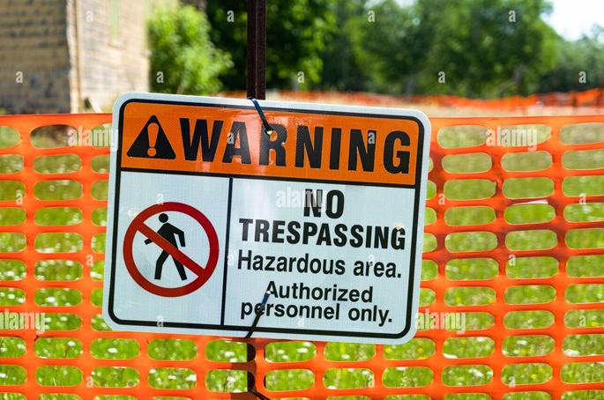
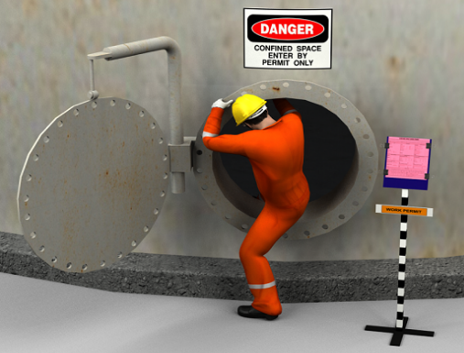
Accidents due to unsafe Acts
No Helmet
No Harness
Unauthorized access in Hazardous zone
Person inside confined space

Slide 5
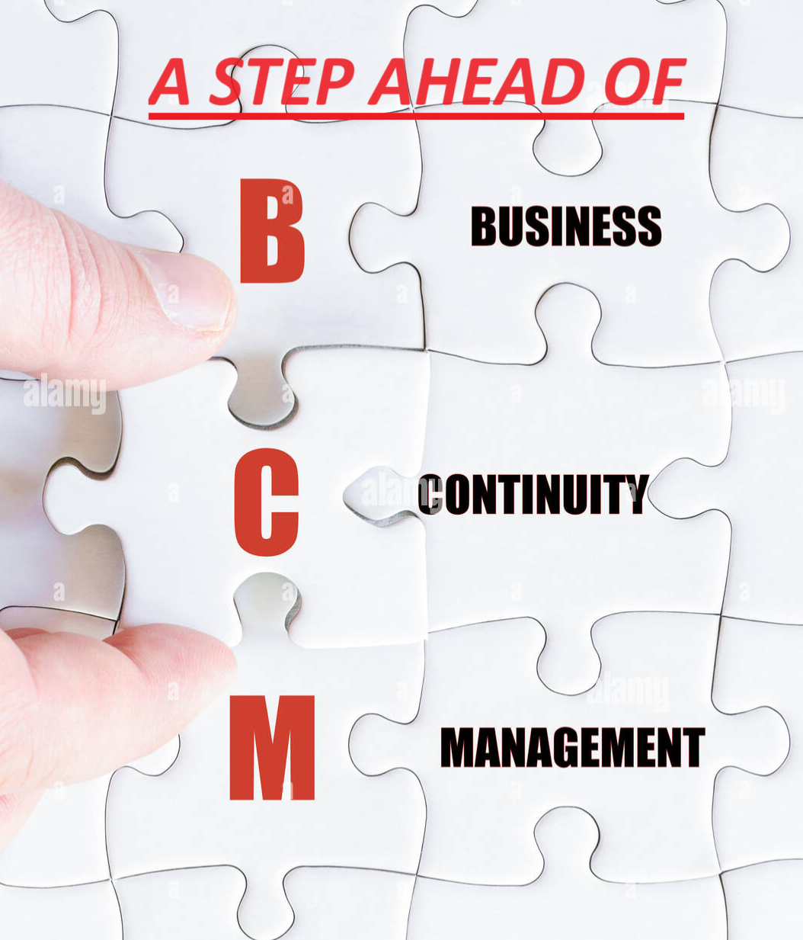
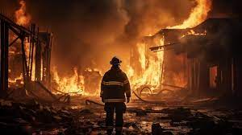
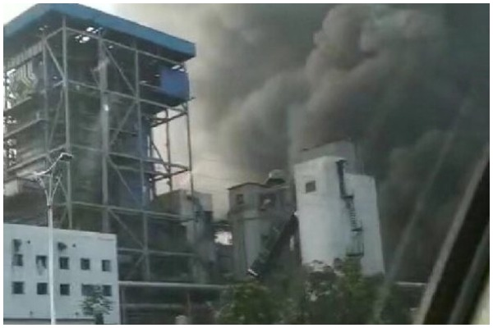
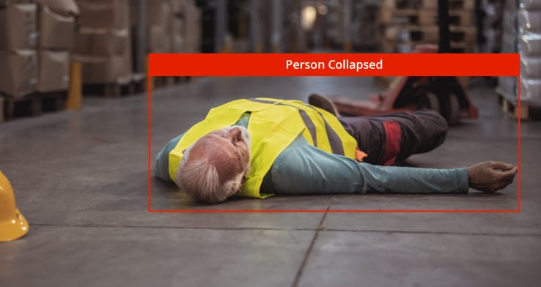
Damages due to Unsafe Conditions
Fire Hazard
Smoke Hazard
Person Collapsed

Slide 6
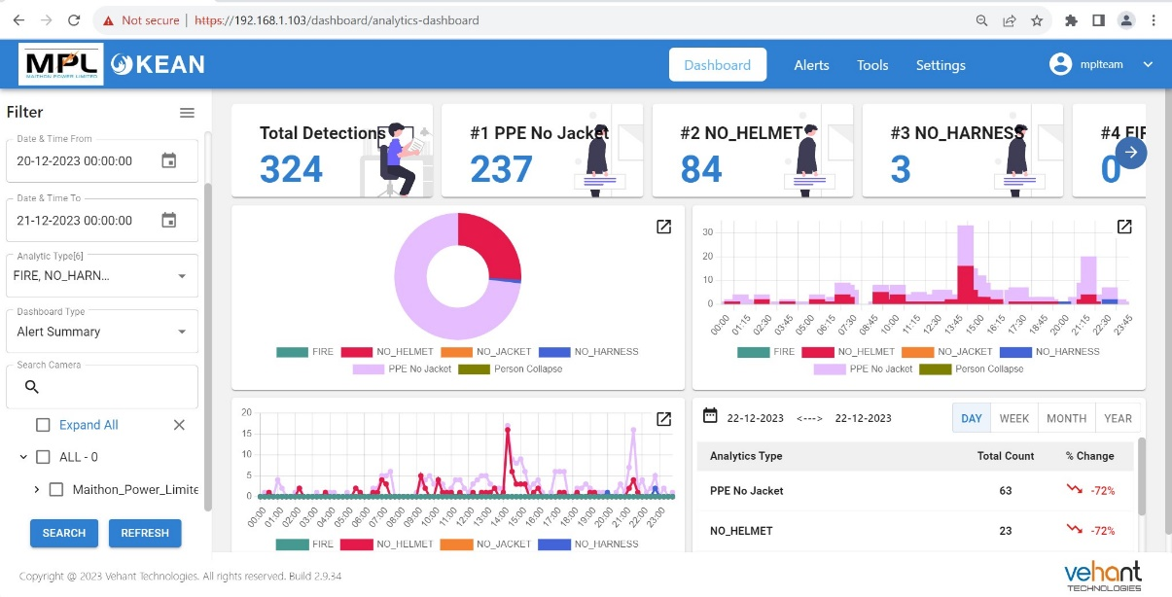
Alert Summary & Type of Violations in Analytics
01
FIRE & SMOKE ALERT
02
UNAUTHORIZED ENTRY ALERT
03
NO HELMET VIOLATION
04
04
PERSON INSIDE CONFINED SPACE
NO JACKET VIOLATION
05
NO HARNESS VIOLATION
06
PERSON COLLAPSE ALERT
07
NO JACKET VIOLATION

Slide 7

Key Steps to achieve Goal of zero Incidents
Real-Time Monitoring
Violation Capturing
Alert to
Operator
Annunciation System
Safety
“A HABIT”
* IP Cameras installed for continuous monitoring of vital areas.
* Capturing of 8 types of violations as unsafe acts & unsafe conditions.
* Pop-up notification having information of area, type of violation.
* Speakers installed in vital areas for Continuous annunciation in Auto as well as Manual mode.
* Recall procedures & safe approach at shop floor through continuous Annunciation of Safety slogans, Tool Box Talk, Do’s & Don’ts according to work in particular area.
* Option of easy access to live feed of particular camera through pop-up.
* 3 months data collection in server for analysis purpose.
* Data Collection in form of pictures & short video clips of violation in highlighted form for action & investigation.
* Automated Continuous Annunciation in local languages of different or same messages in all areas.
* Audible alert in case of violation in workstation to get attention of operator.
* Manual Annunciation by operator in case of violation not only corrects it for once but continuous intervention builds habit resulting behavioral improvement at shop floor.
* Safety Drives based on violation type analysis by VA System.
* Manual annunciation in particular or all areas through easy selection option.
* List of alerts in Dashboard for effective monitoring.

Slide 8







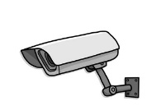



System Architecture
Networking protocol used in project are TCP/IP and UDP
VA & VMS allows to access all CCTV camera with ONVIF platform connected to network.
The Operating System used is Linux- Ubuntu and Programming languages used for implementation of VA are Python, PostgreSQL, Java Script.
Switch
Alert Speaker
Mic
Workstation
VMS Server
VA Server
Integration of all the application in single workstation for ease of operator to monitor and take action according to captured violation.
Camera
Speaker

Slide 9
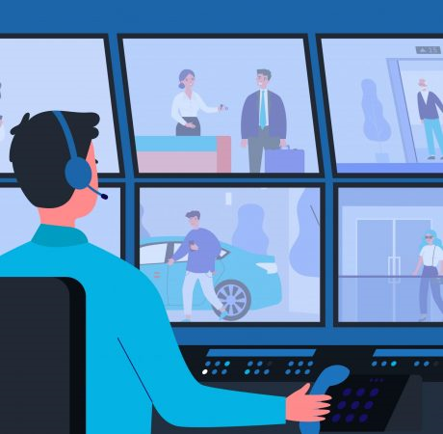



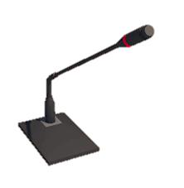








Control Room
Alert
Person Without Helmet

Slide 10
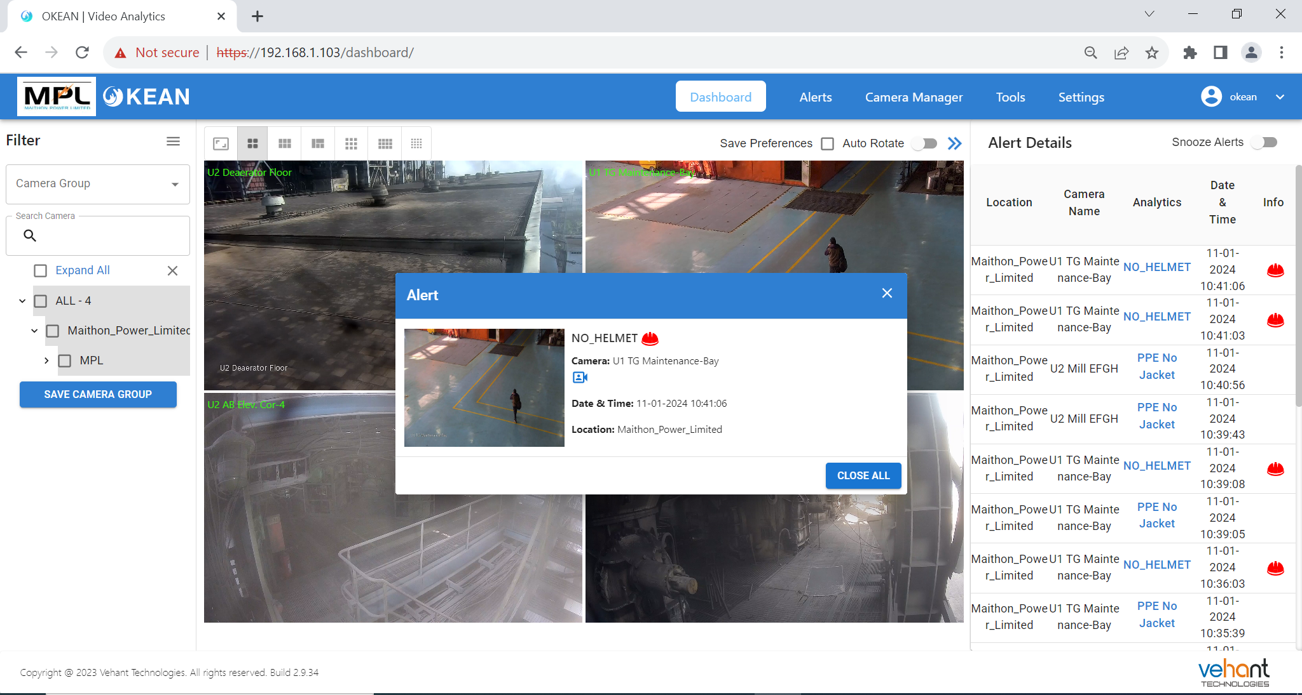
Video Analytics Dashboard with Violation alert

Slide 11
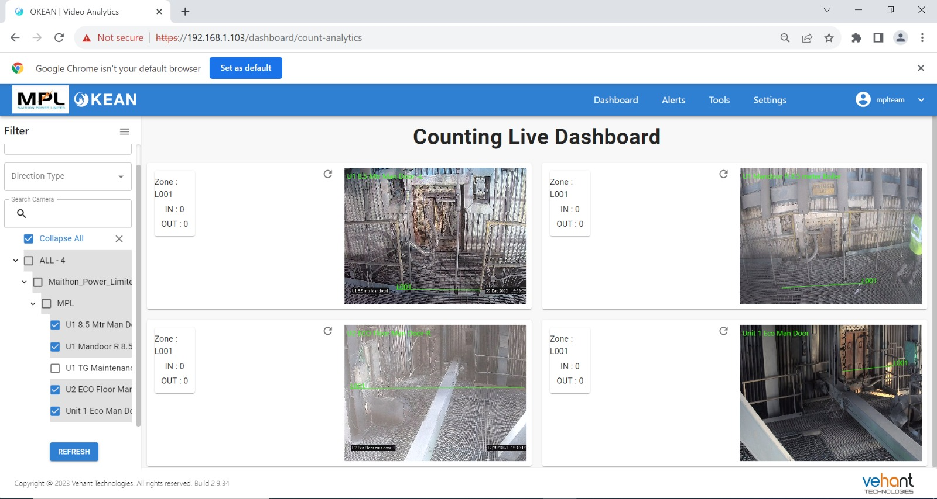
Count Analysis Dashboard

Slide 12
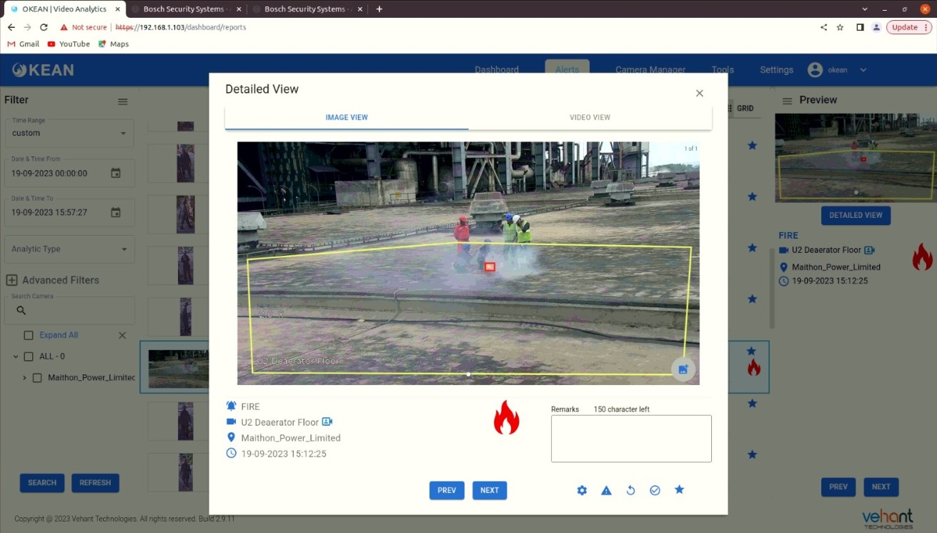
Fire Alert in Analytics
Fire Alert

Slide 13
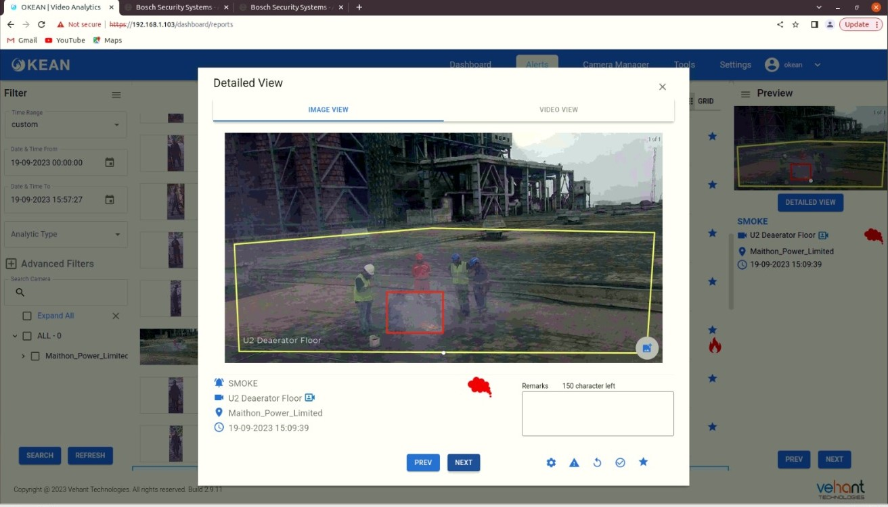
Smoke Alert in Analytics
Smoke Alert

Slide 14
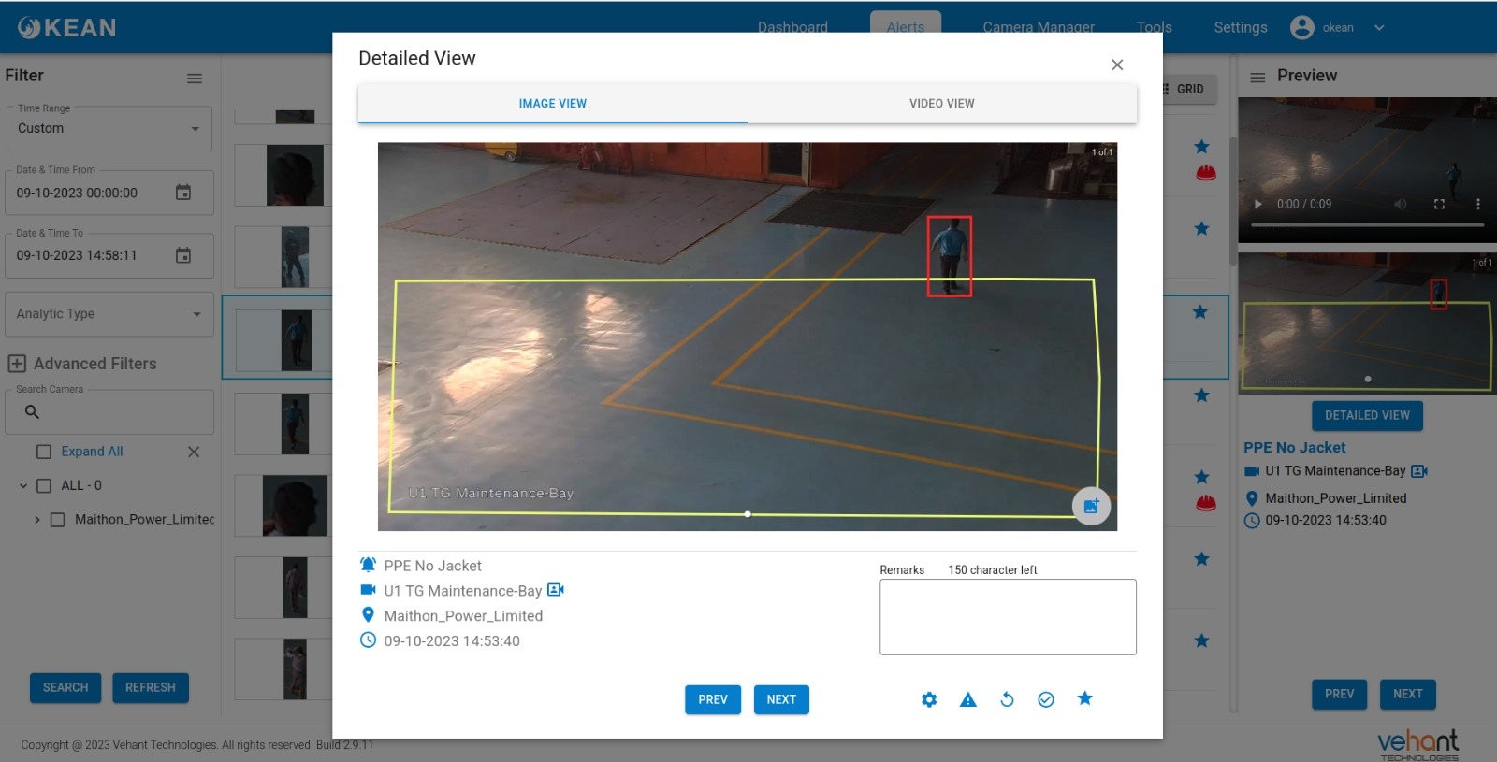
No Jacket Violations in Analytics
No jacket Alert

Slide 15
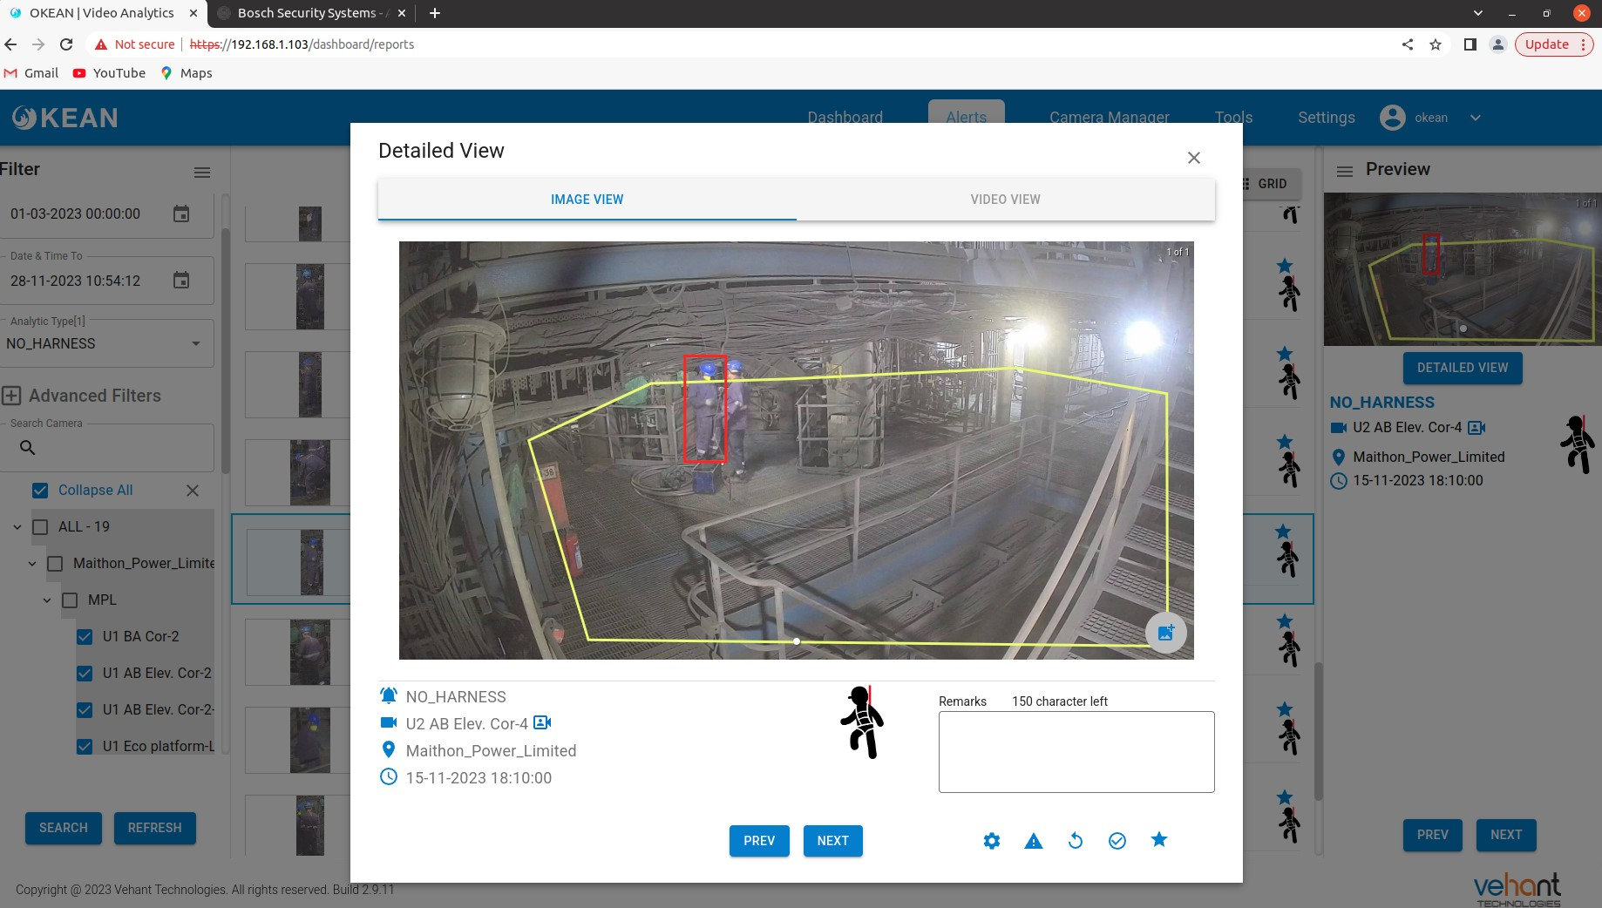
No Harness Violations in Analytics
No Harness Alert

Slide 16
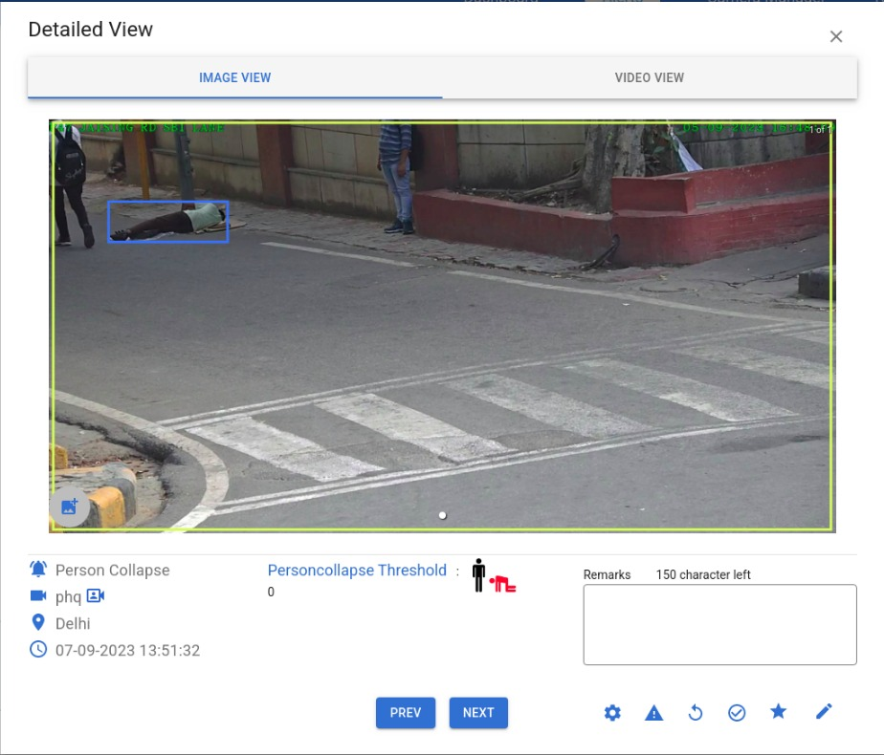
Person Collapse Alert in Analytics
Person Collapse Alert

Slide 17
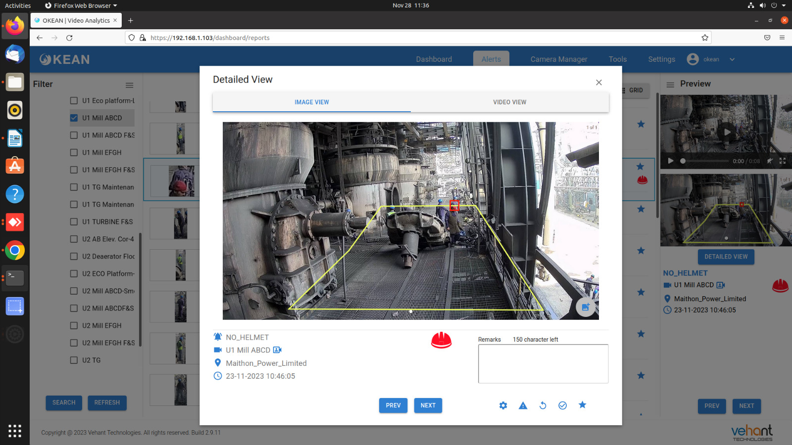
No Helmet Violations in Analytics
No Helmet Alert

Slide 18
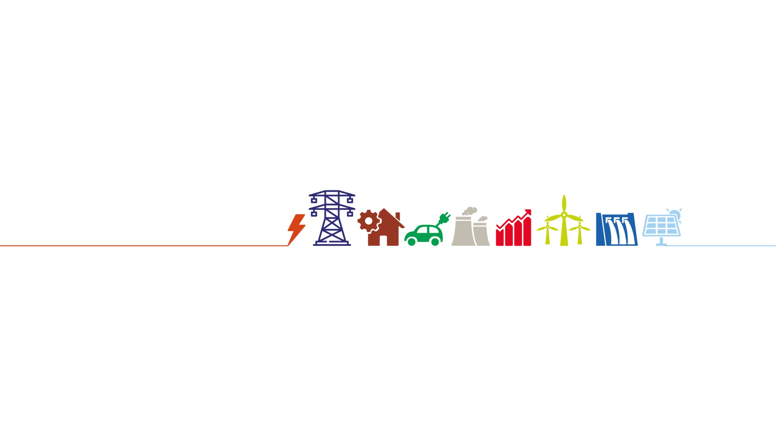
Disclaimer: The contents of this presentation are private & confidential. Please do not duplicate, circulate or distribute without prior permission.
Thank You!
Website: www.tatapower.com
Email Id: ankit.anand@tatapower.com
Contact: (+91) 7645801754
Private and Confidential

