Slide 1
Water Conservation & Management at Sasan Power Limited

Slide 2
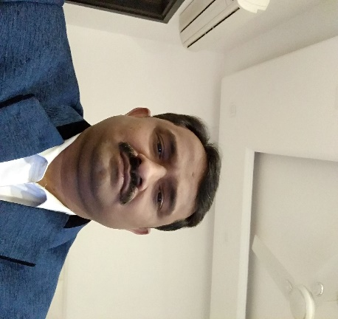
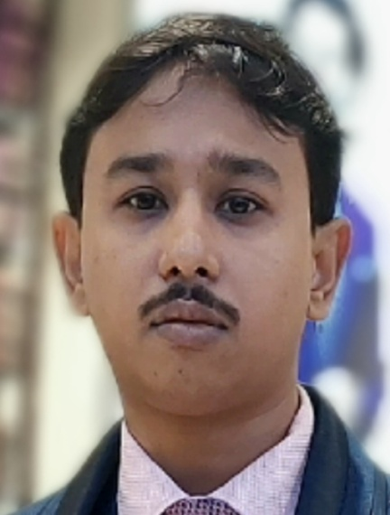
Prakash Upadhyay HOD (Operation) Sasan Power Limited Experience – 26 years for O&M of Thermal Power Plant
Arijit Debroy DGM (O&E)
Sasan Power Limited Experience – 13 years for O&M of Thermal Power Plant

Slide 3
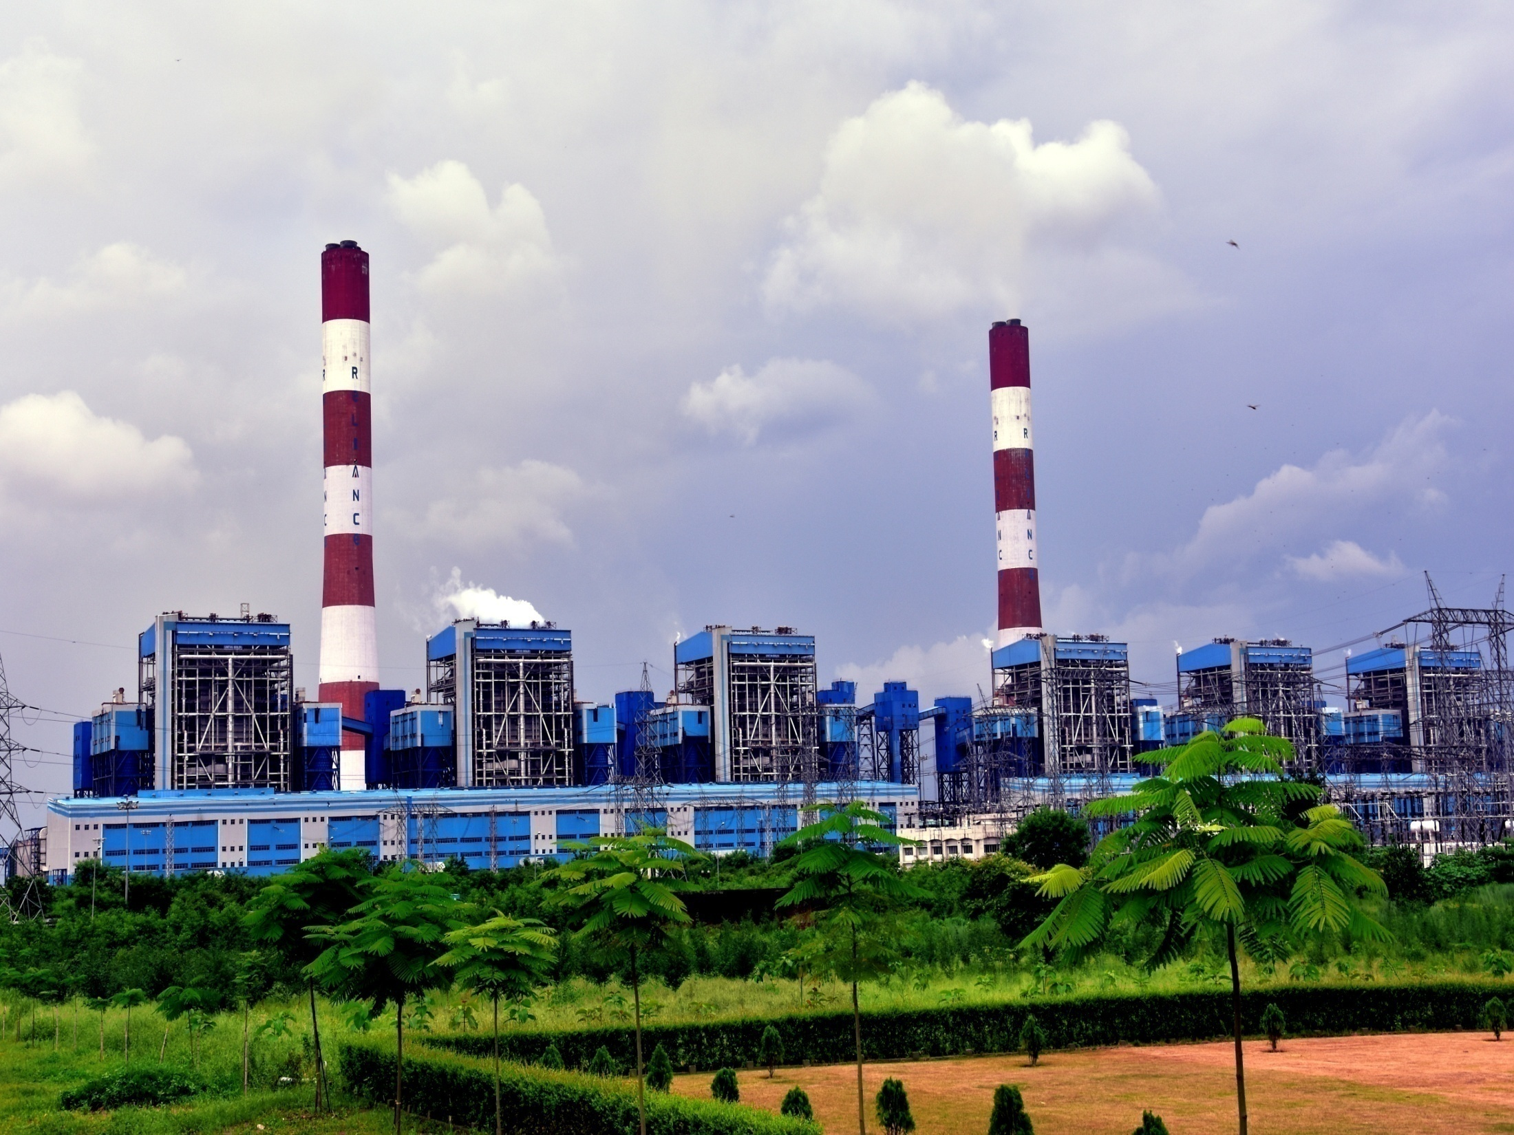
SASAN POWER LIMITED ISO-9001,ISO-14001,ISO 45001 & ISO 50001 Certified Company World’s Largest Integrated Coal Mine and Power Project At A Single Location

Slide 4
Sasan Project Salient Features
The First Integrated Ultra Mega Power Project along with Integrated Captive Mine which provides power at most competitive tariff in the country to 14 DISCOMs in 7 states.
First and Only Ultra Mega Power Project based on Domestic coal with 20 MTPA Coal Production capacity & “State of Art” mining equipment and Largest Size HEMM
Super Critical Technology which reduces approx 2.5 MMT of carbon di-oxide emission over a time span of 25 years.
Sasan Power Limited clocked more than 94% PLF (Plant Load Factor) from FY’19 to FY’22, thus consolidating its top-most position amongst all thermal power plants of India for four consecutive years.
Lowest Specific Water Consumption amongst all similar capacity supercritical thermal power plants in India (SWC <1.85 m³/MWh)
Environment friendly, Cheapest, Fastest Overland conveying system of length 14.2 km conveying 4500 TPH coal with VFD driven drive at 5.6 m/s belt speed
Robust Power Evacuation – 4 transmission lines of 765 kV and 4 lines of 400 kV.

Slide 5
Performance Parameters: Y-o-Y Progress

Slide 6
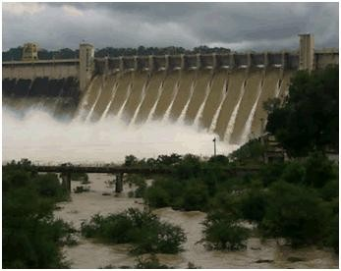
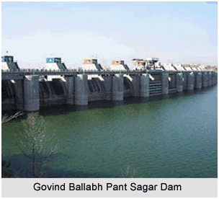
Water Requirement, Source & Challenge for Sasan Power Limited
Water is one of the key requirement for thermal power plant generation. Water is required for process cooling in condenser, ash disposal, removal of heat generated in plant auxiliaries and other various plant consumptive usage.
Sasan Power has been allocated 70 MCM water per year from Govind Vallabh Pant Sagar reservoir.
The Raw water in take pump house is situated at a distance of 25 km from plant site. We have infrastructure to meet 270 % of our daily water requirement. 3 x 6500 m3/h capacity pumps are installed. Concrete based Water Reservoir with total capacity of 15.6 Lacs m3 is established in Plant, which can meet water demand of plant for 8 days at full load operation & we regularly monitor the Rihand dam level as well.
Initially large quantity of water was needed for the power plant post project completion phase. In FY 14-15 approx. 2.1 m³/MWh was required. Now only 1.8 m³/MWh water is used for full generation of Sasan Power Limited (6*660=3960 MW).
Recently, the state government of Madhya Pradesh has taken significant steps in response to the growing water scarcity in the State.
Water charges have been increased by approximately 60 to 70%. Raw water charges have seen a notable rise from 5.5 Rs/m³ to 8.0 Rs/m³ after December 2022 and also there will be an annual increase of 5% in water costs.
With the lowest tariff in the country, Sasan Power had to accept the challenge and curtail the raw water requirement at plant to cope up with the annual growth in the Water Cost.

Slide 7
WATER CONSERVATION GUIDELINES
As per guidelines of MOEF&CC, dated; 07-Dec-2015, all the cooling tower based power plant shall reduce specific water consumption up-to maximum of 3.5 m3/MWh
Slide 7

Slide 8
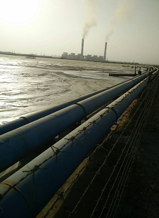
RAW Water Optimization Initiatives Summary
Change over from LCDS to HCDS
Increasing COC from 5 to 7
Recycle & Reuse of drain water
Implementation of Zero water discharge
All the BTG area drain water collected and transferred to Ash water sump for reuse.
Usage of all CT Sludge Pump Discharge Water in Coal Yard.
Fuel switching had been done in SPL from HFO to HSD
All unit cartridge filter backwash water connected to Bottom hopper over flow tank for reuse.
Ground Water Recharge & water collection pits

Slide 9
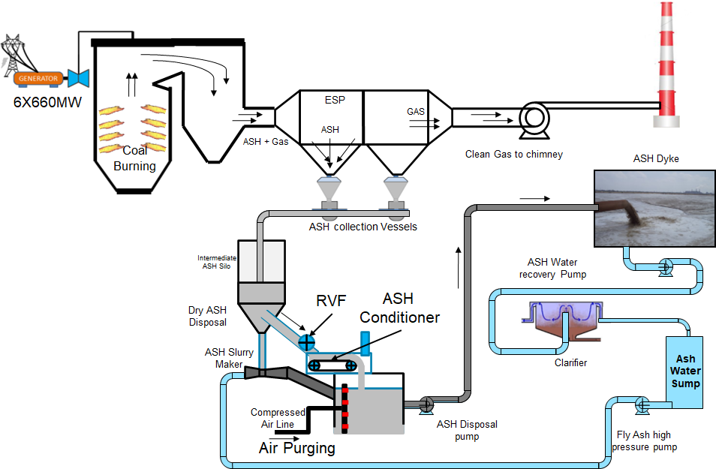
Change Over from LCSD to HCSD
Modification –
Ash conditioners with RVF installed top of ash slurry sump. Inlet line from ash silos to Ash conditioner. Outlet of Ash conditioner in the ratio of 80:20 (Water: Ash) and was directly taken into ash slurry sump to increase ash concentration up to 40:60 (Water: Ash) . Air purging given for agitation when required.
Sl.no | Description | Running Qty
 |  | Earlier | Now
1 | FAHP-Pump | 6 | 1
2 | Ash disposal pump | 8 | 4
3 | Recovery Water pump | 2 | 0.5
4 | Feeder ejector | 12 | 2

Slide 10
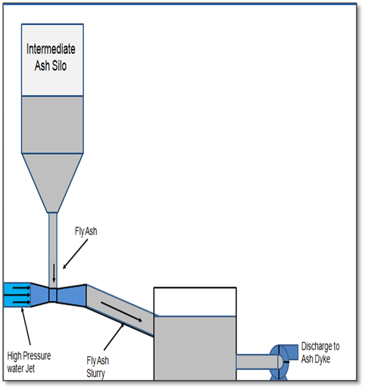
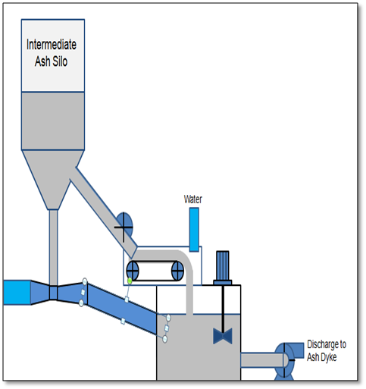
Innovative use of Hydro Mixed Dust Conditioner (HMDC) for Reduction water consumption & Aux Power Consumption
AD Pump (250 kW) running: 4 nos.
FAHP (110 kW):3 nos.
Recovery Pump (220 kW): 2 nos.
Ash : Water ratio: 20% : 80%
AD Pump running: 2 nos.
FAHP: 1 no.;
Recovery Pump: 0.3 nos.;
Ash : Water ratio: 60% : 40%
AFTER
BEFORE

Slide 11
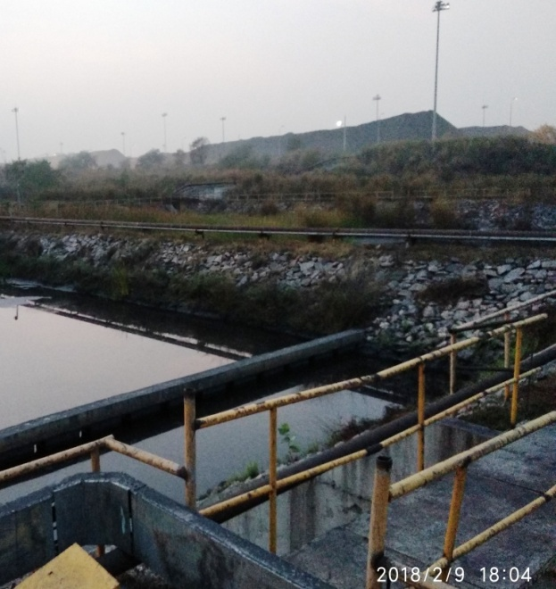
Usage of CT Sludge Pump Discharge Water in Coal Yard
Strategic Water Repurposing: We reuse sludge water for sprinkling in the coal yard, showcasing a strategic approach to water conservation.
Dual Purpose Achieved:
It serves the basic purpose of maintaining COC of the CTs.
Addressing Dust Suppression: The system also aids in dust suppression within the coal yard.
Water Optimization:
After sprinkling, water containing coal particles drains off the coal yard into Coal Settling Ponds.
After effectively separating coal particles we ensure that the clear water is recycled back into the plant.
This reduces the fresh water demand for Coal Yard.
This process of using CT Sludge Pump Discharge for sprinkling and recycling drain water through a coal settling pond is an effective way to conserve water. It reduces the demand for fresh water, lowers operational costs, and contributes to environmental sustainability by minimizing water wastage and promoting recycling

Slide 12
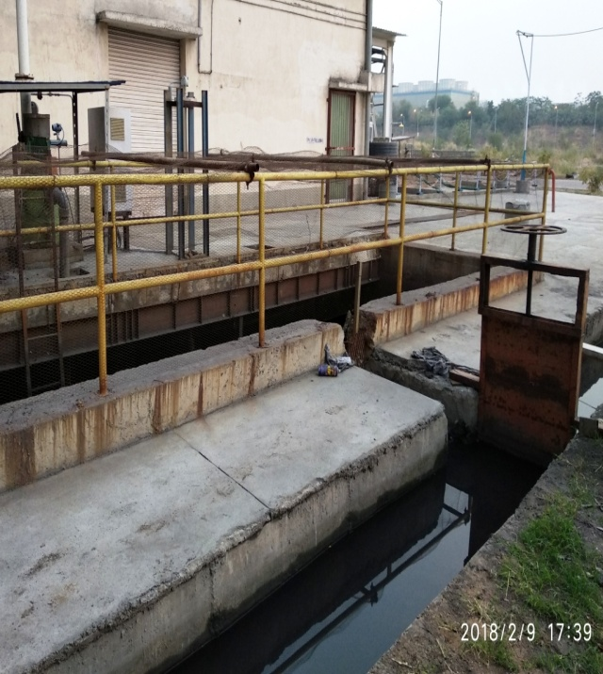
Implementation of Zero Water Discharge
All BTG area drain water ACW (Auxiliary Cooling Water) PHE, ACW Debris filter and Blow down tank water) is collected and transferred to again in Ash Water sump for re-use.
Three strategic location in plant area isolating valve installed for recollection and reuse of drain water .

Slide 13
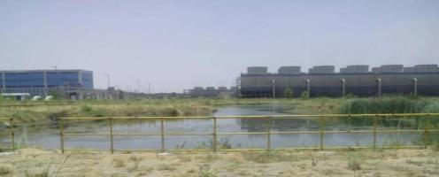
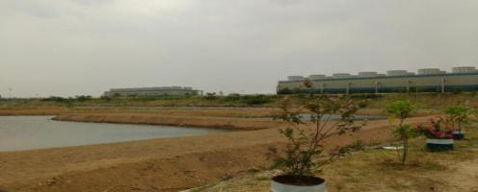
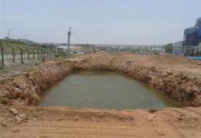
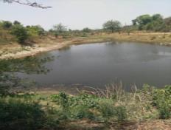
Ground Water Recharge & Water Collection Pits
Recharge pits connected to the storm water drains –
These pits receive water from storm water drains and help in increasing/recharging ground water table
Rain water harvesting ponds –
Rain water is collected into these artificial ponds created at strategic locations. It helps in ground water recharging as well as for gardening in nearby area.
Construction of Sedimentation ponds –
Clean water after sedimentation is utilized for housekeeping and other miscellaneous works.

Slide 14
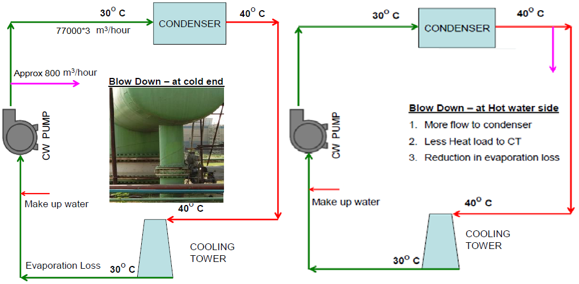
Other Ingenious Water Conservation Initiatives at SPL
CT Blowdown taken from hot end rather from cold end as per actual OEM design to reduce evaporation loss, heat load in CT and more flow to condenser.
All unit cartridge filter backwash water which was earlier connected to N Pit through waste water pump had been modified by connecting the pump discharge line to Bottom ash hopper for reuse in the system saving 6480 m³/year raw water.
Plantation done alongside the water reservoir to partially reduce the evaporation loss.
Installation of water flow meter at specific locations to carry out water consumption audits. Regular water audits are conducted by O&E team and observations related to DM water wastage are noted by field engineers during BTG walkdown.

Slide 15
DM Make Up Optimization
Boiler water treatment switched from AVT to OT
Optimization of Soot Blowers Operation
Reduction in DM water Loss
Fuel switching from HFO to HSD
High energy drain valves passing survey & rectification
Reuse of VAM condensate DM water for reduction of total DM water consumption
Every 1 % increase in DM make up causes heat rate loss of 5 KCal/kwh.
Notes:
For DM make up optimisation
We have optimised the soot blower operation,
Also checklist is prepared for identification of leakages & attending them online if possible or during opportunity.
The Optimisation of VAM steam inlet pressure set point as per the ambient condition is being carried out.
One of the major improvement in this area is by fuel switching from HFO to HSD. By this the steam required for atomising the HFO is cut off, which results in considerable reduction in DM consumption.

Slide 16
THANK YOU
Think Big, Think Fast, Think Ahead. Ideas Are No One’s Monopoly.
- Dhirubhai Ambani Founder, Reliance Group
Sasan Power Limited

