Slide 1

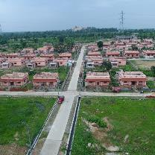
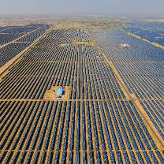
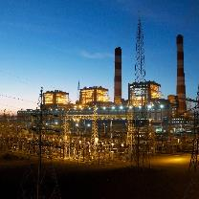
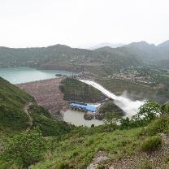
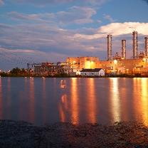
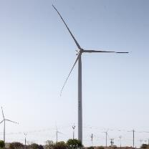
Solapur
NTPC R&R Colony, Darlipali
NTPC Bhadla
NTPC Kudgi
O&M Conference 2024 | Raipur
NTPC Koldam
NTPC Kayamkulam
NTPC Rojmal
Follow us on:
/ntpc1
/ntpcltd1
/ntpclimited
/Company/ntpc
/ntpclimited

Slide 2
UNIQUE BTL CHALLENGES ENCOUNTERED IN SOLAPUR TOWER TYPE SUPER-CRITICAL BOILERS
A SOLAPUR PERSPECTIVE
Notes:
Make it more vibrant

Slide 3
Contents
Introduction
Overview
Exhibit-1
Exhibit-2
Exhibit-3
Conclusion

Slide 4
Introduction
BTFs – a major cause of Forced Outages in Power Plants
Cost of BTFs – Repair, Start up Oil & Lost Production
BTL attending in Solapur Boilers challenging – due to unique design causing severe space constraints.

Slide 5
NTPC SOLAPUR
2 x 660 MW Super-Critical Tower Type Boilers
Unique design – Difficult and time consuming to attend BTLs
Unit 1 Solapur - Chequered History relating to BTLs
BTLs controlled using out-of-the-box thinking and innovative methods

Slide 6
Overview
3 exhibits – each exhibits highlights a particular type of failure
10 Nos repetitive failures
Classified in 3 categories
  Weld joint failure in RH2 (5)
  STOH in SH2 (3)
  LTOH in RH2 (2)

Slide 7
Exhibit-1: It’s All Mixed Up
05 Nos failures in RH2 erection site welded joints
Circumferential crack observed
Tube Details:
Tube Material: SA213 M UNS S30432 SP
Tube Dimensions: 63.5 X 4.0 mm

Slide 8
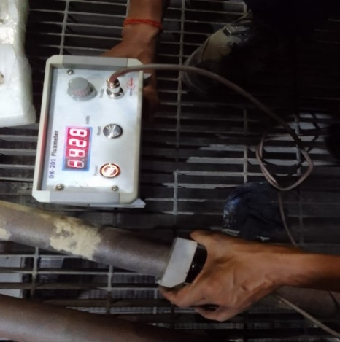
Exhibit-1: Root Cause – Filler wire mix-up
Exfoliation checked with flux meter and found to be on higher side.
Magnetization of the joints
PMI checking of root and filler pass done using an XRF Analyzer:
(a) Root pass: Cr content – 8.5%
(b) Filler pass: Cr content – 17%
Filler wire mix up

Slide 9
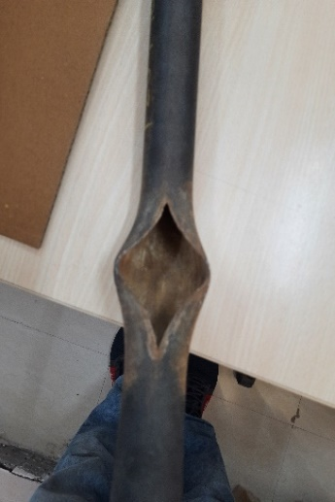
Exhibit-2: “I’m Starved”, says the boiler
03 Nos failures in SH2 outlet joint
Fish-mouth opening
Tube Details
Tube Material: SA213 M T91
Tube Dimensions: 38 X 5.6 mm

Slide 10
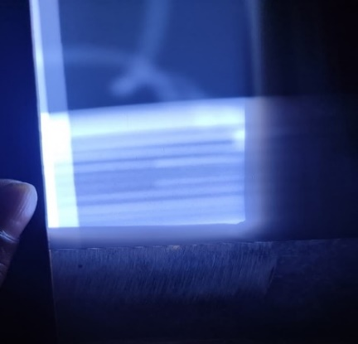
Exhibit-2: Root Cause - Starvation
Thin lip fish mouth opening, indicative of STOH
Boroscope, sponge ball test – no abnormalities
GO/NO-GO gauge – Slight bulging observed
Suspected – Starvation due to Partial Flow due to foreign material, exfoliation debris etc
Radiography Test (RT) was done on bottom tubes, near bends
RT Film – Bunch of filler wires observed
The fillers removed and unit put back into service

Slide 11
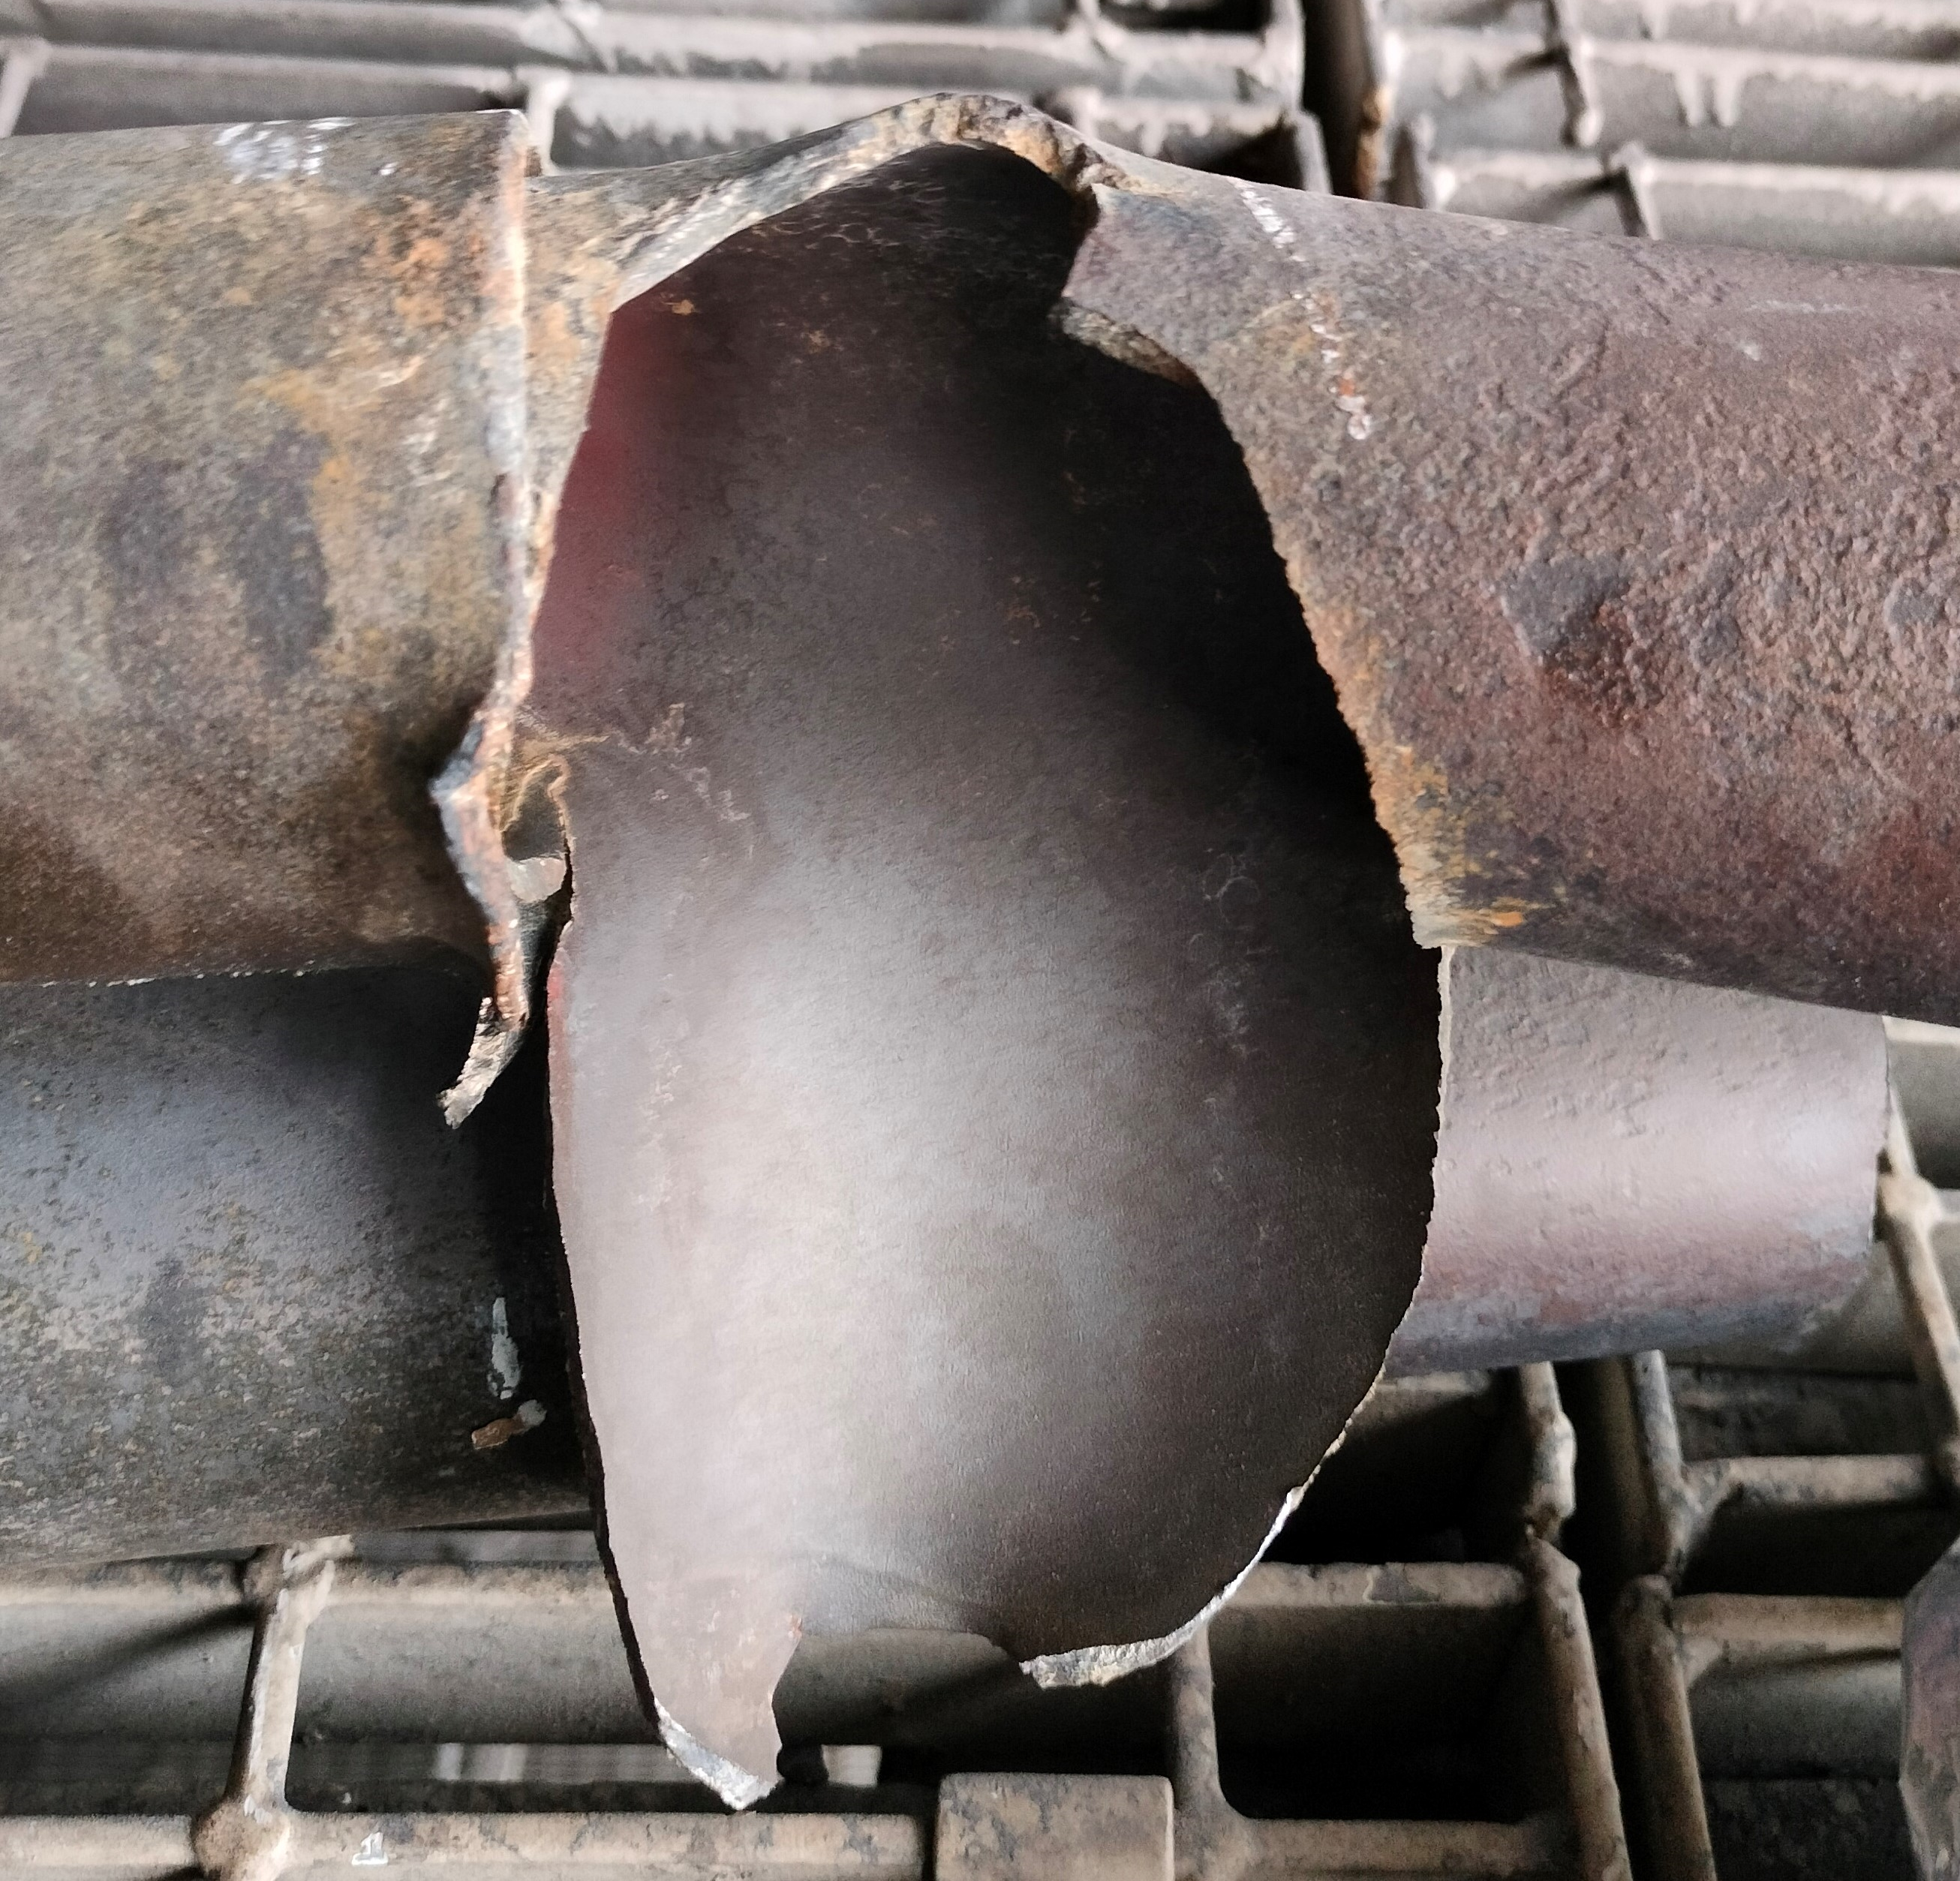
Exhibit-3: Window Type Opening in RH2
02 Nos back-to-back failures
Window type opening in RH2 outlet coils
Tube Details:
Tube Material: SA213 M UNS S30432 SP
Tube Dimensions: 63.5 X 4.0 mm

Slide 12
Conclusion
Exhibit-1: Once the rectification works were completed, and the unit was put into service in October 2022, there has been no further failure in this area for the past 420 days of operation of the unit
Exhibit-2: After the foreign materials were identified through the innovative use of Radiographic Technology (RT) and removed, the unit has sustained for a period of 180 days of continuous operation.
Exhibit-3: After successful identification and subsequent replacement of defective tubes, the unit was put into service in the month of June 2023. In the past 7 months, there has not been a single failure of this type.

Slide 13
Conclusion
Simple, cost-effective and can be deployed easily without much additional resource mobilization.
The benefits accrued in the form of reduced Forced Outages (BTLs) more than compensates for the minimal investments (time, monetary and manpower) which may be required for adoption of the technologies.

Slide 14
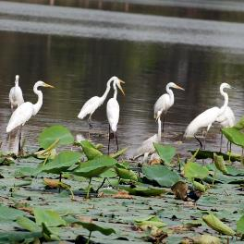

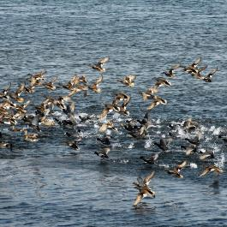
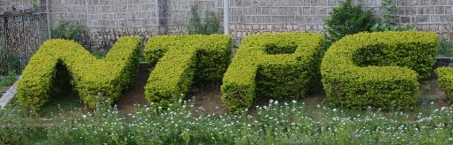
Migratory Birds at NTPC Dadri
Thank You
Stations
Engineering
OS
Region
NTPC Ramagundam
Website: www.ntpc.co.in | Email: solapur@ntpc.co.in
Follow us on:
/ntpc1
/ntpcltd1
/ntpclimited
/Company/ntpc
/ntpclimited

