Slide 1
Presentation at
Indian Power Station Meet - 2024
NKSTPP

Slide 2

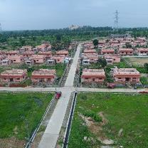
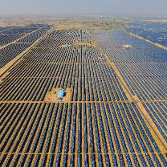
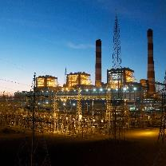
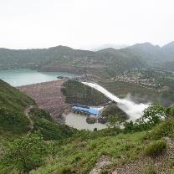
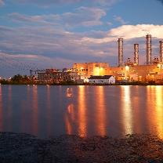
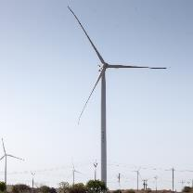
NTPC R&R Colony, Darlipali
NTPC Bhadla
NTPC Kudgi
Imbibe Safety Culture Through Real Time Monitoring
NTPC Koldam
NTPC Kayamkulam
NTPC Rojmal
By:
Sh. Manoj Kumar (AGM-Safety)
Sh. Satya Ranjan Mahapatra (Sr.Manager-MTP)
Follow us on:
/ntpc1
/ntpcltd1
/ntpclimited
/Company/ntpc
/ntpclimited

Slide 3
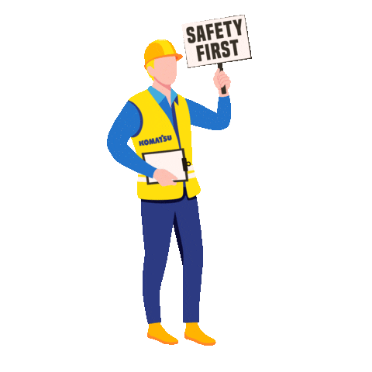
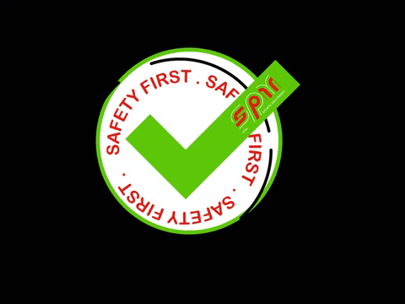
Content
Imbibe Safety Culture Through Real Time Monitoring
1
Introduction
2
Proposed Solution
3
Pilot Project
Technology & Implementation
Prototype
Schematics
4
Key Benefits and Advantage
5
Conclusion

Slide 4
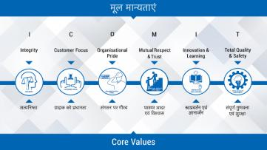
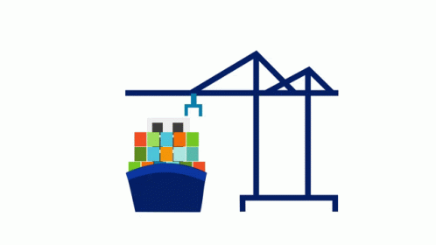
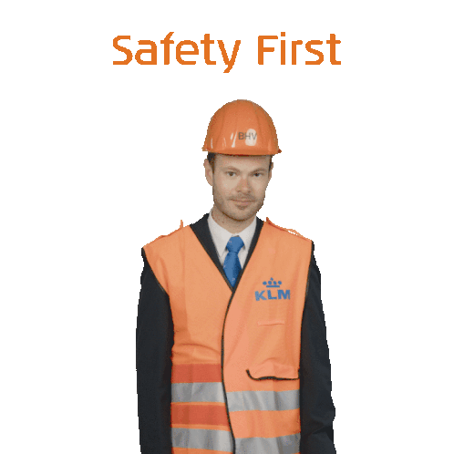
Introduction
Aim & Objective: Safety is part of our core values.
All accidents are preventable;
Objective to provide safe working environment Goal : “Zero Accidents” at work.
Vision of Safety Dept.:
        "The health and safety of its employees is NTPC’s top priority. The ultimate aim is to have no incidents that harm its people, neighbors or put its plants at risk."
Vulnerable Areas
  Construction Projects
  Running Drives
  Boiler, turbine area and BOP

Slide 5
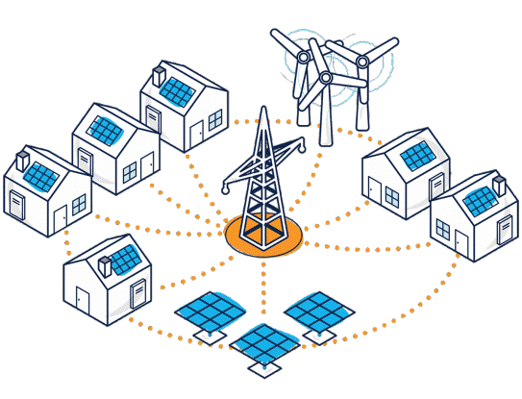

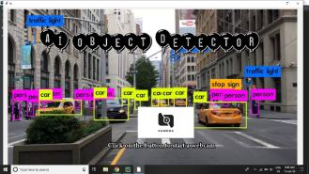

Proposed Solution
Object detection Camera, recognition, processing & signaling
  Camera takes & sends the picture to a remote computer
  Analyze the object detected (specified AI model)
  Determines the class of the object
  Sends the class of the object back to the Camera
  Executes the object-specific command entrusted on it
  Computer signal & Processing/ Rashberry pi system/ Python language programming

Slide 6
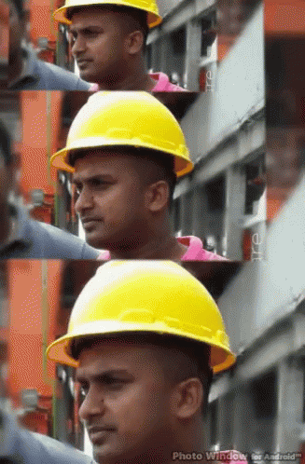

Infrastructure
Object detection Camera, recognition, processing & signaling
          Total images used: 570 , divided into 80% training data and 20% test data.
          Helmets color [Hard hat] : Red, Blue, Yellow & White variety
          Image sizes: 320 pixel x 320 pixel square shape
          Total image features handled: 102400 [the more features, the more complex processing & slower processing]
          Classification model used: MobileNetV2 SSD FPN-Lite & YOLO5 [both works]
          Model detection: 89% for individual [ 38% collective for all 20% ]
          Python3 SDK model is the backend to raise alarm, flag etc.
          Single board computer used: Raspberry Pi,4GB RAM
          Other SBC: like Orange Pi, Jetson Nano etc will also work.

Slide 7



Project Suraksha
”-
“Safety at Work-Place”
◄
7

Slide 8
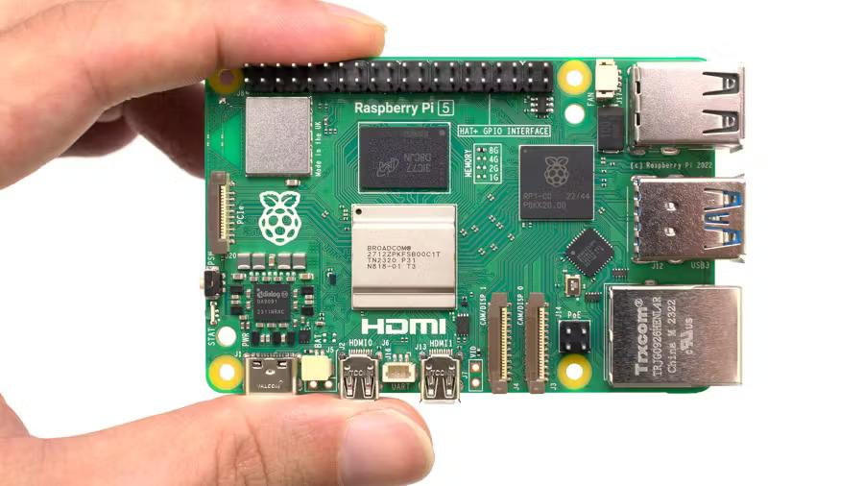
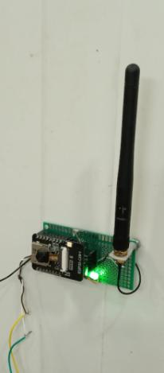
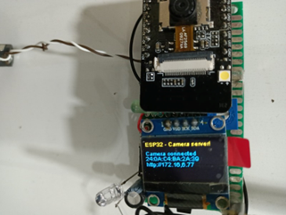
Pilot Project
Infrastructure requirement
  Camera takes & sends the picture to a remote computer
  ESP32 with Camera = INR 650.00**
  IC555 = INR 50.00
  BC547 – 02 nos = INR:50
  100K Variable = INR:50
  HT7333 or LM1117 [3.3V regulator] = INR:50
  10 nf, 470 MFD one each = INR:50
  5V relay = INR:50
  LiPO Battery, connecting wires etc extra.
  10K resistor, 100K POT, 5V SMPS = INR 200
  Software , Internet connection – Inhouse
  **For initial operation ESP32 camera was used. Subsequently, Rashberry pi 5 setup was used.

Slide 9
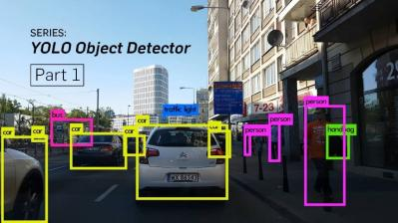
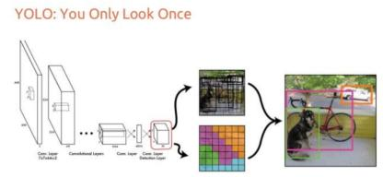

Technology & Implementation
Camera Specifications:
  Camera capturing pictures at a 2MBPS rate
  Can send pictures up to 200 meters distance wirelessly to the nearest WiFi network!
  GPIO output of Camera triggers the IC555
  IC555 inturn drives the relay [5..30 seconds delay]
  Real-time Object Detection with YOLO5
  An algorithm that uses neural networks to provide real-time object detection
  This algorithm is popular because of its speed and accuracy
  Used in various applications to detect traffic signals, people, parking meters, and animals.
  Link for practical demonstration
https://smartphone.edgeimpulse.com/classifier.html?apiKey=ei_b0725f24b4b470f704cdf9545d217791c43736ff900f1fbfc5557437bc33d182

Slide 10

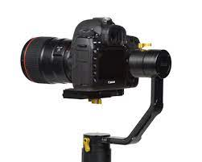

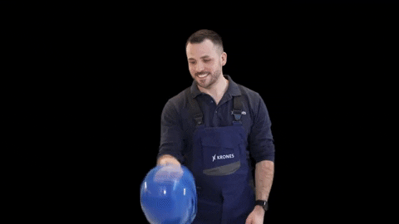
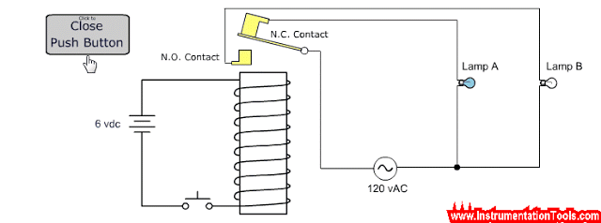
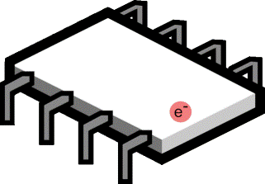
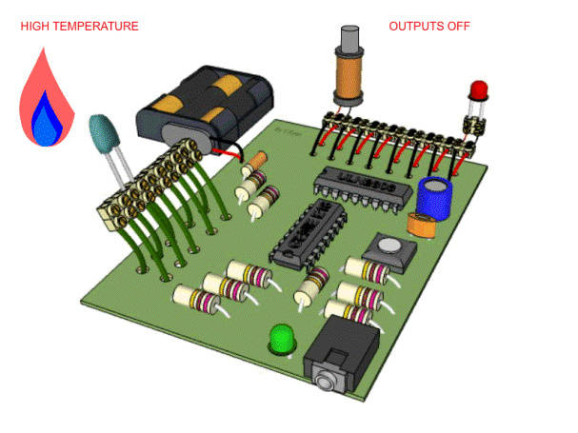


Object Recognition Process – AI Model
Camera
Object
  Computer signal & Processing/ Rashberry pi system/ Python language programming
Micro-processor
Relay
WiFi Internet
Legend
Relay = Warning / Alarm Signal
Object = Person without helmet
Laptop with WiFi

Slide 11

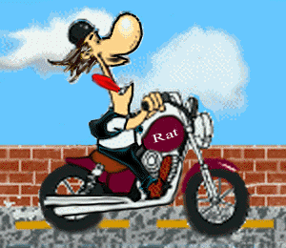
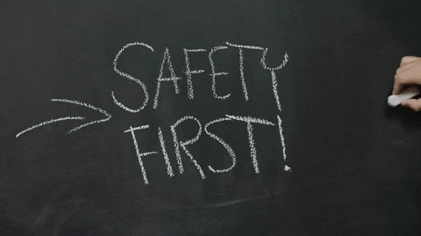
Further Scope
Alarm along with face recognition
  Data base generation for deviation
  Monitoring and control
Crash helmet monitoring at entrance of plant gate/ township location
  Warning and deviation recording
Safety PPE for working at a height job
  Warning and deviation recording

Slide 12
Key Benefits & Advantages
Real Time Faster Object detection
  Speed (45 frames per second — better than real time) – Detect upto 28 meter distance
  Network understands generalized object representation (This allowed them to train the network on real world images and predictions on artwork was still fairly accurate).
  faster version (with smaller architecture) — 155 frames per sec but is less accurate.
  Safety of Human Life
  Proactive accident prevention
  Alarm/ sound system to alert
  Data analysis for disciplinary action / correction of working procedure
Cheap and user friendly
  Overall cost of project less than Rs. 5,000/-
  Safety/Reliability of Operation
  As long as the supply & WiFi network available ,the system works!

Slide 13
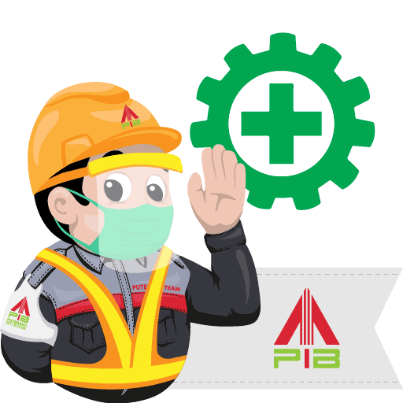
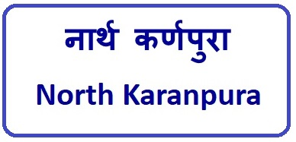
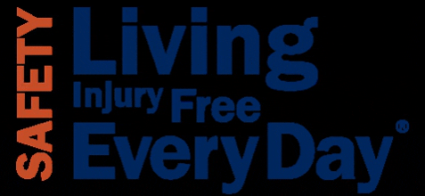

Ongoing Projects
Intelligent Material Separation Project
  For conveyor belt foreign material detection (Coal vs shell vs boulders)
Intelligent Door Project
  For control room door openings
Machine Oil Leakage Detection Project
  Dry floor vs oily floor vs wet floor detection
  Intelligent Fencing Project
  For safety along the boundary wall of township and plant.

Slide 14


Conclusion
“Coming Together is the Beginning.
Keeping Together is Progress.
Working Together is Success.” - – Henry Ford

Slide 15
Bibliography
Bochkovskiy, A. (2020, April). Yolo v5, v4 and v3 for Windows and Linux. (GitHub). https://github.com/AlexeyAB/darknet
https://www.electronicsforu.com/electronics-projects/object-detection-esp32-camera-acts-as-a-sentry
Farahnakian, F.; Koivunen, L.; Makila, T.; Heikkonen, J. Towards Autonomous Industrial Warehouse Inspection. In Proceedings of the 2021 26th International Conference on Automation and Computing (ICAC), Portsmouth, UK, 2–4 September 2021
NVIDIA Jetson TX2: High Performance AI at the Edge, NVIDIA. Available online: https://www.nvidia.com/en-gb/autonomous- machines/embedded-systems/jetson-tx2/
Jin, R.; Niu, Q. Automatic Fabric Defect Detection Based on an Improved YOLOv5. Math. Probl. Eng. 2021.
Jocher, G.; Chaurasia, A.; Qiu, J. YOLO by Ultralytics. GitHub. 1 January 2023. Available online: https://github.com/ultralytics/ultralytics
Bochkovskiy, A., Wang, C.-Y., & Mark Liao, H.-Y. (2020). YOLOv4: Optimal Speed and Accuracy of Object Detection. arXiv. https://arxiv.org/pdf/2004.10934.pdf
Redmon, J., Divvala, S., Girshick, R., & Farhadi, A.(2016). You Only Look Once: Unified, Real Time Object Detection. arXiv
◄
15

Slide 16

Thank You
Thanks
QUERIES AND FEEDBACK ARE WELCOME
“Whatever Level you reach, getting better never stops”-SR Tendulkar

Slide 17
'Hazard’: an object or situation that has the potential to harm a person, the environment or cause damage to property.
‘Incident’: any unplanned event resulting in, or having a potential for injury, ill health, damage or other loss.
‘Injury’: any physical or mental damage to the body caused by exposure to a hazard.
‘Near miss’: an incident that could have resulted in an injury or illness to people, danger to health, and / or damage to property or the environment.

