Slide 1
Innovative Tools & Techniques and New O&M practices
Deepak Kumar Dash
(BE-Chem., NIT- Rourkela)
Head-Chemistry

Slide 2
Presentation Flow
GWEL –At a Glance
GWEL Journey Towards Excellence
Team Constitution
Problem Description
Measurement & Monitoring of Baseline Data
Failure Mode Effect Analysis
Solutions Identification & Implementation
Innovative Solutions
Benefits Envisaged

Slide 3
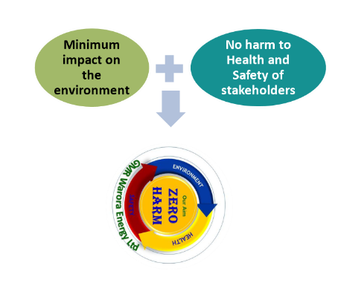

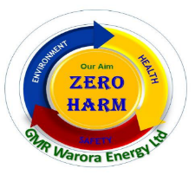
GWEL At a Glance - Group’s Vision, Values & Mission
Vision
“GMR Group will be an institution in perpetuity that will build entrepreneurial organization making a difference to society through creation of value.”
Mission
GMR Energy wants to be the most profitable and one of the leading Integrated Energy Companies in India and derive value by
Diversifying strategically across Energy value chain
Being a preferred employer
Being socially responsible”
Employees
Contractor’s workforce
Community stakeholders
In line with Group’s Vision & Mission,
GWEL strives to create a difference to society through creation of Value by Institution Building
  Health & Wellbeing
  Safety
  Health & Wellbeing
  Safety
  Clean Environment
  Social wellbeing

Slide 4
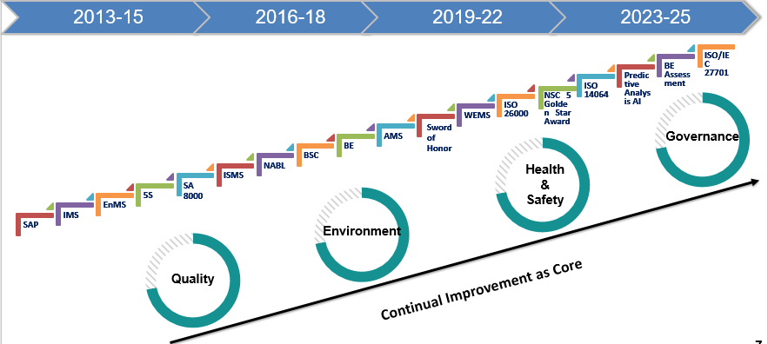
Institution Building through System Approach-
The GWEL Journey Towards Excellence

Slide 5
Team Constitution
Mr. Deepak Kumar Dash
Head, Chemistry
Author
Mr. Angeshwar Dewangan
AM -Chemistry
Co Author
Mr. Sourjya Sarkar
AM-OS & Efficiency
Co Author

Slide 6
Problem Description
Problem Statement:
GWEL was facing few chronic issues over the few years concerning water efficiency in terms of water or chemical consumption
Issue I :- Specific water consumption of the plant was running on higher side (2.39 m3/MWh against the limit of 3) due to various category of water is used at various point. This was creating chronic problem for identifying the increased water consumption at which section due to multiple users in the system.
Issue II :- The non-regenerated type resin of stator column was discarded periodically after getting exhausted. Around 250 kg of stator resin was generated as waste on yearly basis.
Issue III :- Increasing cost of the boiler water chemical i.e., Hydrazine and its consumption quantity was also high.
Business Case:
Freshwater Savings can improve DM water annual energy consumption by 200 Mwhr. And can realize savings of INR 1 cr.
Resin & chemical optimization can annually save INR 5 lacs.

Slide 7
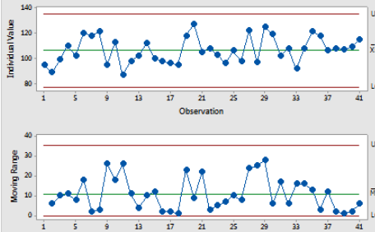
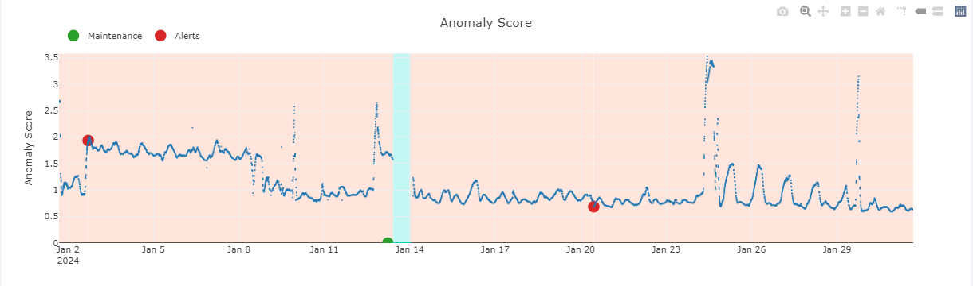
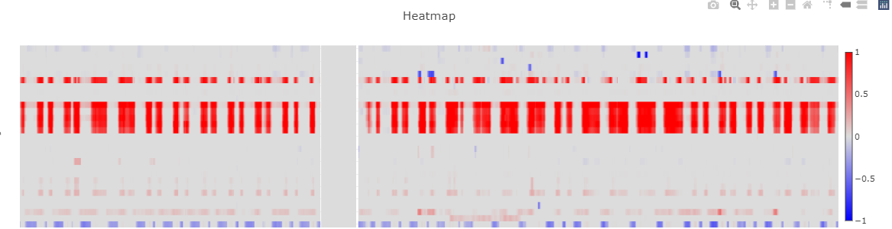
Measurement & Monitoring of Baseline Data
Measurement & Monitoring of Data:
Predictive Analytics – Anomaly detected in the system was identified by the predictive analysis software well ahead of time
Heat Map Diagram - Heat map diagram showed the severity and intensity of the anomaly.
Process Capability & Stability Check - Monitoring the Mean and variation of water consumption shows deviation & process instability.
Mean – 2.27
UCL – 2.54
LCL – 1.99
Max- 2.39
Min – 2.1
St. dv – 0.09
Pp – 0.56
PPk – 0.48

Slide 8
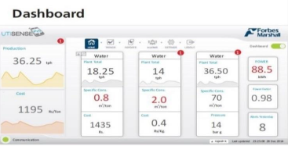
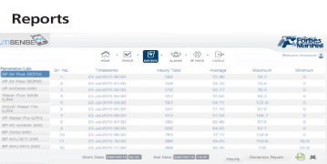
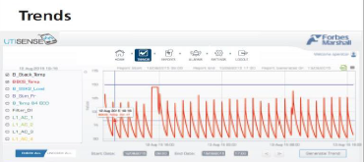
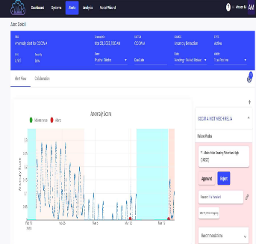
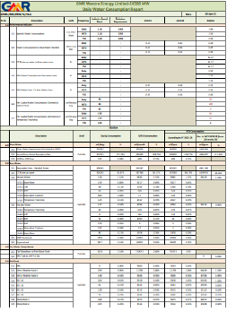
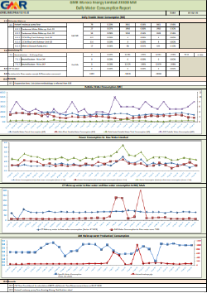
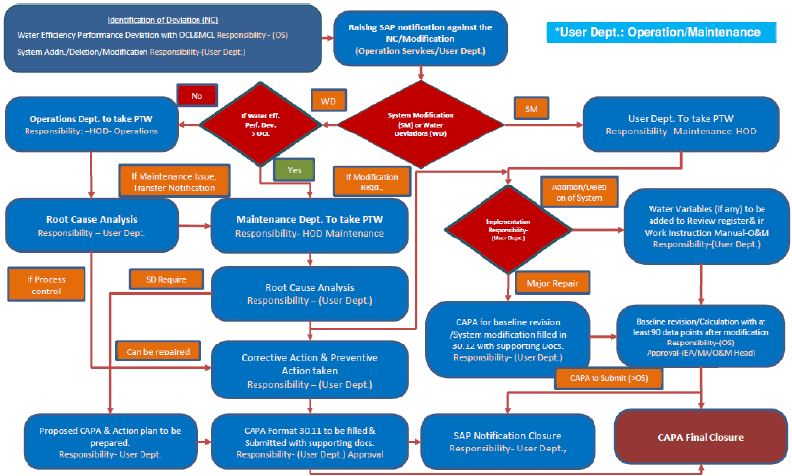
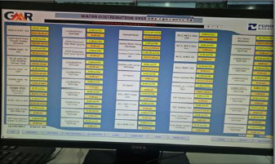

Water Monitoring & Review Mechanism
Centralized Water Management System
Measurement- Process Mapping, installation of flow meters & calibration at predefined frequencies.
Monitoring – Daily, Monthly & Yearly Consumption pattern & deviation analysis through standard formats. Real time water usage monitoring through dedicated System-Water SCADA. A total of 40 no’s of flow meters are installed across plant premises.
Predictions – Integration of Water SCADA with state-of-the-art technology predictive Analytics.
Reporting – Integrated through SAP; Change Mangt.& CAPA closure& approval
Review & Control - Water & Efficiency Management Cell group meetings; CIPs & SIPs for various initiatives & projects.
Daily MIS Reports for Monitoring of Water Consumption & Real time Monitoring System
Daily Water Consumption & Deviation Report
Process Map of “Water Deviation” Closure
“Water SCADA” - Dashboard
“Water SCADA” – Alarm Monitoring Page

Slide 9
Failure Mode Effect Analysis
Sr. No. | Item and Function | Potential Failure Mode | Potential Effect(s) of Failure | SEV | Potential Cause(s)/Mechanism(s) of Failure | OCC | Current Design Controls | DET | RPN
1 | Water Conditioning | Low DM Water Quality | Boiler Tube Leakage | 9 | High TDS in DM water | 1 | Online BTLD system | 1 | 9
2 |  |  | Turbine Blade Corrosion | 9 | High Silica In DM water | 1 | Continuous Water Quality Monitoring through SWAS | 7 | 63
3 |  |  | High Operating Cost | 7 | Low Unit Performance | 1 | Monitoring of Cost Implication of similar incidences | 3 | 21
4 |  | High Specific Water Consumption | High Operating Cost | 7 |  | 5 | Continuous Monitoring of SWC | 3 | 105
5 |  | High Auxiliary Power Consumption | High Operating Cost | 7 |  | 3 | Continuous Monitoring of APC | 3 | 63
6 |  | High Chemical/ Resins Consumptions | High Operating Cost | 7 | Non regenerated type resins & increasing cost of hydrazine | 7 | Continuous Monitoring of Chemical Consumption | 3 | 147

Slide 10
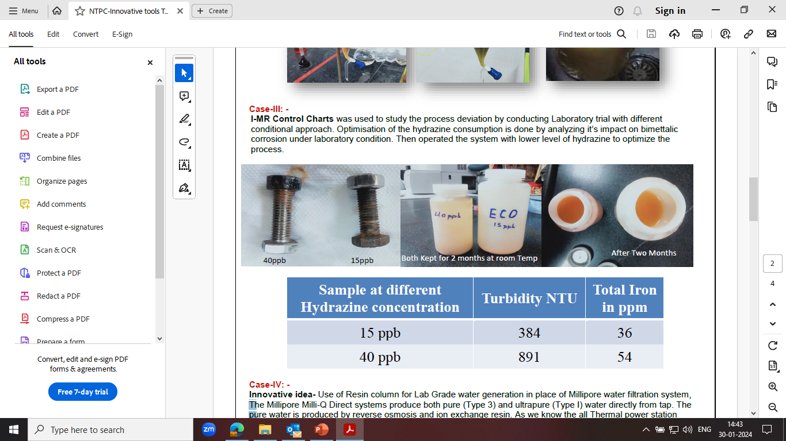
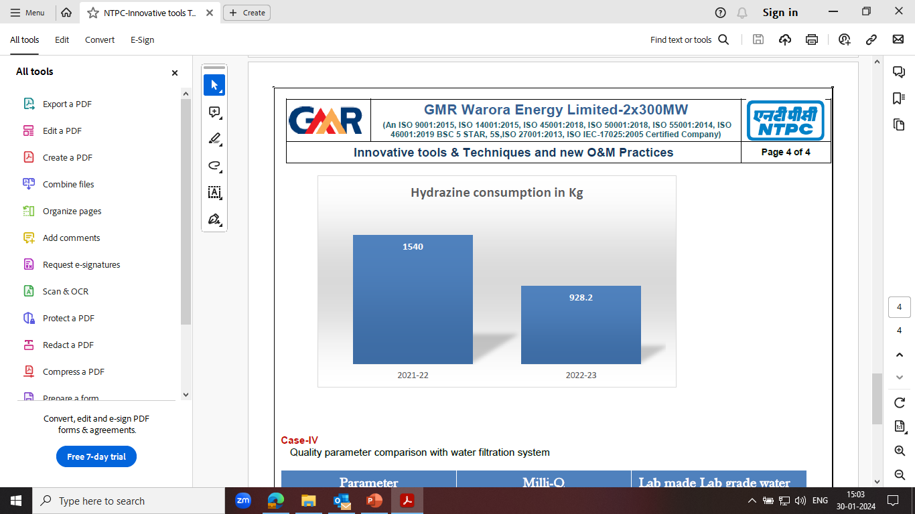
Solutions Identification & Implementation
Through design of Experiments and fitting them into multivariable regression models – It was safely concluded to convert the functional group of the resin from H+ to Na+ used in stator water system and later used in softener.
Case I: (Regeneration of Resins)
Separation of the mixed resin in exhausted condition and then soaking with 4% HCl to remove the copper.
After removing the copper, the resins are regenerated 2- 3 times with brine solution.
H+ ions are completely replaced by Na+ ions thus these resins are made suitable to be used in softener.
Case II: (Optimization of Hydrazine Consumption)
Through laboratory experiments and generating data of impact on bimetallic corrosion at various level of hydrazine concentration and correlating those data; optimum concentration of hydrazine was identified.
Case I : Regeneration of Resins
Case II : Optimization of Hydrazine Consumption

Slide 11
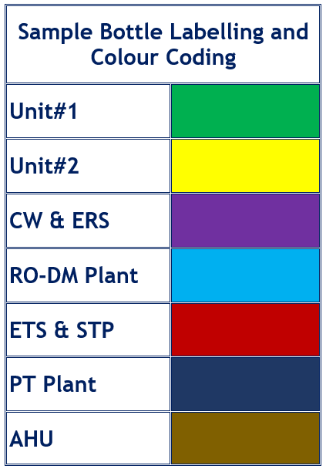
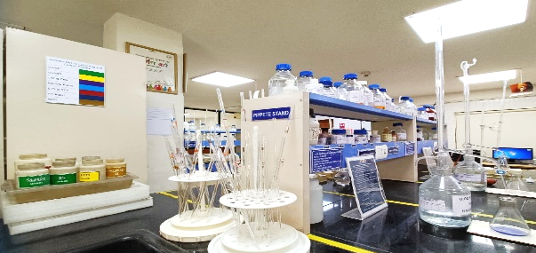
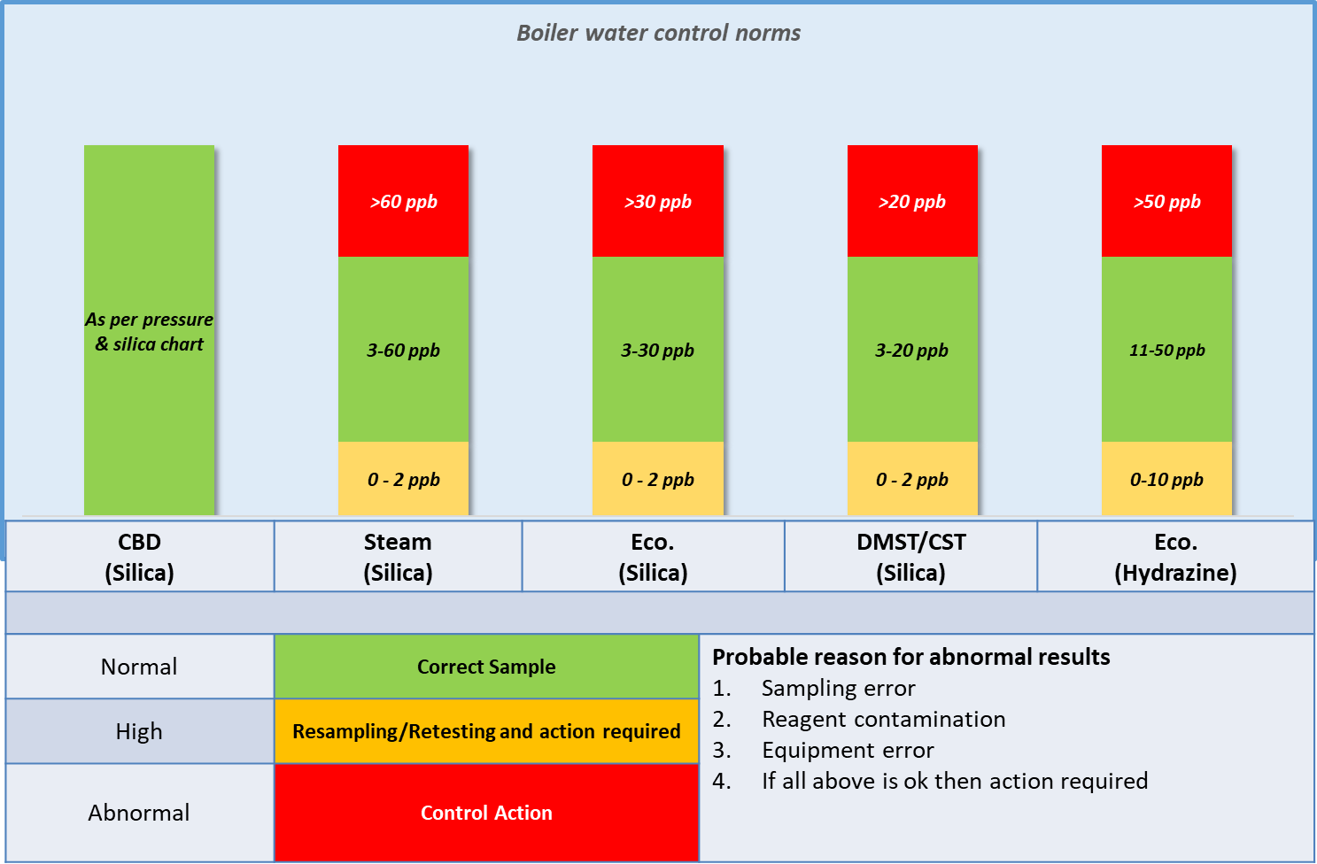
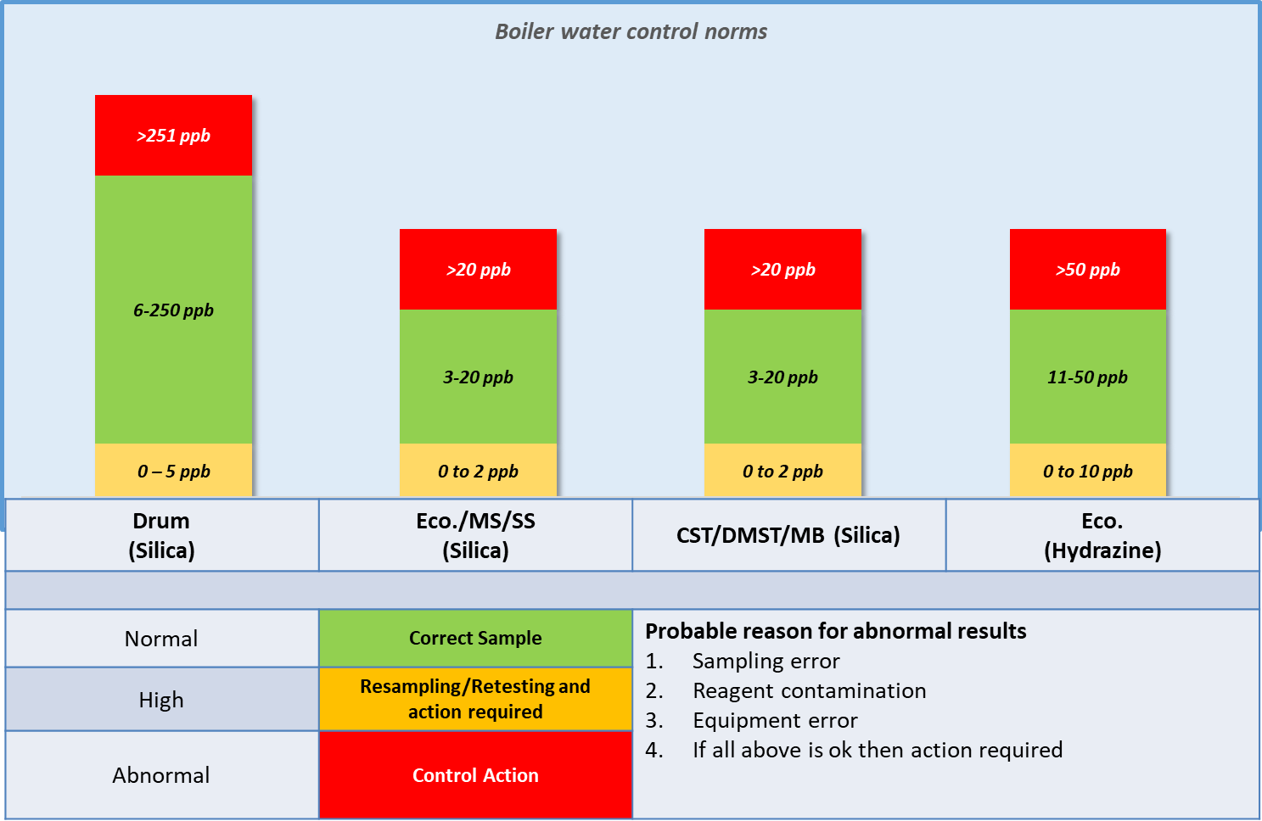
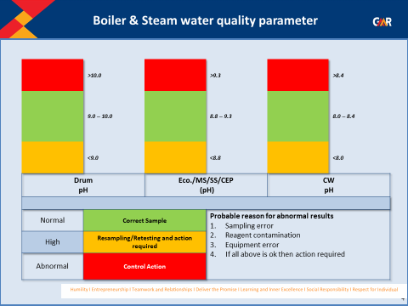
Innovative Solutions
Innovation I - Use of Resin column for Lab Grade water generation in place of Millipore water filtration system
The Millipore Milli-Q Direct systems produce both pure (Type 3) and ultrapure (Type I) water directly from tap. The pure water is produced by reverse osmosis and ion exchange resin.
Polishing unit have one resin column installed in DM water tap.
The discharge water used for laboratory purpose (reagent preparation, glassware washing etc.) in place of Millipore water filtration system.
Parameter | Milli-Q | Lab made Lab grade water
pH | 6.51 | 6.40
Conductivity us/cm | 0.07 | 0.08
Silica ppb | 5 | 5
Innovation I : Use of Resin column for Lab Grade water
Innovation II – Color Coding of Sample Bottles & Various Limits of Control Parameters
Sample bottle label color coding for easy recognition of sample wise sample container, to reduce the contamination of the sample
Display of control chart matrix depicting the various limit range of parameters and their respective control measure near all testing equipment
Innovation II : Color Coding of Sample Bottles & Control Parameters

Slide 12
Benefits Envisaged
Tangible Benefits
Achieved Fresh Water Savings 574585 m3 in 2023-24.
In-tangible Benefits
Bimetallic corrosion is reduced in boiler water circuit.
Auxiliary Power Consumption savings 230400 KWhr.
Annually 400 lit resin is reused.
Annual Saving of 611.8 kg hydrazine without any deviation in feed water parameters.
Risk associated with handling of hazardous chemical is reduced.
Improvement in steam quality and reduction in dumping during light up.
Freshwater Savings
574585 m3
APC Savings
230400 kWhr.
Regeneration of Resins
400 Liters
INR 1 Lac
Hydrazine Consumption Optimization
611.8 Kg
INR 5.39 Lacs
Replacing Millipore Water Filtration System
Annual maintenance Cost
INR 1.46 Lacs
INR 12.65 Lacs
INR 8.06 Lacs
Reduction in Carbon Footprint due to Fresh Water Savings 2,16,043.96 kg.
Reduction in Carbon footprint due to regeneration of resins – 2280 Kg.

Slide 13
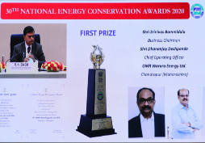
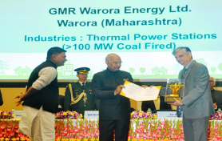
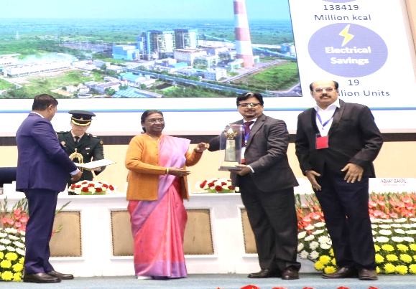
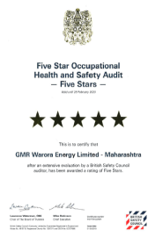
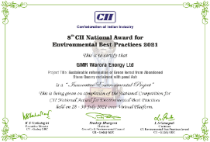
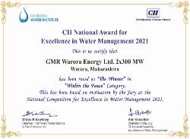
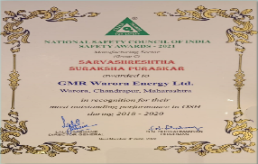
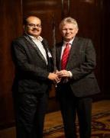

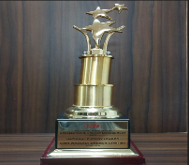
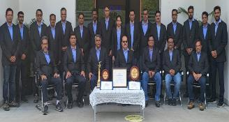
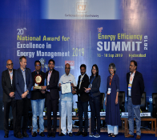
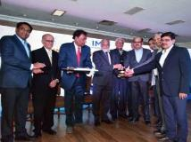

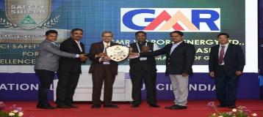
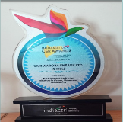
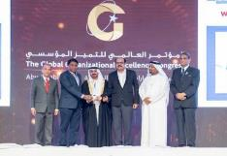
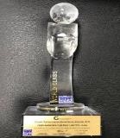
    Awards & Accolades
BEE-National Energy Conservation Award 2023-Consecutive 3 Times
BSC 5 Star 2019
CII Innovative Environmental Project & Water Management Excellence 2021 & 2023
NSC-Sarvashreshtha Suraksha Puraskar-3 Times
Sword of Honor 2019
CII Excellent Energy Efficient Unit Award (Consecutive Seven Times) & National Energy Leader Award (Consecutive Five Times) & Most Useful Presentation -2022,2023
IMC Ramakrishna Bajaj National Quality Award 2017
National Safety Council - Safety Shield’
Maharashtra CSR Award _WASH
Global Performance Excellence Award 2018-World Class

