Slide 1
Indian Power Stations O&M Conference (IPS-2024)
Motor Bus Transfer System : Implementation of Problem Experienced in Thermal Power Plant Live Motor Bus
Manish Kumar Shrivastava, Lav Kumar Kaushik
Electrical Testing Division,
HasdeoThermal Power Station, Chhattisgarh State Power Generation Co. Ltd, Korba Chhattisgarh-495450 INDIA.
MANISH KUMAR SHRIVASTAVA, LAV KUMAR KAUSHIK, CHHATTISGARH STATE POWER GENERATION CO LTD, PP 18

Slide 2
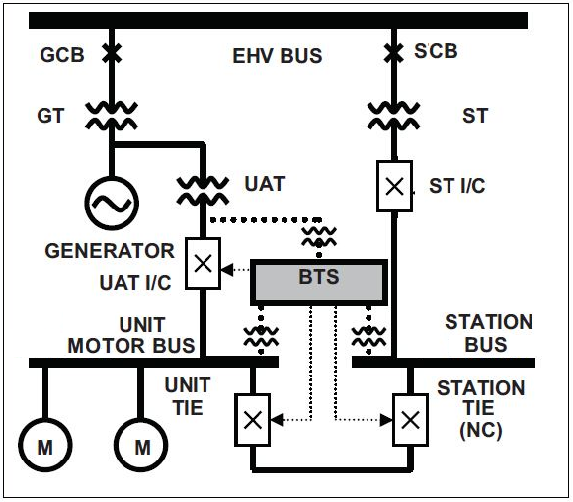
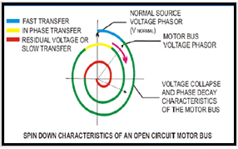
Indian Power Stations O&M Conference (IPS-2024)
Typical Bus Transfer Scheme of Thermal Power Plant
MANISH KUMAR SHRIVASTAVA, LAV KUMAR KAUSHIK, CHHATTISGARH STATE POWER GENERATION CO LTD, PP 18

Slide 3
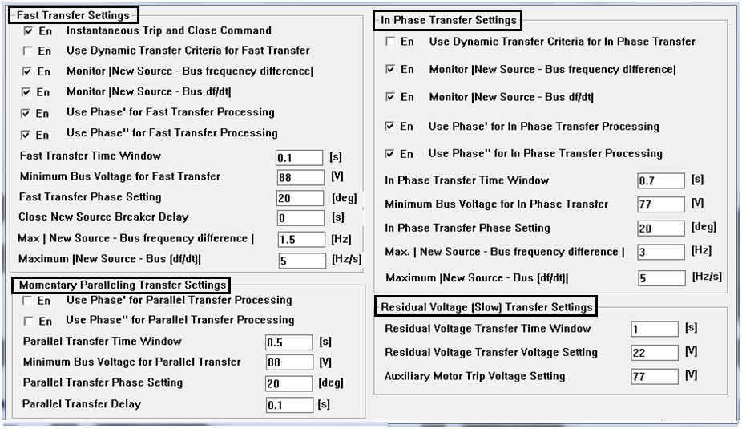
Indian Power Stations O&M Conference (IPS-2024)
BUS TRANSFER MODE
MANISH KUMAR SHRIVASTAVA, LAV KUMAR KAUSHIK, CHHATTISGARH STATE POWER GENERATION CO LTD, PP 18

Slide 4
Indian Power Stations O&M Conference (IPS-2024)
BUS TRANSFER INITIATION
Manual Transfer :- Manual transfer is used for planned transfers during startup, shutdown, or certain kinds of maintenance activities of the plant. The momentary paralleling mode is commonly used for manual transfer for safer changeover of source of motor bus.
2. Protective Transfer :- The protective transfer(s) are initiated automatically on the pickup of different protective relay elements input to the BTS. For instance, a Main-Tie configuration BTS in a thermal power plant has Class A (generator trip, load throw-off) and Class B (turbine and boiler trips) inputs, which actuate immediate changeover of the unit board from the UAT to the station board.
During Source Failure an important challenge is the estimation of the open circuit time constant (or the decay constant) of the motor bus terminal voltage for the combined motors. Typical spin-down characteristics of a unit motor bus is showing with operating region of different bus transfer modes.
MANISH KUMAR SHRIVASTAVA, LAV KUMAR KAUSHIK, CHHATTISGARH STATE POWER GENERATION CO LTD, PP 18

Slide 5
Indian Power Stations O&M Conference (IPS-2024)
Problem Experienced in Thermal Power Plant Live Motor Bus
Bus Transfer during Load Throw Off
Unit Motor Bus Dead due to Breaker Mal-Function during Bus Transfer
MANISH KUMAR SHRIVASTAVA, LAV KUMAR KAUSHIK, CHHATTISGARH STATE POWER GENERATION CO LTD, PP 18

Slide 6
Indian Power Stations O&M Conference (IPS-2024)
Load & Protection detail before Load Throw off of 400 KV Switchyard
S. No. | Feeder Name | FEEDER BUS DETAIL | Import/Gen. (MW) | Export (MW) | Protection Operated
01 | ICT-1 | BUS-I |  | 55 | Neutral Over current
02 | GT-1 | BUS-I | 383 |  | Generator Over Frequency
03 | ST-2 | BUS-II | 7.18 |  | -
04 | B/C |  | 68 |  | Neutral Over current
05 | GT-2 | BUS-II | 246 | - | -
06 | Raita-I | BUS-I | - | 248 | Zone -1 C-G Fault/ AR LO
07 | Raita-I | BUS-II |  | 264 | -
08 | Khedamara | BUS-II |  | 174 | -
09 | Korba West | BUS-II | 124 |  | -
MANISH KUMAR SHRIVASTAVA, LAV KUMAR KAUSHIK, CHHATTISGARH STATE POWER GENERATION CO LTD, PP 18

Slide 7
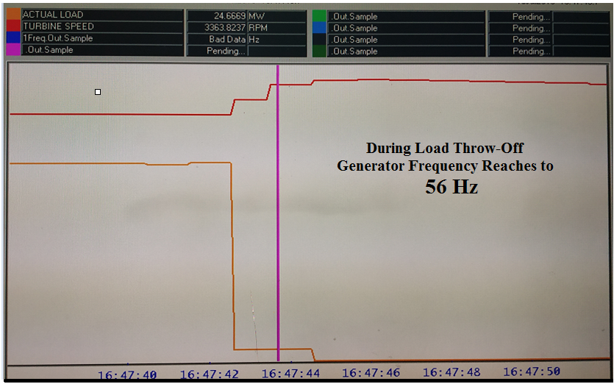
Indian Power Stations O&M Conference (IPS-2024)
TURBO-GENERATOR Speed & Load Trend During Load Throw Off
MANISH KUMAR SHRIVASTAVA, LAV KUMAR KAUSHIK, CHHATTISGARH STATE POWER GENERATION CO LTD, PP 18

Slide 8
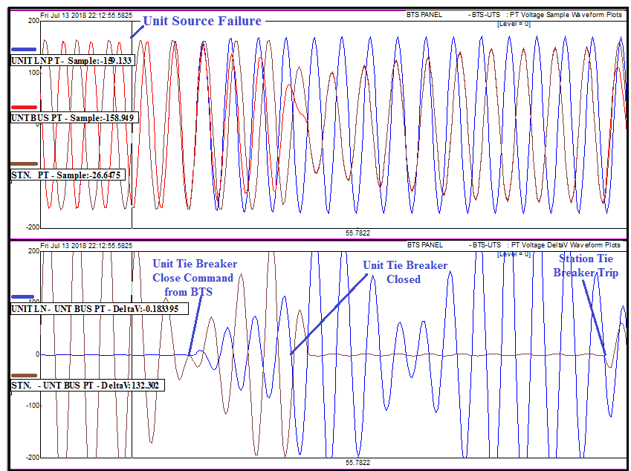
Indian Power Stations O&M Conference (IPS-2024)
Unit Motor Bus Spin down characteristic during Load throw-off condition
MANISH KUMAR SHRIVASTAVA, LAV KUMAR KAUSHIK, CHHATTISGARH STATE POWER GENERATION CO LTD, PP 18

Slide 9
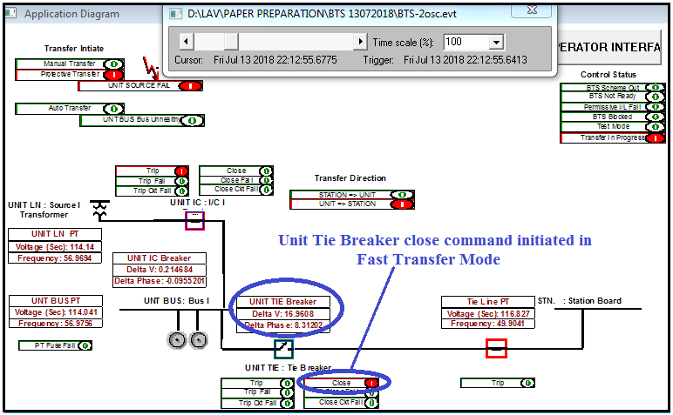
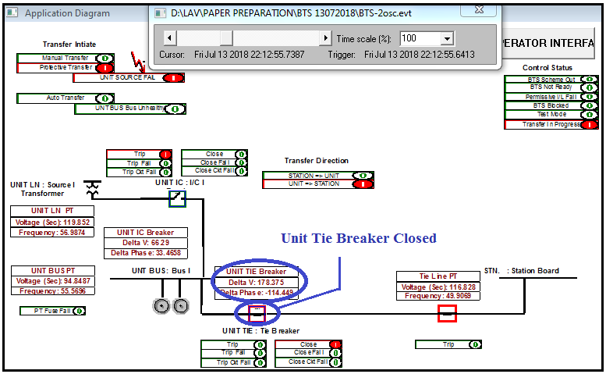
Indian Power Stations O&M Conference (IPS-2024)
Bus Transfer During Load Throw Off
MANISH KUMAR SHRIVASTAVA, LAV KUMAR KAUSHIK, CHHATTISGARH STATE POWER GENERATION CO LTD, PP 18

Slide 10
Indian Power Stations O&M Conference (IPS-2024)
BTS SOE during Load throw-off condition
Time | BTS Sequence of Event | Unit Line PT |  | Unit Bus PT |  | Station Bus PT |  | Unit Line PT - Unit Bus PT |  | Unit Bus PT - Station Bus PT
 |  | V | Hz | V | Hz | V | Hz | ∆V | ∆ø | ∆V | ∆ø
22:15:55:620 |  | 114.22 | 56.95 | 114.01 | 56.96 | 116.69 | 49.90 | 0.00 | 0.00 | 227.38 | 160.55
22:15:55:640 | Unit Source Failure | 113.95 | 56.92 | 113.68 | 56.92 | 116.74 | 49.91 | 0.00 | 0.00 | 181.38 | 103.78
22:15:55:678 | Close Command to Unit Tie Breaker | 114.14 | 56.97 | 114.04 | 56.98 | 116.83 | 49.04 | 0.00 | 0.00 | 16.96 | 8.31
22:15:55:686 | Unit Incomer Breaker Open | 114.31 | 56.97 | 114.10 | 56.86 | 116.82 | 49.90 | 1.37 | 0.68 | 20.35 | -10.02
22:15:55:720 |  | 116.35 | 57.37 | 106.80 | 55.24 | 116.82 | 49.90 | 48.36 | 24.53 | 123.81 | -67.06
22:15:55:731 | Unit Tie Breaker in Intermediate Stage | 119.40 | 57.13 | 94.85 | 55.57 | 116.83 | 49.91 | 60.65 | 30.20 | 161.78 | -99.16
22:15:55:738 | Unit Tie Breaker Close | 119.85 | 56.99 | 94.85 | 55.57 | 116.83 | 49.91 | 66.29 | 33.46 | 178.38 | -114.45
22:15:55:790 |  | 120.48 | 57.02 | 73.20 | 49.51 | 74.67 | 49.52 | 123.81 | -75.07 | 1.56 | 0.00
22:15:55:941 | Station Tie Trip on Over Current | 120.65 | 57.11 | 104.46 | 49.91 | 105.60 | 49.91 | 95.51 | -49.57 | 1.22 | 0.00
MANISH KUMAR SHRIVASTAVA, LAV KUMAR KAUSHIK, CHHATTISGARH STATE POWER GENERATION CO LTD, PP 18

Slide 11
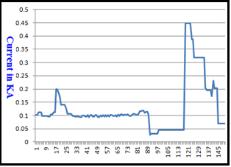
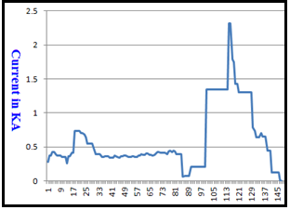
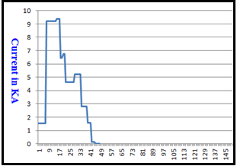
Indian Power Stations O&M Conference (IPS-2024)
Effect on Motor & Unit Motor Bus
Current Trend of CEP-1B Motor (925 KW, Rated Current- 100A)
Current Trend of CW Pump-1B Motor (3 MW, Rated Current- 328A)
Current Trend of Unit Tie Breaker during Transfer.
MANISH KUMAR SHRIVASTAVA, LAV KUMAR KAUSHIK, CHHATTISGARH STATE POWER GENERATION CO LTD, PP 18

Slide 12
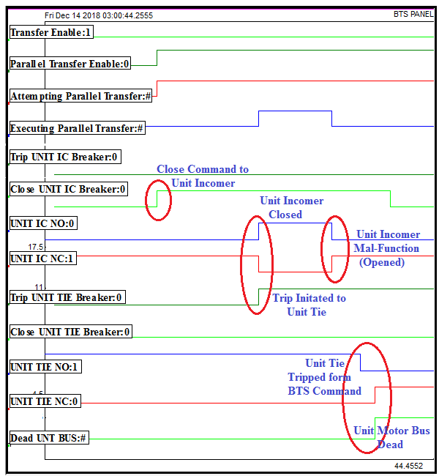
Indian Power Stations O&M Conference (IPS-2024)
Unit Motor Bus Dead due to Breaker Mal-Function
MANISH KUMAR SHRIVASTAVA, LAV KUMAR KAUSHIK, CHHATTISGARH STATE POWER GENERATION CO LTD, PP 18

Slide 13
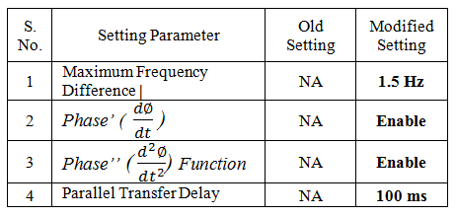
Indian Power Stations O&M Conference (IPS-2024)
Implementation of Solution
Maximum Frequency Difference blocking in Fast Transfer Mode :-
A considerable frequency difference between unit motor bus and station bus has been observed during load throw-off, results a dynamic spin down characteristic, with vide variation in ∆ø; in mean time fast transfer initiation results out of phase closure of unit tie breaker. To prevent such condition during fast transfer mode maximum frequency difference criteria is incorporated.
Use of Phase’ & Phase’’ Function in Fast Transfer Mode :- During load throw-off dynamic spin down charteristic has been observed \ on unit motor bus. In case of fast transfer aim is to minimize dead time, which lead to out of phase closer of unit tie breaker. In order to avoid such condition predicted phase coincidences shall be compared with the new breaker closing. In order to accurate predict phase coincidences, considering the unit motor bus frequency, the phase angle, slip frequency and rate of change of frequency between unit motor bus and the station bus must be calculated and inserted in the second order partial differential equation by using Phase’ & Phase’’ to calculate advance angle to compensate the breaker losing time during fast transfer mode precise breaker closing.
Parallel Transfer Delay in Momentary Paralleling Transfer Mode :- In Parallel transfer the phase angle, delta voltage and delta frequency from the motor bus and the new source are evaluated prior to the transfer, to assure that the motor bus and the new source are in synchronism, so we add a parallel time delay of 100 ms means both breaker will be in close condition, to ensure healthiness of closing of source breaker.
MANISH KUMAR SHRIVASTAVA, LAV KUMAR KAUSHIK, CHHATTISGARH STATE POWER GENERATION CO LTD, PP 18

Slide 14
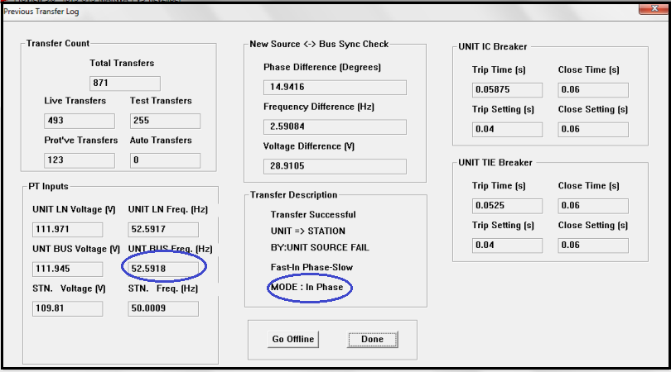
Indian Power Stations O&M Conference (IPS-2024)
TESTING VALIDATION
Maximum Frequency Difference Blocking Setting In Fast Transfer Mode
MANISH KUMAR SHRIVASTAVA, LAV KUMAR KAUSHIK, CHHATTISGARH STATE POWER GENERATION CO LTD, PP 18

Slide 15
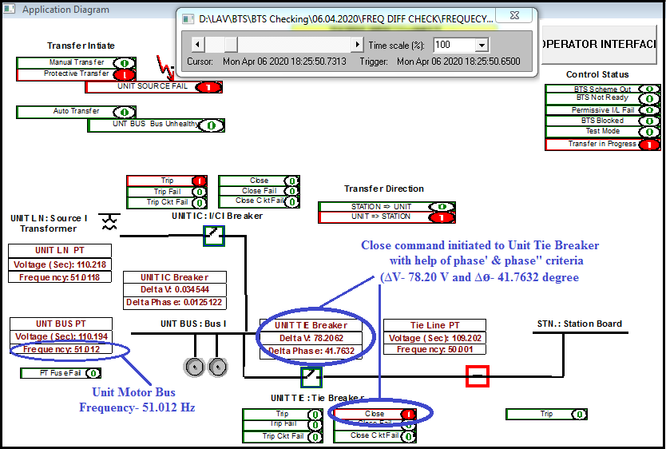
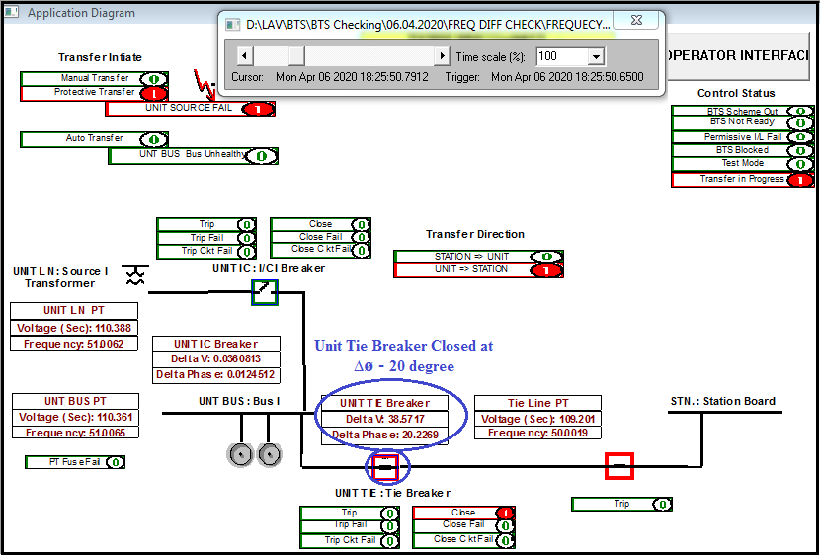
Indian Power Stations O&M Conference (IPS-2024)
2. Use Phase’ & Phase’’ for Fast Transfer Processing
MANISH KUMAR SHRIVASTAVA, LAV KUMAR KAUSHIK, CHHATTISGARH STATE POWER GENERATION CO LTD, PP 18

Slide 16
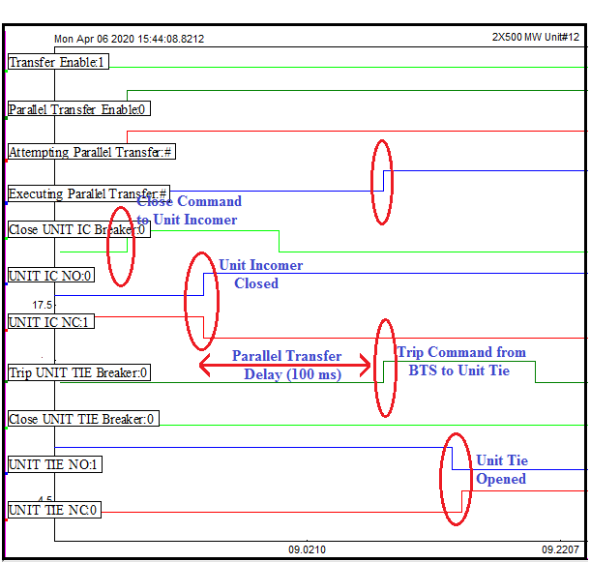
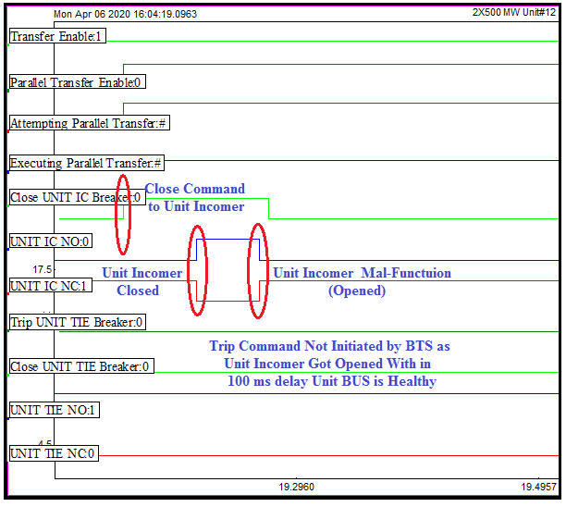
Indian Power Stations O&M Conference (IPS-2024)
3. Parallel Transfer Delay in Momentary Paralleling Transfer Mode
MANISH KUMAR SHRIVASTAVA, LAV KUMAR KAUSHIK, CHHATTISGARH STATE POWER GENERATION CO LTD, PP 18

Slide 17
Indian Power Stations O&M Conference (IPS-2024)
Conclusion
This Paper Describe detail analysis of two problem experienced in thermal power plant. The nature of logic and setting modification that are carried out after such incident, with proper testing validation.
Thanks
Questions
MANISH KUMAR SHRIVASTAVA, LAV KUMAR KAUSHIK, CHHATTISGARH STATE POWER GENERATION CO LTD, PP 18

