Slide 1
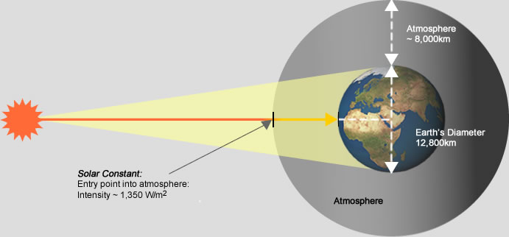
Reduction of the Carbon Footprint in the existing Plant by Blending Steam with Solar Tower Technology
Solar Constant
Entry point into atmosphere
Intensity ~ 1350W/m²
Dr. T.MALLIKHARJUNA RAO, ADDITIONAL DIRECTOR
Materials Technology Division
Central Power Research Institute, Bangalore

Slide 2
Net zero carbon is a state where the amount of carbon dioxide emissions from human activities is balanced by the amount of carbon dioxide removed from the atmosphere.
Some principles of net zero include:
Prioritizing reducing emissions
Minimizing the need for offsets
Ensuring environmental integrity

Slide 3
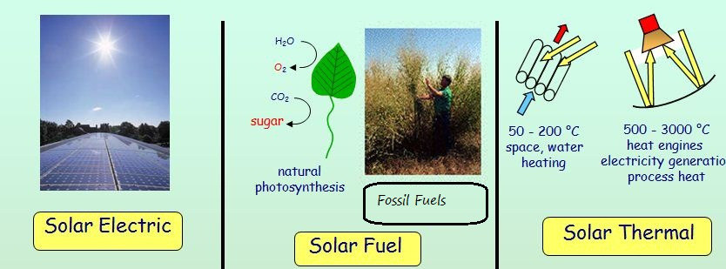
Methods of Solar Power Electric Production

Slide 4
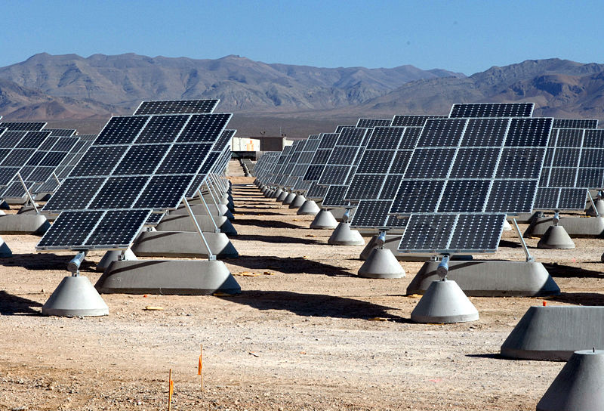
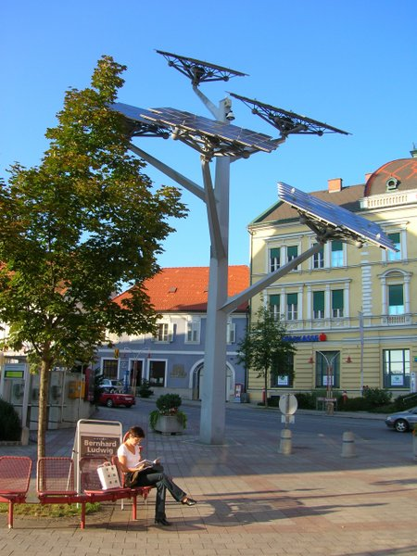
1MW PV solar power plant will requirement- Approx. 20,000m² to 30,000m² (5 to 7.5 acres).
More than 2MW requires special high voltage transmission lines (over 7kV).Apart from these separate O & M setup required for these type of plants.
High environmental effects of used Solar Panels disposal as discussed below.

Slide 5
Solar Electricity by PV Modules
A method of generating electrical power by converting solar radiation into direct current electricity through some materials (such as semiconductors) that exhibit the photovoltaic effect.

Slide 6
Life of the Solar Panel
If the solar industry is to truly present a sustainable solution, the photovoltaic solar panels end-of-life phase must be addressed.
PV panels have normally a 20 ~ 25 year life after which it is to be discarded. There is a degradation
For a commercial 1 MW system consists approximately 4000 panels
A large issue, often overlooked, is what to do with a PV system once it is decommissioned?

Slide 7
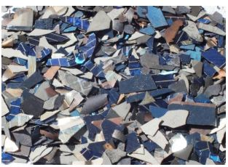
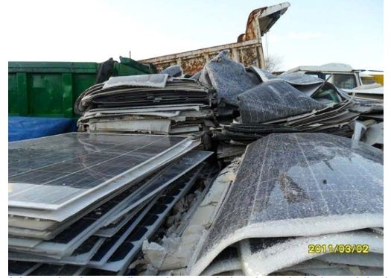
With present rate of Solar Installations, it is anticipated that, after 20 years , the weight of discarded panels may reach up to 20 million tones, which is 2000 times the weight of Eiffel Tower (7300 tons)

Slide 8
These problems will be eliminated/minimized , if an existing thermal power plant is hybridized with solar Thermal power
And also carbon emissions can be reduced.
In this proposal the solar energy can be utilized in the from Solar Thermal energy instead of Solar PV panels.
The following table compares efficiencies of solar PV and Solar Thermal process of Electricity production.
Description | ENERGY EFFICIENCY
Solar Photovoltaic system for Power Production | 9.5 %
Integrated Solar Rankine cycle system for Power Production | 16.37 %

Slide 9

How to Use Solar Thermal Energy
Solar Thermal Energy
Working fluid
Solar Radiation
Solar Thermal Energy
Solar collector
Solar Radiation
Solar Radiation
thermal energy
Solar Radiation
working fluid

Slide 10
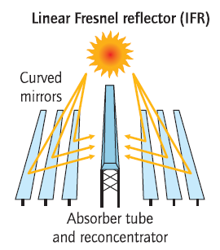
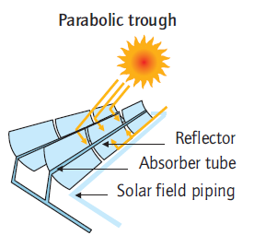
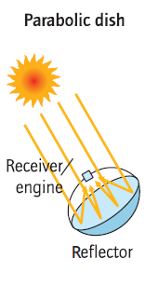
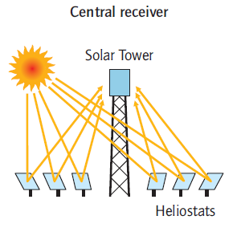
Concentrated Solar Power

Slide 11
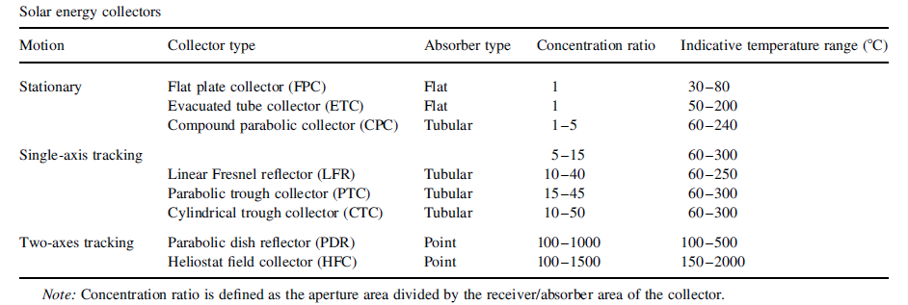
Types of Solar Collectors
Solar Thermal Energy
Low temperature
Medium
temperature
High temperature
Collectors and working temperature

Slide 12
Heliostat field collector
Solar Thermal Energy
A heliostat is a device that includes a plane mirror which turns so as to keep reflecting sunlight toward a predetermined target.
Heliostat field use hundreds or thousands of small reflectors to concentrate the sun’s rays on a central receiver placed atop a fixed tower.

Slide 13
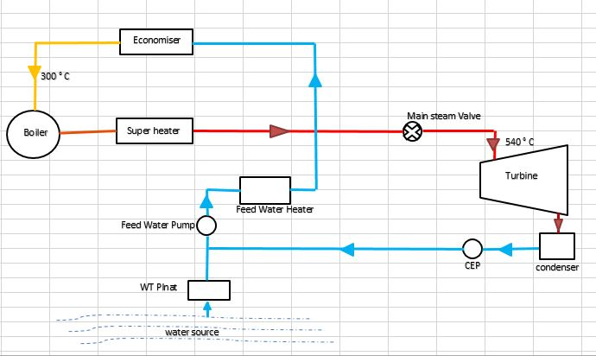
Steam blending with Solar Tower Technology
Existing steam circuit

Slide 14
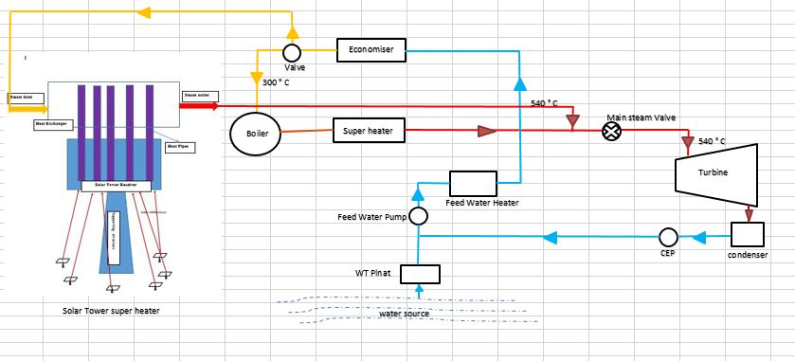
Steam blending with Solar Tower Technology
Proposed steam circuit

Slide 15
The solar heating system's intake will be coupled with the economizer's outlet.
The solar heater will raise the 300º C temperature of the steam coming out of the economizer to 550º C.
Now, the steam produced by the coal and this superheated steam are combined.
As a result, there will be a decrease in the amount of coal used, resulting decrease in CO₂ emissions.
The output of a steam power plant won't be impacted by this mixing of steam.

Slide 16
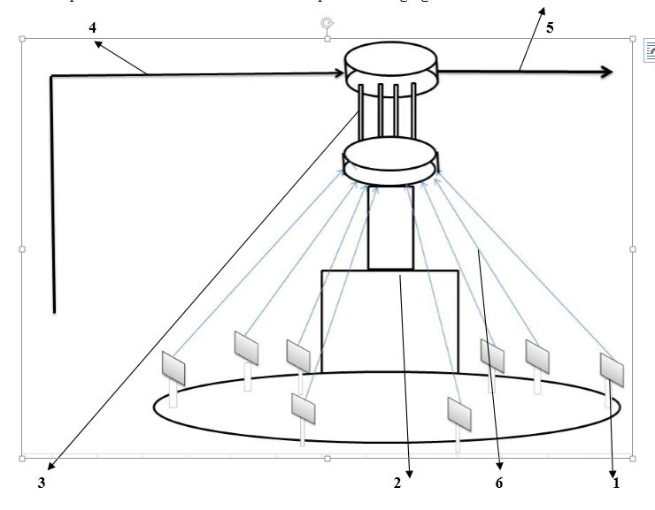
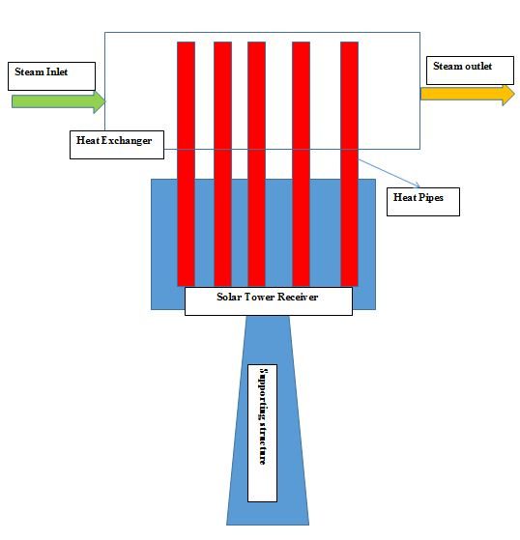
Solar Tower Technology

Slide 17
The area required for this solar tower
can easily accommodated at the vacant
land available at existing
Thermal Power Plants

Slide 18
Comparison the parameters with proposed solar steam blending
Sl. No | Description of Parameter | Existing Plant | Modification with Solar Blending | % Improvement
1 | Coal quantity | 40 kg/s or 3456tons per day | 32 k/s or 2764.8 tons per day | 20 % coal saving
2 | Coal quantity per day | 3456 tons | 2764.8 tons | 691.2 tons of coal saving
3 | Carbon Di oxide (Co₂) emission per day | 3294.5 t | 2635.8 | 19 % of Co₂ that is 658.7 tons of Co₂ reduction

Slide 19
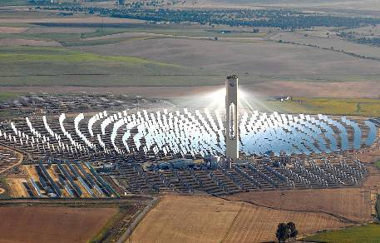
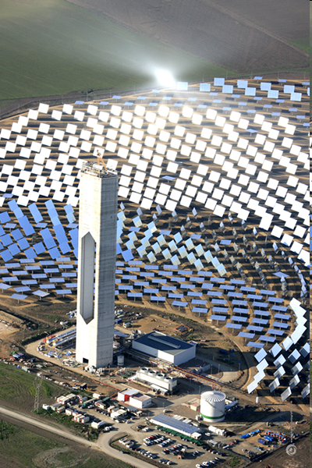
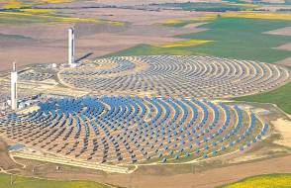
Solar Thermal Power
PS10 and PS20 solar power tower (HFC)
(Seville, Spain). 2007 and 2009

Slide 20
