Slide 1
Application of Data Analytics
In Dry Ash Conveying System
Adani Power Limited Tirora

Slide 3
Notes:
In last 2 decades Adani Group has emerged as largest Private port & logistics, Largest Agrei business, Largest Transmission , largest integrated Coal Management & largest private power producer under the leadership of our Honorable Chairman Sh Gautam adani.
The group is directed through our Chairman’s Vision

Slide 5
Adani Power: Current Operational Capacity…
Mahan Acquired by Adani Power
Adani Power Ltd
Raipur & Raigarh – Acquired by Adani Power
SN
Location
Capacity (MW)
No of Units
Technology
1
Mundra (Gujarat)
4,620
4 X 330
5 X 660
Sub-Critical
Supercritical
Kawai
2
Tirora (Maharashtra)
3,300
5 X 660
Supercritical
3
Kawai (Rajasthan)
1,320
2 X 660
Supercritical
4
Udupi (Karnataka)
1,200
2 X 600
Sub-Critical
Godda
5
Raipur (Chhattisgarh)
1370
2 X 685
Supercritical
Mundra
6
Raigarh (Chhattisgarh)
600
1 X 600
Sub-Critical
Tirora
7
Mahan (Madhya Pradesh)
1200
2 X 600
Sub-Critical
Udupi – Acquired by Adani Power
8
Godda (Jharkhand)
1600
2 X 800
Ultra Super-Critical
Total Generation
15,210
Ultra-supercritical - 2 nos
Supercritical units- 14 nos
Sub-Critical Units- 9 nos.
Green field
Acquired by APL

Slide 6
Plant Brief

Slide 7
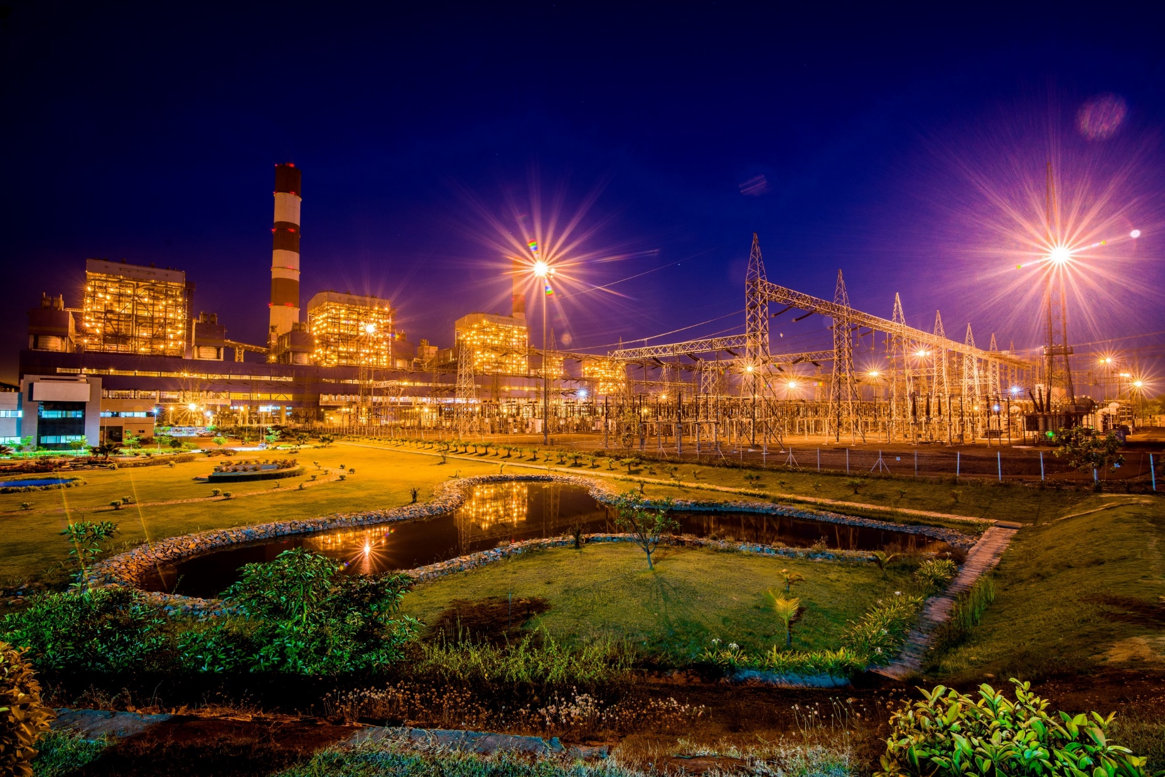
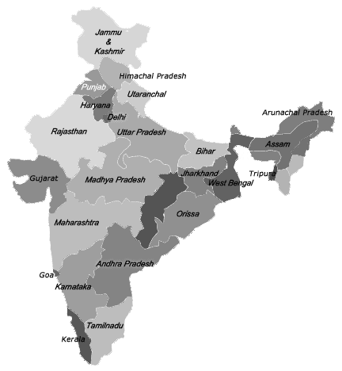
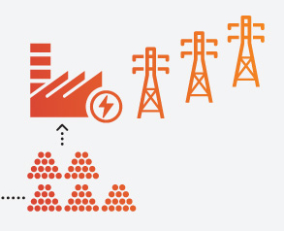
APL-Tirora Overview
First super-critical technology-based power Plant of Maharashtra
Capacity : 5 X 660 MW (3300MW)
Coal sourced from different subsidiaries of Coal India.
Water sourced from Wainganga River.
Power evacuation through 400KV & 765KV lines

Slide 8
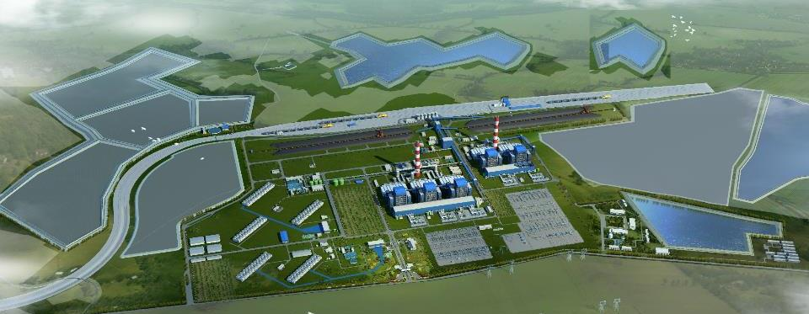
Plant Layout
RWR-2
RWR-4
Ash Silo
WT & TH
Ash Dyke
Coal Yard
Starter Dyke
RWR-3
4
5
2
1
CT Area
3
765 KV SWYD
Stores
400 KV SWYD
RWR-1
Rail
Safety
Park
3300MW
49000 MT Coal
18000 MT Ash

Slide 9
Unit 5 COD
11th Oct 2014
APL-Tirora
Journey
Unit 4 COD
31st Mar 2014
2014
Unit 3 COD
14th June 2013
Unit 2 COD
30th Mar 2013
2013
Unit 1 COD
23rd September 2012
2012
Project Zero Date
1st January 2008
2008

Slide 10
Ash Handling Plant – A Brief
The composition of Fly Ash and Bottom Ash is 80% and 20% respectively
Each unit has two lines dedicated for fly ash conveying
The Electrostatic Precipitator (ESP) has 10 fields and 16 hoppers for each field.
At all units in full load, approximately 18000MT of ash production is expected :
Bottom Ash part is around 3600 MT
Fly ash around 14400 MT
The overall time taken for fly ash evacuation is around 4.5 hours in a shift of 8 hrs (13hrs/day)

Slide 11
Line Diagram for Fly Ash Disposal
APH Hoppers 8nos
ESP Hoppers 160 nos
Drain Sump for Ash Slurry PH Drain
Wetting Head (62 TPH)
DRY
Collecting Channel
Ash Slurry Sump
Collector Tank
Seal Box
WET
AH Pump House
Three Cell Collector
Ash Disposal Pond
In Plant Surge Hopper
Vacuum Pump
D Pump
ASH SILO

Slide 12
Problem Statement
Reduction in entire ash handling system availability
Number of defects in dry ash conveying line were 1206.
Availability of dry ash conveying was 92.79%
Interruptions in dry ash evacuation.
Increase in Auxiliary Power consumption (APC).
Difficulty in limiting the fugitive ash as per environmental norms

Slide 13
Team Composition
O&M Head
Maintenance Head
POC
AHP MMD Head
User (AHP MMD)
Shubham Shrivastav & Pankaj Kumar
Analytics Center of Excellence
Business Partner
M/s JEPL

Slide 14
Parameter Analysis
Principal Component Analysis
Root Cause Analysis
Defect Analysis
D-Pump defects
Vacuum Pump defects
Factor Analysis
Coal Quality and Quantity
Breakdown Maintenance
Defects in silos
Defects in conveying lines
Coupling leakages
Various seal leakages
Bag filters damages
Repetition in defects
Maintenance practices
Seasonal Impact
Metallurgy of pipes
Mechanical breakdowns
Maintenance requirements
Ash handling challenges
Environmental factors
Operator errors

Slide 15
Data Extraction & Analysis
Exploratory Data Analysis (EDA) process was carried out for 2.5yrs of SAP data.
From EDA it was clear that Dry ash & Bottom ash defects contributed 70% to the total downtime.
Pareto chart’s drill down methodology for concluding the Line Leakage and then to Column Leakages
Following were the key arguments for examining availability of dry ash system:
Frequent failure or line leakages or interruption in dry ash evacuation system.
No proper Data Management to identify frequency of leakages.
Mild Steel (MS) pipe is more viable to leakage, alternatives are not identified.
No priority for replacement/rotation of pipe.

Slide 16
Statistical approach for Failure Prediction
Statistical approaches available for predicting failure were:
Poisson Distribution- to model number of events in fixed interval of time
Exponential Distribution- when failures occur randomly and time between failure is exponential
Weibull Distribution- to model the time until an event occurs
Why Poisson Distribution?
To model the number of failures occurring in a month with a known constant mean rate and independently of the time since last failure.
Why Exponential Distribution?
To calculate Mean Time Between Failure.

Slide 17
Existing Maintenance Practice
Maintenance team had a philosophy of 180° rotation of that very piece
Specific nomenclature was not given to the point of leakage
All units were treated alike for maintenance and overhauling
Challenges Faced & its Solution
Nomenclature of defect
Data Recording
Standardization in defect logging
Thickness Survey
Unapproachable location
New columns numbering initiated (130 nos & each Units has 2nos of lines ) & Same was punched in SAP for defects
Between columns A, B & C (along the flow of ash particles) marking was done in SAP
SAP entry become more specific & with more information such as leakage type, spot and line length replaced

Slide 18
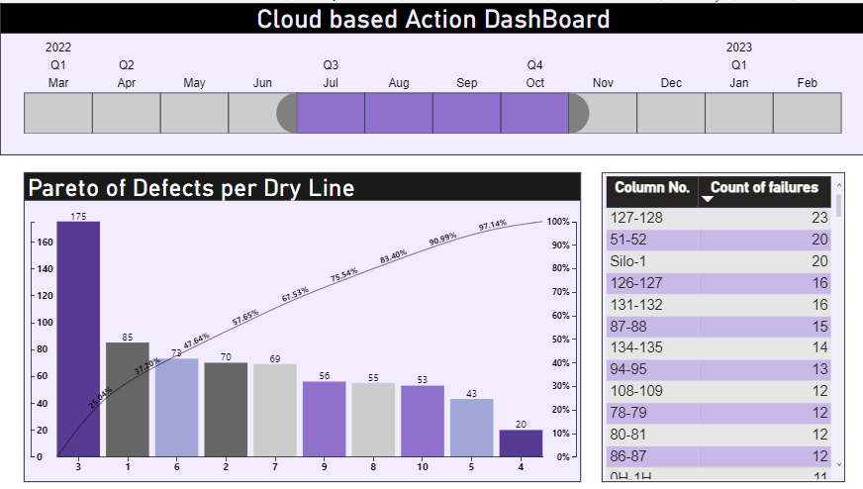
Action Dashboard
Dashboard 1
The dashboard shows different failure rates across different units as shown.
The dashboard provides recommendations for the right locations for dry line replacement and rotation, aiming to reduce the quantity of dry line replacements and improve the overall efficiency of the ash handling system

Slide 19
Action Dashboard

Slide 20
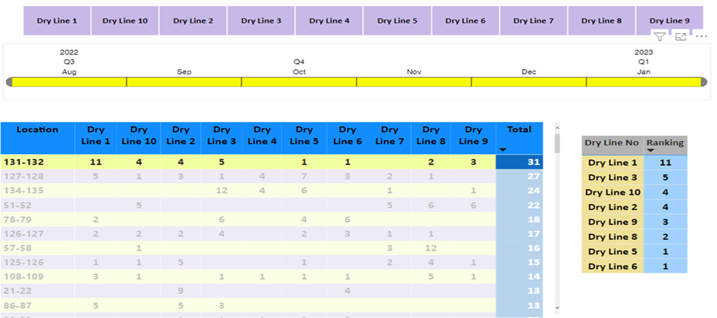
Action Dashboard
Dashboard 2
As cast basalt lines had a longer life, so, if the MS line or the High Grade 410 line was to be replaced by cast basalt line, for that a prioritization matrix was made.
Fixing of costly cast basalt lines can be done as per the ranking table

Slide 21
Action Dashboard

Slide 22
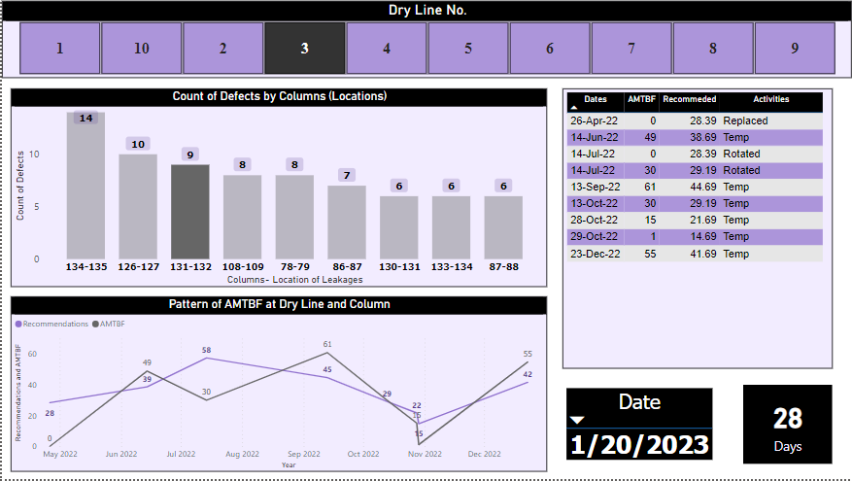
Action Dashboard
Dashboard 3
The dashboard shows trending of Mean Time Between Failure (MTBF) in the same column.
With input such as activity carried out in all the failures such as rotation or replacement, the dashboard was used to predict the date when the next failure was expected to occur.
Accordingly, the maintenance team could plan the recommended activities (either rotation or replacement) prior to the expected failure date

Slide 23
Action Dashboard

Slide 24
Process to use Action Dashboard
Updating Defect log
Defect log in Microsoft form by end user
Logging activities carried out by end user
Power BI
Refresh data in Power BI
Dashboard
Pareto Dashboard
MTBF & action date
Prioritization Dashboard

Slide 25
Benefit Estimation Methodology
Benefit will be driven by:
Lowering the quantity of dry line replacement, adopting the rotation schedule.
Improved gain post rotation of dry line by 120-degree to attain prolonged life of that line.
Lowering cost incurred for replacing dry line with MS line or Cast Basalt piece.
Start
T
Ro
T
Rep
T
Ro
T
Rep
T
Ro
T
Rep
Current practice
T
Ro
T
Ro
T
Rep
T
Ro
T
Ro
T
Rep
Recommended practice
Increment in life
Earlier practice by user team: 180-degree rotation.
Initiative intervention and recommended practice: 120-degree rotations
Reduction in replacements/Increment in life: 33.33%

Slide 26
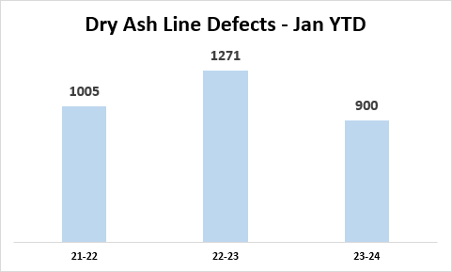
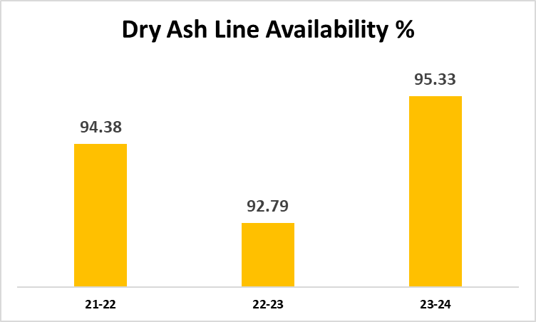
Potential Benefits
Replacement of 758mtr (10% of total line) of line and incurring expenses of 62.8 lacs INR in 2022 which was replaced 513 mts in 2023
Reduction in Auxiliary Power consumption (APC) due to running in wet + dry mode.
Increase in water consumption due to wet mode operation.

Slide 27
Thank You

Slide 28
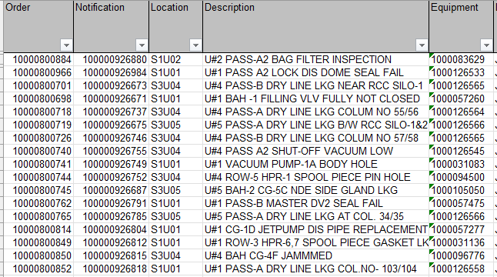

Slide 29
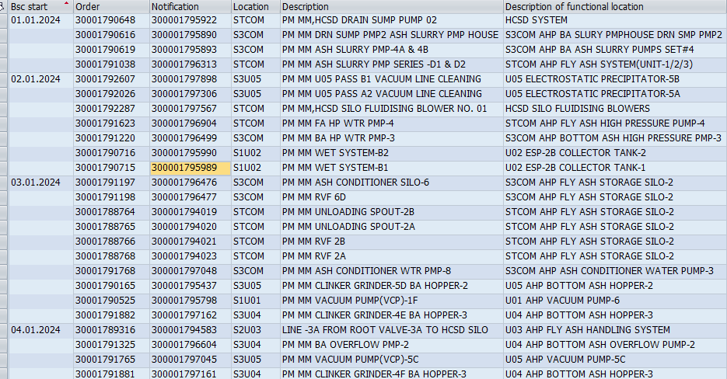

Slide 30
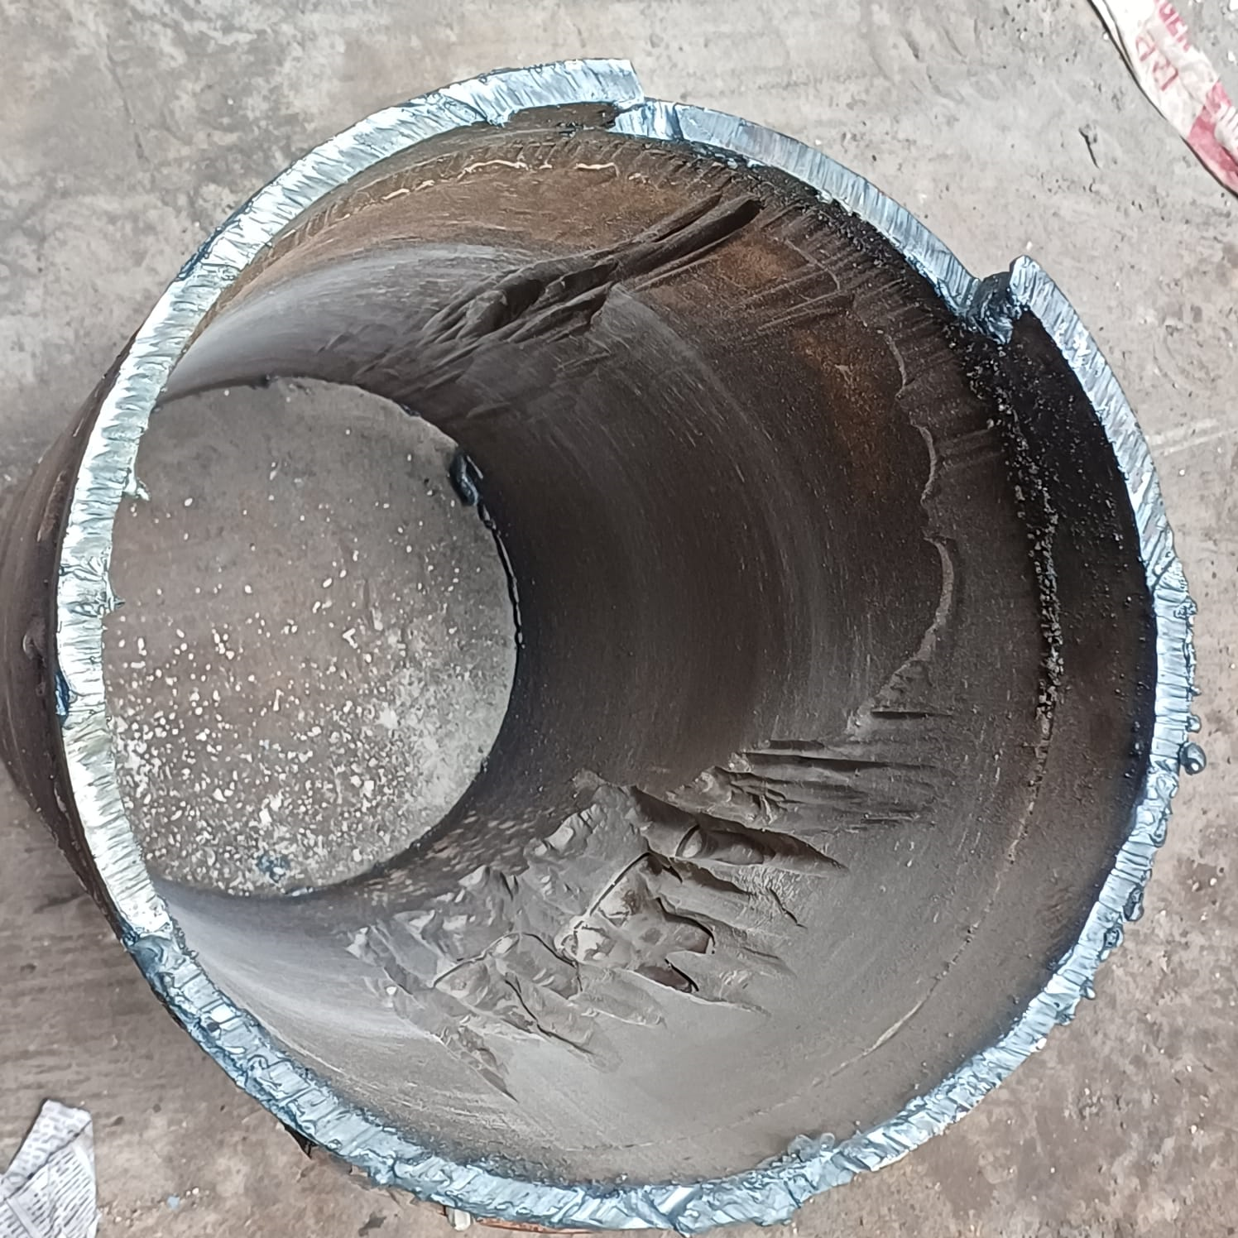
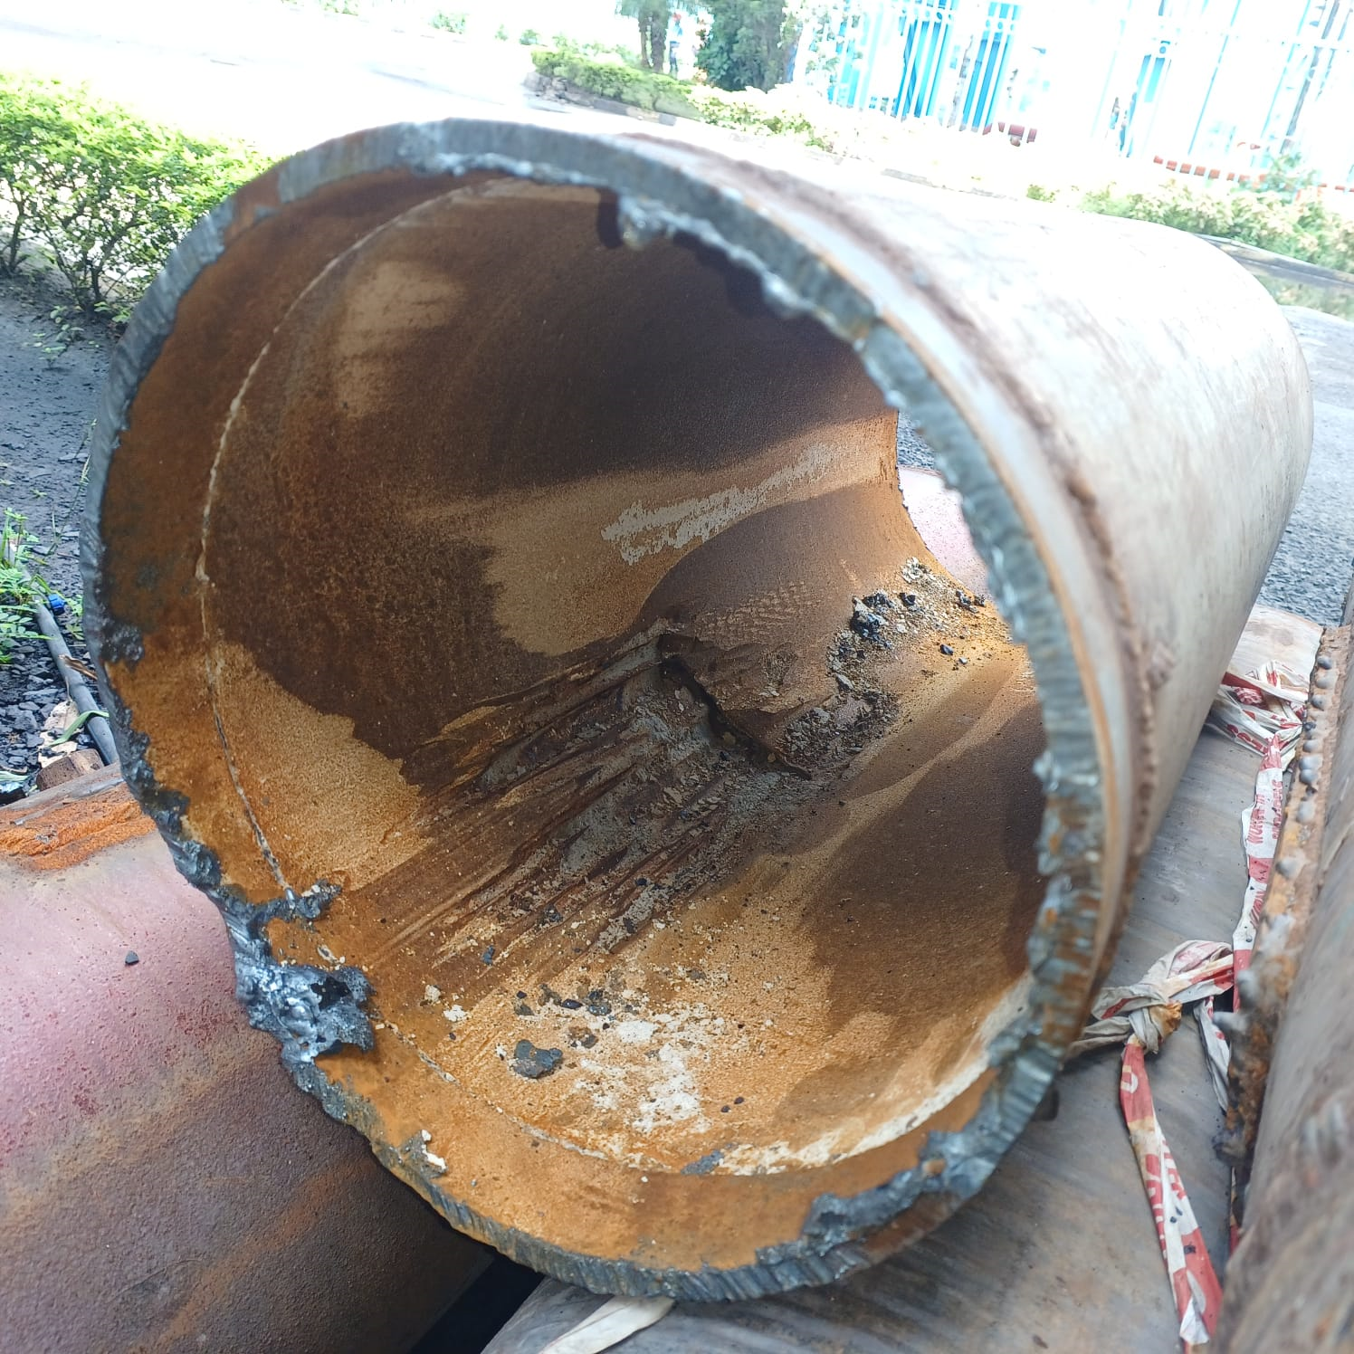

Slide 31
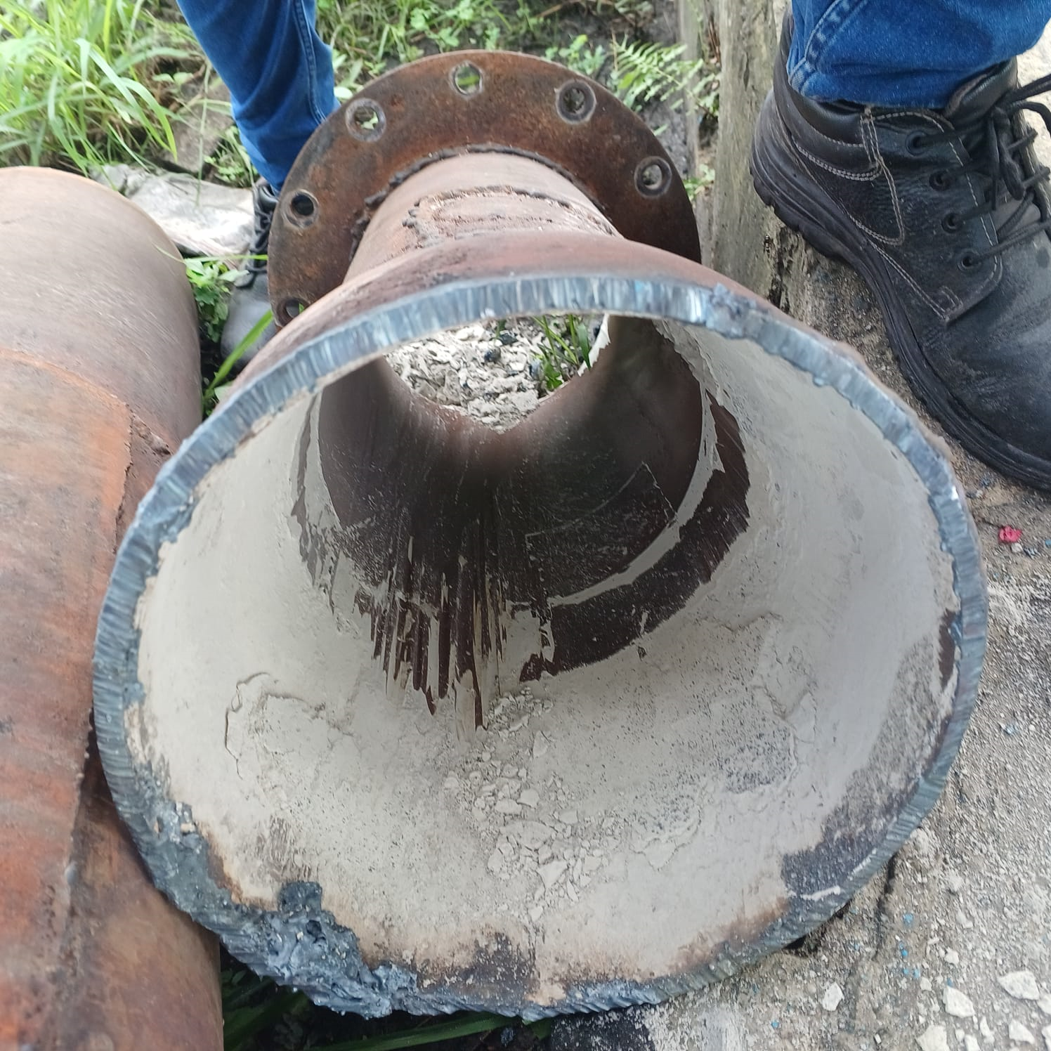
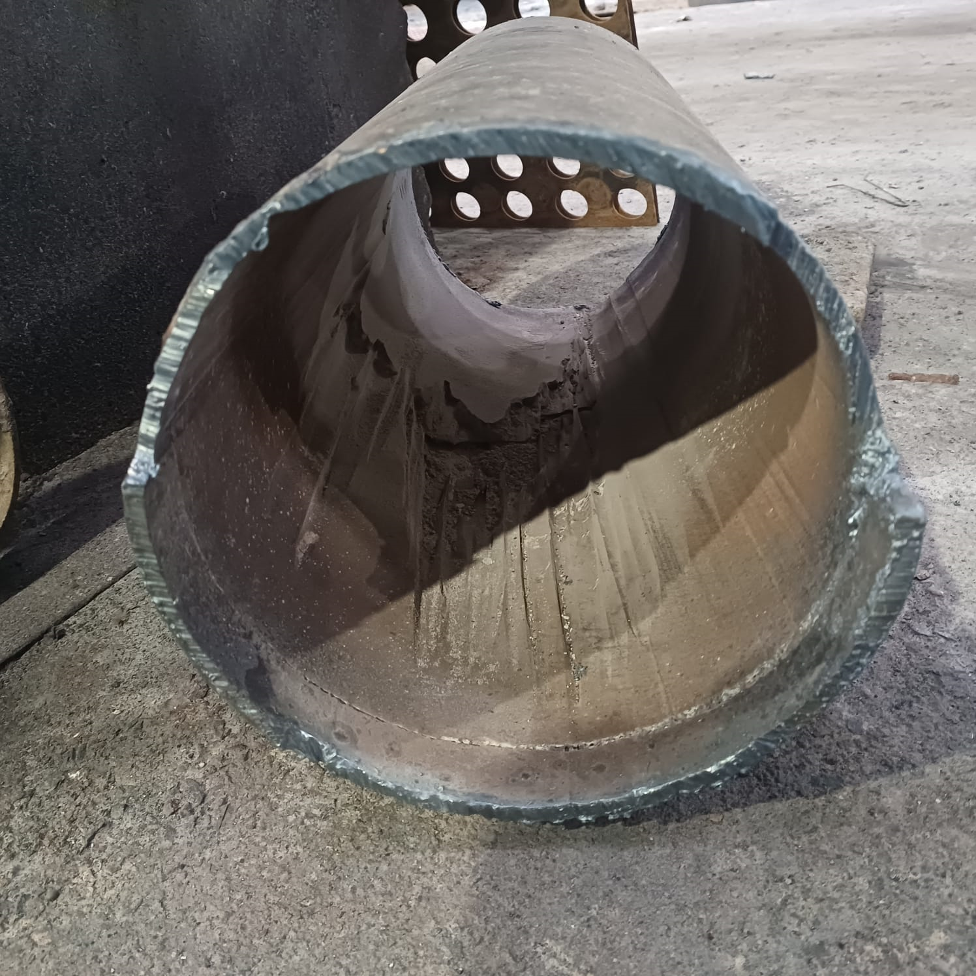

Slide 32
Award & Accolades

Slide 33
Our Achievements
BSC
Boiler
SUP
NSC
received FIVE STAR rating based on the audit conducted by British Safety Council.
with 2nd position in Best Boiler Use-2022 organized by Directorate of steam boiler, GOM.
M/s. CII, certified APML as Single Used Plastic Free organization in Sep’21
Certificate of Appreciation received for Best Safety practices for 2020 in Manufacturing Industry
(Thermal Power) category
FICCI
5S
IMS
NABL
Received Gold award in maintenance excellence in power category
“5S” certification in the Par excellence category from QCFI & JUSE
Recertification of
IMS by TuV Nord.
NABL Accreditation - Environment & Chemistry Laboratory of APML
RBNQA
NSC
Boiler
Achieved 2nd Position in IMC RBNQA Performance Excellence Trophy-2019
Certificate of Appreciation received for Best Safety practices for 2020 in Manufacturing Industry
(Thermal Power) category
1st Prize for Best Suggestions,
3rd prize as best Boiler User in Boiler-2020 Conclave by director of steam boilers, Mumbai
MPCB
Safety
FICCI
5 Star Rating for Plants with lower PM in Stack Emissions for 3 consecutive years (for 2017, 2018, 2019)
Safest Plant of the year for two consecutive years i.e. 2017-18 & 2018-19 by Central safety committee of Adani
Certificate of Appreciation for Safety Systems Excellence in FY 18-19 by FICCI

