Slide 1
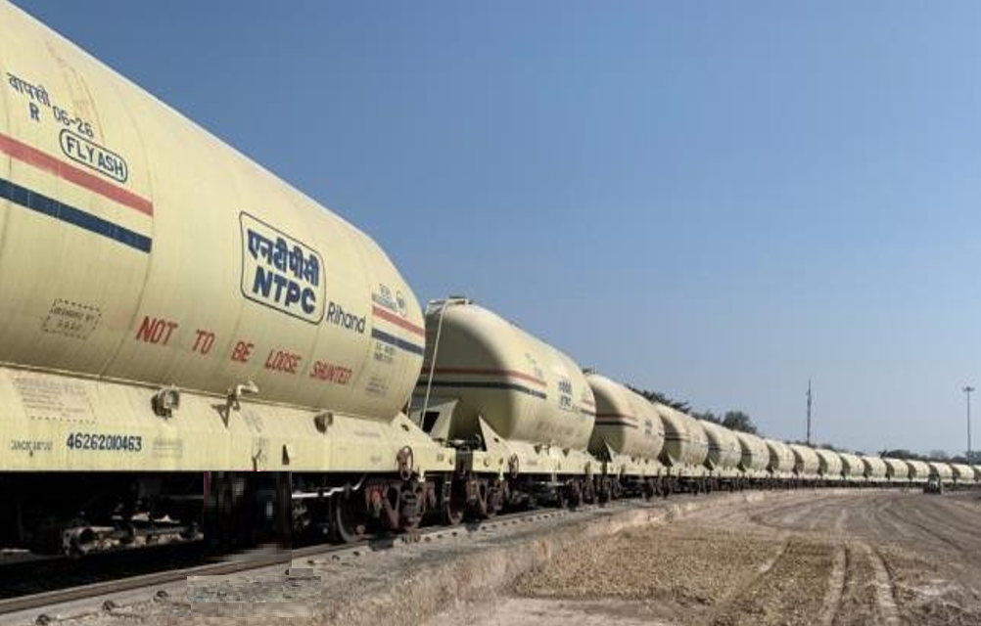
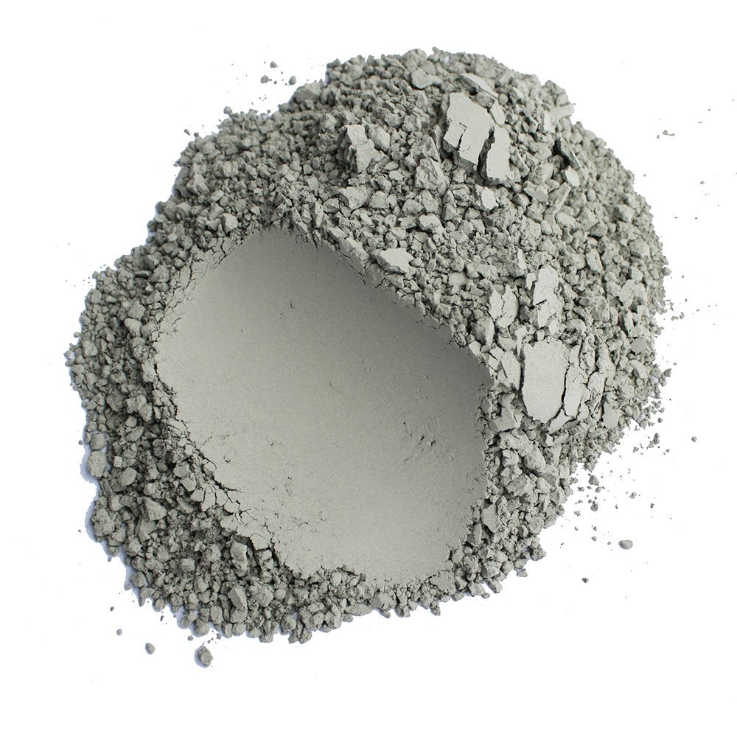
Way of Sustainable Ash Utilisation : Fine Fly Ash Collection and Transportation through BTAP wagons

Slide 2
RIHAND
Category-C
AU Compliance as per MoEF&CC Notifications: Category C : (As ash utilization < 60% in FY 2021-22) 5-year compliance cycle | No minimum ash utilization % requirement in FY 2022-23 & FY 2023-24 Minimum 80 % ash utilization in FY 2024-25, FY 2025-26 & FY 2026-27 Overall Avg. 100 % ash utilization at the end of 5 Years compliance cycle ie FY 2026-27
Current AU Progress | FY 2022-23 | FY 2022-23 till Last Month | FY 2023-24 (Projected) | Projected upto Last Month in FY 2023-24 | FY 2023-24 till Dec 23
Ash Utilization (%) | 52.90 | 52.11 | 76.54 | 72.71 | 70.02
EC(Comp. cycle) as per previous FY AU trend- 950.5 Cr.
Target to avoid EC in Comp. Cycle- 121.48 %
EC applicable in FY 23-24 at current rate of AU (Cr) | Asking rate to achieve 80% AU in FY 23-24 (%) / (MT)
NA | 108 % / 11178.9 MT
Asking Rate (MT/Day) wrt station Target
Avenue
Projected
Actual
Asking Rate
Cement & Ind.
694
552
1100
Roads
5556
5657
6699
Mine
0
0
0
Land Dev
1111
1558.4
0
Brick Ind.
556
237
1180
NI /Agg. /BA
667
153.3
2200
Total
8583
8157.7
11179
Legacy Ash Stock as on 31.12.2023: 28.58 LCM (w.e.f 01.04.2022)

Slide 3
Avenue Wise Ash Utilization Plan & Utilization Trend
5 YEAR AU Plan of Rihand*
Considering Avg Rihand Ash Production in 05 years: 37 LMT Per Annum
Avenues | 2022-23 | 2023-24 | 2024-25 | 2025-26 | 2026-27
Wasteland Dev | 2.33 | 4 | 11 | 12 | 12
Mine Filling | 0 | 0 | 6 | 10 | 15
Cement Industry | 1.66 | 2.5 | 4 | 5 | 8
Brick etc. | 1.14 | 2 | 3 | 4 | 5
Road Projects | 13.83 | 20 | 10 | 10 | 12
Ash Mound | 0 | 0 | 0 | 0 | 0
Aggregate / Sand/Geo Polymer / Cenosphere | 2.4 | 2.4 | 1.25 | 1.0 | 2.0
Fine Fly Ash | - | 0 | 2.0 | 3.0 | 4.0
Total (LMT/%) | 21.36 | 30.9 | 37.25 | 45 | 58
 | 52.90% | 83.51% | 101% | 122% | 157%
Dry Ash Utilization in last 04 Years
Financial Year | Ash Generated (LMT) | Ash Utilised (LMT) | Ash Utilization (%)
2019-20 | 10.4 | 1.394 | 13.40
2020-21 | 10.45 | 2.45 | 23.45
2021-22 | 9.88 | 2.46 | 24.89
2022-23 | 10.76 | 2.80 | 26.00
2023-Till Dec’ 23 | 8.35 | 2.53 | 30.29
BTAP: FY 20-21: - 09 Rakes, FY 21-22: - 45 Rakes, FY 22-23: - 48 Rakes & FY 23-24(Running): - 46 Rakes

Slide 4
Overview
One more product is Classified (fine fly) Ash:
AMCC.
Classified ash is the ash which conforms to IS 3812 (part1) in term of fineness or as per customer requirement.
It is either collected through Classifier or through modification of existing collection system in separate Silo from second / third … field onwards.
Separate guideline for issue/sale of classified ash has been issued by AMCC.

Slide 5
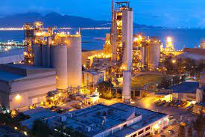
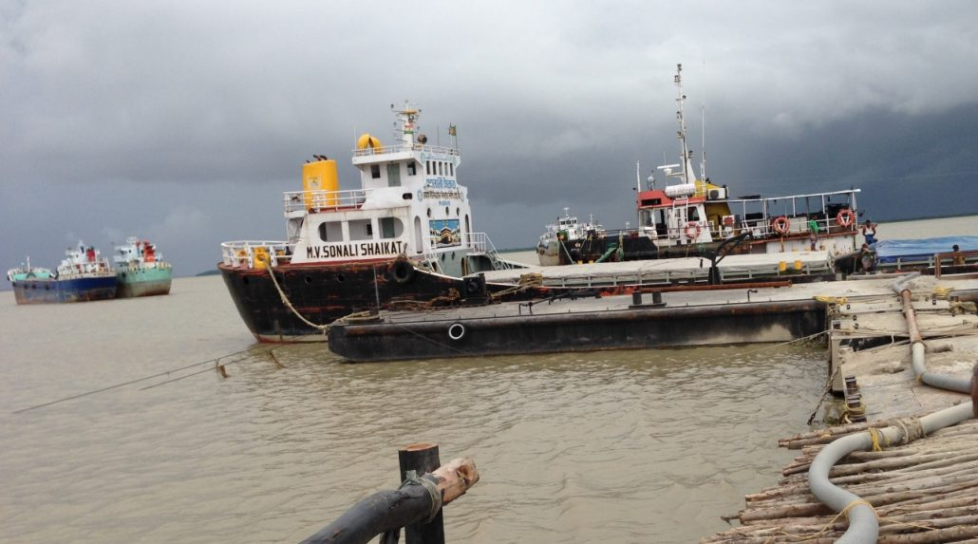
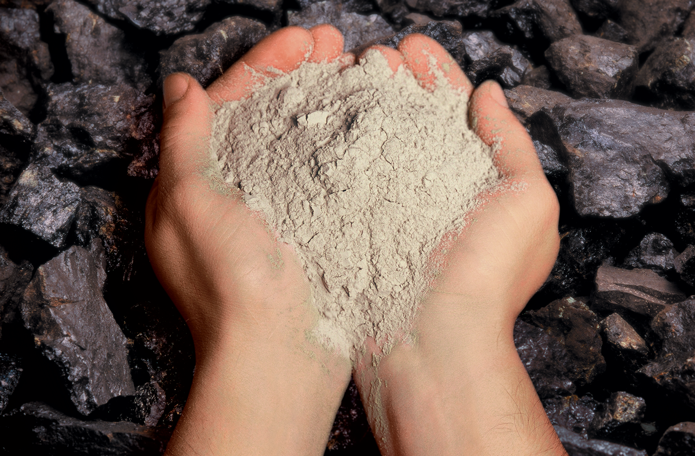
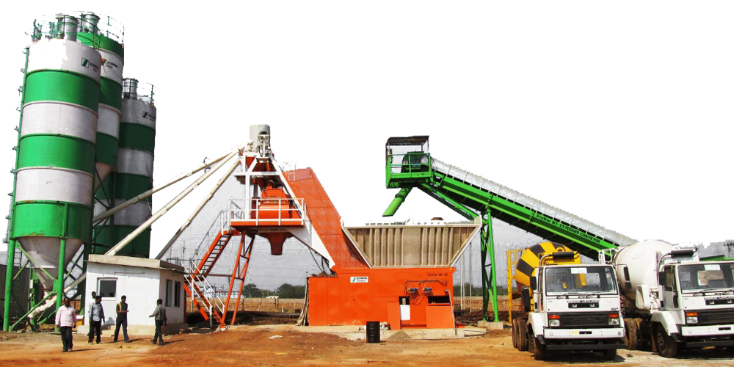
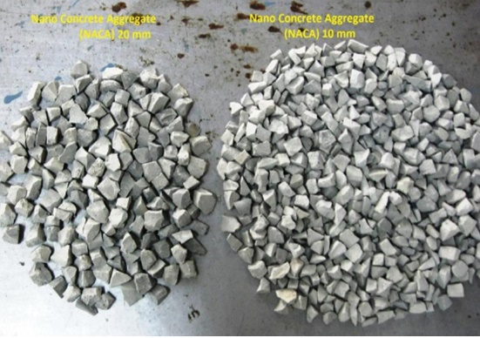
Classified Ash Avenues
Ready Mix Concrete (RMC)
Demand of high Blaine size ash in Cement Industry
Export of Classified Ash as per international standard
FINE FLY ASH
In aggregate production
Mixing of Fine fly ash in Concrete upto 35 %

Slide 6
NTPC Ash Collection systems
100 % Dry Ash system which have normally 02 buffer hopper for each pass like Mouda.
Wetting head along with dry system which have 01 buffer hopper in each pass like Vindhyachal.
NTPC Fly ash evacuation system may be majorly categorized as
Flushing apparatus/Ejector along with dry system which have 01 buffer hopper in each pass like Sipat.
Ejector along with dry system which have 01 buffer hopper in each pass like Ramagundam.

Slide 7
Air In Take V/V
ESP Hopper
SCHEMATIC DIAGRAM OF FINE FLY ASH SYSTEM
8
FAHP
Vacuum Bkr
Vacuum Line
Inst air for purging bags
7
WET Ash Inlet valve
Bag Filter
Vent Fan
Wetting Unit
Bag Filter
6
DRY Ash Inlet valve
Ash Silo
Collector Tank
Air Washer
5
Equalizing Line
Transfer
Hopper
To ESP Duct
4
Vacuum Pump
Fluidizing Blower
3
2nd Field onwards
Seal Box
Buffer Hopper
2
Rotary Feeder
Ash Conditioner
Slurry Trench
1
MHV
Fluidizing Blower
Closed Bulker
Open Truck
Header V/V
Transporter
Ash Evacuation Line
Receiver
To Wet System

Slide 8
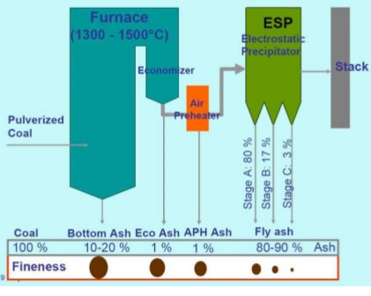
Technical Specification and Analysis
COAL ANALYSIS
GCV | 3778
Carbon % | 39.75
Ash % | 30.01
Moisture % | 7.94
Volatile matter % | 22.3
COAL MILL FINENESS ANALYSIS
MILL | 50 | -100 | -200
LIMIT | 1% | 90% | 70%
A | 0.6 | 90 | 68
B | 0.5 | 92 | 72
C | 0.4 | 94 | 72
D | 0.5 | 91 | 71
E | 0.2 | 96 | 77
F | 0.4 | 92 | 73
G | 0.5 | 91 | 72
H | 0.4 | 93 | 68
J | 0.3 | 95 | 76
FLY ASH DENSITY ANALYSIS
ESP PASS
A | B | C | D
0.95 | 1 | 0.85 | 0.9
LIMIT:0.75 gm/cc
Unburnt Carbon Analysis
Area | Fly Ash | Bottom Ash
value (%) | 0.2 | 0.6
Limit (%) | 1.0 | 1.5
Fly Ash Collection in ESP Hopper for 500 MW unit
HR | Coal fired TPH | % Ash in Coal |  | Total Ash Produced (TPH) | Bottom Ash (20%) | Fly Ash ESP(80%) | Ash per pass (TPH)
 | 300 | 30% |  | 90 | 18 | 72 | 18
24 | 7200 | 30% |  | 2160 | 432 | 1728 | 432
ESP Field wise Ash collection
Field No |  |  | % Distribution of Ash | % of Ash / pass |  | Ash T/pass / hr
1 |  |  | 64 | 64 |  | 11.52
2 |  |  | 20.3 | 20.3 |  | 3.65
3 |  |  | 8.4 | 8.4 |  | 1.51
4 |  |  | 3.96 | 3.96 |  | 0.71
5 |  |  | 1.8 | 1.8 |  | 0.32
6 |  |  | 0.85 | 0.85 |  | 0.15
7 |  |  | 0.45 | 0.45 |  | 0.08
8 |  |  | 0.24 | 0.24 |  | 0.04
Total |  |  | 100 | 100 |  | 18
Total One Day Ash Collection Per Pass |  |  |  |  |  | 432
Total one Day Four Pass Ash Collection |  |  |  |  |  | 1728
Particle Size: >80 Micron 40 to 80 Micron
Analysis of Fly Ash | % by weight
Greater than 40 microns | 20
30-40 microns | 10
20-30 microns | 14
10-20 microns | 24
Less than 10 microns | 32
Total | 100

Slide 9
Procedure
Procedure for Coarse ash(1st hopper) and Fine ash (2nd onward hopper) collection through deferent mode:
Mode-1: ESP Hopper no. 1of all branch lines of any Pass can be evacuated for 02 Cycles thorough Wetting head and taken to ash dyke. The same process can be repeated for all passes.
Mode-2: ESP 2nd hopper to 8th hopper of all branch lines of any Pass can be evacuated thorough Buffer hopper and subsequently it can be transported to silo (identified for fine fly ash) through fly ash conveying line. The same process can be repeated for all passes with respective Buffer hoppers and fly ash conveying line .
Initially, all the operation has to be performed on Manual mode of selection on trial basis, however for continues collection of fine fly it can be done through change in C&I logic.
*- All numbers mentioned is for reference only, any buffer & silo combination may be used.

Slide 10
Flexible Operation of Fine Fly Ash evacuation System
Flexible Operation of Ash evacuation system
Load |  | Shut off Vacuum
coal |  | Line Vacuum
Mode of Operation | Evacuation Cycle | Hopper No. | Time Taken (Minutes) | Cycle Time
Wet | 2 | Line-1 to 4 ( Hopper-1) | 15 | 70
 |  | Line-1 to 4 ( Hopper-1) | 8
C/O |  | wet to Dry Mode | 10
Dry | 1 | Line-1 to 4 ( Hopper-2 to 8) | 27
C/O |  | Dry to Wet Mode | 10
Wet | 2 | Line-1 to 4 ( Hopper-1) | 20 | 96
 |  | Line-1 to 4 ( Hopper-1) | 12
C/O |  | wet to Dry Mode | 8
Dry | 1 | Line-1 to 4 ( Hopper-2 to 8) | 48
C/O |  | Dry to Wet Mode | 8
Wet | 2 | Line-1 to 4 ( Hopper-1) | 26 | 104
 |  | Line-1 to 4 ( Hopper-1) | 12
C/O |  | wet to Dry Mode | 8
Dry | 1 | Line-1 to 4 ( Hopper-2 to 8) | 50
C/O |  | Dry to Wet Mode | 8
Wet | 2 | Line-1 to 4 ( Hopper-1) | 33 | 115
 |  | Line-1 to 4 ( Hopper-1) | 18
C/O |  | wet to Dry Mode | 8
Dry | 1 | Line-1 to 4 ( Hopper-2 to 8) | 48
C/O |  | Dry to Wet Mode | 8
Wet | 2 | Line-1 to 4 ( Hopper-1) | 30 | 103
 |  | Line-1 to 4 ( Hopper-1) | 12
C/O |  | wet to Dry Mode | 8
Dry | 1 | Line-1 to 4 ( Hopper-2 to 8) | 45
C/O |  | Dry to Wet Mode | 8
Wet | 2 | Line-1 to 4 ( Hopper-1) | 23 | 94
 |  | Line-1 to 4 ( Hopper-1) | 15
C/O |  | wet to Dry Mode | 8
Dry | 1 | Line-1 to 4 ( Hopper-2 to 8) | 40
C/O |  | Dry to Wet Mode | 8
Fly Ash Collection in ESP Hopper for 500 MW unit
HR | Coal fired TPH | % Ash in Coal | Total Ash Produced (TPH) | Bottom Ash (20%) | Fly Ash ESP(80%) | Ash per pass (T)
 | 300 | 30% | 90 | 18 | 72 | 18
24 | 7200 | 30% | 2160 | 432 | 1728
Field wise Ash collection |  |  | ESP Pass wise Ash collection
Field No | % of Ash | Ash T/hr | Time (Hr) | One pass | Two pass | Three pass | Four pass
1 | 64 | 0.00 | 1 | 6.48 | 12.96 | 19.44 | 25.92
2 | 20.3 | 3.65 | 2 | 12.96 | 25.92 | 38.88 | 51.84
3 | 8.4 | 1.51 | 3 | 19.44 | 38.88 | 58.32 | 77.76
4 | 3.96 | 0.71 | 4 | 25.92 | 51.84 | 77.76 | 103.68
5 | 1.8 | 0.32 | 5 | 32.40 | 64.80 | 97.20 | 129.60
6 | 0.85 | 0.15 | 6 | 38.88 | 77.76 | 116.64 | 155.52
7 | 0.45 | 0.08 | 7 | 45.36 | 90.72 | 136.08 | 181.44
8 | 0.24 | 0.04 | 8 | 51.84 | 103.68 | 155.52 | 207.36
 | 100.00 | 6.48 | 9 | 58.32 | 116.64 | 174.96 | 233.28
 |  |  | 10 | 64.80 | 129.60 | 194.40 | 259.20
 |  |  | 11 | 71.28 | 142.56 | 213.84 | 285.12
 |  |  | 12 | 77.76 | 155.52 | 233.28 | 311.04
 |  |  | 13 | 84.24 | 168.48 | 252.72 | 336.96
 |  |  | 14 | 90.72 | 181.44 | 272.16 | 362.88
 |  |  | 15 | 97.20 | 194.40 | 291.60 | 388.80
 |  |  | 16 | 103.68 | 207.36 | 311.04 | 414.72
 |  |  | 17 | 110.16 | 220.32 | 330.48 | 440.64
 |  |  | 18 | 116.64 | 233.28 | 349.92 | 466.56
 |  |  | 19 | 123.12 | 246.24 | 369.36 | 492.48
 |  |  | 20 | 129.60 | 259.20 | 388.80 | 518.40
 |  |  | 21 | 136.08 | 272.16 | 408.24 | 544.32
 |  |  | 22 | 142.56 | 285.12 | 427.68 | 570.24
 |  |  | 23 | 149.04 | 298.08 | 447.12 | 596.16
 |  |  | 24 | 155.52 | 311.04 | 466.56 | 622.08
8
7
2nd Field onwards
6
5
4
NTPC Rihand started collecting fine fly Ash from 2nd field onwards.
3
2
1
Flexible Operation of Fine Fly Ash evacuation was started with 02 cycles of 1st field and one cycle of 2nd field onwards ( Hopper no 2 to 8).
MHV
^{1st}
Field
Header V/V
2nd field onwards can be considered fine with ash collection quantity of collection of 622 MT per day.

Slide 11
Report received on 09.12.2023 with 21 percent retention on 45-micron sieve.
However on testing of this collected ash by 45 µm sieve analysis, value was 21-22 in comparison to accepted value of 16 for fine ash categorization for accepted industry norms.

Slide 12
Procedure with alternate hopper
Procedure for Coarse ash(1st hopper) and Fine ash (2nd onward hopper) collection through deferent mode:
Cycle-01
Mode-1: ESP Hopper no. 1of all branch lines of any Pass can be evacuated thorough Wetting head and taken to ash dyke. The same process can be repeated for all passes.
Mode-2: ESP 2nd hopper to 8th hopper of all branch lines of any Pass can be evacuated thorough Buffer hopper and subsequently it can be transported to silo (identified for fine fly ash) through fly ash conveying line. The same process can be repeated for all passes with respective Buffer hoppers and fly ash conveying line .
Cycle-02
Mode-1: ESP Hopper no. 1&2 of all branch lines of any Pass can be evacuated thorough Wetting head and taken to ash dyke. The same process can be repeated for all passes.
Mode-2: ESP 3nd hopper to 8th hopper of all branch lines of any Pass can be evacuated thorough Buffer hopper and subsequently it can be transported to silo (identified for fine fly ash) through fly ash conveying line. The same process can be repeated for all passes with respective Buffer hoppers and fly ash conveying line .

Slide 13
Flexible Operation of Fine Fly Ash evacuation System
Flexible Operation of Ash evacuation system
Load |  | Shut off Vacuum
coal |  | Line Vacuum
Mode of Operation | Evacuation Cycle | Hopper No. | Time Taken (Minutes) | Cycle Time
Wet | 1 | Line-1 to 4 ( Hopper-1 &2 ) | 19 | 70
C/O |  | wet to Dry Mode | 10
Dry | 1 | Line-1 to 4 ( Hopper-3 to 8) | 31
C/O |  | Dry to Wet Mode | 10
Wet | 2 | Line-1 to 4 ( Hopper-1) | 20 | 88
C/O |  | wet to Dry Mode | 8
Dry | 2 | Line-1 to 4 ( Hopper-2 to 8) | 52
C/O |  | Dry to Wet Mode | 8
Wet | 3 | Line-1 to 4 ( Hopper-1 &2 ) | 37 | 100
C/O |  | wet to Dry Mode | 9
Dry | 3 | Line-1 to 4 ( Hopper-3 to 8) | 46
C/O |  | Dry to Wet Mode | 8
Wet | 4 | Line-1 to 4 ( Hopper-1 &2 ) | 40 | 128
C/O |  | wet to Dry Mode | 8
Dry | 4 | Line-1 to 4 ( Hopper-3 to 8) | 71
C/O |  | Dry to Wet Mode | 9
Wet | 5 | Line-1 to 4 ( Hopper-1 &2 ) | 52 | 106
C/O |  | wet to Dry Mode | 8
Dry | 5 | Line-1 to 4 ( Hopper-3 to 8) | 37
C/O |  | Dry to Wet Mode | 9
Wet | 6 | Line-1 to 4 ( Hopper-1 &2 ) | 44 | 107
C/O |  | wet to Dry Mode | 9
Dry | 6 | Line-1 to 4 ( Hopper-3 to 8) | 46
C/O |  | Dry to Wet Mode | 8
Fly Ash Collection in ESP Hopper for 500 MW unit
HR | Coal fired TPH | % Ash in Coal | Total Ash Produced (TPH) | Bottom Ash (20%) | Fly Ash ESP(80%) | Ash per pass (T)
 | 300 | 30% | 90 | 18 | 72 | 18
24 | 7200 | 30% | 2160 | 432 | 1728
Field wise Ash collection |  |  | ESP Pass wise Ash collection
Field No | % of Ash | Ash T/hr | Time (Hr) | One pass | Two pass | Three pass | Four pass
1 | 64 | 0 | 1 | 4.65 | 9.31 | 13.96 | 18.61
2 | 20.3 | 2 | 2 | 9.31 | 18.61 | 27.92 | 37.22
3 | 8.4 | 1.51 | 3 | 13.96 | 27.92 | 41.88 | 55.84
4 | 3.96 | 0.71 | 4 | 18.61 | 37.22 | 55.84 | 74.45
5 | 1.8 | 0.32 | 5 | 23.27 | 46.53 | 69.80 | 93.06
6 | 0.85 | 0.15 | 6 | 27.92 | 55.84 | 83.75 | 111.67
7 | 0.45 | 0.08 | 7 | 32.57 | 65.14 | 97.71 | 130.28
8 | 0.24 | 0.04 | 8 | 37.22 | 74.45 | 111.67 | 148.90
 | 100.00 | 4.65 | 9 | 41.88 | 83.75 | 125.63 | 167.51
 |  |  | 10 | 46.53 | 93.06 | 139.59 | 186.12
 |  |  | 11 | 51.18 | 102.37 | 153.55 | 204.73
 |  |  | 12 | 55.84 | 111.67 | 167.51 | 223.34
 |  |  | 13 | 60.49 | 120.98 | 181.47 | 241.96
 |  |  | 14 | 65.14 | 130.28 | 195.43 | 260.57
 |  |  | 15 | 69.80 | 139.59 | 209.39 | 279.18
 |  |  | 16 | 74.45 | 148.90 | 223.34 | 297.79
 |  |  | 17 | 79.10 | 158.20 | 237.30 | 316.40
 |  |  | 18 | 83.75 | 167.51 | 251.26 | 335.02
 |  |  | 19 | 88.41 | 176.81 | 265.22 | 353.63
 |  |  | 20 | 93.06 | 186.12 | 279.18 | 372.24
 |  |  | 21 | 97.71 | 195.43 | 293.14 | 390.85
 |  |  | 22 | 102.37 | 204.73 | 307.10 | 409.46
 |  |  | 23 | 107.02 | 214.04 | 321.06 | 428.08
 |  |  | 24 | 111.67 | 223.34 | 335.02 | 446.69
Fine fly ash again started with combination of 2nd & 3rd field
Hence ash collected from ESP 3rd field onwards can be considered as fine ash. But quantity of ash collected from 3rd field onwards is mere 270 MT per day and storing this fine ash for longer period may create settling of ash since fine ash is very hygroscopic. However if ash from second field is also included in alternate evacuation cycle than quantity of ash comes to 445 MT per day. Once again ash was collected by operating evacuation system flexibly with inclusion of 2nd field in alternate cycle. Sample of this collected ash was tested by 45 µm sieve analysis, value was 16 thus adhering to accepted industry norms.

Slide 14
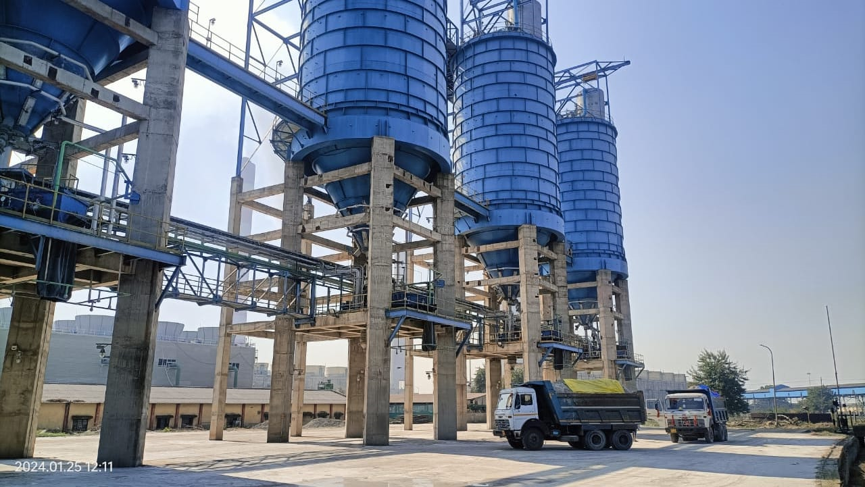
07 days trial operation results
Days | Load (MW) | Coal fired TPH | Two pass Fine Fly ash collection | Collection Time (Hr) | Ash collection in Silo | Maintain flowability of ash | Ash Accumulated in silo
1 | 500 | 301 | 9.34 | 7 | 65 | 30 | 35
2 | 490 | 295 | 9.15 | 8 | 73 | 30 | 43
3 | 498 | 280 | 8.69 | 8 | 69 | 30 | 39
4 | 502 | 302 | 9.37 | 9 | 84 | 30 | 54
5 | 514 | 330 | 10.24 | 8 | 82 | 30 | 52
6 | 494 | 312 | 9.68 | 9 | 87 | 30 | 57
7 | 501 | 299 | 9.27 | 8 | 74 | 30 | 44
Total Ash collection |  |  |  |  | 536 | 210 | 326
This fine ash was collected for 07 days and accumulated in silo with partial unloading (25-35MT per day) into truck from silo to maintain flowability of ash. Later ash was loaded and kept in one BTAP wagon for 07 days. This BTAP wagon was unloaded successfully in our silo after 07 days.
Test report established that we were able to achieve 16 % retention on 45 micron sieve.

Slide 15
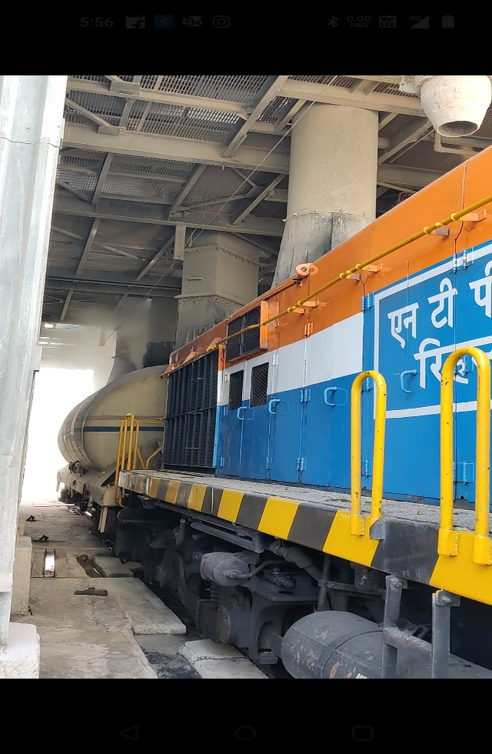
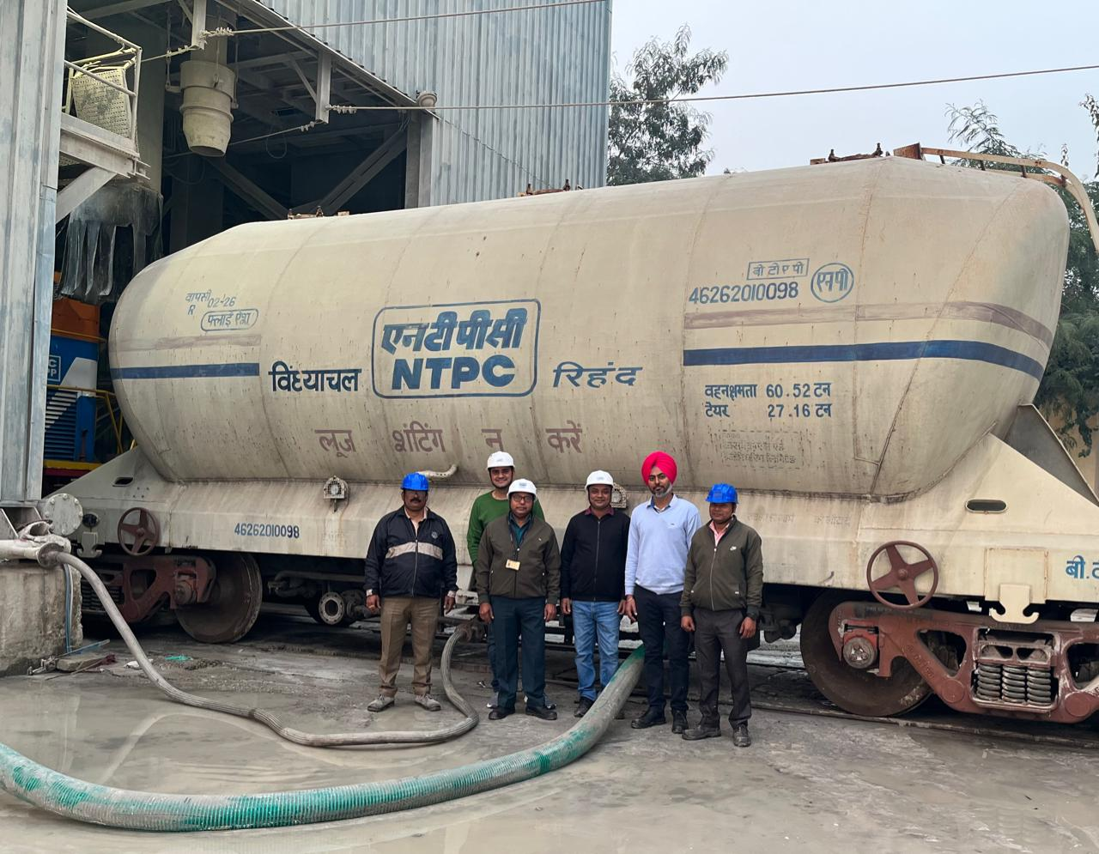
Trial of Loading, Storing & Unloading in BTAP wagons
Fine fly ash was loaded into 01 BTAP wagon which was then kept in MGR to simulate the real time conditions(Assuming min. seven days are required for transporting Ash from Rihand to NCR region via BTAP rakes)
We were able to successfully unload the loaded BTAP wagon after 07 days. With this we became the first Power plant in the country to do successful trail of loading storing & unloading of Fine Fly ash

Slide 16
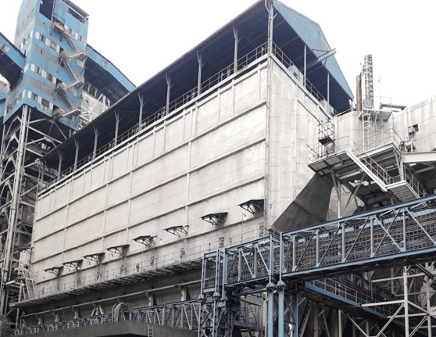
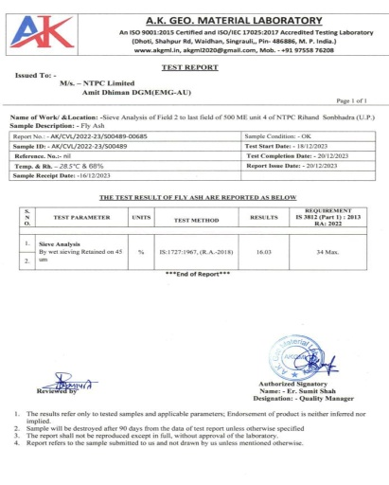
BEST PRACTICES
Best/next practice | Implemented from | Remarks | Benefits/gains
Evacuation & transportation of fine fly ash through BTAP Wagons | Trials completed successfully | 3rd Station in NTPC to Start Fine FlyAsh Collection while 1st Station in NTPC to conduct trial through BTAP wagons | Improved ash utilization. Cost effective transportation to long distances. Enables direct blending with OPC Can be used directly at site of construction

Slide 17
Why Fine Fly transportation via BTAP wagons is a game changer
COST OF ESTABLISHING FINE FLY ASH COLLECTION & TRANSPORTATION VIA BTAP WAGONS
BTAP SFTO registration charges | Procurement of BTAP wagons (159 Nos.) | MGR Augmentation | Infrastructure Augmentation
₹ 7 crore | ₹ 67 crore | ₹ 7 crore | ₹ 3 crore
Total Expenditure : 84 Crores
EXPECTED REVENUE BY SALE OF FINE FLY ASH
EXPECTED PRICE EX. RIHAND | ANNUAL FINE FLYASH GENERATION | EXPECTED REVENUE
₹ 200 PER TON | 4 LAKH MT | ₹ 8 crore
Cost Benefit Analysis for Cement Industries
Industries | Distance from Rihand (Kms) | Present Cost by industries (by road), Rs./MT | Transportation cost through Rail, Rs./MT | Considering Rs 200 paid to Rihand for Fine fly ash. Savings to cement Indutries(Rs./MT)
Satna Cement | 297 | 1000 | 607 | 193
Prism Cement | 281 | 950 | 628 | 222
KJS Cement | 303 | 1000 | 568 | 232
Maihar Cement | 299 | 1000 | 568 | 232
ACC Kymore, | 327 | 1200 | 480 | 520

