Slide 1


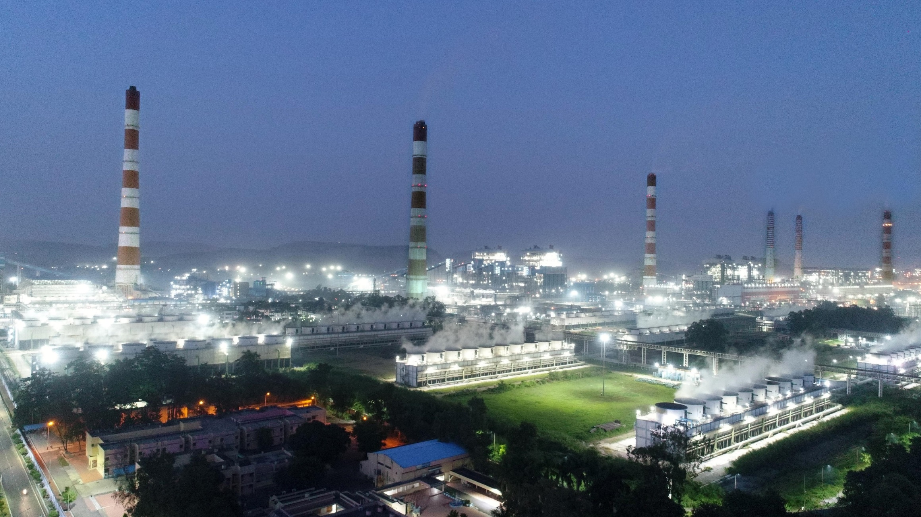
Digital Transformation of Lube Oil Management System (LOMS) and Value creation by Optimization of Process & Lubricants
Presented By:
Pawan Kr. Hassani
Sr. Manager (Opn.)
VSTPP

Slide 2
INTRODUCTION TO LOC
1
RESULTS AND TRENDS ANALYSIS
8
2
INTRODUCTION TO LOMS
FINAL IMPLEMENTATION AND GO LIVE
7
OUTLINE
3
CHALLENGES DURING DIGITALISATION
TRAINING NEED ASSESMENT AND ROLE MAPPING
6
4
PROCESS DESIGN OF ONLINE PROCESS
5
PROCESS MAPPING OF OFFLINE PROCESS

Slide 3

INTRODUCTION TO LOC
VSTPS –The Largest Power Plant of India (4783 MW)
Total Capacity of Thermal = 4760 MW
Small Hydro-8 MW
Solar-15 MW
Stage-1 (1260 MW)
Stage-4 (1000 MW)
Stage-2 (1000 MW)
LUBE
Stage-5 (500 MW)
Stage-3 (1000 MW)
OIL
Small Hydro (8 MW)
CELL
Lube Oil Cell of NTPC Vindhyachal is approx 40 years old.
Handling 39 types of Lubrication oils and 7 types of Grease & meeting Lubricating requirements of approximately 3312 No. of equipment's in a timely manner as per Industry Standards and ensure best quality service in VSTPS

Slide 4
INTRODUCTION TO LOC
Our Vision: Meeting all lubricant requirements timely to maintain leadership performance of VSTPS.
Our Mission was to Implement the appropriate technology solution for Lube Oil Management for Lube Oil Cell (O&M Department) with the objective of Automation of Lube Oil requisition & issuance process and extending MIS available at figure tips to the process owner and optimize the consumption.
By improving the processes and implementing new technology solution, We could reduce the wastage of lubricants by
Analyzing the nature of hurdles arising during top-up and their possible solutions
Review of Oil Consumption Life Cycle for Equipment
Making action plans
Identifying equipment with high Oil consumption and attending defects

Slide 5
INTRODUCTION TO LOMS
Interface for Lube Oil Management (Operation Department) with the objective of Streamlining the process of Lube Oil requisition & issuance process and extending MIS available at figure tips to the process owner and optimize the consumption.
With the implementation of LOMS we aspire to achieve following with focus on core values of our company:
Safely & Timely delivery of lubricants and fulfilment of requirements (Safety, Time, Customer Focus, Innovation).
No error Functioning ( Correct identification of equipment thru System)
Optimization of consumption and preventing wastage through MIS (cost effective and environment friendly).
Sending waste oil to central store for recycling (environmentally friendly)
Adoption of innovative digital platform for fast delivery and communication (Innovation)

Slide 6
CHALLENGES DURING DIGITALISATION
Digital transformation of Lube Oil Management system was not only about integrating new interface and technology into our present operations— it required to change the approach of a section , interactions with requestors. It required elements of Change Management as a whole.
Following challenges were faced during “Digitizing the existing offline Lube Oil Management System
into Online (LOMS)
Driving Adoption for new tools and Processes:
Mapping of existing processes
Lack of Proper IT Skills: With users
Optimizing the Process Flow for LOMS
Integration solution for new equipment in system
Continuous evolution to customer needs

Slide 7
PROCESS DESIGN OF ONLINE PROCESS
Lube Oil Management System
Lube-Oil Mapping
Reorder-by-LOC
Lube-Oil-Recycling/Scraping
Alternate- fit Oil: Exception handling
Lube-Oil-Top-up-Requisition & Refill-Requisition

Slide 8
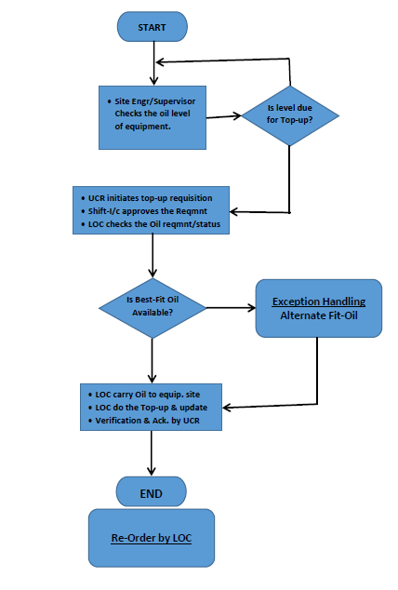
PROCESS MAPPING OF ONLINE PROCESS
Process mapping was carried out by clearly understanding the process flow of offline system being followed at present.
Process mapping:
Inputs from end users
Involvement of stack holders
System Requirements

Slide 9
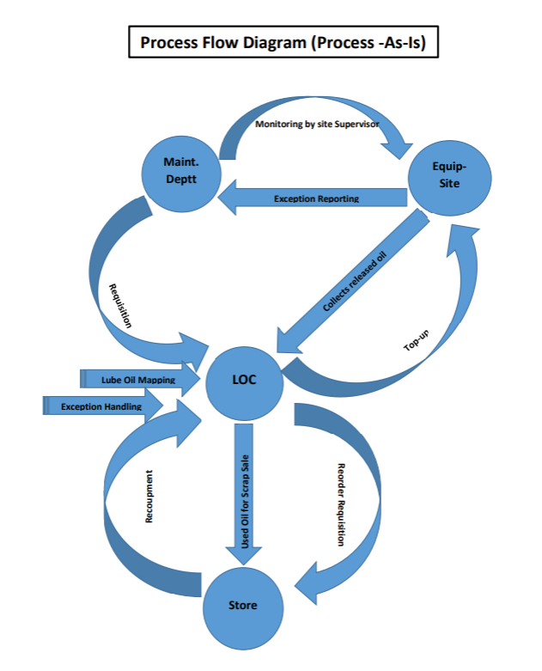
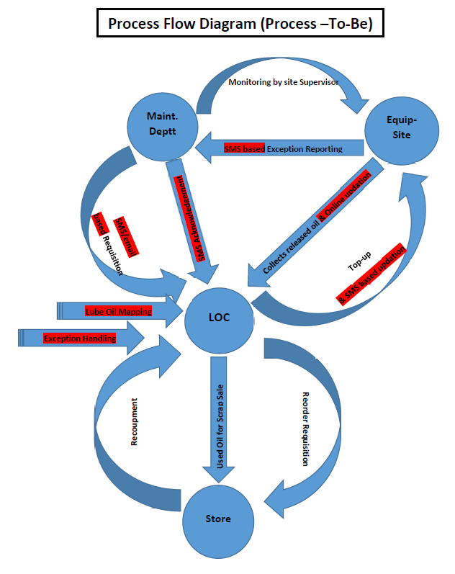
PROCESS MAPPING OF ONLINE PROCESS

Slide 10
TRAINING ASSESMENT / ROLE MAPPING
In LOMS many other functionalities are already added which are available at the “User Manual” .
- User Management: Role assignment were done for Requisitioner, Approver, Admin roles etc. at identified levels as per present practice.
- New Equipment Data can be recorded by Admins

Slide 11
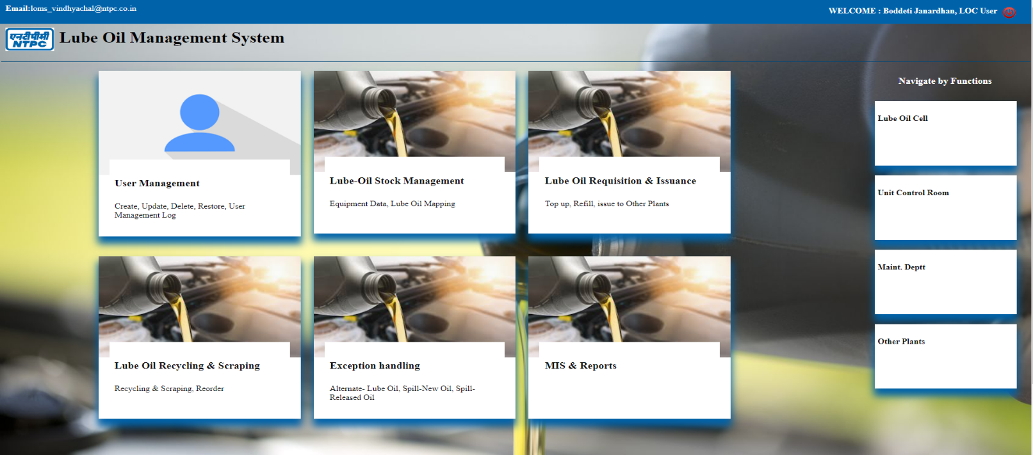
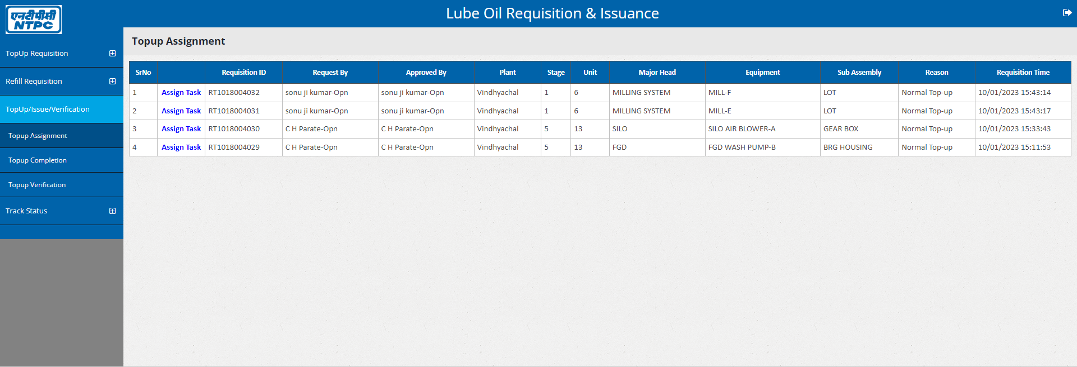
Lube Oil Management-Working Interface
With several meetings with IT department and PROCESS Mapping We came up with working Interface :
Lube Oil Management System

Slide 12
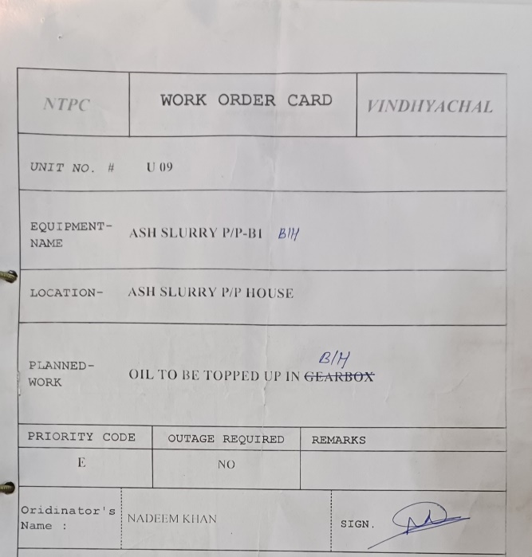
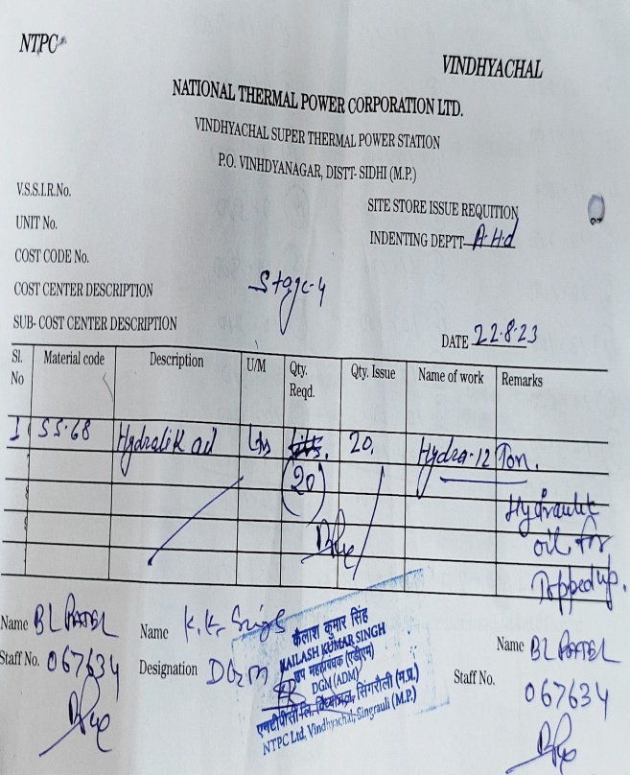
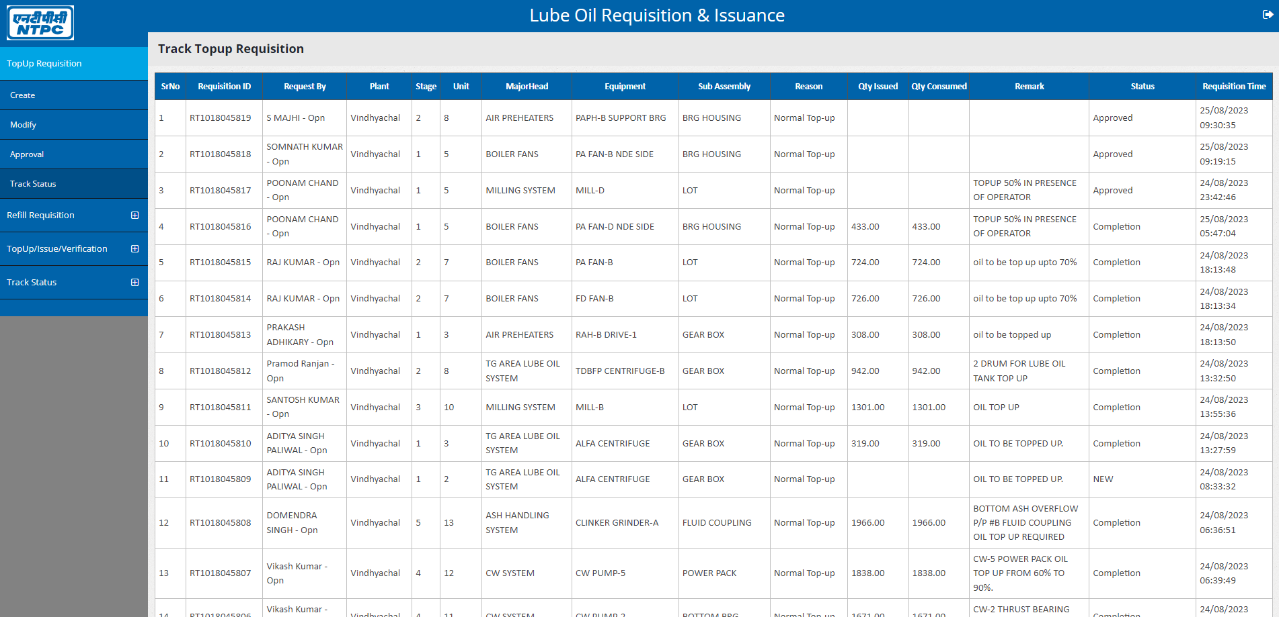
GO LIVE OF LOC
Improvements Achieved:
OLD LEGACY SYSTEM
LOC with ONLINE INTERFACE
OFFLINE WORK ORDERS
ONLINE WORK ORDER

Slide 13
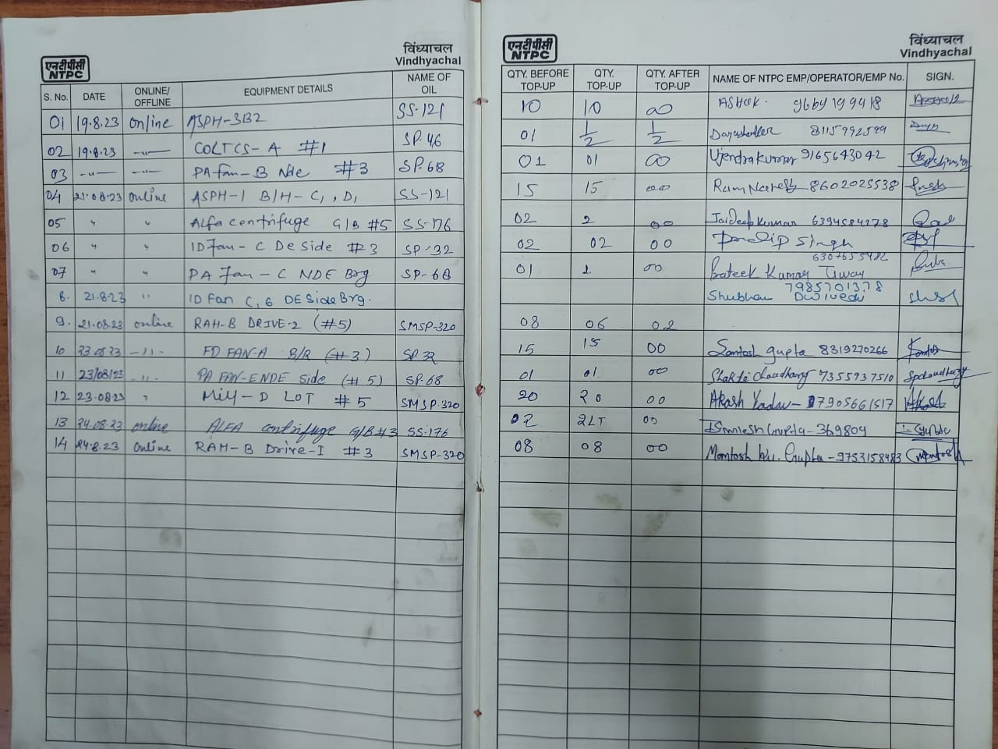
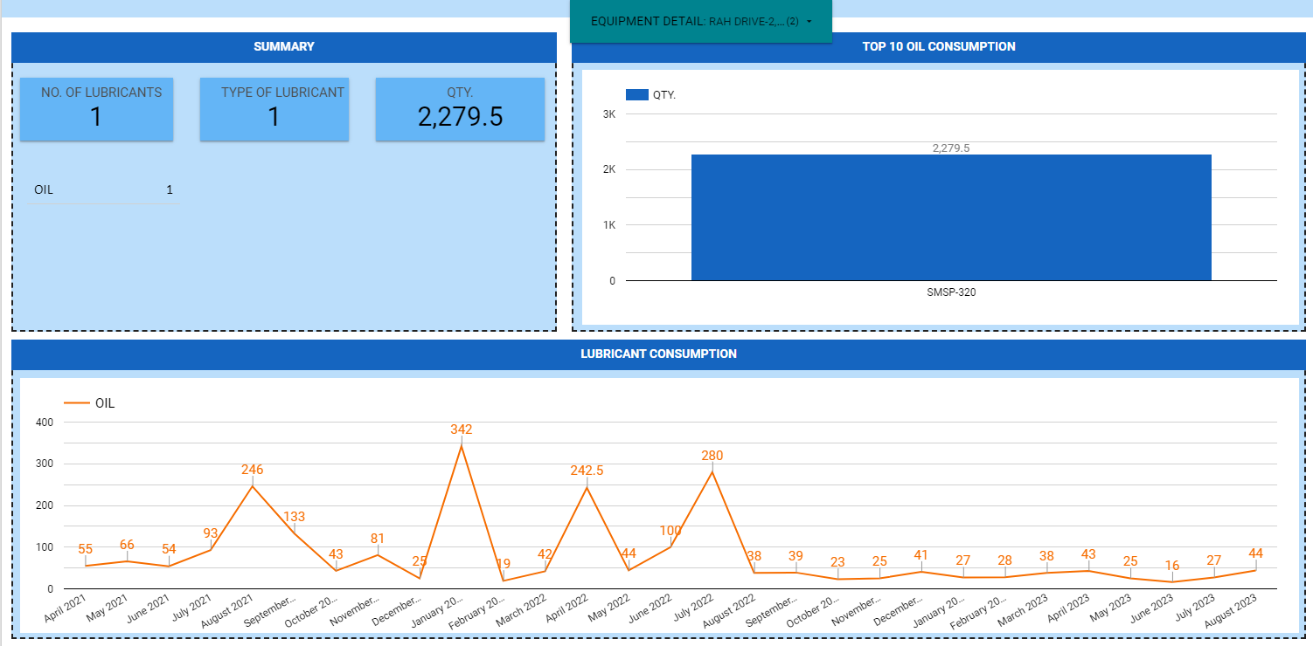
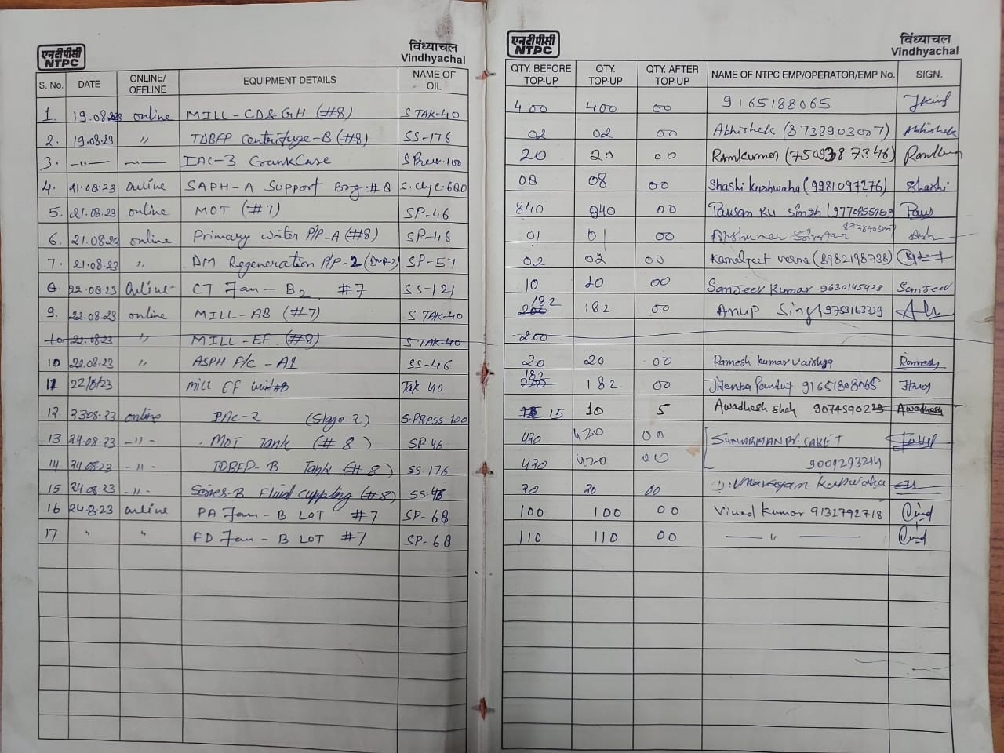
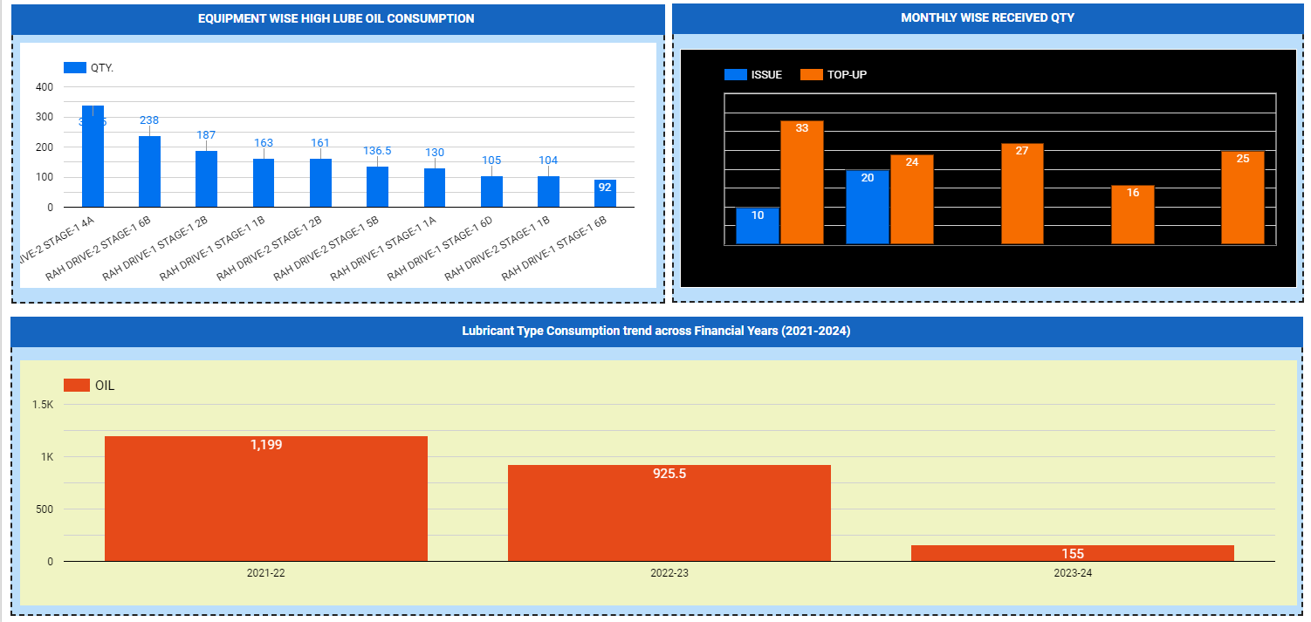
GO LIVE OF LOC

Slide 14
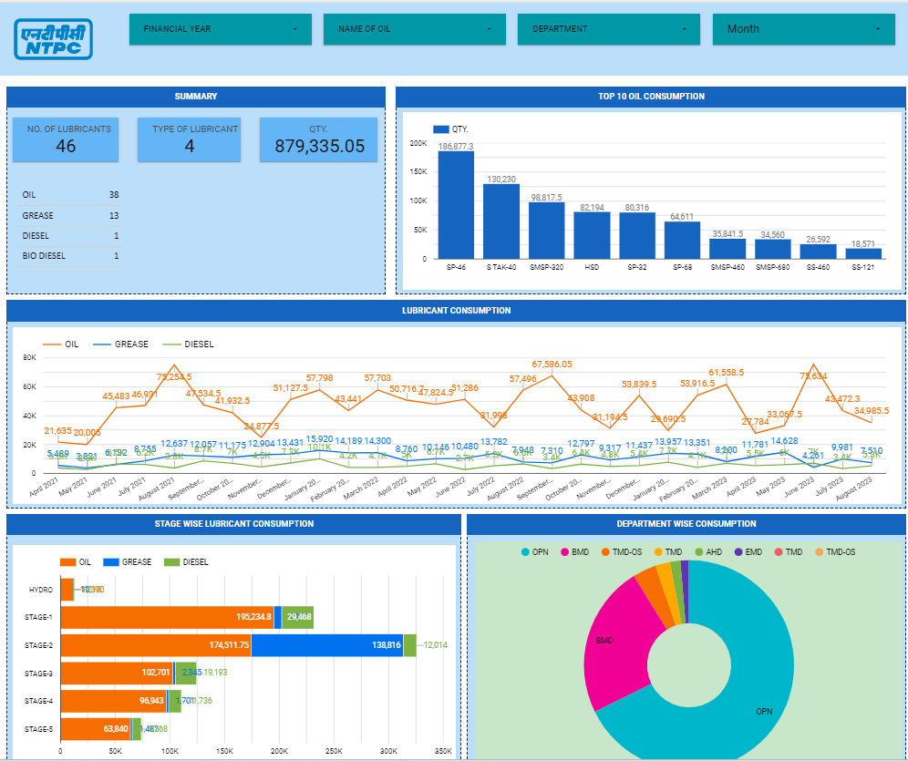
EASE OF USE
Easy Login Based User Interface
Minimum Training Requirement for User
Authorization for Approval at Desired Level
Master Record of All Equipment's
SMS Based Notification for requisitions
MIS and Reporting
Features of LOC Interface
Notes:
Mishandling of Lubricants by unskilled work force leading to maximum wastage in some of the Lubricants
By this activity we continuously monitoring tracking the lubricants consumption pattern in different forms in single platform by taking report online.

Slide 15
DATA ANALYSIS
Deviation in Consumption Patterns
Creation of Trends
Equipment defects Identification
Lube Oil Stock Level Monitoring
Exception Management for Low Qty
STG-1 DG SET-1 LOT Trending
STG-2 U-7 MOT Trending
Notes:
Mishandling of Lubricants by unskilled work force leading to maximum wastage in some of the Lubricants
By this activity we continuously monitoring tracking the lubricants consumption pattern in different forms in single platform by taking report online.

Slide 16
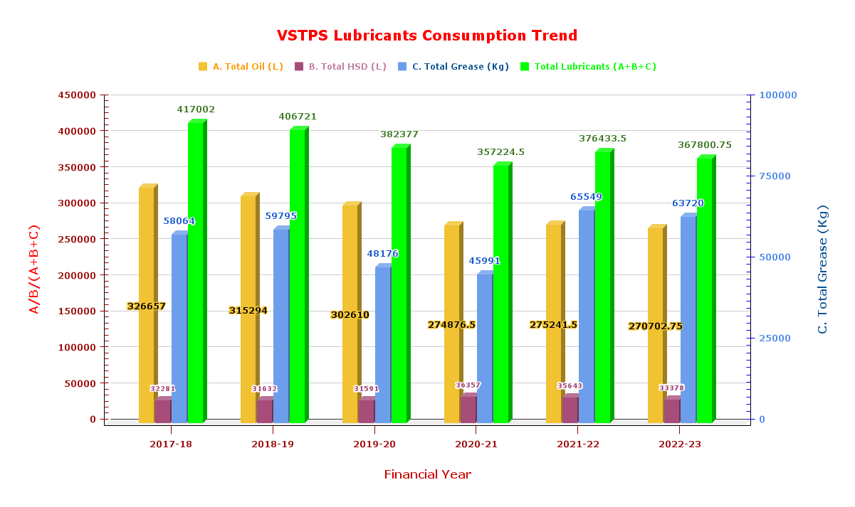
DATA ANALYSIS
Notes:
Mishandling of Lubricants by unskilled work force leading to maximum wastage in some of the Lubricants
By this activity we continuously monitoring tracking the lubricants consumption pattern in different forms in single platform by taking report online.

Slide 17
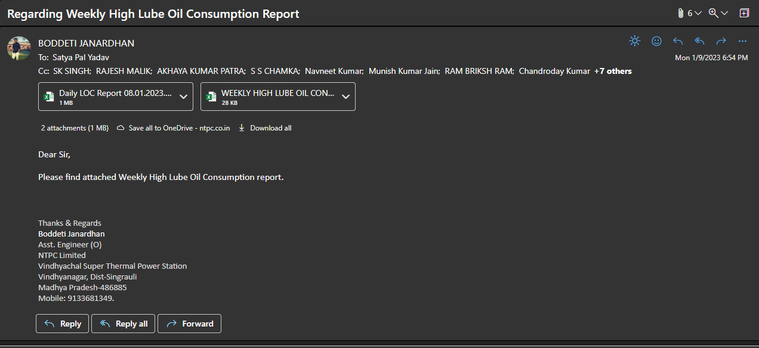
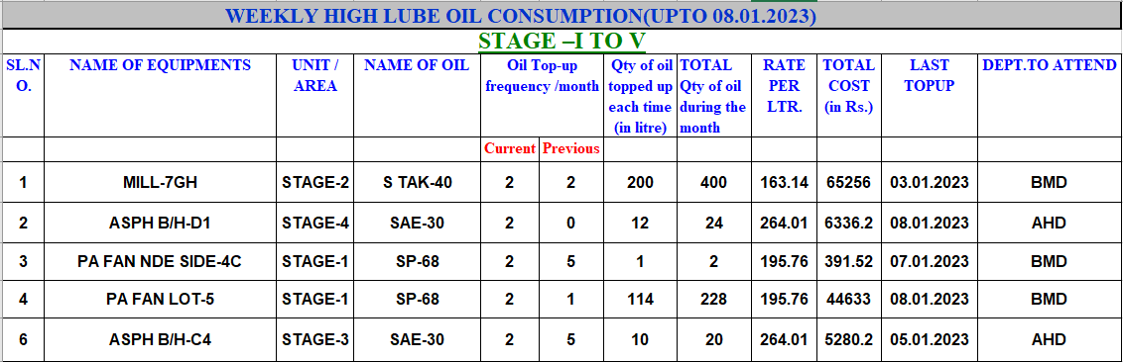
Due to frequent Leakages and air locks (chocking’s) on equipment’s its top-up frequency increases within short span of time.
We promptly analyzed every high lube oil consumption Equipment wise Weekly and send it to EMG department.
Defects are discussed in DPM meetings issues are being taken up
Frequent Exception in trend of Equipment's
111
2022-2023
9%
Increased the consumption due to Leakages

Slide 18
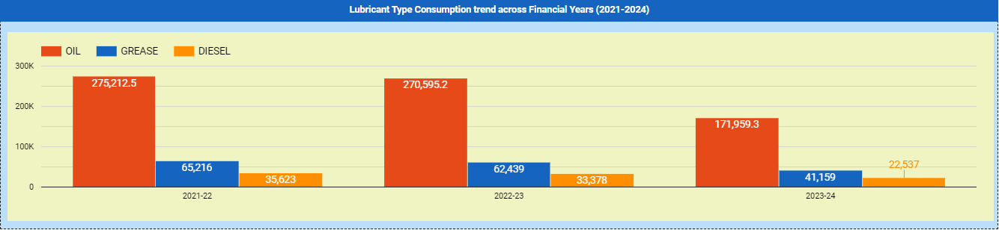
COST BENEFIT ANALYSIS
If Cost of All Lubricants considered constant for last 1 year:
Reduction in cost (Due to Reduced Consumption) (2022 to 2023): About 33 lacs (4.45%)
4.45%
Total Cost of Oil Consumption |  | 2021-22 | 2022-23
A. Total Oil Cost (as per consumption) |  | 46768894.7 | 46105287.11
B. Total HSD Cost |  | 3564300 | 3170910
C. Total Grease Cost |  | 10315569.83 | 8070520.08
 |  | 60648764.53 | 57346717.19
Total No of Paper Saved/Year | 2021-22 | 2022-23
A. No of requisition Raised Online | 3761 | 2969
B. No of Paper Saved | 3761 | 2969

Slide 19
CONCLUSION
Optimizing the Process Flow for Lube Oil Management in Plant
Standardization of the Process across all Stages
Better Reporting Tool with Real Time Information
Better Service to Requisitioner With Faster Response
Cost Saving-Improved inventory Planning, Procurement Management

Slide 20
Software Documentation…
(Front end-html/Visual Studio)
Complete Coded Program –Documented
Optimizing the Process Flow for Lube Oil Management in Plant
Process Optimization
User Manual Document-Easily accessible at interface
DIGITAL ARCHITECHTURE
DATA & ANALYTICS
Software Structure- C# and DoT Net
Standardization of the Process across all Stages
Creation of Trends
Data Base Management-SQL Server ( Common IT Server)
Master Record of All Equipment's
Cost Saving-Improved inventory Planning, Procurement Management
Lube Oil Stock Level Monitoring
User-friendly interface with “Help” and User Manual
Easy Login Based User Interface
Better Service to Requisitioner With Faster Response
Equipment defects Identification

Slide 21
Way Ahead…
Refill Module for Maintenance has been launched recently
SMS Based Triggers for Low Stocks of Lube Oil
Module Standardization with Other Plants and Implementation across NTPC
Integration of Relevant Modules with SAP (ERP)/AI Tools
MIS and Report Development is in progress

Slide 22

https://lookerstudio.google.com/reporting/ffc9c39c-c2e0-4c5d-aa31-03cc3058c71c/page/8r3UD

