Slide 1
Low LP Turbine Differential Expansion in Super Critical Unit Diaphragm Type machines and Remedial Measures.
Avishek Ghosal
K Rajmohan
Tanveer Alam
V Rambabu
Under the Guidance of:-
S B Yadav (AGM – COS SCU/OH)

Slide 2
PRESENTATION OUTLINE
Introduction
What is LPDE
Problem Statement
Probable causes
Remedial Measures
Precautions
Conclusion

Slide 3
INTRODUCTION
Typical Diaphragm type turbine in super critical units consists of HP, IP and LP turbines.
2 LP turbines with a 4-flow tandem compound.
The rotor is mounted with moving blades having low radial and axial clearances.
The diaphragms and moving blades of turbine rotor have axial clearances to cater the unequal axial thermal expansion of rotor and inner casing.
Fig:- Turbine Cross Section Drawing.

Slide 4
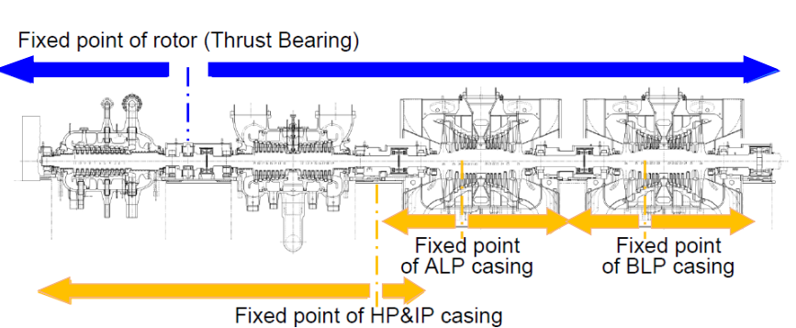
INTRODUCTION
Usually in diaphragm type turbines there are fixed points to anchor the turbine casing with TG deck as shown in Figure.
The rotor is also fixed at thrust bearing and thermal expansion will take place on both the sides of anchor points.
The thermal expansion of casing along with sliding pedestals occurs with respect to the anchor points
Fig:- Anchor Points of 800MW Turbine at NTPC LARA

Slide 5
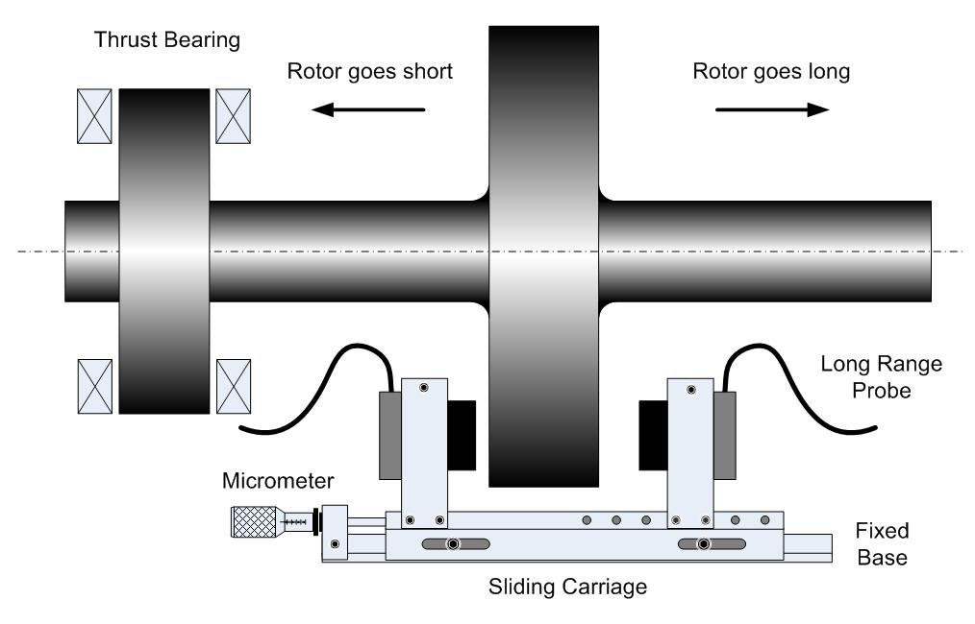
WHAT IS LPDE ?
During initial heating the rotor starts to expand more rapidly than the casing.
DIFERENTIAL EXPANSION =
ROTOR EXPANSION – CASING/SHELL EXPANSION
In absolute cold conditions the Differential Expansion values are set at a particular value (zero setting) and the change in differential Expansion is monitored during startup to full load, full load to shutdown and transient conditions

Slide 6
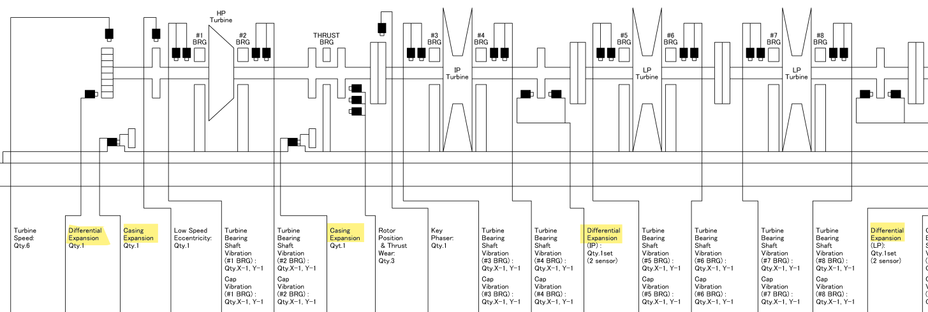
WHAT IS LPDE ?
To monitor the difference in thermal expansion proximity probes are typically installed in
Pedestal 1 for HPDE, Pedestal 3 for IPDE and Pedestal 5 for LPDE
The rotor long and short limits are decided considering the minimum clearance between fixed and moving blades beyond which turbine operation is not recommended.

Slide 7
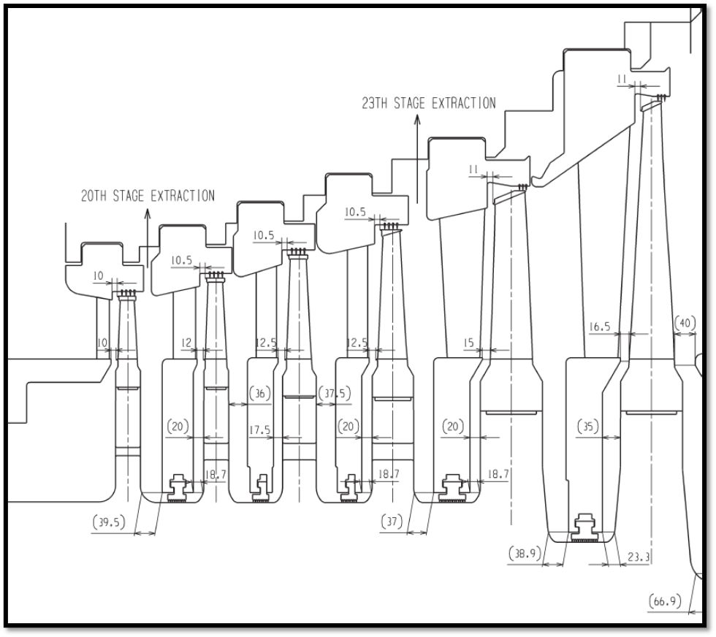
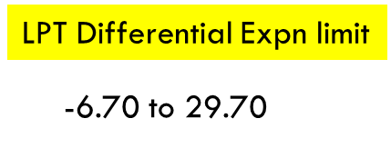
PROBLEM STATEMENT (Case History-1)
In Oct'2023 NTPC LARA#2 (Hitachi TG set) taken under overhaul for Generator and Turbine Valves.
LP differential expansion value reached -6.97mm at absolute cold. (Cold setting value at Erection is 0 mm)
S.No | Parameter | Value
1 | Shell Expansion – HPT | -0.06
2 | Shell Expansion – IPT | +0.02
3 | Differential Expansion – HPT | -0.73
4 | Differential Expansion – IPT | -0.16
5 | Differential Expansion – BLP | -6.97
6 | Axial shift | -0.53
Clearance Diagram

Slide 8
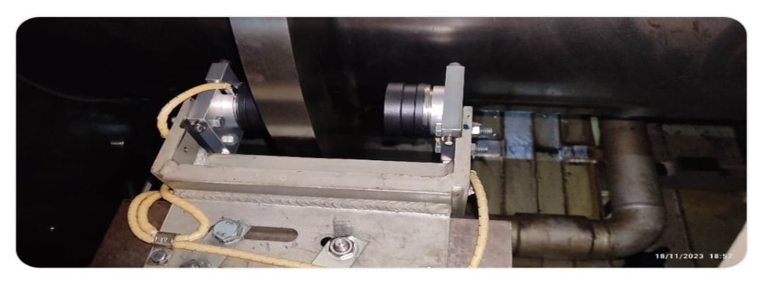
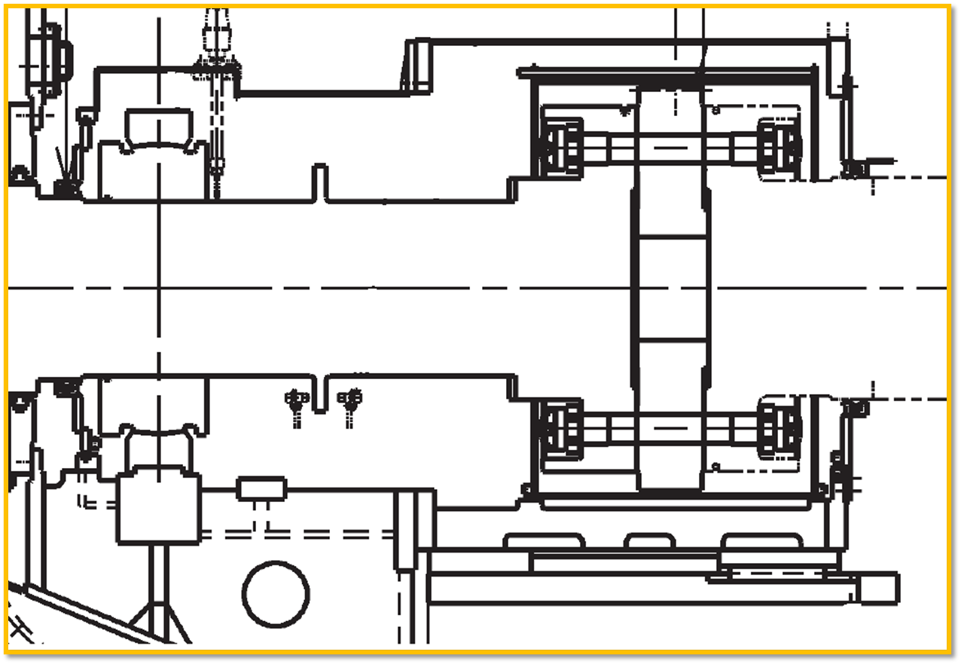
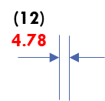
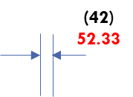
Validation of Observation
(500)
492.13
LPDE Probe
LPDE probe air gap measured
Bearing 8 centre line to rotor collar distance measured.
LP Turbine A and B last blade root to gland cover distance measured.
LPDE measurement

Slide 9
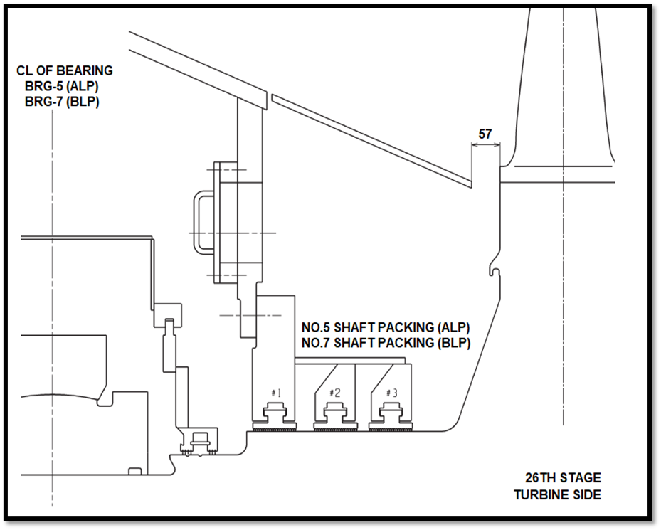
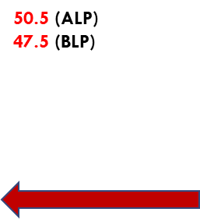
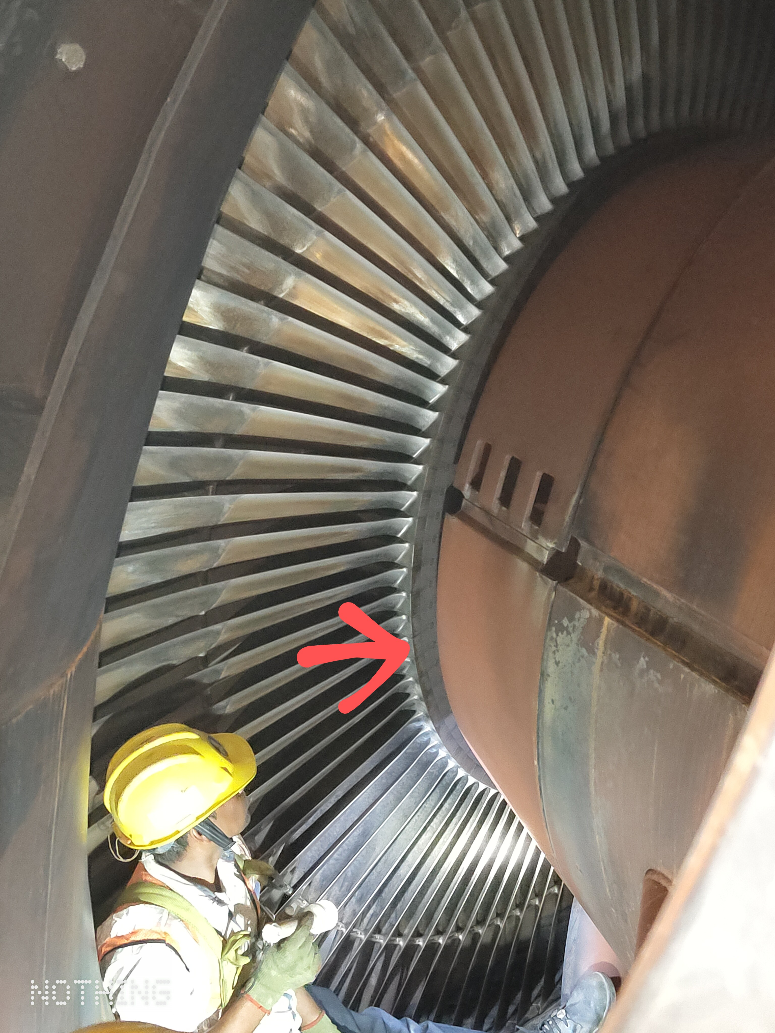
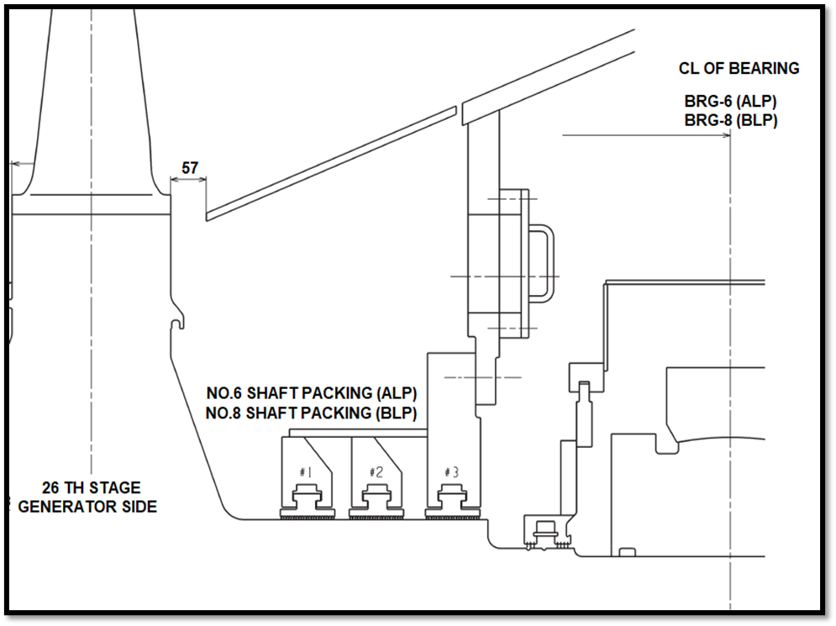
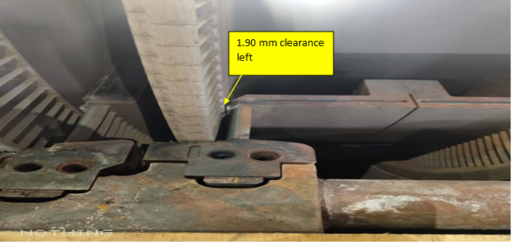
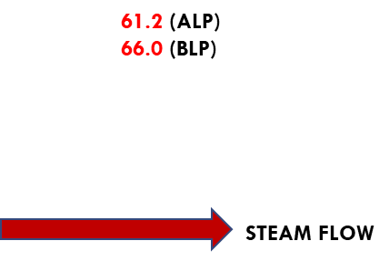
Validation of Observation
All these readings indicated a rotor shortening of 7~8mm
Minimum clearance of 10.00 mm is given on stage 20th-generator side.
Expected clearance left at absolute cold condition was 3.5~4 mm based on proportional calculations.
After discussion with OEM LPT-B inspection was carried out.
Flow path readings were taken and min clearance was found to be 1.97mm at 20th Stage.

Slide 10
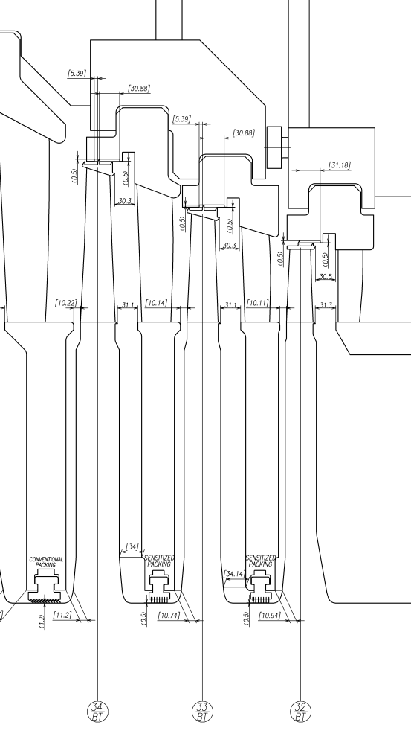
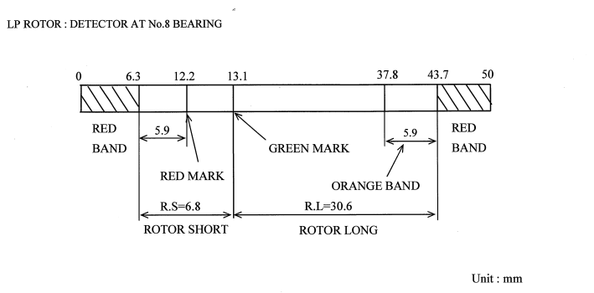
PROBLEM STATEMENT (Case History-2)
MIN Clearance
In Nov'2021 NTPC DSTPS#1(Toshiba TG set) went under shutdown due to boiler rectification work.
After cooling down it was found that LP turbine Differential expansion reduced from 13 mm by 9 mm (approx.) and stabilized around 4 mm which was exceeding operating band limits.
From the long trend data, it was observed that LPT differential expansion was going towards rotor short side from Feb 2019.
It was suspected that LPT nozzle and blade contact in axial direction each other, especially for narrowest gap of 5.39 mm at LPT(B)
Boroscopic inspection done but no contact found between root of the blade and nozzle diaphragm was observed.
5.39

Slide 11
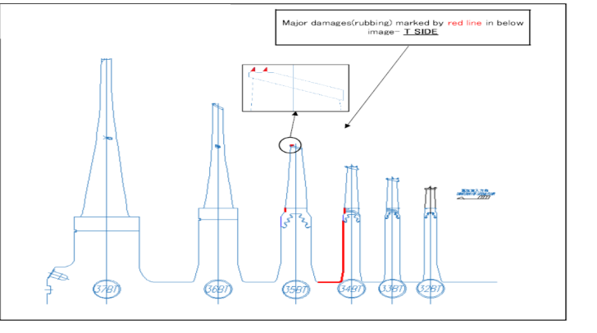
PROBLEM STATEMENT (Case History-2)
On April 22, Unit was tripped due to boiler issue LP Turbine Diff expansion came down to 10.7 mm.
Unit was restarted and rolled but BRG 7X vibration suddenly increased from 50 to 115um and rubbing sound observed in LPB Turbine.
Turning gear tripped due to high current drawn by turning gear motor.
LP-A and B opened for inspection.
Stage 34BT exit side heavy rubbing observed
Stage 35BT exit side blade root rubbing (medium) all around observed.
Stage 35 BT Packing ring groove damaged inlet side.
LPB Outer Casing crack above bearing no.8 was observed at welded locations from inner side of the casing and is propagated to base metal.

Slide 12
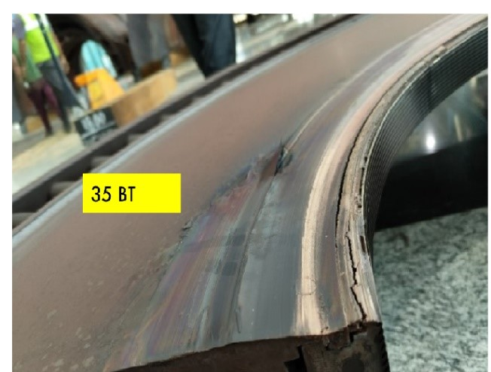
PROBLEM STATEMENT (Case History-3)
Similar Incident occurred in NTPC DSTPS#2(Toshiba TG set).
LPDE in reducing was in reducing trend; On June 2023 Turbine was cooled down for Capital OH and brought to barring speed
Slow cooling of turbine was done as per the experience of Unit#1 and LPDE was not allowed to go below red band.
After dismantling of LP turbine same rubbing phenomenon observed in rotor 34th stage and 35th stage diaphragm.
STG#34BT exit side heavy rubbing was visible with color change (blue colour) in rotor disc face.
35BT NOZ DPH inner ring material sticking with rotor disc face & packing ring outer diameter.
LP-B rotor disc cracks were also observed, and rotor replacement needed to be done.

Slide 13
PROBABLE CAUSES
Category | Possible Cause | Evaluation | Probability
Design | Improper Design | It was confirmed BY OEM that design calculations and selection of material are correct and LP casing has sufficient strength. (*still under evaluation) | LOW
 | Material Defect |  | LOW
Installation | Improper clearances | All the erection protocols were checked, and the minimum clearances recorded were found to be appropriate. | NIL
 | Uneven VIS setting | All TG deck and condenser spring heights were measured with OEM GERB and found in order. | NIL
 | Improper Axial key installation | All axial keys were inspected, and dimensions were measured. No significant deviations were observed. | NIL
Operation | Abnormal steam Parameters | No major deviations in steam parameters common to all units facing this issue. (*Still Under evaluation). | LOW
 | Wet steam/water induction | As per DCS data and long-term trends no indication of rapid cooling due to water induction was found. | LOW

Slide 14
PROBABLE CAUSES
Instrumentation | Improper LPDE setting | The initial setting of LPDE probe air gap was checked and the present air gap was also measured. Further all instrumentation settings were cross checked with OEM, no discrepancy was observed | NIL
External factors | Deck expansion | TG top deck benchmark readings in all the units were measured and it indicated appreciable change in reference distance over the years. (*Still under evaluation) | HIGH
 | External force from Condenser | No appreciable condenser tilting towards generator due to unbalanced forces from flow, piping, vacuum etc. was observed. Condenser spring condition was ok. (*Still under evaluation) | MEDIUM

Slide 15
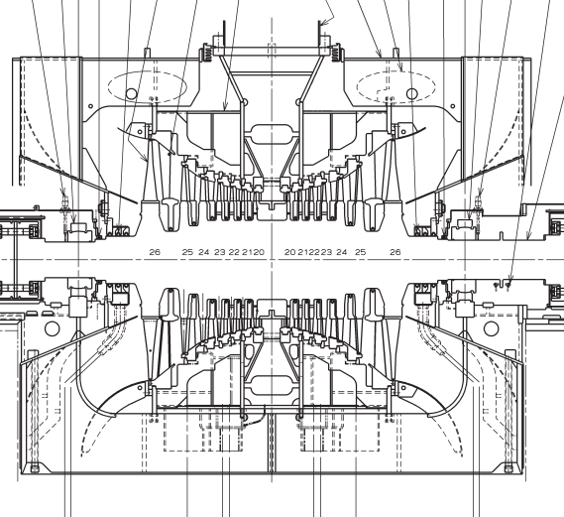
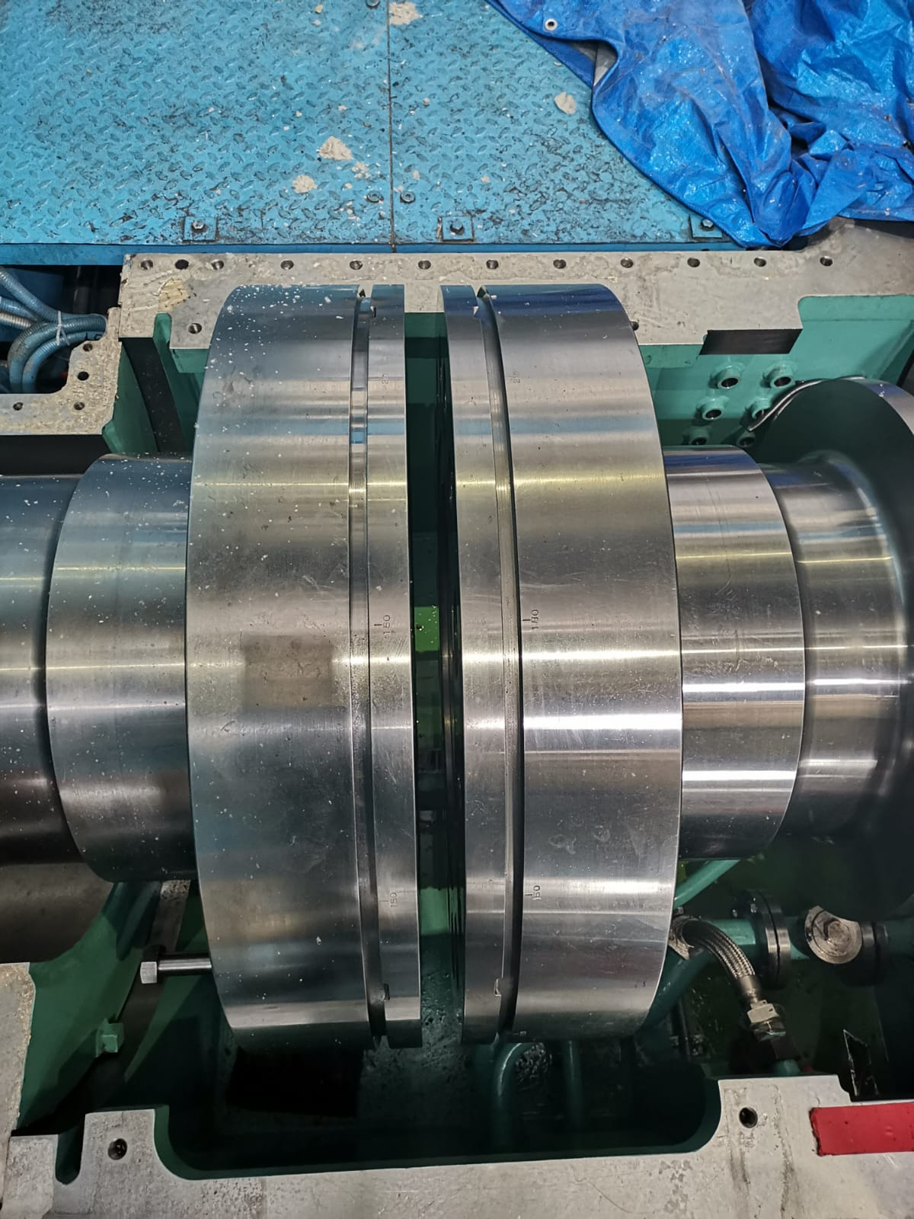
REMEDIAL MEASURES
To address the issue of low LP Differential and diminishing axial clearances, following measures were taken :-
Relocation of Inner Casing:- Inner casing shifting is a quick and effective counter measure to adjust the position of nozzle diaphragms with respect to rotor blades. At NTPC Lara inner casing shifting was carried out successfully to mitigate the problem of low clearance of LPT-B 20th Stage.
Installation of Higher Thickness Spacer in coupling:-Installation of spacer between Rotor coupling of LP turbines can increase the length of LP rotor and acquiring the required minimum clearances.

Slide 16
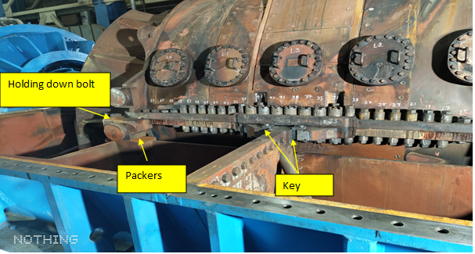
REMEDIAL MEASURES
Relocation of Inner Casing :- In Diaphragm type machines, Inner casing bottom half is placed on outer casing bottom on bottom packer plates with holding down bolts in position. Axial movement between inner and outer casing is restricted by 4 keys 2 in each side of inner casing bottom half.

Slide 17
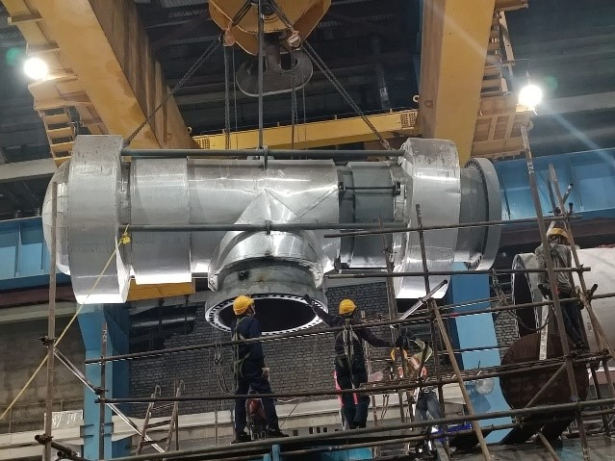
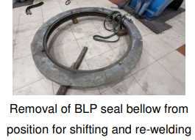
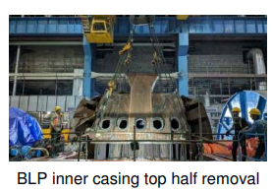
REMEDIAL MEASURES
Steps for Inner Casing Shifting
Removal of LP cross over pipe
Removal of outer casing top half and cutting of expansion bellow
Removal of Inner casing top half and top half of diaphragms
Inspection of LPT-B and Measurment of Flow path readings
Removal of axial keys
Availability of spare gasket for flanges being removed was also ensured.
To address the issue of center offset between inner casing flange and expansion bellow. Expansion bellow was removed by cutting after outer casing removal
After inner casing top removal all top diaphragms to be removed one by one. All bottom diaphragms support bar elevation readings with respect to inner casing should be noted.
Inspection of rotor and diaphragms and measurement of flow path clearances
Inner casing bottom half slope and elevation to be measured before removal of keys. No left right deflection during removal of axial keys to be ensured.

Slide 18
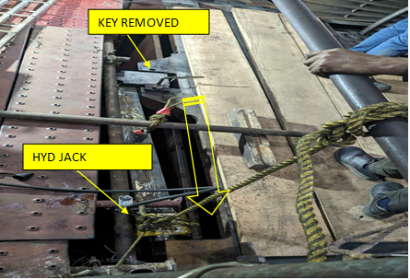
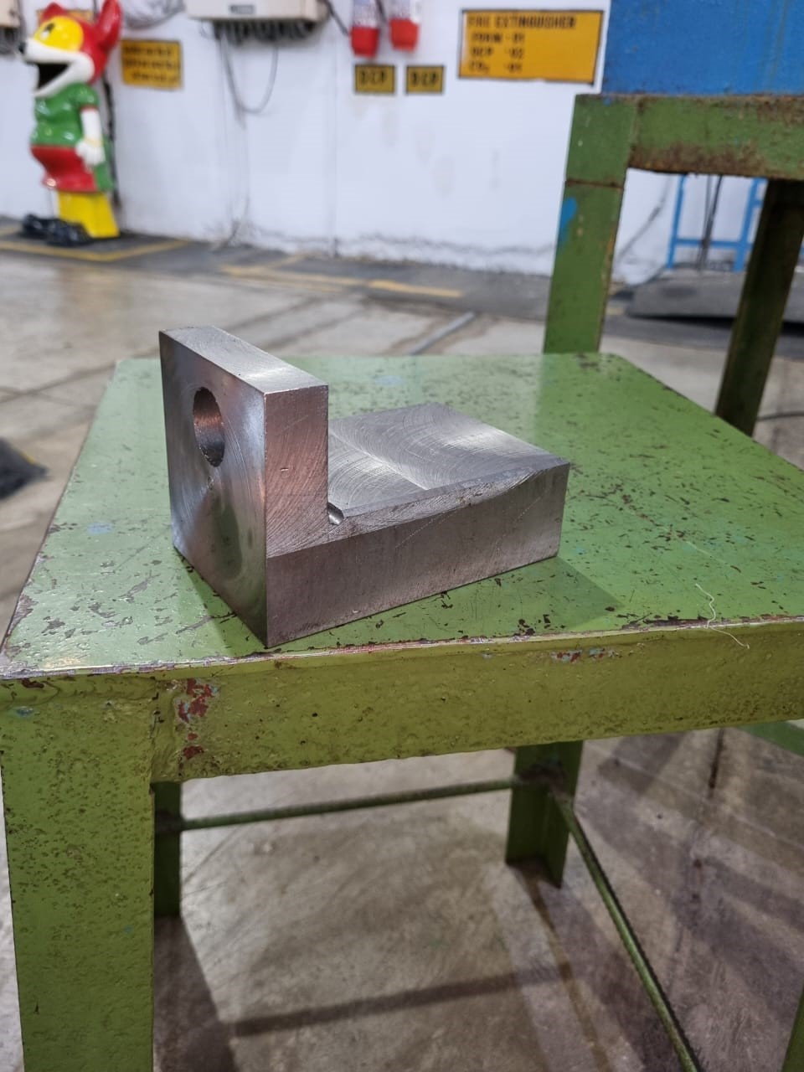
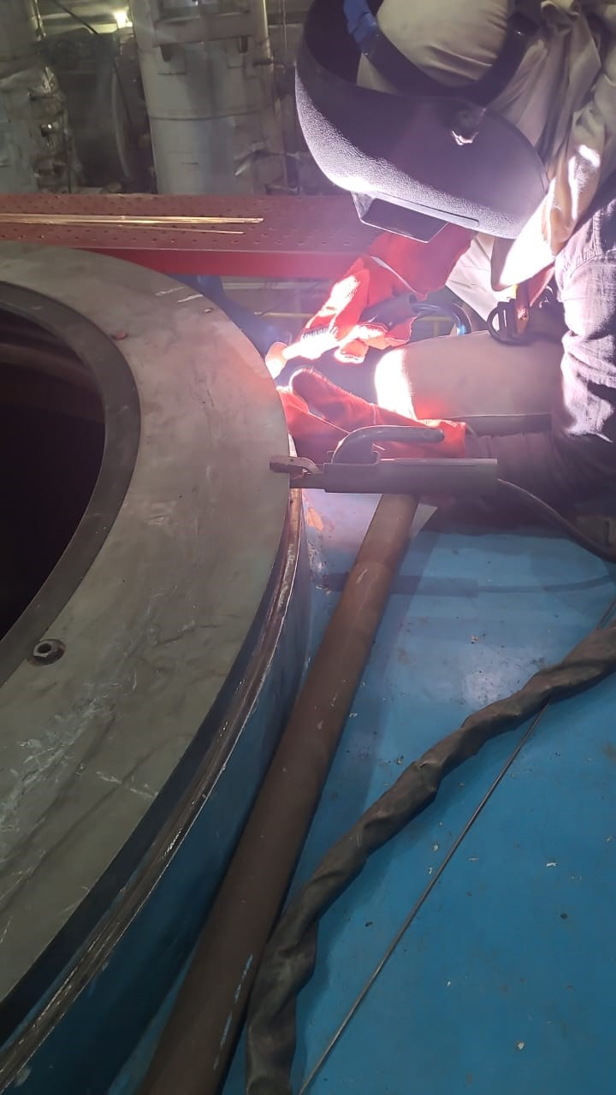
REMEDIAL MEASURES
Shifting of inner casing
Final flow path measurement and Box up of top diaphragms
Inner casing box up and outer casing temporary placement.
Installation of new keys with new dimensions
Bellow centering and welding
Outer casing and Cross over pipe final box up
Inner casing shifting towards turbine side to be done through jacking arrangement. Inner casing slope measurements and elevation to be matched with initial readings before shifting.
After locking with temporary keys, new dimensions of keys required were measured and new keys were fabricated and installed at site.
Shifting done by 6.2mm. 8mm min clearance achieved
Any deviation of support bar elevation readings from initial, elevation correction must be carried out as it will disturb the radial clearances. Final flow path readings to be taken to find out the clearances achieved.
After inner casing tightening the outer casing top half is temporarily placed with expansion bellow over inner casing for centering.
It is important to note that since only inner casing is shifted the two gaskets sealing the outer casing expansion bellow and crossover pipe should be aligned perfectly. After proper alignment outer casing expansion bellow welding was carried out at site.
Outer casing assembly with expansion bellow and Cross over pipe box up done

Slide 19
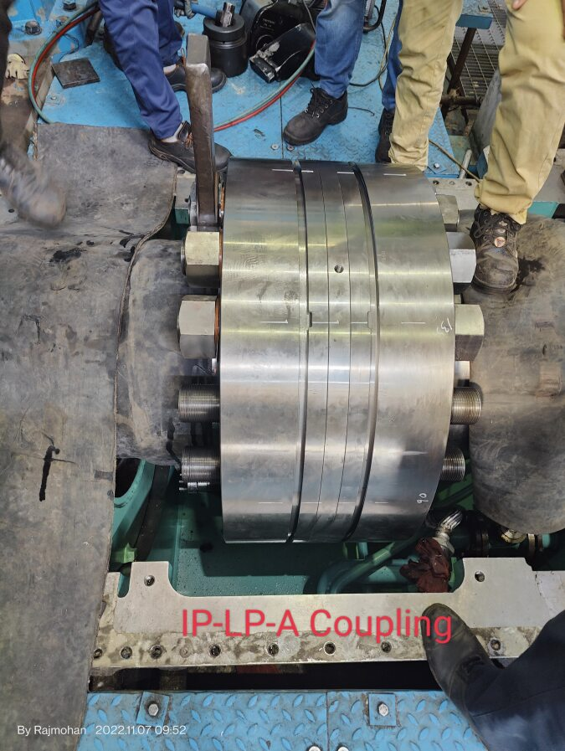
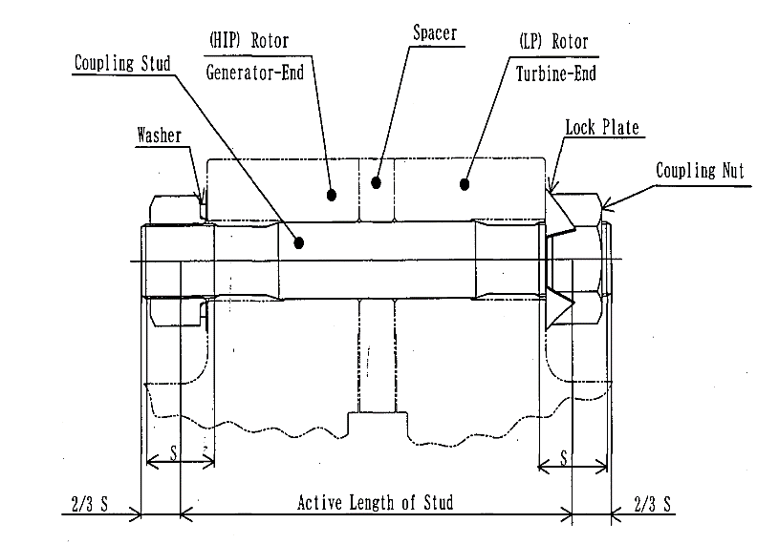
REMEDIAL MEASURES
Installation of Higher Thickness Spacer in coupling:- In diaphragm type machines (Toshiba, Hitachi etc.) spacer is already installed between rotor couplings and coupling bolts run through the spacer. To mitigate the rotor shortening higher thickness spacer was installed at 2 couplings (LPA-LPB and LPA-IP) in one of the units of NTPC DSTPS to increase the rotor length.
The total change in rotor length at Generator end was 14 mm.
Higher thickness spacer installation may require new coupling bolts with different lengths

Slide 20
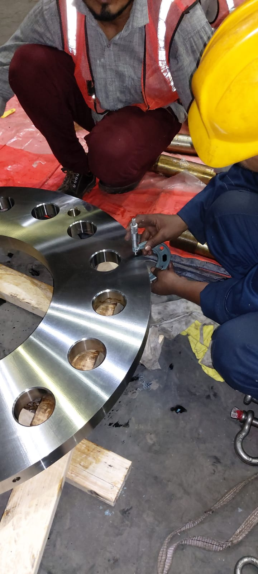
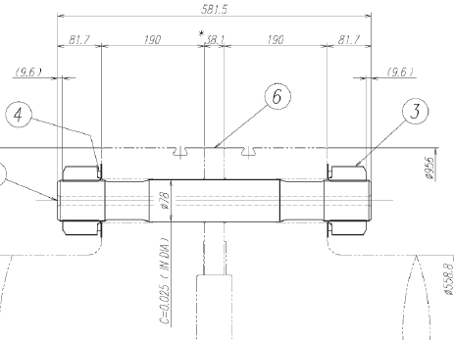
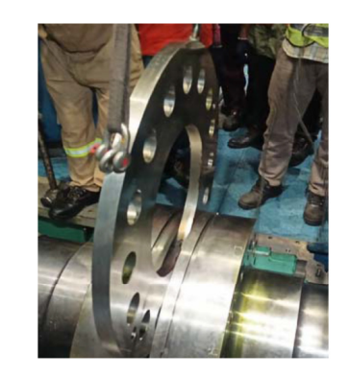
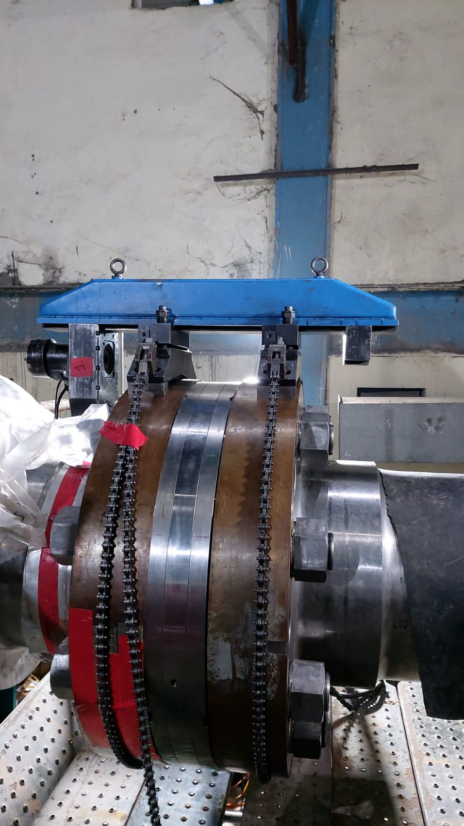
REMEDIAL MEASURES
LP cross-over pipes, outer casing and inner casing removal
Removal of top half diaphragms and flow path measurement
Rotor Lifting.
Rotor decoupling
Installation of spacer and placement of rotor
Reaming & Honing and Coupling
Box up
All steps for dismantling of LP turbine as mentioned earlier to be followed.
Design Thickness 38.1 mm
During rotor decoupling coupling bolts to removed carefully to avoid any damage to bolts
Flow path measurement was carried out; Gland box and bearing top half was removed.
All measurements prior to rotor removal like seal bore, axial reference readings etc were taken and rotor was lifted.
Actual Thickness 45.10 mm
Higher thickness spacer as per existing flow path readings was installed and rotor was placed and alignment was carried out.
REAMING TOOL
As per OEM Recommendation Reaming & Honing was carried out to match the center line of all the holes for both Coupling flanges and spacer.

Slide 21
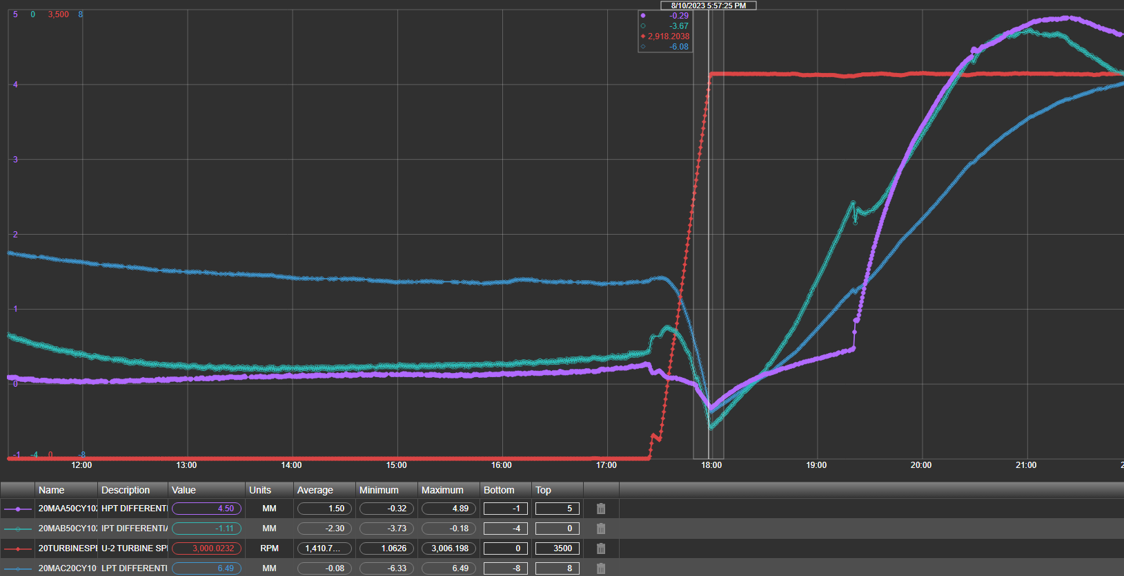
Precautions to avoid any damages due to LPT shortening issue
Strict monitoring of LP differential expansion during startup and shutdown of Unit. proper heating of LP turbine rotor and achieving sufficient margin of LP differential expansion before rolling must be achieved.
Long term trending along with Maintenance must be done to verify and record the change in LP differential with erection protocols.
During long outages forced cooling of turbine must be avoided.
TG deck 3-dimensional mapping must be carried out at least once in six months to verify any shifting of TG deck.
Thorough inspection of condenser internals including neck area for any cracks/abnormalities during OH.
When the turbine is rolled from barring speed to 3000 rpm because of centrifugal contraction the turbine rotor goes short and LPDE value can reach up to alarm levels.

Slide 22
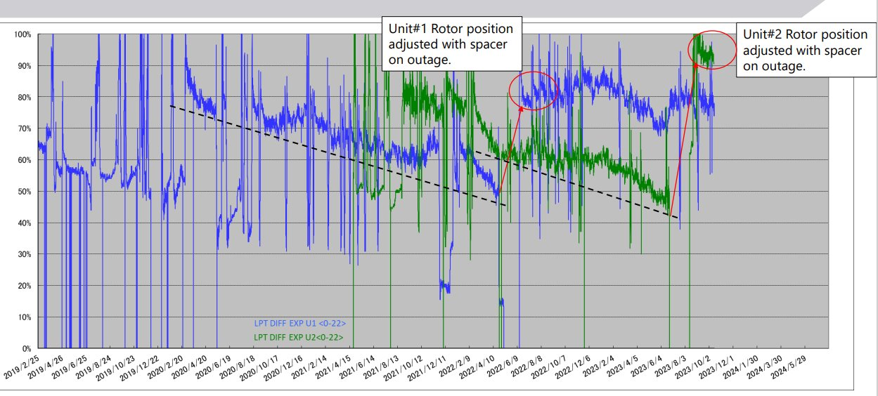
Long Term Trending of LPDE at NTPC DSTPS

Slide 23
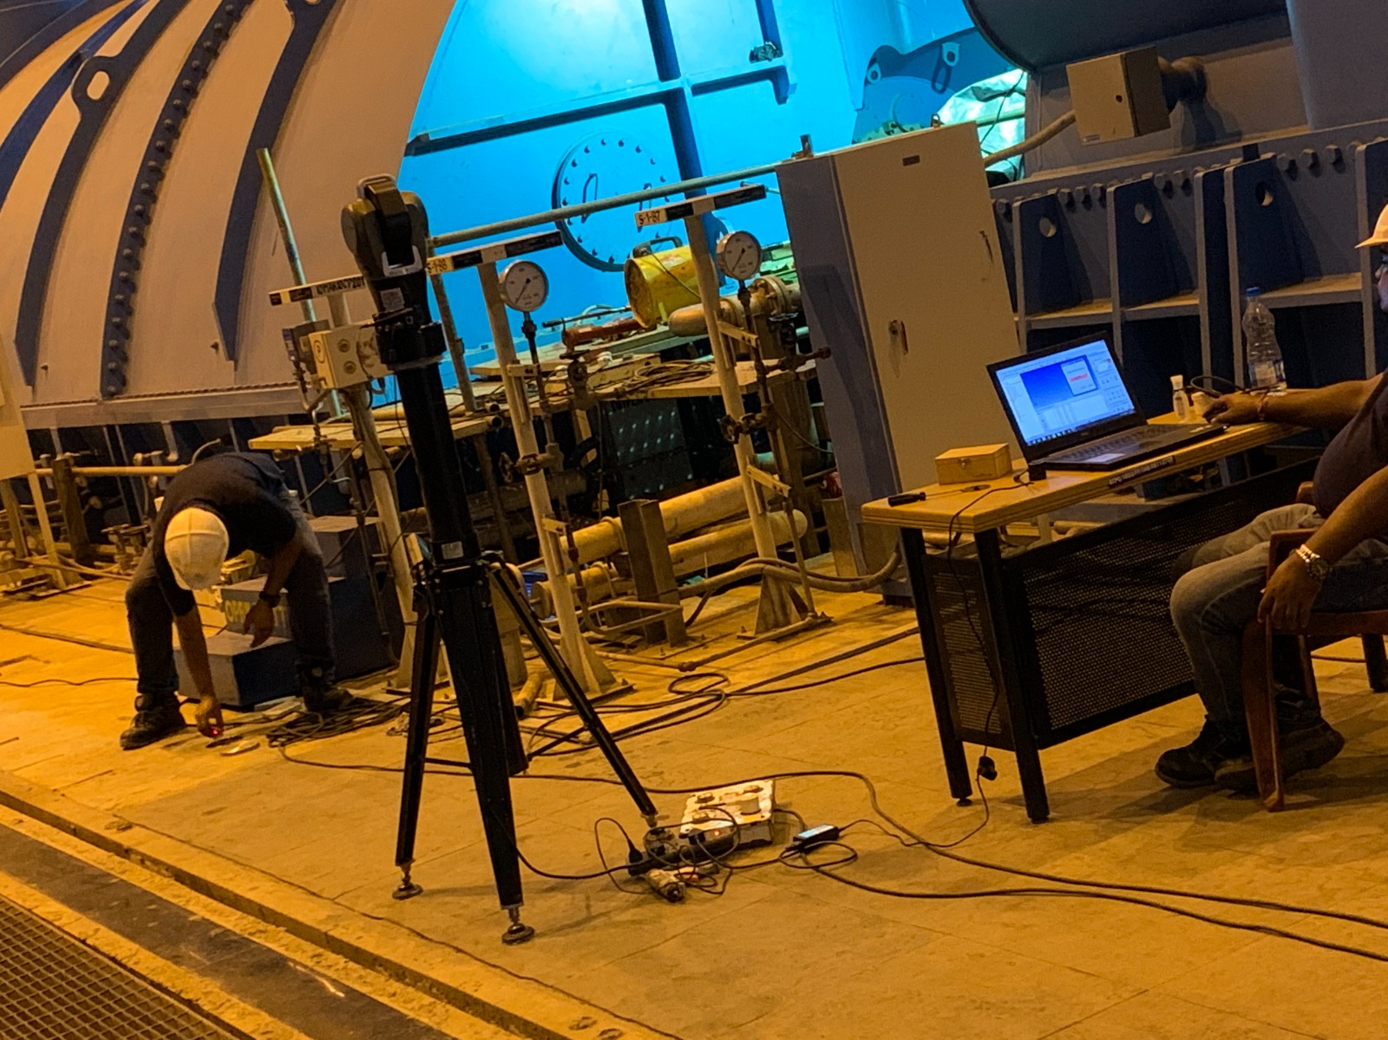
Bench Mark Readings of TG Deck (DSTPS)
 | TG Bearings | Bearing#1 | Bearing#2 | Bearing#3 | Bearing#4 | Bearing#5 | Bearing#6 | Bearing#7 | Bearing#8 | Bearing#9 | Bearing#10
Design C/L distance |  | 0 | 4900 | 7150 | 12990 | 16040 | 21300 | 24620 | 29880 | 33090 | 43490
Digital mapping on 31.01.2023 | BM-1 to 10 | -0.16 | 4897.41 | 7152 | 12991.92 | 16047.7 | 21307.82 | 24628.83 | 29887.53 | 33103.55 | 43511.09
 | BM-20 to 11 | -3.74 | 4897.57 | 7149.65 | 12993.49 | 16044.4 | 21309.33 | 24633.56 | 29895.45 | 33107.16 | 43517.74
 | Measured Avg. value |  | 4897.49 | 7150.825 | 12992.705 | 16046.05 | 21308.575 | 24631.195 | 29891.49 | 33105.355 | 43514.415
 | Deviation from design value |  | -2.51 | 0.825 | 2.705 | 6.05 | 8.575 | 11.195 | 11.49 | 15.355 | 24.415
Digital mapping on 22.08.2023 | BM-1 to 10 | 0.59 | 4898.18 | 7153.18 | 12993.32 | 16049.25 | 21309.6 | 24630.46 | 29889.11 | 33108.14 | 43513.65
 | BM-20 to 11 | -1.45 | 4899.43 | 7151.42 | 12995.42 | 16046.14 | 21310.82 | 24634.94 | 29896.51 | 33108.14 | 43518.76
 | Measured Avg. value |  | 4898.805 | 7152.3 | 12994.37 | 16047.695 | 21310.21 | 24632.7 | 29892.81 | 33108.14 | 43516.205
 | Deviation from design value |  | -1.195 | 2.3 | 4.37 | 7.695 | 10.21 | 12.7 | 12.81 | 18.14 | 26.205
U#2
Axial and Radial distances measured from a master plate.

Slide 24
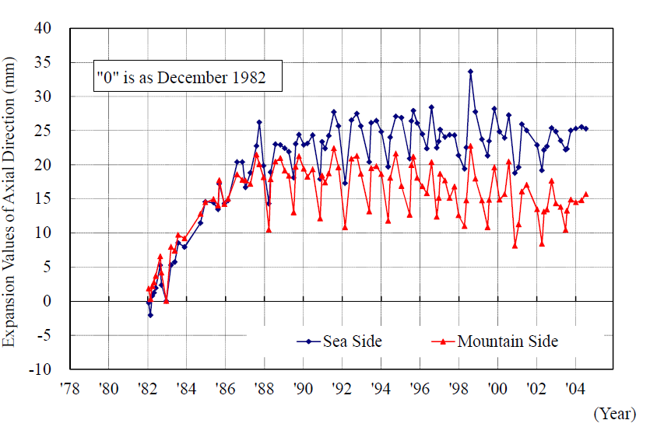
CONCLUSION
As it is evident that reducing LP differential Expansion causes rotor shortening and this condition is usually of greater severeness because clearances upstream of the flow path are generally smaller than downstream for stage efficiency purposes.
This is a major concern for large diaphragm machines as it has the potential to cause long outages and breakdown leading to huge monitory loss.
As on present situation, following suspected reasons are being analyzed and studied.
As condenser is neck welded with LP Turbine any design shortfall in condenser causing unbalanced forces which may lead to axial movement/tilting.
TG Deck Expansion or movement due to Alkali Silica Reaction (ASR) may also have the same effect on LP Outer Casing
Axial movement of deck in U#1 Ikata Nuclear Power Plant in Japan due to ASR

Slide 25
QUESTIONS
THANK YOU
Raipur

