Slide 1

INNOVATIVE SUSTAINABLE SOLUTIONS FOR HIGH VOLUME UTILIZATION OF FLY ASH
Presented by: Sandeep Singh Research Scholar | Co-Author: Dr. Satyajit Patel Associate Professor
Department of Civil Engineering, SVNIT, Surat
IPS2024

Slide 2
Outline
Performance of Road Sections Constructed With Fly Ash
Method for Producing Angular Shaped Fly Ash Aggregate

Slide 3
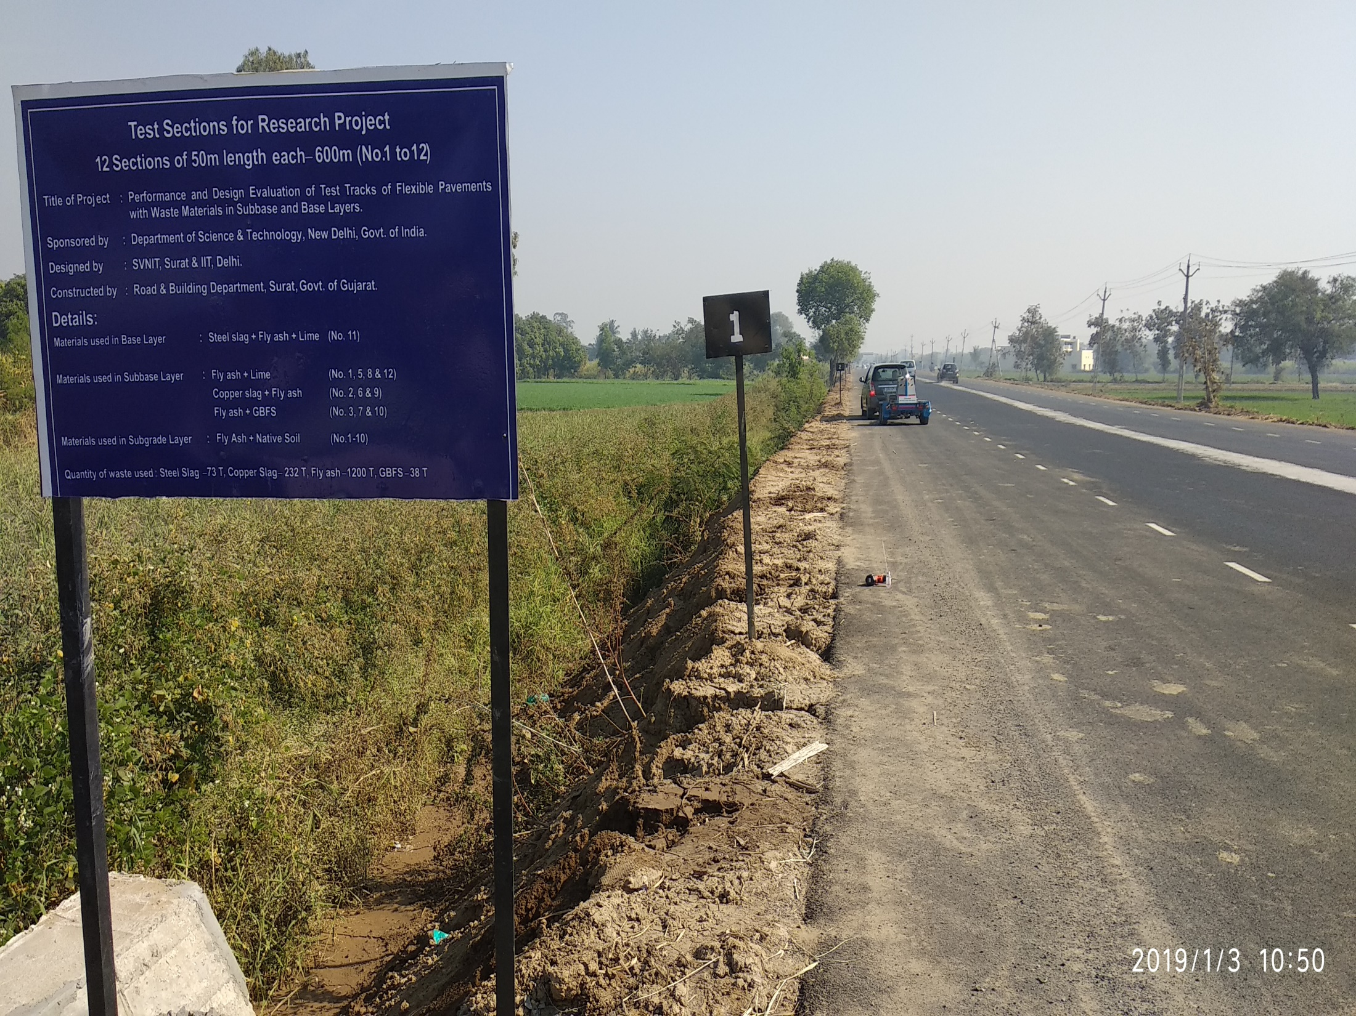
Performance of test sections constructed with fly ash at Olpad-Sahol State Highway (GJ SH-06)

Slide 4
Utilization of fly ash in Flexible Pavements
Pavements are the major application in which fly ash can be effectively used and result in significant savings in land-filling costs.
Previously it is found that the use of fly ash is beneficial with respect to subgrade application and embankments construction in road pavements. (Xie et al. 2001, Kim et al. 2005, Santos et al. 2011).
Addition of fly ash to subgrade soils has reported significant increment in unconfined compression strength, Resilient modulus and California Bearing Ratio values are key parameters in pavement design (Tanyu et al. 2003, Edil et al. 2006, Tastan et al. 2011, Horpibulsuk et al. 2013, Yu et al. 2017,).
Codal Provisions
Application | Reference Code | Recommendation
Subgrade | IRC:37-2018 | Minimum CBR = 5% (for untreated soils)
Subbase | IRC:37-2018 | UCS = 1.5 to 3 MPa at 7 days (for cementitious subbase)
 | MORTH (2013) | Minimum CBR = 30% (for subbase)
Base | IRC:37-2018 | UCS = 4.5 to 7 MPa at 7/28 days (for cementitious base)

Slide 5
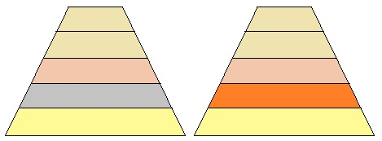
What is innovative in this work ? jConventional granular subbase (GSB) is completely replaced with 95% fly ash +5% lime (FAL) mix or 80% fly ash + 20% GBFS (FAG) mix
Seven test sections (3.5 m wide and 50 m long) were constructed as part of the widening of Olpad- Sahol State Highway (GJ SH-6) executed by Road & Building Department, Surat. All road sections were adopted as per IRC 37 (2012) for 4% CBR and design traffic of 75 MSA.
Cost per m³
Rs. 3500
Rs. 3000
Rs. 1400
Rs. 1330
Rs. 300
BC – 40mm
BC – 40mm
DBM – 140 mm
DBM – 140 mm
WMM – 250 mm
WMM – 250 mm
GSB – 330 mm
FAL or FG subbase-200/300/400 mm
Subgrade -500 mm
Subgrade -500 mm
Details and dimensions of Test section adopted in the field

Slide 6
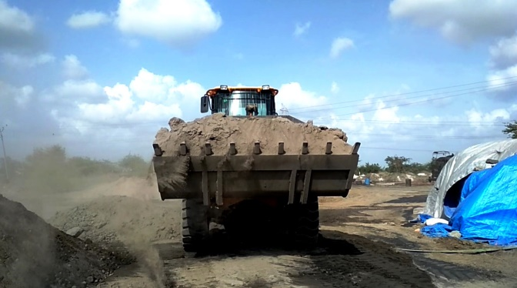
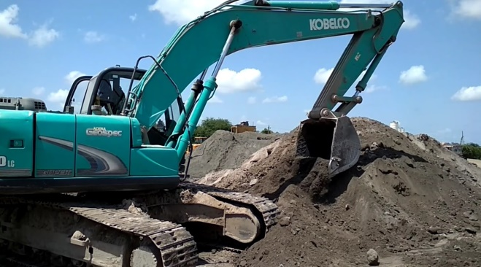
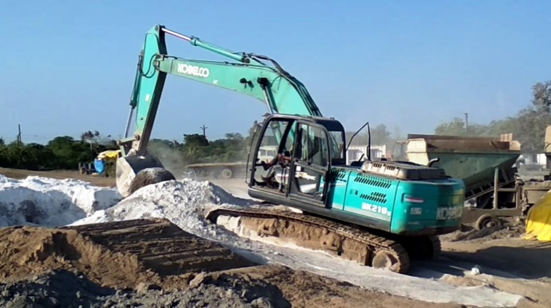
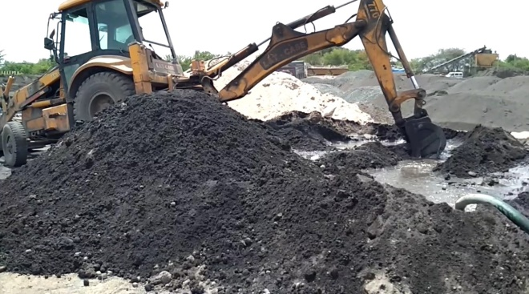
Construction of Fly ash + 5% Lime Subbase
Loading of waste from stockpile
Stacking of fly ash for mixing
Dry mixing with binder
Addition of water in dry heap

Slide 7
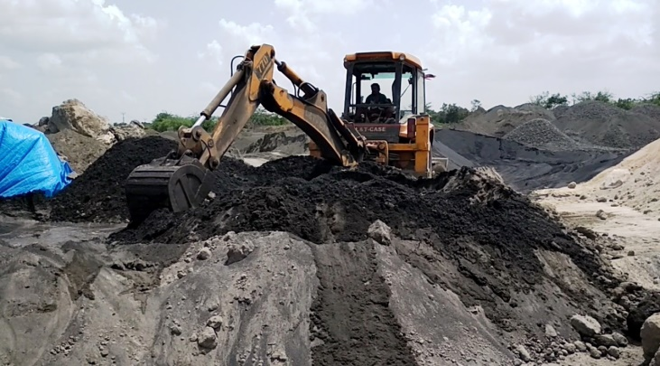
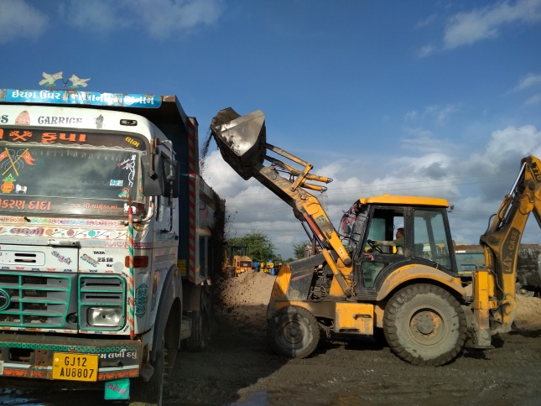
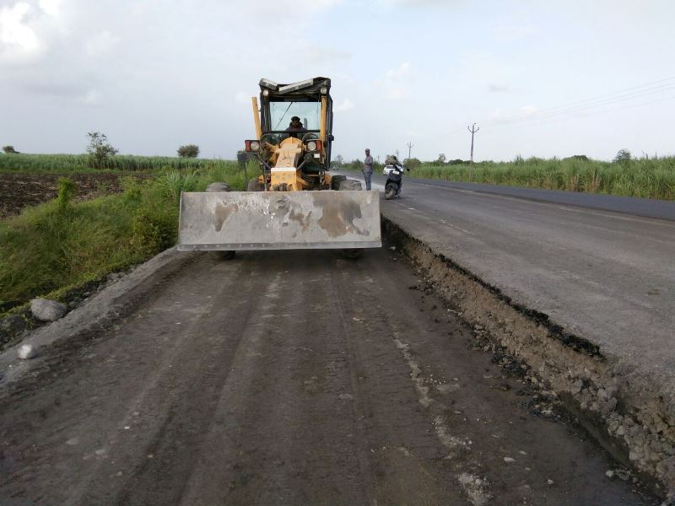
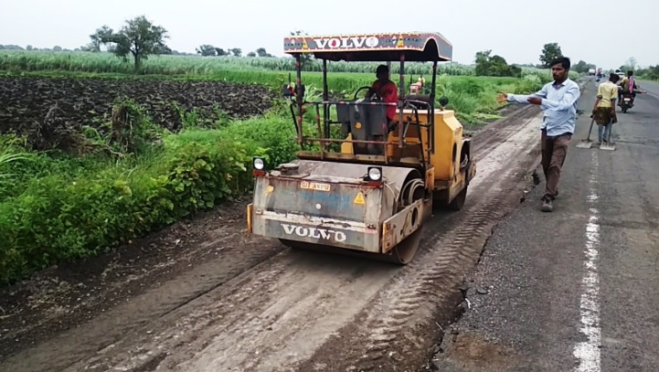
Wet mixing
Loading in dumper
Laying & mixing with grader
Rolling with vibratory roller

Slide 8
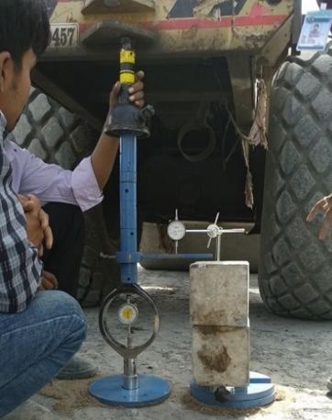
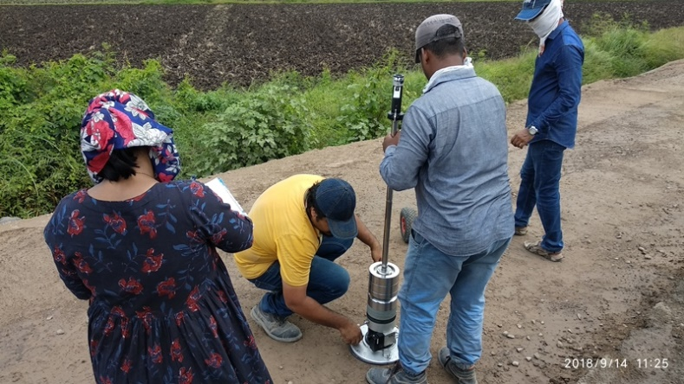
Experimental Program
Test | Reference Standard
Unconfined Compressive Strength | IS:2720-Part 10 (1991)
California Bearing Ratio | IS:2720-Part 16 (2011).
Field California Bearing Ratio | IS:2720-Part 31(1990).
Light Weight Deflectometer (LWD) | ASTM E2583 (2007)
Falling Weight Deflectometer (FWD) | IRC:115 (2014).
Field CBR
LWD Testing

Slide 9
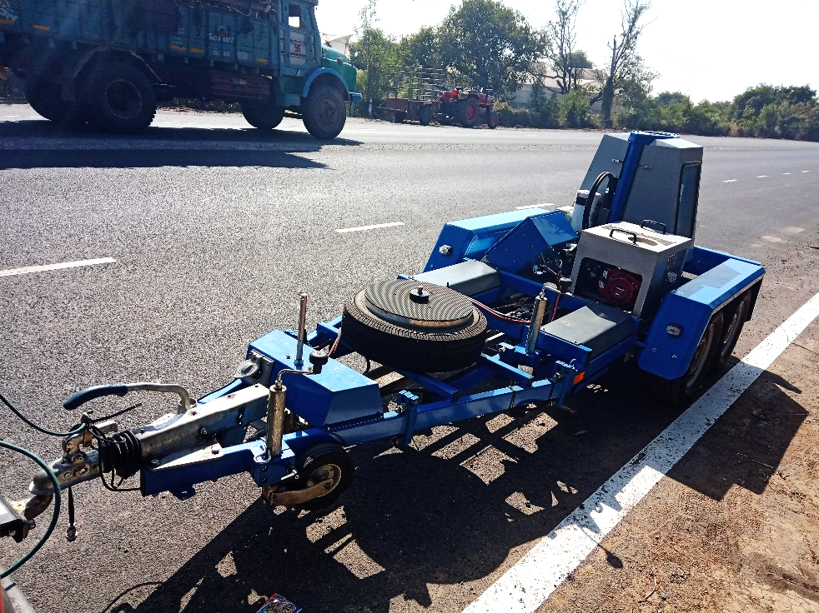
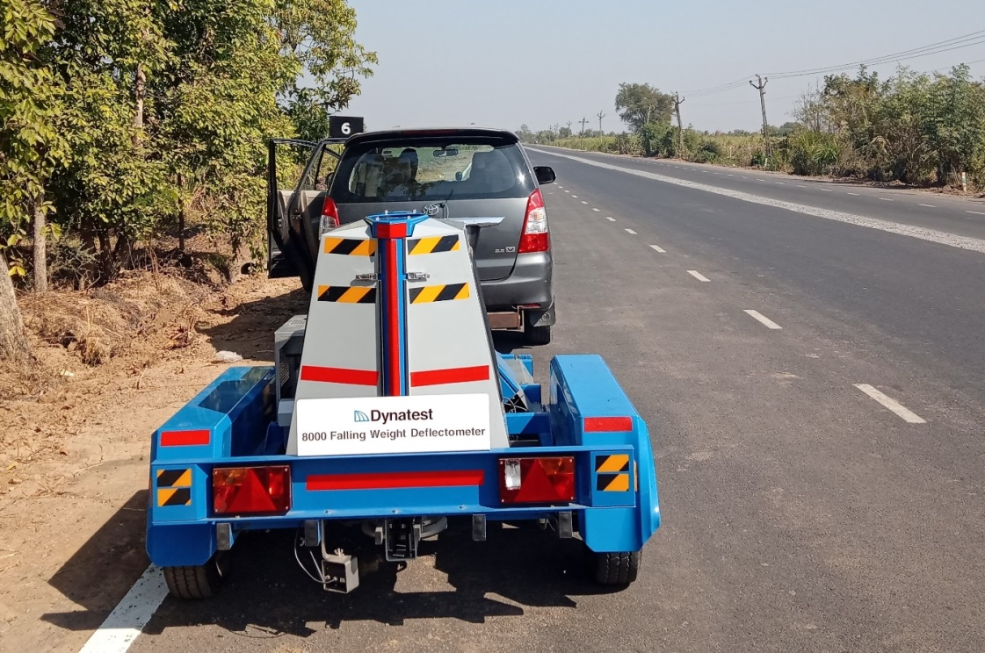
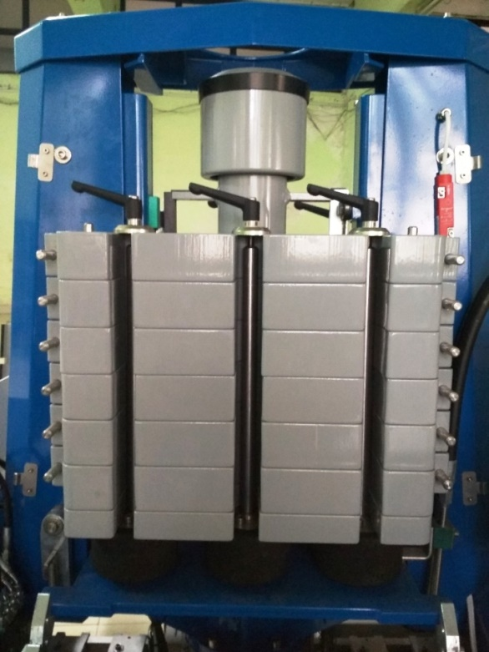
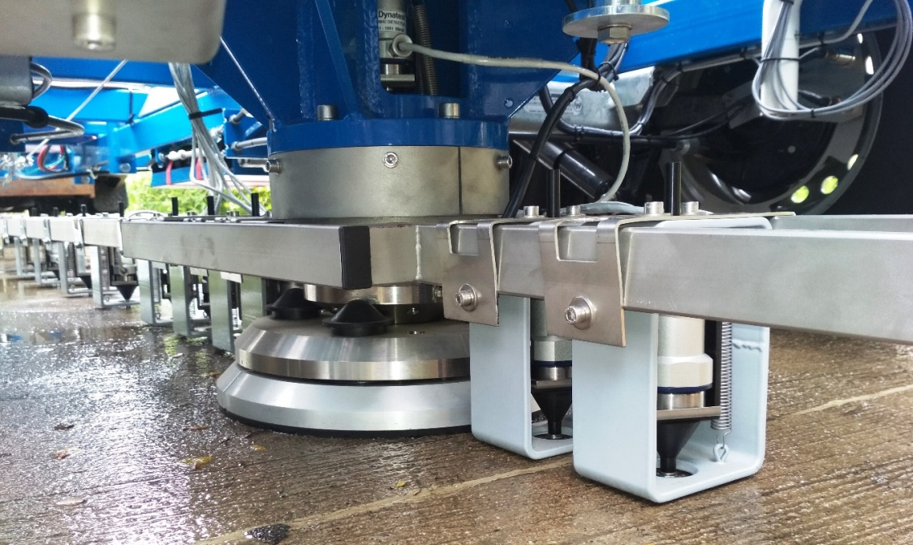
Falling Weight Deflectometer (FWD)
Falling Weight Deflectometer (FWD)
350kg Weight – 120 kN
Loading plate
Geophones

Slide 10
Results and Discussions
95% Fly ash + 5% Lime achieved 2.93 MPa and 80% Fly ash + 20% GBFS achieved 1.66 MPa UCS value after 28 days curing in laboratory.
As per IRC SP 20 (2002), lime fly ash stabilized soils should have minimum UCS value of 1.5 MPa after 28 days curing for subbase application.
Hence, 95% fly ash + 5% lime (FAL) and 80% fly ash + 20% GBFS (FAG) was chosen as optimum mix.
Field Test Parameters-> |  | Peak deflection on top of pavement D₀ (mm) for load of |  |  | Field CBR (Unsoaked) (minimum: 30%) | Composite Modulus – LWD test (7 Days Curing) | Stiffness Modulus – FWD test (28 days curing)
Material | Thickness (mm) | 40 kN | 55 kN | 70 kN
GSB | 330 | 0.781 | 0.932 | 1.149 | 38% | 55 MPa | 108 MPa
FAL mix | 200 | 0.434 | 0.892 | 1.026 | 75% | 169 MPa | 322 MPa
 | 300 | 0.384 | 0.742 | 0.907 | 81% | 187 MPa | 353 MPa
 | 400 | 0.334 | 0.705 | 0.868 | 85% | 206 MPa | 365 MPa
FAG mix | 200 | 0.521 | 0.901 | 1.109 | 48% | 115 MPa | 153 MPa
 | 300 | 0.463 | 0.848 | 1.053 | 55% | 125 MPa | 168 MPa
 | 400 | 0.410 | 0.781 | 0.996 | 63% | 141 MPa | 186 MPa

Slide 11

Service Life Ratio :
Summary of service life ratio, waste utilization and savings in the aggregates for all the waste mix test sections
Material | Thickness (mm) | SLR after 2 years | Overall Construction cost (INR) |  |  | Waste Utilization, in tons/km of road length |  |  | Granular layer thickness in Equivalent design |  |  | Total aggregates used (tons/km) | Aggregate saved compared to control (%)
 |  |  | Rate (m³) | Rate/km (lakhs) | Savings (%) | Flyash | Metal Slag | Total | HMA | Base | Subbase
 |  |  |  |  |  |  |  |  |  | (WMM)
Control section | WMM 250 | 1 | 1,399 | 86.6 | -- | -- | -- | -- | 180 | 250 | 330 | 7435.5 | --
 | GSB 330
 |  |  | 1,328 |  |  | -- | -- | --
FAL | 200 | 1.29 | 683 | 78.4 | 9.43 | 840 | -- | 840 | 160 | 120 | - | 3329.1 | 55
 | 300 | 1.44 |  | 80.7 | 6.81 | 1260 | -- | 1260 | 150 | 110 | - | 3051.7 | 58
 | 400 | 1.54 |  | 83.0 | 4.11 | 1680 | -- | 1680 | 140 | 100 | - | 2774.3 | 62
FAG | 200 | 1.12 | 632 | 77.9 | 10.02 | 672 | 168 | 840 | 160 | 150 | - | 3557.1 | 52
 | 300 | 1.23 |  | 79.9 | 7.74 | 1008 | 252 | 1260 | 150 | 140 | - | 3279.7 | 55
 | 400 | 1.31 |  | 81.9 | 5.35 | 1344 | 336 | 1680 | 150 | 120 | - | 3127.7 | 58

Slide 12
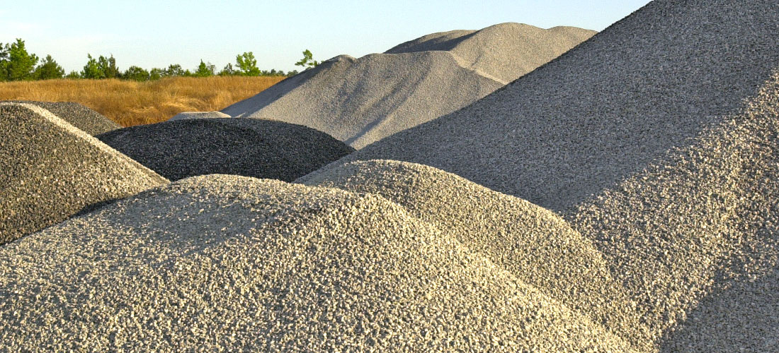
FLY ASH AGGREGATE

Slide 13
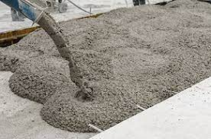
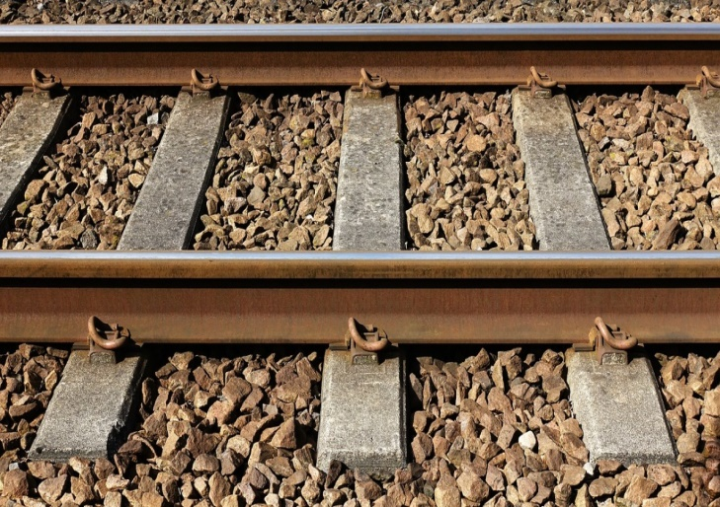
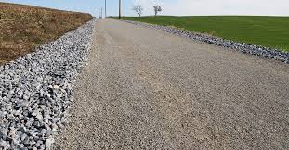
AGGREGATE DEMAND
The overall demand of construction aggregates in the country is estimated to be around 4,500-5,000 million tons/year
Production of 1 cubic meter of concrete requires about 1.7 tons of stone aggregates. Construction of 1 km of 2 lanes (7m wide) road requires about 8500 tons of stone aggregates in base and sub-base layers.
Major uses of Aggregates
Use of aggregate in concrete
Use of aggregate in railway tracks
Use of aggregate in Road Construction

Slide 14
Alternative Aggregates for use in Construction
Construction and Demolition waste
Foundry sand residue
Glass waste and bottle
Blast Furnace Slag, Steel slag, Copper slag etc.
Fly ash aggregates

Slide 15
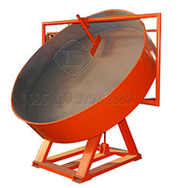
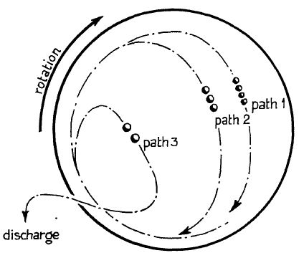
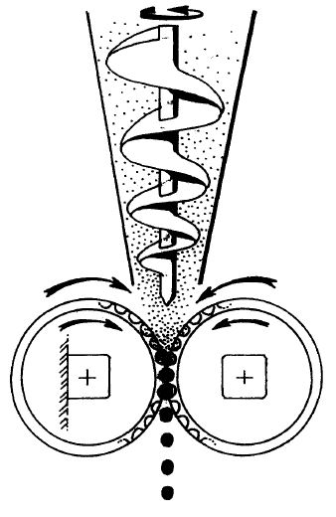
  Methods for Making Artificial Aggregates
Agglomeration
Hardening
Crushing/Sieving
Agglomeration Consolidation of solid particles into larger shapes is termed as agglomeration. It is divided into two types:
Pelletization or granulations- In this method agglomerates are shaped by tumbling forces without any external compacting forces.
Compaction- In this method the desired density is achieved with external compacting forces.

Slide 16
  Methods of Hardening Artificial Aggregates
Table Classification of LWA hardening process based on temperature indication for inorganic matrices (Sarabèr et al. 2012; Bijen 1986)
Production process | Temperature (ºC) | Binding
Cold Bonding | 0-100 | Matrix with calcium alumina silicate hydrate
Hydrothermal | 100-250 | Matrix with calcium alumina silicate hydrate under the pressurized steam condition
Sintering | 900-1200 | Material bridge bonding with alumina silicate
Complete melting | > 1200 | Alumina silicates
The cost of the final product is the important factor needs to be considered while selecting the process of hardening.

Slide 17
  Drawbacks of existing Technology
Higher energy consumption & complicated process
Processes are costly and time-consuming
Round shaped aggregates with poor interlocking properties and hence lower load bearing capacity
Requires high temperature hardening process and chemical treatment
(Yoo, 2002)

Slide 18
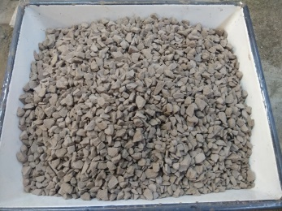
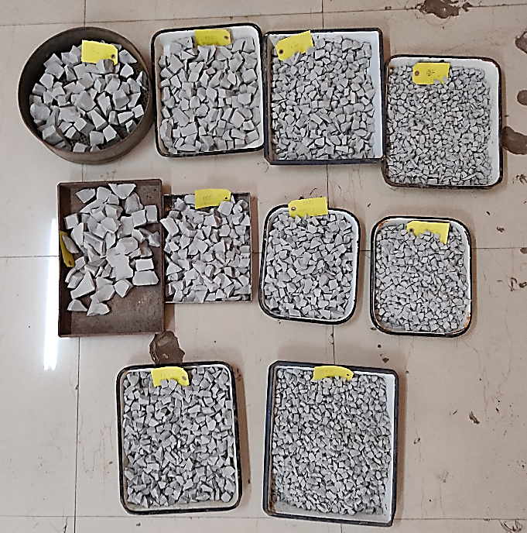
METHOD FOR PRODUCING ANGULAR SHAPED FLY ASH AGGREGATE
(Granted Indian Patent Nos.: 362571 & 457555)
Date of Grant: 23/03/2021 & 09/10/2023

Slide 19
FOUR-STEP PROCESS FOR PRODUCTION OF
ANGULAR SHAPED FLY ASH AGGREGATES
Mixing
(Fly ash + Binders + Water)
Compaction to High Density
Steam Curing in Autoclave
Crushing to required size

Slide 20
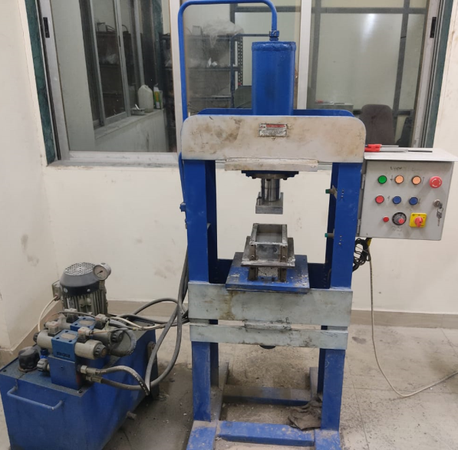
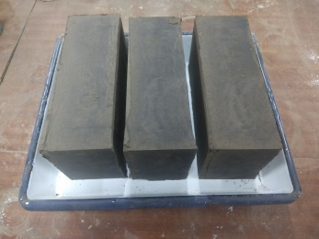
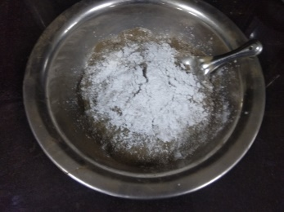
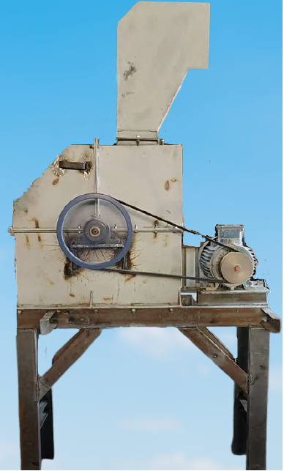
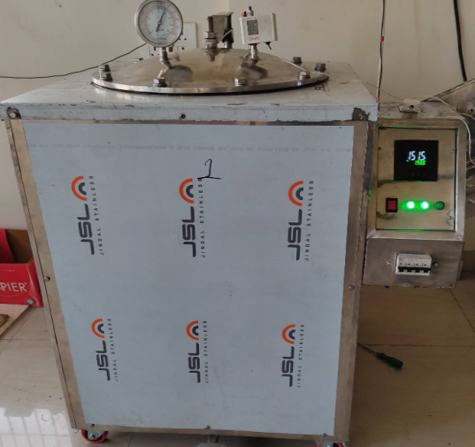
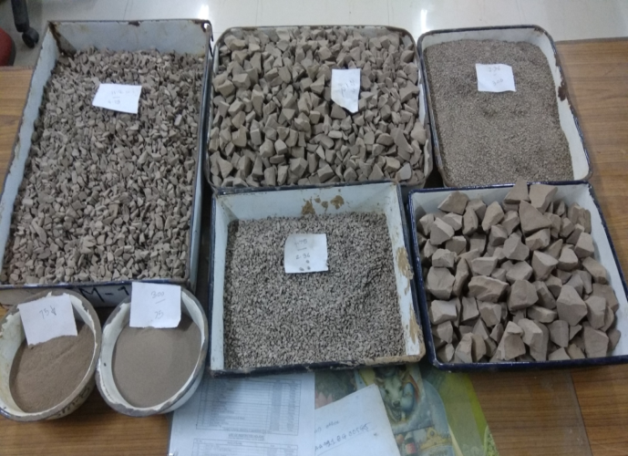
Materials and Process
Mixing
Block Making Machine
Compacted Rectangular Block
Angular Aggregate
Crusher
Autoclave-Curing

Slide 21
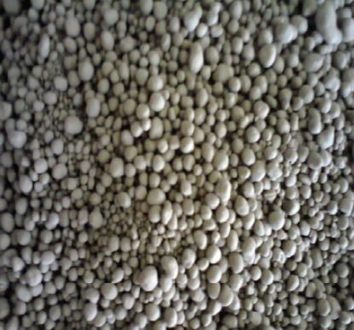
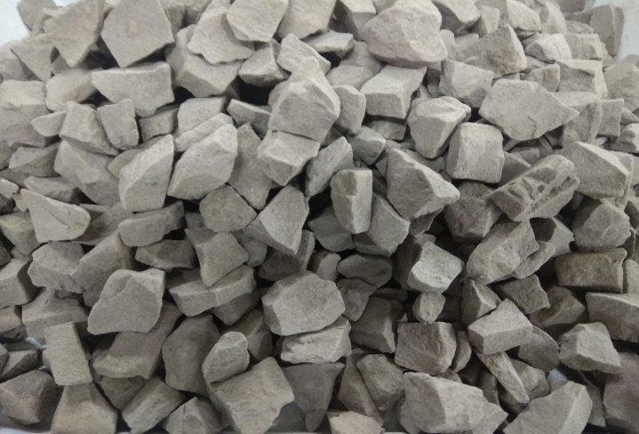
Advantages of the present invented aggregates over sintered aggregates
Parameters | Sintered Aggregates | Proposed Aggregates
Production Process | Tedious | Simple
Curing Method | Temperature of 900-1200ºC is required | -Steam Curing in Autoclave for Low Calcium Fly Ash
Shape of Aggregates | Rounded (inferior interlocking) | Angular (Better interlocking & Load Bearing Capacity)
Production Cost (approx.) | Rs. 1700/ton Rs. 1870/m³ | Rs. 900/ton Rs. 950/m³

Slide 22
Typical physical properties of fly ash based coarse aggregates
Parameters | Authors Aggregates# | Sintered Fly Ash Aggregates* | Natural Aggregates* | IS:383 (2016) requirements for concrete aggregate |  | MORTH- 2013 | IS 9142 (Part 2) 2018
 |  |  |  | wearing surfaces | Non -wearing surfaces
Specific Gravity | 1.51 | -- | 2.9 | -- | -- | -- | --
Bulk Density Loose (kg/m³) | 860 | 650-1050 | 1350 | -- | -- | -- | ≤ 950
Water absorption (%) | 19.3 | 15-30 | 0.5-2 | ≤ 2 | ≤ 2 | -- | ≤ 18
Impact value (%) | 27 | 15-55 | 12-20 | ≤ 30 | ≤ 45 | ≤ 30 | ≤ 40
Abrasion Value (%) | 24 | 29 | 10-18 | ≤ 30 | ≤50 | ≤ 40 | ≤ 40
Crushing Value (%) | 35 | -- |  | ≤ 30 | -- | -- | ≤ 45
Soundness (%) in Na₂SO₄ | 4.4% | -- | 1-5 | <12 | <12 | ≤ 12 | ≤ 12
Shaped of Aggregates | Angular | Rounded | -- | -- | -- | -- | --
Production Cost (Approx.) | Rs 950-1050 per m³ | Rs. 1870 per m³ | Rs. 1400 per m³ | -- | -- | -- | --
* From Literature #NCCBM lab results

Slide 23
APPLICATION OF DEVELOPED FLY ASH AGGREGATE IN CONCRETE
Slump Test
Compressive Strength Test
Split tensile strength test
Flexural Strength Test
Pull Out Test
Failed samples after pull-out test

Slide 24
Comparison of properties for M25 grade of fly ash aggregate concrete with natural aggregate concrete
Parameters | Concrete with fly ash aggregate and natural sand | Concrete with natural aggregate and natural sand | Target values for M25 for 28-day
w/c ratio | 0.41 | 0.41 | -
Cement (kg/m³) | 330 | 330 | -
Sand quantity / m³ in kg | 712 | 712 | -
Aggregate quantity / m³ in kg | 770 | 1301 | -
Density of concrete (kg/m³) | 2015 | 2370 | -
Slump (mm) | 70 | 70 | 75
7- Day Compressive strength (MPa) | 28.4 | 25.2 | -
28-Day compressive strength (MPa) | 33.8 | 35.7 | 31.6
Split Tensile Strength (MPa) | 1.7 | 1.9 | -
Flexural Strength (MPa) | 8.2 | 8.3 | 3.5
Bond Strength (MPa) | 4.7 | 5.3 | 2.2

Slide 25
FINANCIAL ANALYSIS
FOR
SET-UP OF PILOT PLANT
FOR MANUFACTURING
ANGULAR SHAPED COARSE AGGREGATES
FROM FLY ASH

Slide 26
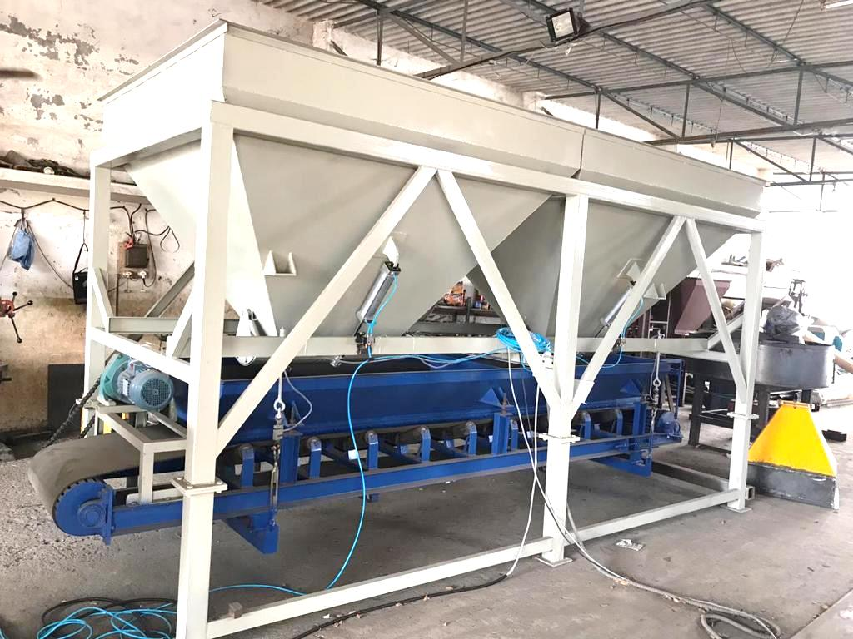
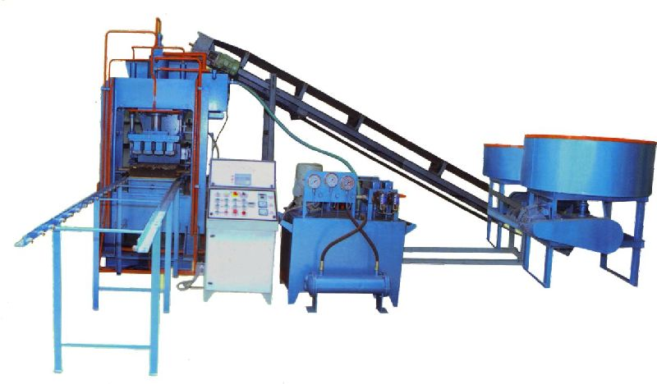
Various components of Pilot Plant
Batching plant
Pan Mixer and Brick press machine

Slide 27
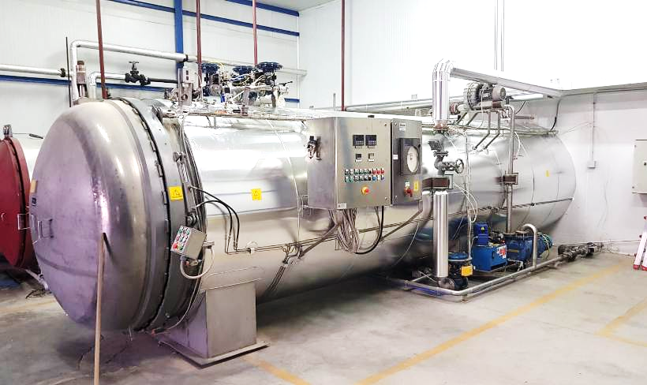
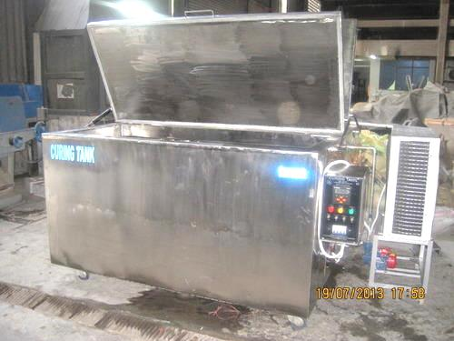
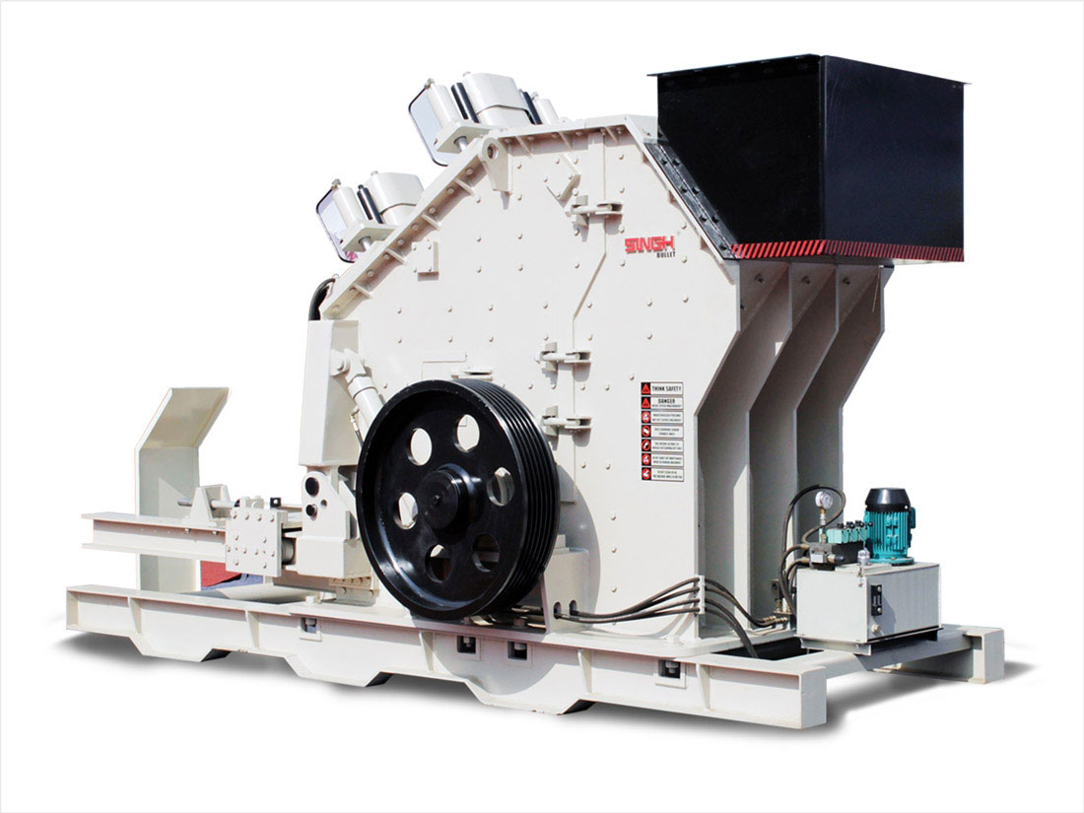
Autoclave
Hot water curing tank
Crusher

Slide 28
Cost of Pilot Plant
Capacity of Plant- 13,558 m³/year, 45.2 m³/day
Sr. No | Particulars | Cost in Lac Rs.
1 | LAND required: 4,000 -5,000m² (Approx.) | -
2 | PRODUCTION SHED (1400 m²) and electrical installations | 150
3 | PLANT & MACHINERIES
 | Batching Plant (1 No.) | 17
 | Pressing (1 No.) | 38
 | Autoclave (4 Nos.) | 210
 | Crusher | 28.5
 | Fork Lift & Loader | 24.5
 | Total | 468 lacs

Slide 29
Production details
Brick per Stroke- | 2
No. of stroke per minute- | 4
Bricks per hour- | 960
No. of Bricks per day- | 19,296
Shift per day | 3
Brick Size- | 230mm*110mm*60mm
Weight per Brick- | 2.34kg
Wastage considered- | 5%
Working days per year- | 300
Aggregate produced per day | 45.2m³ (42.9ton)
Aggregate produced per year- | 13,558m³

Slide 30
Assumptions
Capital raised by promoter (100%): 468 Lakhs
Bank finance: 0%
Binder cost: Rs. 4500 per ton
Electricity cost: Rs. 4.0 per kwh
Water cost: Rs. 10.0 per ton
Manpower cost per day per person: Supervisor- Rs. 550, Skilled Worker- Rs. 450, Unskilled Worker- Rs. 350
Depreciation: 5% for machinery and 2.5% for building
Bank Interest: 0%

Slide 31
Raw Material Requirement
Material | % | Tons/ Day | Tons/Year | Cost/day Rs | Cost/year Rs
Fly Ash | 88 | 35.82 | 10748.7 | 0 | 0
Binder | 12 | 4.89 | 1465.7 | 21986 | 65,95,821
Total RM | 100 | 40.72 | 12214 | 21986 | 65,95,821
Water | 15 | 6.11 | 1832.2 | 61 | 18,322
Wastage | 1 |  |  |  | 66,141
Total |  |  |  |  | 66,80,284

Slide 32
Cost of Aggregates per m³
Total Production Cost | Cost in Lac Rs. | % of Total Cost | Rs. per m³
Raw Material | 66,80,284 | 52% | 492.68
Power & Other Utility | 6,56,640 | 5% | 48.43
Man Power (20 persons) | 25,67,250 | 20% | 189.34
Depreciation | 19,65,000 | 15% | 144.92
Total Maintenance | 9,54,000 | 8% | 70.36
Total Production Cost/year | 1,28,23,174 | 100% | 945.73 per m³
Selling Price |  |  | 1400/m³
Production Cost |  |  | 950/m³
As per Delhi Schedule Rate (DSR), CPWD, 2021
Rate of stone aggregate aggregate = Rs. 1300-1400 per cubic meter

Slide 33
Conclusions
Back-calculated moduli for both FAL and FAG subbase layers were higher than the conventional control section. It increased with the curing period due to the pozzolanic reaction in the fly ash.
SLR of 1.12 to 1.54 can be achieved when the equal thickness of FAL and FAG subbase are used with a cost-efficacy of 4% to 10% compared to the conventional control section.
At least a ton of waste materials can be consumed with maximum savings in the aggregate consumption of 62% compared to the conventional section. These results allow a design of pavement that could serve different purposes, such as minimum crust thickness (FAL 200 section), maximum waste utilization as per the available waste source or maximum saving in natural aggregate consumption.

Slide 34
The present study recommends a simple and cost-effective four-step process for the production of angular shaped high strength fly ash aggregates. The proposed fly ash aggregates is about 30% cheaper than sintered fly ash aggregates.
Proposed angular shaped fly ash aggregates are sufficiently tough, strong, hard, durable and provide effective interlocking which fulfils the specifications MoRTH (2013) for road aggregate and requirement of IS:9142 (2018) and IS: 383(2016) (for structural concrete aggregates.
Fly ash, steam and hot water from cooling towers is available free of cost at thermal power plants. Therefore, steam curing (for low calcium fly ash) are proposed as a commercially feasible methods for the production of angular shaped fly ash aggregate.

Slide 35
M25 grade light weight concrete (density 15% lower) can be successfully prepared from the proposed angular shaped fly ash aggregate with cement content of 330 kg/m3 and w/c ratio of 0.41.
Financial analysis for set-up of pilot plant with capacity of 2 ton/hour for manufacturing angular shaped coarse aggregates from low calcium fly ash is given below:
  Production Cost of Aggregate = Rs 950 per m³
  Selling Price of the Aggregate = Rs 1400 per m³
  Profit Before Tax (PBT) = Sales Realization – Total Production Cost = Rs. 61,59,364

Slide 36
References
Alqahtani, F. K., Khan, M. I., & Ghataora, G. (2014). “Synthetic aggregate for use in concrete.” U.S. Patent No. 8921463 B1, USPTO, USA.
ASTM. 2007. “Standard Test Method for Measuring Deflections with a Light Weight Deflectometer (LWD).” ASTM E2583-07. American Society for Testing and Materials. West Conshohocken, PA.
Buschmann (1983). “Shaped cementitious products.” U.S. Patent No. 4377414, USPTO, USA.
CEA (2022). “Report on fly ash generation at coal/lignite based thermal power station and its utilization in the country for the year 2017-18” Central electricity authority, New Delhi, Ministry of Power, Government of India.
Consoli, N. C., Rosa, A. D. and Saldanha, R. B. (2011). “Variables Governing Strength of Compacted Soil–Fly Ash–Lime Mixtures.” Journal of Materials in Civil Engineering, 23 (4): 432–440. ASCE
Deusen Van, (1998). “Improved spring load restriction guidelines using mechanistic analysis.” Proceedings of the International Conference on Cold Regions Engineering, 188–199. maplewood.
Havanagi, V. G., Sinha, A. K., Mathur, S., and Prasad, P. (2008). “Experimental Study on the Use of Copper Slag Wastes in Embankment and Pavement Construction.” Symposium on Engineering of Ground & Environmental Geotechnics, (1982): 259–264.
IRC 115 (2014). “Guidelines for Structural Evaluation and Strengthening of Flexible Road Pavements using Falling Weight Deflectometer Technique.” Indian Road Congress. New Delhi.
IRC 37 (2012). “Guidelines for the Design of Flexible Pavements.” Indian Road Congress. New Delhi.
IS 1514 (1990). “Methods of sampling and test for quick lime and hydrated lime.” Bureau of Indian Standards, New Delhi.
IS 2386 (Part 3) (2003). “Method of Tests for Aggregates for Concrete: Specific Gravity, Density, Voids, Absorption and Bulking. Bureau of Indian Standards, New Delhi
IS 2386 (Part 5) (2002). “Method of Tests for Aggregates for Concrete: Soundness”. Bureau of Indian Standards, New Delhi

Slide 37
IS 2720 (Part 8) (1983). “Methods of Test for Soils: Determination of Water Content–Dry Density Relation Using Heavy Compaction”. Bureau of Indian Standards, New Delhi
IS 9142-Part 2 (2018). “Artificial Lightweight Aggregate for Concrete-Specification, Sintered Fly Ash Coarse Aggregate”, Bureau of Indian Standards, New Delhi.
Mooney, M. A., and Miller, P. K. (2009). “Analysis of Lightweight Deflectometer Test Based on In Situ Stress and Strain Response.” Journal of Geotechnical and Geoenvironmental Engineering, 135 (2): 199–208. American Society of Civil Engineers (ASCE).
MoRTH (2013). “Specification for Road and Bridge Works, Indian Road Congress”, Ministry of Road Transport and Highway, New Delhi.
NITI Aayog (2018). “Strategy Paper On Resource Efficiency in Steel Sector Through Recycling of Scrap & Slag.” Ministry of Steel, Government of India.
Patel, S. (2016). “Experimental and Numerical Studies on Utilization of Some Industrial Wastes in Flexible Road Pavements.” PhD Thesis, Indian Institute of Technology, Delhi.
Patel, S., and Shahane H. (2019). “Method for producing angular shaped fly ash aggregate.” Indian Patent No. 362571, Patent and Trademark Office, New Delhi, India.
Patel, S., and Shahu, J. T. (2016). “Resilient Response and Permanent Strain of Steel Slag-Fly Ash-Dolime Mix.” Journal of Materials in Civil Engineering, 28 (10): 04016106. ASCE
Patel, S., and Shahu, J. T. (2018). “Comparison of Industrial Waste Mixtures for Use in Subbase Course of Flexible Pavements.” Journal of Materials in Civil Engineering, 30 (7): 04018124.
Rastogi, A., and Paul V. K. (2020). “A critical review of the potential for fly ash utilisation in construction-specific applications in India.” Environmental Research, Engineering and Management, 76 (2): 65–75. Kaunas University of Technology.
Sarabèr, A., Overhof, R., Green, T., & Pels, J. (2012). “Artificial lightweight aggregates as utilization for future ashes–A case study”. Waste management, 32(1), 144-152.
Umashankar, B., Hariprasad, C. and Kumar, G. T. (2016). “Compaction Quality Control of Pavement Layers Using LWD.” Journal of Materials in Civil Engineering, 28 (2): 04015111.
US EPA. (1992). “Method 1311: Toxicity Characteristic Leaching Procedure.” SW-846. United States Environmental Protection Agency. Washington D. C., 1–35.
Walker, (1988). “Process for manufacturing a lightweight aggregate.” U.S. Patent No. 4770831, USPTO, USA.

Slide 38


For any query please contact at
Mob. 9714740022
Email: spatel@amd.svnit.ac.in
satya24may@gmail.com

