Slide 1
IPS 2024
CARBON TRADING FOR ENERGY TRANSITION TOWARDS NET ZERO
Apoorva prakash, NTPC

Slide 2
Towards The End of 1980s USA
THANK YOU

Slide 3
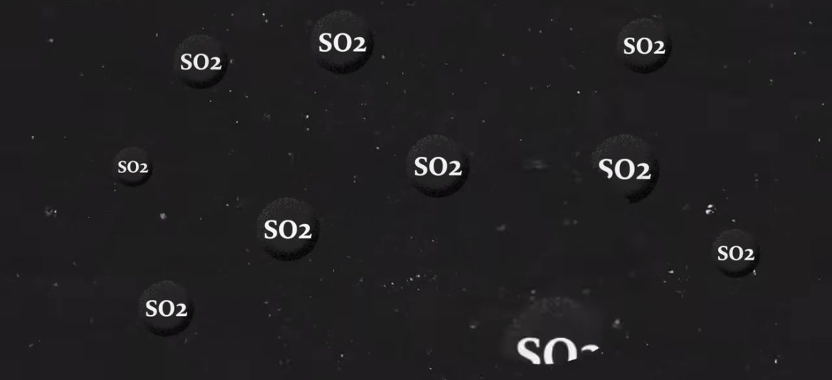
Industries Producing SO2
THANK YOU

Slide 4
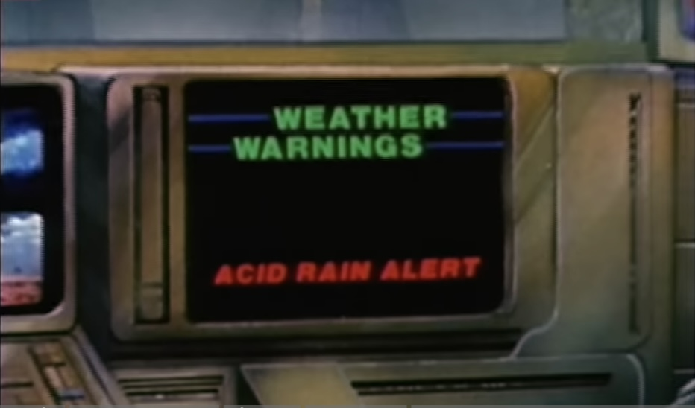
Acid Rain
THANK YOU

Slide 5
Damage Caused by Acid Rain
THANK YOU

Slide 6
No Incentives to Cut Emissions
THANK YOU

Slide 7
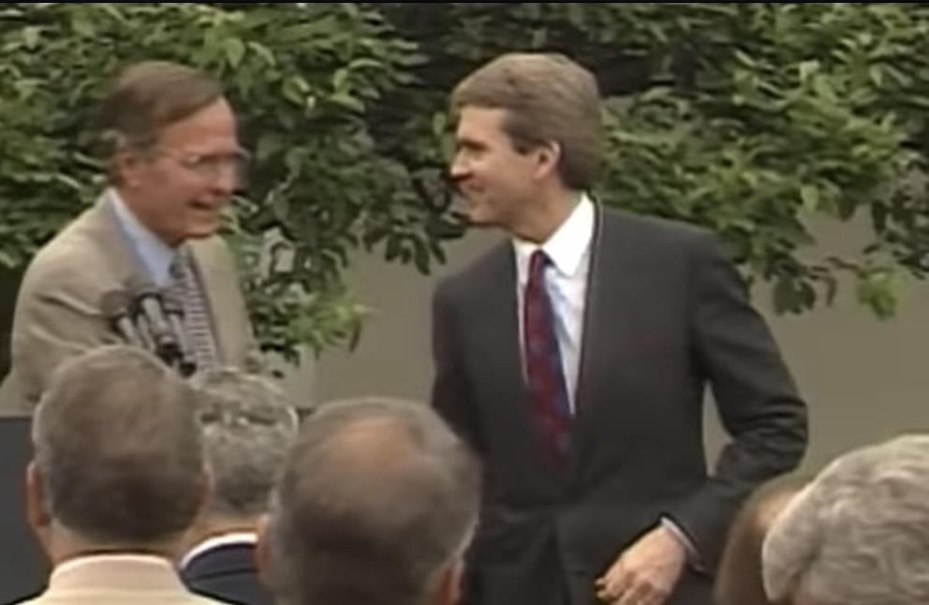
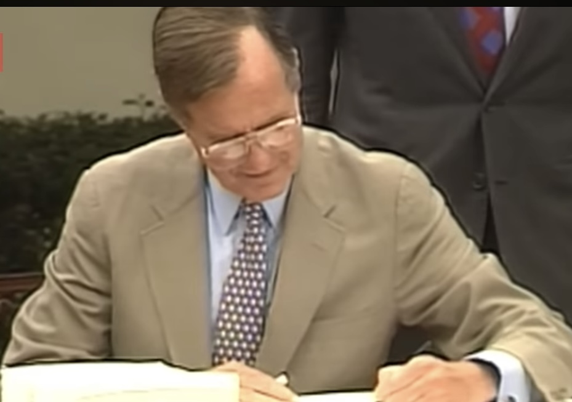
In 1990 The American Government Launches an Experiment of Cap & Trade Method
THANK YOU

Slide 8
Eight Years Later in Eastern America Acid Rain Levels Fell by 20% and a New Way of Cutting Emission Is Born !!!
THANK YOU

Slide 9
Types Of Carbon Market
CARBON MARKET
VOLUNTARY MARKET
COMPLIANCE MARKET
Buyer of the credit are under legal obligation for emission reduction
Buyer are not under any legal obligation for emission reduction, but they do so at their own cost for the good of the world
Size of the Voluntary market was 2Billion US $ in 2020 & can go upto US $ 50 Billion dollars by 2030, depending upon market price of Carbon credit
Compliance markets are typically ruled by Cap & Trade Mechanism
THANK YOU

Slide 10
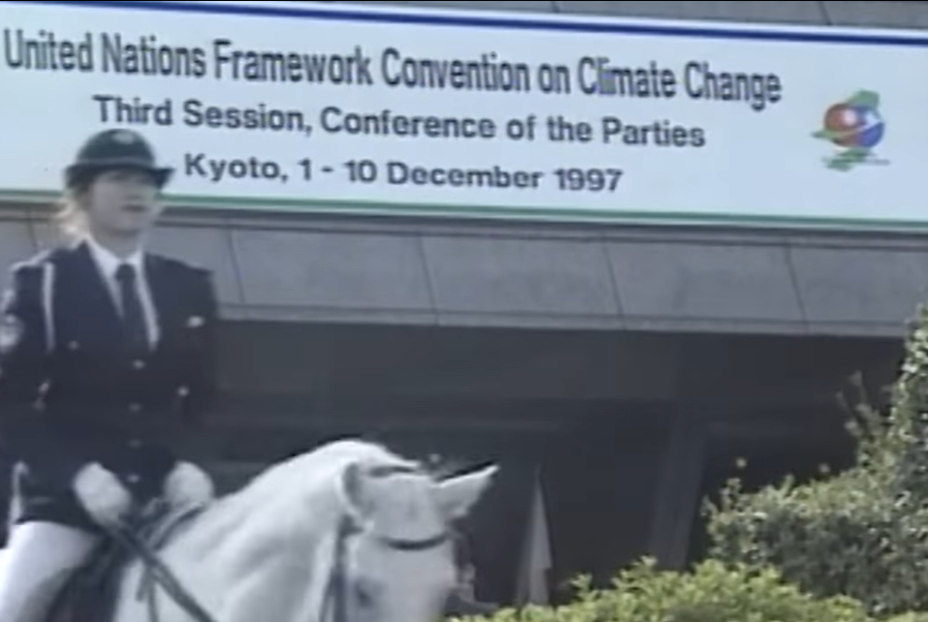
In 1997 COP3 of UNFCC Through Kyoto Protocol Suggested to Apply the Concept of Cap and Trade to Carbon Emissions
THANK YOU

Slide 11
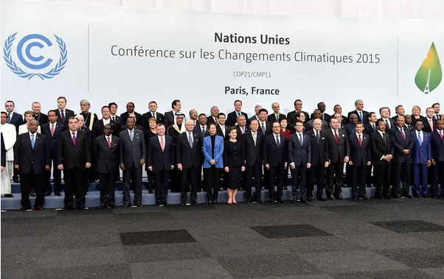
2015 COP 21 Paris Agreement is Inked
THANK YOU

Slide 12
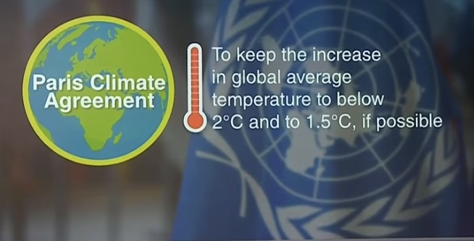
And a Target is Set !!
THANK YOU
India is Signatory to the Agreement

Slide 13
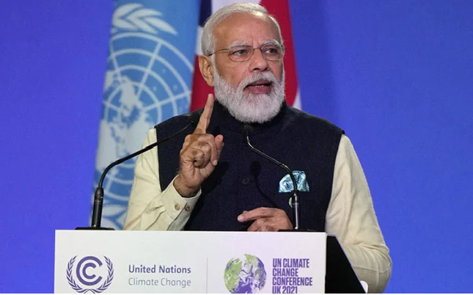
COP26 of the UNFCCC held at Glasgow in 2021
NCAs
THANK YOU
PM Declared NDCs and Net Zero Target by 2070

Slide 14
NTPC’S RE Goals Vis-a vis India
Parameter | India 2030 | NTPC 2032
Installed Capacity (Total) | 777 GW | 130 GW
RE Installed Capacity | 500 GW (64.35%) | 60 GW (46.15%)
Generation by RE | 50 % | -
Net Zero | By 2070 | NTPC signed SoI with NITI Aayog for Net zero targets
NCAs
THANK YOU

Slide 15
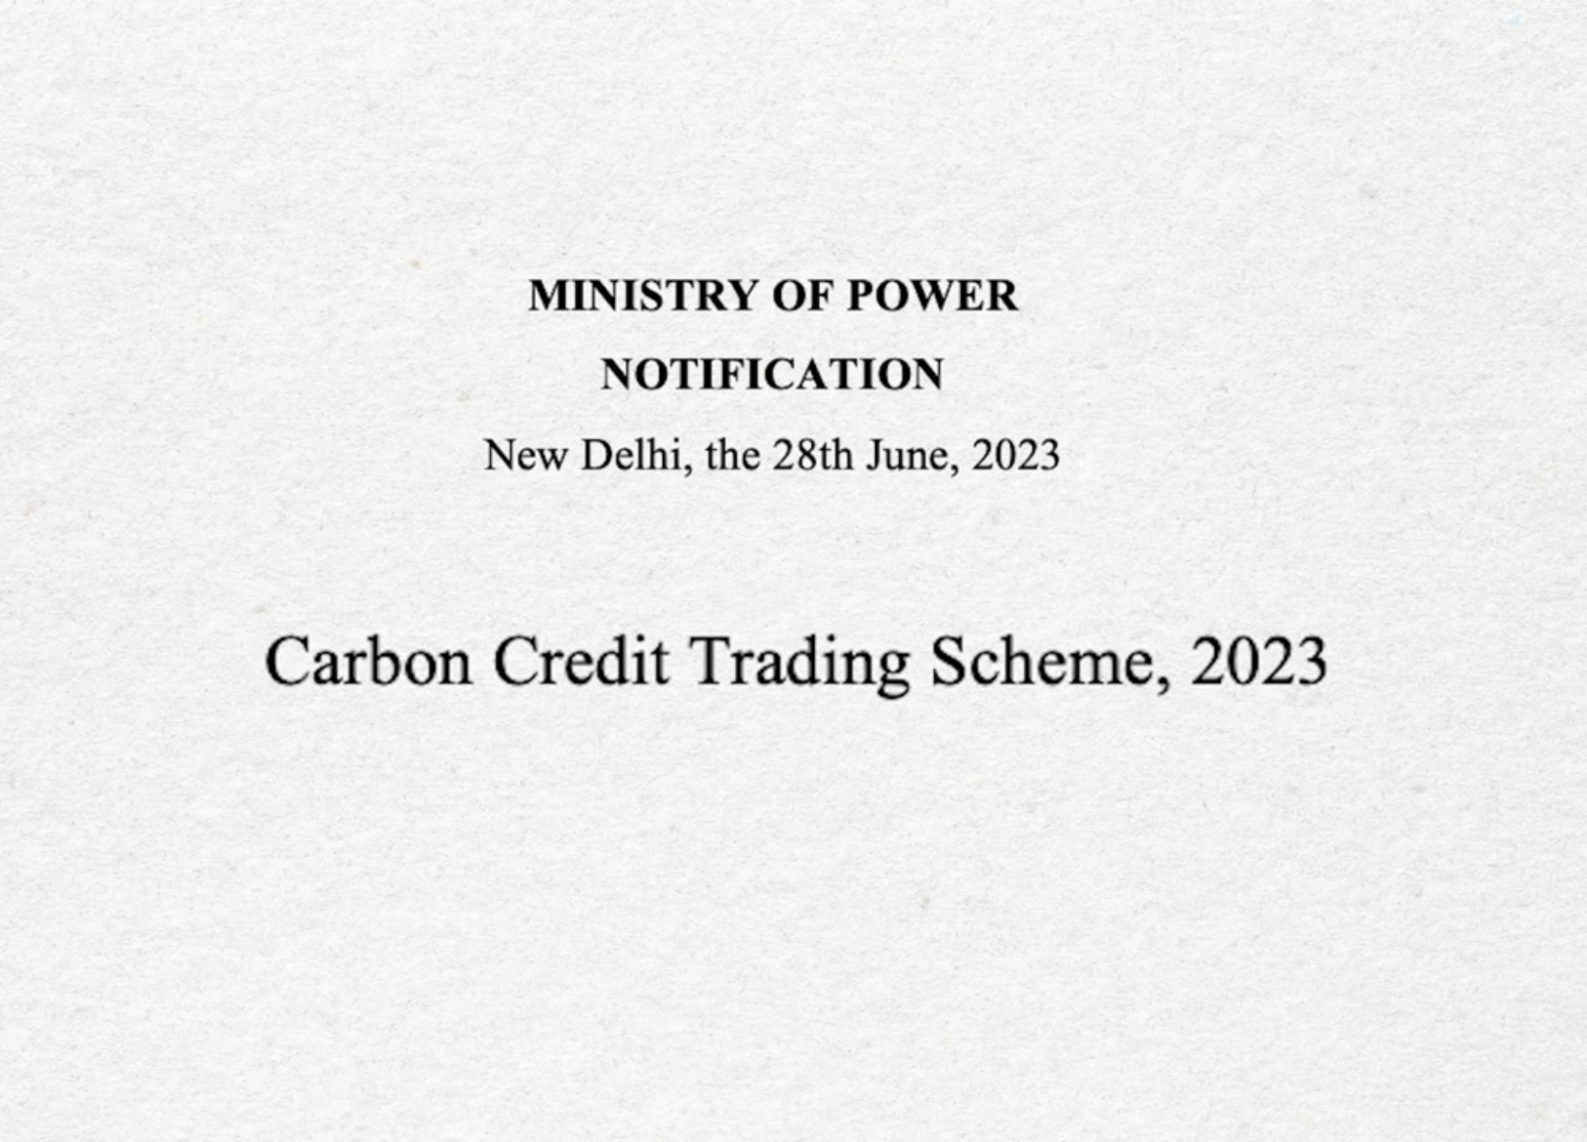
A Very Important Event Took Place In June 2023
THANK YOU

Slide 16
First Step To Set Indian Carbon Market
THANK YOU

Slide 17
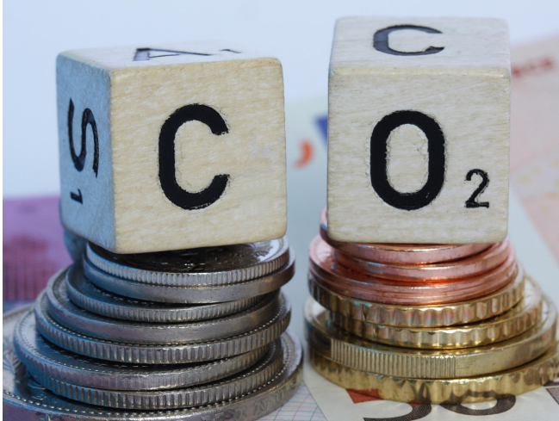
Carbon Trading
THANK YOU

Slide 18
IndianCarbon Market
THANK YOU

Slide 19
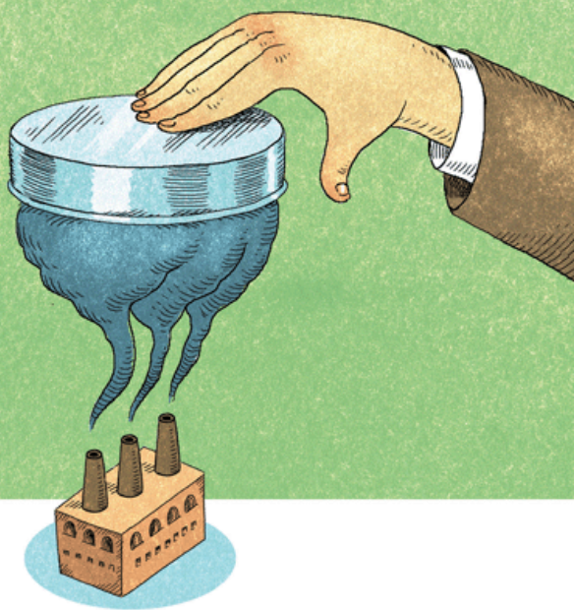
Carbon Credit Trading Scheme Envisages Cap & Trade Mechanism
THANK YOU

Slide 20
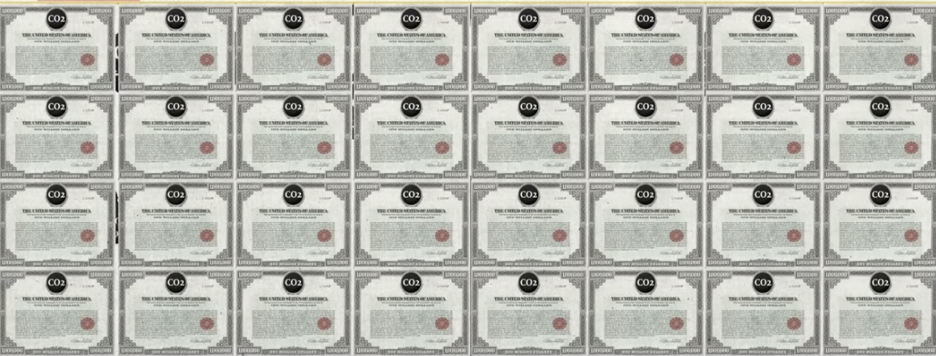
Allowances are Issued by the Authority
THANK YOU

Slide 21
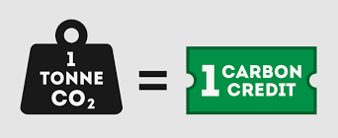
What is a Carbon Allowance ??
1 Carbon Credit/Allowances/Off-sets = 1 tonne of CO2 or CO2eq emissions Reduced or Removed
THANK YOU

Slide 22
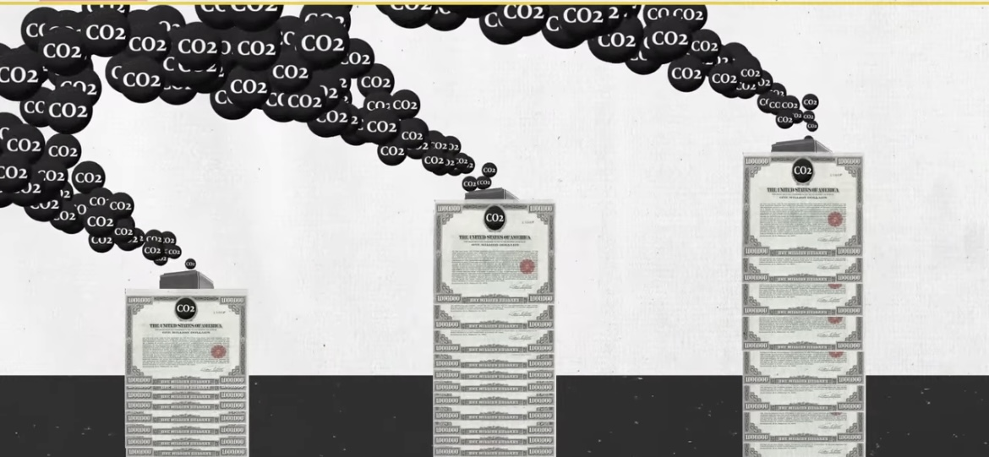
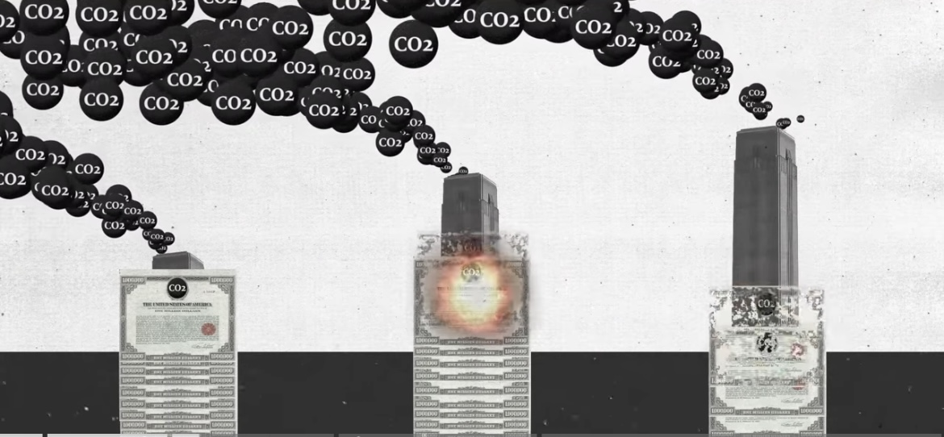
These Allowances are Used by Entities As per the Cap Set
THANK YOU

Slide 23
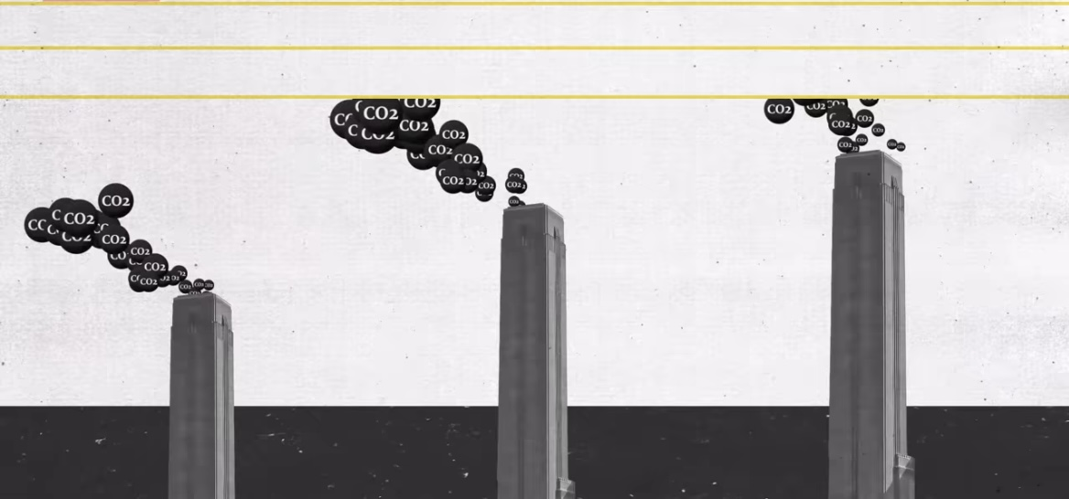
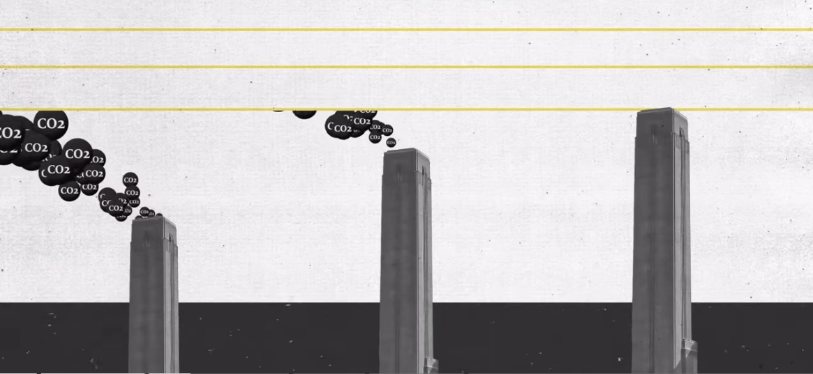
This Cap Gets Stricter With Time
THANK YOU

Slide 24
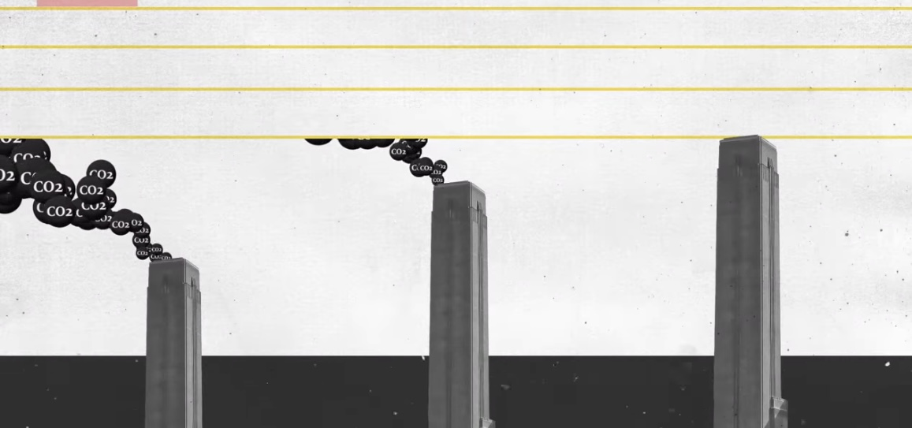
Entities Are Supposed To Adhere To The Cap
THANK YOU

Slide 25
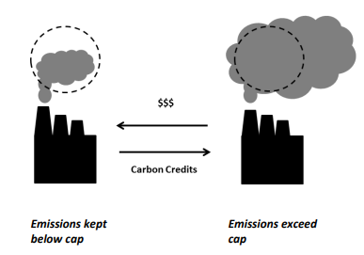
And Thus The Carbon Trading !!
THANK YOU

Slide 26
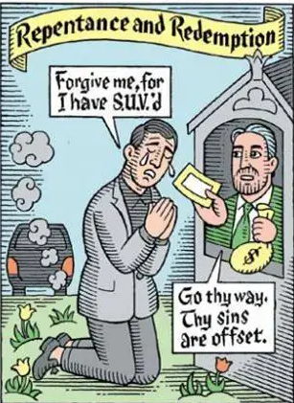
Offsets Can Also Be Purchased From Offset Generating Companies
THANK YOU
Notes:
Companies can also buy offsets

Slide 27
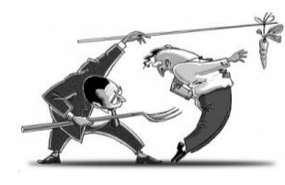
Thus Carbon Market Uses Carrot and Stick Method !
THANK YOU

Slide 28
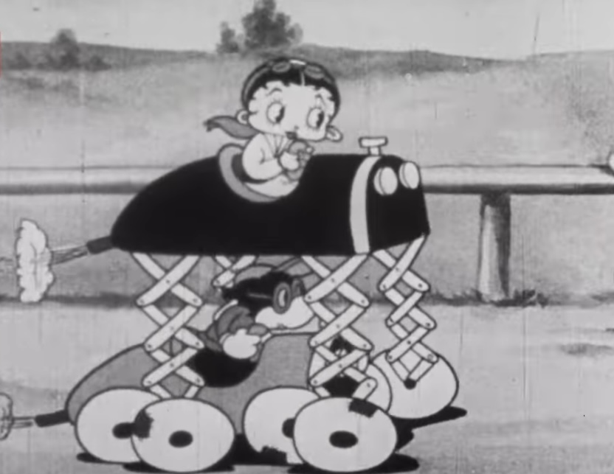
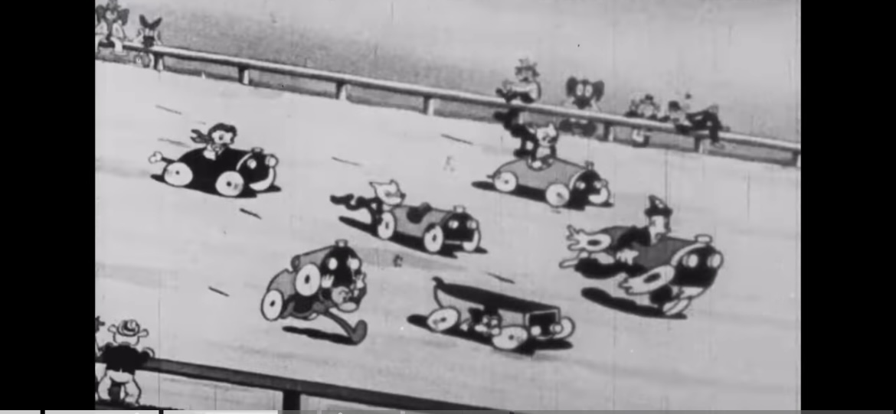
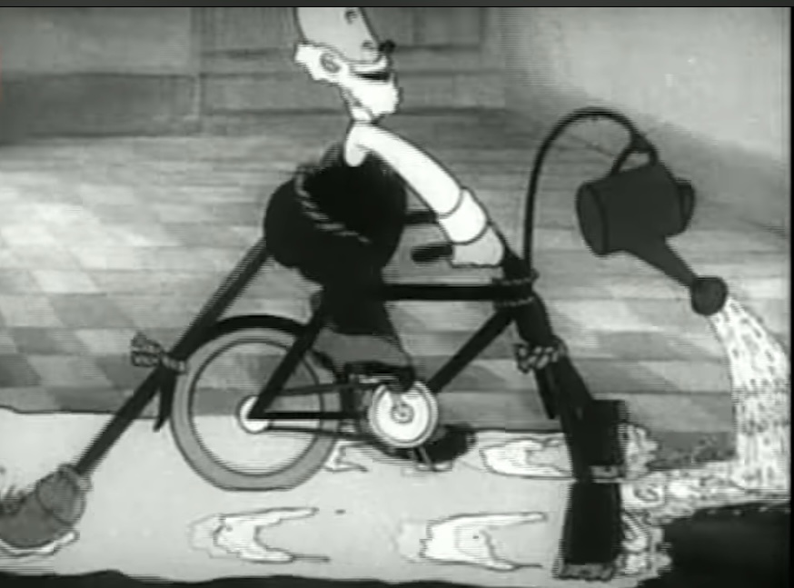
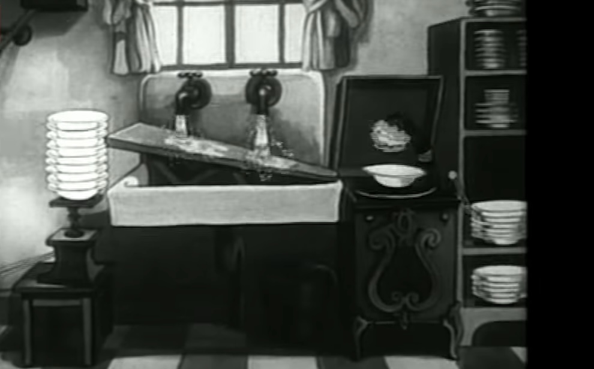
Companies Enter Race to Cut Emission by Innovation As Fast As They Can
THANK YOU
Notes:
Companies enter race to decarbonize by innovation

Slide 29
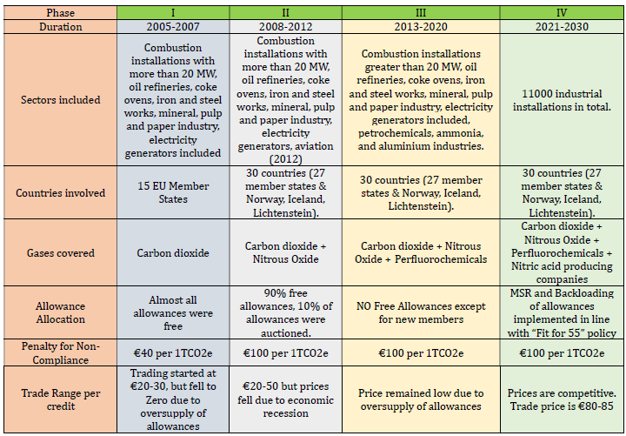
EU-ETS is the World’s Oldest, Largest, Most Robust and the Best Performing Carbon Commodity Market
THANK YOU
Notes:
But is that as simple and easy as it sounds? Carbon markets are great in theories the reality of achieving it far more complicated!!

Slide 30
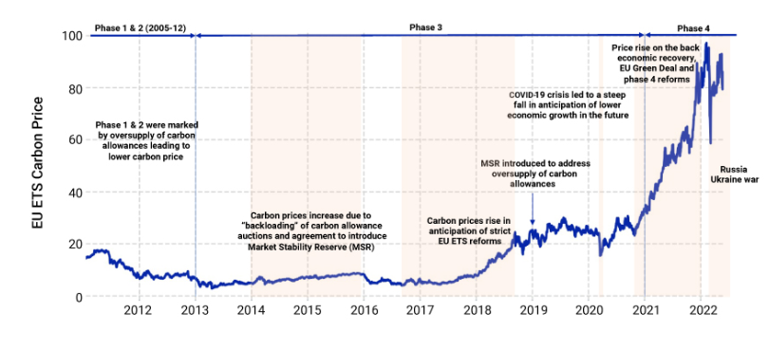
EU-ETS Price Vs Time Graph
THANK YOU
Notes:
The carbon prices hit rock bottom at the end of phase 1 due to oversupply of allowances in the market. In phase II the prices remained low due to economic recession. In phase III again the prices remained low due to oversupply of allowances.

Slide 31
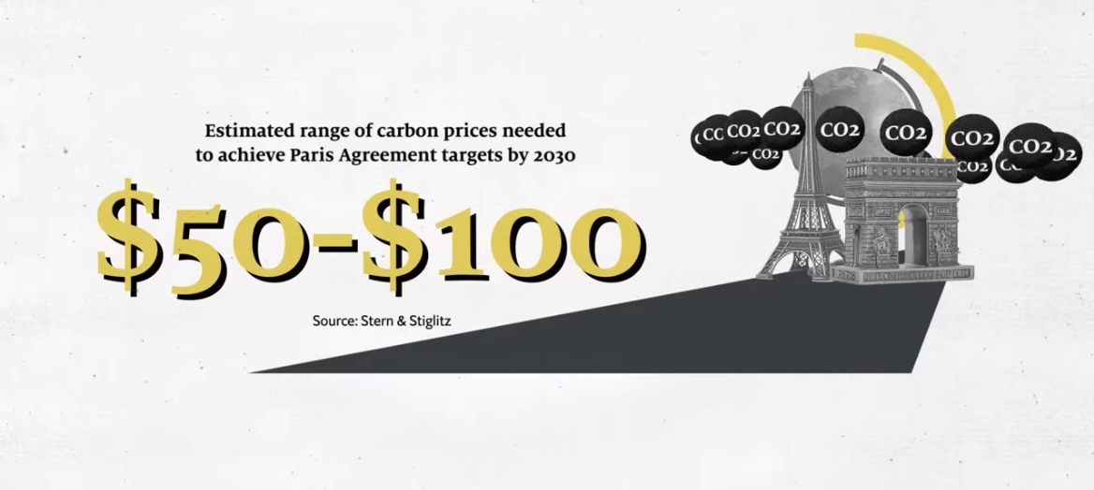
Roadblocks in EU-ETS
THANK YOU
Over Supply of Allowances and low Carbon price
Notes:
EU-ETS Road Block co2 emissions have continued to rise as price of carbon has remained very low to effect ant change

Slide 32
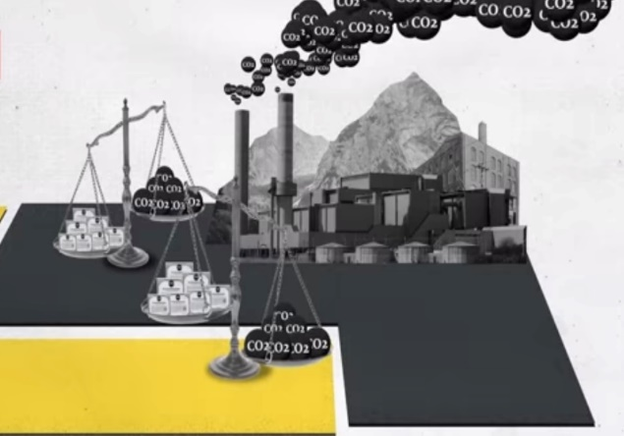
Questions of Cheating Obfuscation and Carbon Leakage Plagues the Market
THANK YOU
Notes:
Cheating obfuscation and carbon leakage

Slide 33
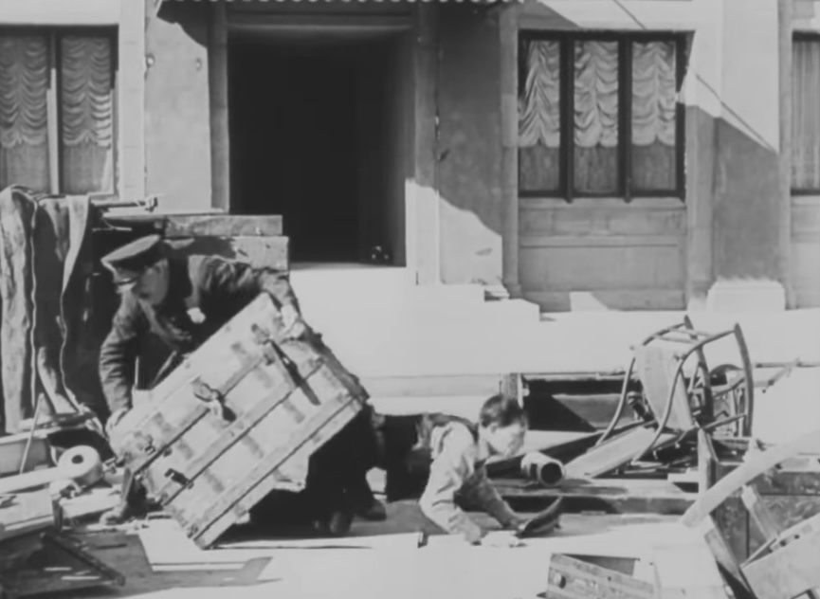
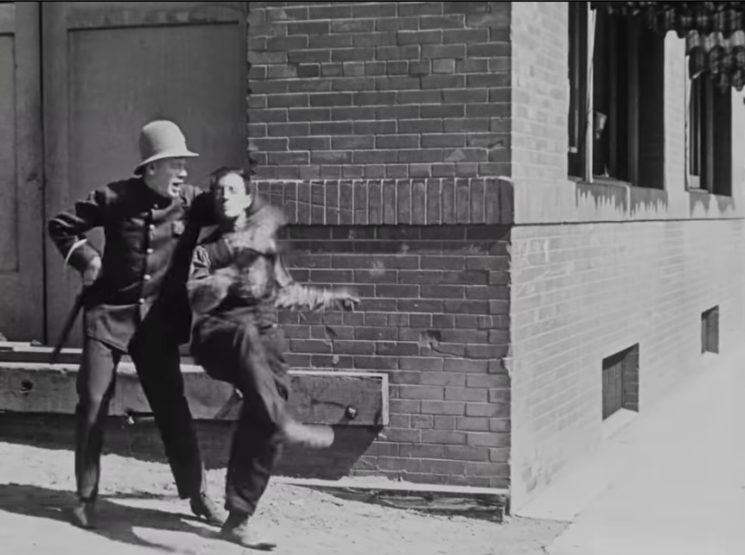
Punishment is Lax….Problems of Direct and Indirect Emissions
THANK YOU

Slide 34
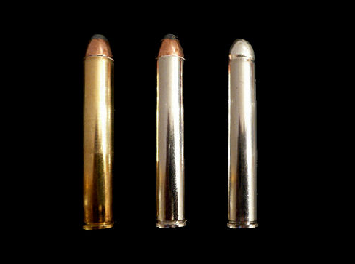
The Silver Bullets For Reform !!!
THANK YOU

Slide 35
1. Backloading
It is the process of temporary reduction the supply of allowances entering the market through regular government auctions with the intention of reintroducing it later.
Backloading was first introduced in 2014 in EU-ETS as at the end of 2013, there was over supply of some 2 billion allowances in the market and the carbon market nosedived from some €30 per ton in 2005 to below €3 per ton in 2013.
The volumes of allowances were removed through backloading were as follows:
2014: 400 million
2015: 300 million
2016: 200 million
THANK YOU
Notes:
The silver bullets

Slide 36
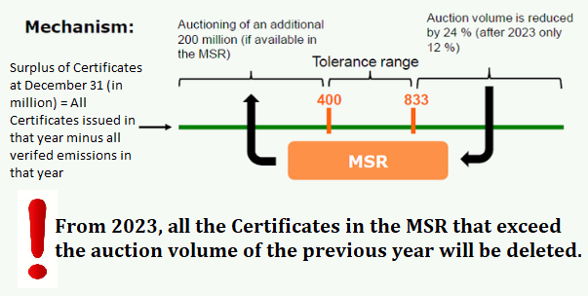
2.The MSR (Market Stability Reserve)
THANK YOU
Notes:
The silver bullets

Slide 37
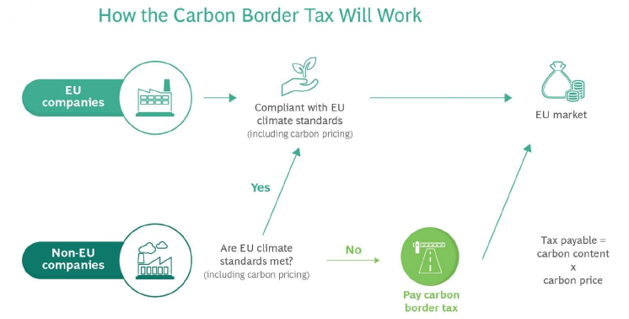
Carbon Border Tax
THANK YOU

Slide 38
IMC (The Indian Carbon Market) Salient Features
MINISTRY OF POWER
* Name sectors & obligated entities
* Fix emission targets
* Hand over above information to MoEFCC for notification
BEE
* As Administrator, recommend MoP in naming obligated entities & fixing emission targets
* Will have the authority to issue carbon credits & Accredit verifying agencies
MoEFCC
* Issue Notification
NATIONAL STEERING COMMITTEE
* Comprised of Sect. of MoP, MoE, Jt. Sect., expert members.
* Technical committee to provide assistance to BEE for implementation
CERC
* Regulator for Trading of Carbon Credit
GRID-INDIA
* Meta-Register of Trading Transactions
THANK YOU
Notes:
Salient Features of IMC

Slide 39
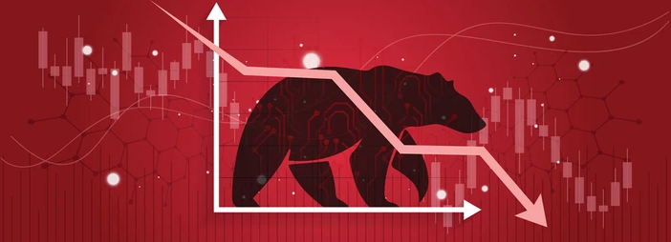
ESCerts under PAT scheme trading at floor price
THANK YOU
Notes:
CERs & ESCerts under PAT scheme trading at floor price

Slide 40
Well…How Should We be Prepared ??
THANK YOU
Notes:
CERs & ESCerts under PAT scheme trading at floor price

Slide 41
To Start With Its Generating Quality Carbon Credit
GENERATING CARBON CREDITS OR OFFSETS
Reducing CO2 Emissions - This should account for 90% decarbonization
Removing CO2 from Atmoshpere - This should account for 10% decarbonization
Short Term
Long Term
Solar Roof Top
One Sun, One World, One Grid
Portable Wind Turbines
Solarization of non-critical pumps in Power Plant
More Gas Power Plants
CCU
CO2 to make concrete ash bricks
THANK YOU

Slide 42
Present MSR Rules in EU-ETS
The current MSR is rule based and is activated by quantity-based triggers
If the total number of allowances in circulation exceeds 833 million, the auction quantity is reduced by 24% in the next year (12% from 2024 onwards).
If the TNAC dops to 400 million then auctioning quantity in the subsequent is increased by 200 million (100 million allowances from 2024 onwards).
From this year 2023 onward all allowances in the MSR exceeding the auctioning amount in the previous year will be invalidated.
THANK YOU

Slide 43
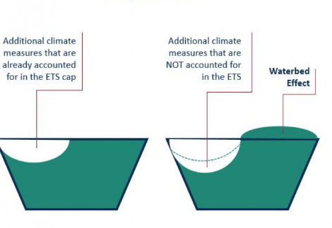
MSR Reforms Suggestion to Waterbed Effect
Additional Climate Change Measures not Accounted
THANK YOU
Additional Reforms
1.Propotional Intake of Allowances ie x%* TNAC/Lower Threshold
2. Revision of thresholds with cap

Slide 44
Now to get the most out of the Indian Carbon Market, policy formulations regarding the same will play a pivotal role. IMC in its incipient stage will pass through VUCA times.
To stabilize the IMC fast and keep the carbon prices competitive (as opposed to EU-ET market which took almost 15 years get reformed) government may take its lessons from EU-ETS and introduces reforms by laws at different times intervals which may not be very long.
THANK YOU

Slide 45
NTPC can have different agile policies in place for various market reforms like back loading and MSR to earn most out of this market and being the leading power producer play its role in keeping the market spirts high.
The policies should be such that it should be just, and equity is maintained to all its stakeholders.
ECerts, RECs and CERs may not find fungibility in the international market. So they may be done away with by getting compensated with allowances
NTPC can also take the lead to surrender excess allowances for power plant closure or if there is one if there is oversupply of allowances to stabilize the market.
Once the carbon trading enters the secondary market, NTPC can rope in public in its green mission creating a positive feedback cycle towards a cleaner and greener nation.
THANK YOU

Slide 46
A successful setting of ICM would harness the magic of the market to unleashing those bullish spirits for decarbonization and would reduce the implementation cost of NDCs by more than half as much as $250 billion by 2030 !!
THANK YOU

Slide 47
And lastly policy makers will have to set rules enforce them enforce will have to make it loud and clear that this is not a frivolous green washing exercise, nudge-nudge wink-wink but a national mission and Bharat will surely come out with flying colors !!
THANK YOU

Slide 48
From world emitting 40billion ton of CO2 to NET Zero; the path of energy transition is tough and long;
But as more hands join, the reality of this energy transition would not be wrong;
Humanity is at stake!
May be an integrated successful carbon market help reverse the fate!!
THANK YOU

