Slide 1


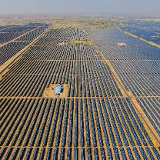
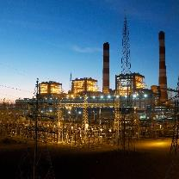
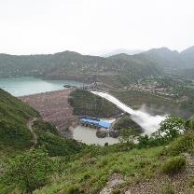
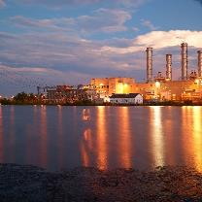

TALCHER-KANIHA
NTPC R&R Colony, Darlipali
NTPC Bhadla
NTPC Kudgi
LIQUID HYDROCARBON ECONOMY AN ENERGY EFFICIENT NET ZERO ALTERNATIVE TO THE ENERGY INTENSIVE HYDROGEN ECONOMY
- LAKSHMINARAYANAN D, Senior Manager, Talcher-Kaniha
NTPC Koldam
NTPC Kayamkulam
NTPC Rojmal
Follow us on:
/ntpc1
/ntpcltd1
/ntpclimited
/Company/ntpc
/ntpclimited

Slide 2

2
+
Hydrogen
Purest form of Energy.
Most abundant chemical element on Earth.

Slide 3

Heading Font Size 45
Font Family: Tw Cen MT (Normal)
Green Hydrogen
2
+
How Energy Efficient is it?

Slide 4
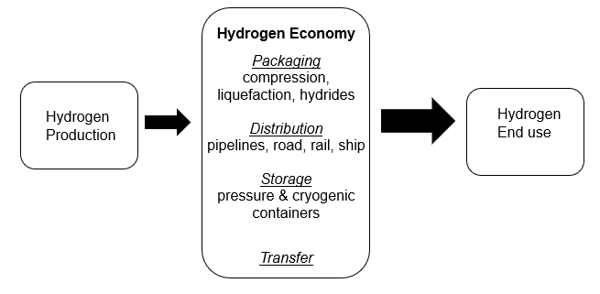
HYDROGEN ECONOMY

Slide 5
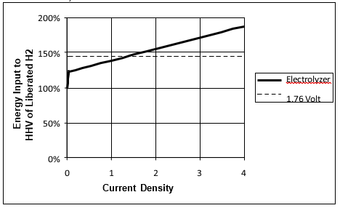
ELECTROLYSIS

Slide 6
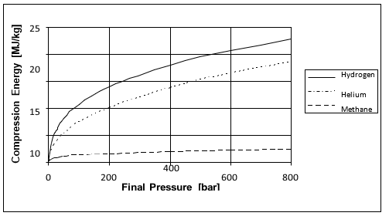
PACKAGING - COMPRESSION

Slide 7
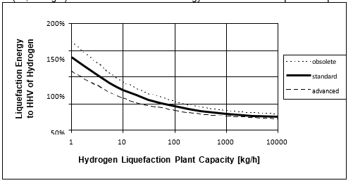
PACKAGING - LIQUIFICATION

Slide 8
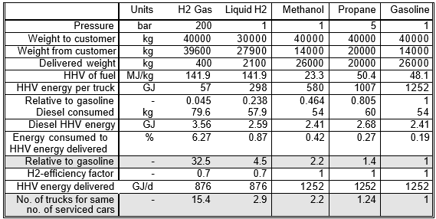
DELIVERY - ROAD

Slide 9
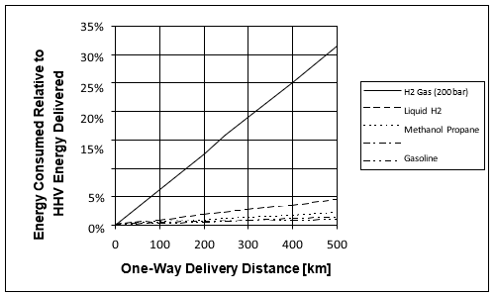
ROAD DELIVERY – ENERGY NEEDED FOR H2 vs FUELS

Slide 10
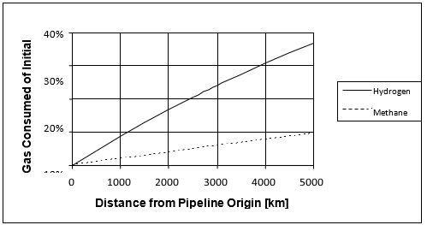
PIPELINE DELIVERY – ENERGY NEEDED FOR H2 vs FUELS

Slide 11
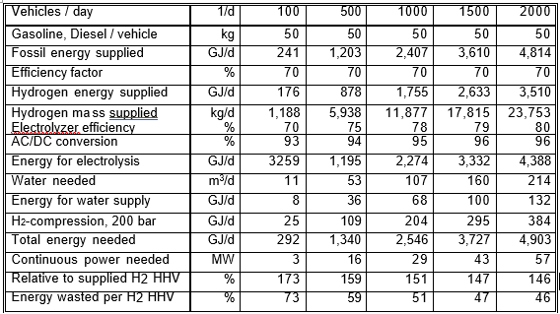
ONSITE GENERATION OF HYDROGEN

Slide 12
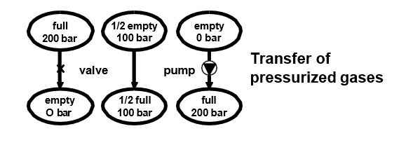
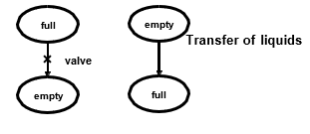
TRANSFER OF FUELS

Slide 13
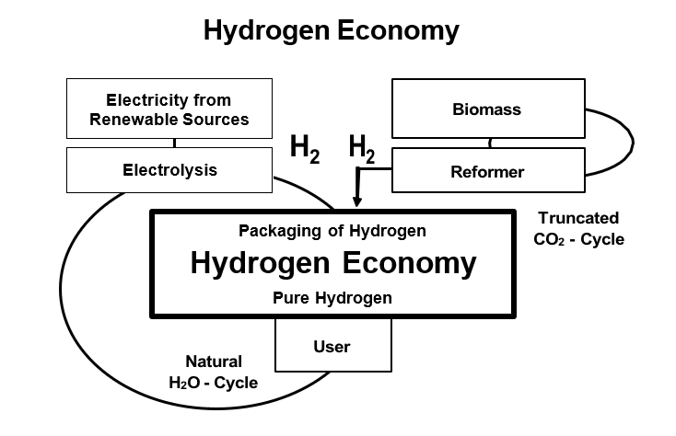
PURE HYDROGEN ECONOMY - LIMITATIONS

Slide 14
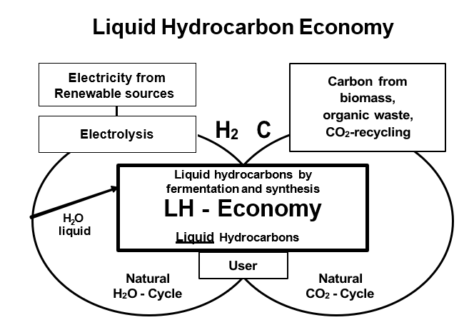
LIQUID HYDROCARBON ECONOMY

Slide 15
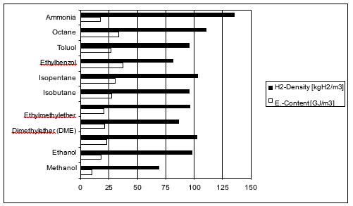
HYDROGEN DENSITY vs HHV ENERGY CONTENT OF SYNTHETIC FUELS

Slide 16

SYNTHETIC HYDROCARBON

Slide 17




Thank You
Follow us on:
/ntpc1
/ntpcltd1
/ntpclimited
/Company/ntpc
/ntpclimited

