Slide 1
Indian Power Stations International O&M Conference
IPS-2024
MOIS Flame Scanner Modification
Samir Kumar Bhatnagar
Manager - C&I
Adani Power Ltd., Kawai

Slide 2
Overview Of System
Micro Oil Ignition System(MOIS) is installed in both units in boiler, which is used during light-up when LDO is in service.
When desk engineer takes MOIS gun, then gun will be proved by its flame ON bit generated from flame scanner control card.
The control card generates flame ON bit, when flame intensity is above the threshold limit set in card. In any case, if flame frequency goes below threshold value, then ON bit becomes low and MOIS gun oil valve will be closed.
At present MOIS Flame scanners are provided by OEM-Yantai, China.

Slide 3
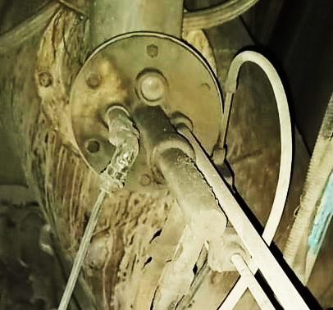
Overview of System- Installation
Flame View Glass
MOIS
Flame Scanner
Ignitor Rod
MOIS Oil Gun
MOIS
Flame Scanner

Slide 4
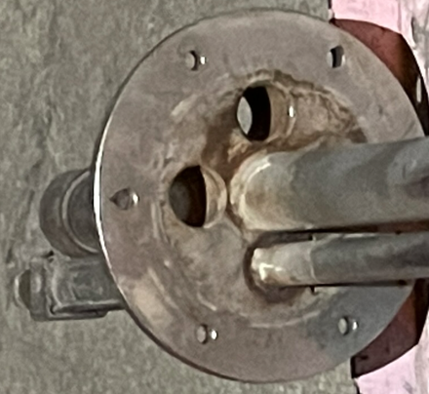
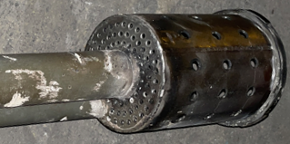
MOIS Scanner/Lens general arrangement
MOIS Gun End View
MOIS Gun Tip View
Present Location of Scanner
View Glass
Ignitor Guide Pipe
Present Location of Scanner
Guide Pipe for Ignitor

Slide 5
Problem Statement
Sometimes, flame is not being detected even though good flame was visible inside the furnace.
While checking the scanner outside with normal torch light, it shows healthy signal.
Coal deposition was also observed on atomizing mesh and oil gun chambers.
Sensitivity of photo diode for sensing flame got deteriorated due to ageing.
Non availability of MOIS flame signal led to delay in light up process.
The flame scanner material is being imported from China and has high lead time with many unforeseen issues.

Slide 6
Brainstorming
Brainstorming was done and below solutions were identified:-
Shift the location of flame scanner without compromising the sensing of actual flame inside the furnace.
Use of indigenously developed Coal/Oil Flame scanner in place of imported MOIS flame scanner module to avoid high dependency on Chinese Yantai scanners.

Slide 7
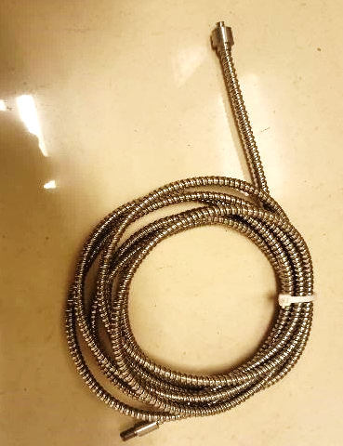
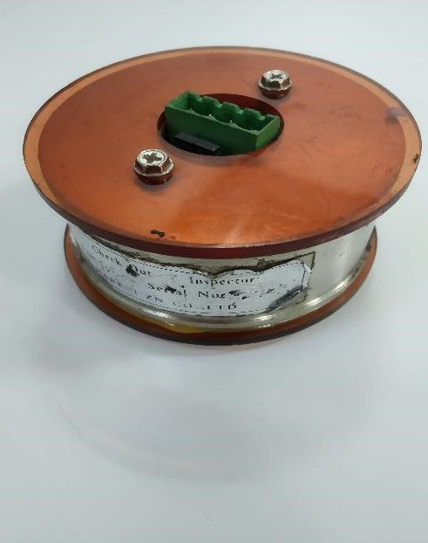
Proposed Scheme- Oil/Coal Scanner Components
Flame scanner control card
Lens
Fiber Cable
Amplifier

Slide 8
Implementation Procedure
It was decided to use the spare flame scanner control cards for MOIS flame signal..
Required modification in gun assembly were identified.
One guide pipe was welded in gun assembly, into which flame amplifier to be installed.
For cooling purpose, small cuts were done in guide pipe through which cooling air can be passed.

Slide 9
Before modification Scanner/lens arrangement
MOIS Gun End View
MOIS Gun Tip View
Present Location of Scanner
View Glass
Ignitor Guide Pipe
Present Location of Scanner
Guide Pipe for Ignitor

Slide 10
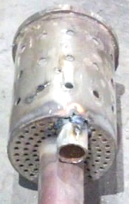
After Modification
Final Location of Scanner
Final Location of Scanner/ Lens
Additional pipe provided for Flame Scanner

Slide 11
Modification in Lens assembly
For modifying the lens assembly below activities were carried out.
1) Lens Module diameter reduced for proper fitment in guide pipe.
2) Threading was done at inner side of module for fitment in pipe.
3) Old flame scanner pipe used and attached with modified flame scanner pipe.

Slide 12
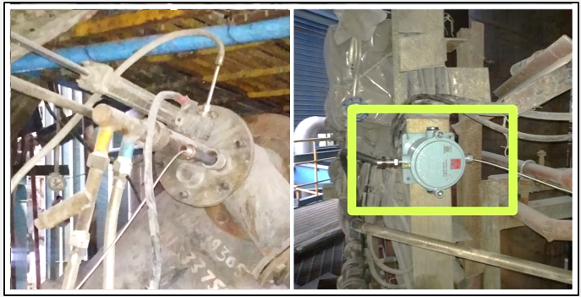
Modified Gun & Lens assembly
Fiber Optic cable support pipe
Flame Scanner Amplifier in JB

Slide 13
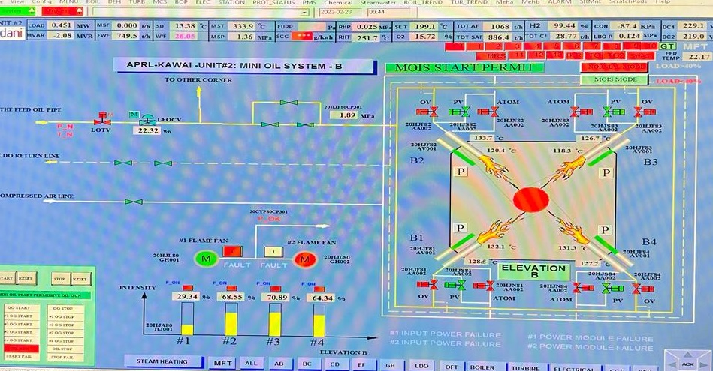
Result

Slide 14
Cost Saving
Cost Saving on converting to indigenous = 10 Lacs approx.
Light-up delay by 1 hour due to non availability of MOIS :- Loss of Rs. 7 Lacs approx.

Slide 15
Conclusion
Flame quality is increased as the scanner now senses the flame just after the atomizing mesh area.
Problem of flame visibility resolved & system reliability improved.
Normal (Oil/Coal) flame scanner module used in MOIS.
Dependency on Chinese-Yantai make flame scanner and its control cards reduced.
Ease of maintenance and fault finding.
Minimized delay in light-up activities due to MOIS flame fault.

Slide 16
THANK YOU

