Slide 1
NEW TECHNOLOGIES & BEST PRACTICES ADOPTED BY
K.Premkumar
Manager-Operations.

Slide 2
About author
Mr. K. Premkumar is a Graduate from Anna University Chennai, Post Graduate Certificate in Digital Transformation from Indian Institute of Management (IIM), Tiruchirappalli.
16 years of experience in thermal power plant in the area of Commissioning and Operation.
Previously associated with Adani Power Ltd. Rajasthan, Udupi Power Corporation ltd. Karnataka, ENMAS O&M services. Chennai, presently working in IL&FS TamilNadu Power Company Ltd as Manager-Operation.

Slide 3
Introduction
We are in the Digital era
Technologies
Innovation
Sustainability
Government polices
To be in the race we need to adopt to these changes

Slide 4
About ITPCL
2*600 MW Imported coal fired subcritical boiler units
Unit 1 run under long term power purchase agreements
Unit 2 run under short term PPAs and through power exchanges
Managing Director -Dr.Sanjeev seth
Station Head-Dr.P.K.Rao
O&M Head- Mr.Gugan

Slide 5
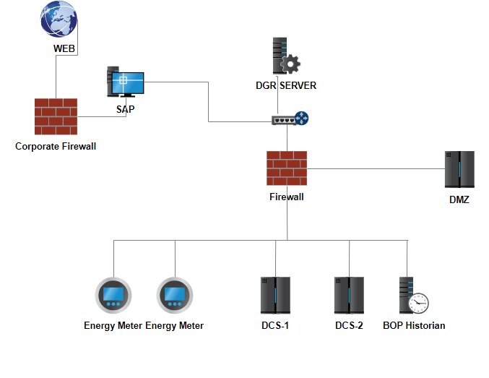
Information
Available
Integrity
Confidentiality
Immutability
Manual DGR
Lack of synchronised time stamping
Consumes More time & manpower.
DGR
generation details
consumptions and stocks
KPI
AUTOMATED DAILY GENERATION REPORT (DGR)
DATA SOURCE | MODE OF COMMUNICATION | PARAMAETERS
DCS (UNIT-1 & UNIT-2) | OPC | Coal flow totalizer, LDO tank level, DM water flow totalizer.
ABT SERVER | OPC | DC, SG, Availability, STOA, Exchange, AG.
ENERGY METERS (12 Nos) | MODBUS | Generation, Import, Export, Grid frequency, Aux power.
SAP | FILE TRANSFER | Gypsum dispatch, Fly ash dispatch
BOP HISTORIAN SERVER | OPC | Limestone consumption, DM water production.

Slide 6
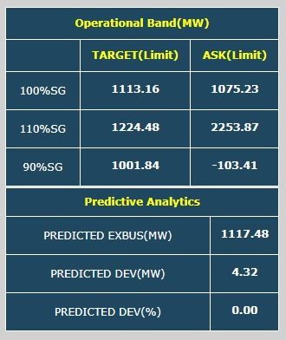
NEW DEVIATION SETTLEMENT MECHANISM (DSM) REGULATION 2022 AND SCHEDULE GENERATION
Tackled the New DSM Amendment with predictive data analytics
Newly Added data columns in ABT
predicted Deviation MW
Reactive power output in Transmission
DAM & RTM prices

Slide 7
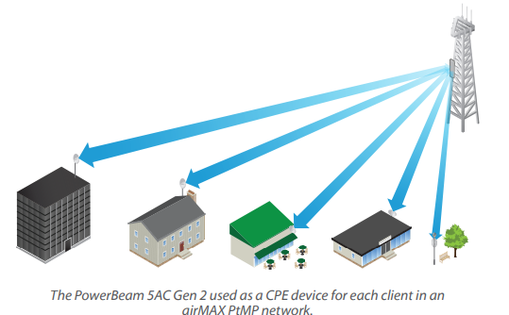
Wireless data transmission in AAQMS (Ambient Air Quality Monitoring station) to server
Six number of AAQMS communicated to Tamil Nadu Pollution control Board (TNPCB) through internet
LAN connection through underground wire created communication violations to TNPCB
Internet connection to AAQMS through Radio Frequency transmitter and receiver system.

Slide 8
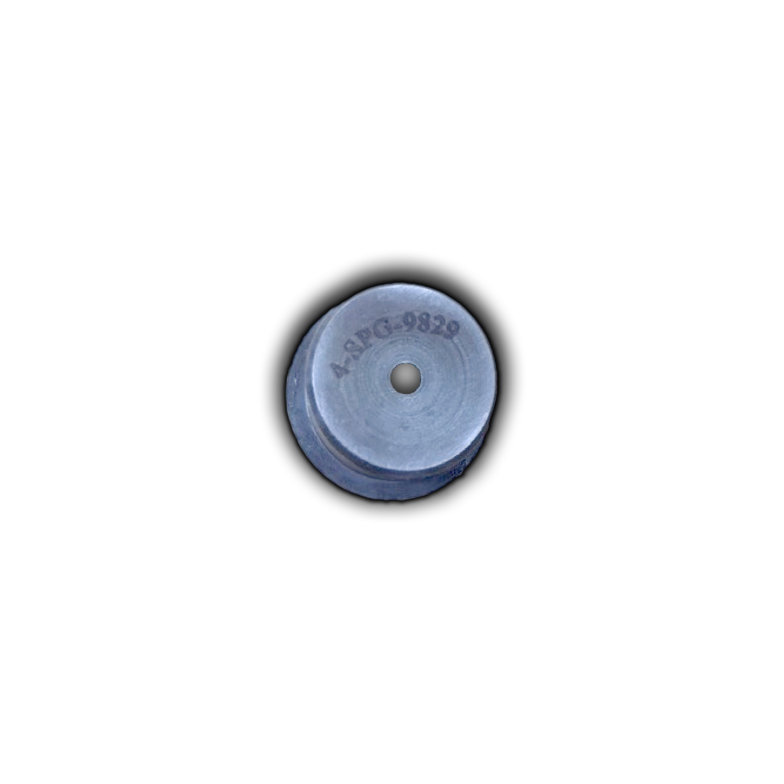
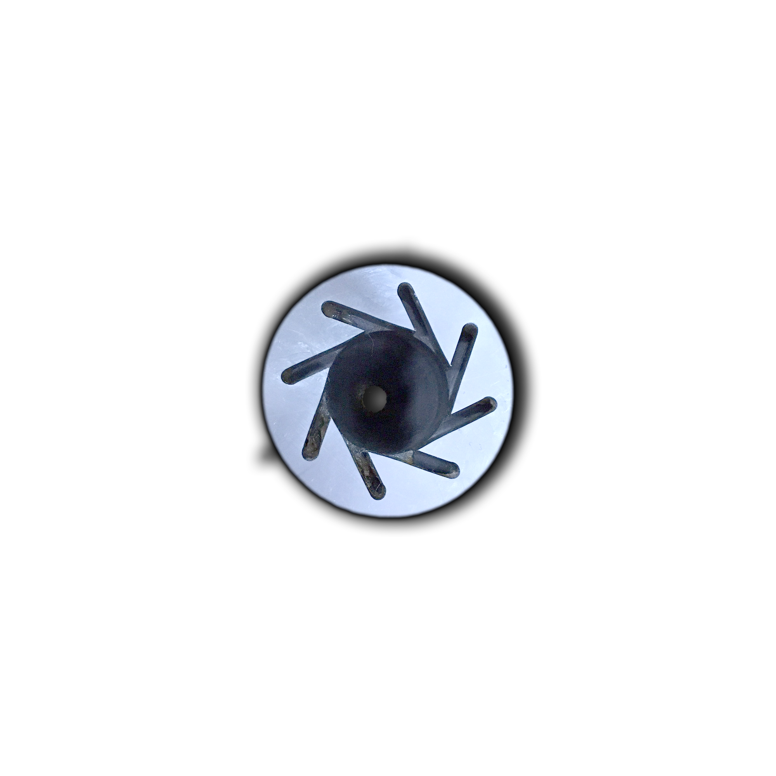
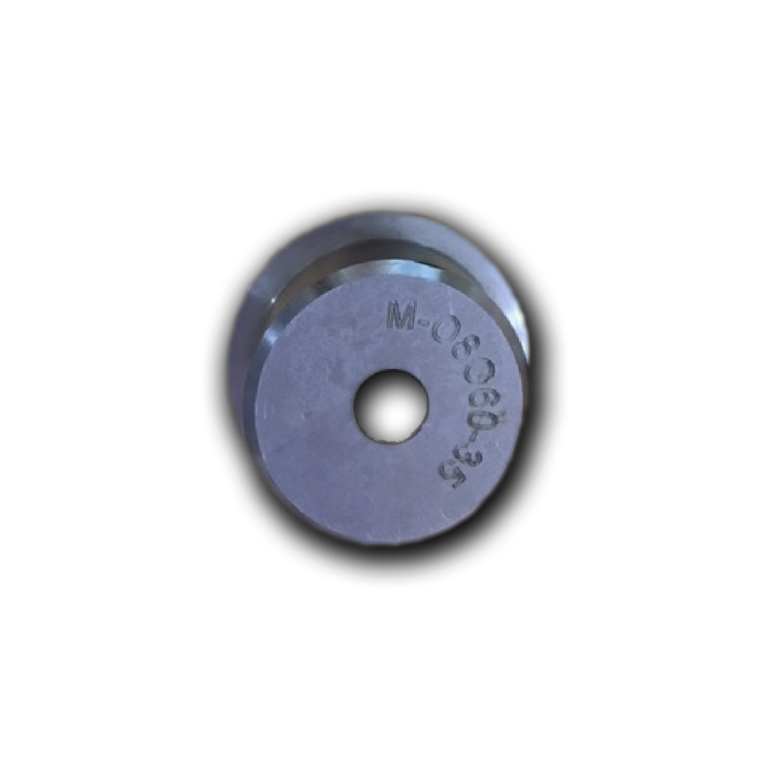
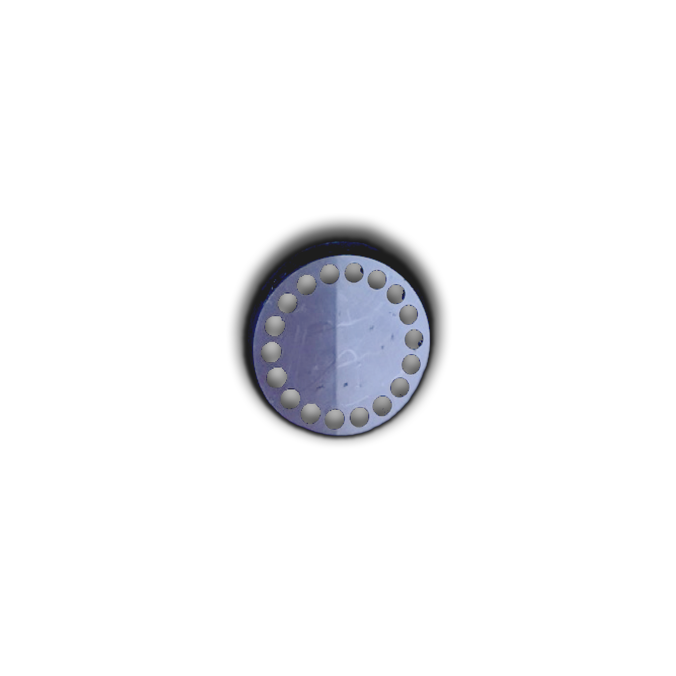
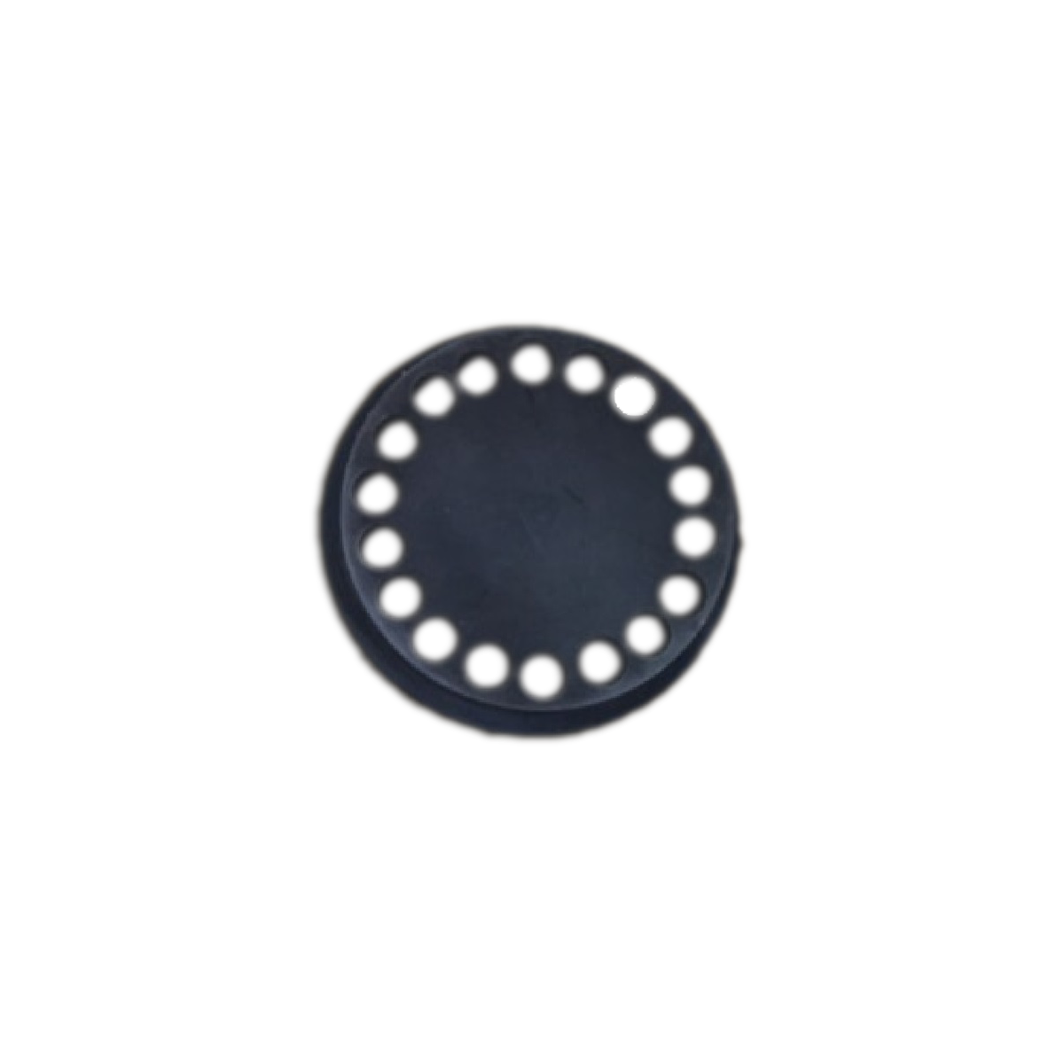
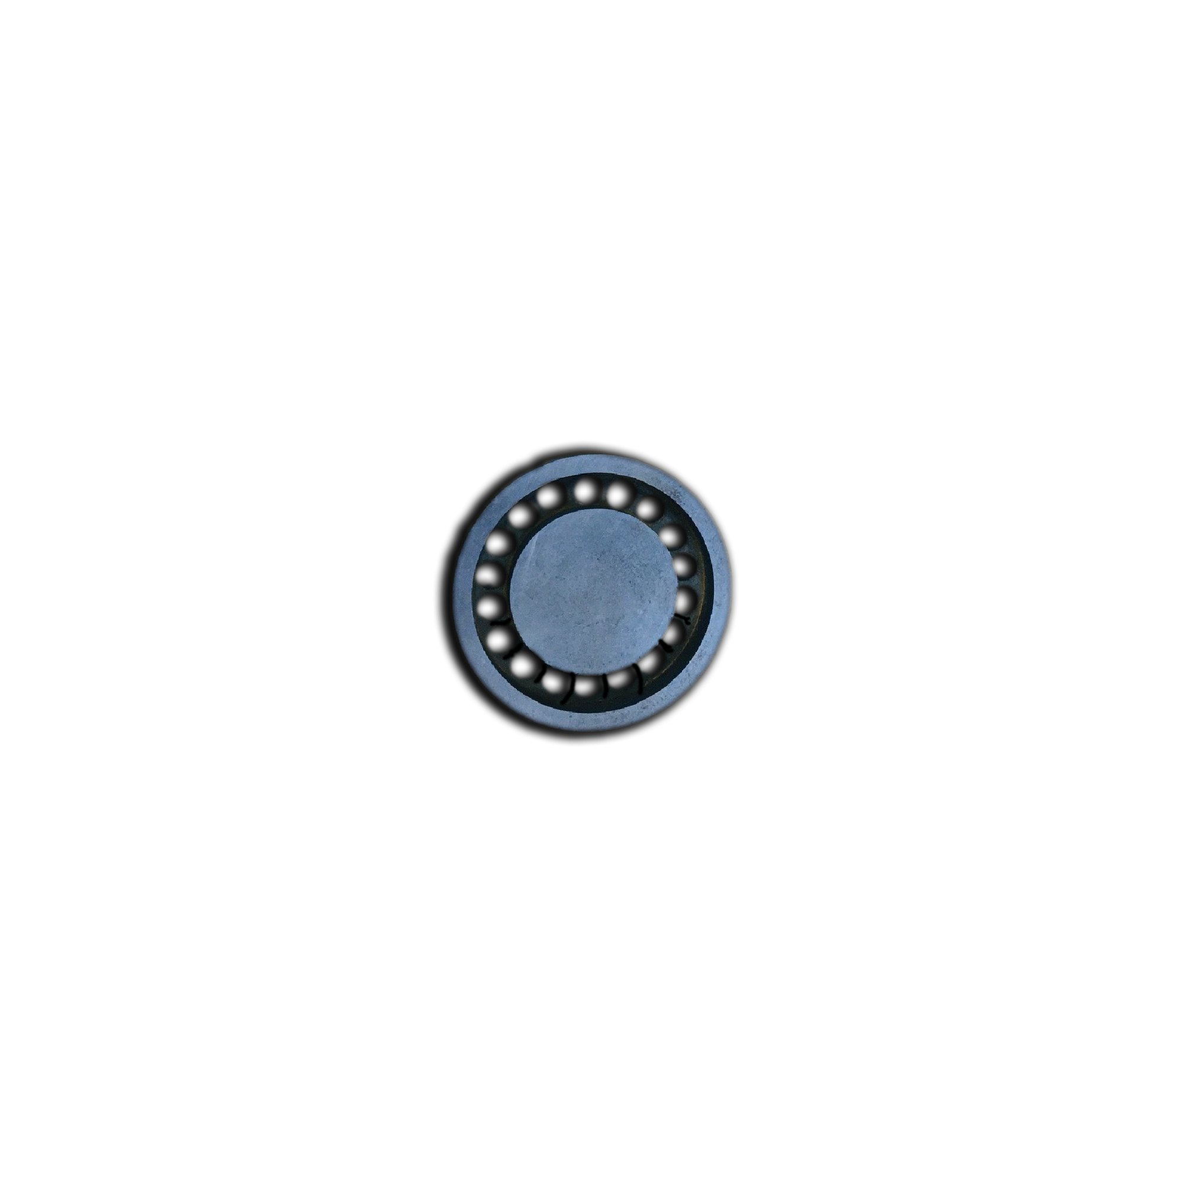
COLD LIGHT UP OIL CONSUMPTION REDUCTION
Three layers of HFO and one layer of HSD guns
Two layers of LDO guns
Oil Gun Nozzle size reduced
 | OEM | Modified
AB elevation oil gun Nozzle size | 8 mm | 4.54 mm
BC elevation oil gun Nozzle size | 8 mm | 5 mm
Gun position from burner swirl tip | +40 mm | -50 mm

Slide 9
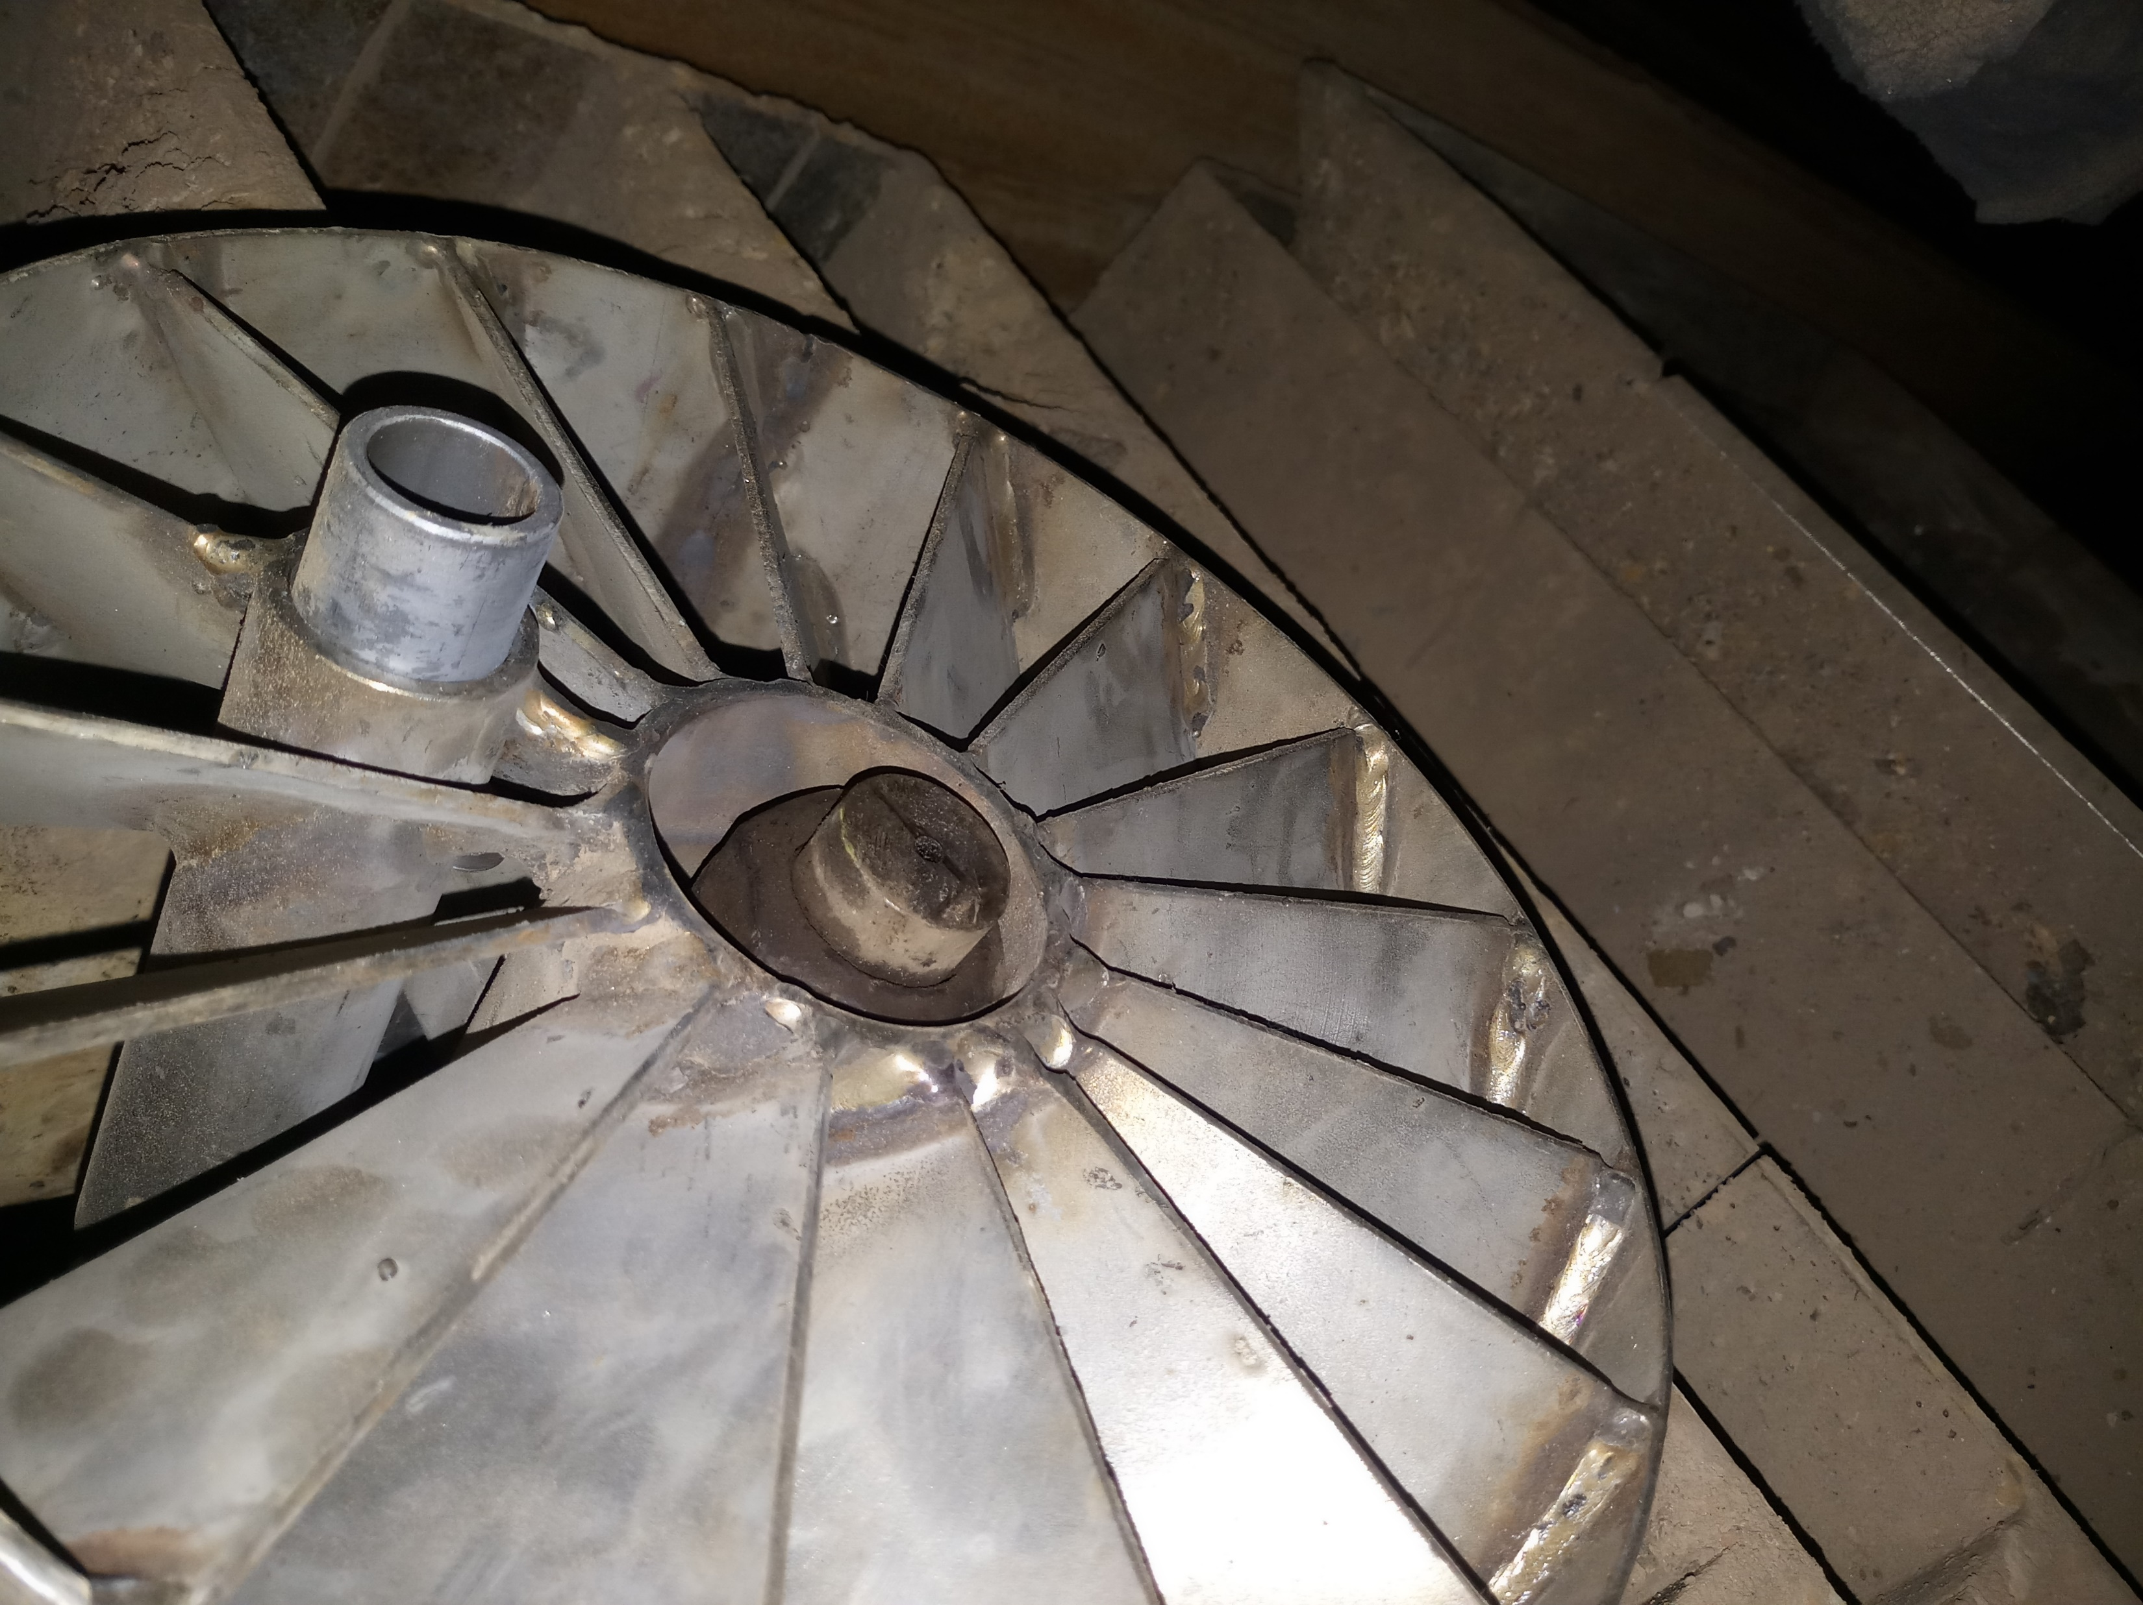
COLD LIGHT UP OIL CONSUMPTION REDUCTION

Slide 10
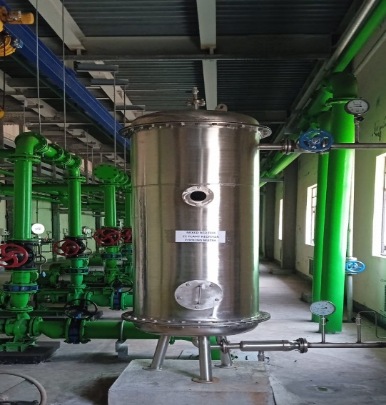
REDUCE AND REUSE OF TREATED WATER
Condenser cooling water pipeline chlorination by NaOCl
electro chlorination (EC)system used for NaOCl production
Around 250 m3 of DM water is used to cool the EC plant rectifiers every day.
S.I No | Description | UOM | Qty.
1 | Average DM water Consumption- Before Installation of MB Unit | m³/day | 468
2 | Average DM water Consumption- After Installation of MB Unit | m³/day | 277
3 | DM water saved by modification | m³/day | 191
4 | Cost of Modification | Rs | 5,69,100
5 | Cost of DM water | Rs/m³ | 51.5
6 | Cost saved by modification | Rs/day | 9,829
7 | Payback period | Days | 58
8 | Annual saving | Rs/Annum | 35,87,431
Reused the return DM water by installing MB polishing unit

Slide 11
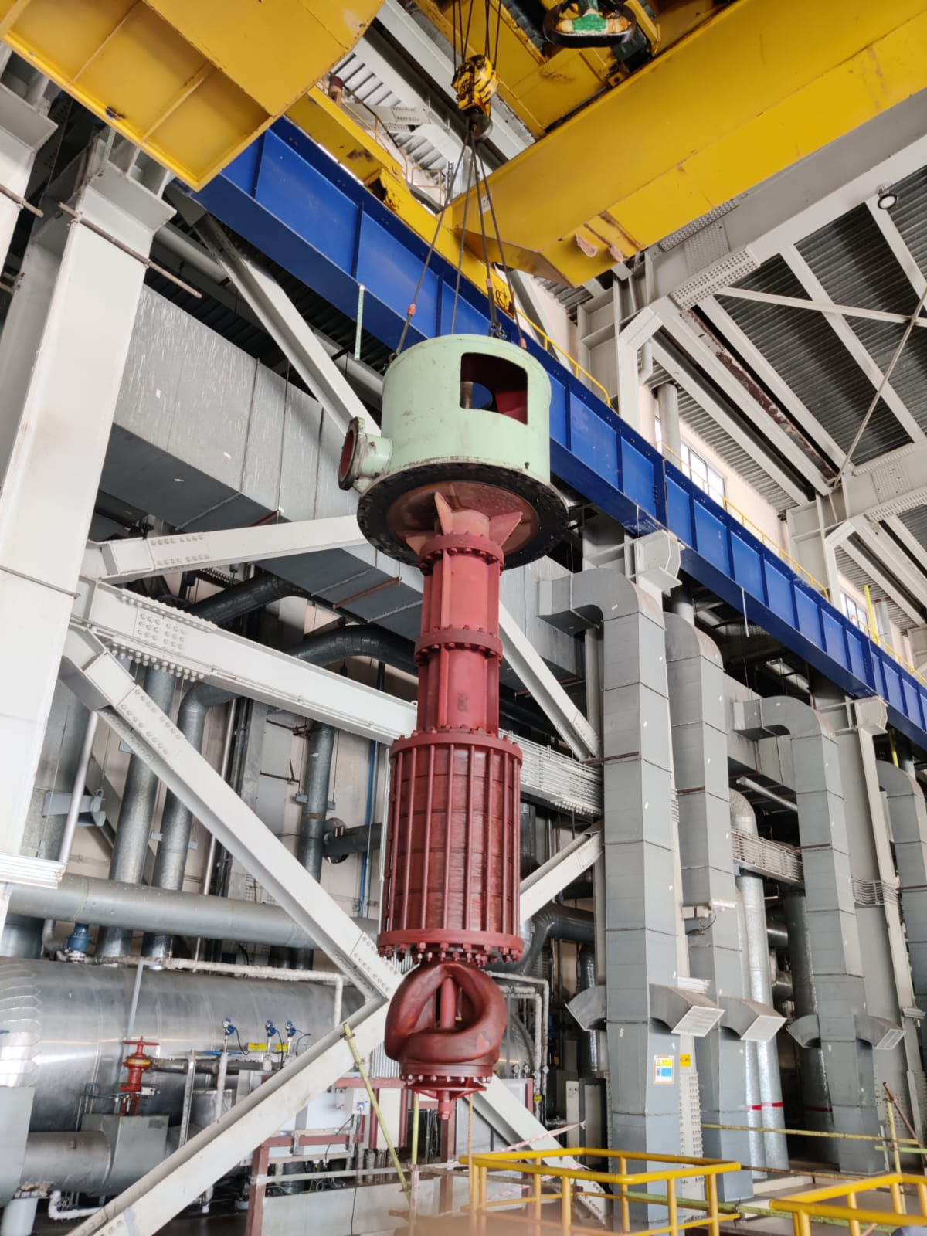
ENERGY EFFICIENCY IMPROVEMENT
Pumps impeller coating
Pump substitution
De-staging of pumps
VFD (variable frequency drives)

Slide 12
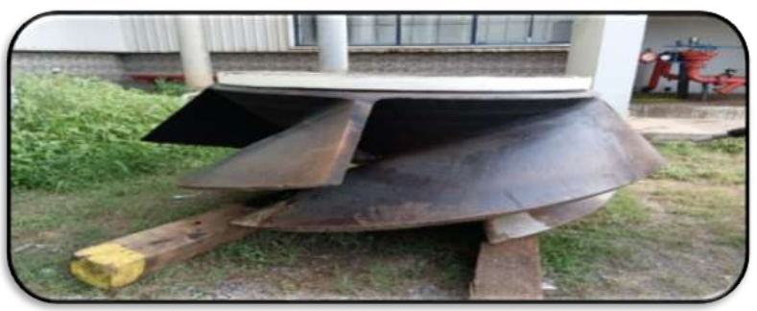
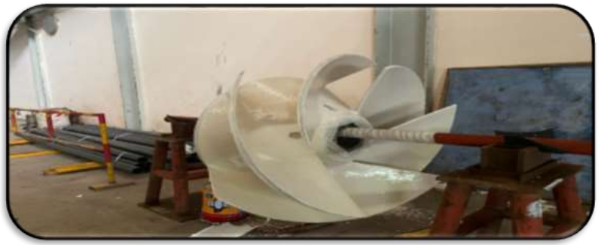
Pump impeller coat
First Coat | Polyglass VEHA
Mixed Coat | Corroglass 602+ poly glass VEHA
Intermediate coat | Polyglass VEHA in multiple coat
Topcoat | fluiglide
Total DFT | 1200 micron
Continuous running pumps with constant flow
Closed circulation cooling water pump
Condenser cooling water blow down pump
Condenser Cooling water pump (CWP)
CWP flow raise 11 %

Slide 13
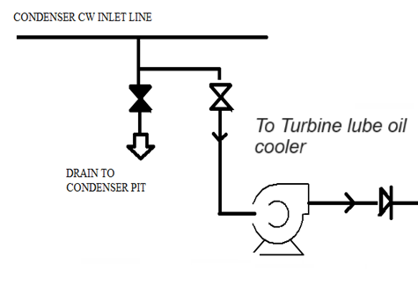
Substitution of lower capacity pump in place of Higher capacity pump
Turbine lube oil coolers, sea water used as a cooling medium for oil
After unit shutdown, Five days we run CWP (2400 KW) for turbine lube oil cooling purpose
Introduced a pump with minimum capacity to run in unit shutdown conditions
After shutdown now CWP runs only for 8 hrs

Slide 14
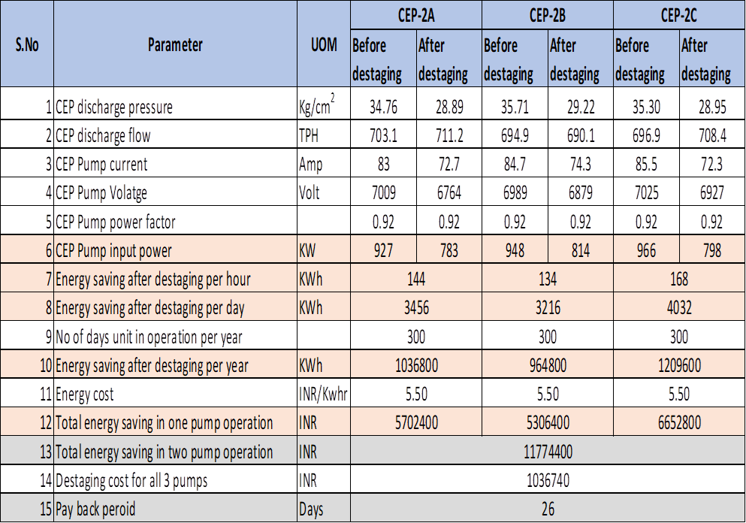
De-Staging of Condensate Extraction pumps (CEP)
Three CEPs installed per unit and Two will run for full load condition, One stage of each CEP removed
Minimize auxiliary power consumption
Avoid throttling in Deaerator control valves
Avoid Throttling pressure loss
Improve reliability of Deaerator CV
Cost saving in spare

Slide 15
Variable Frequency Drives (VFD)
VFD installed drives in ITPCL
LDO forwarding pump
Fire water jockey pumps
Low leak fan in FGD
process water pump in FGD
Chemical transfer pump in Electro chlorination plant
Mill Dynamic Classifiers
A VFD operated drive, we can achieve desired fineness and Better Control on Combustion efficiency by controlling speed of Dynamic classifier.
Dynamic classifiers are doing major contribution in boiler spray, metal temperature and efficiency.

Slide 16
AUTOMATED DAILY GENERATION REPORT (DGR)
NEW DEVIATION SETTLEMENT MECHANISM(DSM) REGULATION 2022
WIRELESS DATA TRANSMISSION IN AAQMS
COLD LIGHT UP OIL CONSUMPTION REDUCTION
REDUCE AND REUSE OF TREATED WATER
ENERGY EFFICIENCY IMPROVEMENT | Pump impeller coat Variable Frequency Drives (VFD) | Substitution of lower capacity pump in place of Higher capacity pump |  | De-Staging of Condensate Extraction pumps (CEP)
Technologies
Innovation
Government polices
Sustainability

Slide 17
Thank you

