Slide 1
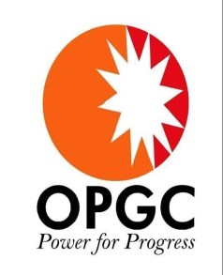
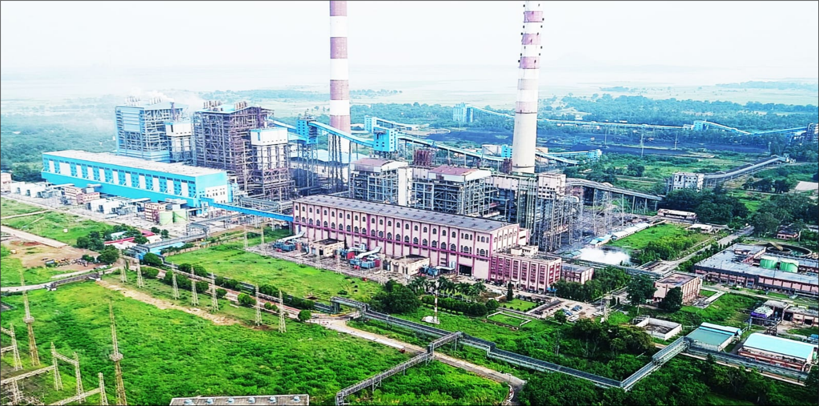
Best Safety Practices for effective O&M
IPS-2024
Odisha Power Generation Corporation
Ib Thermal Power Station,Banharpali, Jharsuguda, Odisha

Slide 2
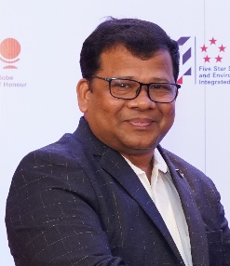
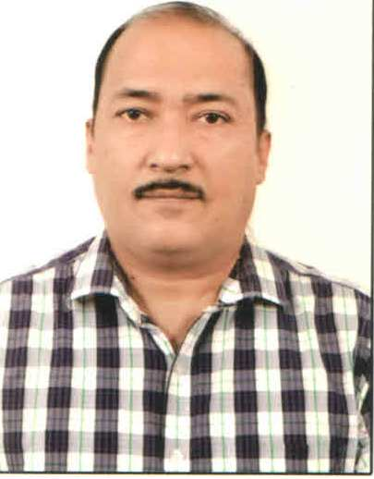
AUTHORS, BIOS
Sarat Chandra Nayak, 45, Degree in Chemistry, Post Diploma in Industrial safety, NEBOSH IGC, Masters in Environmental Science, M.Tech in Environment Engg. from IGIT, Sarang. He is certified internal auditor of ISO 9K,14K & 45K and IS 14489. He has audited many powerplants in India & abroad. He is approved safety officer by Director of Factories & Boilers, Odisha. He is a safety professional having more than 21 years of experience in different industries like, petrochemical, oil & Gas, Steel, Ferro alloys and Power. He joined OPGC in 2013 as a Dy. Manager-Safety and now working as a Sr. Manager-Safety in EHS Dept. He received best safety officer Award for the year-2022 during National Safety Conclave organized by Institute of Quality & Environment Management system in collaboration with Labour & ESI department, Govt. of Odisha.
Sitaram Sahu, 54, graduated in Electrical Engineering from NIT Rourkela. He has been associated in OPGC since 1995 and has worked in various areas like Main Plant, MGR, CHP and EHS in the areas of Operation and Maintenance. He is a Certified EHS Auditor from Bureau Veritas India ltd and has audited various power plants in India and abroad. Currently he is leading EHS department in OPGC.

Slide 3
    About OPGC
Odisha Power Generation Corporation Ltd. (OPGC) is a Government Company of the State of Odisha. It operates state of the art thermal power plants at Banharpalli, Jharsuguda. OPGC has established lb Thermal Power Station with 2 units of 210 MW in the year 1994 & 1996 and 2 units of 660 MW in the year 2019 in lb valley area of Jharsuguda District in the State of Odisha.
Cl2 Emergency drill
Life buoy distribution on AES Safety Day

Slide 4
Abstracts (Contd..)
Why Safety is important for Effective O &M:-
Maintenance is a high-risk activity because it often requires working together with a running process and in close contact with machinery
Direct contact between the worker and machine cannot be reduced substantially
Cl2 Emergency drill
Height rescue drill
Maintenance is an activity where workers need to be in close contact with operations and running machineries
Maintenance operations typically include both disassembly, reassembly, working near high voltage and energized equipment, confined space, height work often involving complicated machinery
This can be associated with a greater risk of human error, increasing the accident risk.
Life buoy distribution on AES Safety Day

Slide 5
Abstracts (Contd..)
Flash back of Industrial accidents in India as per DGFASIL:
Cl2 Emergency drill
Height rescue drill
Fatal and Non-fatal injuries in registered factories (2012-2021)
Life buoy distribution on AES Safety Day

Slide 6
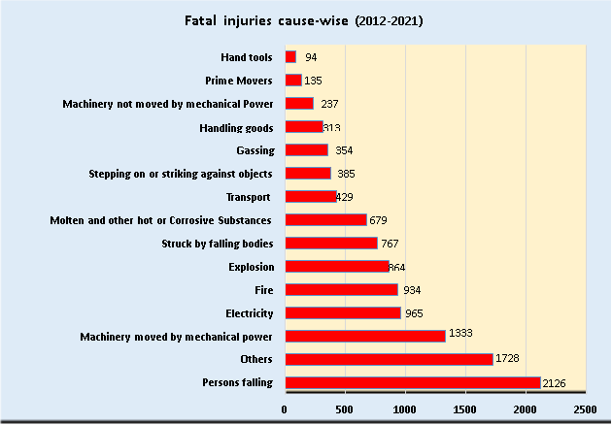
Abstracts (Contd..)
Flash back of cause wise accidents in India as per DGFASIL
Cl2 Emergency drill
Non-fatal injuries in registered factories: cause-wise (2012-2021)
Fatal injuries in registered factories: cause-wise (2012-2021)
Life buoy distribution on AES Safety Day

Slide 7
Abstracts (Contd..)
Outcomes from the accident Statistics
Declined trend observed after implementation of National policy on OSH by Govt. of India and efforts made by the industries
The following causes contributes maximum accidents ( both fatal & non-fatal) in India:-
      Persons falling
      Others
      Stepping on & striking against objects
      Machinery moved by Mechanical Power
All these above causes generally relates to Plant Operation & Maintenance
Cl2 Emergency drill
Height rescue drill
Life buoy distribution on AES Safety Day

Slide 8
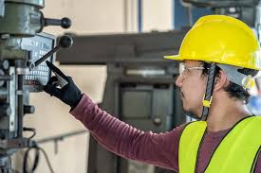
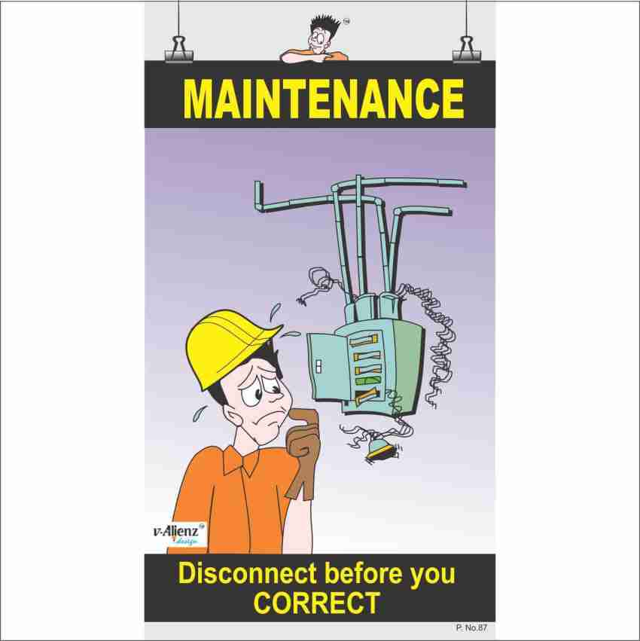
Abstracts (Contd..)
As OSH at workplace as an integral part of every operation , we can’t ignore safety during operation & maintenance. Without following safety guidelines, effective & reliable operation & maintenance is not possible.
The following important factors must be considered & built into while undertaking the maintenance activities: -
Cl2 Emergency drill
Height rescue drill
Life buoy distribution on AES Safety Day

Slide 9
Abstracts (Contd..)
Planning
Scope of the task: Clarity, what needs to be done, how it affect others
Risk Assessment & fixing of controls: This risk assessment process must be followed through job specific JSA or HIRA
Making the workplace safe
Implement Permits to work and lock-out systems
Secure by preventing unauthorized access: by using barriers and signs i.e. moving parts of machinery secured, temporary ventilation installed and safe routes established for workers to enter and exit the work area.
Use of appropriate equipment
The right tools and equipment for the job are available and they are in good condition, ergonomically designed and people are competent to use them.
Implement MOC process: if you introduce any new equipment in the process
SOP & SMP: Safe work procedures have to be communicated and understood by workers and supervisors, and applied correctly. Effective PJB
Competence and adequate training
Competence and training requirements: EIC needs to ensure that all the workforce have the skills to carry out that job and safe work procedures are informed
Working as planned
Take TTR: Equipment is in safe conditions, tools and wastes are cleared, workforce is communicated about TTR and they are away from the equipment
Final check
Time and resource requirements:
Proper communication: Between the various stakeholders at workplace. PJB discussion, ask about the health status of crew members
Procedures need to be in place for unexpected events
Ensure all guards & other protections are re-installed
Communicate the all stake holders
Return the PTW & Restore the Isolation after final check
Selection & use of appropriate PPEs
Cl2 Emergency drill
Height rescue drill
Life buoy distribution on AES Safety Day

Slide 10
    NOMENCLATURE
OSH: Occupational Safety & Health
DGFASIL: Director General of Factory Advice and Labour Institute
O&M: Operation and Maintenance
LOTO: Lock out & Tag out
PJB: Pre-job briefing
TTR: Temporary Tag Release
PTW: Permit to work
SAP: Systems Applications and Products
JSA: Job Safety Analysis
EIC: Engineer in-charge
Cl2 Emergency drill
Life buoy distribution on AES Safety Day

Slide 11
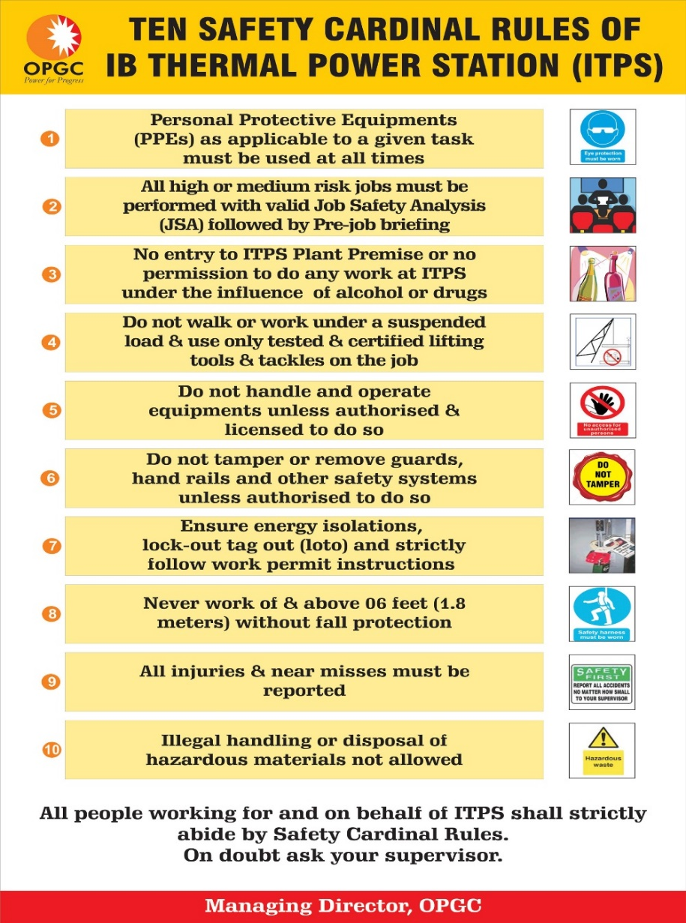
Key health, safety and wellbeing policies at OPGC
The safety policies and principles are well in place and are being followed across the Ib Thermal Power Station.
OPGC EHS Policy
Safety Value
Safety Beliefs
Safety Principles
Safety Cardinal Rules
Stop Work Policy
Safety Reward & Recognition Policy
Safety Disciplinary Policy
Return to work Policy
Wellbeing Policy

Slide 12
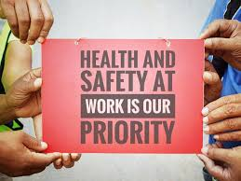
Important best safety practices for effective O&M @ OPGC
The following are important best safety practices has already implemented to make its O&M more effective and safer.
Visible felt leadership in Safety Management
Risk Assessment process through JSA & HIRA
Permit to work system & LOTO through SAP
Use of Technology in safety management
Innovative Machine Guarding
Effective Communication
Stop Work Authority
Use of Appropriate PPE’s & its selection
Cl2 Emergency drill
Life buoy distribution on AES Safety Day

Slide 13
Important best safety practices for effective O&M @ OPGC
Visible felt leadership in Safety Management:-
The Middle and top management modeling through examples and visible felt leadership in the field has a great role in changing human behavior of workers which impacts to improve safety culture. Hence, OPGC has implemented following systems to monitor the leadership engagement in OH&S:
Cl2 Emergency drill
Leadership safety assurance score card for managers & above.
Line managers safety score card for Dy. Manager & below
Life buoy distribution on AES Safety Day

Slide 14
Important best safety practices for effective O&M @ OPGC
Example of monthly Score card:
Monthly Leadership Safety Assurance Score card
Name of the Leader : |  |  | Department:- |  |  | Month:-
Sl.No | Leading Safety Indicators | Monthly Target | Actual to be filled by leader | Maximum Weightage (Total=100) | Actual Score | Compliance | Final Rating
1 | Attending safety meetings ( Apex safety meeting-01,Dept. safety meeting-1 and weekly TBT-4) | 5 | 5 | 15 | 15 | 100% | EXCELLENT
2 | Performing leadership Site Safety walks | 4 | 4 | 20 | 20 | 100% | EXCELLENT
3 | Site visit and application of Stop work Authority | 1 | 1 | 15 | 15 | 100% | EXCELLENT
4 | No. of critical job JSA reviewed by the leaders/No. of close permit audit(for operational leaders) | 4 | 4 | 15 | 15 | 100% | EXCELLENT
5 | Reporting of SIP incidents( Workplace hazards & near miss) | 1 | 1 | 10 | 10 | 100% | EXCELLENT
6 | Participation in incident investigation /Inspections and safety surveys | 1 | 1 | 10 | 10 | 100% | EXCELLENT
7 | Dept. Safety audit compliance / other safety compliance status | 100% | 98% | 15 | 14.7 | 98% | VERY GOOD
 | Overall Safety assurance scoring |  |  | 100 | 99.7 | 98% | EXCELLENT
Cl2 Emergency drill
Life buoy distribution on AES Safety Day

Slide 15
Important best safety practices for effective O&M @ OPGC
2. Risk Assessment process through JSA & HIRA:-
Apart from the HIRA, OPGC has implemented JSA process before applying any PTW which is a multi-phase, dynamic and collective risk assessment thought process for carefully studying each step of a job, identifying existing or potential hazards and risks involved at each step of the job, and determining the Hazard Control measures to eliminate or mitigate the hazard and risk.
Maintenance contractor crew members are being involved along with engineer-in-charge during this JSA preparation at planning stage.
Hazard control measures are being fixed in line with hierarchy of control measures.
All high risk JSAs are being reviewed by concerned Team Leader/Head & Control room Shift in Charge before the JSA implemented at site. PTW will not be issued without job specific JSA.
Before start of the work the JSA is being briefed to work crews and record of the same are being maintained
Cl2 Emergency drill
Life buoy distribution on AES Safety Day

Slide 16
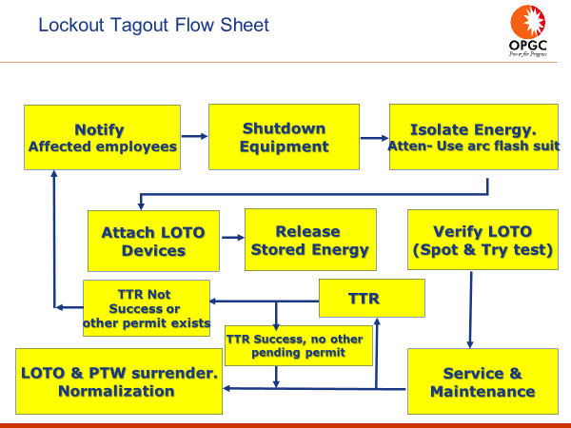
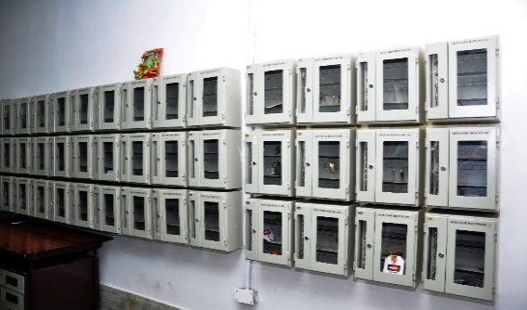
Important best safety practices for effective O&M @ OPGC
3. Permit to work system & LOTO through SAP:-
The process covers, 1- Work request, 2- Work Order 3- Isolations listing & verification, 4- Isolation, 5- Isolation Verification, 6- Permit to Work Order (PTW) & 7- Contractor Interface with PTW.
Cl2 Emergency drill
Life buoy distribution on AES Safety Day

Slide 17
Important best safety practices for effective O&M @ OPGC
4. Use of Technology in safety management:-
OPGC always believe in technology as a great role in preventing accident and monitoring of unsafe conditions/actions at work place. So, OPGC has been using drone and robot to avoid human interference with the high-risk activities. OPGC is using technology in following maintenance activities:
Drone is being used to inspection the remote areas and top of flue gas ducts where high risk is involved to monitor effectiveness of safety control measures.
OPGC is using drone to complete inspection of boiler 1st pass including water wall sections, burner areas and outer side of chimney to eliminate the Confined Space hazard, fall hazards & no slag falling hazard inside the boiler and also saved cost by not erecting scaffolding.
CHP bunker inside shell condition is also monitored by drone without entering workers.
Cl2 Emergency drill
Life buoy distribution on AES Safety Day

Slide 18
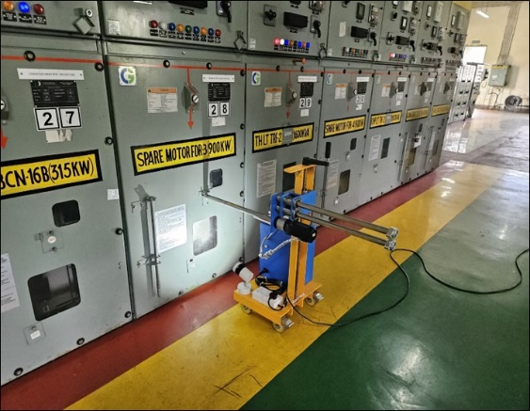
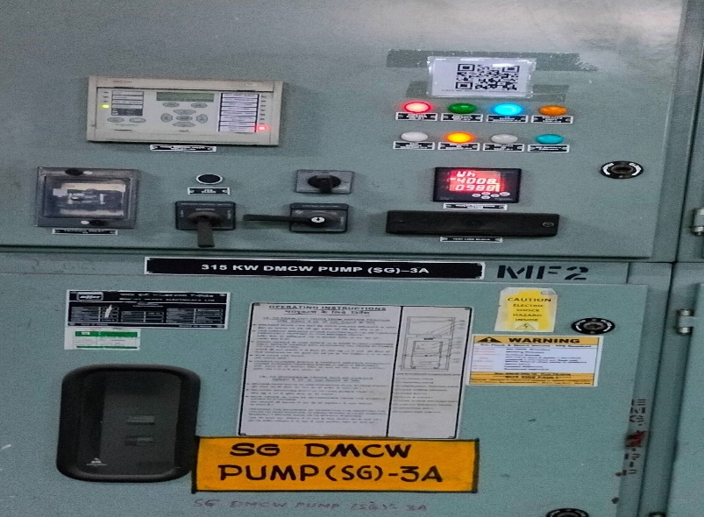
Important best safety practices for effective O&M @ OPGC
4. Use of Technology in safety management:-
Breaker rack in & rack out process involves high risk activities in all power plants. To avoid human interference and for eliminating the arc flash injury, OPGC has implemented remote rack in rack out process of all HT breakers in CHP. The remote rack in rack out device is
OPGC has introduced QR code scanner to obtain schematic drawing of HT/LT switchgear system in mobile devices. This helps to reach out to the drawings on the go for trouble shooting
Cl2 Emergency drill
Life buoy distribution on AES Safety Day

Slide 19
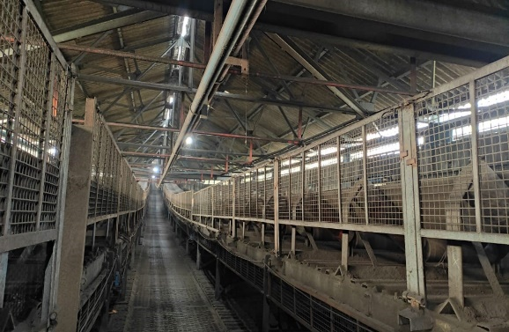
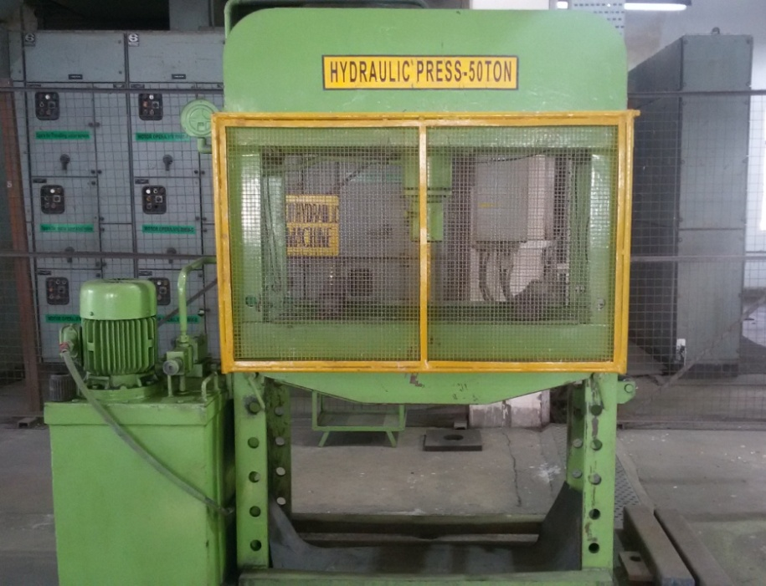
Important best safety practices for effective O&M @ OPGC
5. Innovative Machine Guarding: Proper machine guarding is a matter of concern in power plant as long conveyors and other rotating parts are in operational. So, OPGC has taken a great initiative and ensures all conveyors and other revolving parts of the equipment are properly guarded.
All conveyors at CHP have been adequately guarded. Near about Rupees One crore has been invested for guarding of about four-kilometers conveyor belts.
In machine shop, innovative guarding systems have been implemented by OPGC team to ensure safety of workers.
Cl2 Emergency drill
Life buoy distribution on AES Safety Day

Slide 20
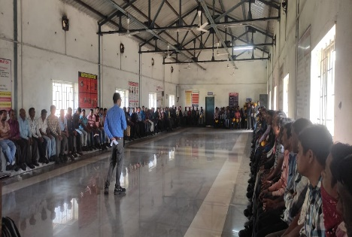
Important best safety practices for effective O&M @ OPGC
6. Effective Communication:
There are several internal communication methods related to OH &S which are being communicated to employees & contract partners at ITPS .
Main channels for Communicating the policies to worksite people: -
Written Communication methods: Safety Procedures, Policies & Principles, monthly safety topics, safety alerts, incident records, RCA reports, HIRA, Safety committee proceedings, mock drill reports, stop works, legal compliance status
Visual/Pictorial
Verbal method
Communicating through Different Safety celebrations
Life buoy distribution on AES Safety Day

Slide 21
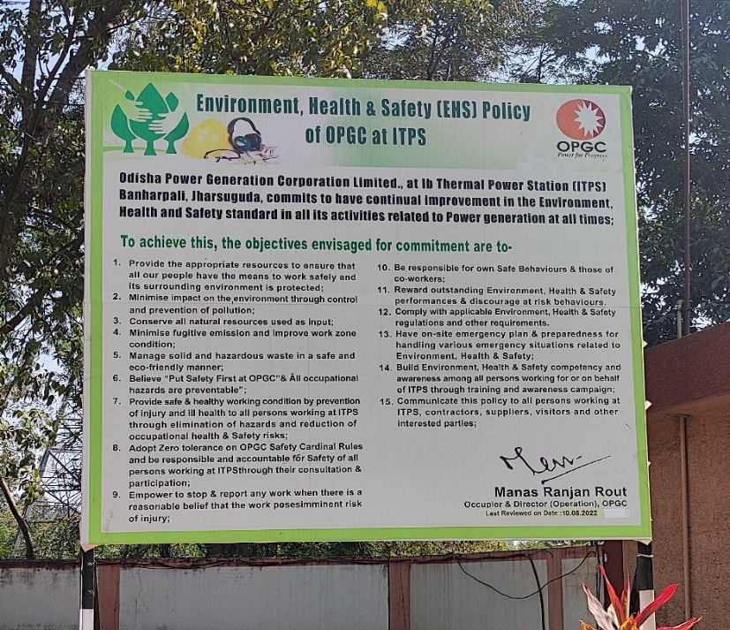
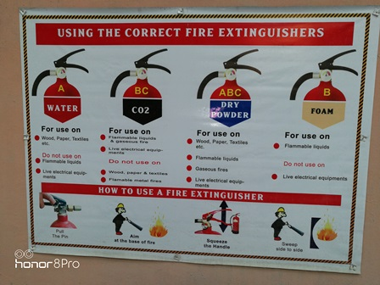
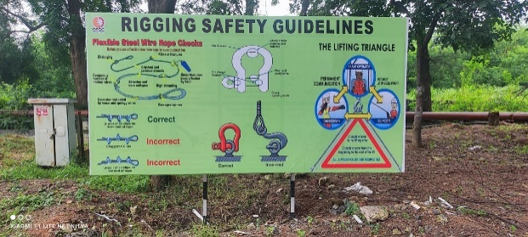
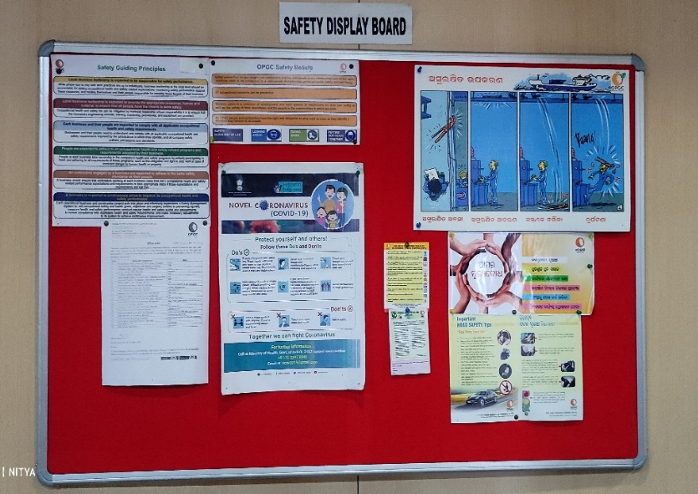
Important best safety practices for effective O&M @ OPGC
Visual/Pictorial:
Cl2 Emergency drill
Life buoy distribution on AES Safety Day

Slide 22
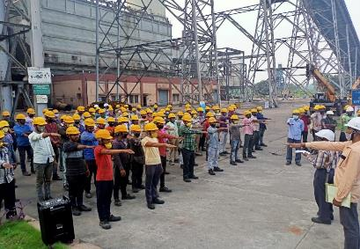
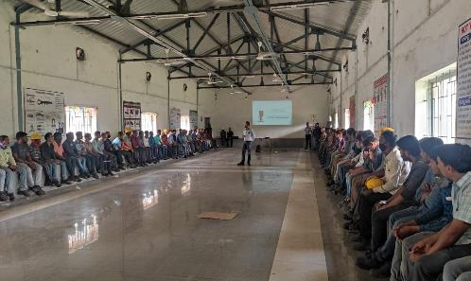
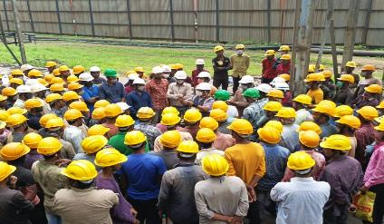
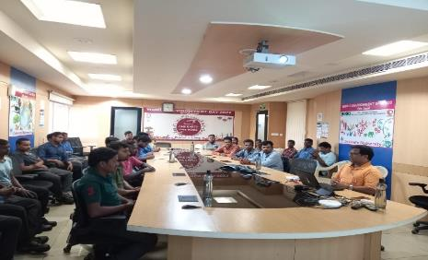
Important best safety practices for effective O&M @ OPGC
Verbal method:-
Cl2 Emergency drill
Life buoy distribution on AES Safety Day

Slide 23
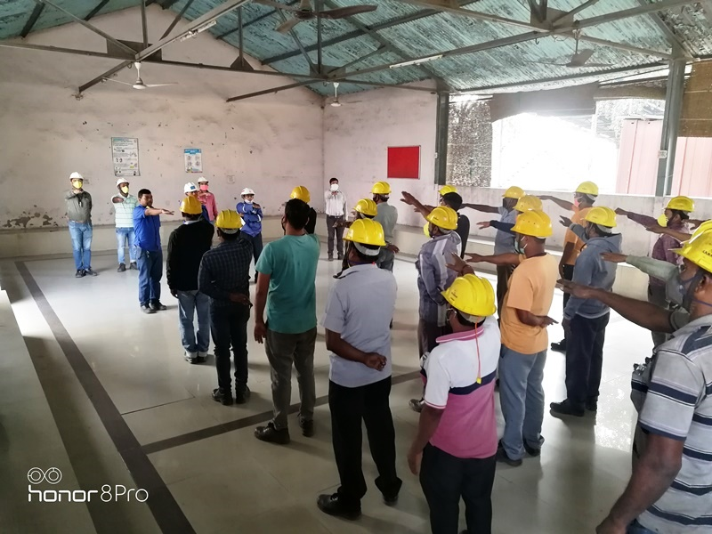
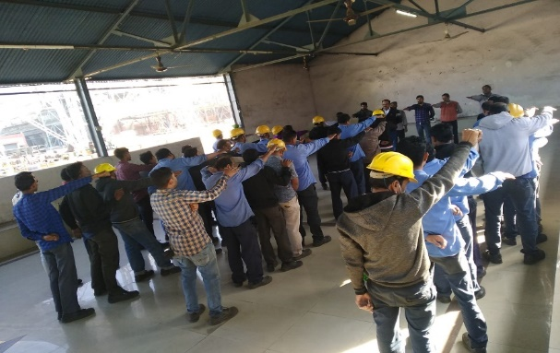
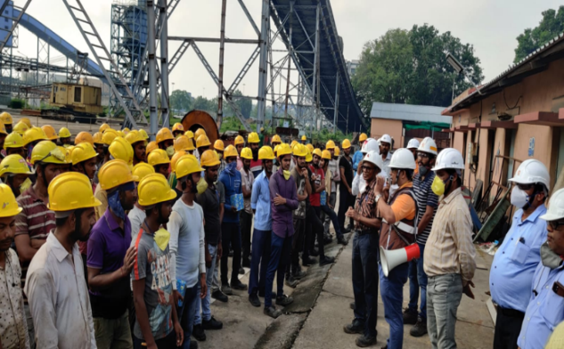
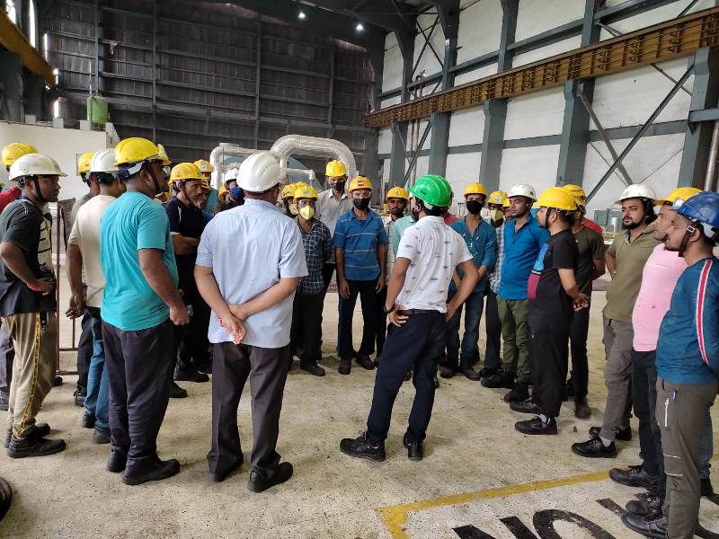
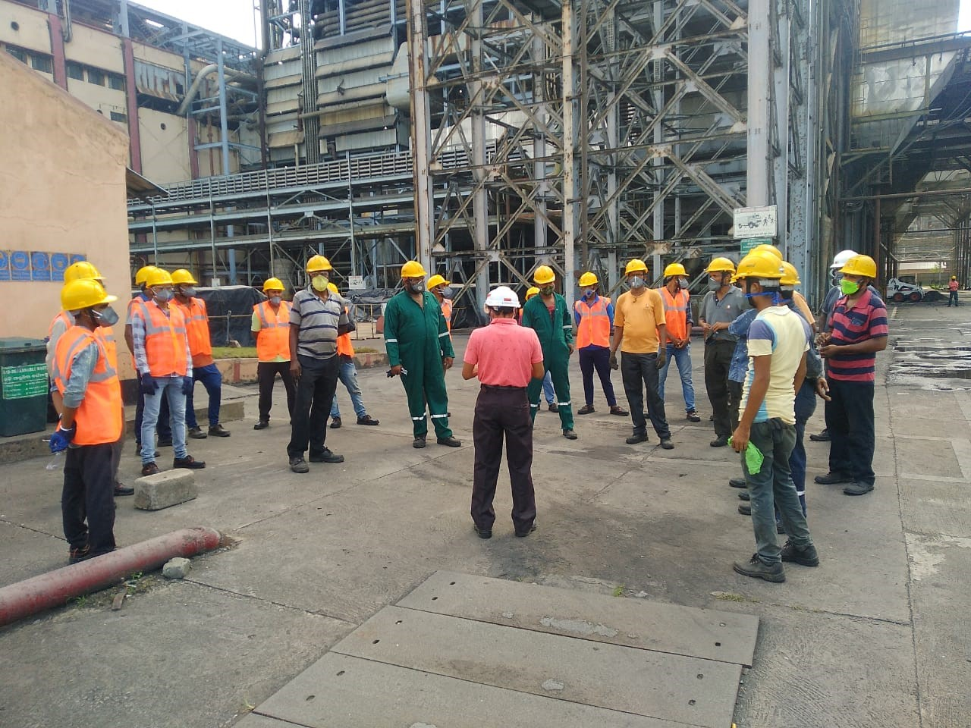
Important best safety practices for effective
O&M @ OPGC
Weekly Mass Tool Box/daily Area wise PJB : -
OPGC is being conducting weekly mass tool box talk/safety talk meet on a safety topic of importance involving all employees and contractor. The talk followed by administering Safety Oath. This meet happens on every Saturday

Slide 24
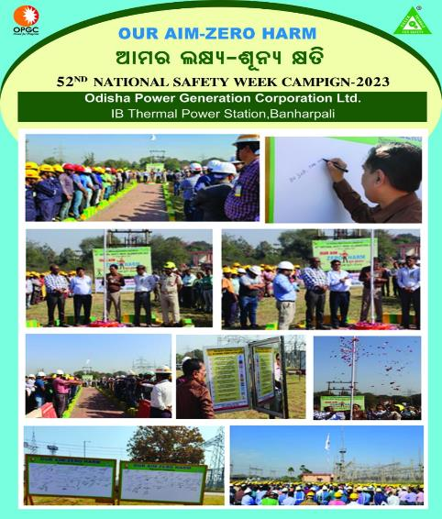
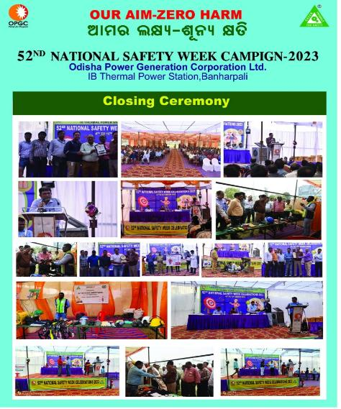
Important best safety practices for effective O&M @ OPGC
Communicating through Different Safety celebrations
Cl2 Emergency drill
Life buoy distribution on AES Safety Day

Slide 25
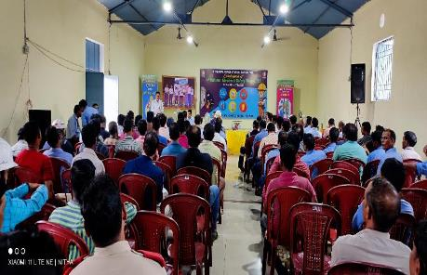
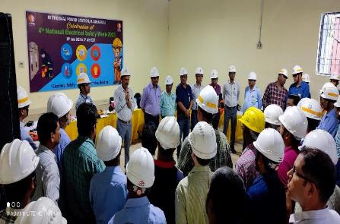
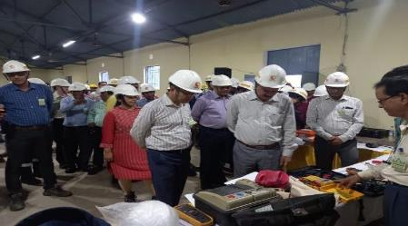
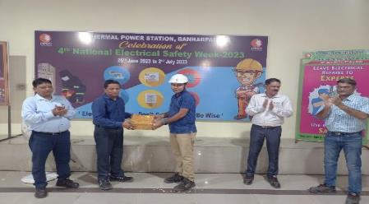
Important best safety practices for effective O&M @ OPGC
Communicating through Different Safety celebrations
Cl2 Emergency drill
Life buoy distribution on AES Safety Day

Slide 26
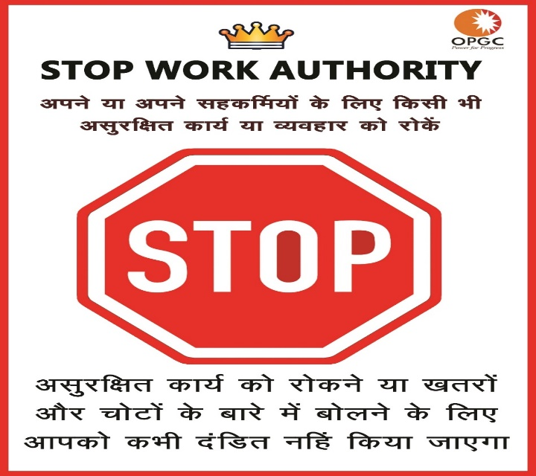
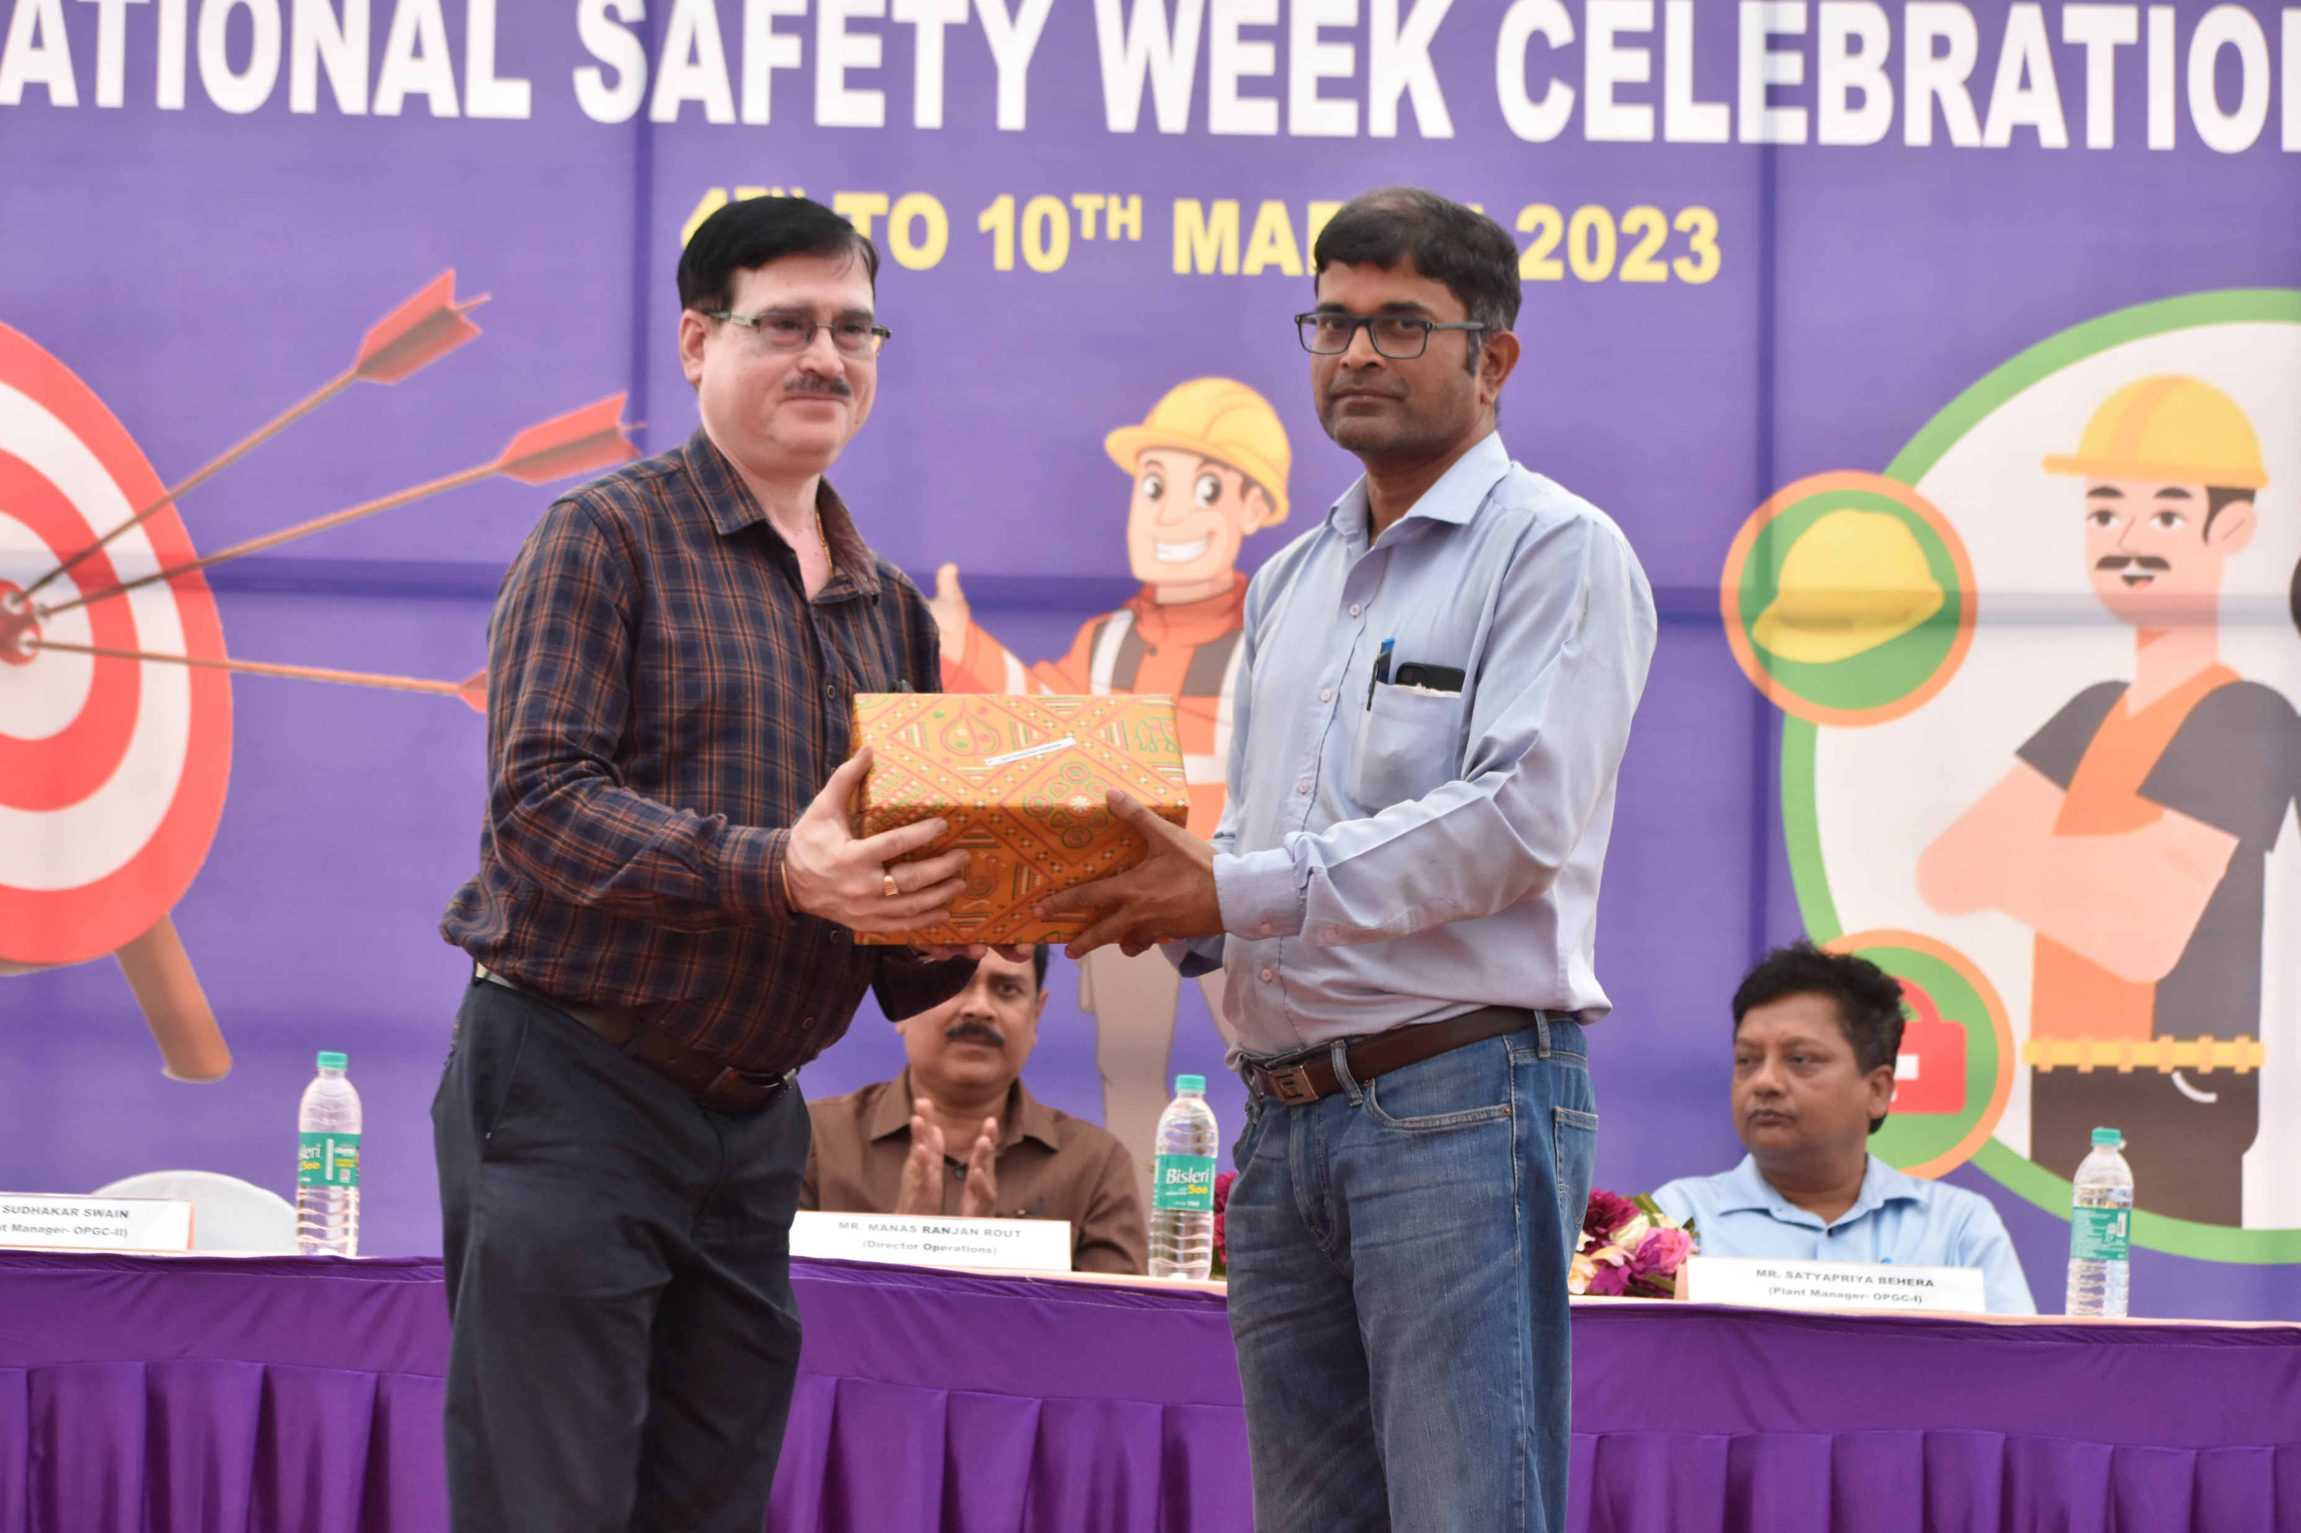
Important best safety practices for effective O&M @ OPGC
7. Stop Work Authority:
Stop work authority is one amongst OPGC’s effective proactive tools to engage OPGC people and contractors to act when a perceived unsafe situation is observed. All OPGC people, Contractors & Visitors have the right and obligation to stop the work as soon as they identify a situation, they believe to be unsafe.
Cl2 Emergency drill
Stop works applied details-2022
SL. No | Month | No
1 | January | 3
2 | February | 4
3 | March | 5
4 | April | 3
5 | May | 7
6 | June | 7
7 | July | 5
8 | August | 3
9 | September | 6
10 | October | 2
11 | November | 3
12 | December | 4
Total |  | 52
Rewarded for best stop work application
Life buoy distribution on AES Safety Day

Slide 27
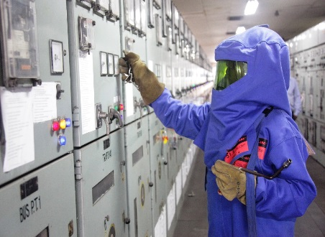
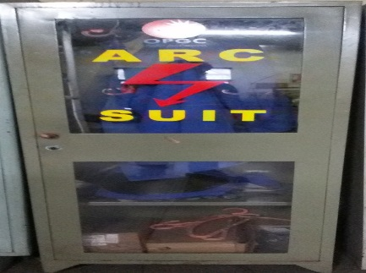
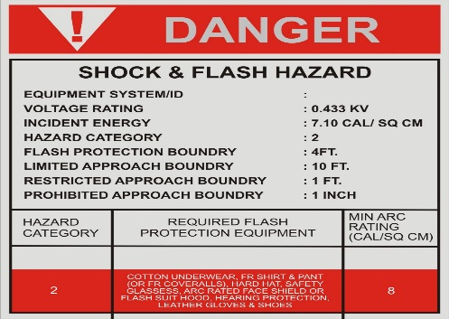
Important best safety practices for effective O&M @ OPGC
8. Use of Appropriate PPE’s & its selection: The PPE Program is intended to be used in conjunction with good engineering, administrative controls and work practices, and should not be viewed as a replacement.
Samples are collected from PPE manufacturers and issued for trial use at work site which was monitored by a PPE’s Task force consisting members of safety committee. Then feedback from workforces were taken regarding quality of PPEs provided. Accordingly, the PPE’s effectiveness is observed and finalized.
For electrical PPE’s & clothing, OPGC has conducted a third-party survey to calculate the incident energy & minimum approach distance of different electrical equipment. The PPE clothing class & Glove Rating is determined based upon the incident energy and voltage class .
Cl2 Emergency drill
Life buoy distribution on AES Safety Day

Slide 28

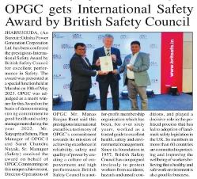
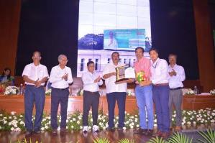
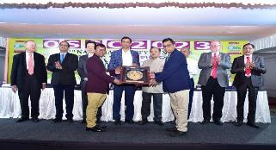
Safety Recognitions @ OPGC
OPGC (2x210MW) in recognition of its superlative safety culture and practices, has been awarded an international safety award in the “Merit winner” category by prestigious British Safety Council in Yr 2022.
OPGC bagged award of Electrical Safety Award-2023 on 4th National Electrical safety week by EIC(E) cum PCEI, Dept. Of Energy, Govt. of Odisha
Cl2 Emergency drill
OPGC (2x210MW) received Kalinga Safety Excellence Award in the Gold Category for the performance year -2022 in recognition of best safety practices. The award received from the chief guest Honrable Dr. Sudhanshu Sarangi, IPS,DG(Fire service, Home Guard & Civil Defence)
Life buoy distribution on AES Safety Day

Slide 29

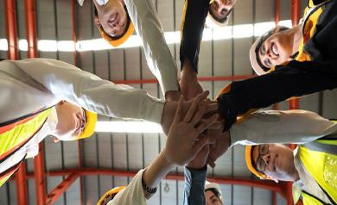
    CONCLUSION
Best safety practices are required during
O&M to ensure plant and equipment in healthy and efficient working order and without risk to health and safety .
The modern concept of safety assurance must stress upon the importance of involvement of all the people, right from the top most CEO of the company to the lower most workers in the safety movement of an organization.
Cl2 Emergency drill
Height rescue drill
Finally, OPGC recognizes that Safety and Health of Workers has a positive impact on productivity, economic and social development.
Life buoy distribution on AES Safety Day

Slide 30
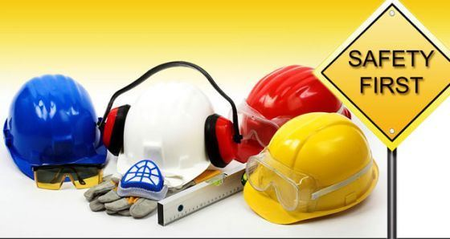

Thank You
Notes:
Date : 23.01.2008
30

