Slide 1
Renovation & Modernization (R&M) & Uprating of NHPC Power Station: A Case Study
Presented By
JAGANATH PANI
SR.MANAGER(O&M)
NHPC LTD

Slide 2
Introduction
Renovation
Aims at extending the life
Modernization
Aims at enhancing the performance
Uprating
Aims at increasing the station capacity

Slide 3
Introduction
Renovation & Modernization, Uprating and Life Extension (RMU&LE) of hydro plants is a cost effective way to extend the generation from the plant to the extended period of 20‐25 years with improved reliability and availability.
R&M programme can be expected to yield benefits in about 3‐4 years as against construction of a new hydro plant of 7‐8 years.
Estimated cost per MW against R&M for Life Extension is much less than the new hydro projects of similar capacity

Slide 4
Requirement of R&M
Various factors are being considered for R&M of hydro power stations where
Generating units that have been crossed their useful life i.e. 40 years.
Generating units have stopped for giving the useful output due to frequent fault persisting in the system.
Silt affected power stations where excessive silt contained in the inflows causes enormous damage to the hydraulic structures and turbines, periodic repair maintenance is required to be carried out almost every year.
Upgradation to digital control system from manual mode of control as in manual mode for easy identification & restoration of any fault.
Uprating of generating units if possible.
For enhancement of performance and efficiency of units.

Slide 5
Experiences of NHPC – A Case Study
Sl No | Name of Power Station | Date of Commercial operation | Completion of useful life of 35 Yrs | R&M proposed to be carried out
1 | Bairasuil (3X60 MW) | April’1982 | March’2017 | Already completed
2 | Loktak (3x35 MW) | June’1983 | May’2018 | Proposed to be undertaken from Dec’2025

Slide 6
Case Study on Bairasuil Power Station (3X60 MW)
Major generating plant equipment incl. Generator, Turbine and Generator Transformers were manufactured / supplied during the year 1975‐76
Units were commissioned during 1980‐81.
Design Energy: 779 MU (In last 38 years of commercial operation, the power station has not achieved design energy in 25 years. Average generation during the last 10 years is 695 MU).
Considering the load factor, incremental kWh/ kW and utilization of water for purely energy generation purposes, the optimum installed capacity of the power station has been retained as 180 MW for which the project was originally designed mainly due to comparative reduction in inflows as well as negligible incremental benefits even beyond 150 MW.

Slide 7
Studies Undertaken
Power potential and optimization studies: 30 years data of observed discharge in river at dam site (From 1984‐85 to 2013‐14). Revised DE: 708.59 MU.
Head loss in water conductor system: Central Water and Power Research Station (CWPRS) in 2014 conducted measurements. The actual head loss measured was 41.11 m against original 32.57 m. The present rated head is calculated as 238.1 m against original rated head of 259 m.
Non‐destructive Tests (NDT) comprising of rebound hammer test, ultra sonic pulse velocity test & cover meter tests and semi destructive tests comprising of coring at pre‐defined locations on certain concrete structures of the power station. The tests were conducted by Deptt. Of Civil Engineering, IIT Roorkee during Aug‐2014 and were found to be satisfactory in respect of the civil structures of the power station. 5

Slide 8
Scope of work under R&M
The major scope of work has been broadly categories in two parts.
R&M of Power House complex
R&M Dam complex

Slide 9
R&M of Power House complex
SL. | Rating of Existing System | Revised Rating after R&M | Revised Rating after R&M
1 | Generator & Excitation System
1.1 | Generator 11 KV, 66.7 MVA, 97.6 efficiency Class B insulation | Replaced with Generator 11 KV, 74 MVA, Efficiency>98%, Class F insulation, better CRGO and addition of brake dust collector, On line PD & Air Gap measurement system etc.
1.2 | Static Excitation System | Retained but compatibility of existing system with SCADA to be done in RMU
2 | Turbine & accessories system
2.1 | Turbine with w.r.t. average efficiency 91.3 % with HVOF. | Replacement with Turbine with weighted average efficiency >93 % with HVOF coating
2.2 | Draft Tube Liner, Stay Ring, Spiral Casing | Refurbishment only (as embedded parts)
2.3 | Lower Ring, Top Cover, Guide Apparatus, etc. | Replacement
3 | MIV/ BFV and accessories system
3.1 | MIV & BFV | Refurbishment only
3.2 | Operating Mechanism & accessories | Replacement with new system like N2 accumulator system, self-lubrication bearings, Main distributing valve, Sensor and instrument compatible to SCADA.

Slide 10
R&M of Power House complex
SL | Rating of Existing System | Revised Rating after R&M
4 | GSU Transformers
4.1 | 25 MVA, 11/220 KV, Single phase Generator Step up Transformer | Replacement due to ageing, increased losses
4.2 | Fire fighting system was water Hydrant type | Replaced with nitrogen-based fire fighting system (first time in NHPC)
5 | Control monitoring & Protection system
5.1 | Control and Monitoring system: - Manual | Newly SCADA system was installed for control & monitoring in AUTO mode
5.2 | CT & PT with accuracy class 1 | Replacement with accuracy class 0.2 s
5.3 | Protection System: - mix of electromagnetic and Static relays. | Replacement with numerical relays that includes Protection of auxiliary system.
6 | Governor System
6.1 | Electronic Hydraulic Governor (Old & obsolete) with 60 Kg/cm2 pressure | Replacement with Digital Governor compatible with SCADA with 100 Kg/cm2 pressure (first time in NHPC)
7 | Power Cables
7.1 | 11 KV, 415 V Paper insulated Cable | Replacement with XLPE cable

Slide 11
R&M of Power House complex
Sl No | Rating of Existing System | Revised Rating after R&M
8 | Other auxiliary system
8.1 | Cooling Water system Open loop type | Replacement with new Pumps including motor and addition of closed loop cooling system
8.2 | HVAC system (out of order). | Replacement
8.3 | Protection System: - mix of electromagnetic and Static relays. | Replacement with numerical relays that includes Protection of auxiliary system.
8.3 | Two nos. 415 V, 500 KVA DG sets | Replacement with two nos. 11 KV, 1000 KVA DG sets

Slide 12
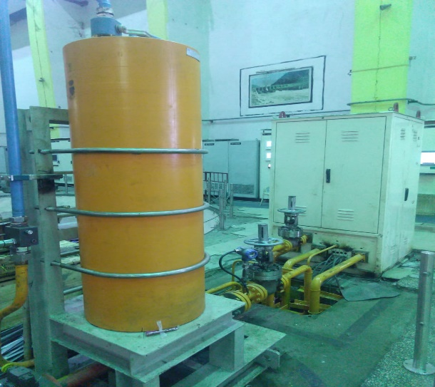
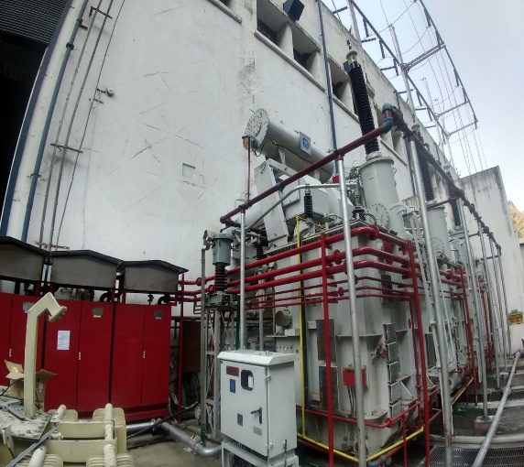
Some Photographs:-
N2 accumulator system for MIV/BFV
N2 accumulator system for Governor
Nitrogen based firefighting system for GT

Slide 13
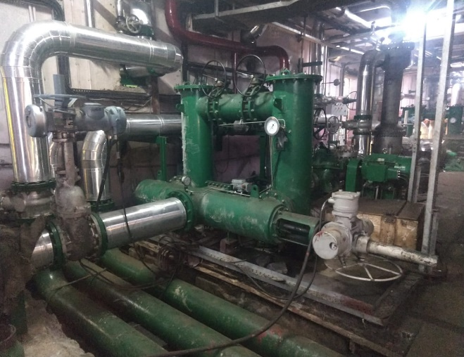
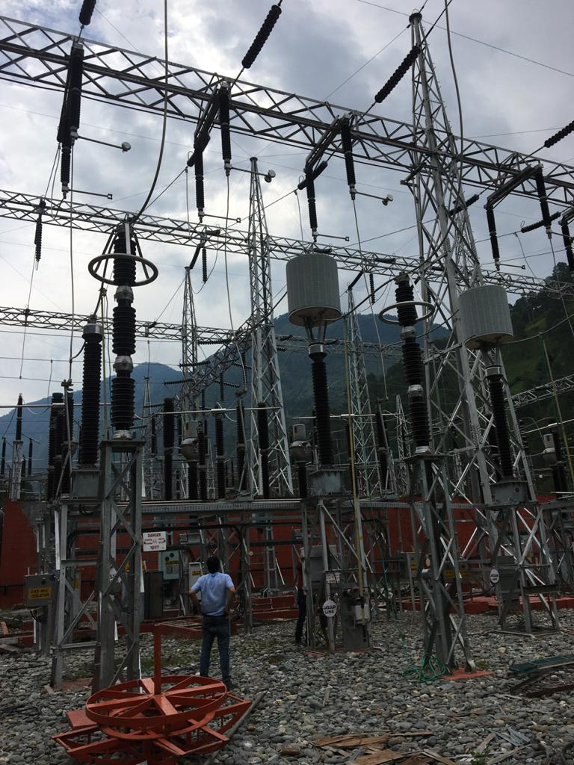
Some Photographs:-
Closed loop water cooling system
New Switchyard equipment’s installed
Refurbished MIV

Slide 14
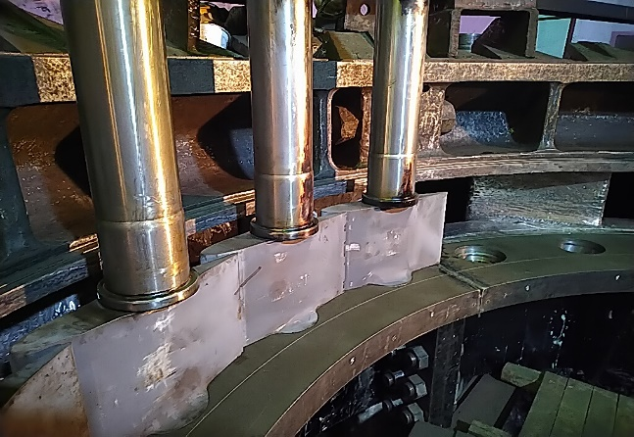
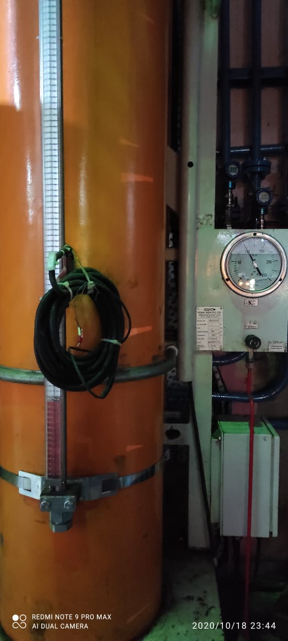
Some Photographs:-
HVOF coated new runner Closed
HVOF coated Guide vane
100 Kg/Cm2 Governor OPU system

Slide 15
R&M of Dam complex
Sl No | Existing System | Revised after R&M
1 | Bhaledh Complex
1.1 | Maximum discharge from Bhaledh system reaches up to approx. 16 cumecs only as against the design discharge of 19.82 cumecs. | To trap available discharge in nallah, one additional Trench Weir is being proposed for providing total 24 cumec discharges in BFT. For augmenting the Bhaledh Feeder Tunnel capacity, it has been worked out that by lowering the finished invert level in tunnel by 0.85 m, the discharge carrying capacity of BFT can be enhanced up to 24 cumec.
2 | Baira Dam Complex
2.1 | Diversion Tunnel Service Gate got jammed very frequently due to silt. (Jammed gate has been raised with difficulty with the use pulling by ropes with the help of dozers etc. in addition to the available hoist capacity). | The gate is equipped with a rope drum hoist of 160T capacity along with suitable hoist supporting structure instead of presently provided 65T capacity rope drum hoist. Related civil structure to be checked/ strengthened for the revised hoist loads and weights

Slide 16
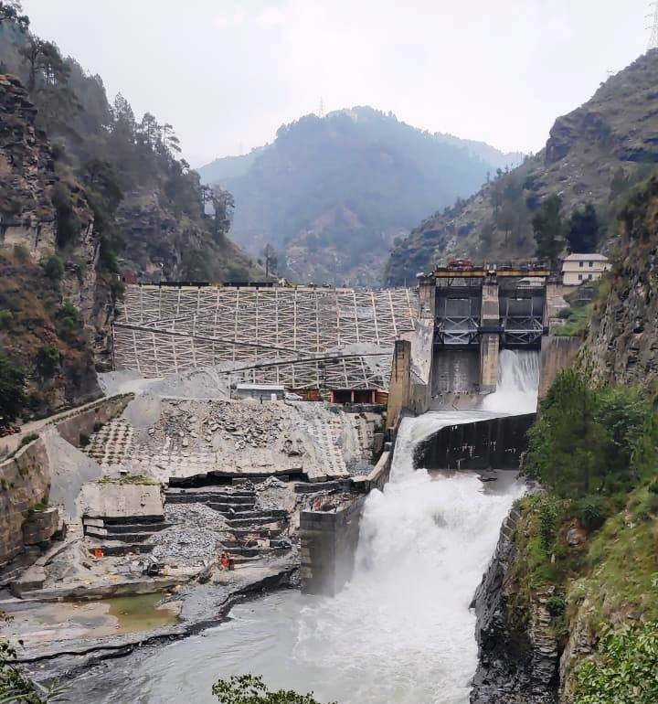
DAM Photographs:-
Before
After
Dam D/s : Cellular Wall & Toe wall

Slide 17
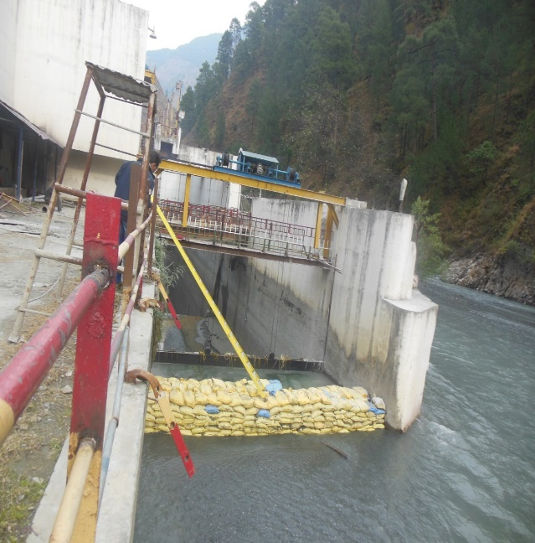
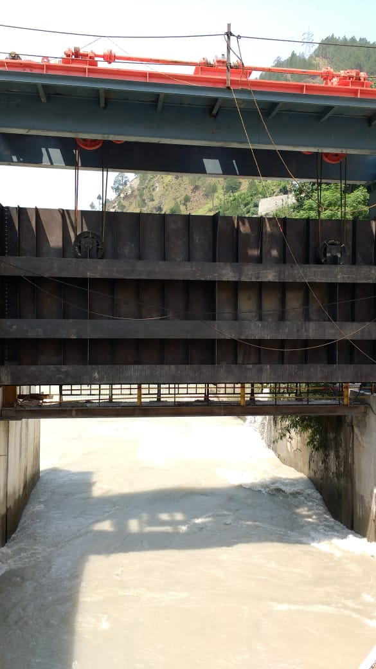
DAM Photographs:-
Before
After
Tail Race Channel: EOT & Hoist Structures

Slide 18
Cost Benefit Analysis
Estimated cost Rs. 341.41 Crore at October 2014 PL including Rs. 68.35 Crores on Interest During Construction (IDC).
Major benefit of the R&M is the life extension of the project.
The cost / MW for the proposed R&M works is about Rs. 2.0 Crs. as against cost / MW of about Rs.10.0 Crs. for new hydroelectric power plant of similar size.
Post R&M, the levelized tariff is likely to be Rs. 4.09 / KWH. Levelized tariff for new project of similar size, considering present day cost of the project @ 10 Crs. per MW, works out to Rs. 6.37 / KWH

Slide 19
Conclusion
It is very advantageous for undertaking R&M of hydro generating units to add more energy benefits to cater the prevailing power requirement.
R&M and uprating are the most economical as well as lower gestation period for capacity addition as compared to build up a new hydro project.
The clearances such as forest clearance, land actuation, R&R issues, feasibility of the project are the major risk to the development of the project as they take considerable time and effort which is not required for R&M of old projects resulting considerable time savings for capacity addition.

Slide 20
Conclusion
Ever changing technology in Hydro sector is bringing redundancy in 10-15 years. Obsolescence of the equipment only leads to unavailability of the spare parts. For example, there is improvement in technology to Class F insulation (instead of Class B), HVOF coating on the runner and underwater parts, Digital control system etc. During R&M phase of old power station, E&M equipment’s are being replaced by the latest technology available to extend the life for a long duration i.e. 25 years.
Online monitoring of vibration levels and PD Analyser has become a safety tool to monitor the units at any instant of time that fault may detect much earlier than getting matured leads the catastrophic failure.

Slide 21
Thanks

