Slide 1






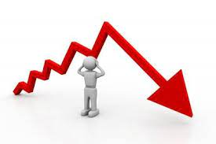
WELCOME TO IPS 2024
CYCLE REGENRATION DEFICIT ??
A CONCEALED
PROFIT EATER
By :-
Ritesh Agarwal, DGM (CenPEEP)
Rajeev Kumar, AGM(EEMG) , VSTPP

Slide 2

Entropy Generation…..Irreversibility …Reduced efficiency …in Real world
Consider A hypothetical situation ….. Tiny Tots Kids taught by IIT/ IIM Professor ?????
Where lies the fault ????
IIT/ IIM Prof has lots of knowledge & experience
Kids have come to study
Problem is that knowledge transfer occurs through very high gradient …….or knowledge difference…….
Therefore the teaching process itself becomes inefficient …irreversible and generates huge entropy
Kids need understanding, patient , caring teacher who can teach them slowly
IIM /IIT prof needs smart ,grown up , CAT / JEE qualified minds……….

Slide 3
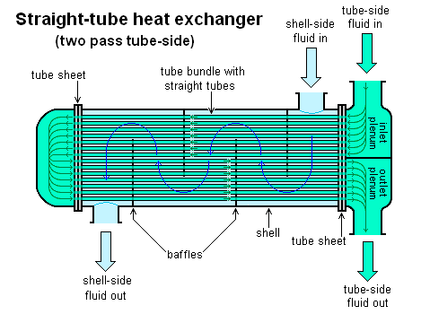
“…Feed Water Heaters of Stage-I……….!!!!”
Extraction Steam Inlet
Drip From Higher Heater (cascading)
Feed Water Inlet
Feed Water Outlet
Drip to lower heater
Basic Construction

Slide 4
BACK TO ENGINEERING COLLEGE
FIRST YEAR
THERMODYNAMICS CLASS

Slide 5
BASIC RANKINE V/s CARNOT CYCLE
Work Output of Rankine cycle (Red shaded area)
Heat rejected in condenser (Lower Rectangle)
Reference :- “Modern Power station Practise, Turbine & Aux .Vol. 3, CEGB, England ”

Slide 6
WHY ..Regenerative Feed heating ???.....
Blue shaded area (Reduced heat rejected in condenser ) > Red shaded area ( Reduced work output )
* As more & more steam is bled from turbine , work output from turbine is reduced but heat dumping in condenser is also reduced at higher rate. Bled steam is used fruitfully , for heating of feed water.
Reference :- “Modern Power station Practise, Turbine & Aux .Vol. 3, CEGB, England ”

Slide 7
7 STAGE FEED WATER HEATING SYSTEM
Blue shaded area (Reduced heat rejected in condenser ) >>>> Red shaded area ( Reduced work output )
Reference :- “Modern Power station Practise, Turbine & Aux .Vol. 3, CEGB, England ”

Slide 8
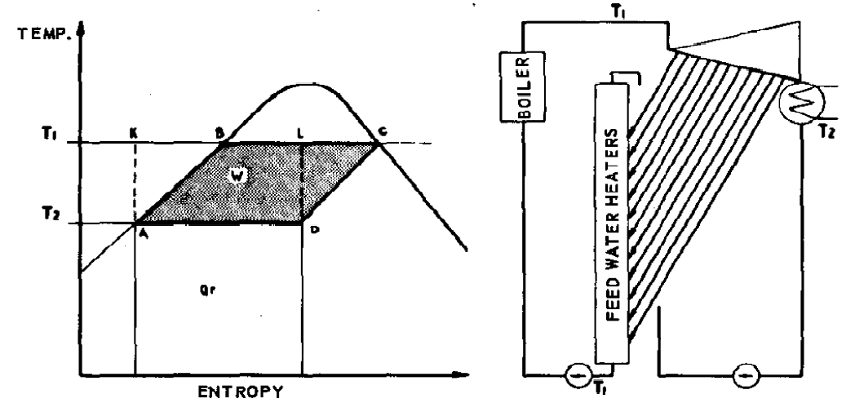
∞ STAGE FEED WATER HEATING SYSTEM
ABCD (Rankine cycle work ) = KADL (Carnot cycle work) { since AB // DC , ∴ △AKB= △DLC }
Reference :- “Modern Power station Practise, Turbine & Aux .Vol. 3, CEGB, England ”

Slide 9
CARNOTIZATION of Rankine Cycle ????...........
Ideal Carnot cycle
Maximum Efficiency (Greatest area of useful work between two temp)
Heating of feed water from condenser to boiling point is reversible isentropic process
Never occur unless temperature difference causing heat flow are (impossibly) kept at 0
Basic Rankine Cycle (No heaters , Entire feed water heat addition in boiler)
Temp Difference = (Hot Flue Gases - Incoming water ) >>>>>> 0 ∴ Highly Irreversible
As Number of Heaters increases in Rankine Cycle ……..
Energy Lost to the condenser reduction rate >>> Useful work area reduction rate ∴ η ↑
Carnotization of Rankine Cycle
As No of heaters -----> ∞ ……. Temp Difference = (Heating steam - Incoming water) -----> 0
Water heating process becomes reversible

Slide 10
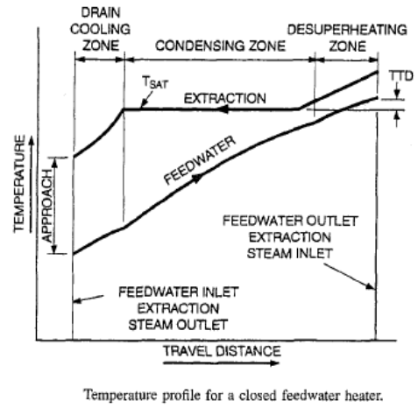
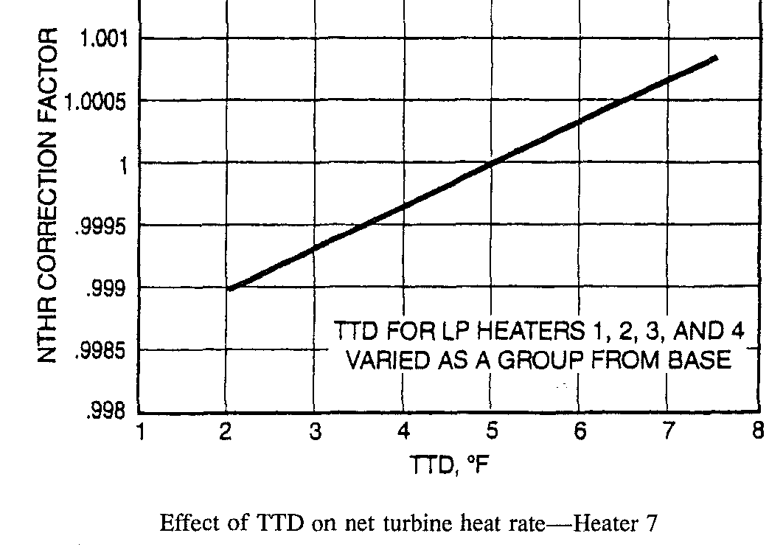
HEATER PERFORMANCE ASPECTS
Reference :- Power Plant Engg. By “Black & Veatch”

Slide 11
BACKGROUND…..INVISIBLE….PROFIT EATER
Every year during peak summers & rainy season , huge partial loss issues occur in stage-I
In spite of booking loss as per CC-OS circular (PCQ) , still some times, some quantum of power loss remains ……….with Challenge to book it under the right head…….
Proper identification of loss areas, is first step towards future improvement.
Why Invisible ??? …..Normal Macroscopic analysis considers almost no loss, if feed water temp after entire heater train, is matching design temp,as happens in case of stage–I. (Design/Actual= 247/246.1 ⁰C )
Microscopic analysis of feed water heater performance based on Efficiency Bible (“ A.B.Gill ”) was carried out
Point by point comparison of actual condensate/feed water /steam parameters with design parameters as per original Heat balance diagram of stage –I was done.
Attempt made to quantify heat rate loss , power loss ,financial loss due to off design operation of feed water heaters …….and diagnose its “Major Profit Eater” status .

Slide 12
SALIENT POINTS
Carnot cycle is ideal cycle in nature. By heat addition in small steps through feed water heaters , we are approaching “Carnotization” of Rankine cycle.
In nature, slow heat addition in small steps is always desirable as it leads to lower losses (entropy generation) in process.( Rather than entire heat addition in one go. )
Else we can remove all the heaters and entire heat addition can take place in single go in boiler but………... it will ultimately increase the coal consumption.
High Pressure steam is high grade energy with higher capacity to do work (higher availability) w.r.t low pressure steam
Temp rise by x ⁰C with low grade steam in LP Heater ≠ x ⁰ C Temp rise with high grade steam in HPH
D/A being contact feed water heater has 0 ⁰C TTD and high efficiency (large surface area)
Terminal Temperature difference (TTD) is a measure of resistance to heat transfer. ( TTD = sat temp corresponding to extraction steam pressure - Feed water o/l temp )

Slide 13
COMPARITIVE POINT WISE STUDY
OF
HBD
V/s
ACTUAL SITE SITUATION

Slide 14
Heat Balance Diagram of 210 MW Unit of Vindhyachal
Sustainability
Final FW Temp

Slide 15
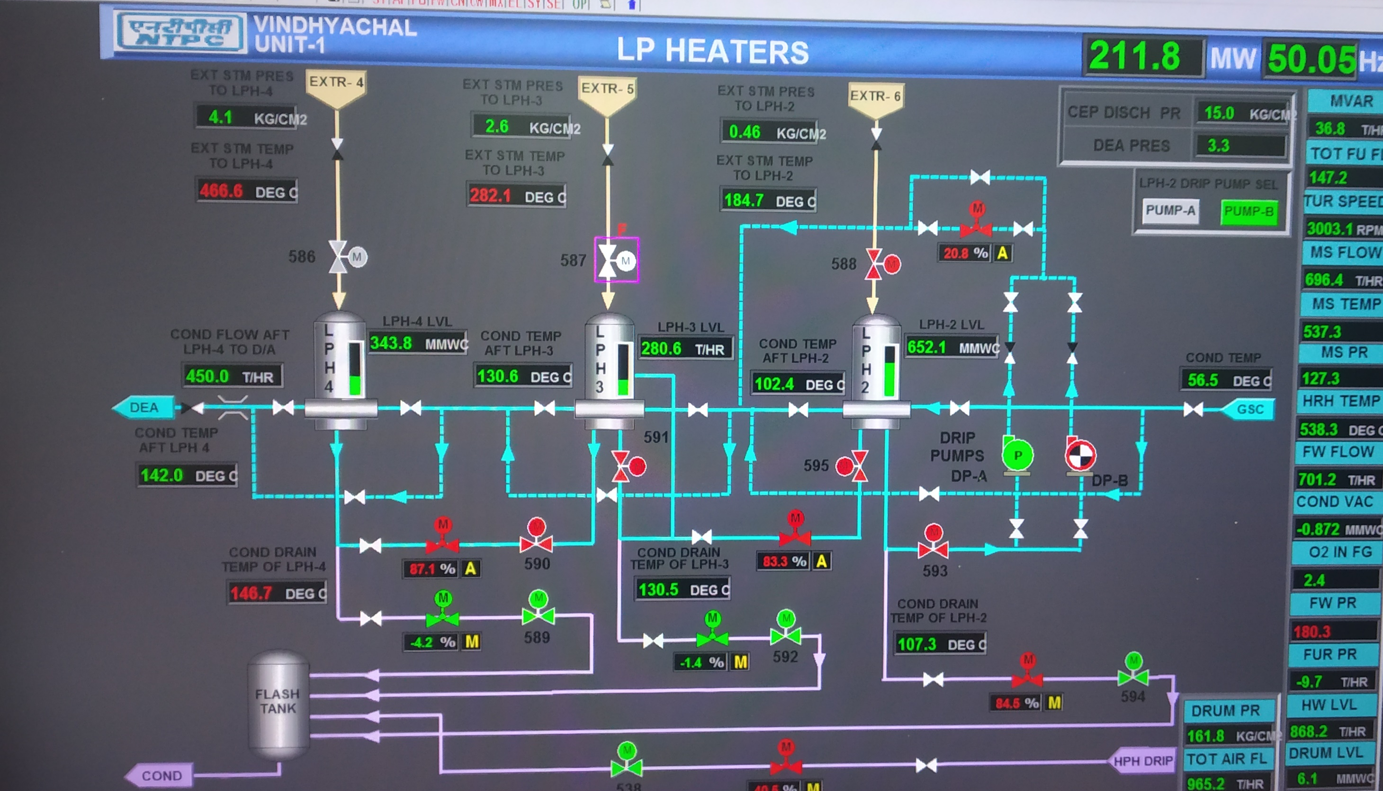

Slide 16
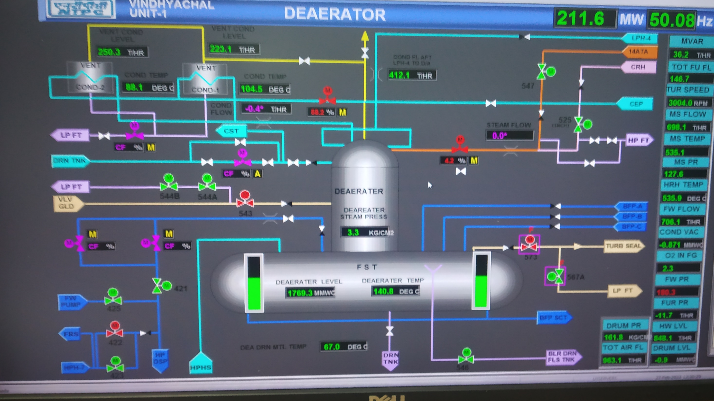

Slide 17
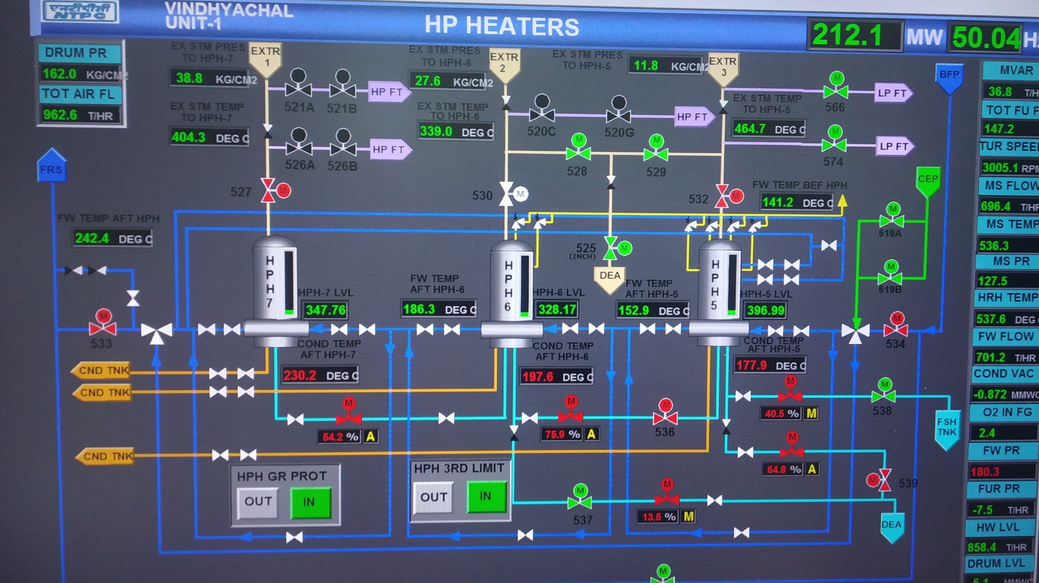

Slide 18
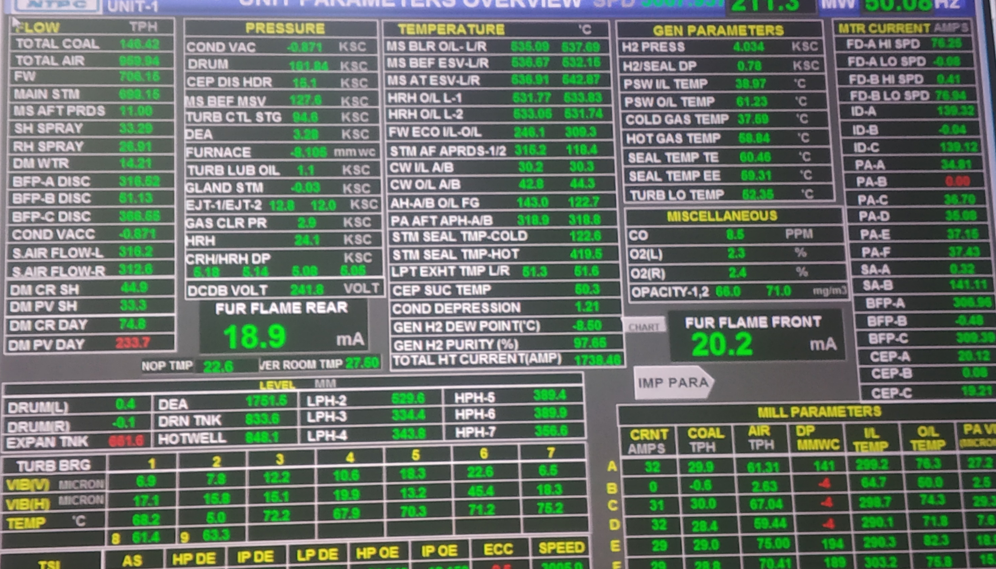

Slide 19
ACTUAL PARAMETER COMPARISON WITH HBD U#1
S.No | Point | Ideal Condensate/Feed water Temp as per HBD (⁰C) at outlet | Actual Condensate/Feed water Temp (⁰C) at Heater O/L | Temp Difference (⁰C) | Bleed Stage
1 | LPH-2 O/L | 100 | 102.6 | 2.6 | 23 rd Stage
2 | LPH-3 O/L | 129 | 130.5 | 1.5 | 21 st Stage
3 | LPH-4 O/L | 159 | 142.1 | -16.9 | 18 th Stage
4 | D/A O/L | 164 | 140.8 | -23.2 | Heating by HPH-5 drip
5 | HPH-5 O/L | 182 | 152.9 | -29.1 | 15 th Stage
6 | HPH-6 O/L | 225 | 186.4 | -38.6 | 12 th Stage/CRH
7 | HPH-7 O/L | 246 | 242.4 | -3.6 | 9 th Stage
21
56

Slide 20
REPORT DISCUSSION
Reference :- “Power Plant performance by A.B. Gill ” U.K, Drakelow Power stations

Slide 21
RECOMMENDATIONS & ACTION PLAN

Slide 22
RECOMMENDATIONS & ACTION PLAN

Slide 23
RECOMMENDATIONS & ACTION PLAN

Slide 24
HEATER TUBE PLUGGING DETAILS
S.No | Heater No | U#1 | U#2 | U#3 | U#4 | U#5 | U#6
1 | LPH-2 | NIL | 8 | 32 | 27 | 13 | 92
2 | LPH-3 | 29 | 3 | 10 | 4 | 8 | 9
3 | LPH-4 | 148 | 8 | 14 | 27 | 40 | 10
4 | HPH-5 | 1 | NIL | NIL | 1 | NIL | NIL
5 | HPH-6 | NIL | NIL | 1 | NIL | NIL | NIL
6 | HPH-7 | NIL | NIL | NIL | NIL | NIL | NIL
Reference :- “TMD Team Data”

Slide 25
FUTURE ROAD MAP …………Some Thoughts …
STAGE-I Heaters in their long journey of operation approximately for 31 years
…..May Have faced erosion , wear , tube thinning , damaged baffles , exfoliation (tube metal flaking off) , choking of venting line orifice ,deposition in steam space , water side deposits…………
Tube Plugging Status :- As per attached sheet (Maximum plugging in LPH -4 )
Last Water Side Cleaning :- ?
Last Steam side Cleaning :- ?
Last Shell Vent line orifice inspection for choking :- ?
Last DP measurement across water tubes :- ?

Slide 26
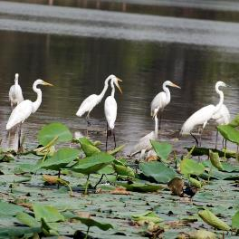

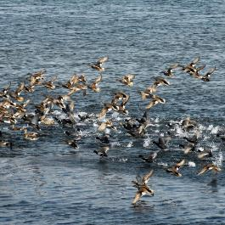
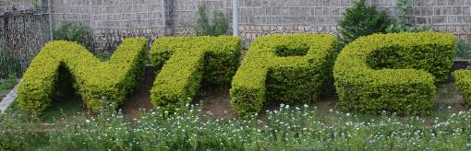
Thank You
NTPC Vindhyachal
Website: www.ntpc.co.in | Email: info@yoursite.com
Follow us on:
/ntpc1
/ntpcltd1
/ntpclimited
/Company/ntpc
/ntpclimited

