Slide 1
O&M Strategies for Cost Management
Rajkumar Natra (Analytics Practice Head, Fluentgrid Limited)

Slide 2
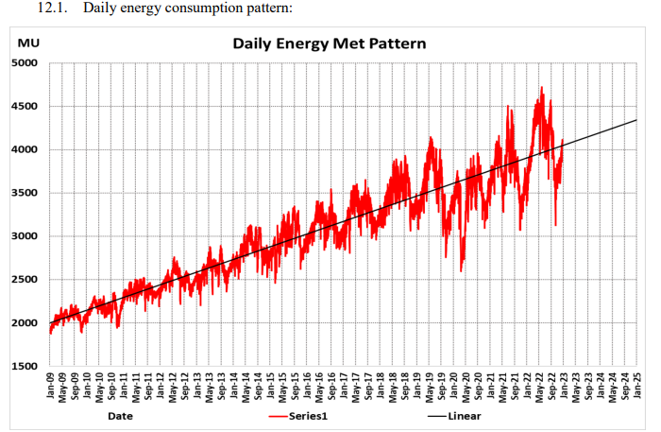
Introduction
The rapidly growing population and expanding industrialization in India have led to a substantial increase in energy demand(Figure-1), necessitating comprehensive strategies for sustainable and efficient energy production and consumption.
In this dynamic landscape of power generation in India, NTPC Ltd, stands as a key player, contributes 25% (Approx) of All India Energy demand of the country, continually seeks innovative approaches to optimize its operations.
NTPC's expansive network of power plants, comprising a mix of thermal and renewable energy sources, underscores the complexity of its operational landscape.
Plants faces the challenge of optimizing partial outages and resource allocation for effective cost management. The need for a proactive approach to O&M is imperative, particularly in the context of scheduling maintenance activities.
The Digitalization and integration of advanced analytics offers a promising avenue for improving the accuracy of forecasting of schedule generation and optimum coal stock enables better planning and scheduling of coal deliveries, optimizing the use of resources, and minimizing downtime with the actual operational needs of the thermal plant.
This paper discusses about pioneering initiatives undertaken at NTPC Ltd under the Project named “Advanced Data Analytics and Visualization Platform”
Figure-1

Slide 3
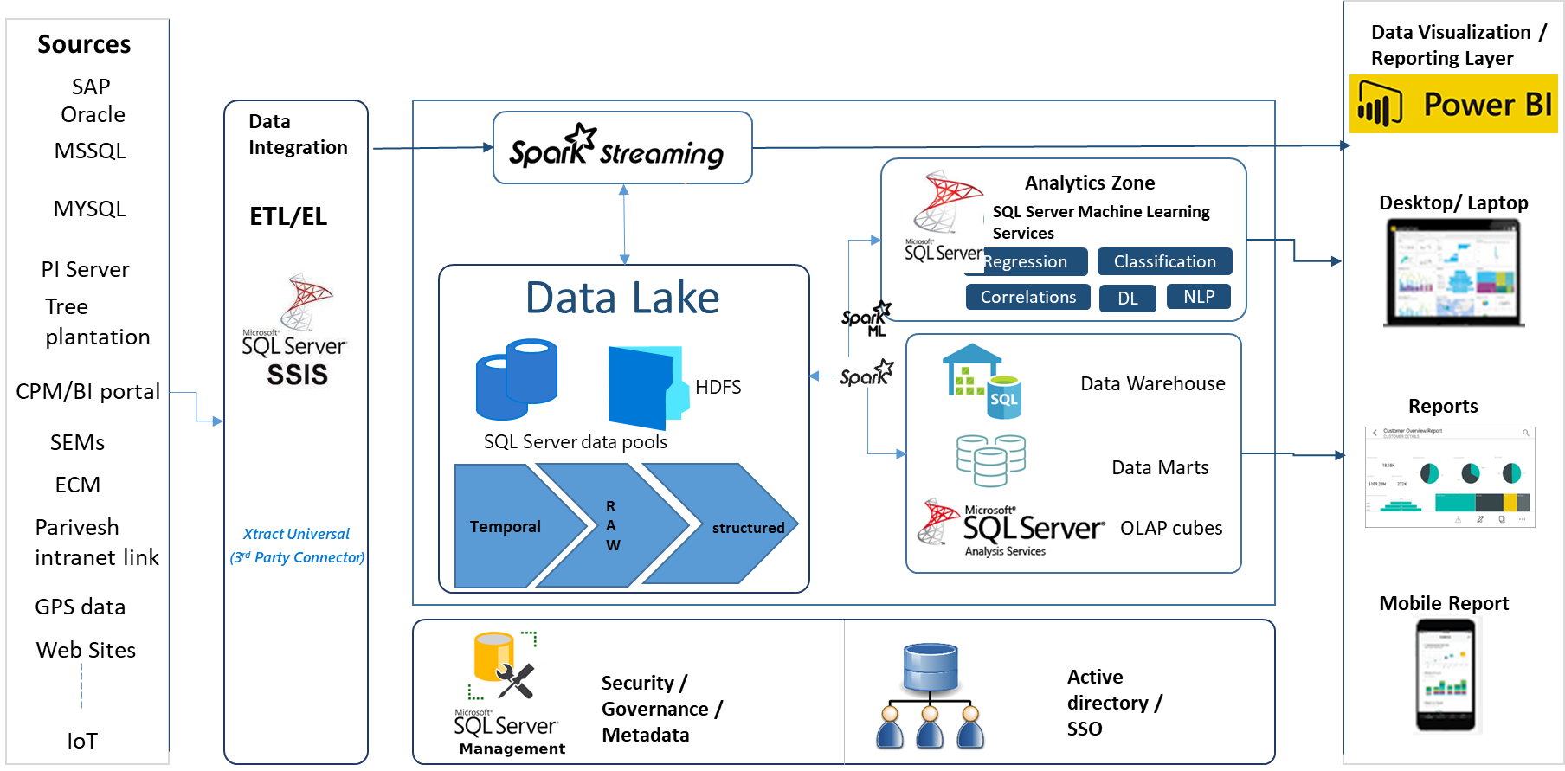
Advanced Data Analytics and Visualization Platform
Key components of this Platform:
1) Data Acquisition and Ingestion
Business Use case Definition
Data Source Identification
Data Integration of 18 Sources
Data Validation and Quality
2) Big Data Platform
Data Lake
Data Warehouse & Data Marts
Data Management
In-Memory Analysis(Cubes)
3) Data Visualization and Reporting
Data Discovery & Investigation
KPIs & Dashboards
Self‐service Analytics
Deviation Alerts
4) AI & ML – Advanced Analytics
Predictive Analytics
Augmented analytics
Correlation & Root cause analysis
Speech Recognition

Slide 4
Implementation Methodology
Fluentgrid follows below Steps for AI/ML Use Case Implementation:
1) Business Understanding
Understand the Problem Statement
Define the Clear Objectives and goals
2) Data Understanding
Data Collection
Univariate, Bivariate and Segmented
variate Analysis
3) Data Preparation
Handling Outliers
Handling Missing
Perform feature engineering to create
new meaningful features.
Split the data into training and testing
Sets with 80:20 ratio in most cases
4) Modeling
Select the Algorithm
Train the selected models
Optimize model hyperparameters
Validate the models
5) Model Evaluation
Evaluate model performance using appropriate metrics
Compare multiple models to select the best-performing one
Validate the model's robustness using cross-validation techniques
6) Model Deployment
Deployment in a production environment
Integrate to model into existing business Systems
7) Monitoring and Maintenance
Dashboard for monitoring the model's performance
Model retraining or updates with New data
Business Understanding
Data Understanding
Data Preparation
Modelling
Model Deployment
Monitoring and Maintenance
Model Evaluation

Slide 5
Problem Statement and Approach
Problem Statement: NTPC Generation Forecasts for Thermal Plants
Objective: Forecasting of Schedule Generation for each of the commercial stage of NTPC
Methodology:
Benefits:
By forecasting of SG, NTPC will know the demand of beneficiary in coming Mid-Term accordingly plan for the small Outages as well as resources
Based on the forecasting accuracy, various critical decisions can be taken. For Example, If beneficiaries not scheduled, NPTC can decide whether to RSD of Plants or able to decide how much generation can be sold out in the market
Phase1
Demand Forecasting at State level and All India
Phase2
RE Forecasting at State levels and All India
Phase3
NTPC Generation Forecasts

Slide 6
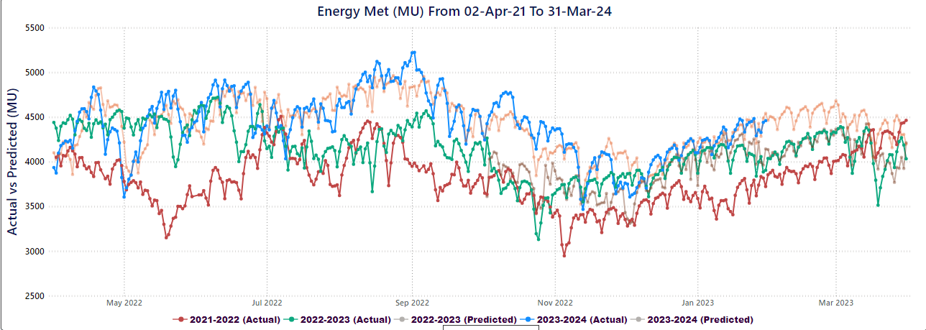
Phase1: Demand Forecasting for States and India level
Data Collection: Last 3 Years
Energy Met data of each of the state
Historical weather data from multiple locations in the state
State and National Holidays and events
GDP Growth data
Data Understanding: From the below Figure-2, it can be observed that data is Linear and Time Series
Figure-2

Slide 7
Phase1: Demand Forecasting for States and India level
Historical Data
for last 3 years
Model Training Pipeline:
As data is Linear and Time Series, we have considered the following Algorithms like:
Linear Models : Lasso, Ridge, Elasticnet
Time Series Models : SARIMAX, Prophet
Deep Learning Models : LSTM
This Pipeline gets the historical data from the data lake and applies the above algorithms and calculate the Model Metrics and stores in the ML Zone of Data lake. This pipeline can be seen in the Figure-3. This Pipeline runs for every month as part of Model Re-Training.
The Model Metrics of all the States will be given as Input and built the Hybrid Model for All India. The Figure-4, represents the Hybrid Models of this Framework
Model Training
Energy Met Data
Linear
ML Zone of Data Lake
Save the
Model Metrics
GDP
Prophet
Weather Data
Holiday Data
Ensemble
Figure-3
Lasso
Elasticnet
Prophet
LSTM
Best Model for AP
Best Model for Jharkhand
Best Model of State-N
Hybrid Model : an ensemble of all states
Figure-4

Slide 8
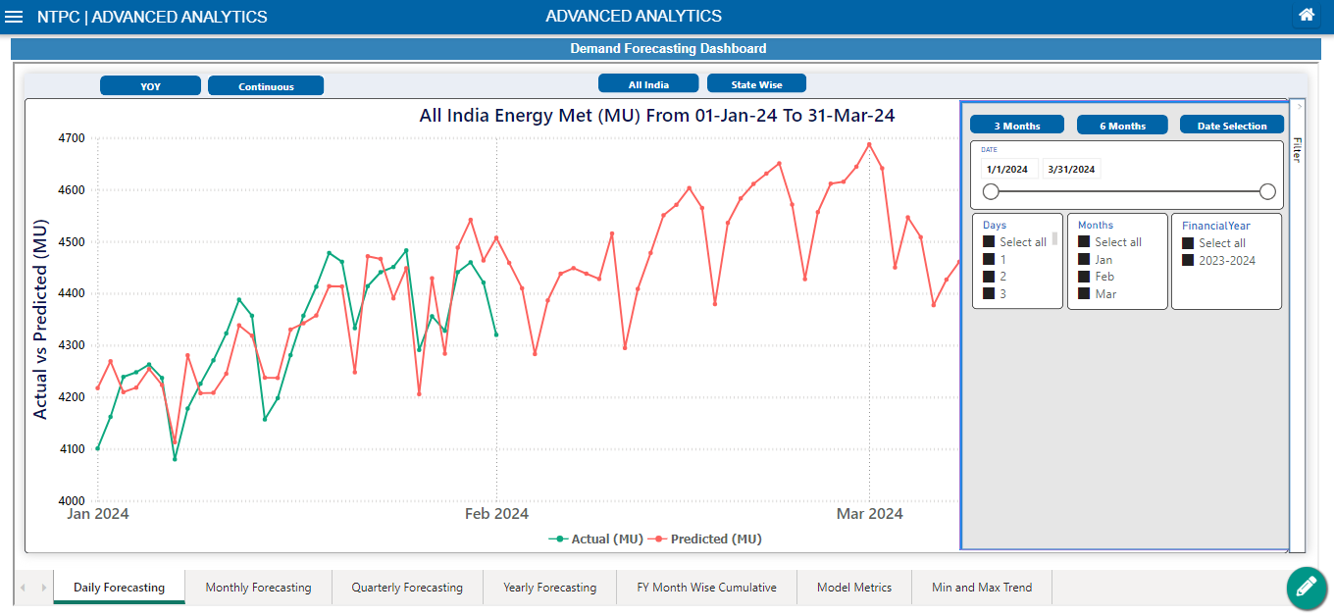
Phase1: Demand Forecasting for States and India level
Model Performance Metrics:
Model | RMSE
Elasticnet | 0.9
Prophet | 0.45
Hybrid | 0.25
LSTM | 0.7
Lasso | 0.5
Model Inference pipeline for Energy Forecasting
Demand Forecasting Dashboard
Future Data for Next 365days
Weather Data
Save the
Forecasted
Energy Demand
Data Lake
Cube
GDP
Holiday Data

Slide 9
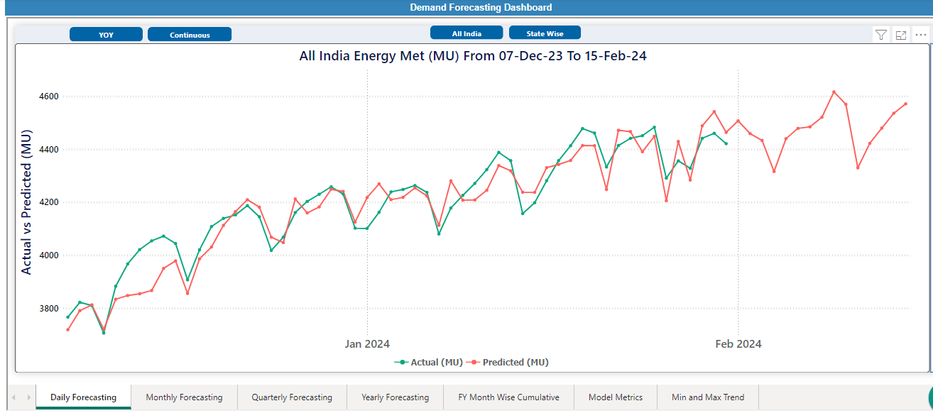
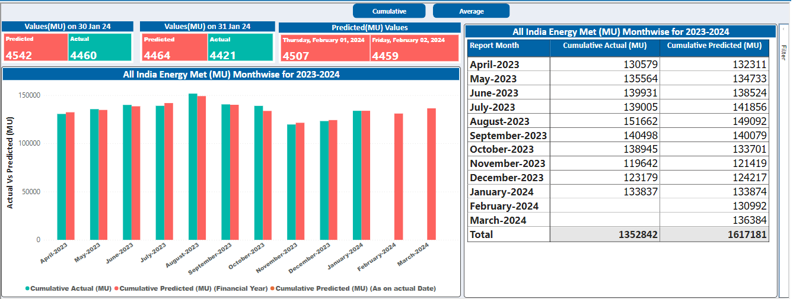
Phase1: Demand Forecasting for States and India level
Visualization:
Dashboard has following Features
All India/State wise
Daily/Monthly/Quarterly/Yearly
Min and Max Trends
Financial Year Month wise Cumulative
Model Metrics
Year to Year Comparison
Day wise comparision of Actual and Prediction
FY Monthwise Cumulative
Min and Max Trends of Financial Year

Slide 10
Phase2: Forecasting RE(Wind & Solar) for States and India level
Objective: Forecast RE Generation for each state for (Solar & Wind)
Datasets: Wind Parameters Solar Parameters:
Model Development:
As RE is Uncertainty, we have considered the below models and built the framework to select best Model with Performance Metrics
Non-Linear Regression Models : SVR
Ensemble Models : RF and XGBoost
Time Series : SARIMAX and Prophet
Deep Learning : LSTM and NARX
Humidity
Clouds
Temperature
Wind Speed
Wind Direction
pop
wind gust
dew point
Humidity
Clouds
Temperature
pop
Pressure
Sun Duration

Slide 11
Phase2: Forecasting RE(Wind & Solar) for States and India level
Model Metrics for Wind
Visualization of Wind
Model | RMSE
Prophet | 0.58
SVR | 0.77
XGBOOST | 0.32
RF | 0.96
SARIMAX | 0.87
Model Metrics for Solar
Visualization of Solar
Model | RMSE
Prophet | 0.35
SVR | 0.55
XGBOOST | 0.55
RF | 0.85
SARIMAX | 0.42

Slide 12
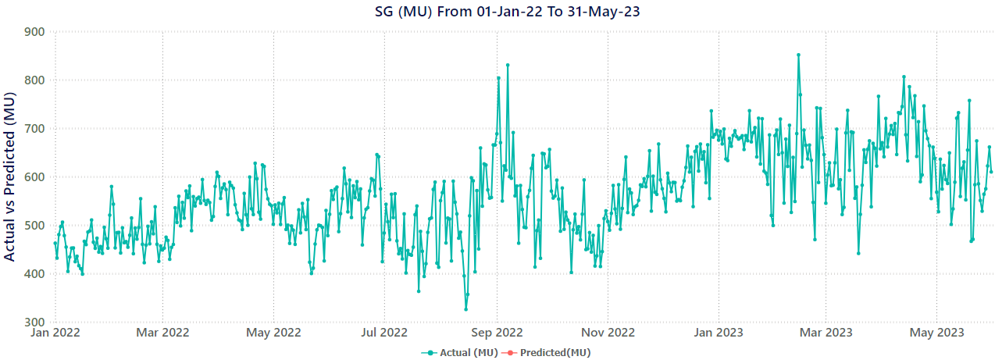
Phase3: NTPC Generations Forecasts
Datasets: Collected over the period of two years (2022-2023)
SG(MU)
DC(MU)
Allocation
Planned Outages
Energy Met for RE, Thermal and Others for state wise
ECR (Energy Charge Rate)
Data Understanding:
From the trend of Figure-5, it can be observed that data is Non-Linear
Figure-5

Slide 13
Phase3: NTPC Generations Forecasts
Model Training Pipeline:
The prediction variable is the SG for each plant, while the input variables include plant, DC, Allocation, ECR, Energy Met, RE. The dataset is partitioned into training and testing sets with an 80:20 ratio. Basing on the data, Multiple models are constructed which includes RF, SVR, XGBoost, and LSTM and stores the model metrics into data lake. This pipeline runs for every month as part of Model Retraining
Model Performance Metrics:
Model | RMSE
SVR | 1.90
XGBoost | 0.04
RF | 0.78
LSTM | 0.56
Historical Data for last2 years
Model Training
Energy Met
RE
RF
ML Zone of Data Lake
Save the
Model Metrics
ECR
Prophet
Share and Allocation
DC
LSTM

Slide 14
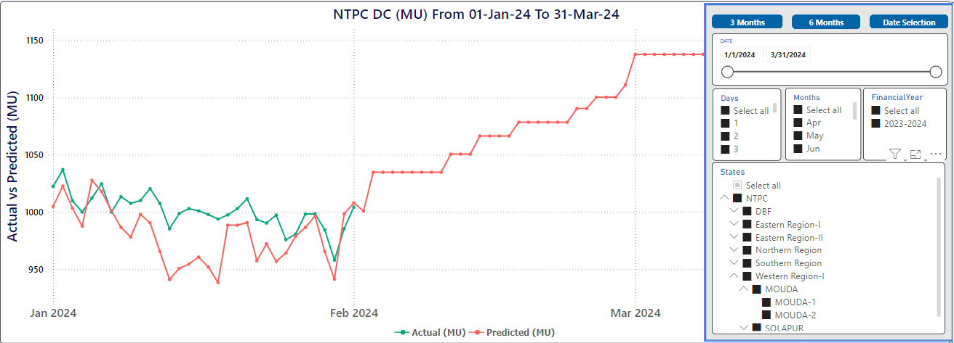
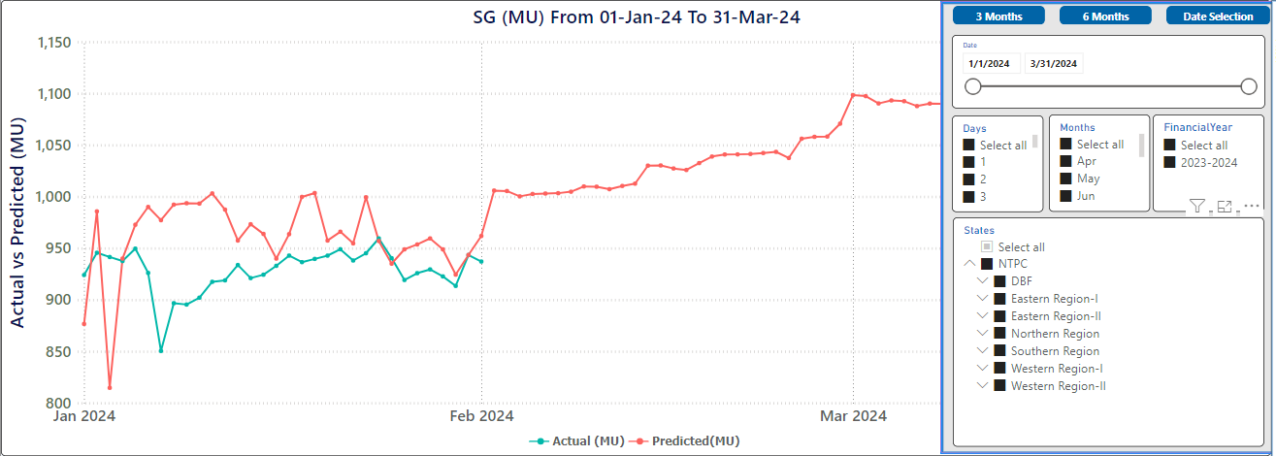
Phase3: NTPC Generations Forecasts
Model Inference pipeline for DC Forecasting
DC Forecasting Dashboard
Future Data for Current
Financial Year for DC
APC
Save the
Forecasted DC
data for each Stage
Data Lake
Cube
APC
FO + PO
Shut Down
Future Data for Current
Financial Year for SG
Model Inference pipeline for SG Forecasting
SG Forecasting Dashboard
Energy Forecast
RE Forecast
Save the
Forecasted SG Data per each Station
Data Lake
Cube
DC Forecast
ECR
Share
Allocation

Slide 15
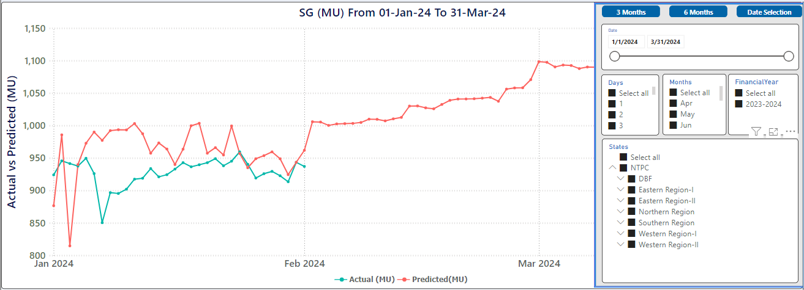
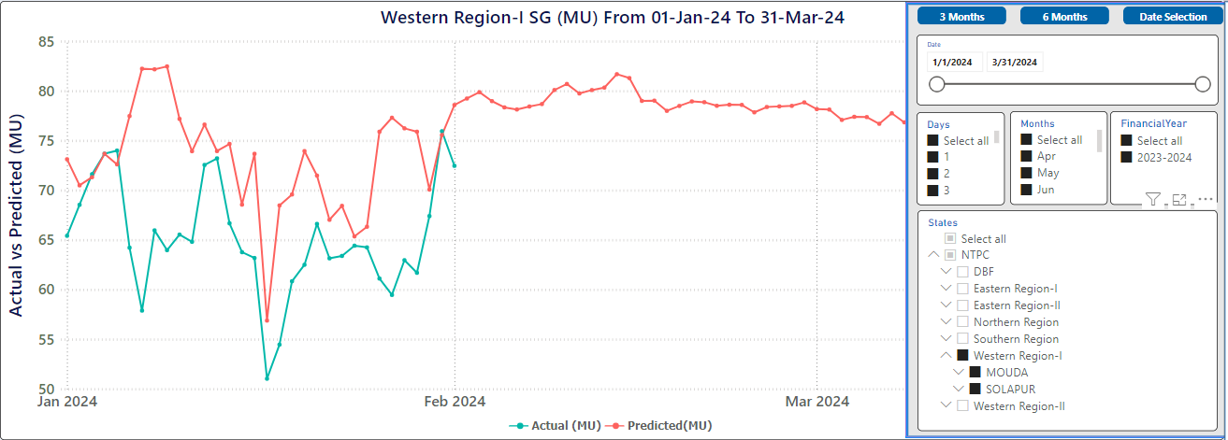
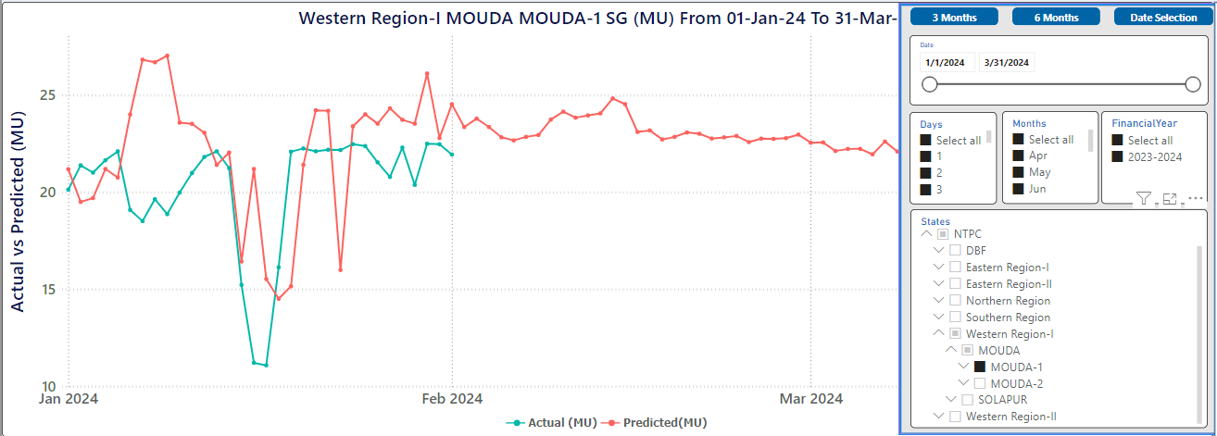
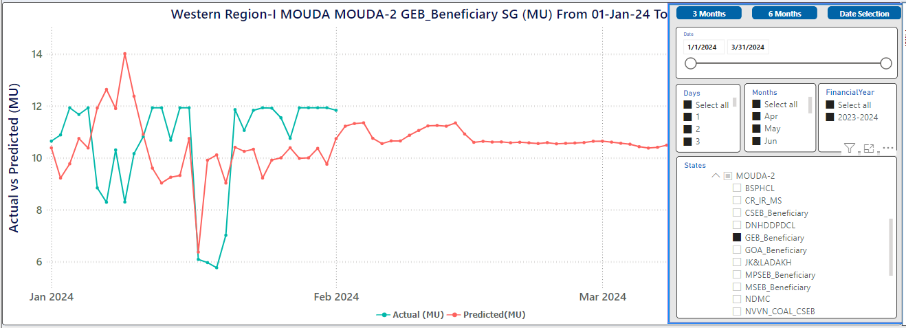
Phase3: NTPC Generations Forecasts
SG Actual Vs Forecast at NTPC Level
SG Actual Vs Forecast at Region Level
SG Actual Vs Forecast at Stage Level
SG Actual Vs Forecast at Beneficiary Level

Slide 16
Current Implementation: Optimum Coal Stock Prediction
Daily coal requirement for both Pithead and Non-Pithead plants would be estimated @85% PLF and number of days for which stock needs to be maintained would vary from 12 to 17 days for Pithead plants and 20 to 26 days for non-pithead plants with month-wise variation based on coal dispatch/coal consumption pattern.
The framework provides the configuration screen for end User to select the no. of days for coal required to available at for each Thermal plant.
The Specific Coal Consumption for SG for each plant will achieve by dividing the Specific Coal Consumption with APC in percentage.
The Coal Requirement in Million Tons will be calculated by multiplying the Specific Coal Consumption for SG with Forecasted SG (MU) and Number of days required.
No. of Days
(Pit Head/
Non-Pit Head)
Forecasted SG
Coal Requirement
(MT)
Optimum Coal Stock to be maintained
Specific Coal Consumption

Slide 17
Conclusion
The novel solution of implementing the machine learning models proves to be a transformative approach for forecasting the schedule generation and optimum coal stock required at NTPC Ltd.
Benefiting in planning the small Outages, RSD, Generation Sold out, Coal Maintenance & deliverables and resources which enhances the operational efficiency and cost management.
This Model is under Observation and implemented with retraining framework for improving accuracy.
The next phase is Block wise scheduling with providing maximum and minimum schedules which will provide insights and planning for stations to participate in different available platforms of power exchange

Slide 18
Question & Answer
Thank you

