Slide 1

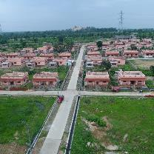
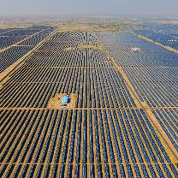
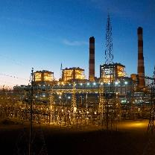
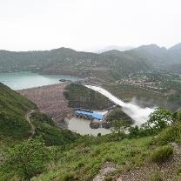
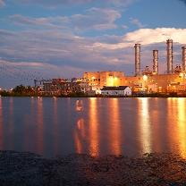
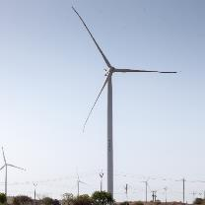
NTPC R&R Colony, Darlipali
NTPC Bhadla
NTPC Kudgi
Monitoring of Corrosion Products in Low-Oxygen Regime Water Cooled Synchronous Generators with Copper Hollow Conductors.
By- Dharmendra Dange, Madhur Sherawat
NTPC Dadri
NTPC Koldam
NTPC Kayamkulam
NTPC Rojmal
Follow us on:
/ntpc1
/ntpcltd1
/ntpclimited
/Company/ntpc
/ntpclimited

Slide 2
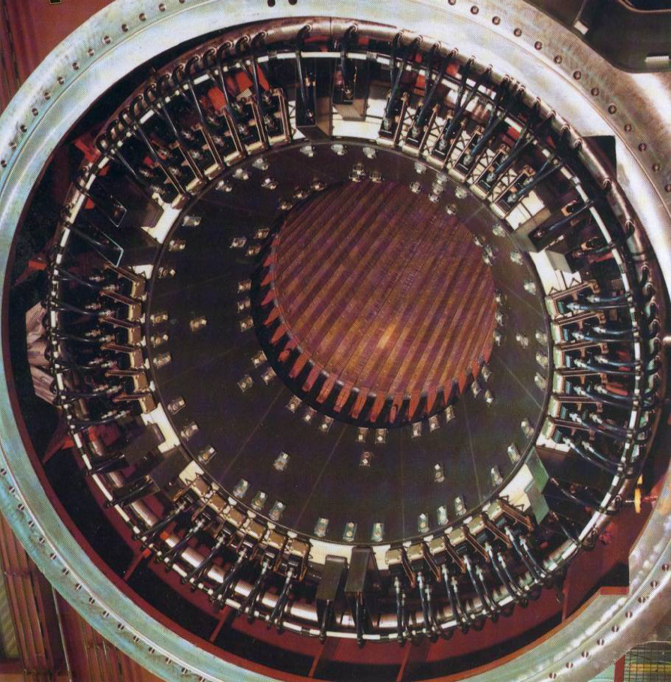
Agenda
Introduction
Corrosion & Plugging mechanism.
Low oxygen alkaline type water regime
Monitoring of corrosion products.
Addressing plugging.
Conclusion
References

Slide 3
INTRODUCTION

Slide 4
SYNCHRONOUS GENERATOR
The large synchronous generator uses:
-Direct DM water cooling for the stator winding,
phase connectors & bushings.
-Direct hydrogen cooling for the rotor winding.
-Iron losses, windage losses and stray losses,
are also dissipated through hydrogen.
Effective heat dissipation- to maintaining generator electric power output
Operational reliability -for safe, reliable & cost-effective power generation.
The name plate details of the generator under discussion is:
500MW, 588 MVA, 0.85 P.F. (Lag), 21 KV , 50 Hz.
Stator water flow: 64 m³/h, Stator water winding DP= 1.1 bar (design),
Type of water treatment: Low DO alkaline regime.

Slide 5
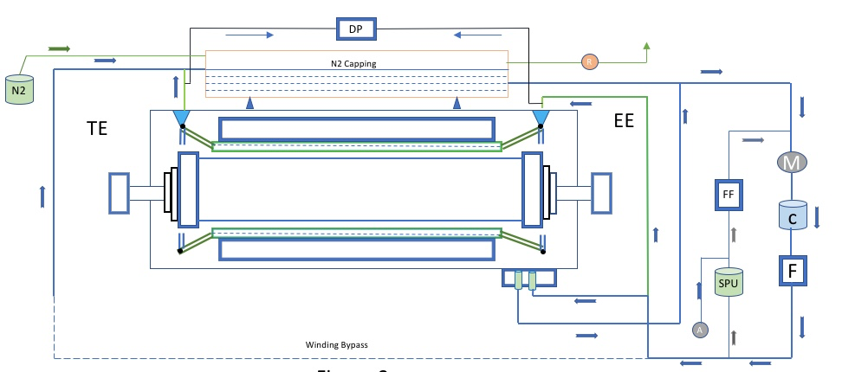
Stator winding cooling system
M-Motor pump set, C-Coolers, F-Filters, SPU-Ion exchanger, FF-Fine filter, A-Alkaliser,
DP- Winding DP transmitter, N2- Cylinder for N2 capping in stator water tank, R-N2 relief valve
Figure-1

Slide 6
Typical stator winding bar
For Direct water cooling:
Hollow conductors embedded
between the individual
solid copper conductors.
Refer figure-2
Hollow conductor size:
Height: 2.5mm
Width: 5mm
Length: 8100mm
Winding Bar
CU Solid strand
CU Hollow strand
Insulation
Equalizing Strip
Figure-2
The bar also have Roebel transposition throughout the length.
In slot portion: 540-degree transposition of strands
In end winding portion: transposition, bar ends short circuit
To reduce skin effect & to neutralize induced voltages.

Slide 7


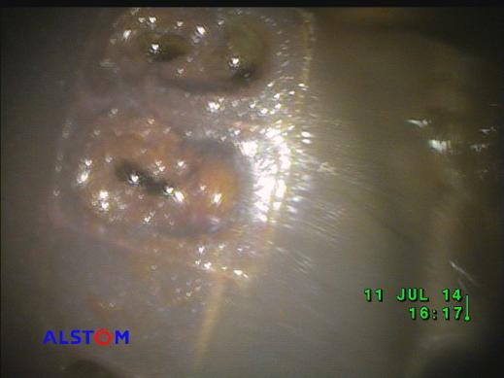





Background
Alarm- “500MW Generator slot temperature high”
-Observation: Alarm was actual.
-Load reduction up to 20 MW done to contain the slot temperature.
-Large sum of money i.e. in CRORES were spent to attend this problem.
Figure-3

Slide 8
Corrosion & Plugging mechanism

Slide 9

Key chemistry related problem
Stator windings of large generators are cooled by water circulating through hollow strands.
If these hollow conductors are of copper & stator cooling water contains oxygen, risk of plugging by copper oxide deposition is there which leading to a winding overheating.
(1) Oxidation of the Copper,
(2) Release of the Oxidized Copper,
(3) Transport of the Released Copper
(4) Re-deposition of the Migrating Copper
Plugging has affected practically all designs of all manufacturers and in all water chemistry regimes.
Figure-4

Slide 10
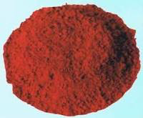
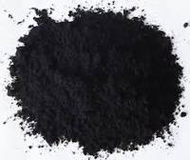
Corrosion & Plugging mechanism
Oxidation of the Copper
In low-oxygen systems :
cuprous oxide (Cu2O) will be formed.
In high-oxygen systems:
cupric oxide (CuO) will be formed.
Release of the oxidized Copper
Copper release is low both at very low oxygen & very high oxygen levels, also an increase in pH reduces copper release.
The copper is released from surfaces as dissolved copper ion (Cu+ and Cu++) particle or as colloid (CuO, Cu2O, and Cu).
Transport of the released Copper
Once the copper and its corrosion products (CuO, Cu2O) are released to the water, they migrate with the water flow
Re-deposition of the migrating Copper
Transport continues until either removal of products by the ion- exchanger and the filters or until it redeposits in the system.
Copper will be released the most where copper solubility is highest & be re-deposited where it is lowest.
Re-deposition of copper and oxide particles may take place by gravitational, centrifugal, field stress or other mechanical forces

Slide 11
Water chemistry options
Water treatment for permanent operation | Keeps oxidation low | Keeps release rate low
Low oxygen/ neutral | YES
Low oxygen/ alkaline | YES | YES
High oxygen/ neutral |  | YES
High oxygen/ alkaline |  | YES
Table-1

Slide 12
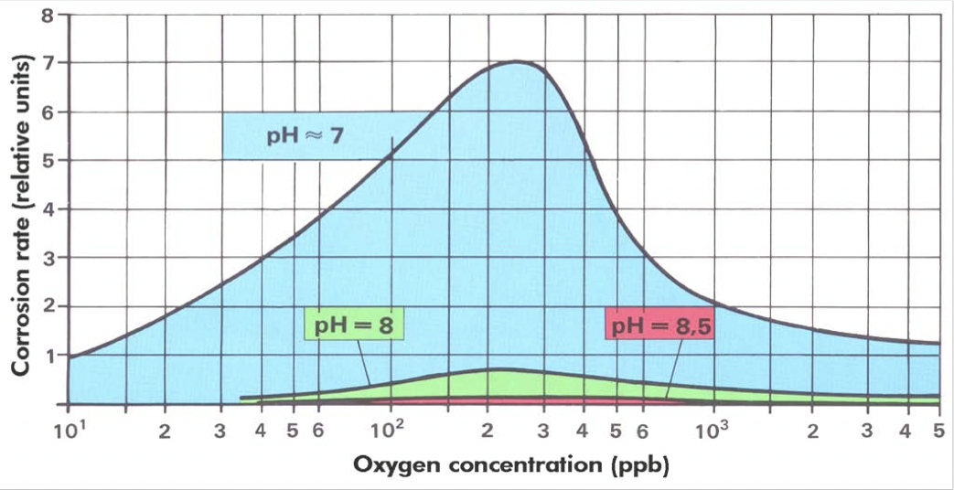
Why Low oxygen alkaline type water regime ?
Figure-5

Slide 13
Low oxygen alkaline type water regime
Designed with pure grade nitrogen capping provision.
- capping facilitates de-aeration and acts as a sealing from atmospheric air.
The low oxygen stator primary water is alkalized.
- to prevent flow blockage due to copper corrosion in water cooling windings.
Stator water polishing unit (SPU) is a mixed bed ion exchanger.
- used to remove any soluble and insoluble contaminants (Cu, Fe, CO2 etc.)
- maintain DM water conductivity within recommended range.
- SPU must be kept in continuous service at rated flow.
- replacement of the SPU resins is required when the conductivity downstream
of the ion exchanger is higher than in main circuit or rises to a value 0.5μmho/cm.
- The ion exchange resins used can be replaced while the generator is on load.

Slide 14
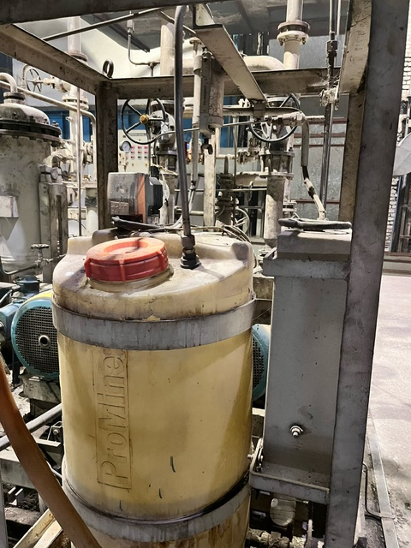
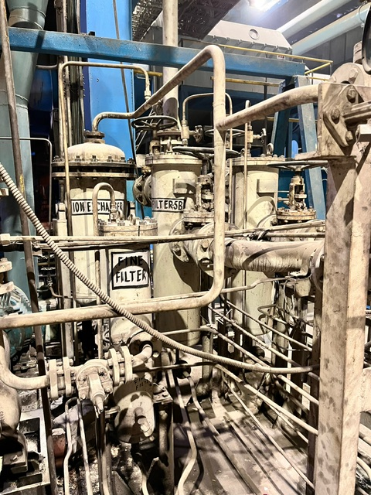
Alkaliser & Mixed bed ion exchanger
Alkaliser system
Mixed bed ion exchanger,
Figure-6
Figure-7

Slide 15
Copper flaking
In this regime, corrosion is inhibited by formation of passive layer of cuprous oxide (Cu₂O).
Copper flaking: occurs when copper oxides changes from Cuprous oxide (Cu₂O) to
Cupric oxide (CuO) or vice versa.
Stresses incurred during the transition cause the copper oxide to flake off.
The corrosion products:
- detached from the metal surfaces,
- deposit on the tube ends & also on inlet and outlet hoses of generator windings,
- resulting in flow rate restriction.
Despite defined chemistry regime:
- corrosion observed in generator with copper hollow conductors

Slide 16
Monitoring of corrosion products

Slide 17
Monitoring of key chemistry parameters
Conductivity | Online Monitoring of stator water conductivity to avoid loss of electric insulation.
pH | Periodic monitoring assures that water is in the correct range of chosen stator water regime.
Dissolved Oxygen | Online monitoring assures that water is in the correct range of chosen stator water regime.
Copper concentration | Periodic monitoring to monitor copper release.
Electrochemical potential | Online continuous monitoring. ECP indicates risk conditions for stator bar plugging.
Alkaliser sodium concentration | Periodic monitoring to confirm whether alkaliser works correctly.
Parameters | Normal value | Limit value
Conductivity | 1.8-2.0 μmho/cm | 2.0 μmho/cm
pH | 8.5 - 9
Na+ ion concentration | 25 to 250 ppb | 300 ppb
Cu concentration | < 5 ppb | 10 ppb
Fe concentration | < 5 ppb | 10 ppb

Slide 18
Monitoring of Generator Process variables
PROCESS VARIABLES
Reactive power (MVAR)
Stator water flow (dm3/sec)
Stator current (KA)
Terminal voltage (KV)
Stator winding DP (kg/cm²)
Cold gas temperature (°C )
Hot gas temperature (°C )
Winding inlet temperature (°C )
Winding outlet temperature (°C )
Stator water outlet
temperatures of the
winding bars.
influence
Winding RTD’s are embedded in the distributed uniformly winding over the three phase.
- Analyze temperature deviations.
- Differences in the temperature up to 5°C may be due to tolerances & mounting conditions.
- If temperature deviation observed, identify the root cause & original temperature restored.
- If there exists the danger of overheating, a corresponding load reduction to be made.

Slide 19
Monitoring of electrochemical potential
It is a voltage difference between a metal immersed in given environment
& an appropriate standard reference electrode.
All corrosion is electro-chemical in nature.
Corrosion activity has a measurable electro chemical potential (ECP).
Why Electro Chemical Potential ?
Monitoring DO levels alone does not provide an indication of the copper oxide state.
Variation in the corrosion potential of copper hollow conductor can occur while the
measured DO level maintains within limits.
-It provides real time monitoring.
-Allow the operators to take the necessary action
-Providing a valuable measurement tool.
Parameter | ECP normal operating values | ECP short term action level
Low oxygen regime | <223mV | >266mV

Slide 20
Addressing plugging of winding bars

Slide 21
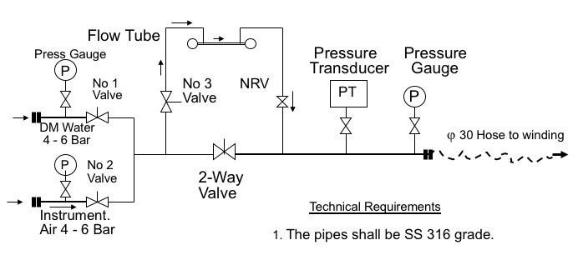
Air water flushing
Air water flushing method:
Visual inspection of stator winding bar water boxes by borescope.
Perform single bar flow Vs DP measurement.
Mechanical cleaning (Air water flushing).
Assessment of improvement & decision on further steps.
Function and performance assessment of installed equipment & processes (e.g. alkaliser, make-up water).
Assessment of piping and equipment condition by visual Inspection (borescope) including conical filter.
Optimize DP measurement to exclude conical filter.
The recommended flow through each bar is (minimum) 1 m3/Hr. (i.e. 1000 LPH) at a water inlet pressure of 4Kg/cm2.
Outcome of Air water flushing:-
-Winding DP reduced from 2.11 to 1.3 Kg/cm2
-Affected bar flow achieved < 1000 LPH
-Affected bar temperature reduced by 5°C.
Hence planned for chemical cleaning.

Slide 22
Cleaning with chelating chemical
Chemical cleaning a method which uses chelating chemical :
Chemical cleaning uses a chelating chemical that dissolves copper oxides without affecting the base copper. The copper oxide is removed together with the chelant through the mixed bed ion exchanger.
Alternative chemical treatments attack copper as well as oxides.
Application: Water-cooled generators with hollow copper conductors.
Can be applied- Online, Offline & For cleaning of Individual stator bars.
ONLINE | OFFLINE
During normal operation of generator | During shutdown of generator
Conductivity :max 9-20 μS/cm | Conductivity: up to 900 μS/cm
Takes 10-15 days | Takes 3-5 days

Slide 23
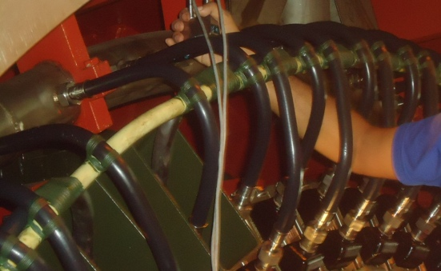
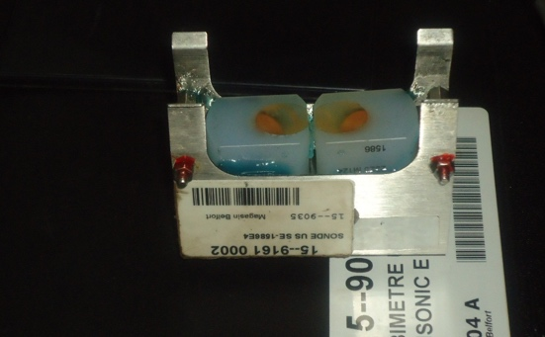
Offline cleaning with chelating chemical
Step-1: Winding bars doppler flow measurement.
Step-2: Winding bars flow comparison & identification of plugged bars.
Step-3: Visual inspection of winding bar water box through borescope.
Step-4: Single bar flow measurement & comparison with reference bar.
Step-5: Chemical cleaning of plugged bars with chelating chemicals.
Step-6: Flow measurement of each plugged bar & comparison with
reference bar.
Step-7: After getting desired results, winding bars connections to be
normalised & Makeup to be taken in the system as per procedure.
Step-8: Complete stator water system chemical cleaning to be done.
Step-9: After getting desired results, complete water system to be drained.
Step-10: Fresh makeup to be taken as per procedure.
Figure-8

Slide 24
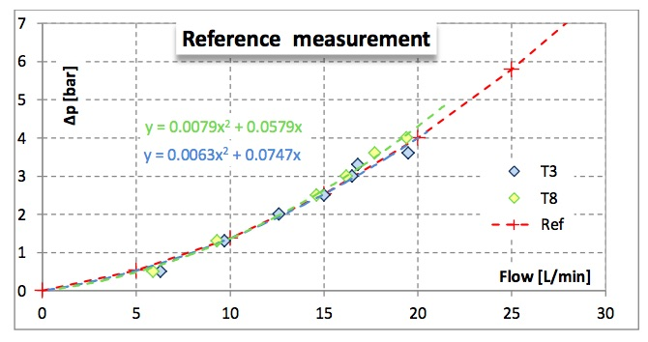
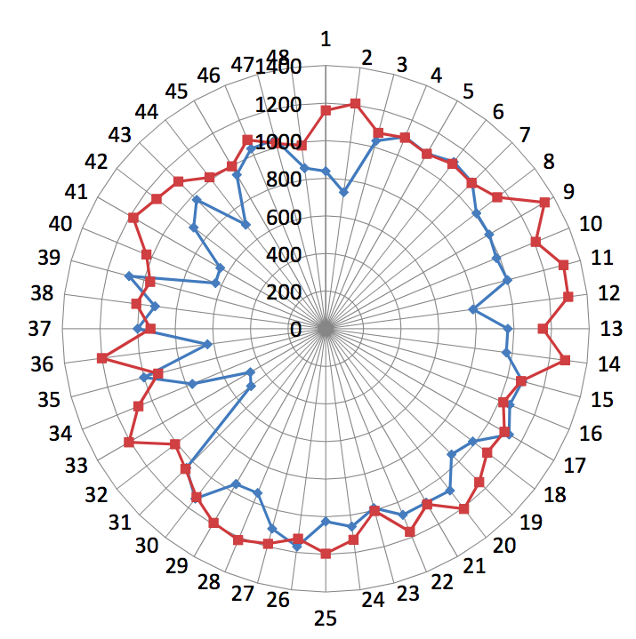
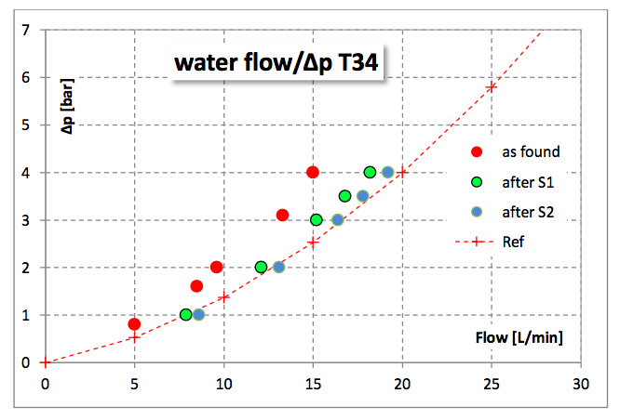
Doppler flow measurement of bars
Max flow= 1200 LPH =20 LPM
Min flow= 475 LPH = 8LPM
*Plugging observed in top bars..
Bottom bar
Top bar
Figure-9

Slide 25
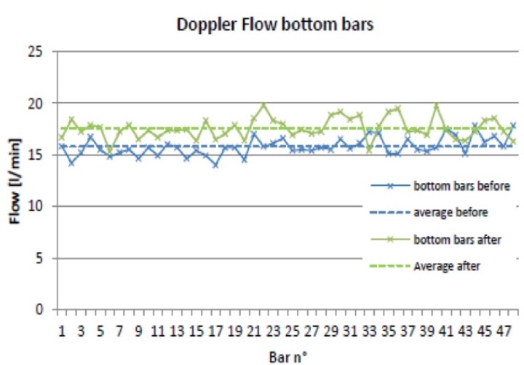
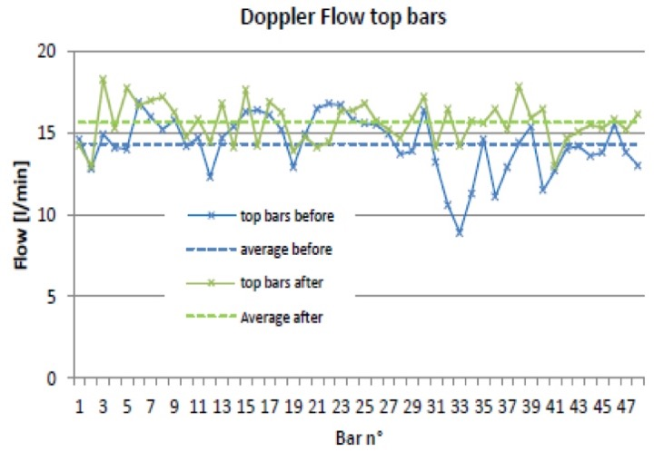
Outcome of winding bars cleaning
Figure-10
After chemical cleaning with chelating chemicals:
Flow through plugged bars increased.
Overall increase in Average flow in winding bars observed.

Slide 26
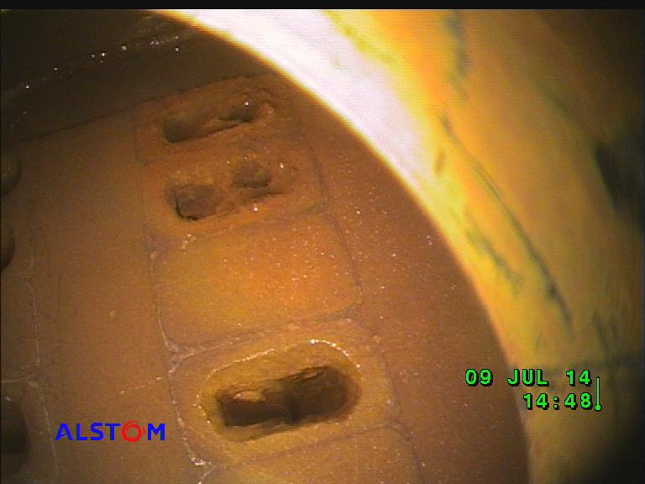
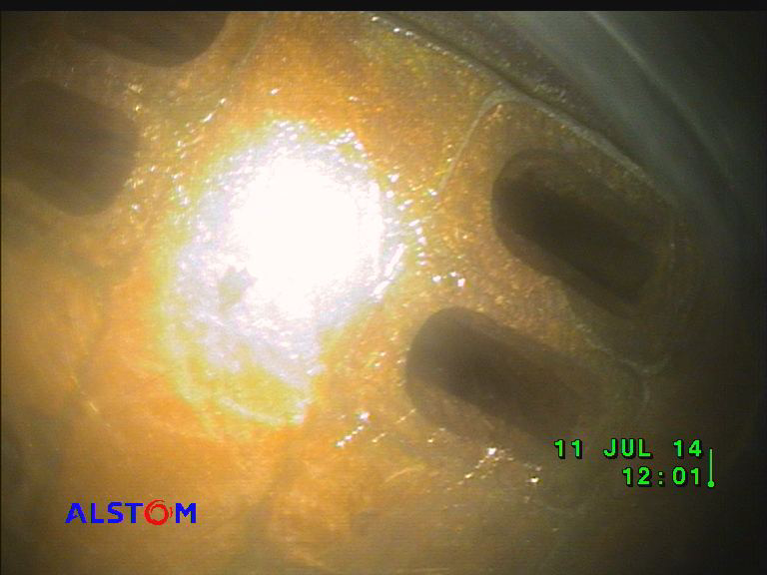
Borescope view of winding bar water box
Figure-11
Figure-12
Before cleaning
After cleaning

Slide 27
Plugged bars flow improvement
Figure-13

Slide 28
Conclusion
Effective heat dissipation from stator windings is very important to maintaining generator electric power output and winding performance.
Corrosion will impairing effective heat dissipation from stator windings of a generator.
Large sums of money are spent each year repairing the effects of, or preventing, corrosion.
A defined water chemistry regime if operated properly reduces corrosion & it’s after effects.
Despite defined chemistry regime, corrosion observed in generator with copper hollow conductors.
Based on condition of plugged hollow conductors, chemical cleaning using a chelating chemical may be planned, as it dissolves copper oxides without affecting the base copper & shall increase the flow through hollow copper conductors.
Monitoring of corrosion products will help in maintaining the operational reliability of the stator winding cooling system which is very important for safe, reliable & cost-effective power generation

Slide 29
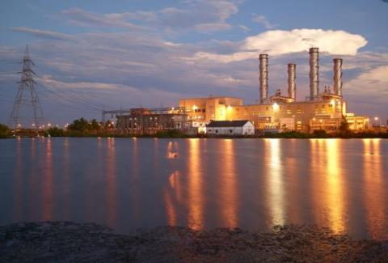
Thank you

Slide 30
References
Guide on Stator Water Chemistry Management, 2011. International Council on Large Electric Systems, Paris, France, CIGRE TB 480.
Svoboda, R., Interpretation of Stator Cooling Water Chemistry Data. Power Plant Chemistry 2018, 20 (2018) No. 3, 154.
Electrochemical Corrosion Potential (ECP) of Hollow Copper Strands in Water Cooled Generators, 2007. Electric Power Research Institute, Palo Alto, CA, U.S.A., EPRI 1006684.
ALSTOM India & ALSTOM Switzerland Generator services
O&M Manual, 1988, KWU, B.H.E.L. Haridwar, India.
Corrosion: Understanding the Basics (#06691G), ASM International. NACE International IMPACT Study.
Siemens India & Siemens Germany Generator O&M services BHEL Haridwar, India O&M services

