Slide 1
NTPC Welcomes You
At IPS 2024, Raipur

Slide 2
IPS 2024
Understanding LPT Last Stage Blade Failure Mechanism and Prevention Techniques Adopted by NTPC

Slide 3
Understanding LPT Last Stage Blade Failure Mechanism and Prevention Techniques Adopted by NTPC Pump premature failure analysis and Life enhancement in Flexible Operation regime
Mentor
Guide
Authors
VIKRAMJEET SAINI
SM (CC-OS)
SANJAY NANDAL
DGM (TMD)
BB PADHY
AGM (CC-OS)
FALGUNI HUI
AGM(CC-OS)

Slide 4
Presentation Outline
Steam Turbine Low Load – Industry Trends
Low Load Operation-What exactly happens in LPT Turbine
Low Load Operation – Effects on L-0 Blades Integrity & Failure Mechanisms
NTPC Strategies to mitigate L0 Blade Failures

Slide 5
Safety Message – L-0 Blade Reliability/Operability Impacts
Steam Turbine Damage Scenarios
Generation Loss
LP Turbine Bearing Damage
Fire Damages (lube oil system and Hydrogen)
Steam Turbine Operation
Excessive Lateral Vibrations
High Bearing Temperature
Condenser Level Increase
Unexpected Trips
Secondary Damages

Slide 6
Steam Turbine Low Load – Industry Trends

Slide 7
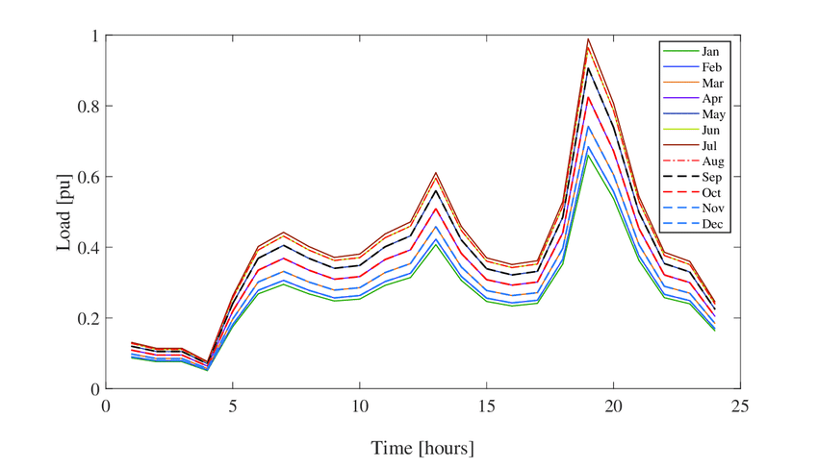
Steam Turbine Low Load – Trends (Coal Units)
Extended low load operation has been part of the flexible operation profile

Slide 8
Low Pressure Steam Turbine - Low Load Operation

Slide 9
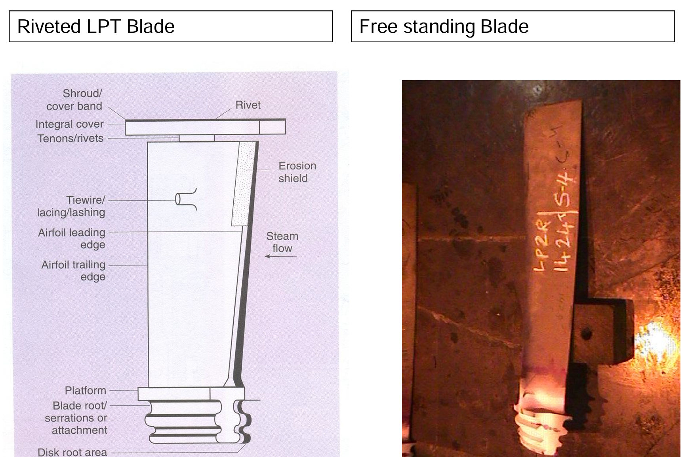
Introduction to LPT Last Stage Blade
Longer length last stage blades can reduce exhaust losses
at high flow conditions by increasing the exhaust annulus
flow area which reduces flow velocity and the associated
kinetic energy losses. In pursuit of improved efficiency,
vendors continue to push the limits of blade length.
Last stage blade length is typically a compromise
between managing exhaust losses over the range
of operating conditions expected (steam flows and condenser
pressures) and managing blade stresses and potentially damaging
vibration which increase with blade length.
A typical 500 MW LP Rotor last stage material is X10CrNiMoV1222 and length upto 975mm.

Slide 10
Low Load Operation
Thermodynamic Changes
Stage Pressure Ratio Changes
Phase Transition Zone Changes
Latter Stages Flow Pattern Changes
LP Exhaust Windage Heating
Moisture Generation and Growth
Start- up/Shut- down
Sub-Cycle Operation
Minimum Load

Slide 11
Effects on L-0 Blades Integrity & Failure Mechanisms

Slide 12
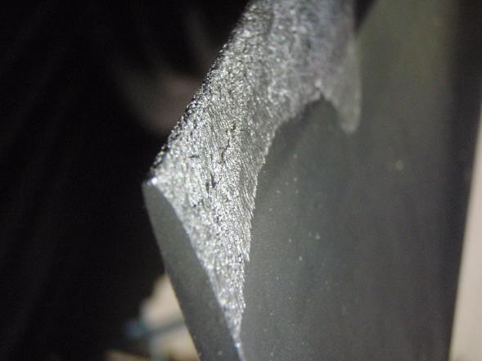
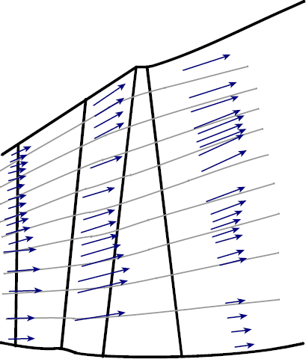
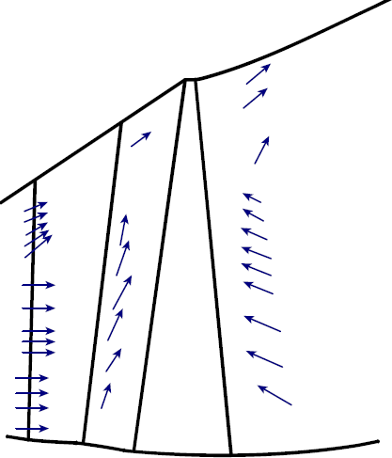
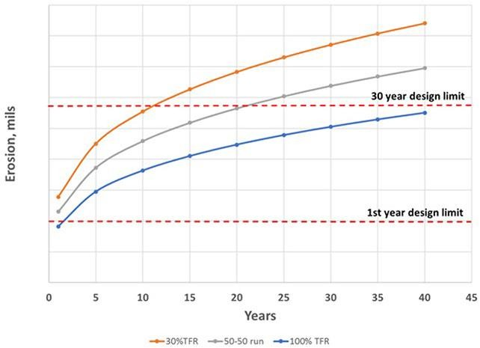
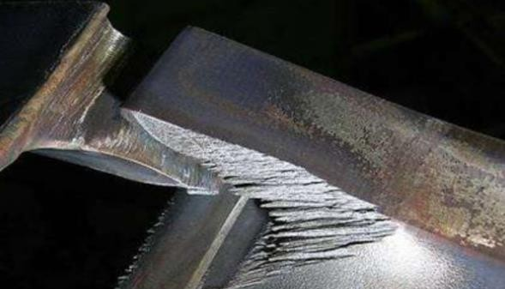
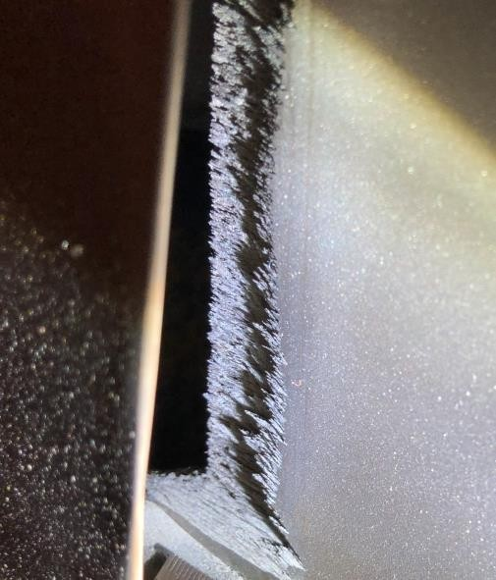
Effects on L-0 Blades Integrity
Droplet Erosion – Leading Edges
Full Load
Low Load Predicted erosion rate for baseload and various levels of part load
Reheat steam conditions and condenser pressure, will influence the level of moisture, steam density, and, ultimately, droplet size and velocity, which can accelerate the rate of leading-edge erosion
Steam flow pattern at low loads => vortices, larger droplets migrate towards blade tip
LSB droplet erosion damage – blade leading edge and tip, and damping elements
Failure of interlocking elements => change in blade row damping characteristics and dynamic response/natural frequency => potential for HCF damage

Slide 13
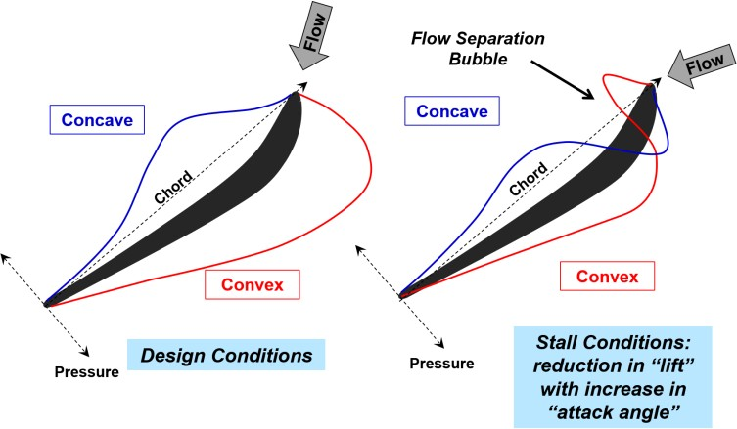
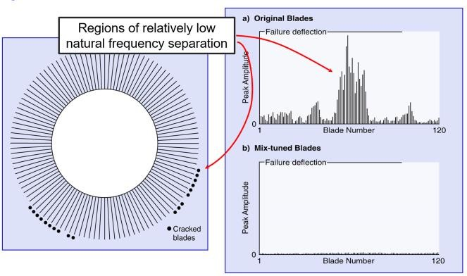
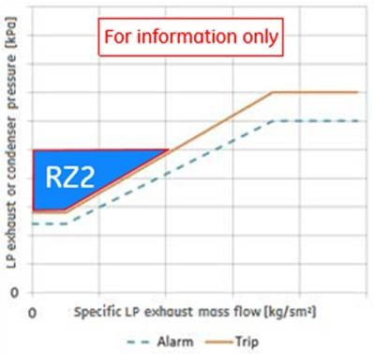
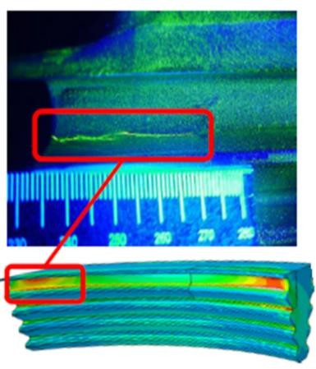
Effects on L-0 Blades Integrity
Aerodynamic Instabilities
L-0 blades - designed to operate efficiently for specific ranges of flow conditions (load and backpressure).
Certain combinations of low steam flows and exhaust conditions could result in aerodynamic instabilities and high nonsynchronous blade vibration - operation with elevated backpressures, or low steam flow and low backpressure.
Three principal mechanisms that cause the high alternating stresses under the low mass flow conditions:
unsteady flow field conditions of the reverse flow
buffeting - self-excited vibrations resulting from interaction between the flow boundary layer on the airfoil suction side and compression shocks at transonic flow conditions
the rotating stall - forced vibrations caused by subsynchronous rotational frequency of the stall cells that produces stimulus at non-integer harmonics of shaft speed
Contributing factors:
Exhaust hood design and configuration
Low aerodynamic damping due to low steam density
Low pressure steam are more sensitive to small changes in pressure
L-0 blades - relatively low frequency vibration modes that can be excited at low load conditions

Slide 14
Characteristics of Loading on LP Blading
LP turbine blades are exposed to:
Steady and unsteady mechanical loads.
Environmental conditions that can cause or contribute to material degradation.
Later-stage LP blades typically have higher
Steady loads: centrifugal load and steam bending loads
Higher dynamic loads: steam flow dynamics or torsional vibration of the rotor
Low thermally induced stresses.

Slide 15
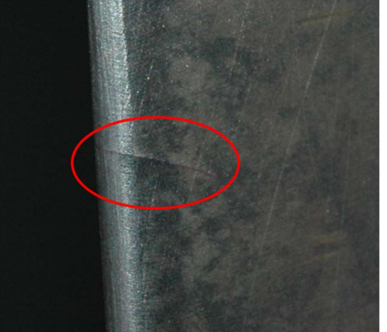
L0 Blade Damage
In recent times, major damages on LP blades/rotor noticed in following area
At aerofoil trailing edge around 300 mm below tip
Crack in LP rotor fir root.
Near Blade root
At airfoil area (Below 350 mm from Tip)

Slide 16
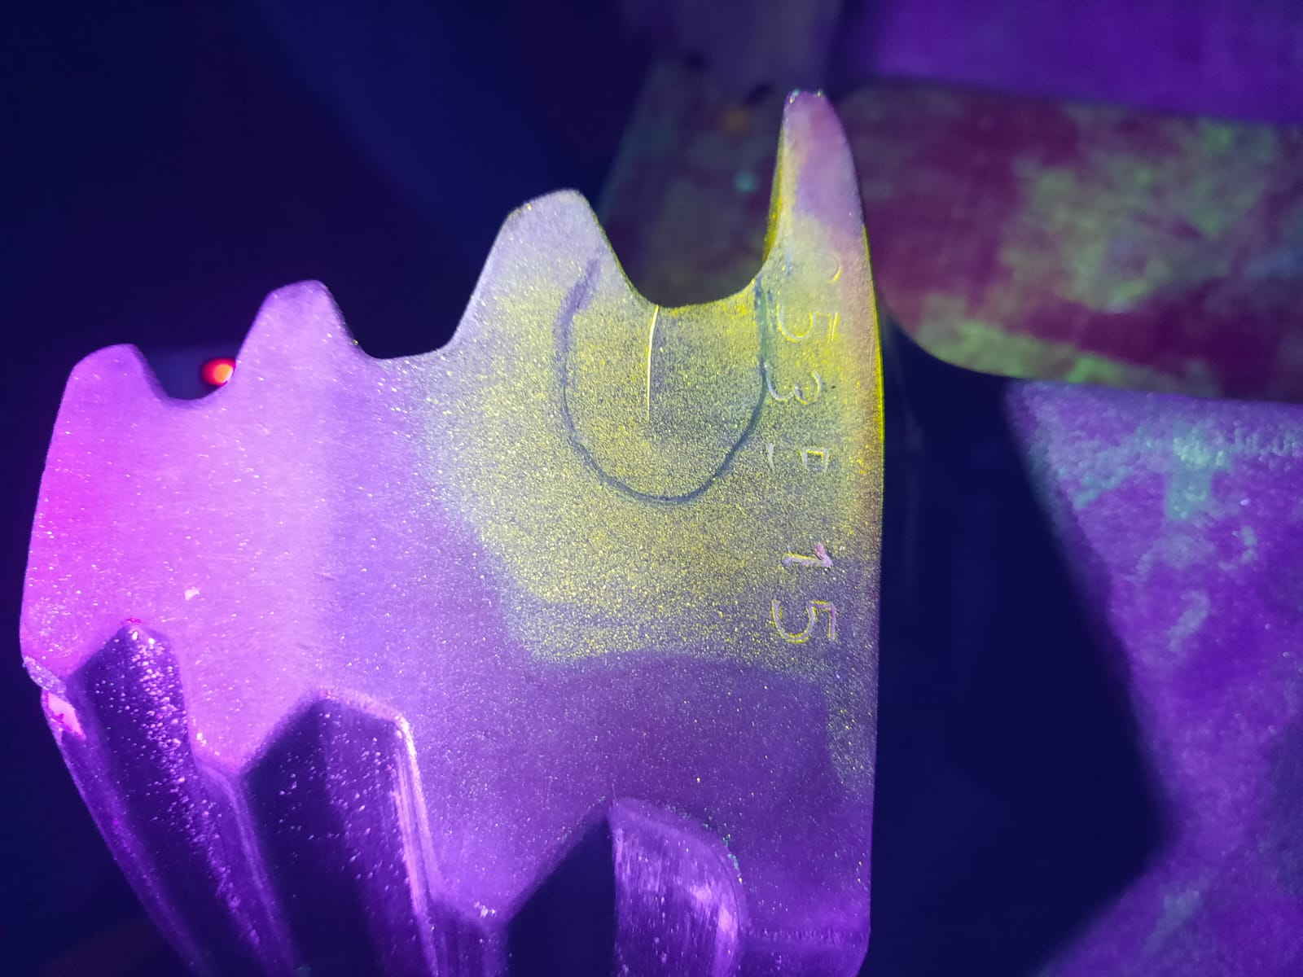
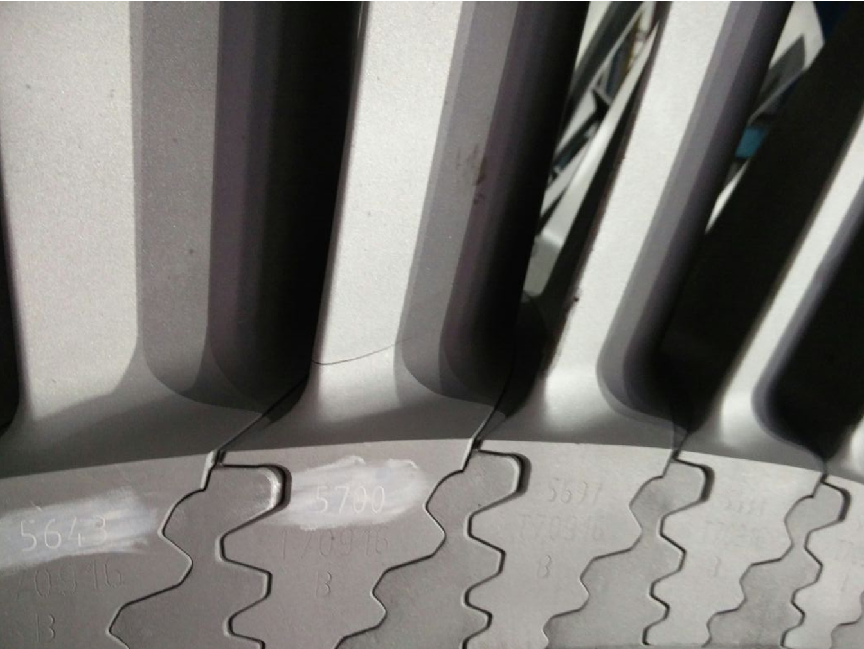
L0 Blade Damage
At Fir root area
At the base of the airfoil trailing edge

Slide 17
Possible Mechanisms of L-0 Blade Failure
Failure Mechanisms:
Mechanical Modes
– Fatigue
o High Cycle Fatigue (HCF)
o Low Cycle Fatigue (LCF)
– Fretting
Environmentally-assisted Modes
– Droplet Erosion
o Moisture Impact Erosion
o Trailing Edge Erosion
– Corrosion Fatigue
– Pitting
– Stress Corrosion Cracking

Slide 18
Failure Analysis at NTPC Level
Analysis of Failure:-
Detailed analysis of above failure was carried out with help of OED/OEM like M/s Siemens, M/s BHEL.
EPRI was also consulted for analysis of failure.
Tests were conducted as measurements on both free (loose) blades (New Blade set) as well as blades (set with
cracked blade) installed by the manufacturer on a new spare low- pressure (LP) rotor.
This provided an opportunity to consider individual blades and the combined effects of blade and steeple variability.
The following tests were conducted during the analysis by these agencies:-
Mass and Center of Gravity (CG) :- The summary data show relatively low values for percent standard deviation on mass and CG location. The mass values are essentially identical while the CG values are within 0.6%.
Natural Frequencies Testing : The individual blade natural frequencies were measured on a foam pad. This is also known as a free-free support. The natural frequencies were determined by striking the blade and monitoring the response using accelerometers mounted on the blade.
NTPC provided data to EPRI on measured natural frequencies for these same blades after installation on the rotor by the turbine manufacturer. In the data provided, measured frequencies were only listed for the first two blade modes. The BHEL tests used fixed-blade roots so that the blade vibrates as a cantilever beam.

Slide 19
Failure Analysis
Material Hardness: The blade hardness was obtained using a test device that allows the user to acquire multiple measurements and then calculate a mean value and the standard deviation for each blade.
Metallography:- Blades were examined for chemistry by a portable laser-induced breakdown spectroscopy (LIBS) system and were found to be representative of the M152 alloy, also referred to as X10CrNiMoV1222.
The fractographic and metallurgical examination provide no significant contributing factor to high-cycle fatigue crack initiation, there is no feature or material anomaly consistently present near the crack-initiation sites of all three blades that could be considered as a factor in the root cause of the blade cracking.
The root cause of failure might be SCC and fluttering of blades which lead to failure/crack.

Slide 20
NTPC Strategies to mitigate LPT-Last Stage Blade Failures

Slide 21
NTPC Strategies to mitigate L0 Blade Failures
Shot peening & Detuning of the last stage blades (3L & 3R) with a minimum frequency difference of 0.4 Hz.
In-situ Inspection of LPT every 2/4 years using NFT, PAUT, MPI and DPT checks.
Change in Area clearance and chord Angle measurement of free-standing stage blade.
Installation of online BVMS sensors for last-stage blades for online monitoring of blade healthiness (under implementation).
Implementation of Vacuum (Back Pressure) Limitation Curve.
Turbogenerator Instant Tripping on 2/14 Bearing Vibration High Logic.
Periodic operational data review to identify any abnormal operation outside of the operational envelope recommended by the manufacturer.

Slide 22
Summary
Stage Performance Changes
Detuning of L0 Blades
Droplet Erosion –
L-0 Leading Edge and Damping Elements
Lower Mass Steam Flow
Moisture Formation Changes
NFT
MPI
PAUT
DPT
Low Load
Droplet Erosion –
L-0 Trailing Edge
Thermodynamic Changes
Steam Flow Vortices
Reverse Exhaust Steam Flow
L-0 Blade Aerodynamic Instabilities (Flutter)
L0-Blade Vibration Monitoring System
Steam Flow Pattern Changes
Windage Heating
L-0 Blade Material Creep/ Excessive Differential Expansion/Rubs
Operational Vacuum Conditions & Trip Logics
Excessive Exhaust Hood Spray
NTPC’s aiming towards zero Blade Failure

Slide 23
Additional References
Low Pressure Steam Turbine Latter Stage Blades: Reliability Considerations and Risk Mitigation.
EPRI, Palo Alto, CA: 2017. 3002008574.
Steam Turbine Low-Load Operation. EPRI, Palo Alto, CA: 2019. 3002013589.
Steam Turbine Flexible Operations Update. EPRI, Palo Alto, CA: 2020. 3002019309
HRSG–Steam Turbine Interactions: An Interdependence Study. EPRI, Palo Alto, CA: 2020.
3002016242.
Last Stage Blade Erosion Investigation. EPRI, Palo Alto, CA: 2021. 3002018670.
Low Pressure Turbine Last Stage Blades – Roadmap to Managing Erosion Damage. EPRI, Palo
Alto, CA: 2021. 3002021593.

Slide 24
“Striving towards Zero-Blade Failures”
Thank You All

