Slide 1
UNDERSTANDING THE CRITERIA AND FACTORS AFFECTING QUALITY OF WET FGD GYPSUM
Author & Presenter : Radesh Kumar, AGM(Chem.)
Co-Author : Dr. Manisha Rajput, Sr.Manager(Chem.)
O&M-Chemistry, NTPC-Unchahar, Raebareli-229406, India; email:radeshkumar@ntpc.co.in

Slide 2
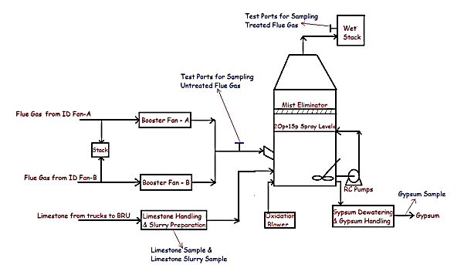
INTRODUCTION
The Wet Flue Gas Desulphurization (FGD) system has been retrofitted treating 100% of the flue gas from Stage-IV 500 MW coal fired Unit. The FGD system having one (01) Absorber train is designed to achieve 95.06 % removal of SO₂ with a maximum inlet loading (Sox) of 2025 mg/Nm³.
FIGURE 1: Basic Diagram of Wet FGD Stage-IV(1x500 MW unit)

Slide 3
LIMESTONE
The Mineral Limestone is generally found as sedimentary rocks of white to greyish colour. The chemical composition includes CaCO₃ (calcium carbonate) accompanied with MgCO₃ (Magnesium Carbonate) present in different mineral forms, calcite (CaCO₃), Dolomite (CaMg(CO₃)₂ and/ or Magnesite (MgCO₃) and in different proportions.
The Annual production of Limestone is approximately 30 to 35 MMT.
Producing States: Rajasthan, Madhya Pradesh, Andhra Pradesh & Chhattisgarh,
Karnataka and smaller quantities in Gujrat, Assam, Bihar,
Himachal Pradesh, Jammu, Kashmir, Jharkhand, Bihar,
Kerala, Uttar Pradesh, Meghalaya etc.

Slide 4
Limestone Quality
Limestone Quality
Purity
Reactivity
Measure of time taken for Neutralization of Acidic solution by limestone
Calcium Carbonate (CaCO3) Concentration

Slide 5
Limestone Quality & Reactivity
CaCO3 + SO2 + ½ O2 + 2H2O CaSO4.2H2O + CO2
Impurities in Limestone
Magnesium Carbonate MgCO3
Aluminium Oxide
Iron Oxide
Quartz, Manganese
R
E
A
C
T
I
V
I
T
Y
Salts
Cl, F
Aluminium

Slide 6
LIMESTONE SPECIFICATIONS FOR FGD
Limestone Parameters | Values (%)
CaO | 47-51
MgO | 0.9-2.0
SiO₂ | 2.1-4.5
Al₂O₃ | 1.19-2.1
Fe₂O₃ | 0.45-1.0
LOI | 39.0-41.3

Slide 7
Limestone Purity Requirement for FGD System
CaO
47%-51 %
CaCO₃
84%- 91%
Guaranteed CaCO₃
89 %
CaCO3 above 90 % purity is high quality limestone and is also known as Steel Grade Limestone.
CaCO3 between 79 % to 89 % (CaO-44% -52 %) is known as cement grade lime stone.
CaCO3 above 95 % is known as Chemical grade limestone

Slide 8
BASIC REACTIONS OCCURING IN WET FGD
S.No. | Step | Reactions
1 | Absorption | SO₂(g) + H₂O ↔ HSO₃⁻ + H⁺ , O₂(g) ↔ O₂(aq)
2 | Neutralization | HSO₃⁻ (aq) + Ca⁺⁺(aq) ↔ CaSO₃(aq)+ H⁺(aq), Ca⁺⁺(aq) + H₂SO₄(aq) ↔ CaSO₄(aq) + 2H⁺(aq) H⁺(aq) + HCO⁻(aq) ↔ H₂O(l) + CO (g), H⁺ (aq) + OH⁻ (aq) ↔ H2O(l)
3 | Regeneration | CaCO₃(s) + H₂O(l) ↔ Ca²⁺ (aq) + HCO₃⁻ (aq) + OH⁻ (aq)
4 | Oxidation | HSO₃⁻ (aq) + 1/2 O2(g) ↔ HSO⁻ (aq)
5 | Precipitation | Ca²⁺ + SO₃²⁻ + 1/2 H₂O(l) → CaSO₃ · 1/2H₂O (s), Ca²⁺ + SO²⁻ + 2H2O(l) → CaSO4 ·2H2O (s)

Slide 9
Experiences during the PG Test of Wet FGD system of Stage-IV
The PG test of FGD system was conducted⁵ from 19.06.2023 to 21.06.2023 for the performance guarantee parameters. Samples of coal, crushed Limestone, Limestone slurry, Absorber tank slurry, Inlet and outlet flue gas and Gypsum were taken as per EPRI Method A1. Three test runs were conducted during the duration of PG test. Three (03) samples were taken in each test run. The limestone samples were prepared by crushing and pulverizing to size 45 micron. Rest samples were analyzed as such. Locations from where samples were taken are shown in Images 1,2,3 and 4. The samples were analyzed for guaranteed parameters as listed below:
Limestone consumption
Auxiliary Power consumption
SOX Reduction
Gypsum Moisture and
Gypsum Purity
S.No. | Sample/ Sample location | Parameter | Test Method/ Instrument
1 | Absorber Slurry/Gypsum bleed discharge | pH | EPRI Method C1
 |  | Density | EPRI Method D2
2. | Limestone slurry | Particle size distribution | Laser Beam Diffraction/ Microtrac PSD Analyzer
3. | Flue Gas Inlet and outlet | SOX, NOx, O₂, CO₂, SPM | IS:5182-2019
4. | Limestone | CaO, MgO, Al₂O₃, Fe₂O₃, SiO₂ | IS:1760-1992
5. | Gypsum | CaO, MgO, Al₂O₃, Fe₂O₃, SiO₂, LOI | IS: 1288-1982

Slide 10
Understanding the variations in achieved results and their impact on the SOX reduction efficiency and Gypsum quality
Slurry pH and Density
2. Available Calcium Oxide Content (%)
3. Silica Content of Limestone
4. Chloride concentration
5. The Particle Size Distribution of Limestone Slurry
6. Stoichiometric Ratio
7. Reactivity of Limestone

Slide 11
Slurry pH and Density
Slurry pH is one of the process variables that has a significant effect on SOX removal efficiency is the pH of the recycle slurry. Reaction tank slurry pH is the primary process variable controlling the rate at which limestone reagent is added to the reaction tanks. The amount of lime or Limestone reagent that is added to the process is adjusted automatically to maintain a slurry pH set point (min = 5.0 max pH = 6.0). When the reaction tank pH falls below its setpoint, the limestone reagent feed to the system is increased. When the pH rises above its setpoint, the limestone reagent feed is decreased.
During the Trial and Commissioning and PG test the pH and slurry density were monitored at regular intervals. pH controls are separate for Gypsum production and Limestone reagent slurry addition.
When density range for Gypsum production was maintained from 1135 to 1116 kg/m³. The pH of the slurry in tank was maintained from pH 5.3 to 5.6. In case when the density is not achieved, and pH is reducing (due to SOX in flue gas continuously being bubbled through the slurry) then some amount of reagent slurry is added (Limestone slurry add pH point = 5.49 stop pH point = 5.59.
The slurry pH is normally measured for the reaction tank where spent recycled slurry from the Absorber is mixed with fresh lime or Limestone slurry or reagent slurry. Both online and offline measurements are done at a sampling line from Gypsum bleed discharge. Limestone slurry pH sample is taken from Primary hydro cyclone under flow.
The pH of Limestone slurry is found to be in the range of 8.1 to 7.8.

Slide 13
Available Calcium Oxide
The Limestone being sourced for NTPC Unchahar is mainly from Katni, MP. The Limestone consists of greyish colored stones.
It has CaCO₃ (as CaO) in Limestone is in the range of 47–51%. The higher the percentage of CaO (Calcium Oxide) better will be the efficiency of SOX removal. Poor quality Limestone will escalate consumption of Limestone.
Furthermore, it will reduce SOX removal efficiency and also the impurities get carried along in Gypsum thus bringing down its purity.
So, it is essential that good quality Limestone be allocated to power plants, wherein available Calcium oxide should be around 90%. Less pure Limestone will result in higher Limestone consumption and increased impurity in Gypsum.

Slide 14
Silica content of Limestone
The Limestone is mined and crushed for supply which is called as run-of-mine Limestone. There are two ways in which silica content in Limestone may vary.
Firstly, the silica that is embedded in the rock structure (during formation of rocks by sedimentation). This silica is inherent silica and cannot be removed.
Secondly, during mining and crushing, there is possibility that loose dirt, mud get mixed due to rains, operational neglect leading to contamination of Limestone.
This impact is more visible during monsoon season, when water floods the mines carrying along dirt and mud. A better planned Limestone management with little or no supply during monsoon season may be a good measure.

Slide 15
Chloride Concentration
As per the specifications of Gypsum the Chloride levels should be below 100 ppm.
With continuous FGD operation, concentration of chloride species increases until reaching equilibrium, which is a function of the incoming chlorides (coal, makeup water and limestone) and outgoing chlorides (purge stream and Gypsum).
During the tests it was found that the chloride levels in Gypsum samples are in the range of 100 to 250 ppm.
The makeup water for slurry preparation is taken from Cooling water blowdown. The typical levels of Chloride in this water are 40 to 50 ppm. This slurry is recirculated many times, so it’s obvious that the chloride levels will shoot.
Gypsum washing is done to ensure low chloride levels. But impurities like silica and fine crystal structure of Gypsum may hamper the removal of chlorides leading to high chloride concentration in Gypsum.

Slide 16
The Particle Size Distribution of Limestone Slurry
The particle size of the Limestone solids is critical in achieving high Limestone utilization. A smaller particle size results in increased surface area per unit mass of solid and thereby, increases the dissolution rate. The reagent slurry particle size is typically reported as the weight percent of slurry solids that will pass through a 325 mesh (44 micron) screen.

Slide 17
Stoichiometric Ratio
Stoichiometric Ratio (SR) is the ratio of the amount of Reagent i.e. Limestone required to neutralize the SO₂ gas to the theoretical amount required to neutralize the SO₂ and other acidic species in the flue gas. Limestone Consumption Analysis during the performance test is used to determine the stoichiometric ratio of calcium to sulfur dioxide removed by the Absorber.
The Limestone Stoichiometric ratio (LSR) is calculated by the following equation:
LSR = [moles of Ca – moles of Mg] / [moles of Sulfite + moles of Sulfate]
LSR Average = LSR average of 3 valid tests of Gypsum Sample analysis
Limestone consumption (LS), (kg/hr) :
LS = (LSR Average) *Quantity of SO₂ removed across FGD(kmol/hr )*Molecular Weight of CaCO₃ / (Purity of Limestone, % /100)
LS average is average of 3 valid tests based on 3 valid tests of Quantity of SO₂ removed.

Slide 18
Guaranteed Limestone consumption
Guaranteed Limestone consumption = Theoretical Limestone consumption Kg/h * SR cfr
SR cfr : This is the correction factor for the available CaCO₃ from purity perspective. Let the available component of CaCO₃ be Y.
Y = (Measured CaO% (by wt) – Measured MgO (by wt) * 56.0774/40.3044)*100.0869/56.0774
Y is % of available CaCO₃ component in the reagent Limestone
For Y ≥ 89%: Guarantee Point: SR cfr = 1 (SR from the contractual performance guarantee)
For Y = 79%: Design Point: SR cfr = 1.024 (SR from the Approved Design Case Mass Balance)
For 89% > Y > 79%., SR cfr = SR cfr guarantee point + (89%-Y%)/(89%-79%)* (SR cfr Design case - SR cfr guarantee point)
ie. SR correction factor = 1 + (89%-Y%)/(89%-79%)* (1.024 – 1)

Slide 19
Reactivity of Limestone
An important parameter of Limestone directly affecting the quality of Gypsum is the Reactivity of Limestone. The Limestone reactivity is measured as the conversion or dissolution-reaction rate of the particles at a constant acidic pH value and is important for the design and operation of Wet FGD processes. It is important to determine the reactivity of Limestone to see how long it will take for Limestone to dissolve and react in the FGD Absorber tank slurry.
Reactivity of Limestone
Method of determination of reactivity of Limestone
A fixed amount of powdered Limestone is taken, and its slurry prepared. Then small amounts of acid of fixed molarity is added, keeping pH at 5.0. The solution is kept under stirring during the whole experiment. The amount of acid required to neutralize the amount of powdered Limestone (0.04mm) maintaining pH= 5.0 for the duration of the test for nearly 360 minutes is known as the reactivity of Limestone.
Time in minutes

Slide 20
Reactivity of Limestone
This Reactivity of Limestone (a Kinetics parameter) depends upon various factors as explained below:
Particle Size: Finer particle provides greater surface area available for acid to react leading to greater reactivity. The requisite is to maintain PSD where more than 95% particles pass through 45-micron sieve.
Porosity of Particles: Pores on the surface of the Limestone particles will help in reaction of acid with calcium carbonate.
c) Dolomite Content This Reactivity parameter is by far of the most concern to us. The Limestone generally found in nearby areas have dolomitic Limestone⁷ where CaCO₃ and MgCO₃ are present in a very stable and has uniform lattice in a stoichiometric ratio of 1:1. This stability of the crystal lattice slows down the reactivity of the dolomitic Limestone.

Slide 21
Reactivity of Limestone
Samples of Limestone were taken from trucks and after crushing from bottom of day silo. Available (reactive) CaCO₃ in Limestone was determined by following formula:
Available (Reactive) = (CaO %- MgO%)* (56.0774/40.3044)* (100.0869/56.0774)
CaCO₃ in Limestone (%)
If the available CaCO₃ in limestone is > 89% then the Correction factor is 1.0
If the available CaCO₃ in limestone is equal to 79% then the Correction factor is 1.024

Slide 22
Reactivity of Limestone
If the available CaCO₃ in limestone is between 89% & 79% then the correction factor is calculated using the equation 1+(89-Availble CaCO₃ in Limestone)/(89-79)*(1.024-1)
If the available CaCO₃ in limestone is < 79% then the reagent is outside the specified value.
The Available (reactive) CaCO₃ in Limestone (%) was calculated for the samples. It was found that in some samples the reactivity was below 79%.
A correlation was found between reactivity of Limestone and percentage of CaO and MgO in Limestone.
The Limestone received has some percentage of dolomitic Limestone which means that CaCO₃ and MgCO₃ are present in equal ratio in a lattice which is so stable that it renders both calcium and magnesium ions from being available for reaction.

Slide 23
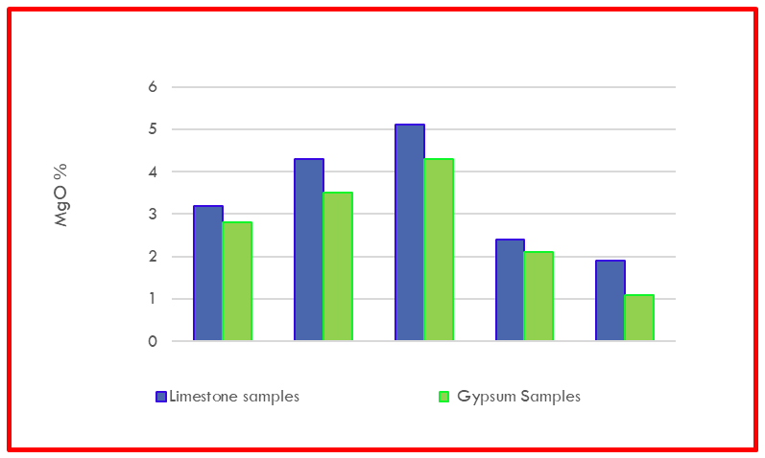
Reactivity of Limestone
The percentage of MgO in Limestone and Gypsum is almost similar as shown in GRAPH. This clearly shows that the reactivity of Limestone is also affected by the presence of Dolomitic Limestone.

Slide 24
Reactivity of Limestone
Further correlation was also done between the percentage of dolomite part in Limestone and purity of Gypsum. clearly showing how the purity of Gypsum reflects the presence of Dolomitic Limestone.

Slide 25
CONCLUSION
From above analysis of results, it can be clearly stated that for optimum consumption of Limestone, as well as optimum operation of FGD and getting better purity of Gypsum, it is essential that Limestone reactivity should be in the range 79% to 89% or better.

Slide 26
THANKS

