Slide 1
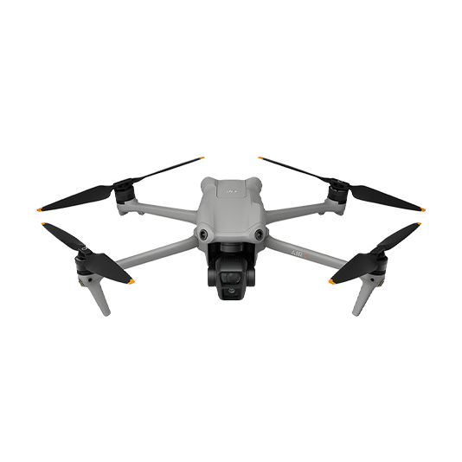
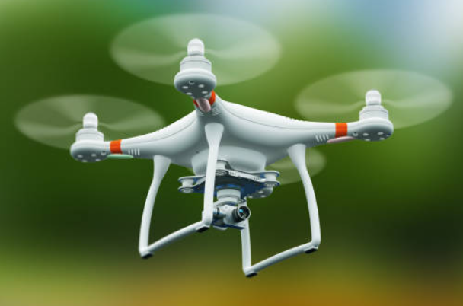
O&M Conference -2024
Gadarwara
(2 x 800 MW)
PROJECT: DRONE KAWACH

Slide 2
PDCA CYCLE

Slide 3
PLAN: Identifying the problems

Slide 4
Some Safety & security related incidents in NTPC
Incidence 6
Incidence 5
Incidence 4
Incidence 1
Incidence 3
Incidence 2

Slide 5
Theft in Townships
Multiple incidents of theft and robbery have occurred in NTPC townships
Incidence 6
Incidence 5
Incidence 4
Incidence 1
Incidence 3
Incidence 2

Slide 6
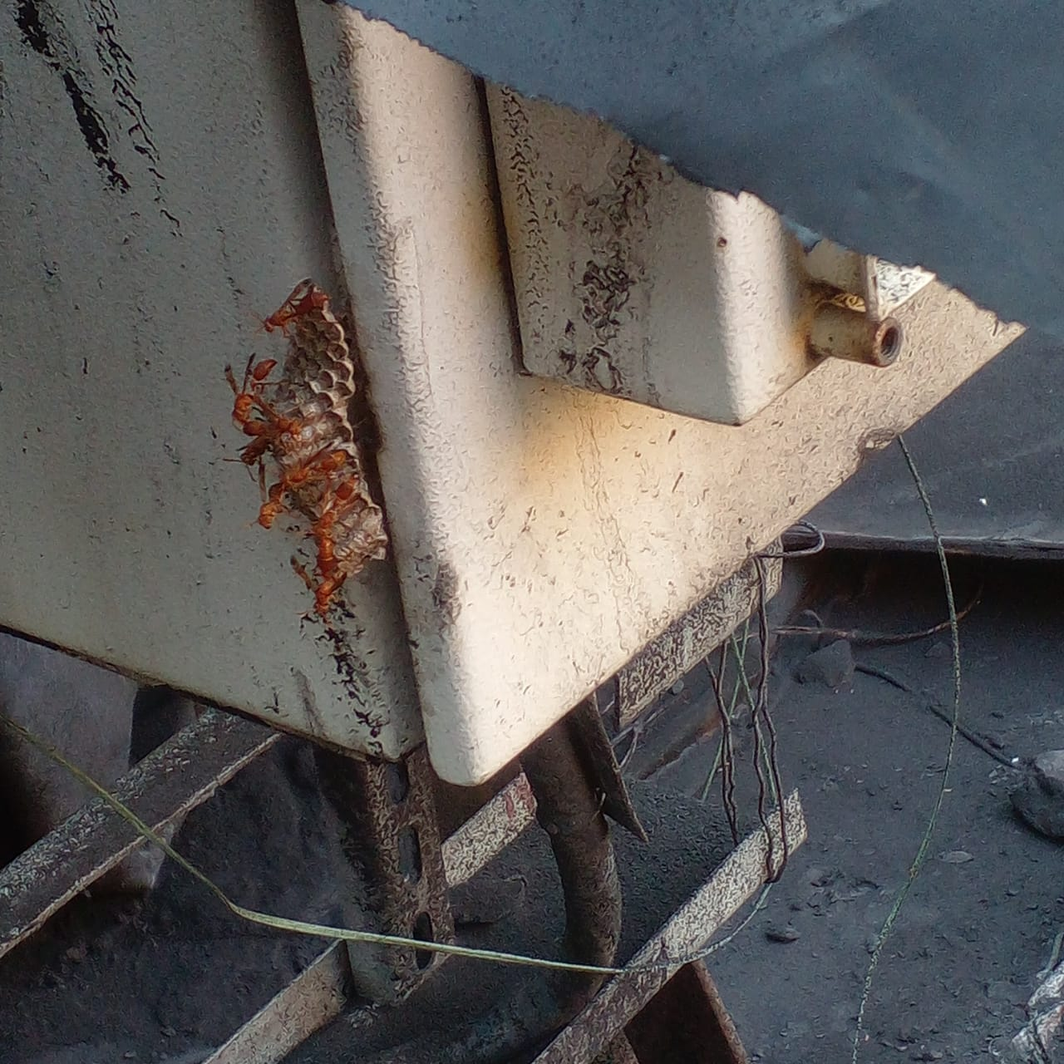
Unauthorized entry of man &material in plant premises
An incident happened at Gadarwara station where a
man entered plant premises inside wagon of coal rake
who nearly missed fatal accident while tippling of the
wagon at wagon tippler.
Similarly multiple material like trolley bags, dead
animal bodies inside sack.
These incidents have affected the process and
workers around causing a serious unsafe condition.
Incidence 6
Incidence 5
Incidence 4
Incidence 1
Incidence 3
Incidence 2

Slide 7
Honeybee Bite
Multiple incidents of honeybee bite have occurred in plant premises affecting the workers around adversely.
Incidence 6
Incidence 5
Incidence 4
Incidence 1
Incidence 3
Incidence 2

Slide 8
Stacker Reclaimer 1 rail track crack
Stacker Reclaimer 1 rail track gradually weakened due to stress and eventually got cracked which if was not identified on time could have led to derailment or toppling of the stacker.
Incidence 6
Incidence 5
Incidence 4
Incidence 1
Incidence 3
Incidence 2

Slide 9
Fatal accident while working at height
A fatal incident happed while working at height at FGD chimney area due to not taking proper safety measures which are to be followed while working at height.
Incidence 6
Incidence 5
Incidence 4
Incidence 1
Incidence 3
Incidence 2

Slide 10
Fatal incident due to fall of cable tray structure
1 worker met with fatal incident while doing cable dressing work on mobile ladder in one of the stations. Due to cable tray support material failure the entire cable tray structure fallen down.
Incidence 6
Incidence 5
Incidence 4
Incidence 1
Incidence 3
Incidence 2

Slide 11
Problem Statement
All these safety incidents could have been averted if monitoring would have been done in a more continuous and efficient way.
At present we are relying on human monitoring which is failing to be a continuous & efficient way of monitoring.
HOW CAN WE IMPROVE OUR MONITORING ?
How about we do monitoring using a DRONE FLEET ?

Slide 12
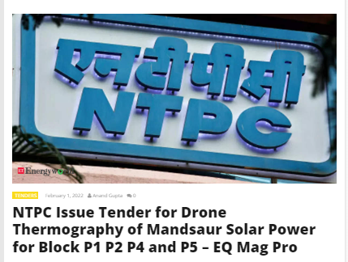
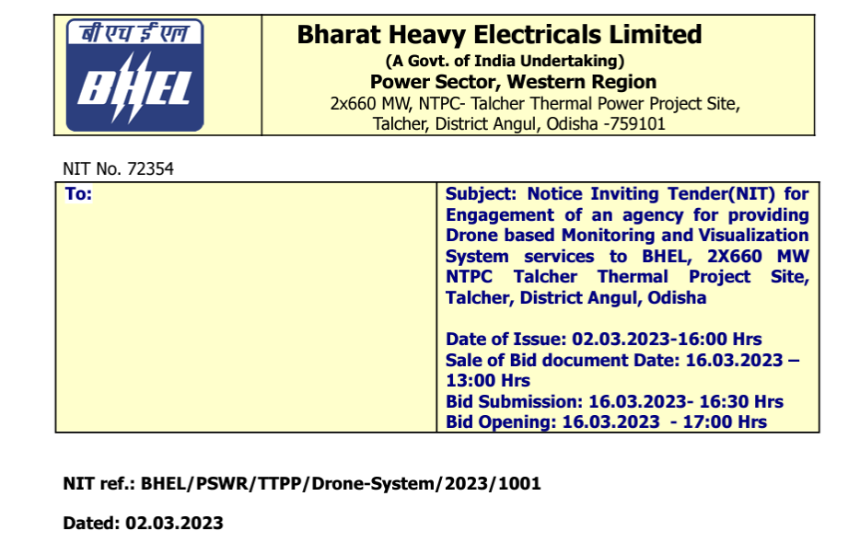

Slide 13
Solution
Drone Fleet capable of autonomous missions
Autonomous drone
Battery Swapping Dock
Task Specific AI models
Ground Control station

Slide 14
Solution Breakdown
Stage 1
Indigenous Drone Development- Micro Category
Stage 2
Swappable Battery Design & GCS setup
Stage 3
Autonomous Flight
Stage 4
Precision Landing
Stage 5
Battery Swapping Dock
Stage 6
Task specific AI models development
Stage 7
BVLOS operation
Stage 8
Internet of Drones

Slide 15
Stage 1: Indigenous Drone Development
Why Indigenous?
Customized Solution needs Indigenous development.
To scale up tailored features viz- LIDAR , RTK GNSS, On-board Edge Computing etc.
Battery Swapping Dock @ Network connected Ground Control Station(GCS).
Cost Effective
Maintenance Capability as developed in-house.

Slide 16
Stage 2: Swappable Battery design & GCS Setup
Why Swappable Battery?
To reduce Drone downtime
GCS Setup?
Mission Control/ Fleet Control and Coordination Center
Data Feed, Camera Feed, Mission Execution Logs etc. – From Drone to GCS

Slide 17
Stage 3:Autonomous flight
Way point marking by us.
Precise path following by the drone.
Altitude hold
Return to home.

Slide 18
Stage 4 : Precision Landing
Target:-
Landing within 50*50 sq cm Landing Pad under windy condition(25-30 kmph).
Two-Pronged Solution –
Using DGPS (RTK) – Position Accuracy <10cm
Using ArUco Markers and Computer Vision guided landing
ArUco Marker

Slide 19
Stage 5: Battery Swapping Dock
X
LANDING PAD (50 cm*50 cm)
DRONE ALIGNMENT
Y
BATTERY SWAPPING DOCK

Slide 20
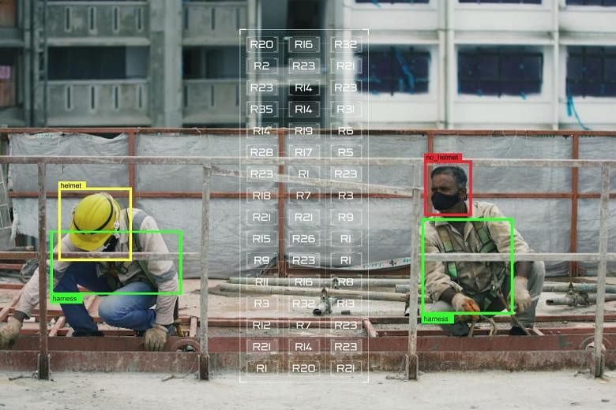
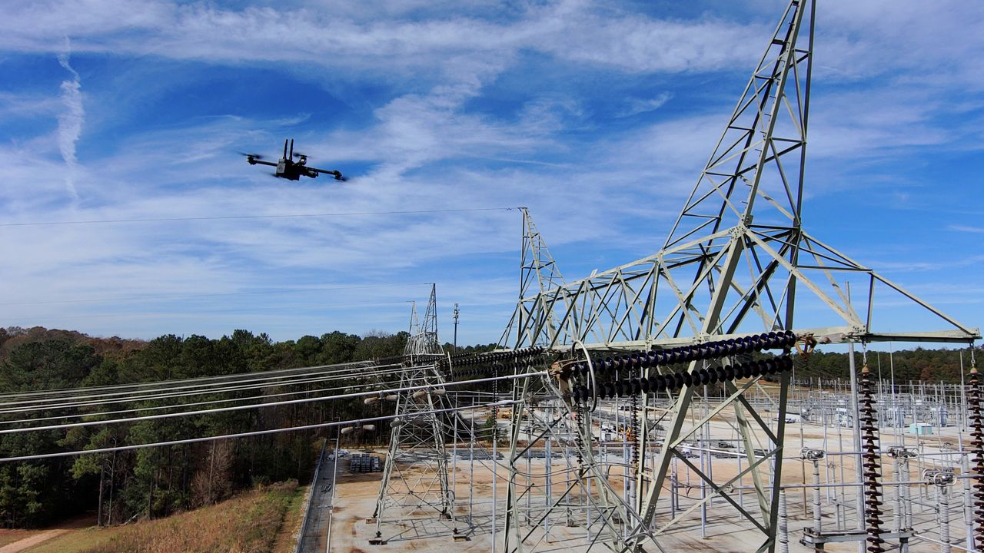
Stage 6: Task specific AI Models
Safety related models
For detecting PPEs
Switchyard Hotspot monitoring
Aerial Supervision of Critical structures/ Areas
Railway track inspection
Vehicle Speed monitoring
Premise Security Surveillance
Unsafe condition detection e.g. bee hive

Slide 21
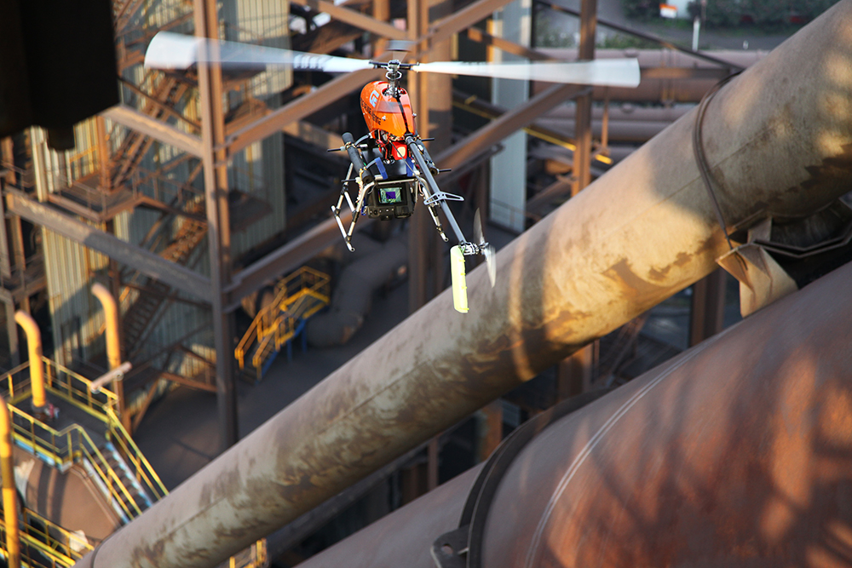
Stage 6: Task specific AI Models
Safety related models
For detecting PPEs
Switchyard Hotspot monitoring
Aerial Inspection of Critical structures/ Areas
Railway track inspection
Vehicle Speed monitoring
Premise Security Surveillance
Unsafe condition detection e.g. bee hive

Slide 22
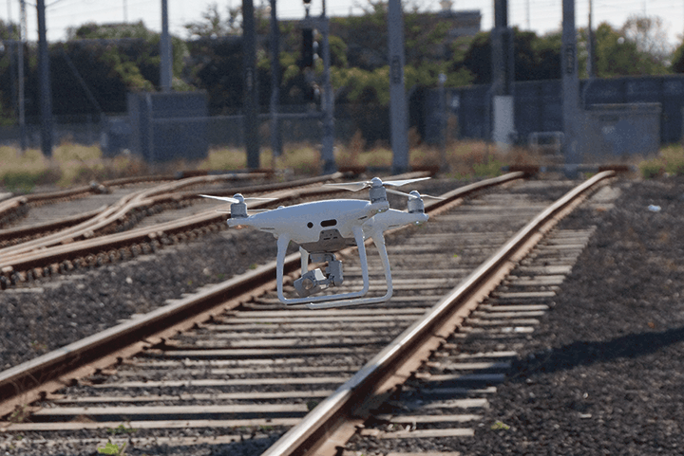
Stage 6: Task specific AI Models
Safety related models
For detecting PPEs
Switchyard Hotspot monitoring
Aerial Inspection of Critical structures/ Areas
Railway track inspection
Vehicle Speed monitoring
Premise Security Surveillance
Unsafe condition detection e.g. bee hive

Slide 23
Stage 6: Task specific AI Models
Safety related models
For detecting PPEs
Switchyard Hotspot monitoring
Aerial Inspection of Critical structures/ Areas
Railway track inspection
Vehicle Speed monitoring
Premise Security Surveillance
Unsafe condition detection e.g. bee hive

Slide 24
Stage 6: Task specific AI Models
Safety related models
For detecting PPEs
Switchyard Hotspot monitoring
Aerial Inspection of Critical structures/ Areas
Railway track inspection
Vehicle Speed monitoring
Premise Security Surveillance
Unsafe condition detection e.g. bee hive

Slide 25
Additional AI models
Stage 6: Task specific AI Models
Reservoir monitoring
Solar PV – Monitoring, Cleaning
Boiler structure Insulation Thermal Mapping
Make up lines leakage inspection
Coal pile – Volumetric Analysis, Thermal Inspection
BTL/Duct inspection

Slide 26
Stage 7: BVLOS
BVLOS- Beyond Visual Line of Sight
4g Drones– Limitless Range from GCS

Slide 27
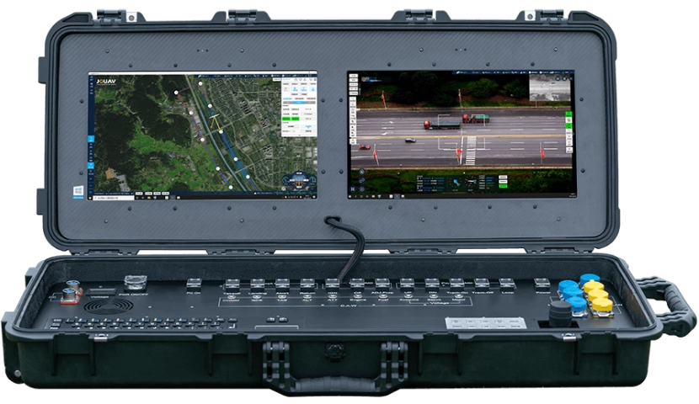
Stage 8: Internet of Drones (IOD)
IOD- Internet ( Interconnected) Drones

Slide 28
DO: Project implementation

Slide 29
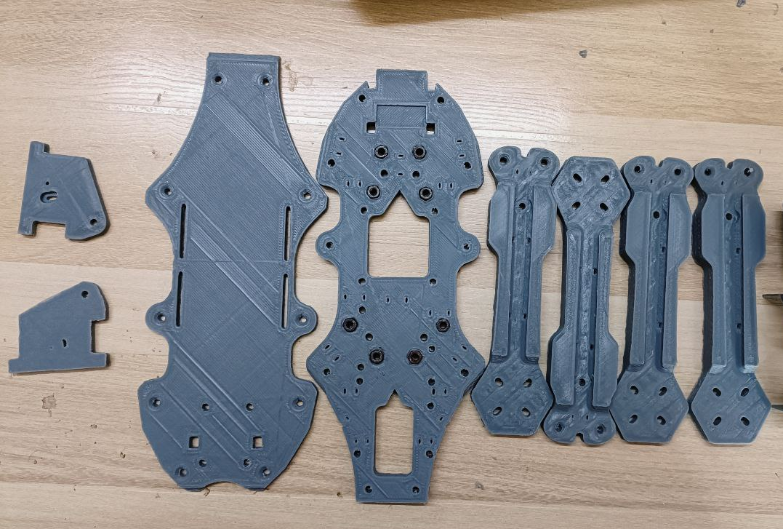
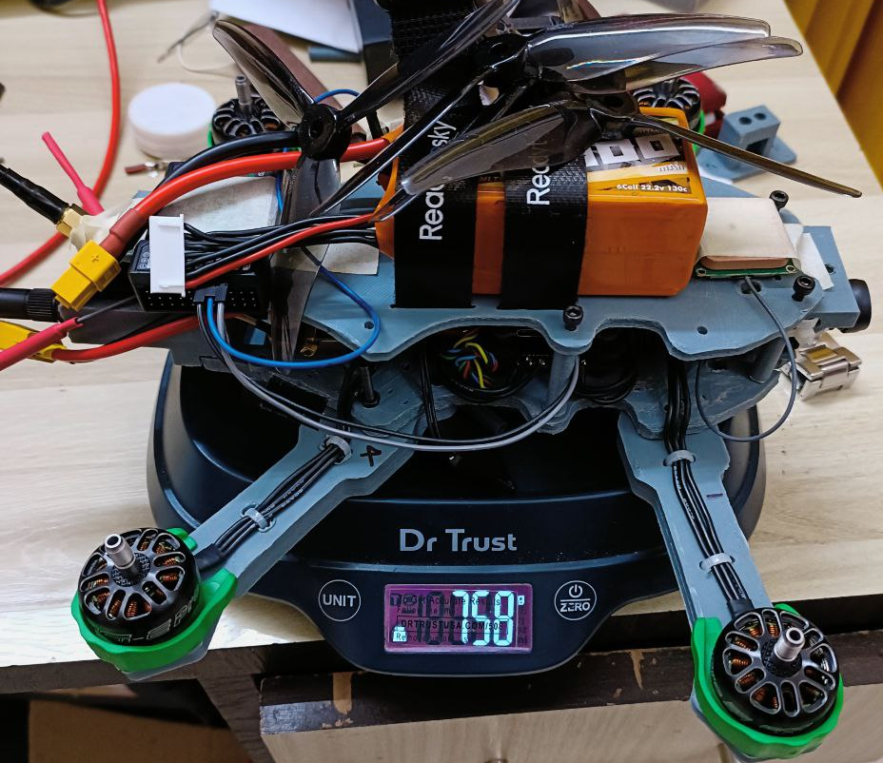
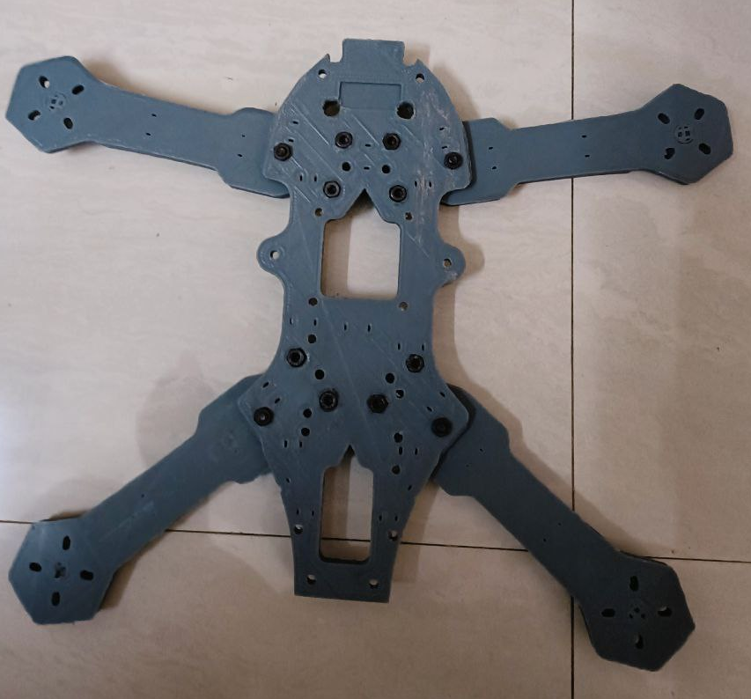
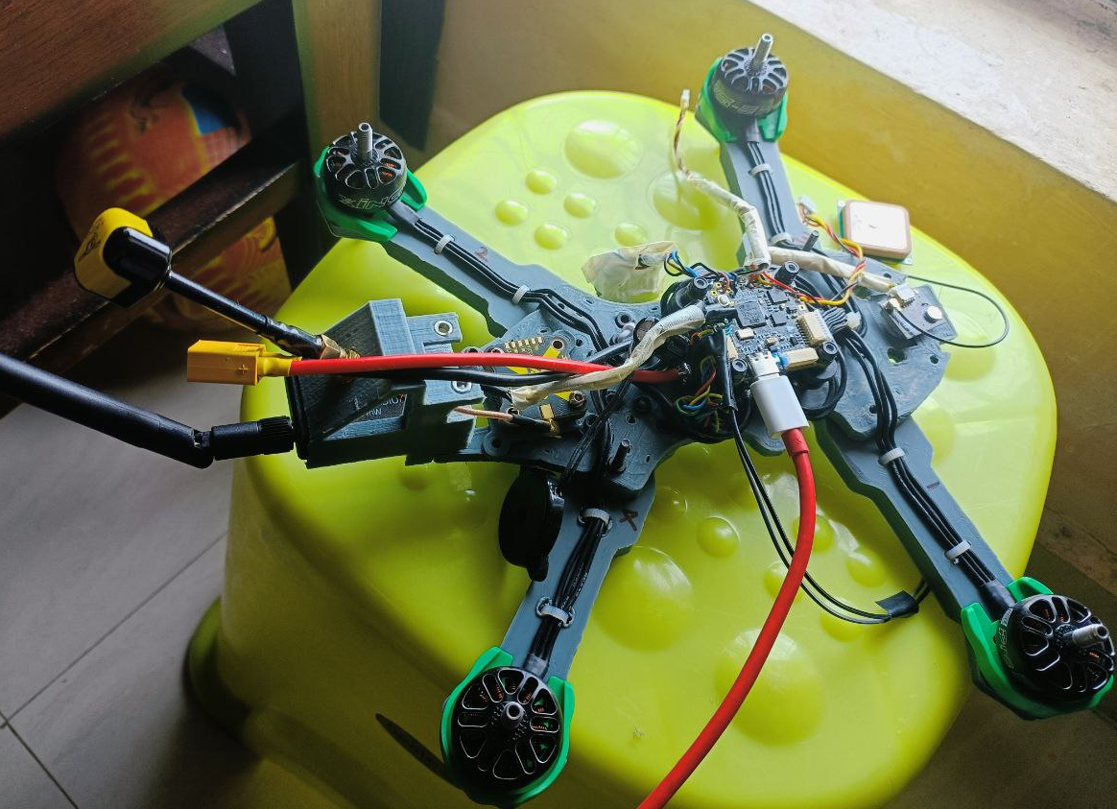
Stage 1: Drone development
758 gms
3d PRINT
FINAL BUILD
FRAME
CODING

Slide 30
Stage2: Swappable Battery Design & GCS setup
Prototype- 3d Design
Battery Pack
Drone Battery Case
Assembled Look

Slide 31
Actual Hot swap Battery case and housing
Stage2: Swappable Battery Design & GCS setup
Battery Pack
Drone Battery Case
Assembled Look

Slide 32
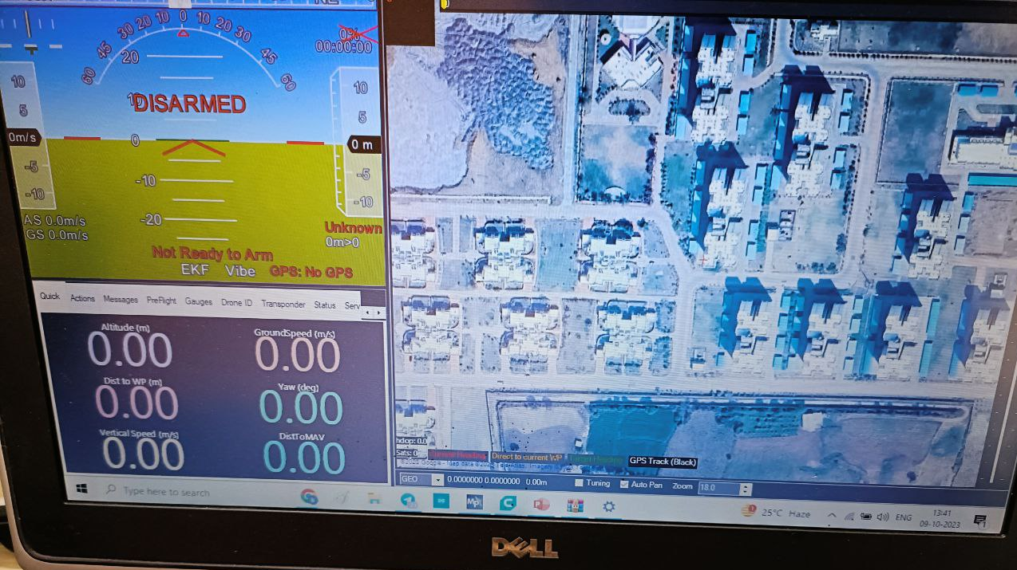
GCS Interface
Stage2: Swappable Battery Design & GCS setup

Slide 33
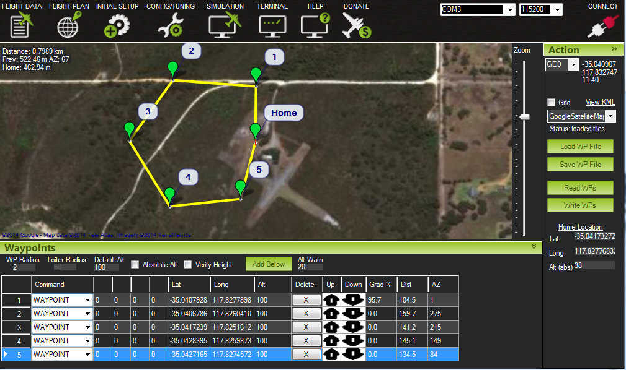
Stage3: Autonomous Flight

Slide 34
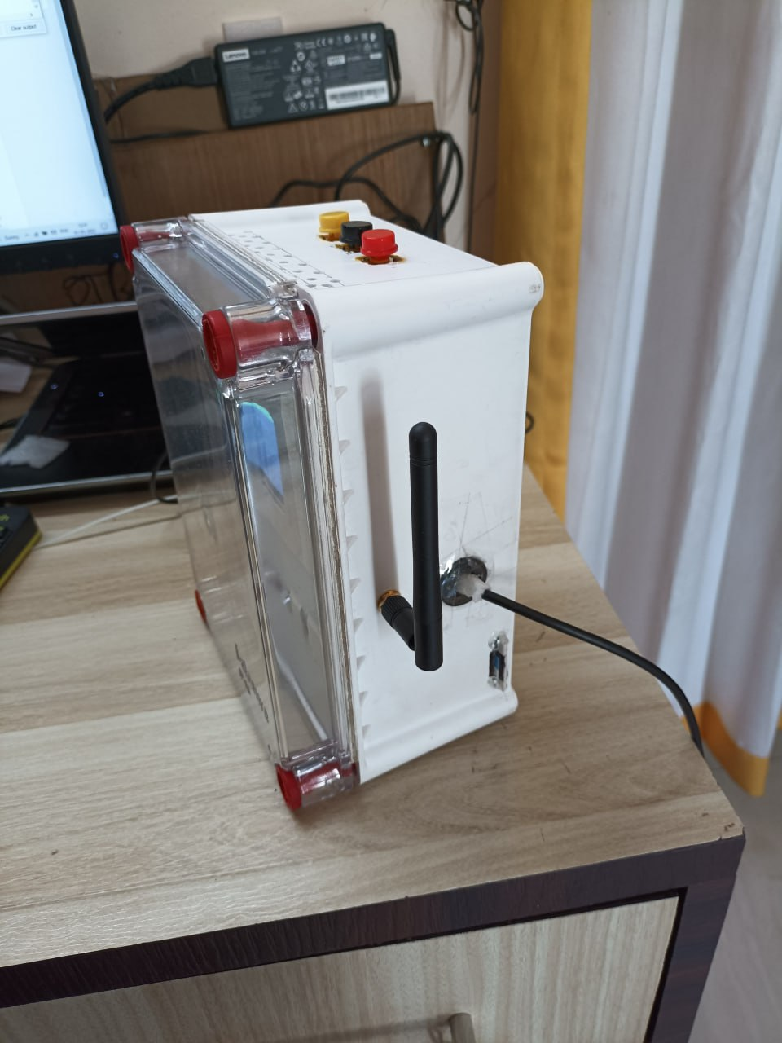
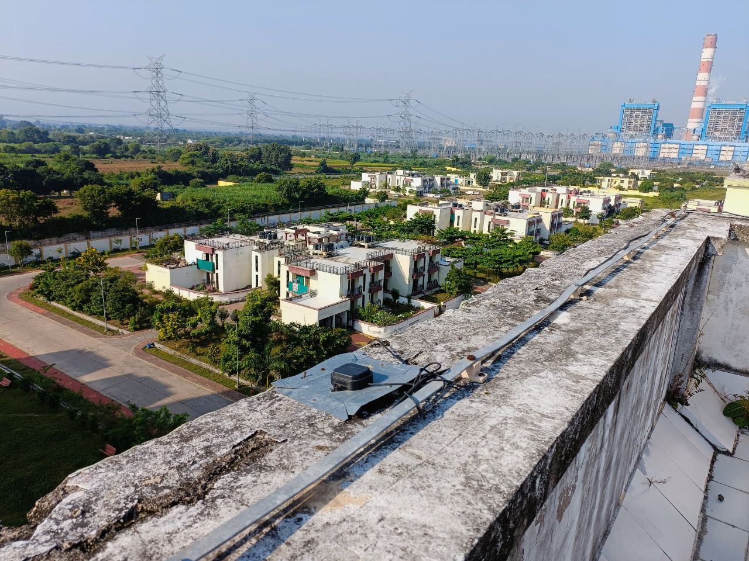
DGPS Base Station Setup
Stage4: Precision Landing
Base Station
Base Station Multi-Band Antenna

Slide 35
Further stages under development
Stage 5- Battery Swapping Dock - By Mar 1st Week, 2024
Stage 6 – AI Models - Running Task, But important Models by Mar 4th week.
Stage 7 –BVLOS - By Feb 2024
Stage 8- IOD -By June-July 2024
Ext. Fields Trials with Missions. -Ongoing.

Slide 36
Check: Study Results

Slide 37
Check: Study Results
Base Station Precise co-ordinates
Position Accuracy ~ 2-3 mm
Data analyzed by geodetic integrated services, Natural Resources Canada after 24 hrs. survey-in

Slide 38
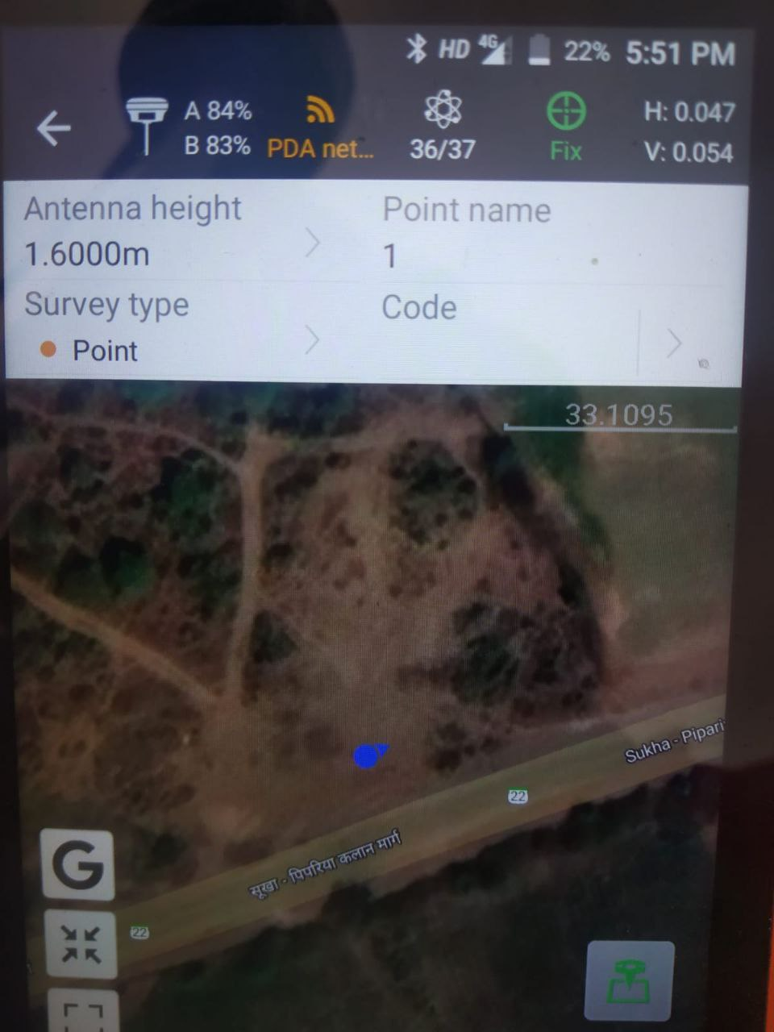
GNSS Base Corrections testing with Rover
Rover @ 35-40 km away in LOS
Position Accuracy:
Horizontal- 0.047 m – 4.7cm
Vertical – 0.054 m- 5.4 cm

Slide 39
Cost Estimation
One Drone cost:
Motors + ESC + FC + Lidar +
Onboard Computer + 4g + Telemetry+
Digital HD camera + RTK module
One Base Station setup ( L1,L2,L5 band)
For a Fleet of 6 drones + 1 base -
~ ₹ 1.5- 2 Lakhs/ drone
~ ₹ 1- 1.5 lakh
~ ₹ 10-13 Lakhs

Slide 40
Scalability & Replicability across NTPC
In-house development--- Scalable to any fleet size, Any specialized task.
Problem statement’s Similarity across stations
Township and Plant Premises Security– A major common concern
Scalability & Replicability--- Definitely, YES

Slide 41
Conclusion
Indigenous, Autonomous, Inter-connected AI-Enabled Drone Fleet
Greatly Enhancing Safety and Security ---Providing us a aerial KAWACH.
DRONE- KAWACH

