Slide 1
NTPC O&M Conference (IPS 2024) Ultra supercritical Boiler Combustion optimization via Furnace Zone temp. Monitoring & Burner Management
Adani Power Jharkhand Limited (APJL)

Slide 2
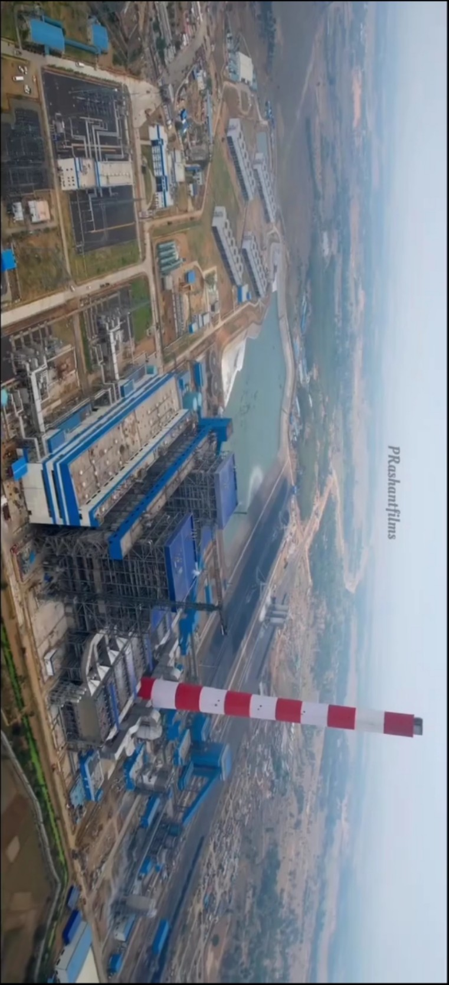
Ultra supercritical Boiler Combustion optimization
Contents:
Boiler Combustion optimization
Design.
BURNER
BURNER TIP TEMPERATURE
Dynamic orifice on Coal pipe
Furnace Zone Temperature
Operation Data
Conclusion.

Slide 3
Ultra supercritical Boiler Combustion optimization
After the comprehensive transformation of combustion system for a 800 MW ultra-supercritical boiler, there are a series of problems such as combustion deviation of left and right sides, high CO content at the outlet of economizer, high carbon content of slag and poor low-nitrogen combustion effect due to unsatisfactory operation adjustment. In order to solve the problem of abnormal combustion, combustion optimization adjustment test was carried out, including oxygen leveling, secondary throttle adjustment, exhaust throttle adjustment, optimal oxygen adjustment. By combustion optimization adjustment test, the economy, safety and environmental protection of the boiler combustion get obvious increase. Oxygen distribution is more uniform along the furnace width direction, and the problems of abnormal combustion are solved significantly. The wall temperature distribution is more uniform along the furnace width, and the wall temperature deviation is decreased obviously.
APJL800MWBOILEROVERVIEW:
Manufacturer: | Babcock&WilcoxBeijingCompanyLtd.
Typeoffiring | Wall-firing
TypeofWaterWall(Spiralwall/Vertical) | Spiral wall
CoalBurners | Low Nox Dual Register Pulverized Coal Burners
Numberofelevationsofburners | 4（Front）、3（Rear）
No.ofcoalburnersfedbyeachpulverizer | 6
PostcombustionDe-NOxprovided | Yes
TypeofPostcombustionDe-NOxsystem | SCR

Slide 4
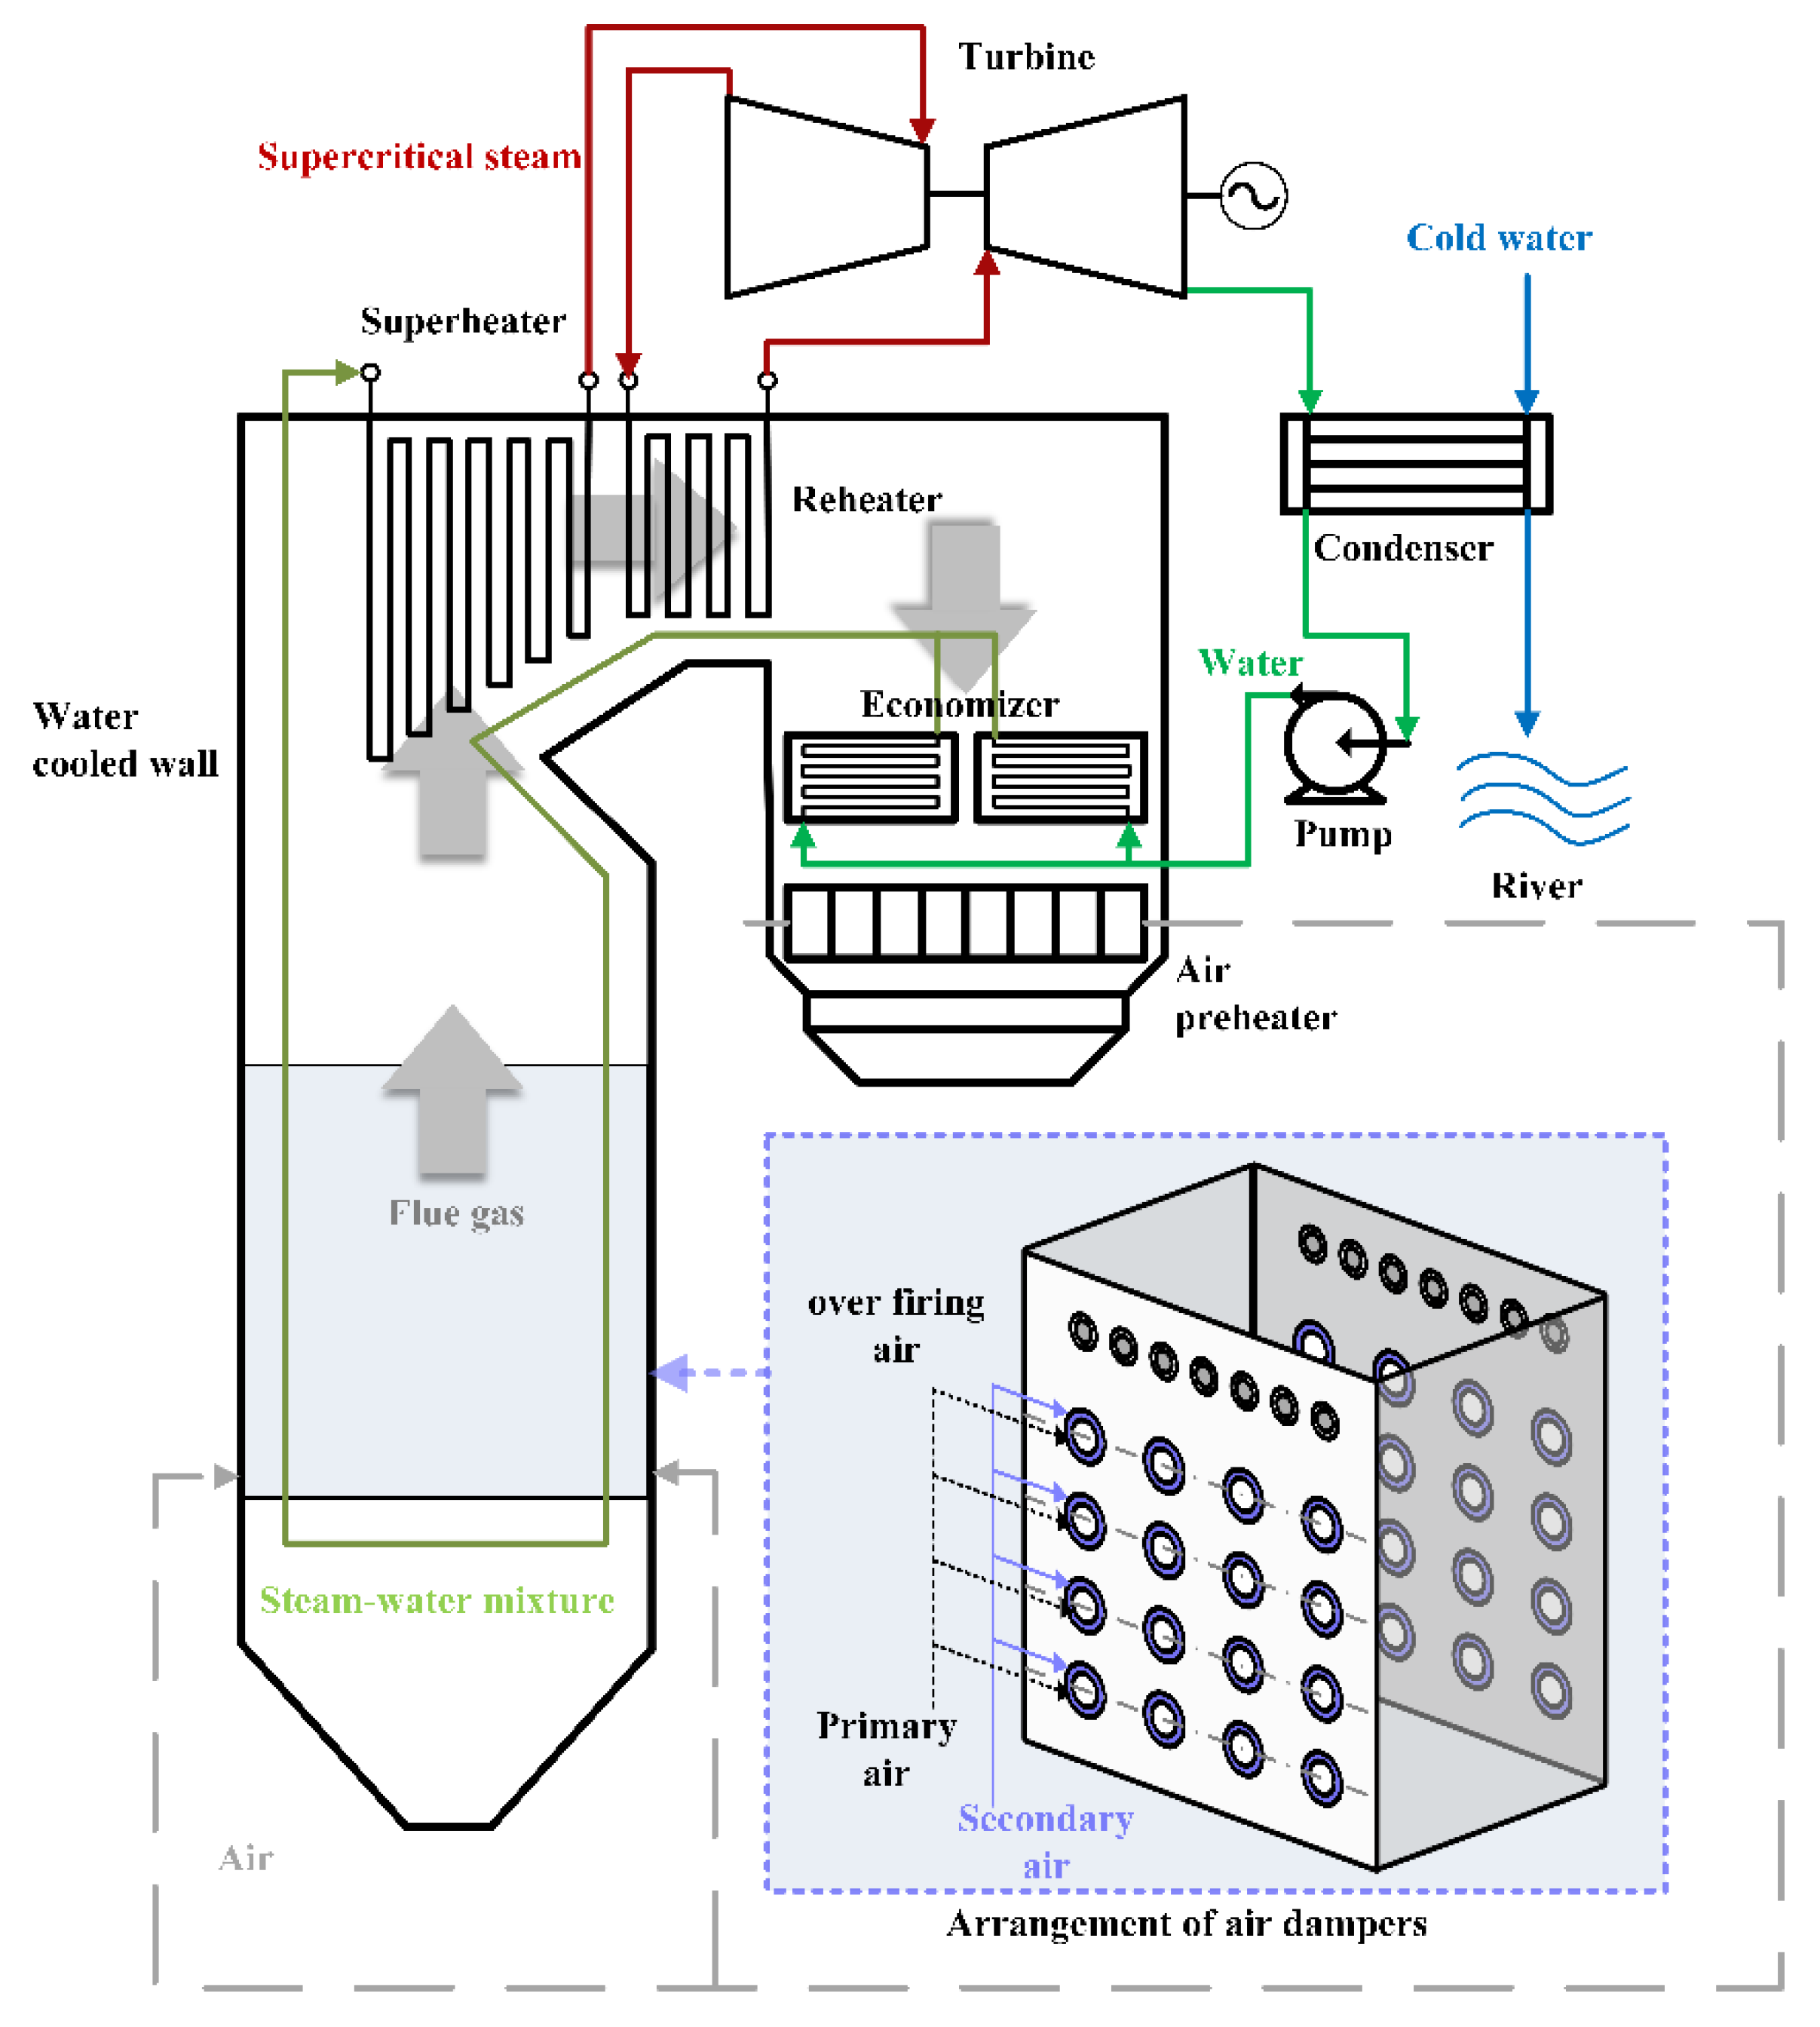

Slide 5
DESIGN
BASIC DESIGN
The boiler combustion system consists of XCL burner,OFA ports,compartmented windbox,minor-oil ignition system,high energy and flam scanners.forty-two (42) sets of XCL coal fired burner will be supplied to each boiler in total,which will be arranged in the compartment windbox of front wall and Rear wall.There are four levels of burner installed at the front wall and three levels of burner installed at the rear,six burners for each level.there are eight OFA ports on each wall.
Six burner located on lowest layer of front wall are equipment with minor oil ignition device.These burners are used for ignitions and stabilization combustion during boiler startup.during normal operation,these burners function as main burner.all the other burners are equipment with normal oil guns.
XCL burners are designed to efficiently burn pulverized coal in a manner that greatly reduces emissions of nitrogen oxides. The burner also functions to establish a stable point of ignition at the burner throat over a suitable turn down range.the arrangement of the burners within the furnace is designed to control NOx emission while providing a thermal environment with sufficient residence time to complete combustion
XCL Burner description and Initial setting
The PA/PC mixture from the pulverizer travels through the coal piping to the burner elbow. The burner elbow acts to concentrate the PC into a dense stream along the outer radius of the elbow due to centrifugal force. Upon leaving the burner elbow, the PA/PC mixture enters the burner nozzle. Each burner nozzle is equipped with a deflector and conical diffuser. The function of the deflector is to redirect coal from along the outer radius of the burner elbow into the conical diffuser. The conical diffuser consists of an inner plug and an outer shroud. The shroud directs the coal into a pattern more fuel rich along the inner wall of the burner nozzle, and fuel lean in the middle. This pattern improves flame stability and emission performance. XCL burner (refer to Drawing 4-2) has two SA zones with adjustable vanes located in each zone which can enhance the ignition. Secondary air enters a burner and travels past the pitot grid to the entrance to the inner and outer air zones. Inner and outer SA flow has the same swirling orientation.
The opening range of the inner SA adjustable vane is 20°~60°. Initially, the spin vanes should be set to 40 degrees open

Slide 6
DESIGN
Burner and OFA port cooling
When a layer of XCL burners are out of service, the associated control damper located on branch duct will be set to a minimum position to provide sufficient cooling air flow to prevent component overheating. Field to install two (2) permanent thermocouples on each burner. The maximum allowable temperature reading for the thermocouples on the burner coal nozzle is 900 deg.C and the maximum allowable temperature reading for the thermocouples on the outer burner sleeve is 850 deg.C.
High energy ignition device
Except lowest layer of burners on front wall，for other burners, each one will be equipped with a set of High-Energy Spark Ignition system to ignite the fuel automatically. This igniter consists of voltage increaser, ignition rod, ignition cable, spark, oil gun and retractable cylinder.
Operation of Burner
Maintain proper secondary air flow is also important for burner performance. Too much secondary air will increase NOx formation, and too few secondary air will cause incomplete combustion.
OFA ports should first be set to moderate flow rates,to better evaluate burner performance.
The inner vanes effect recirculation patterns at the root of the coal flame and are typically set 40º. Opening the outer vanes past 50º reduces flame stability. The inner vanes should not be closed past ~30º open, as this can lead to flow blockages from ash accumulations in the inner air zone, and possible burner overheating. The outer vanes are typically set near 60º open. Opening the outer vanes past 70º reduces flame stability. Closing the vanes past 50º tends to disrupt the flame.
Once burner vanes are adjusted and tuned, they should not be readjusted on a day to day basis. The final settings of the vanes should be fairly uniform for all burners
ITEM | UNIT | Design coal value | Worst coal value
Primary Air Temperature | deg.C | 68 | 68
Secondary Air Temperature | deg.C | 331 | 338
Primary Air Velocity | m/s | 21.7 | 22
Primary Air Ratio | % | 26.4 | 31.6
Secondary Air Ratio | % | 49.2 | 48.2
OFA Air Ratio | % | 23.5 | 19.3

Slide 7
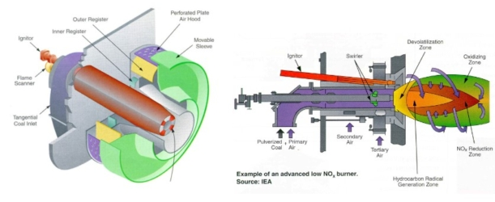
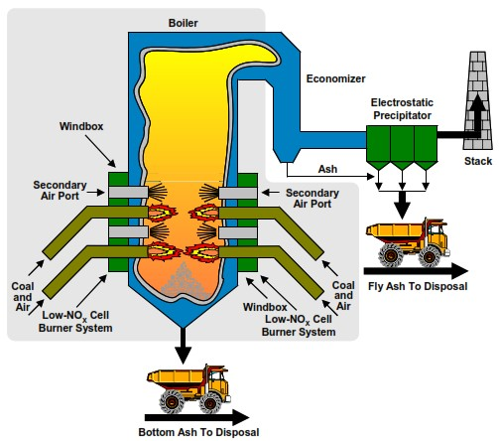
BURNER

Slide 8
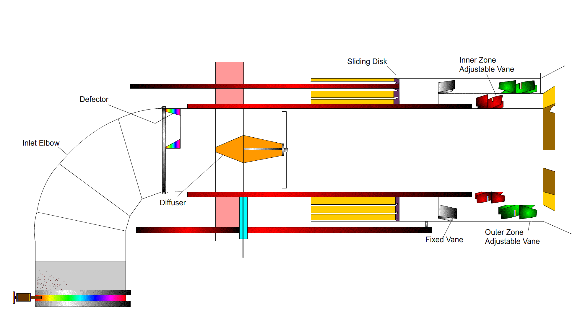
BURNER

Slide 9
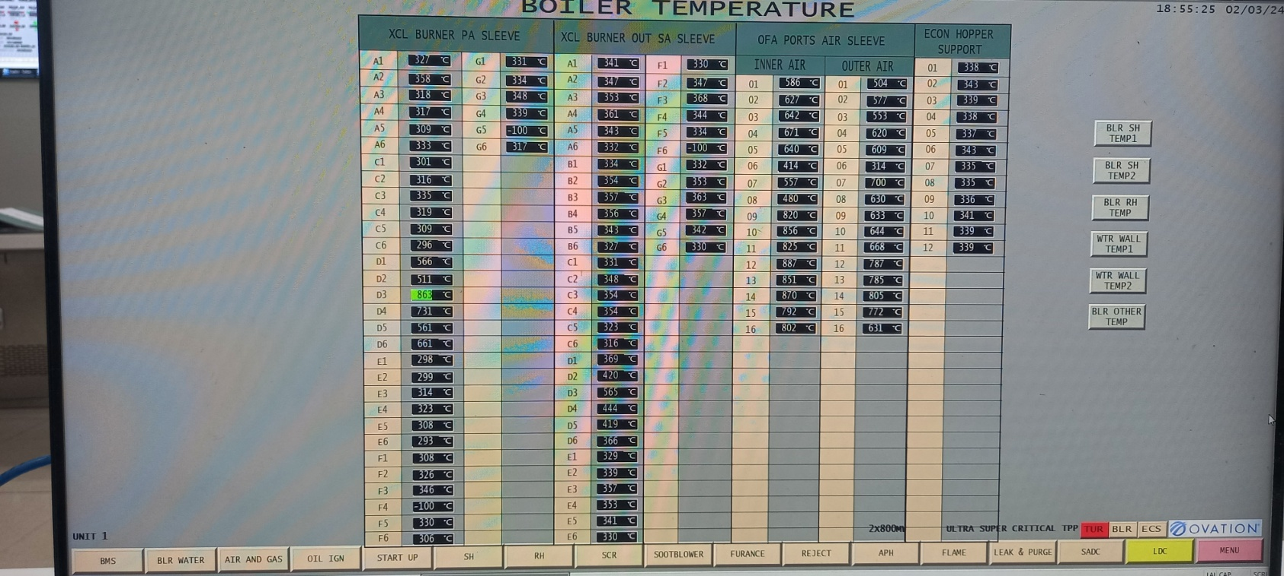
Burner Temperature

Slide 10
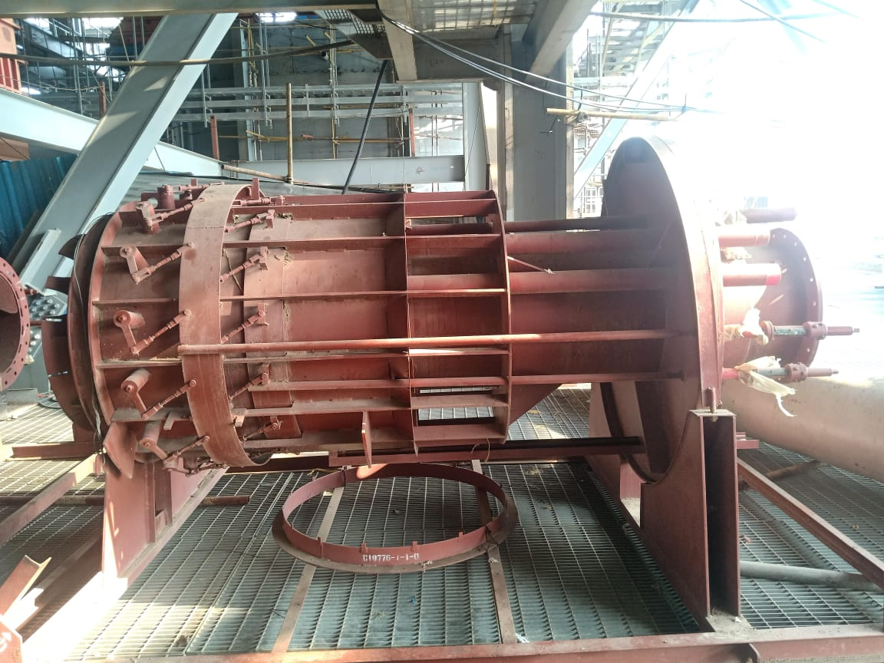
BURNER

Slide 11
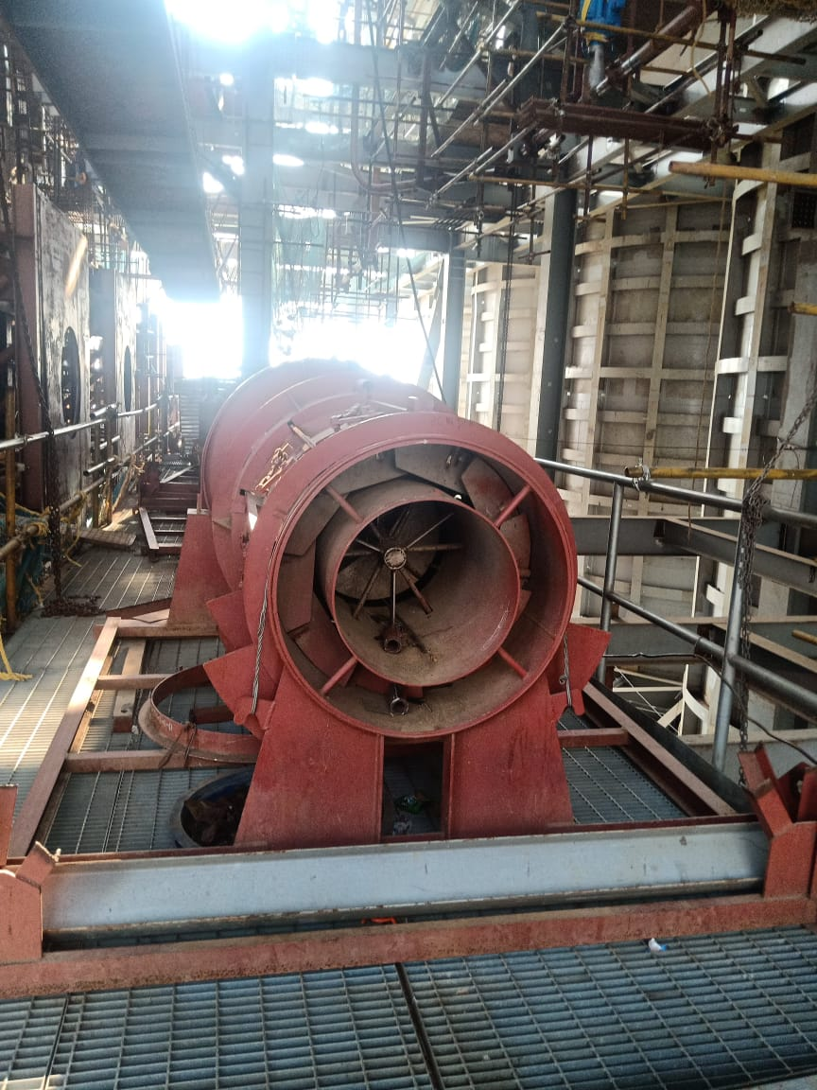
BURNER

Slide 12
BURNER SCALE MEASURMENTS
L2
R2
L1
R1

Slide 13
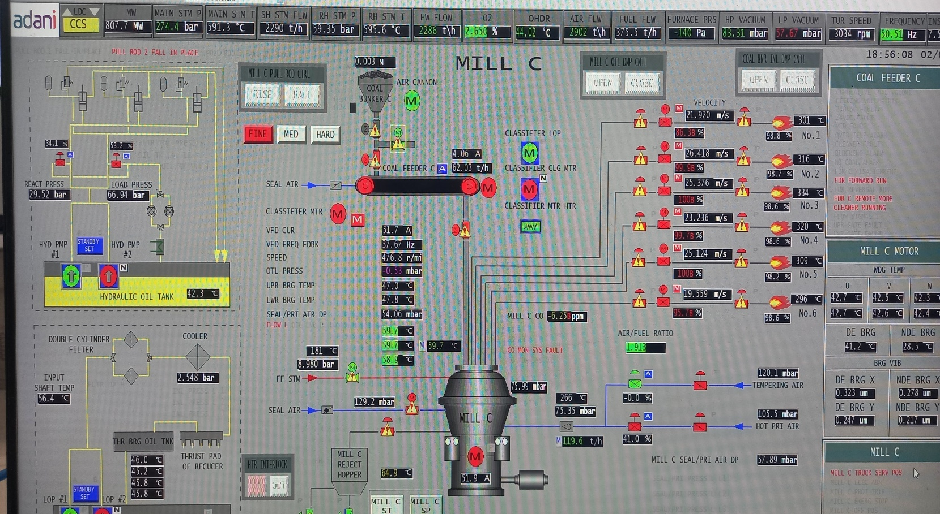
Dynamic orifice on Coal pipe

Slide 14
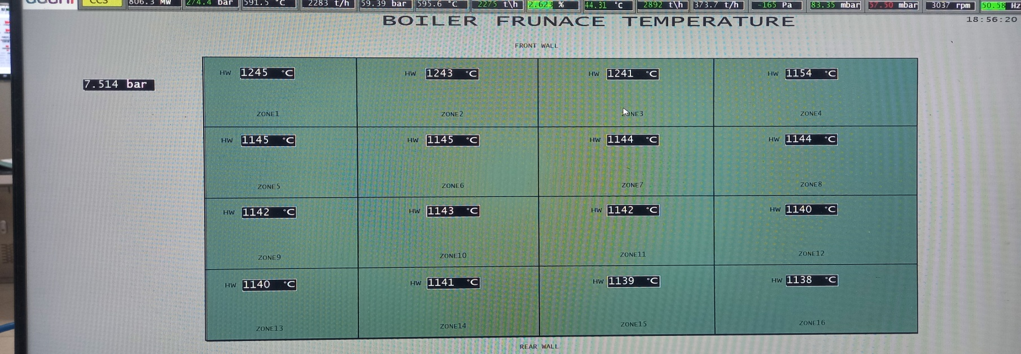
Furnace Zone Temperature

Slide 15
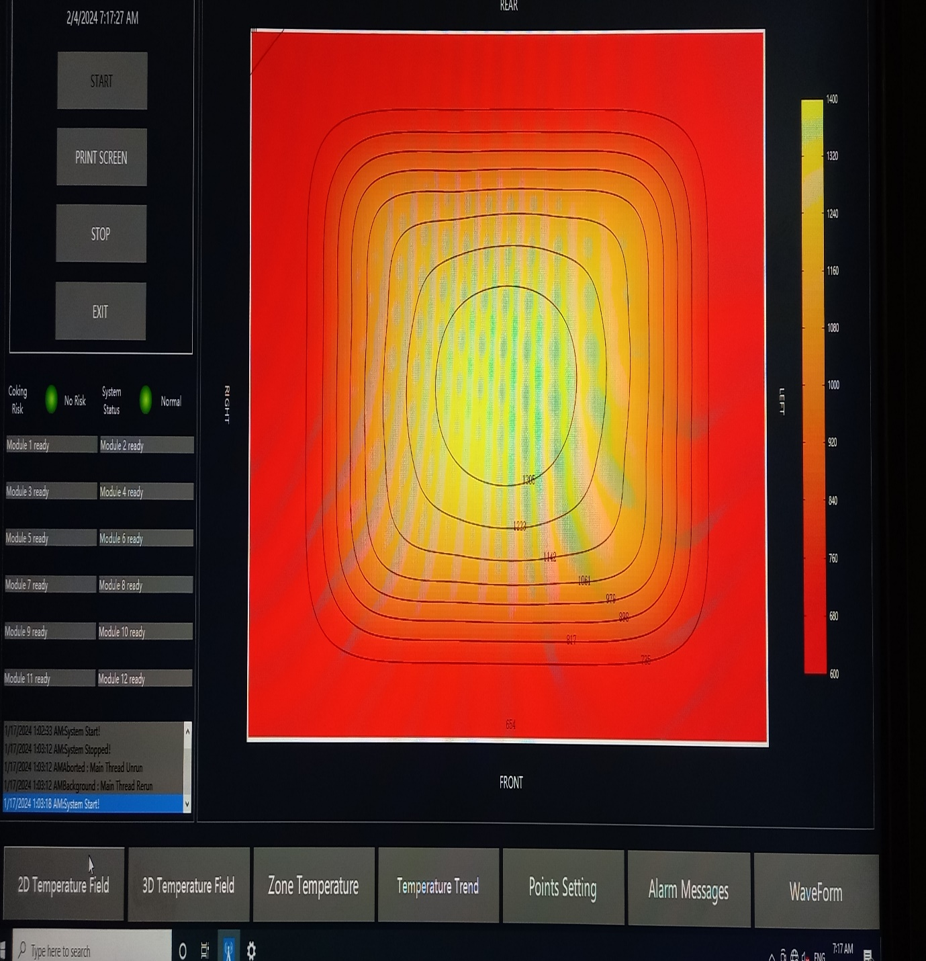
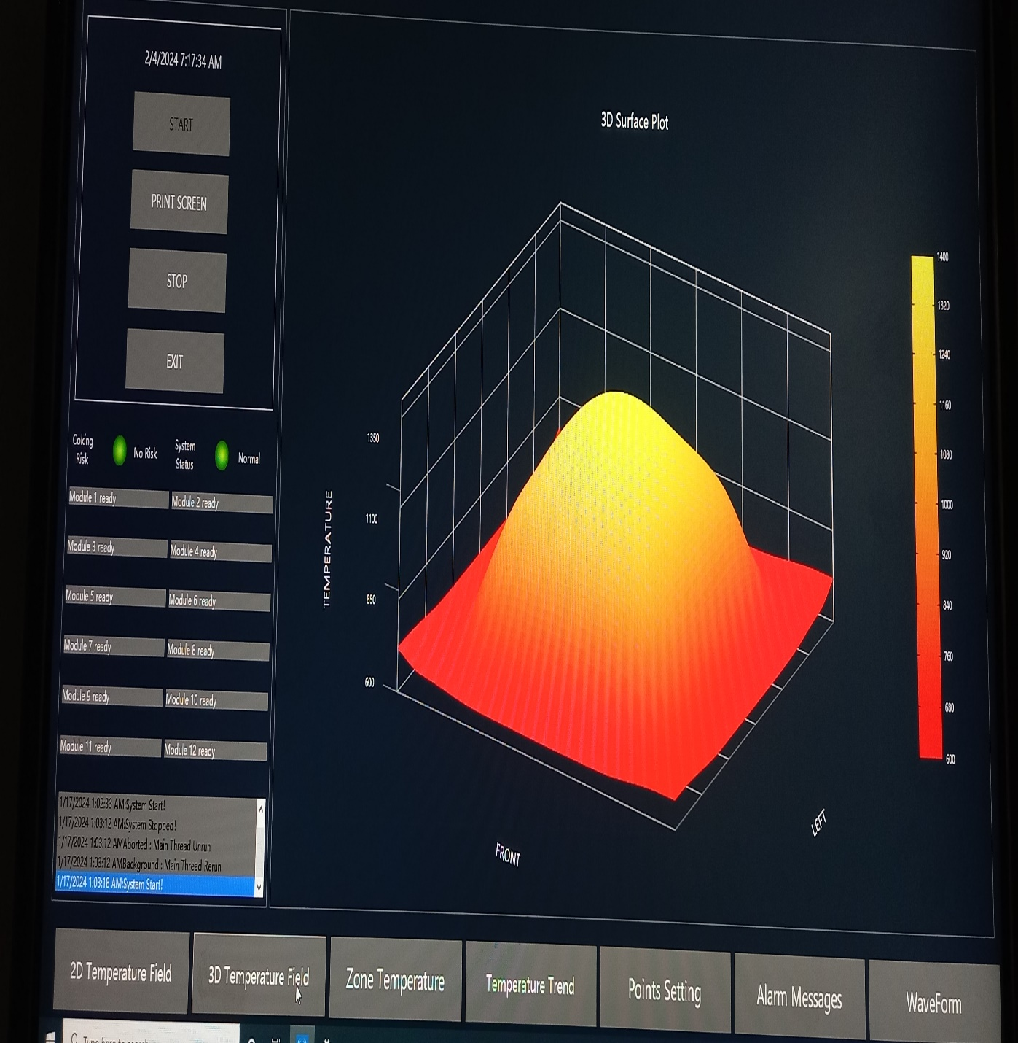

Slide 16
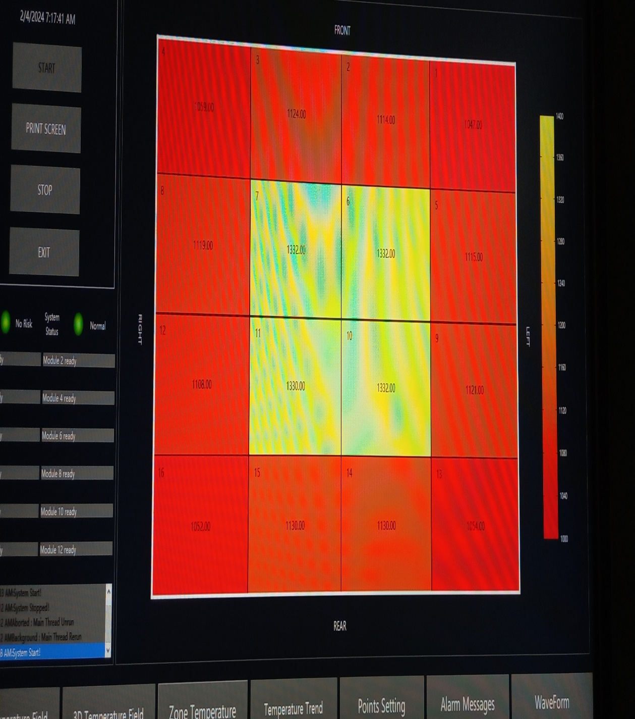
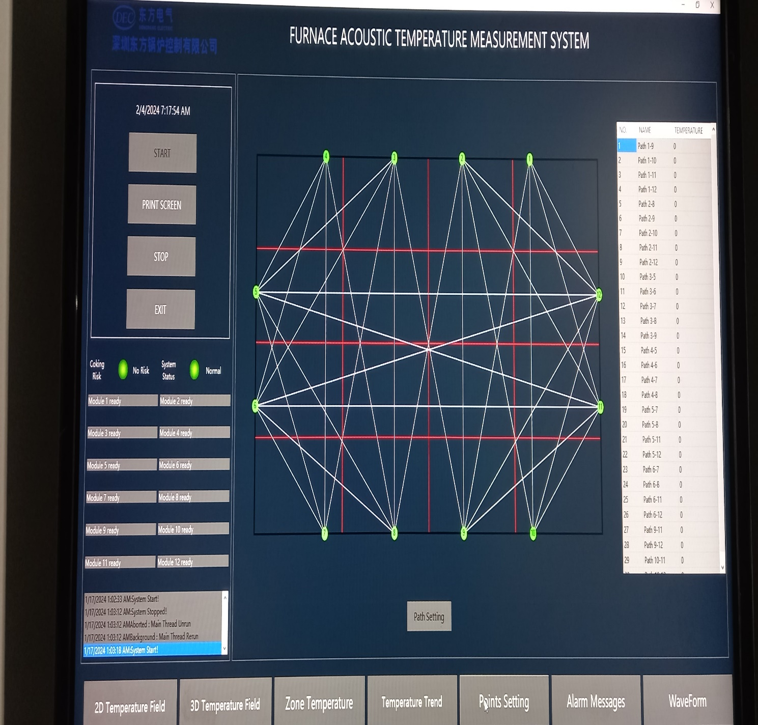

Slide 17
APJL DATA
FUEL CHARACTERISTICS: (from Boiler)
FLUE GAS CONDITION OF SCR INLET & OUTLET: (Design Coal)
Coal Analysis | Symbol | Unit | Design Coal | Worst Coal | Range
Carbon, as received | Car | % | 36.75 | 30.75
Hydrogen, as received | Har | % | 2.90 | 2.50
Oxygen, as received | Oar | % | 10.51 | 10.30
Nitrogen, as received | Nar | % | 1.79 | 1.85
Sulphur, as received | St,ar | % | 0.55 | 0.60 | 0.5-0.6
Ash, as received | Aar | % | 37.50 | 45.00 | 32-45
Moisture, as received | Mt | % | 10 | 9.00 | 9-20
Moisture, air dried | Mad | % | 4 | 3
Volatile Matter, dry & ash free | Vdaf | % | 49.52 | 45.65
Volatile Matter, as received | Var | % | 26 | 21 | 21-26
Lower Heating value, as received | Qnrt,ar | KJ/Kg | 13952 | 11863
Gross Calorific Value | Qgr | KJ/Kg | 14818 | 12621 | 12621-16535
Fixed Carbon |  | % | 26.5 | 25 | 25-31
Grind ability | HGI |  | 50 | 48
Ash Fusion Temperature (Reducing Atmosphere )
Initial deformation temp. | DT | degC | 1524 | 1504
Sphere temperature | ST | degC | 1546 | 1557
Hemispherical temperature | HT | degC | 1566 | 1574
Flow temperature | FT | degC | 1591 | 1591
Ash Fusion Temperature (Oxidizing Atmosphere )
Initial deformation temp. | DT | degC | 1480 | 1460
Sphere temperature | ST | degC | >1500 | 1480
Hemispherical temperature | HT | degC | >1500 | >1500
Flow temperature | FT | degC | >1500 | >1500
SNo | Unit | BMCR | VWO | TMCR | 80 % TMCR | 60 % TMCR | 40 % BMCR
SO2 (wet,actualO2) (SCR inlet) | mg/Nm3 | 2223 | 2223 | 2223 | 2110 | 1966 | 1892
SO3 (wet,actualO2) (SCR inlet) | mg/Nm3 | 28.1 | 28.1 | 28.1 | 26.6 | 24.8 | 23.9
Nox (dry,6% O2) (SCR inlet) | mg/Nm3 | 450 | 450 | 450 | 440 | 437 | 428
SO2 (dry,6% O2) (SCR outlet) | mg/Nm3 | 2127.2 | 2127.2 | 2127.2 | 2008.8 | 1859.7 | 2115.9
SO3 (dry,6% O2) (SCR outlet) | mg/Nm3 | 53.75 | 53.7 | 53.68 | 52.1 | 50.21 | 53.45
Nox (dry,6% O2) (SCR outlet) | mg/Nm3 | ≤ 100 | ≤ 100 | ≤ 100 | ≤ 100 | ≤ 100 | ≤ 100

Slide 18
Conclusions
Conclusions:
In order to effectively improve boiler combustion efficiency, reduce the co-emission of NOx and carbon dioxide, and aim at actual industrial application requirements, this paper proposes a data-driven online combustion optimization system. Boiler combustion is a non-linear process with violent fluctuations. The idea of piecewise linearization is used to divide the historical data based on the multi-variable combination of MS Flow, Mill to obtain a lot of partitions, and the linear model was used to construct local linear models for each partition. The multiple local linear models approximate global non-linearity. The prediction error of the data-driven model is small and can meet industrial application requirements. The full-scale industrial test of the combustion optimization online control system based on this model also obtained effective optimization results. The results show that the average value of NOx emissions (6%O2) decreased by 3 % and had an average increase of 0.39% in boiler efficiency.

Slide 19
ADANI POWER JHARKHAND LIMITED
Thanking steward leadership & APJL Family

