Slide 1
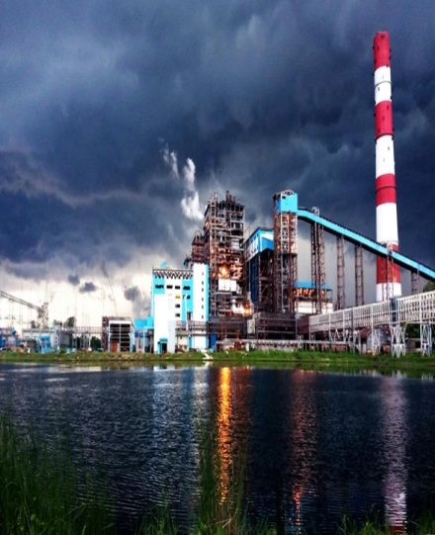
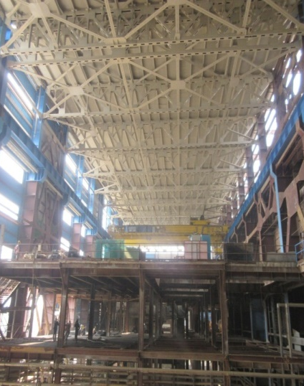
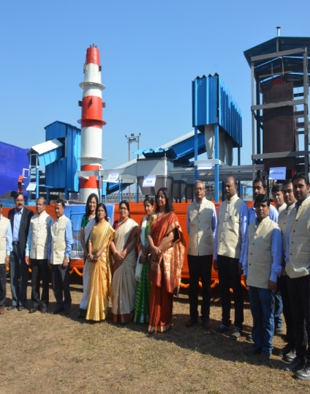
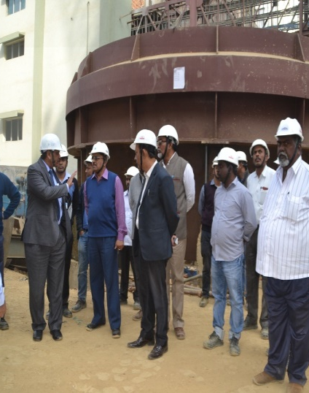
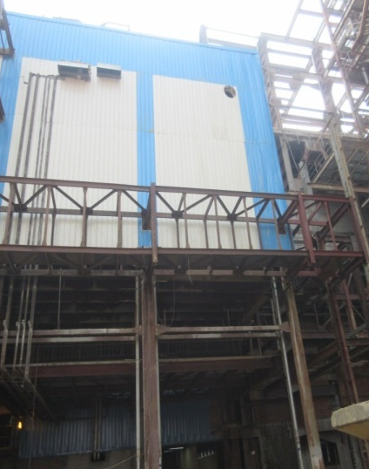
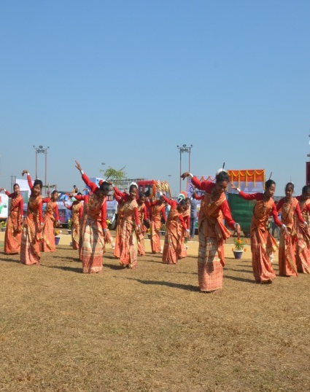
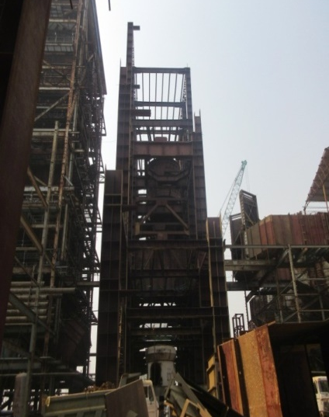
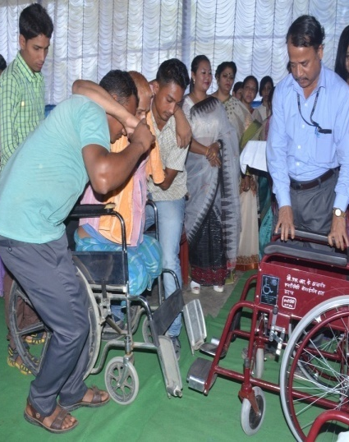
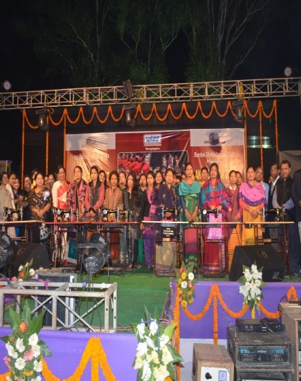
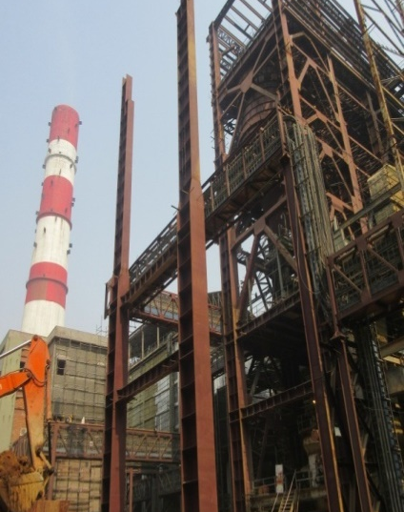
STUDY ON IMPACT OF CHEMICAL CLEANING OF
STATOR WINDING HOLLOW CONDUCTORS ON
GENERATOR COOLING WATER SYSTEM COMPONENTS

Slide 2
Authors
STUDY ON IMPACT OF CHEMICAL CLEANING OF
STATOR WINDING HOLLOW CONDUCTORS ON
GENERATOR COOLING WATER SYSTEM COMPONENTS
Anand Pandey (DGM-EMD)
Nitesh Khandelwal (Sr. Manager- MTP)
KORBA SUPER THERMAL POWER STATION

Slide 3
Presentation By
Anand Pandey (DGM-EMD)
KORBA SUPER THERMAL POWER STATION

Slide 4
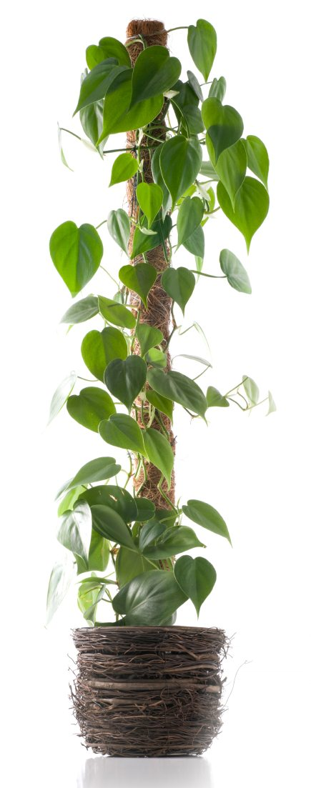
Content
1
Introduction to Acid Cleaning of Generator winding
2
Process of Acid cleaning
3
When/ Why : It is done?
4
Concern with Chemical Cleaning
5
Process Assessment through Diagnostic test
6
Learning & Conclusion

Slide 5
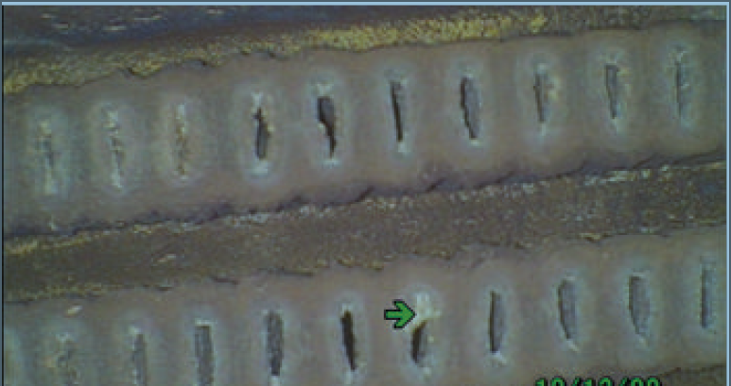
INTRODUCTION
It is estimated that about 10 % to 20 % of the 2000 water-cooled generators worldwide (not including the former USSR and China) suffer from flow restrictions within the first 25 years of operation.
Source:
International Association for the Properties of Water and Steam, IAPWS TGD10-19, Technical Guidance Document: Chemistry Management in Generator Water Cooling during Operation and Shutdown. (2019)
Cross section of stator bar hollow conductor with copper oxide deposits

Slide 6
INTRODUCTION
Generator Winding with Anaerobic Stator water system are vulnerable for copper oxide clogging (LOW oxygen regime) , if exposed to O_{2.}
OEM Specifies Dissolved Oxygen DO < 20 ppb ( BHEL Make).
Higher dissolved O₂ concentration leads to formation of CuO (Cupric Oxide) And/or Cu₂O (Cuprous Oxide) inside the hollow conductor .
Flow of cooling water is restricted due to clogging in hollow conductors .
Reduction in flow leads to increase in winding temperature and accelerated ageing of machine insulation.
On this condition either Generator load is to be restricted or machine may fail on stator earth Fault.
At Extreme case :
Complete rewinding of Generator may be required.

Slide 7
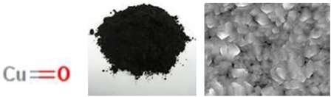
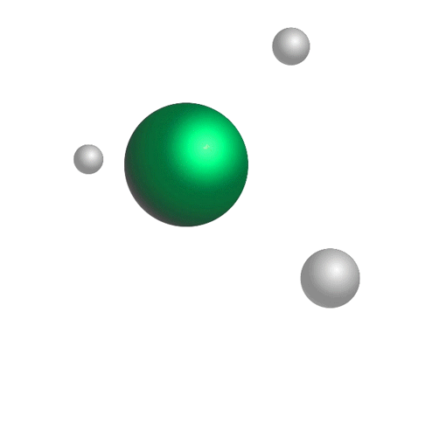
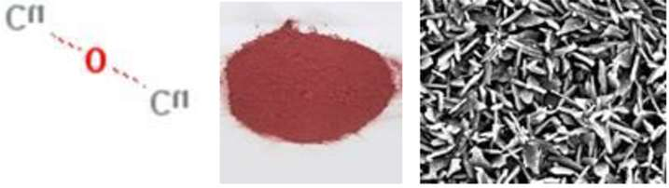
PROCESS: Copper Oxides Clogging
Cupric oxide : Black in colour
Cuprous oxide : Reddish Brown in colour

Slide 8
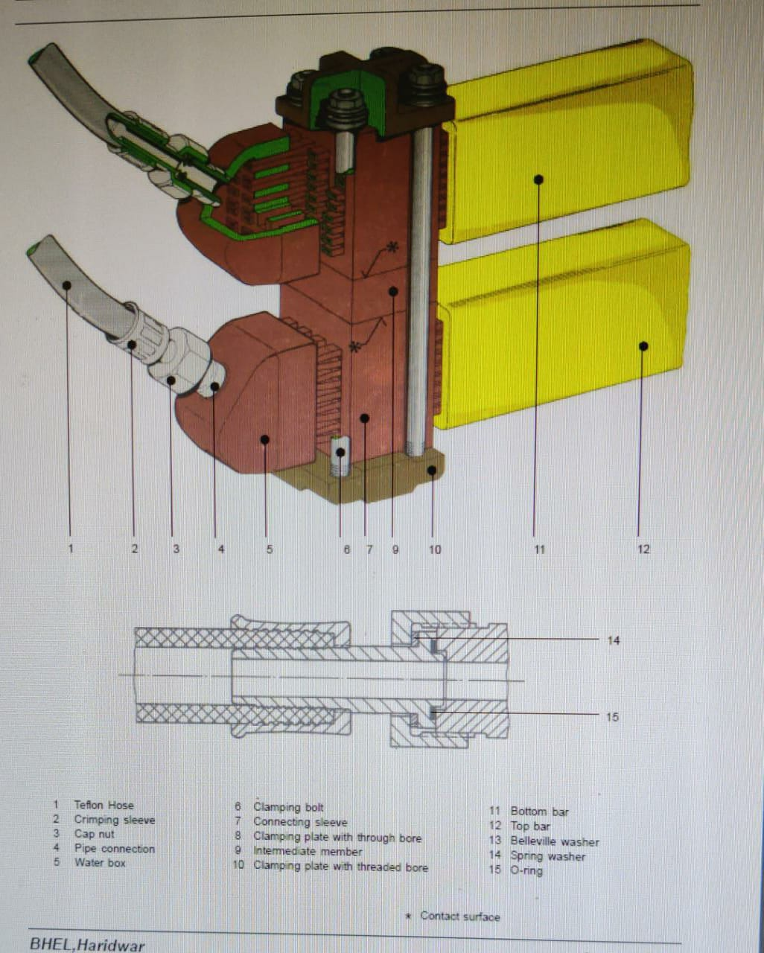
INTRODUCTION: Winding Bar
BOTTOM BAR
TOP BAR
Winding configuration with Top & Bottom Bar
Total 96 bars
Each Bar has 20 hollow conductor
Total 1920 hollow conductors
Size of hollow conductors: 8100 x 5 x 1.6 (aprox.) mm

Slide 9
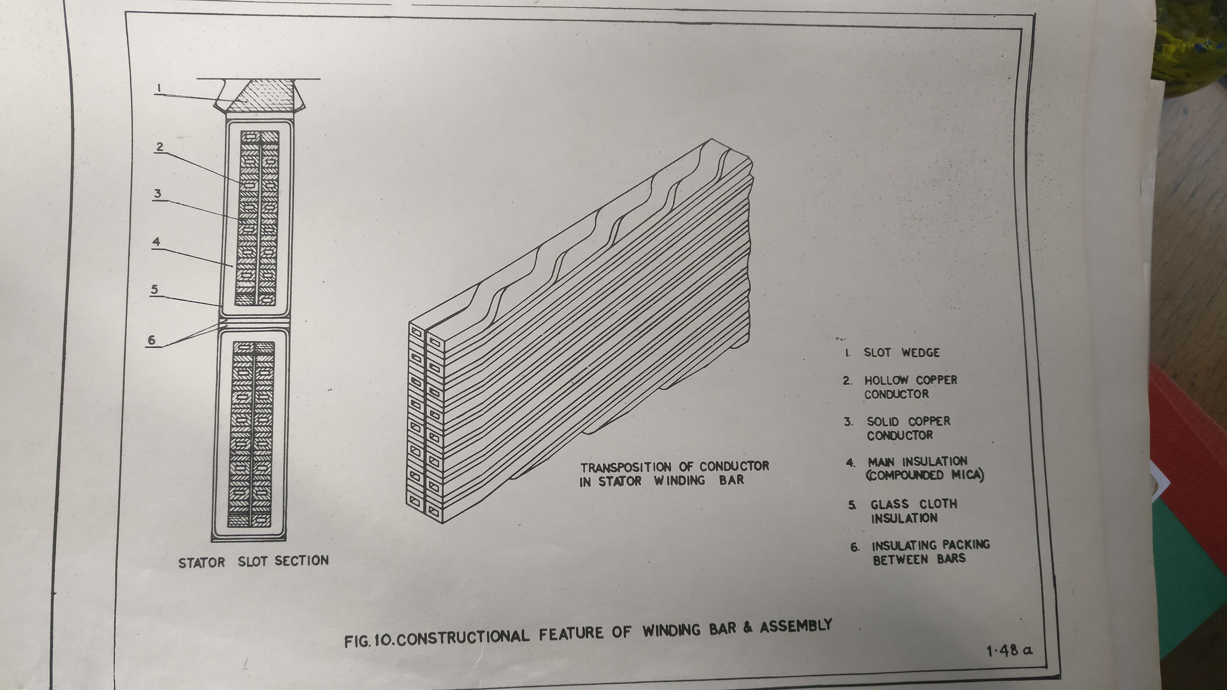
INTRODUCTION: Winding Bar
Solid conductor
Hollow conductor
Solid Conductor : Current Flow
Hollow Conductor : Water Flow

Slide 10
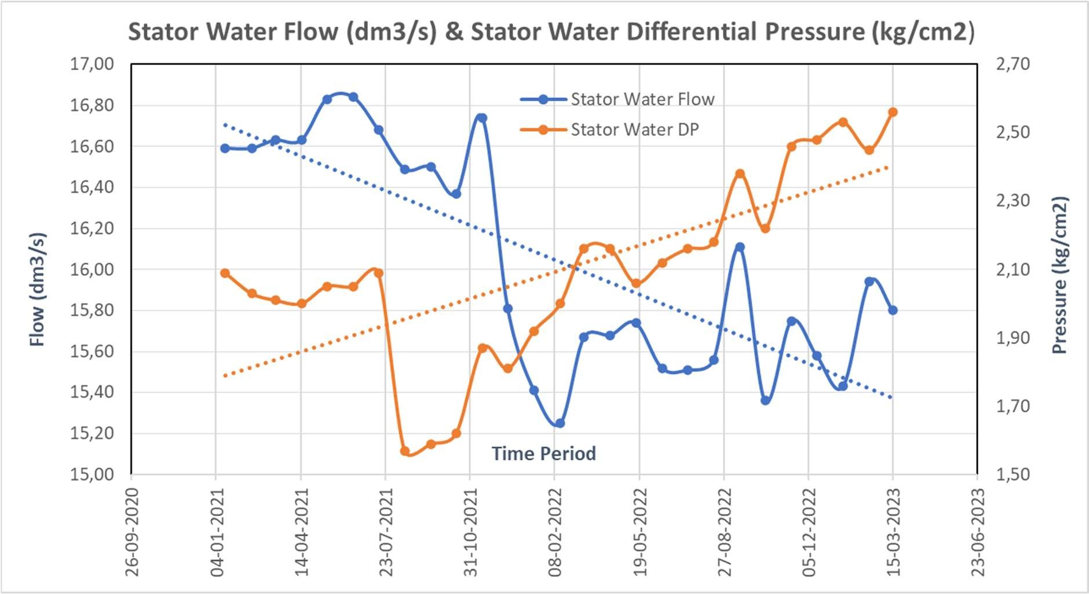
INTRODUCTION: 500 MW Generator Clogging Problem
Differential Pressure(DP) of PW across stator winding inlet & outlet increases with clogging
Stator winding cooling water Flow reduces as clogging or obstruction in flow path increases

Slide 11
When Chemical Cleaning is required?
DP is high.
Winding flow is low /reducing.
Stator winding, I/L pressure is high.
Flow through Bushing is increasing.
No improvement even after Conical filter mechanical cleaning.
Traces of non-magnetic reddish-brown debris observed on conical filter/mechanical filter indicating unstable layer
PW outlet temperature from Winding in increasing trend.

Slide 12
INTRODUCTION: Acid Cleaning of Generator
Copper oxide deposition can be removed by Acid cleaning of Generator winding hollow conductors.
EDTA (Ethylene diamine tetra acetic acid) is used as a complexing agent for chemical cleaning and is injected in PW System in controlled manner.
It dissolves only copper oxides and does not react with copper metal.
EDTA is very efficient for Cupric oxide removal as it forms complex (Cu.EDTA) but not for Cuprous oxide.
To increase EDTA efficacy, H₂O₂ (Hydrogen Peroxide) is added to PW system
Removal of copper oxide through chemical cleaning is not possible with completely choked/blocked hollow conductor.

Slide 13
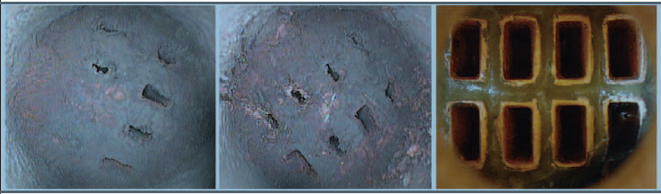
Advantage: Mech Vs Chem Cleaning
Before Cleaning Fully choked hollow conductor
After Mechanical Cleaning: Partially open
After Chemical Cleaning

Slide 14
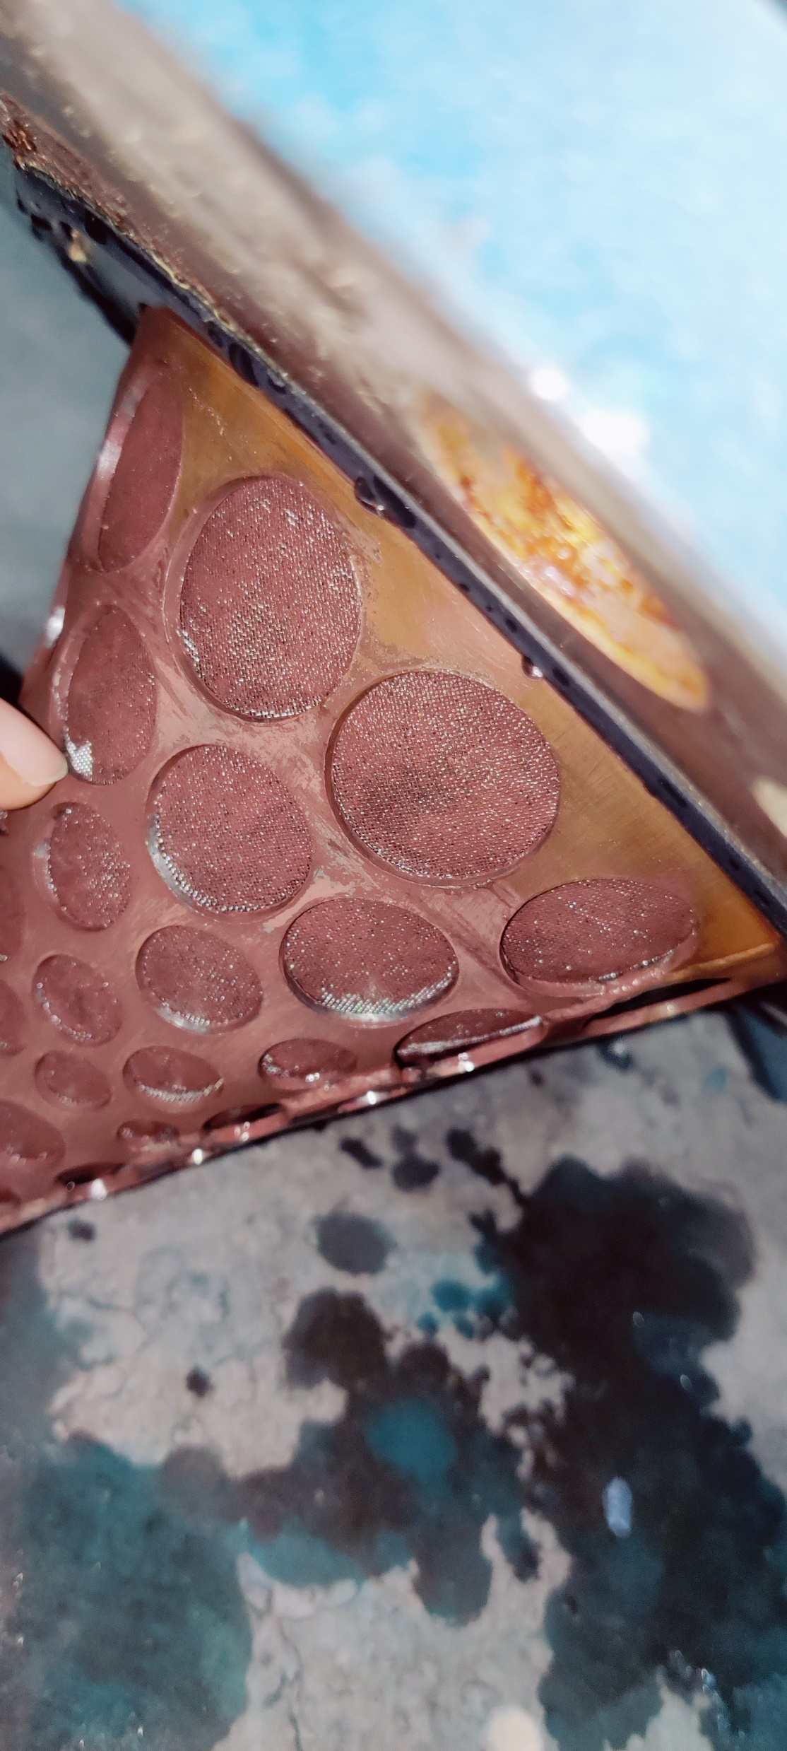
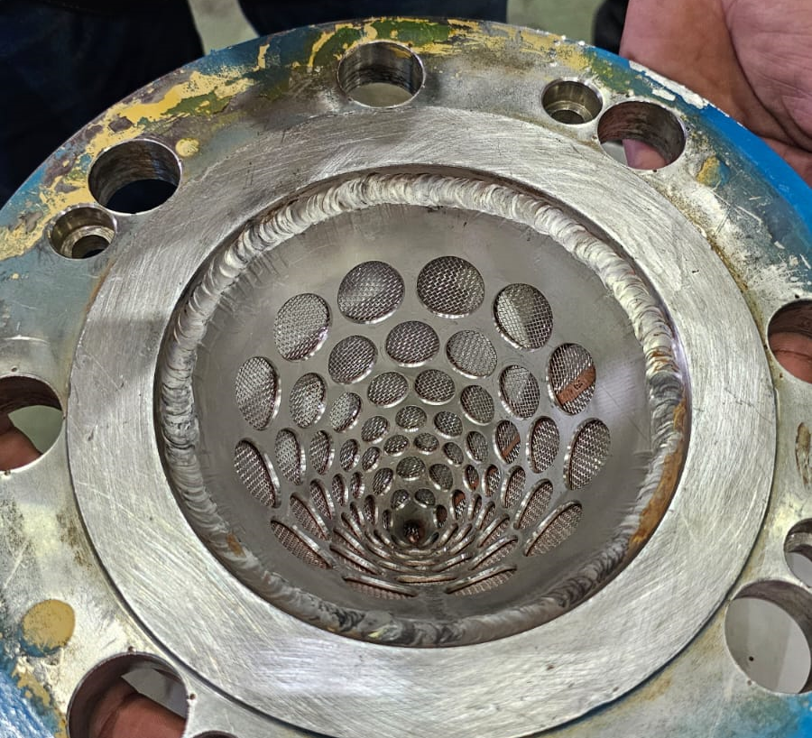
Copper Oxide Deposition
Cuprous Oxide
Choked conical Filter
After Chemical cleaning

Slide 15
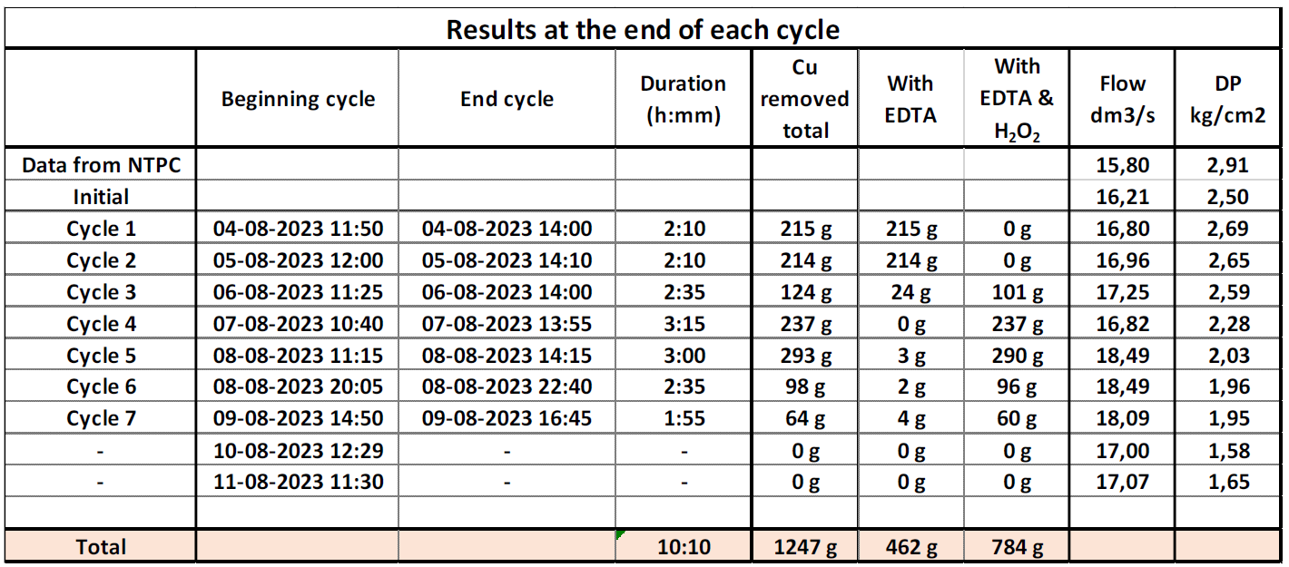
Process of Chemical cleaning
Chemical cleaning is done in Cycles and based on reaction yield EDTA/H2O2 is added to system as shown below:

Slide 16
Why Chemical Cleaning ?
The process is effective & proven way of removal of copper oxide clogging.
The process is extremely cost effective as compared to complete rewinding of generator.
Can be done without opening the generator or rotor thread out ( if hollow conductors are not fully blocked).
Process gets complete in max 10 days
Increased flow keeps the winding temperature within design limits , there by control insulation ageing
Chemical cleaning with EDTA only removes copper oxides and does not attack any system materials????

Slide 17
CONCERN WITH CHEMICAL CLEANING
What shall be the impact of these chemicals over various Generator primary water components which includes strand copper, braze materials, valves and piping ?
Studies revealed that previously used “Citric Acid” attacked both copper and solder material.
However, EDTA & H2O2 barely attacked the tested system materials

Slide 18
CONCERN WITH CHEMICAL CLEANING
What shall be the impact of these chemicals over various Generator primary water components which includes strand copper, braze materials, valves and piping ?
Studies revealed that previously used “Citric Acid” attacked both copper and solder material.
However, EDTA & H2O2 barely attacked the tested system materials

Slide 19
Real time case studies
The process is a patented and executed by external agency
World wide more than 330 Generators are cleaned with this process of removal of copper oxides through EDTA
In India 9 generators have used this process to address High stator winding DP problem
 | Pre Cleaning |  | Post Cleaning
Parameter | DP | Flow (dm3/s) | DP | Flow (dm3/s)
Case -01 | 2.91 | 15.8 | 1.65 | 17.07
Case-02 | 2.03 | 16.6 | 1.39 | 17.5

Slide 20
Real time case studies
CASE -01
No. of cycles | 07
EDTA | 32.7 kg
H₂O₂ | 6.50 Liters
Copper Oxide removed | 1.247 Kg
Cupric Oxide | 462 gm
Cuprous Oxide | 784 gm
Copper removal per conductor | 0.65 mg
CASE -02
No. of cycles | 05
EDTA | 23.2 kg
H₂O₂ | 5 Liters
Copper Oxide removed | 2.7 Kg
Cupric Oxide | 190 gm
Cuprous Oxide | 2514 gm
Copper removal per conductor | 1.4 mg

Slide 21
IMAPCT ASSESMENT OF EDTA
Study was carried out to analyzed the impact of chemical cleaning of hollow conductors
Data of certain electrical and mechanical test were compared (Pre & Post chemical cleaning )
These test are carried out to ascertain suitability for sustainable operation of Stator
Only those tests were considered which provide the data corresponding to the parameters which were responsible for the sustainable operation of generator in long run and may get deteriorated with the acid cleaning

Slide 22
DIAGNOSTIC TESTS OF GENERATOR WINDING
Sl no. | Type of test | Name of Test | Remark
1 | Elect. | Winding Resistance | Value may alter in case acid interacts with the braze material Reduction indicate shorting of conductors and Increase of winding resistance may indicate poor contact resistance or compromised braze joints.
2 | Elect. | Tan Delta & Cap. | Tan delta test will provide an overall indication of the dielectric losses and general status of total insulation system of the winding. Teflon tubes, associated gaskets etc come in direct contact with acid during chemical cleaning. Dielectric loss analyser (Tan delta) equipment will measure capacitance, tan delta and dielectric losses. Any change in system insulation will get reflected in test result. Change in Dielectric quality reflects in capacitance value.

Slide 23
DIAGNOSTIC TESTS OF GENERATOR WINDING
Sl no. | Type of test | Name of Test | Remark
3 | Mech. | Stator winding Hydro test | Performed to access the mechanical strength of hollow conductors (Loss of copper from hollow conductor) and associated hoses, gasketed joints of PW system. Since any of these may get affected by the acid used during chemical cleaning. If Stator winding holds the test pressure for pre-defined duration than it indicates the hollow conductors are mechanically strong enough to meet the operating conditions of vibration, expansion /contraction and pressure without fail.
4. | Mech. | Physical inspection | For any visible deviation after chemical cleaning

Slide 24
Sample Selection
Sl. No. | Category Type | Chemical cleaning Process
1 | A | Never done
2 | B | One time
3 | C | Two times
Generator classification based on chemical cleaning Frequency

Slide 25
Winding resistance test Data
Test Name | Winding resistance (mΩ) @25 deg C Applicable Standard IEEE-1995
Gen- A | 1.466 (2020) | 1.465 (2015) | 1.465(2011)
Gen- B | 1.44 (2022) (After acid Cleaning) | 1.49 (2020) (Before acid Cleaning) | 1.47 (2011)
Gen- C | 1.43 (2023) - After 2nd Cleaning | 1.44 (2018) – 4 years After 1st cleaning | 1.43 (2014) After 1st cleaning
No significance variation in trend of resistance values
All three Category of generators exhibit same order of variance which is
well with in acceptance norms.
This indicates that impact of EDTA on copper and specially on Braze and Solder Materials is negligible (at least even after second cleaning in Gen-C)

Slide 26
Winding Resistance
Values are presented is descending order for year of testing

Slide 27
Tan Delta Test Data
Test Name | % Tan delta @ 10 KV
Phase | R/Y/B (Value x 0.01) | R/Y/B (Value x 0.01) | R/Y/B (Value x 0.01)
Gen- A | 1.28/1.26/1.27 (2020) Conductivity 0.2 mho | 2.46/2.50/2.50 (2015) Conductivity 0.9 mho | 1.63/1.60/1.57 (2011) Conductivity 0.5 mho
Gen- B | 2.73/2.72/2.70 (2022) Conductivity 0.3 mho (After acid Cleaning) | 2.46/2.50/2.50 (2020) Conductivity 0.5 mho | 4.79/4.61/4.61 (2011) Conductivity 1.5 mho
Gen- C | 1.33/1.35/1.33 (2023) Conductivity 0.2 mho After 2nd Acid cleaning | 1.69/1.60/1.55 (2018) Conductivity 0.23 mho 4 year After 1st cleaning | 2.15/2.07/1.91 (2014) Conductivity 0.5 mho
Test results depends highly on PW conductivity, temperature etc
All the pre & post cleaning values are well within the acceptable limit

Slide 28
Tan Delta
The variation in Tan Delta Values is due different conductivity at the time testing
Values are presented is descending order for year of testing

Slide 29
Capacitance test Data
Test Name | Capacitance (nF)
Phase | R/Y/B | R/Y/B | R/Y/B
Gen- A | 263.1/265.7/262.3 (2020) | 263.7/266.3/265.7 (2015) | 260.5/262.9/262.2 (2011)
Gen- B | 236.6/237.1/237.1 (2022) | 235.5/236.2/236.4 (2020) | 238.4/238.1/237.5 (2011)
Gen- C | 250.8/250.3/252.2 (2023) After 2nd Acid cleaning | 254.7/255.4/254.3 (2018)-After 4 year of 1st Cleaning | 249.2/248.4/250.3 (2014)-After 1st Cleaning
Capacitance is function of dielectric (Insulating material)
Polymer materials (Insulating material) can be found in the SCWS, ranging from Teflon hoses to gaskets and O-rings
All the pre & post cleaning values are well within the acceptable limit

Slide 30
Winding Resistance
Values are presented is descending order for year of testing

Slide 31
Mechanical Test
Hydro Test : 6 Ksc for 24 hrs
All 3 category Generator withstood Successfully
Physical Inspection of Gasket/Teflon Hoses:
No abnormality or deviation observed among sample Generators

Slide 32
Conclusion
Acid cleaning of generator winding hollow conductors is an efficient way of removing clogging.
Chemical analysis has proven earlier that EDTA & H2O2 is safer as compared to other acids like citric acid
Variation in test results of different years is in same order as for generator over which chemical cleaning was never performed
Various diagnostic test reflects that there is no abnormal deviation in pre and post chemical cleaning test data
It can be concluded satisfactorily that chemical cleaning with EDTA & H2O2 is safe for generator when carried out is standard manner

Slide 33



Thank you

