Slide 1
OPTIMIZATION OF DM PLANT REGENERATION PROCESS- TO ENSURE DM WATER AVAILABILITY
By
Dr. Dipravath Kumar Seth
Deputy Manager (O&M Chemistry)
NTECL/ NTPC Vallur

Slide 2
De-Mineralisation Plant
ACF
WAC
SAC
Filter water Header
DEGASSER
DG blower
WBA
SBA
MB
D/G P/P
DM-ST

Slide 3
ANION vessel IN SERVICE
Air and Carbon di Oxide (CO₃²⁻)
A⁻ = Cl⁻, SO₄²⁻, NO₃⁻
Cl
A⁻
H⁺
SiO₂
H⁺
SiO₂
Mixed Bed Vessel
Water from SAC
A⁻
SiO₂
H⁺, A⁻, CO₃²⁻,
SiO₂
H⁺
WBA
SBA
AIR
H⁺
H⁺
SiO₂
SiO₂
SiO₂
< 20ppb
De gasser Tank
< 200ppb
De gasser
P/P

Slide 4
De-Mineralisation Plant
Cation resin vessel removes all type of cationic
impurities.
5% HCl required for Cation resin regeneration.
Anion resin vessel removes all type of anionic
impurities and Silica.
5% NaOH required for Anion resin regeneration.

Slide 5
SBA REGENERATION PROCESS
DOWN FLOW WATER
Caustic (approx. 50% NaOH) Metering Tank
Cl
2% NaOH solution
Pump
WBA
SBA
Power Water
To N-Pit
5% NaOH solution

Slide 6
NORMAL OPERATION Stg II DMP
Normal OBR for ST#2 DM Plant = 1600m³
Design flow for one DM stream = 130m³/hr
Operation time for one stream = 12.5 hrs
Regeneration time = 6 hrs
Average Station consumption per day = 2800-3100m³
HEALTHY DM WATER STOCK TO BE MAINTAINED AROUND 6000 TO 6500m³.

Slide 7
DM water consumption pattern
Consumption (m³)
Year wise Daily Average DM water Consumption

Slide 8
PROBLEMS FACED
Deterioration of raw water quality
Increasing trend of make-up (DM water)
Premature exhaustion of SBA : DM output decrease (Shooting of SiO₂)
Increase in frequency of regeneration : High Caustic Consumption
More effluent generation
Attrition loss of resin : Resin loosing efficiency
More outage time due to regeneration: Less production time

Slide 9
Initiative taken
DG Blower
DG Tank
SBA
As per design CO₂ limit at DGT O/L- 5 ppm
Found CO₂ – 200 ppm
DG Blower
DG Tank
SBA
DG Blower
CO₂ Found – 174 ppm
DG Tower Inefficiency
High CO₂ ingress in WBA
Extra load on WBA
Decrease in ion exchange capacity of WBA

Slide 10
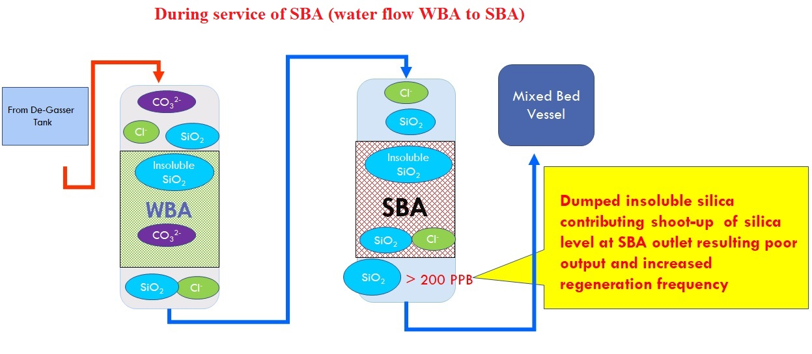
SUMMARY OF PROBLEM
With 50%
efficiency

Slide 11
UNDERSTANDING..
Caustic (Approx. 50%) Metering Tank
Normal regeneration process
Ingressed CO₃²⁻
: Soluble silica converted to insoluble silica
Cl
Soluble SiO₂
Insoluble SiO₂
Insoluble SiO₂
2% NaOH
Pump
WBA
SBA
Power Water
5% NaOH solution
To N-Pit

Slide 12
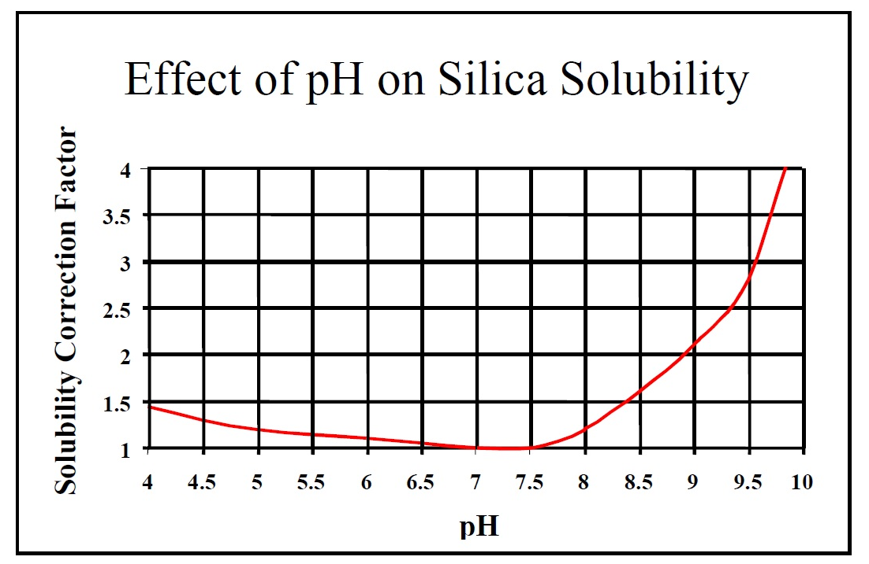
LEARNING PROCESS..

Slide 13
SUMMARY OF STUDY:
Ingression of high CO₂ into WBA: formation of carbonic acid
Decrease in the pH of the regenerant: Insoluble silica dumped in WBA
Ingression of high CO₂ into WBA: extra ionic load on WBA
Extra load on SBA: SBA got fully exhausted
SBA consumes almost entire amount of caustic for regeneration: WBA regeneration hampered
Despite of using freshly prepared Caustic solution we are getting low output.

Slide 14
Outcome of study
Remedy
Use of 4 times caustic
Result
Getting better OBR than before
Demerit
Increased production cost of DM water.

Slide 15
Brain STORMING…

Slide 16
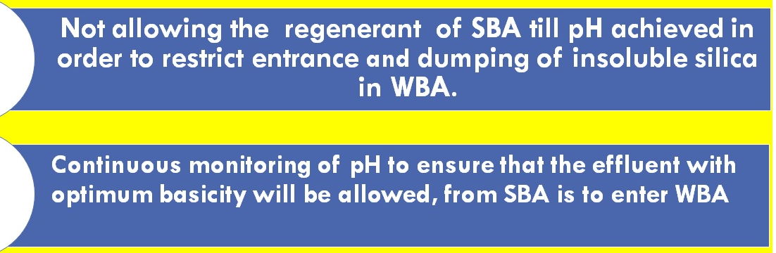
WORK OUT
Caustic (Approx.50 %) Metering Tank
Cl
Low pH of
regenerant
Insoluble SiO₂
Insoluble SiO₂
2% NaOH: Optimum pH
Pump
WBA
SBA
Power Water
To N-Pit
5% NaOH solution
To N-Pit

Slide 17
RESULT

Slide 18
COST BENEFIT
Average monthly production
at St#2 DM Plant 50000 M³
Cost of caustic used in Jan 2022 = 24.3 Lac
Cost of caustic used in next 6 month = 6.3 Lac
(after modification)
Savings due to lesser
caustic spent pm = ~18 lac

Slide 19
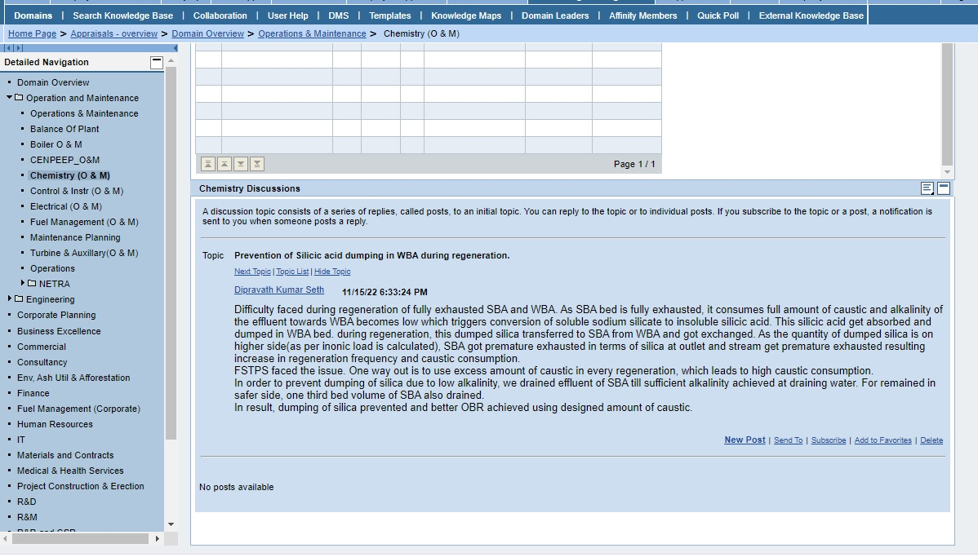
SHARING OF EXPERIENCE..

Slide 20
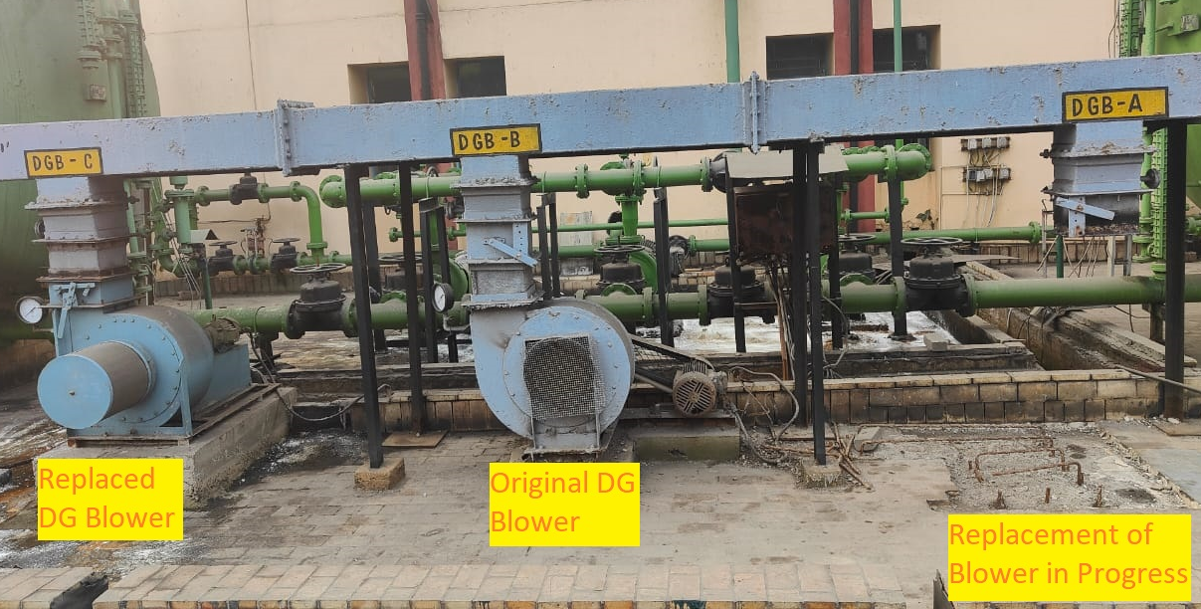
RCA to Permanent Solution
R&M of DG Tower
Replacement of DG Blower
Poor Performance of DG Tower
CO2 level at DG Tank O/L < 4 PPM.
Presently no issue of Insoluble silica

Slide 21
CONCLUSION
Safer tank level achieved.
Caustic consumption almost
normalised.
OBR restored to 1000 m³ compared to 500 m³
during critical hours

Slide 22
Acknowledgements
NTPC IPS 2024
Mr. B. S. Rao (AGM Chem NTPC Farakka)
Mr. Kajjal Pramanik (Co-other NTPC Farakka)

Slide 24
ANY QUESTIONS?

